Slide 1

Data standards and formats in the geoscience community
Kety Giuliacci | kety.giuliacci@ingv.it
Notes:
Title slide

Slide 2
The Role of Data in Geosciences
Geosciences rely on the collection and analysis of complex, multi-source datasets.
These include time series, spatial grids, vector data, and satellite imagery.
To ensure that such diverse data can be compared, integrated, and reused across different disciplines and institutions, the use of shared data standards and formats is essential.
Notes:
Content slide

Slide 3
What Are Data Standards and Formats?
Data standards
define how data should be structured, described, and interpreted, across different applications and users, independently of the storage format.
Data Formats
refer to the physical or digital encoding used to store the data.
Notes:
Content slide

Slide 4
Importance of Using Standard Formats
Standard formats ensure that:
Data can be easily exchanged between researchers and institutions
Interpretations are consistent and reproducible
Archiving and future access remain possible without needing proprietary software
Standardization accelerates science by avoiding data conversion errors and promoting automation.
Notes:
Content slide

Slide 5
Examples of Widely Used Formats in Geosciences
Format | Scientific Domain
NetCDF | Climate science, oceanography
HDF5 | Volcanology, 3D geophysical modeling
miniSEED | Seismology
GeoTIFF | Remote sensing, geology
GRIB | Meteorology
CSV/TSV | Geodesy, environmental monitoring
Notes:
Content slide: tables

Slide 6
Types of Geoscientific Data
Time series data (e.g., seismic waveforms, weather stations)
Gridded data (e.g., climate models, remote sensing imagery)
Point and vector data (e.g., GPS measurements, faults, boreholes)
3D and 4D datasets (e.g., subsurface models, evolving volcanic plumes)
Each type presents unique challenges and requires tailored formats to capture essential information without loss.
Notes:
Content slide

Slide 7
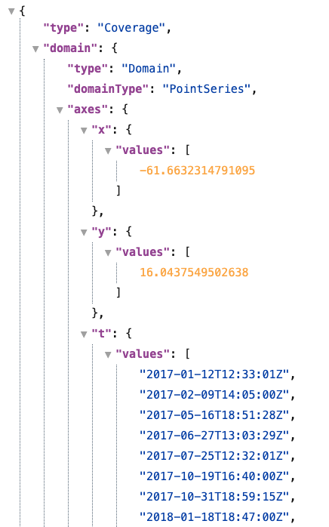
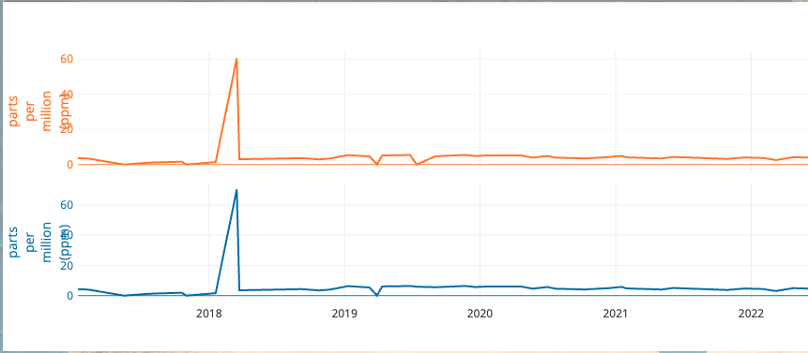
Time Series Data
In fields like seismology and volcanology, time series data are used to monitor changes in ground motion, gas emissions, and temperature.
Formats like miniSEED, ASCII-based and CovJSON standards support compact, efficient, and long-term recording of such data, often in high-frequency environments.
Multigas at la Soufrière de Guadeloupe volcano: Concentration ratios timeseries,Institut De Physique Du Globe De Paris (IPGP). (2021). Data collection of the seismological and volcanological observatory of Guadeloupe. Institut de physique du globe de Paris (IPGP). https://doi.org/10.18715/GUADELOUPE.OVSG .
Accessed on 21-06-2025 through the EPOS Data Portal (https://www.epos-eu.org/dataportal )
Notes:
Content slide

Slide 8
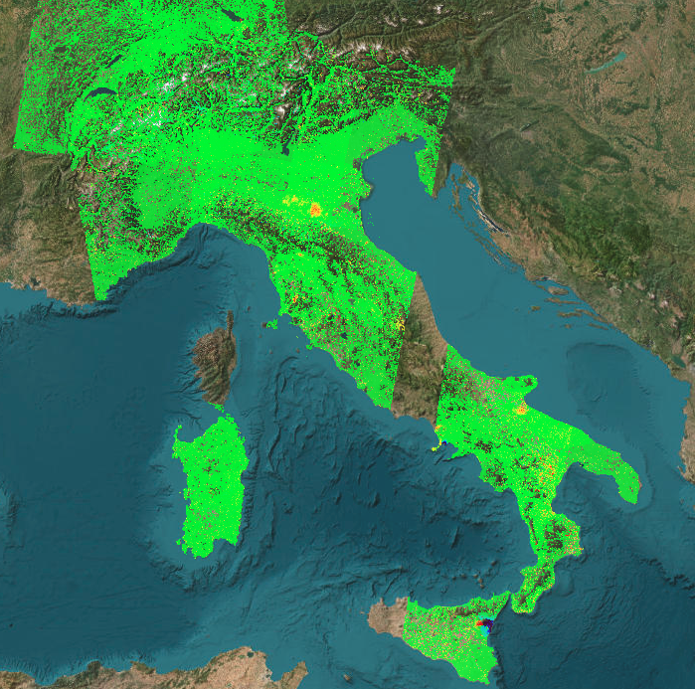
Gridded and Raster Data
Gridded datasets are common in atmospheric
sciences, oceanography, and remote sensing.
Standardized formats such as NetCDF-CF
(Climate and Forecast conventions) and
GeoTIFF support the structured storage
of spatial data on regular grids.
These formats are widely adopted and
ensure interoperability for visualization,
modeling, and statistical analysis.
LOS Displacement Time Series, provided by CNR-IREA - Istituto per il Rilevamento Elettromagnetico dell'Ambiente - IT, ISTerre - Institut des Sciences de la Terre de Grenoble - FR, UoL - University of Leeds - GB, https://creativecommons.org/licenses/by/4.0/ .
Accessed on 21-06-2025 through the EPOS Data Portal (https://www.epos-eu.org/dataportal )
Notes:
Content slide

Slide 9
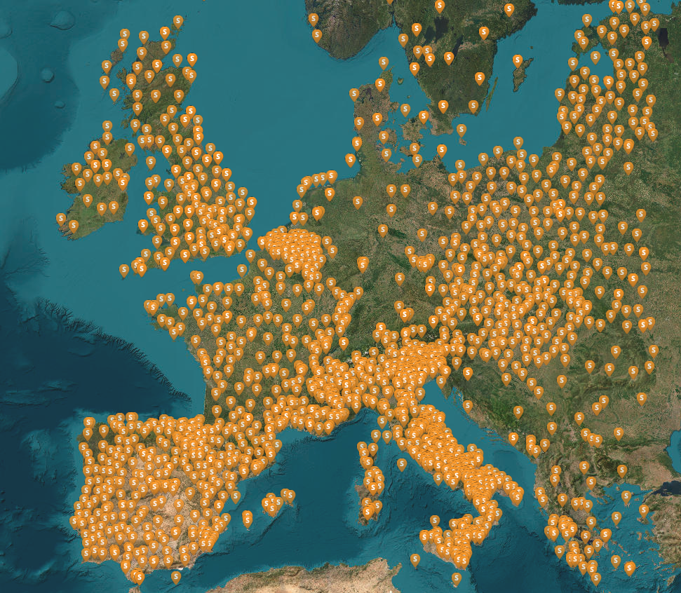
Vector and Point-Based Data
Point measurements from GNSS stations, geological surveys, and field observations are typically stored in tabular or geospatial formats to represent discrete features like epicenters, fault traces, or volcanic vents.
Common formats include:
CSV: widely used, but not standardized for geospatial use
ESRI Shapefile: de facto standard, but proprietary and not fully open
GeoJSON: open standard defined by the IETF
GML: XML-based open standard developed by the OGC
GNSS Stations with Products, provided by UBI - University of Beira Interior, https://creativecommons.org/licenses/by/4.0/. Accessed on 21-06-2025 through the EPOS Data Portal (https://www.epos-eu.org/dataportal)
Notes:
Content slide

Slide 10
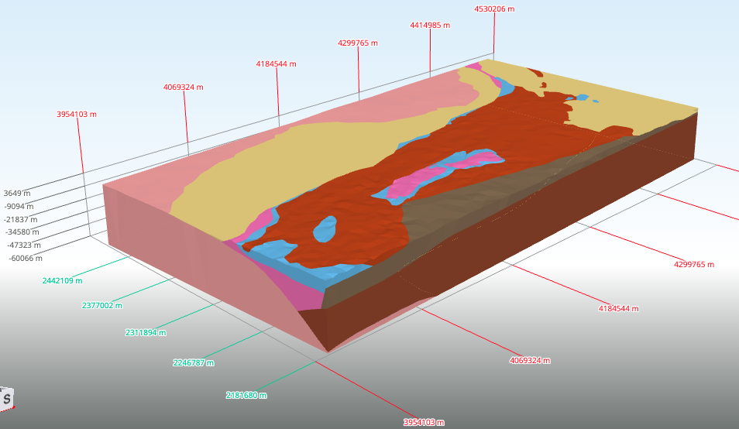
Multi-Dimensional and 4D Data
Some geoscientific applications require representing
complex, multi-dimensional datasets (3D or 4D),
such as tomographic models or evolving deformation
fields.
NetCDF and HDF5 are widely used formats for storing
structured scientific data.
NetCDF, especially when combined with CF or UGRID conventions, provides a standard framework for atmospheric, oceanographic, and hydrological data, while HDF5 is a general-purpose format that becomes effective in geosciences only when used with specific community conventions or schemas.
3D/4D Model Download Service, provided by GEUS - De Nationale Geologiske Undersøgelser for Danmark og Grønland - DK, https://creativecommons.org/licenses/by/4.0/ .
Accessed on 21-06-2025 through the EPOS Data Portal (https://www.epos-eu.org/dataportal )
Notes:
Content slide

Slide 11
MENTIMETER 1/2
"Can you name one or more formats or standards you have used, and briefly describe the context?"
Notes:
Content slide

Slide 12
Challenges Without Standardization
Lack of common standards results in:
Incompatibility between datasets from different sources
Loss of information during data conversion
Reduced ability to reproduce results
Increased manual processing and data cleaning
To avoid this, communities are encouraged to adopt established formats.
Notes:
Content slide

Slide 13
How Are Data Standards Defined and Adopted?
Standards can be:
Formal:
defined by recognized organizations (e.g., ISO, OGC, FDSN)
Community-driven:
adopted by practice and consensus (e.g., CF Conventions,)
Notes:
Content slide

Slide 14
Examples of Data Standards in Geoscience
Standard | Scientific Domain / Application
ISO 19115 | Geographic information metadata structure
CF Conventions | Climate and forecast data in NetCDF
OGC WMS / WFS | Web map and feature services (GIS)
WOVOdat schema | Volcanology observatory database model
IAGA-2002 | Geomagnetic time series
FDSN Standard | Seismic data and station metadata
Notes:
Content slide: tables

Slide 15
MENTIMETER 2/2
"Which features make a data format more useful in geosciences?” e.g.,Open and well-documented, Supports multidimensional data, Compact and efficient, Compatible with GIS tools, Broad community adoption"
Notes:
Content slide

Slide 16
Data Formats and Standards as Enablers of FAIR Principles
Findable
Using well-known, widely adopted data formats (e.g., NetCDF, GeoTIFF) helps ensure that data can be indexed and recognized by discovery platforms. Standardized naming and structural conventions increase searchability.
Accessible
Open formats make data readable without relying on proprietary software. Formats like CSV, HDF5, and GRIB are accessible through multiple platforms, ensuring users can retrieve and use data without barriers.
Interoperable
Standard formats follow defined structures that enable integration across tools and scientific domains. For example, NetCDF-CF allows seamless use of climate data across oceanography, meteorology, and hydrology.
Reusable
When data are stored in formats that are well documented and broadly supported, they can be confidently reused in new analyses, models, and studies, even years later
Notes:
Content slide

Slide 17
Conclusions
Geoscience research depends on robust and interoperable data formats.
Standardization ensures compatibility, quality, and long-term usability of data.
Adopting community standards is vital for enabling cross-disciplinary collaboration.
Investing in shared data formats supports transparent, efficient, and impactful science.
Notes:
Content slide

Slide 18

Thank you for your attention!
kety.giuliacci@ingv.it
www.epos-eu.org/on | #EPOSon
Notes:
Thank you slide

