Slide 1



From Field to FAIR: A Guide to FAIR sample and IGSN registration
Olaya Dorado| olayadorgeo@gmail.com
Notes:
Title slide

Slide 2
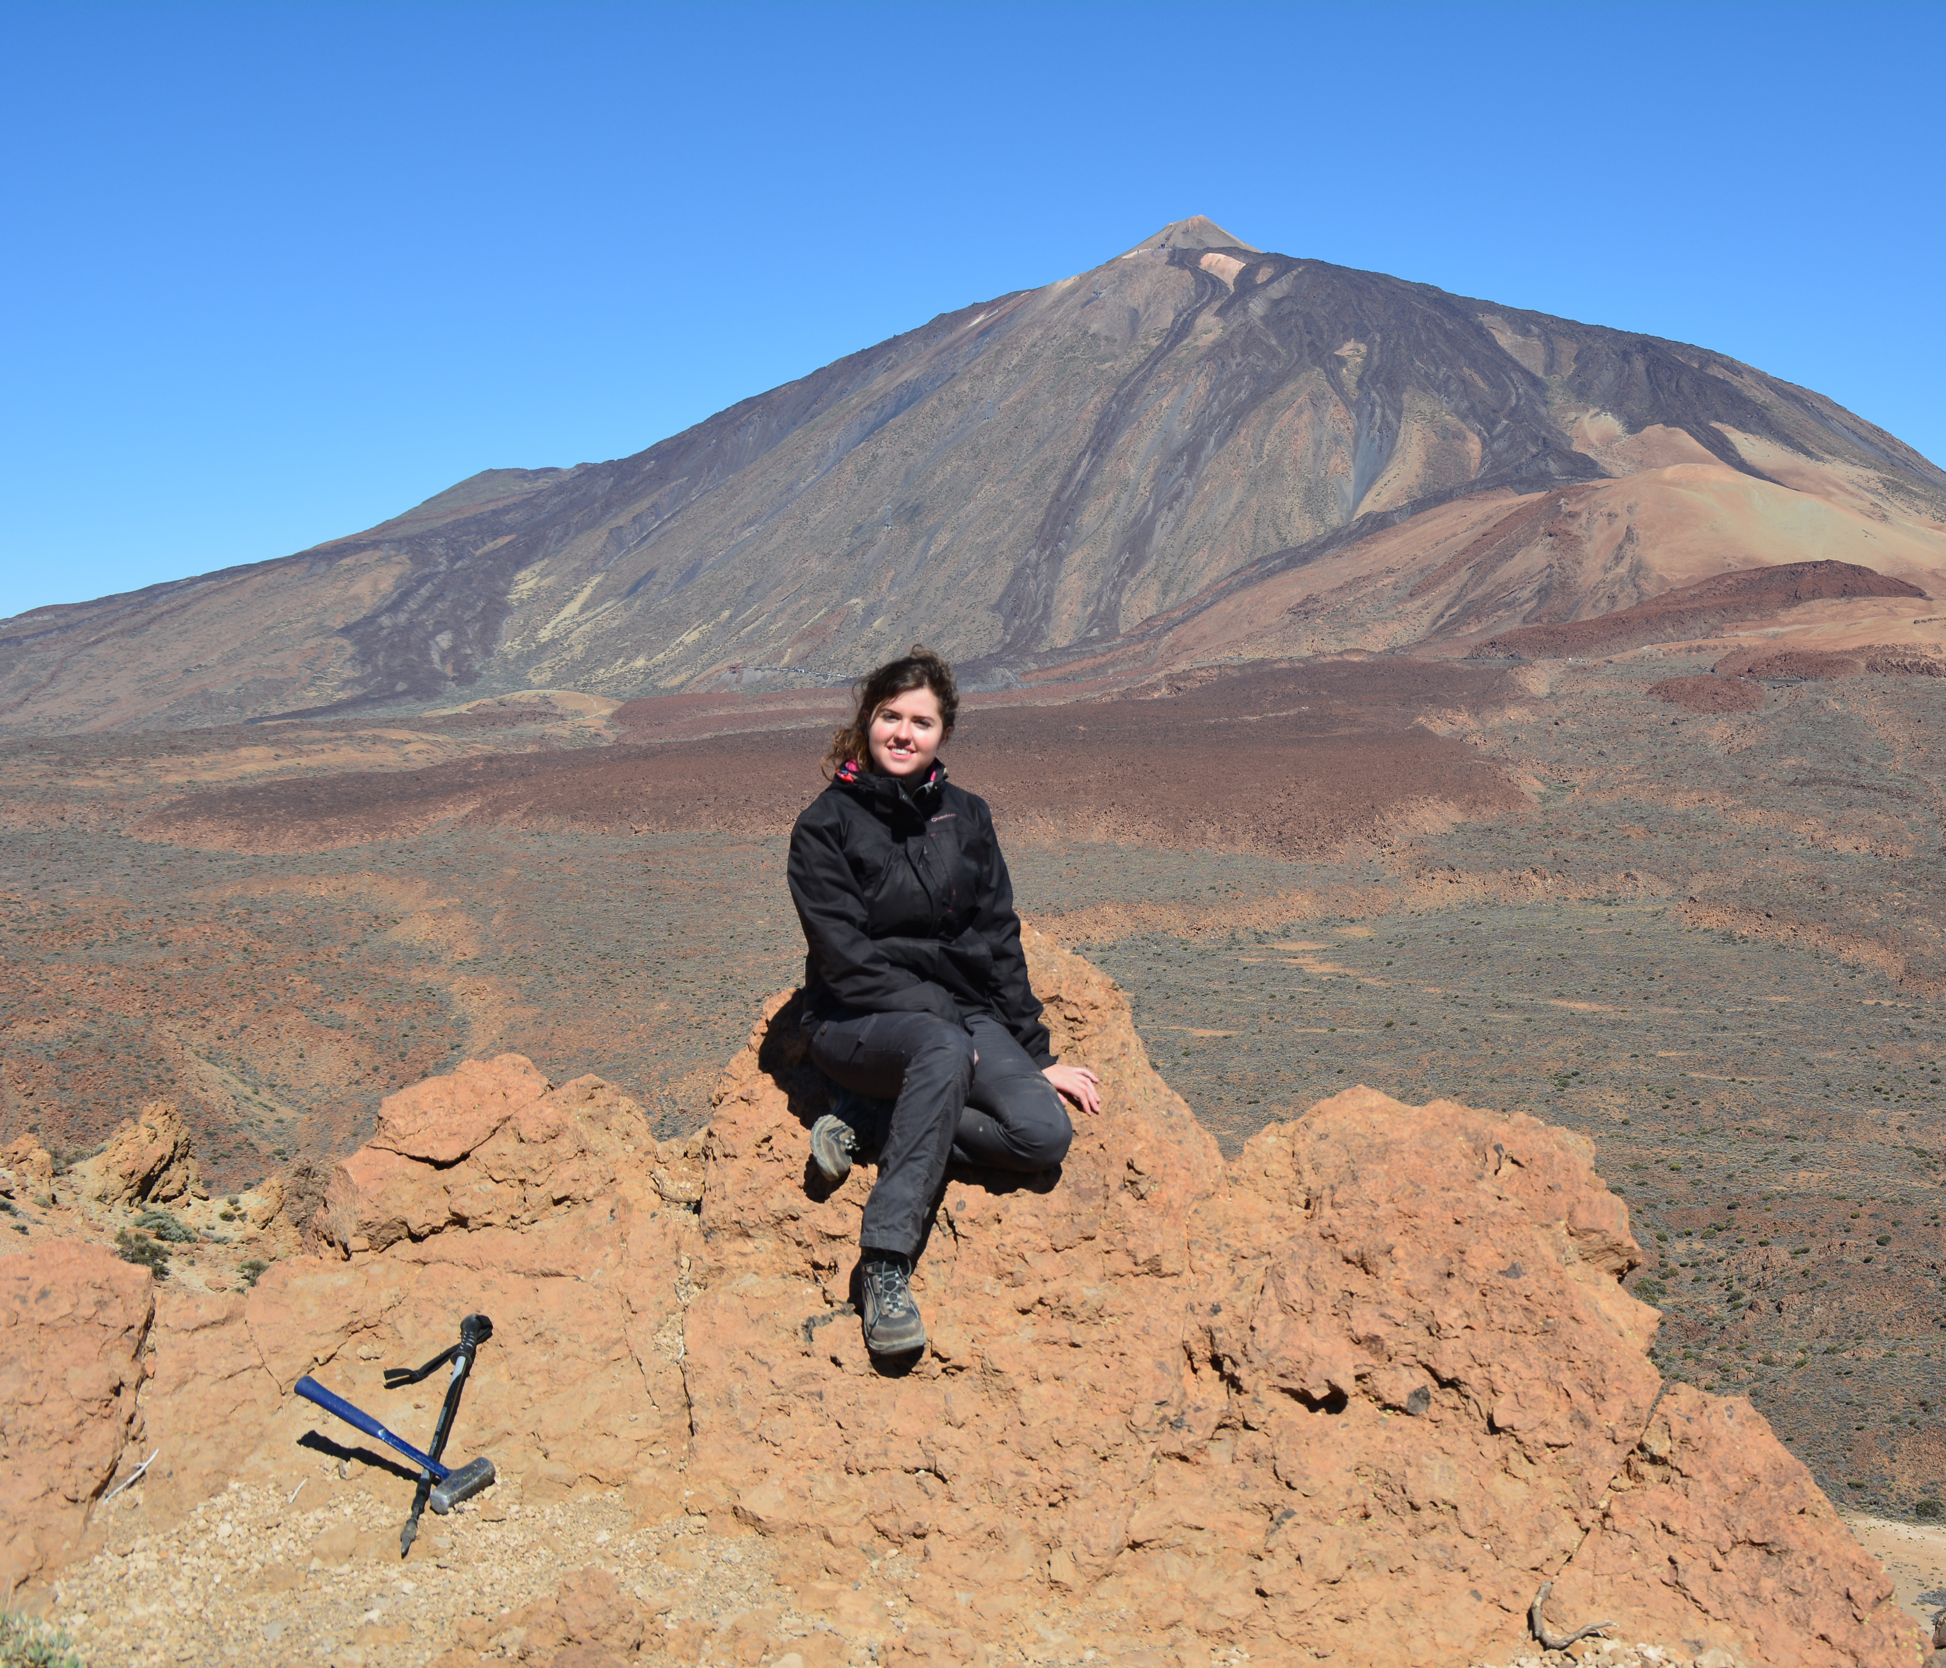
Brief presentation
My background:
  Geologist (I love rocks <3)
  Master in Mineral Resources and Geological Hazards.
  PhD in Earth Science: Petrology and Geochemistry applied to Volcanology (Teide volcano!)
Currently working as Project Manager of EPOS-ES.
Notes:
Content slide

Slide 3
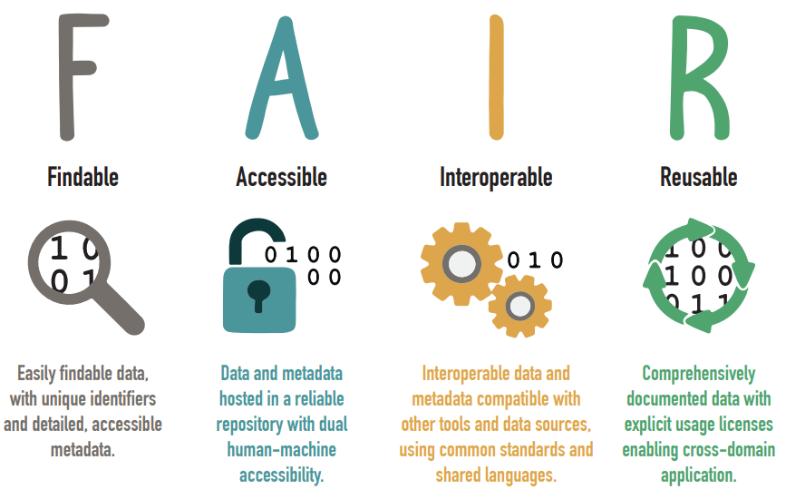
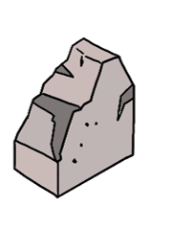
Why FAIR sampling matters?
DOI: 10.5281/zenodo.15167622
Natural sample:
  Rocks.
  Minerals.
  Sediments.
  Soil.
  Cores.
Notes:
Content slide – 2 boxes

Slide 4
MENTIMETER SLIDE
Do you usually work with natural samples?
Notes:
Content slide – 2 boxes

Slide 5
Why FAIR sampling matters?
Natural sample: object or data?
Samples themselves are key scientific objects.
If we don’t document them properly:
  It's harder to trace, compare, or reanalyse.
  It's disconnected from derived datasets.
  It can’t be reused by others — or even by ourselves in the future.
“The long-term curation of collected materials is an important investment for the future” – Corsaro et al. (2025)
Notes:
Content slide – 2 boxes

Slide 6
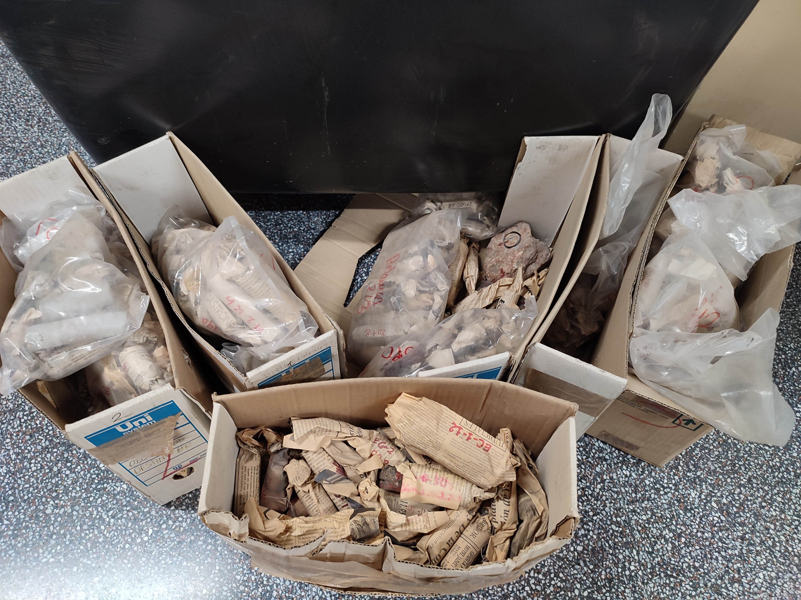
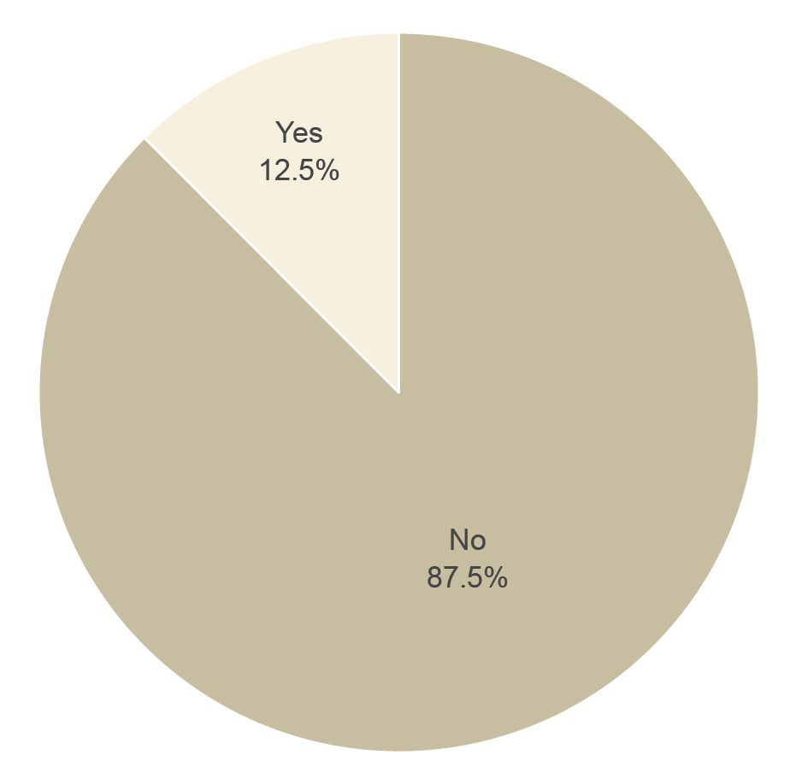
The risk of poor documentation
Dorado (2024)
Samples of T-PV volcanic system (Tenerife) with and witout coordinates.
29/06/2021
Notes:
Content slide – 2 boxes

Slide 7
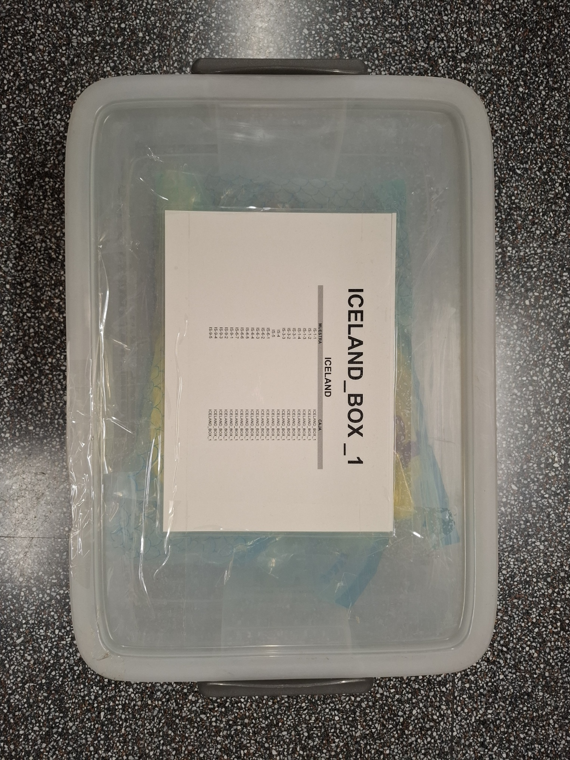
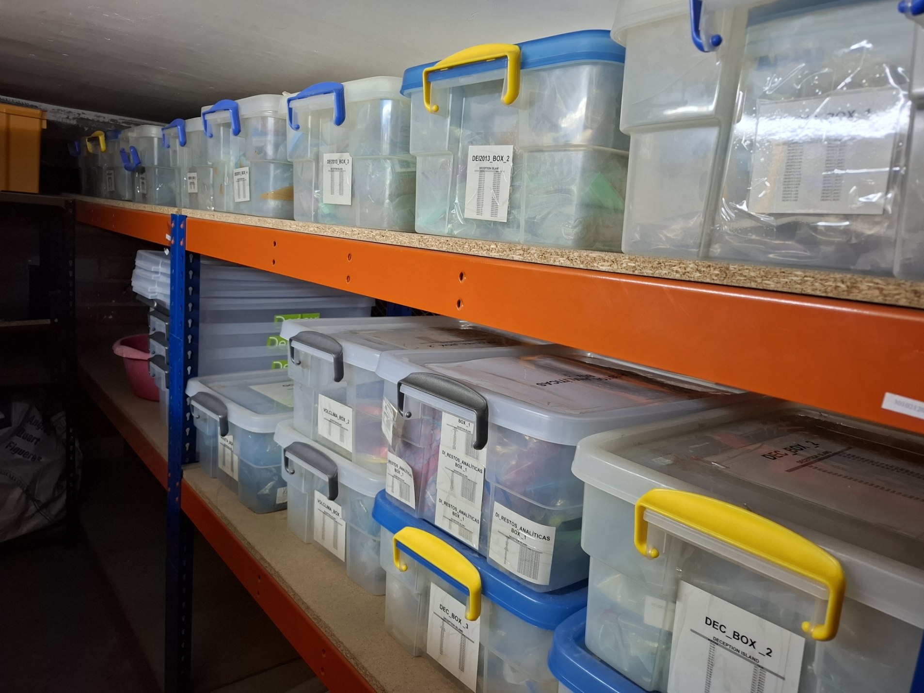
The risk of poor documentation
20/06/2025
Notes:
Content slide – 2 boxes

Slide 8
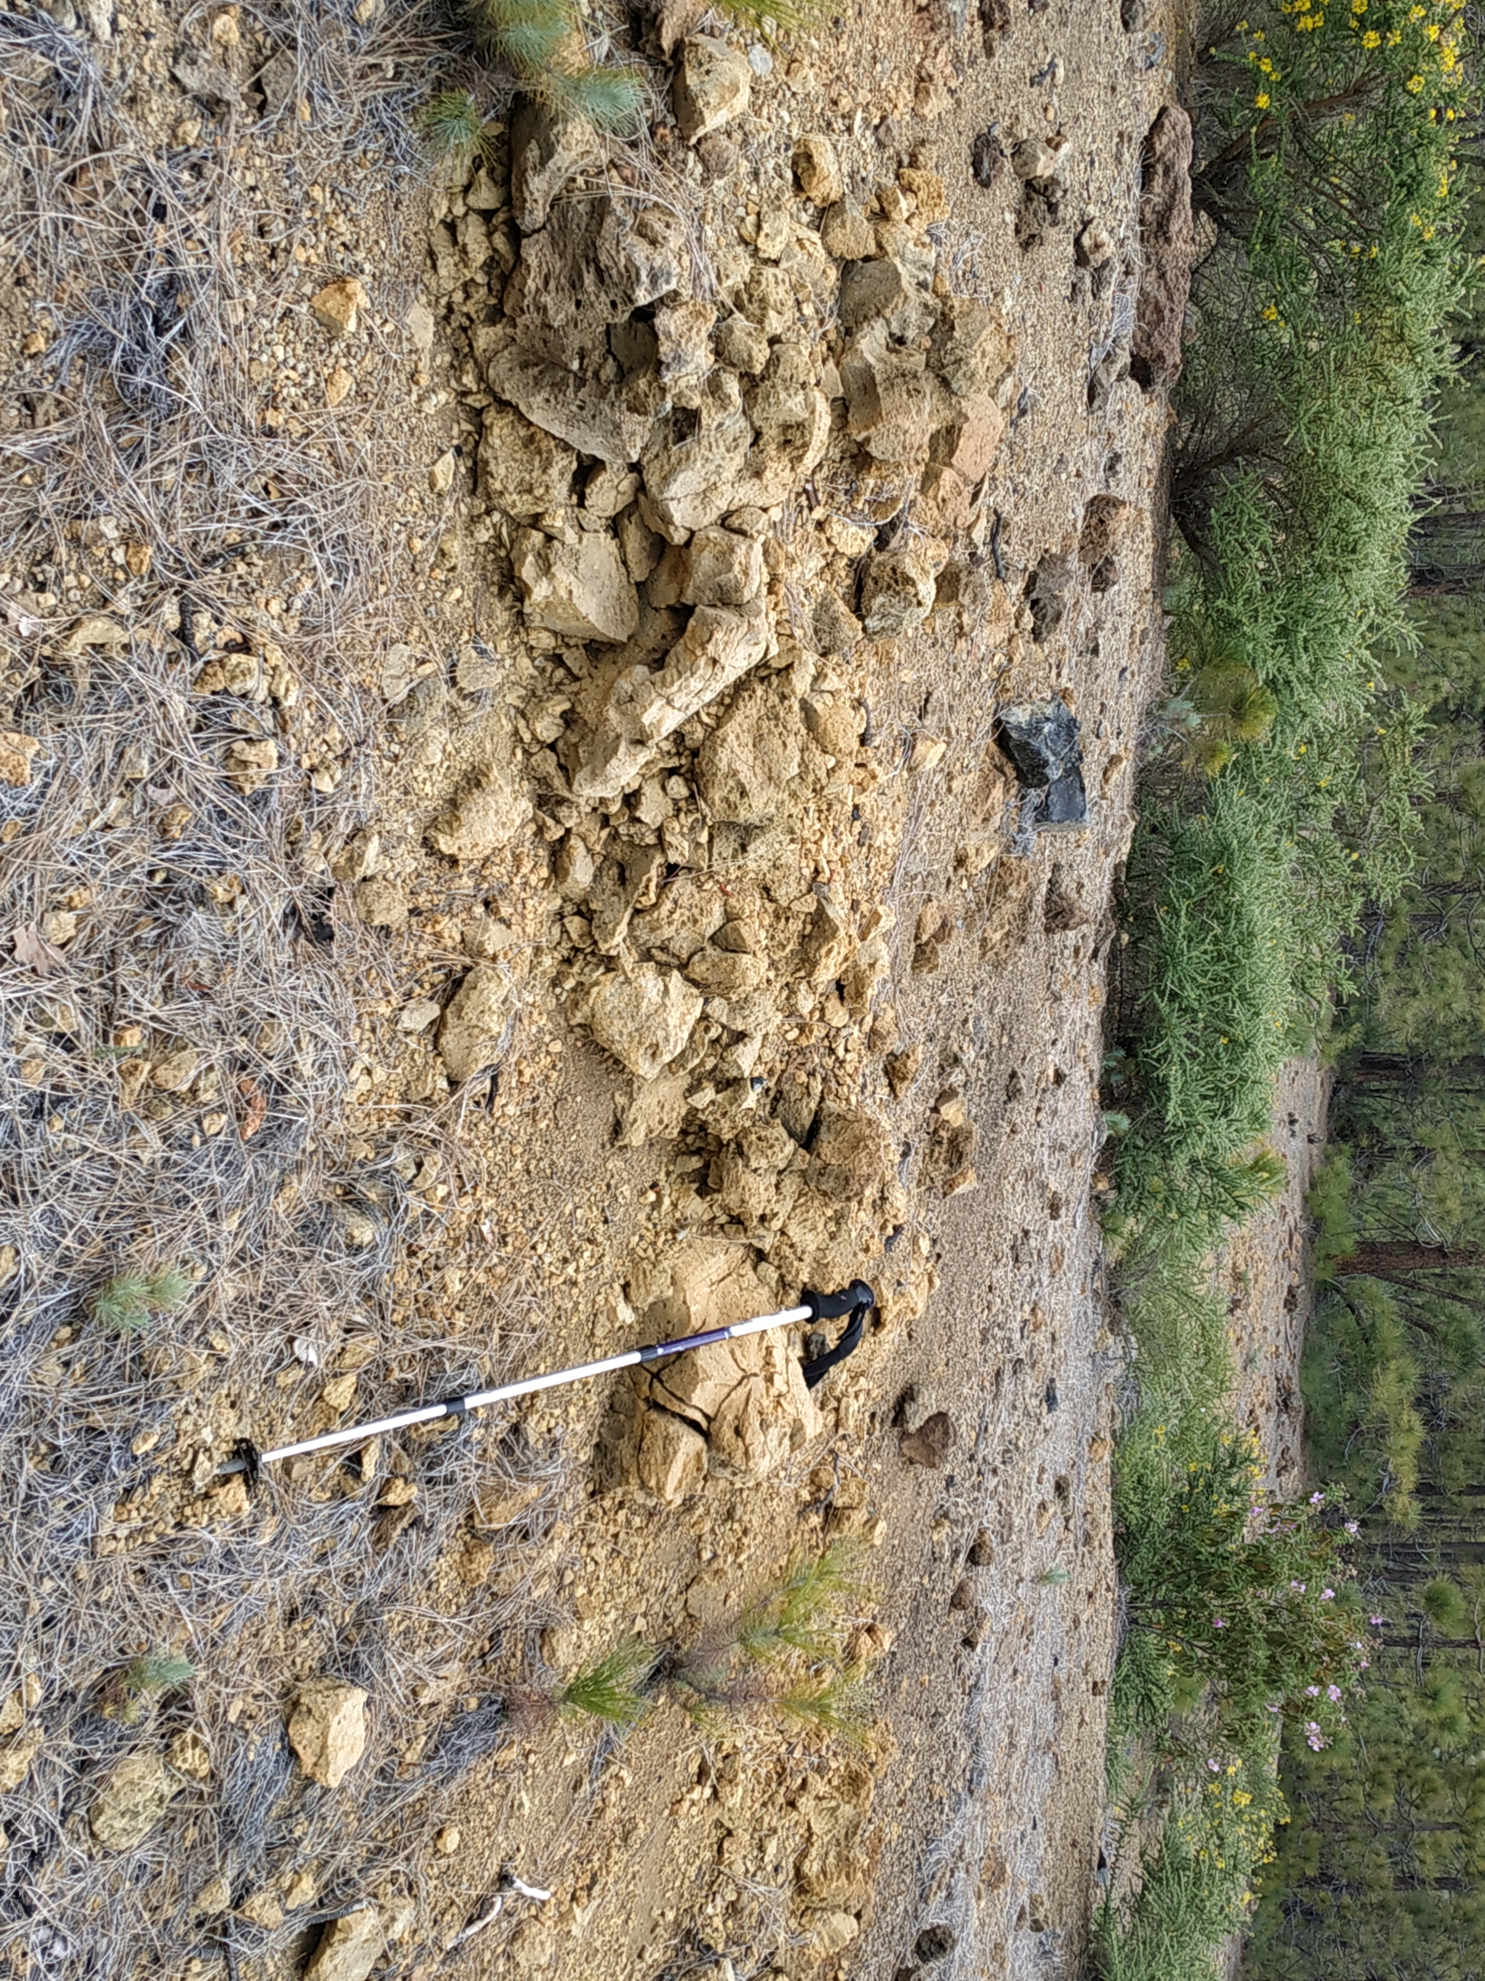
Metadata collection starts in the field
Metadata collection needs previous planning.
Levels of metadata:
  Minimum.
  Recommended.
  Optional.
The more, the best!
Notes:
Content slide – 2 boxes

Slide 9
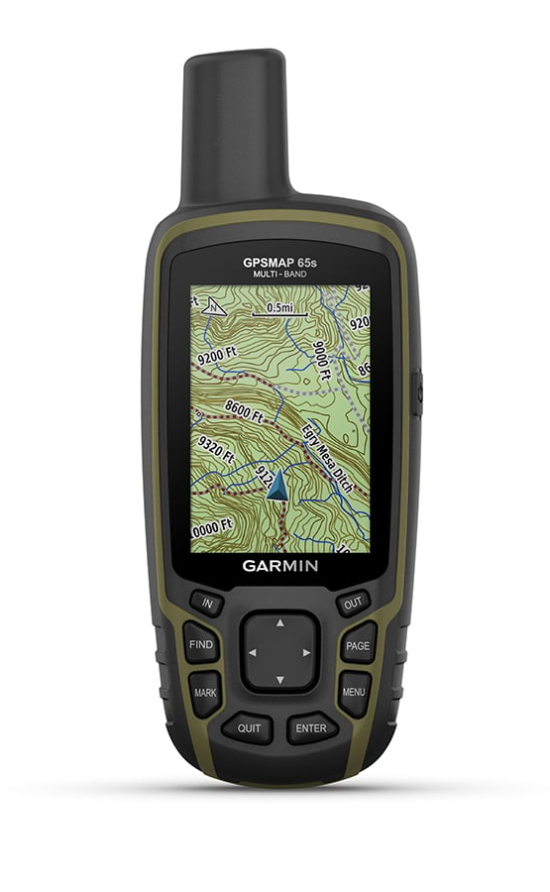
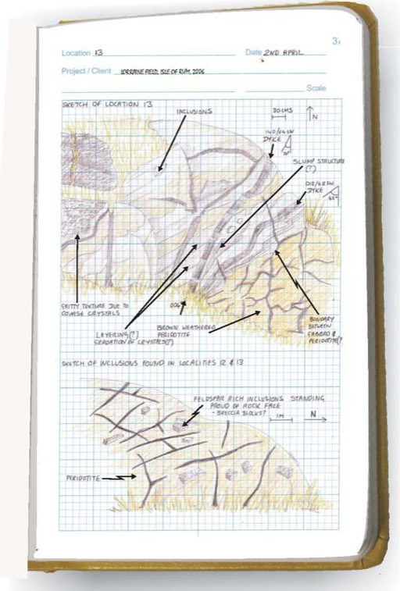
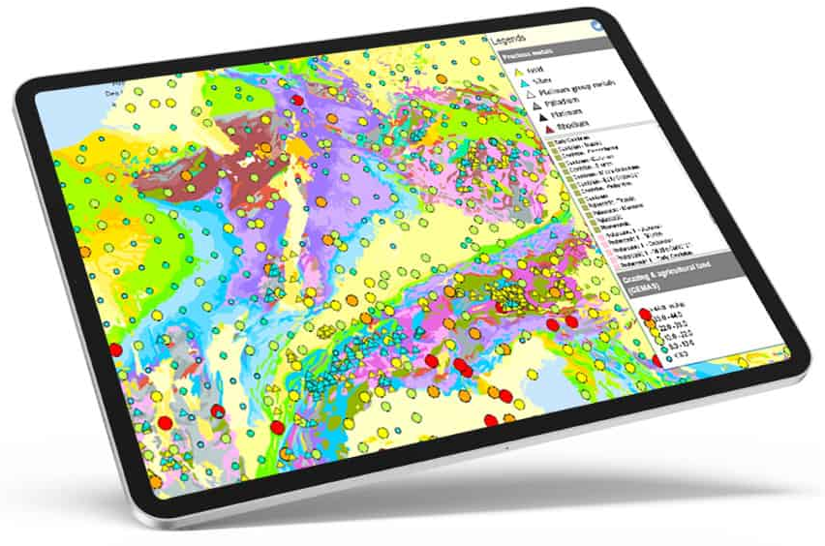
How to collect metadata in the field?
Field notebooks: paper or digital (e.g. ipad).
Pre-filled forms or templates (it is very easy to forget something!).
GPS devices.
Camara. If possible, with photo annotation tools.
Mobile apps.
GPS Garmin GPSMAP 65S +
Jerram and Petford (2011)
https://eurogeosurveys.org/data/
Notes:
Content slide – 2 boxes

Slide 10
MENTIMETER SLIDE
What metadata do you usually take when you go to the field (or do you think it should be taken)?
Notes:
Content slide – 2 boxes

Slide 11
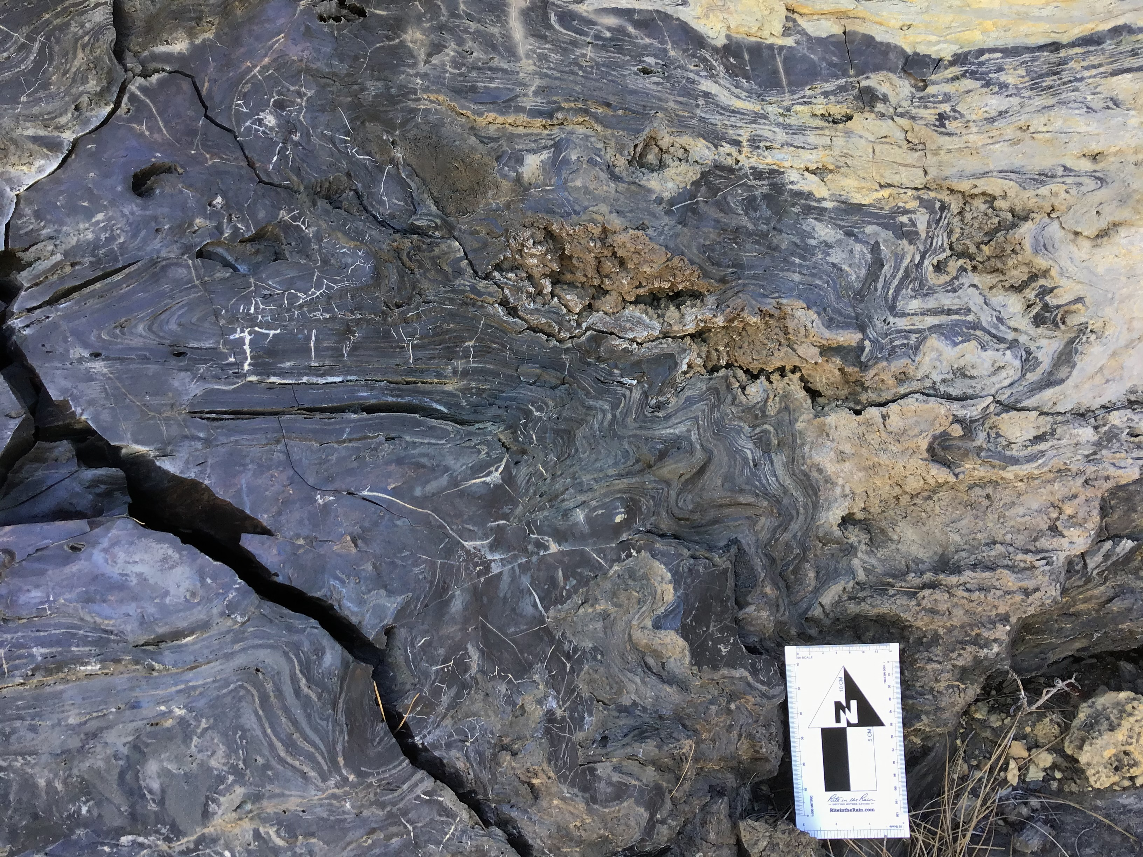
Minimum metadata (Always required!)
Sample name: pre-established unique identification code.
Geographical coordinates (latitude and longitude).
Collector’s name.
Date of collection.
Collection method.
Sample type (e.g., rock, sediment, soil, water)
Etc…
Notes:
Content slide – 2 boxes

Slide 12
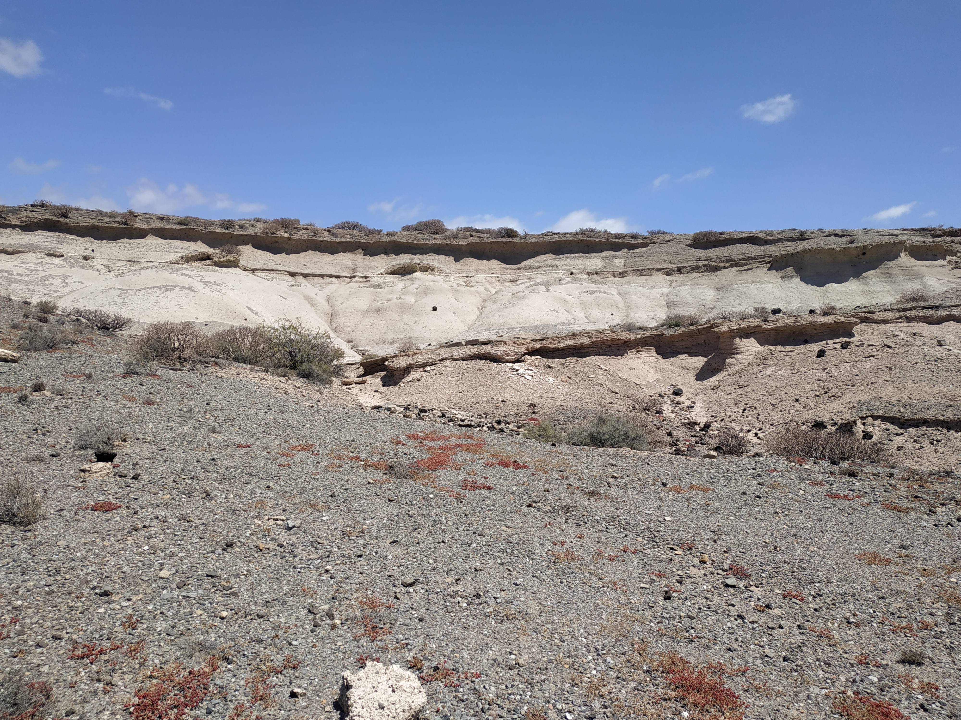
Strongly recommended metadata
Geographycal, geological and/or environmental context.
Stratigraphic position.
Sample orientation.
Sample description.
Photos of the outcrop and/or schetchs.
Borehole name
Notes:
Content slide – 2 boxes

Slide 13
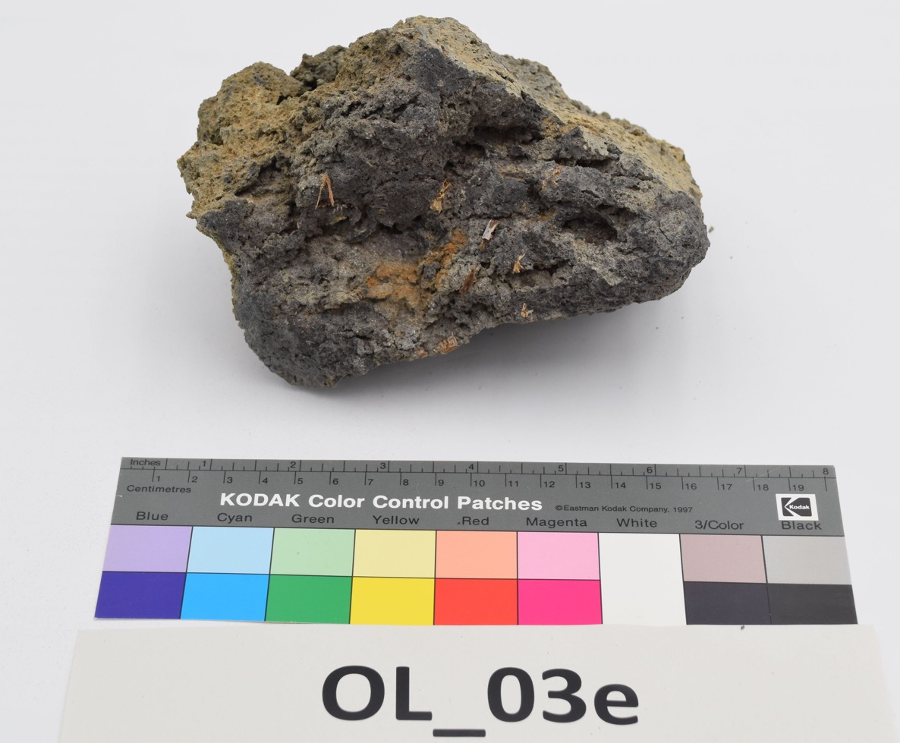
Back at the laboratory…
Photograph of the samples: identification code, sizescale, and color reference.
Assign an IGSN (International Geo Sample Number) to each sample.
Assign a DOI to the sample collection.
Cite the DOI of the sample collection and the individual IGSNs in related publications.
IGSN: 10.58052/IEGVFOL03F
Notes:
Content slide – 2 boxes

Slide 14

More and more metadata
Recomended Reading: Corsaro et al. (2025). Guidelines and metadata model for a repository of volcanic samples. Bulletin of Volcanology, 87(5), 32.
Notes:
Content slide – 2 boxes

Slide 15
More and more metadata
IMPORTANT!
Where are your simples?
Current archive.
Current archive contact.
Shelf.
Box.
Recomended Reading: Corsaro et al. (2025). Guidelines and metadata model for a repository of volcanic samples. Bulletin of Volcanology, 87(5), 32.
Notes:
Content slide – 2 boxes

Slide 16
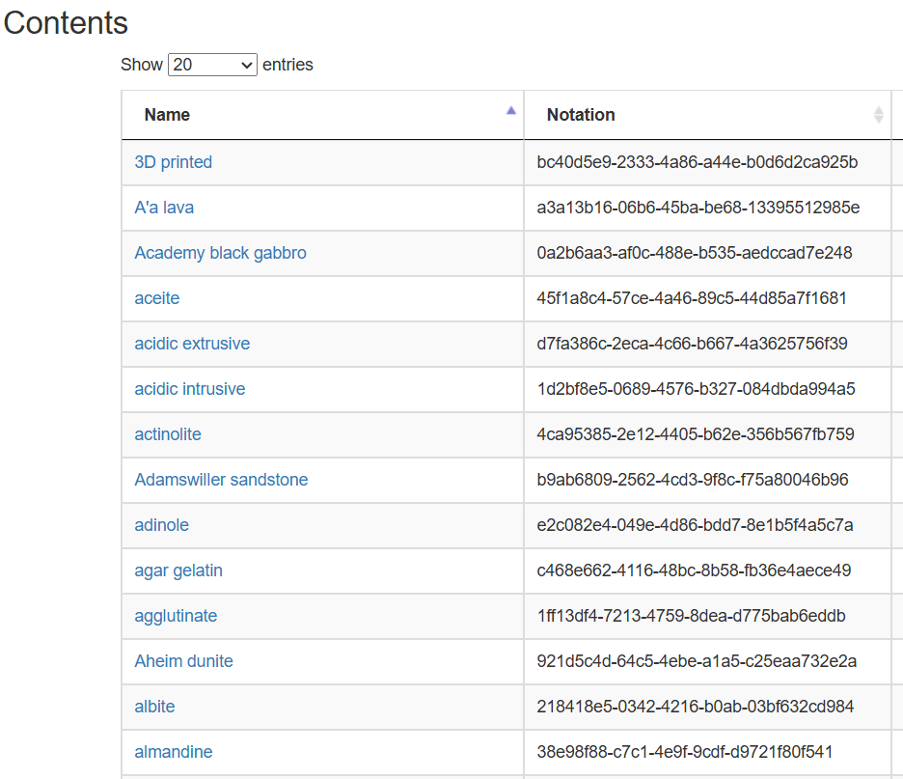
Controlled vocabularies
MSL TCSs vocabularies - https://registry.epos-eu.org/ncl/FAIR-Incubator/_tcs-MSL
Categories and vocabularies must be:
  Machine-readable.
  Consistent.
  Interoperable with large databases.
  Enable data integration and discovery.
Examples:
  Rock type: "basalt", "Basalt", "volcanic rock", "lava“.
  Method: "hammer", "manual sampling", "hand collected“.
Notes:
Content slide – 2 boxes

Slide 17

Resources and vocabularies for Earth Science
Databases and reference institutions:
  SESAR (IGSN registration).
  EarthChem.
  Georoc.
  EarthRef.
  UGGS.
  BGS.
  EPOS.
  Geonames.
  GFZ Data Services.
  Etc…
TAKE HOME MESSAGE:
Use pre-defined lists whenever available.
Document your terms clearly in each project/publication.
Reuse vocabularies from large databases and infrastructures.
Notes:
Content slide – 2 boxes

Slide 18
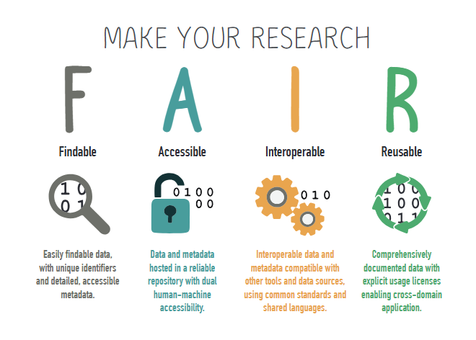
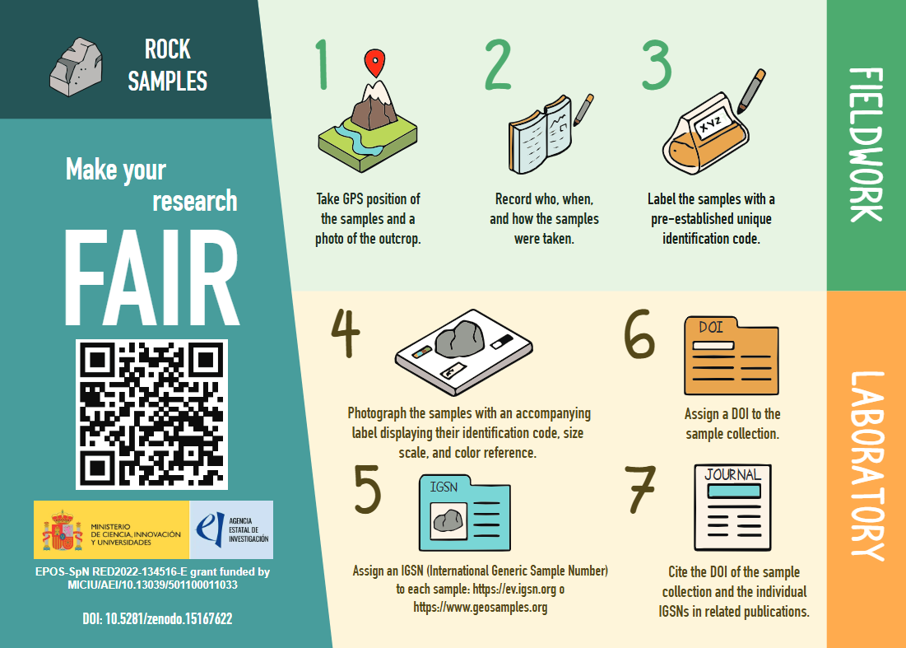
https://epos-es.org/principios-fair/
Notes:
Content slide – 2 boxes

Slide 19

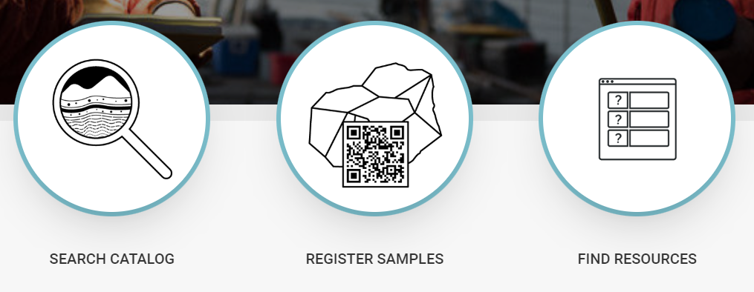
Assigning an IGSN using SESAR
https://www.geosamples.org/
Notes:
Content slide – 2 boxes

Slide 20
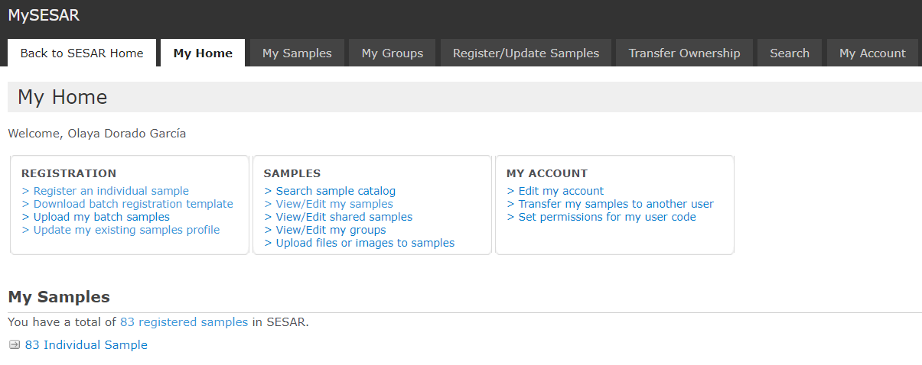
Assigning an IGSN using SESAR
Notes:
Content slide – 2 boxes

Slide 21
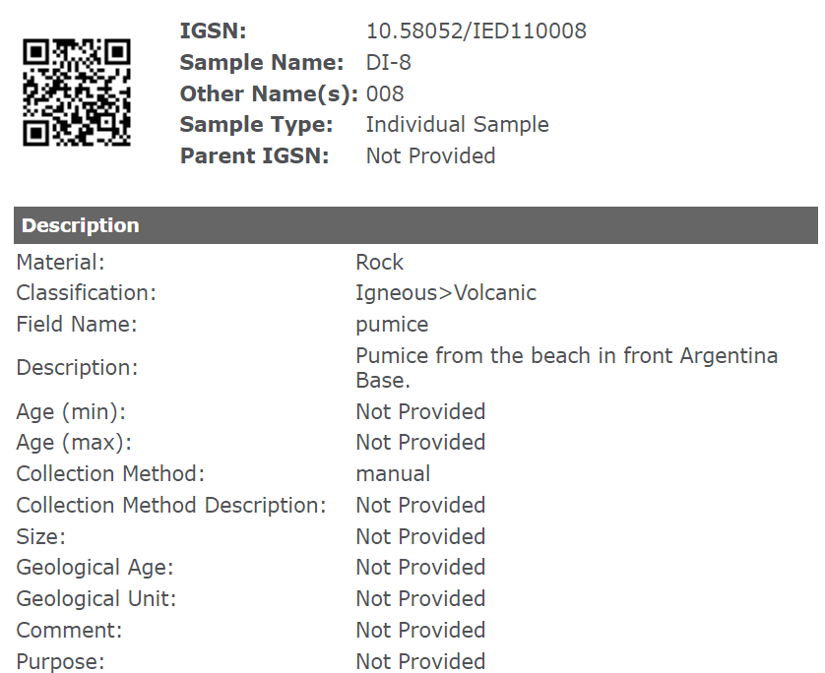
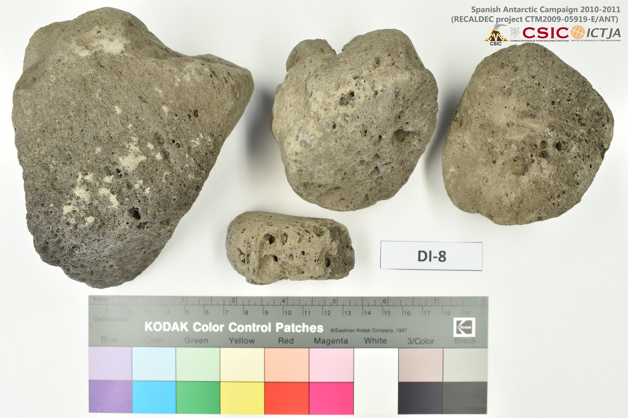
Assigning an IGSN using SESAR
https://app.geosamples.org/sample/igsn/10.58052/IED110008&header=1
Notes:
Content slide – 2 boxes

Slide 22
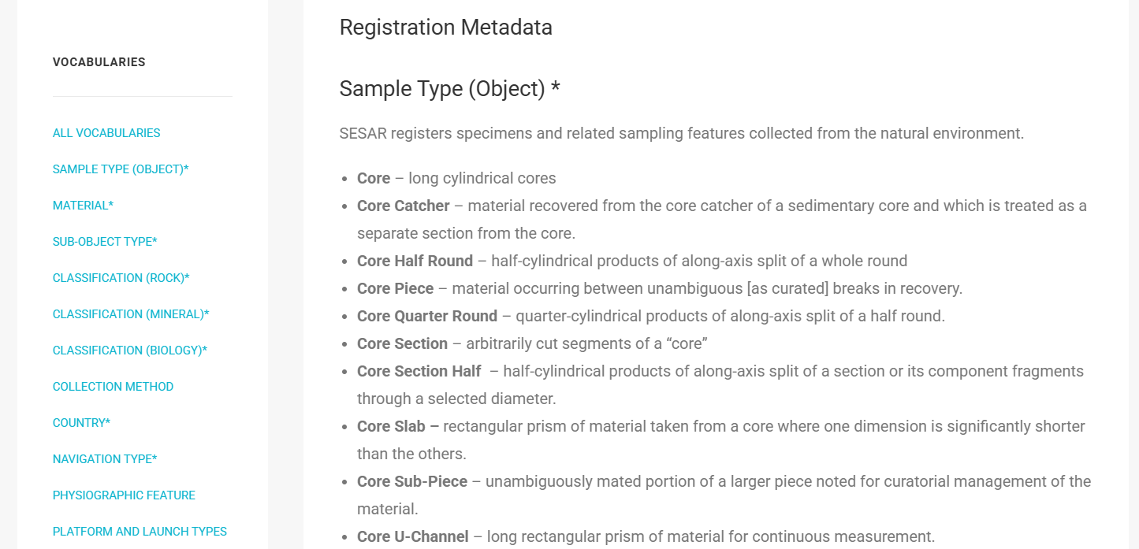
SESAR vocabularies
https://www.geosamples.org/vocabularies
Notes:
Content slide – 2 boxes

Slide 23

Thank you for your attention!
Any questions?
olayadorgeo@gmail.com
Notes:
Thank you slide

Slide 24
Notes:
Logo only

