Slide 1


The role of (domain) repositories for Open Science and how can they help you in making your data FAIR
Kirsten Elger and the GFZ Data Services Team
GFZ Helmholtz Centre for Geosciences

Slide 2





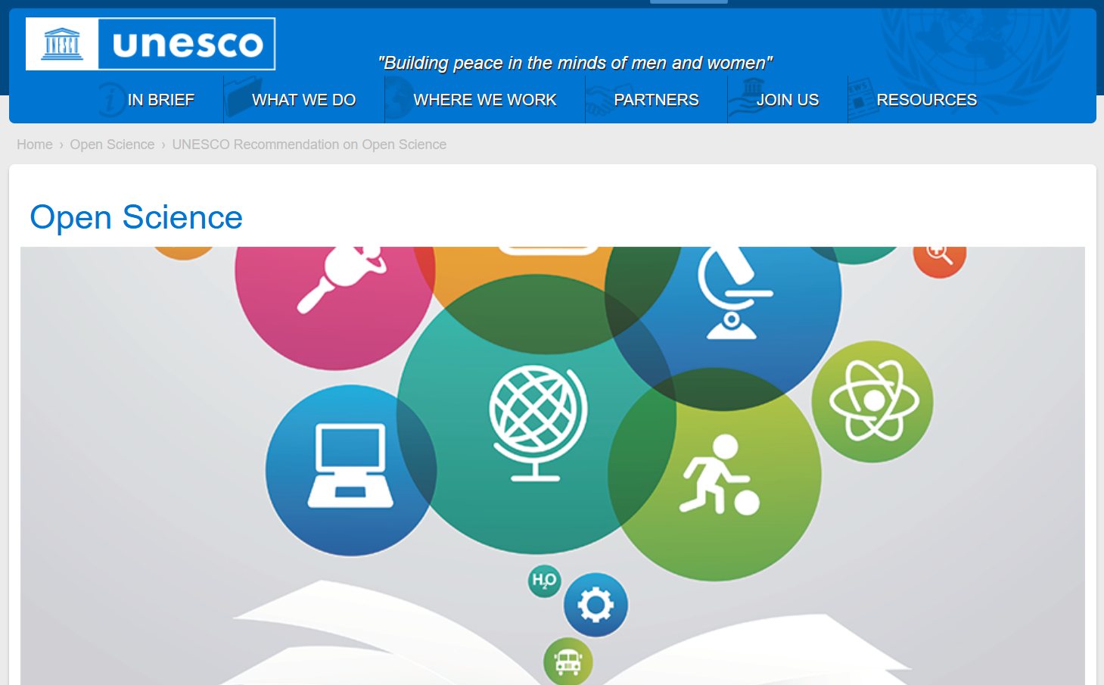




The Open Science Movement
Berlin Declaration on Open Access to Knowledge in the Sciences and Humanities (2003): „Open access contributions include original scientific research results, raw data and metadata, source materials, digital representations of pictorial and graphical materials and scholarly multimedia materials.”
Recommendation on Open Science 2023
Open Software
Data Availability Statement
Repositories, Repositories, Repositories,
Repositories
Open Peer Review
Open Data Policies
Data Management Plans
Data Citations

Slide 3
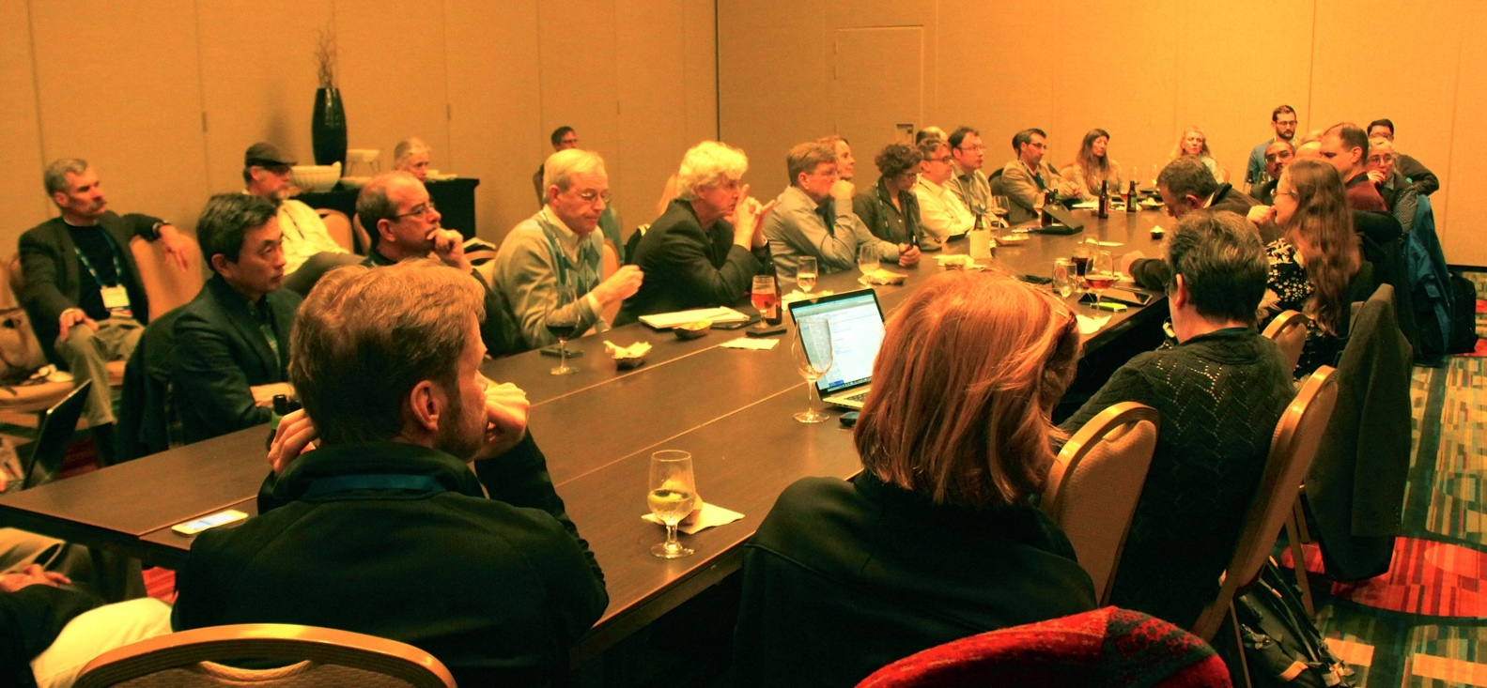
How re-usable are data supplements?
COPDESS @ AGU 2014
“Scholarly publication is a key high-value entry point in making data available, open, discoverable, and usable. Most publishers have statements related to the inclusion or release of data as part of publication, recognizing that inclusion of the full data enhances the value and is part of the integrity of the research. Unfortunately, the vast majority of data submitted along with publications are in formats and forms of storage that makes discovery and reuse difficult or impossible.”
2015
Hanson et al. (2015, https://doi.org/10.1029/2015EO022207) and www.copdess.org

Slide 4
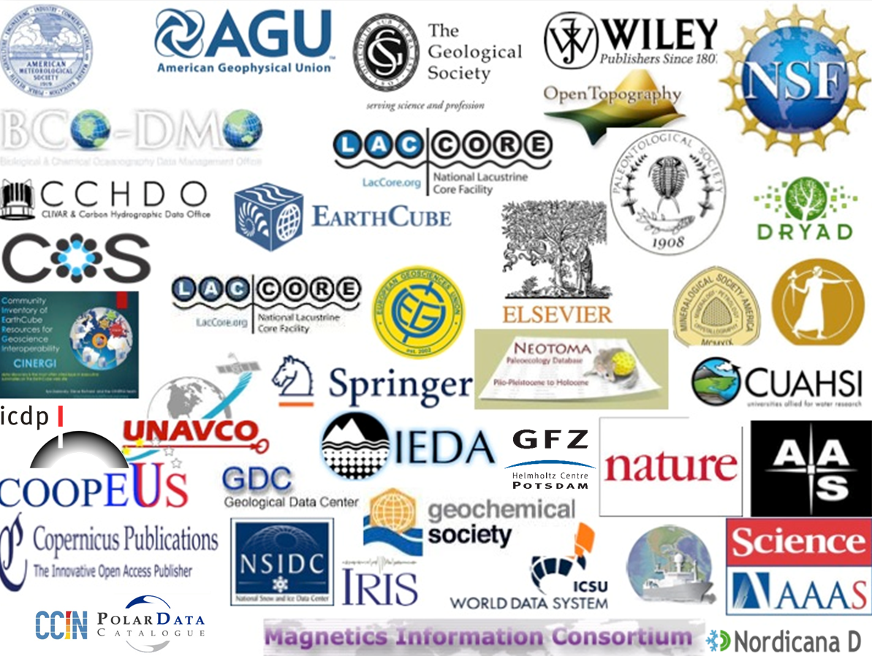
COPDESS
2015: Data Publications with DOI are citable in research articles (COPDESS Statement of Commitment)
STATEMENT OF COMMITMENT
data should be stored in appropriate domain repositories.
citations of data sets should be included within reference lists.
include in research papers concise data availability statements.
links to data sets in publications and corresponding links to journals in data facilities
http://www.copdess.org/statement-of-commitment/

Slide 5

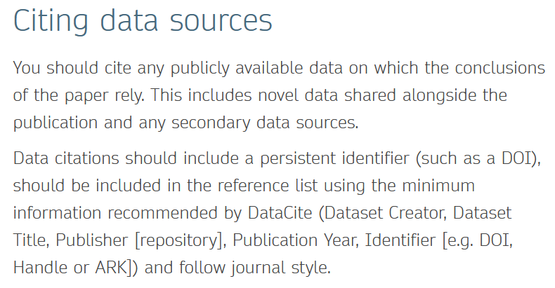
Journal Policies: data and code citations in articles
Data and software policy
AGU requires that the underlying data and/or software or code needed to understand, evaluate, and build upon the reported research be available at the time of peer review and publication. […]. This entails:
Depositing the data and software in a community accepted, trusted repository, as appropriate, and preferably with a DOI
Including an Availability Statement as a separate paragraph in the Open Research section explaining to the reader where and how to access the data and software
And including citation(s) to the deposited data and software, in the Reference Section.
https://www.agu.org/Publish-with-AGU/Publish/Author-Resources/Data-and-Software-for-Authors (last access 2 Sep 2024)
https://www.springernature.com/de/authors/research-data-policy/data-availability-statements (last access 11 Oct 2024)

Slide 6
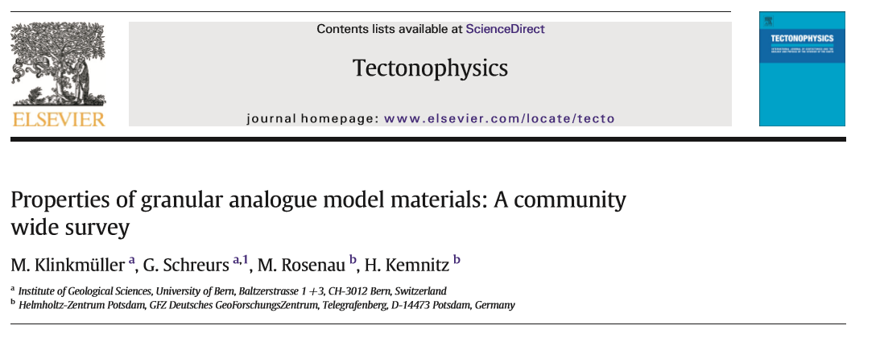
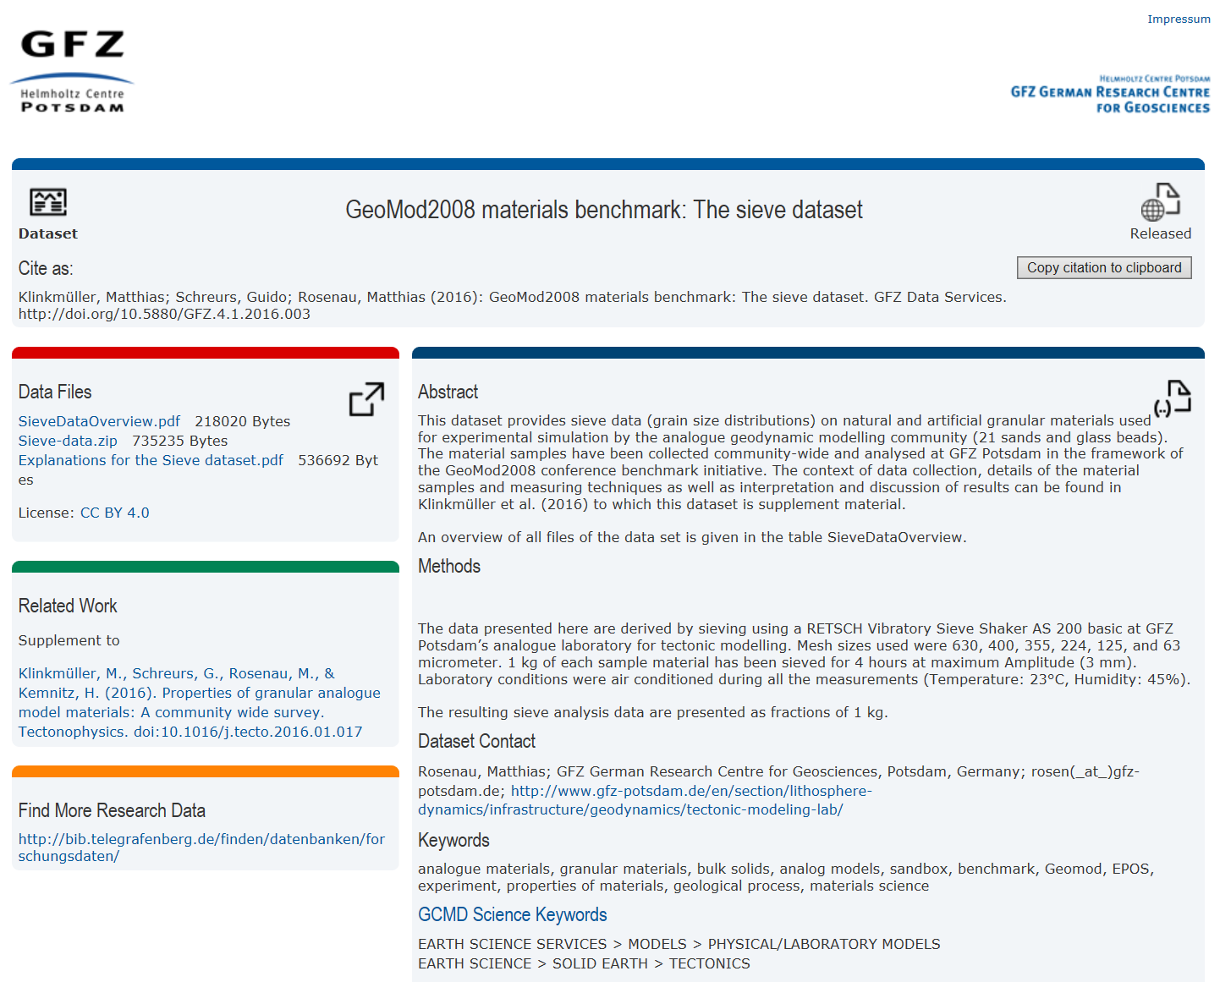
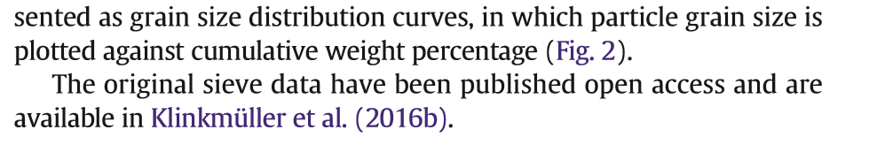

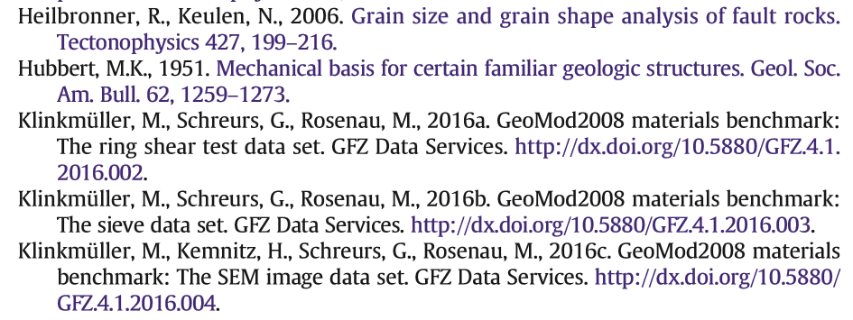
Citation of Dataset-DOIs
How do I cite a dataset?
3. Data access via DOI
Link to paper
1. Citation in the text
2. Full reference with DOI in the References

Slide 7
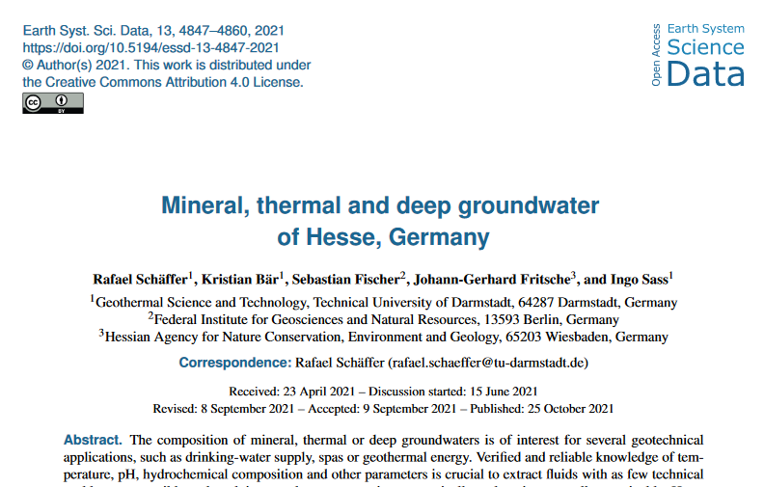
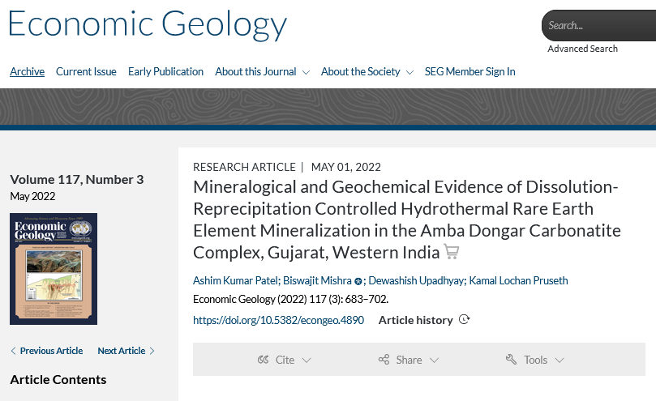

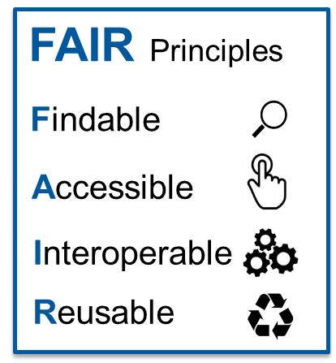


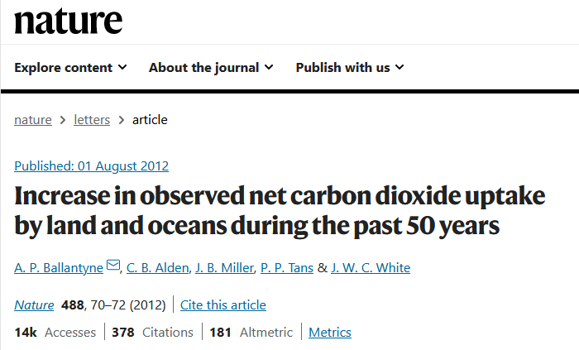



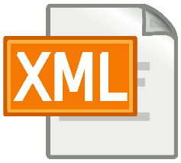



How does this concern me as a researcher?
I am not much interested in metadata, FAIR…
https://www.alamy.de/stockfoto-wissenschaftlerin-mit-lupe-163648035.html
However….
It is increasingly difficult to publish papers without making the underlying data available
h-index
Repositories can help you!

Slide 8











Research Data Repositories
Permanent archives and access points to research data
institutional, general, domain
Ideally open access
persistent identifier (ideally DOI)
“Domain repositories: These repositories provide quality and standards [for their domain], enriching and organizing data from multiple sources to facilitate new discoveries. They are in many ways the best stewards of the data but are not currently well connected with most publishers, and many data are thus not finding their proper home.”
Hanson et al.(2015) Eos, 96, https://doi.org/10.1029/2015EO022207

Slide 9
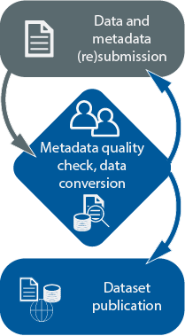

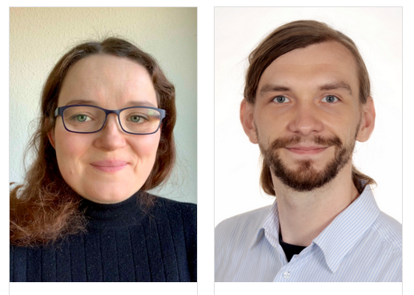

Domain Repositories – what makes them different?
“Domain repositories [….] provide quality and standards [for their domain], enriching and organizing data from multiple sources to facilitate new discoveries. They are in many ways the best stewards of the data but are not currently well connected with most publishers, and many data are thus not finding their proper home.” Hanson et al.(2015) Eos, 96, https://doi.org/10.1029/2015EO022207
Data curation
by domain scientists
feedback loop
geology
informatics
mineralogy
geosciences

Slide 10
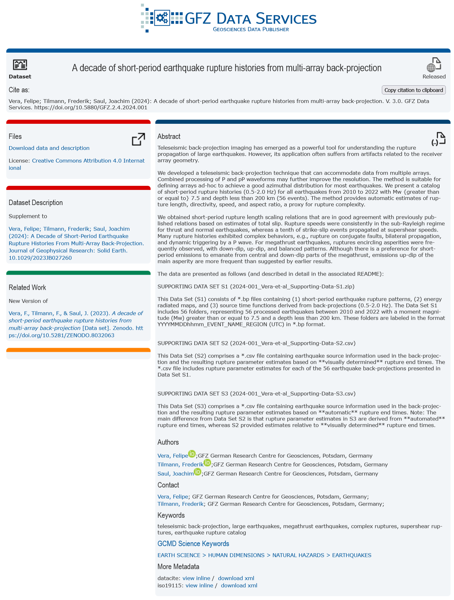
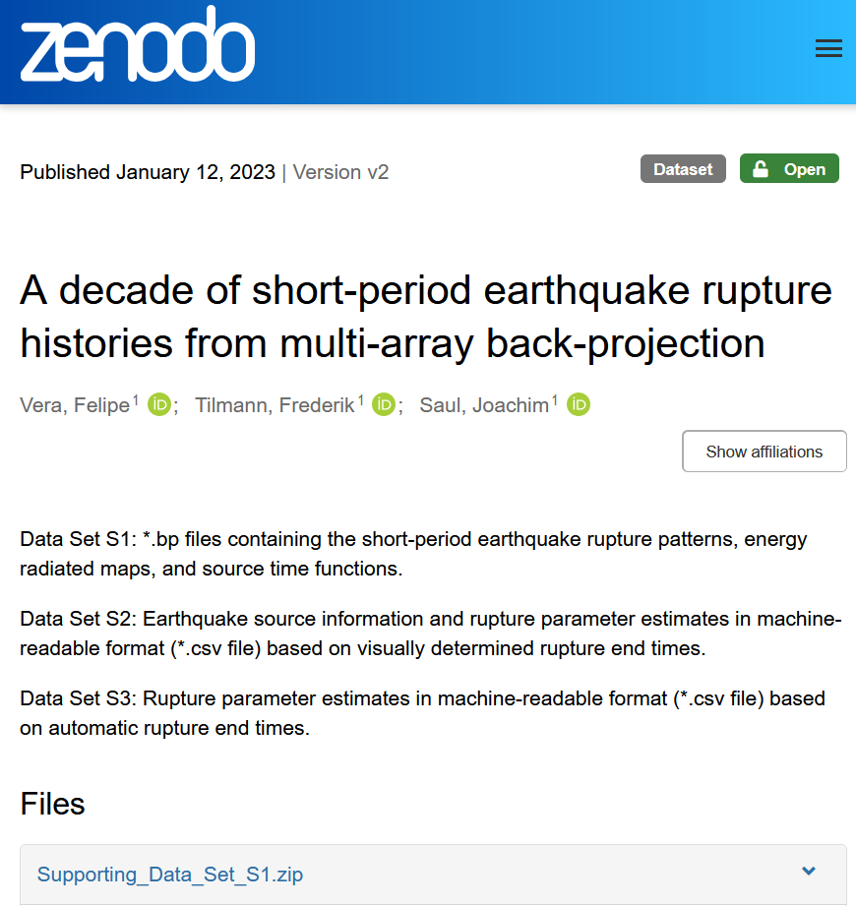

Data curation example
Citation and licence
Self-service DOI via generalist repository
Description
Related references: paper, data, code, IGSNs
Authors, ORCID etc.
Thematic keywords
https://doi.org/10.5880/GFZ.2.4.2024.001

Slide 11
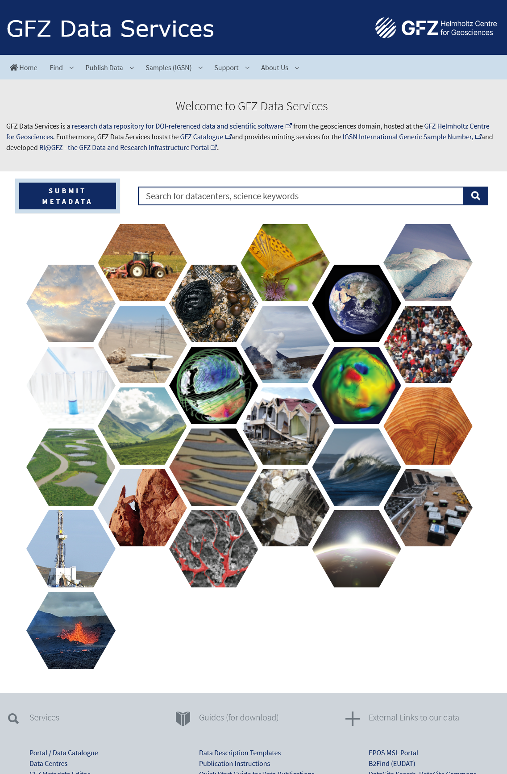






Profile
Domain repository for the Geosciences since 2006
DOIs for data and scientific software
IGSNs for physical samples
Data curation by domain scientists
Partner of:
Supporting FAIR data
International metadata standards (human & machine readable)
Controlled vocabularies for „rich“ metadata
PIDs
Open Licences for data
and software
OAI-PMH interface
schema.org → Google Dataset Search
in prep

Slide 12
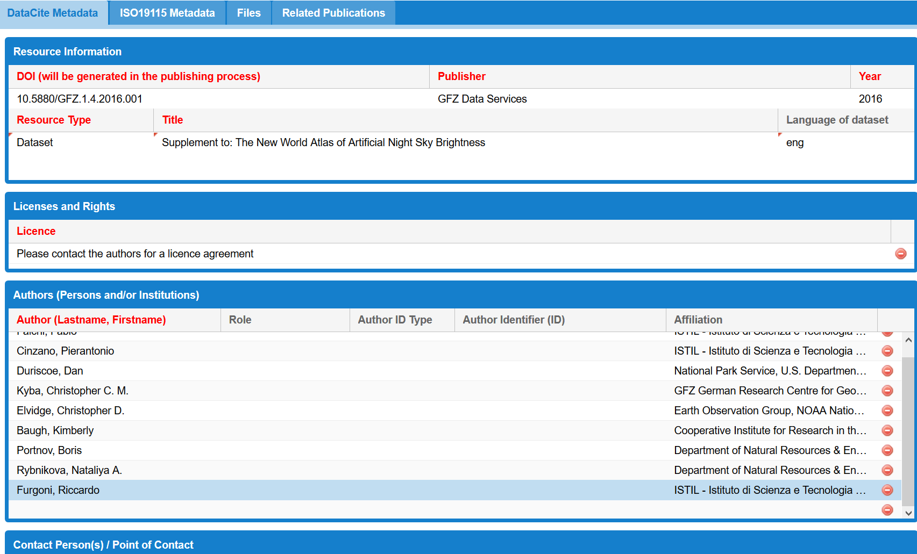
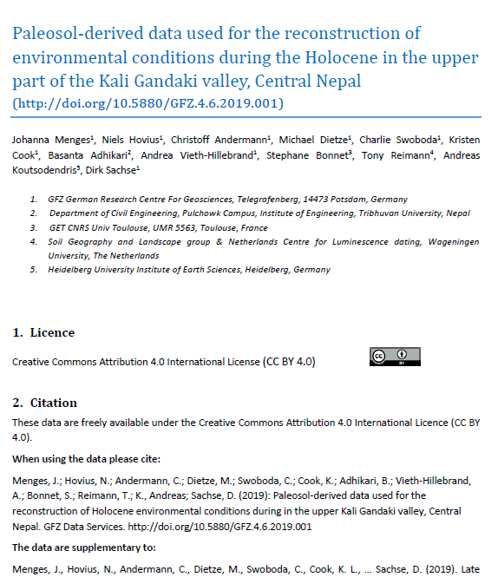
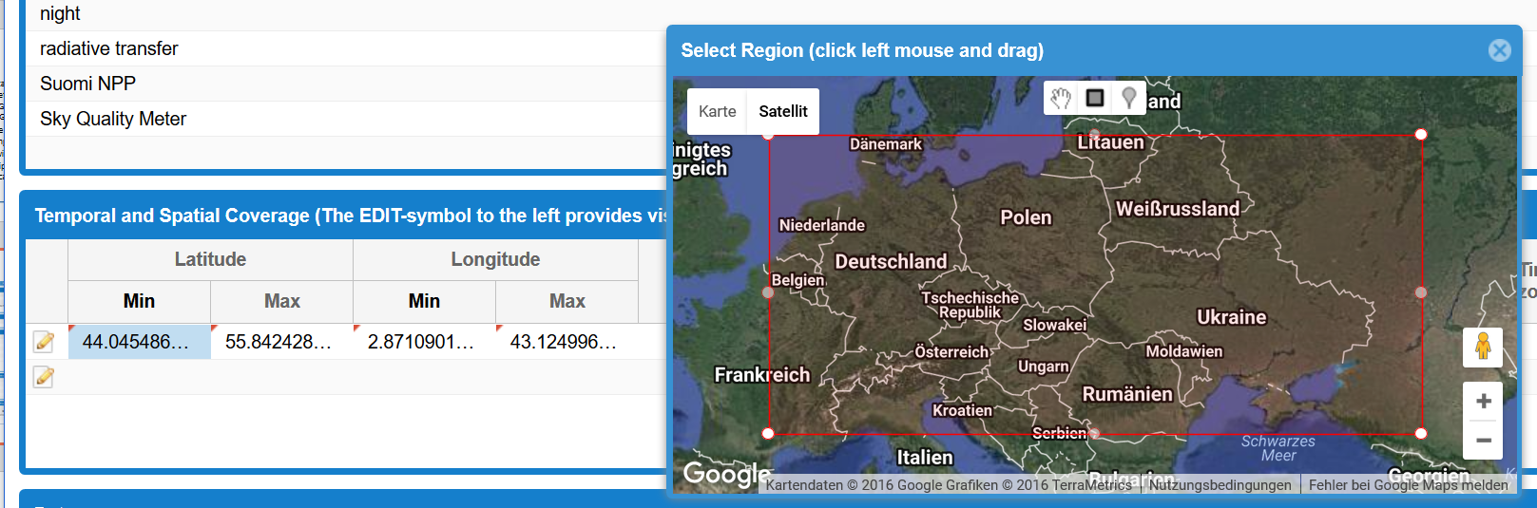

Tools for data publications by GFZ Data Services
collection of rich, structured metadata
additional technical data description
Online Metadata Editor
Data Description Template

Slide 13
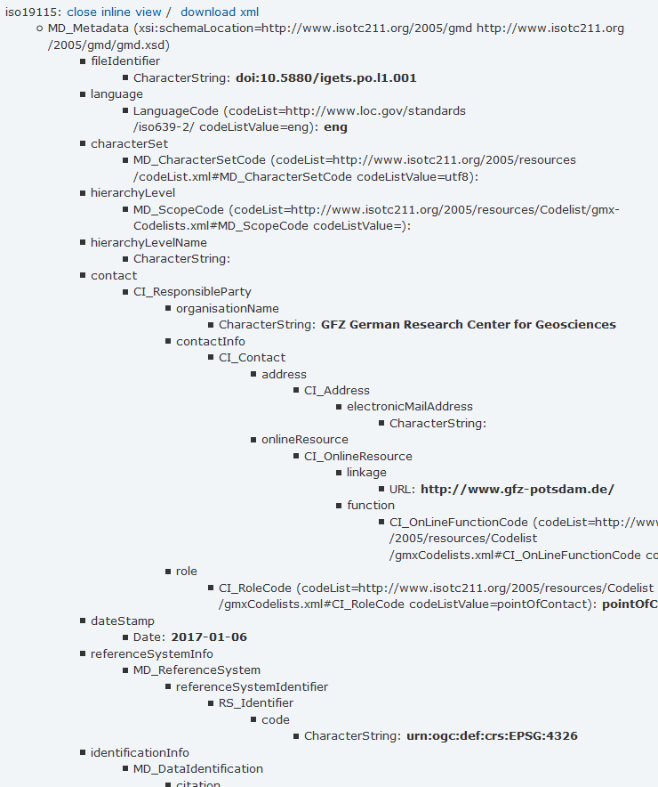
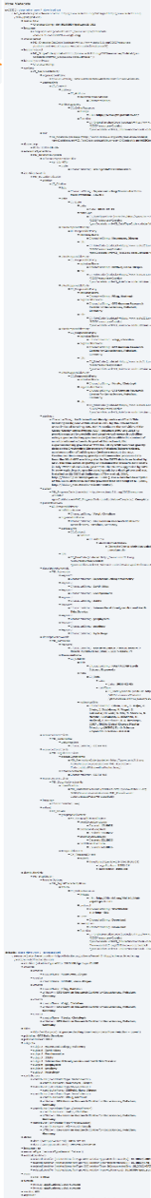
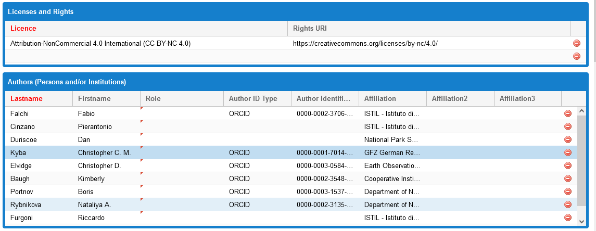
GFZ Metadata Editor (Java Script „translator“)
Input: provided by researchers
Output: XML (Extensible Markup Language): Metadata exchange format
Access via https://dataservices.gfz-potsdam.de/panmetaworks/metaedit/

Slide 14



GFZ Metadata Editor (Java Script „translator“)
Output: Standardised XML files (Datacite, ISO 19115, Dublin Core)
Input:
provided by researchers
DOI Landing Pages
Data Catalogue
„Special“ Features:
Interactive map
Searchable vocabulary lists
Standardised API
Data Portals
Access via https://dataservices.gfz-potsdam.de/panmetaworks/metaedit/
Notes:
Ein wichtiges Werkzeug für die Erfassung von Metadaten ist unser Metadaten Editor. Der Input erfolgt direkt durch die Wissenschaftler und der Output sind XML files in verschiedenen Standards. Diese sind auch die Quelle für die DOI Landing Pages.
Special Features sind einerseits eine interaktive Karte, die es erlaubt, das Untersuchungsgebiet direkt einzuzeichnen bzw die Lokalisierung von eingetragenen Koordinaten durch Visualisierung überprüft. Zum anderen bieten wir unsere Kontrollierten Vokabularien in durchsuchbarer Form an. Damit muss man nicht die Hierarchie der Vokabularien kennen, um den geeigneten Begriff zu finden.
Über unsere Schnittstelle gehen die Metadaten zu DataCite um die DOI zu registrieren. Darüber hinaus werden unsere Metadaten von anderen Portalen geharvested und sind somit auch an anderer Stelle auffindbar.

Slide 15

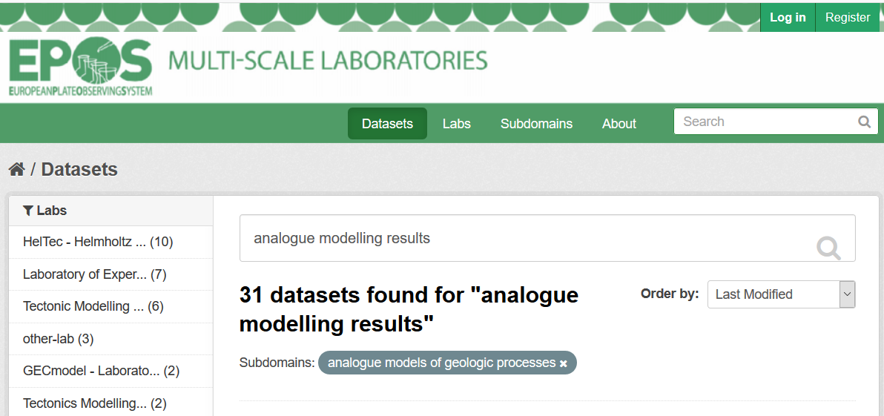
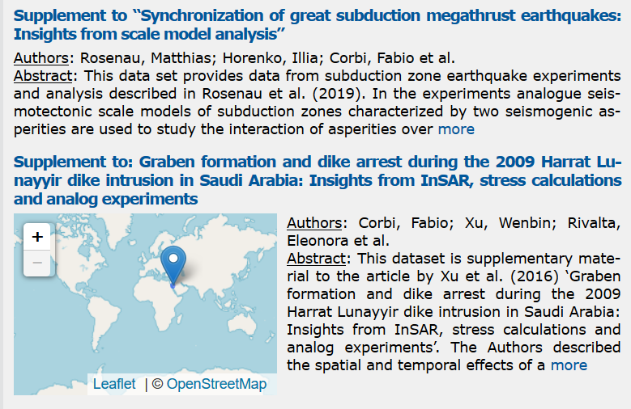
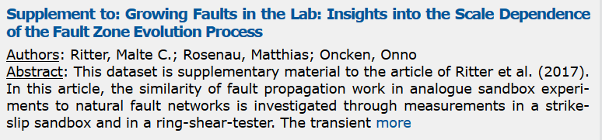

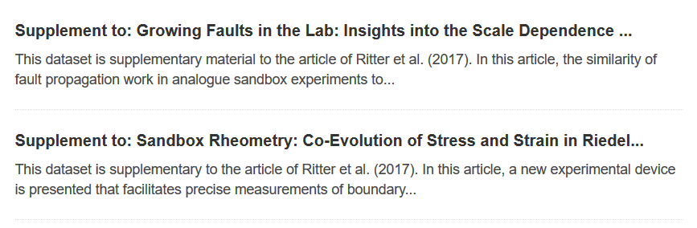
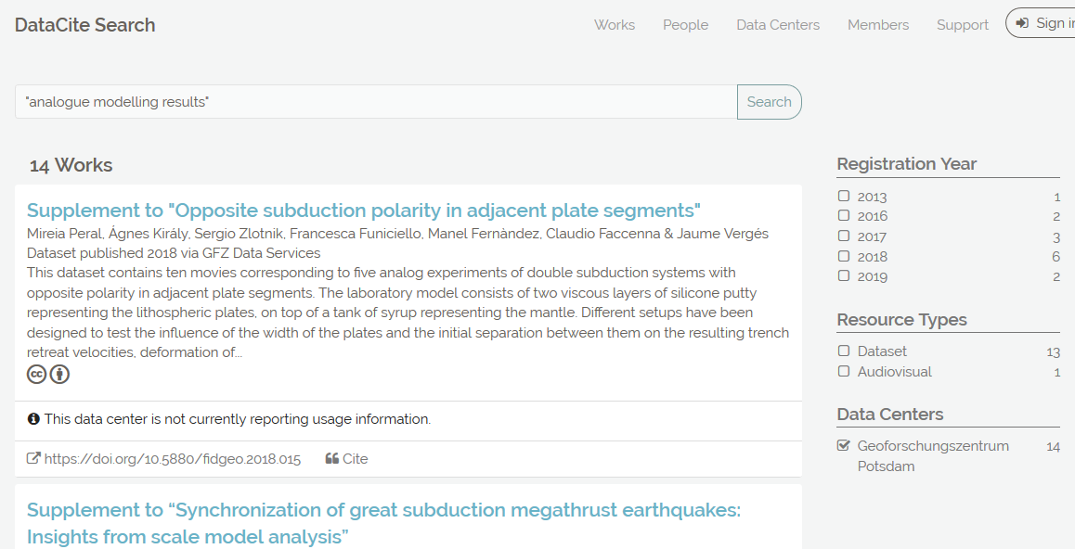


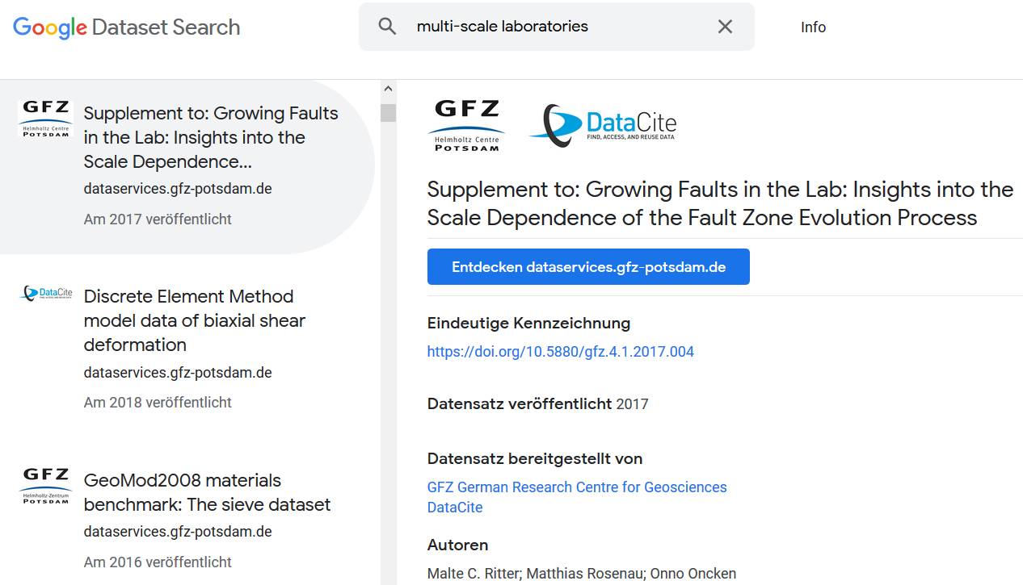
Automated metadata exchange increases visibility

Slide 16
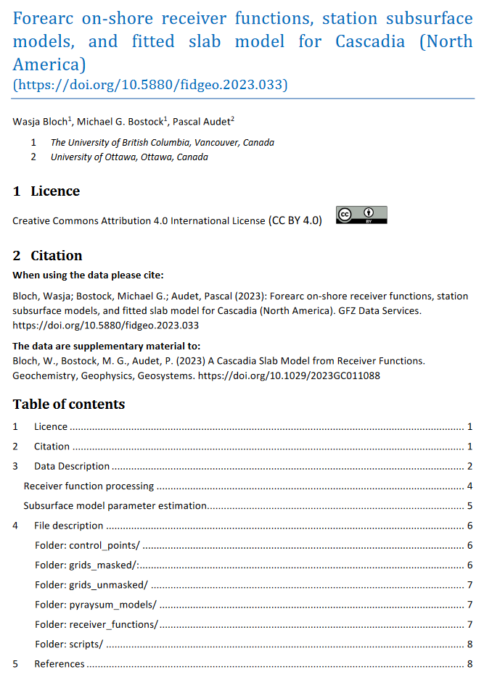
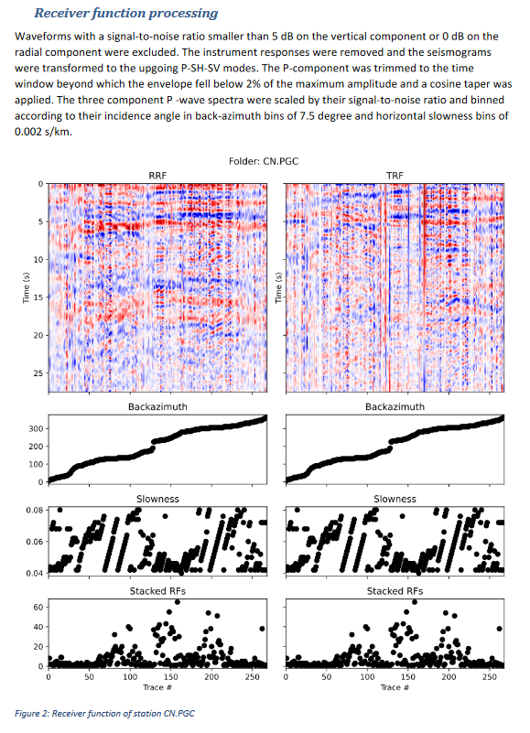
Data Description Templates
Technical data description in standardised form
Data Description Templates: https://gfzpublic.gfz-potsdam.de/pubman/item/item_5007103

Slide 17

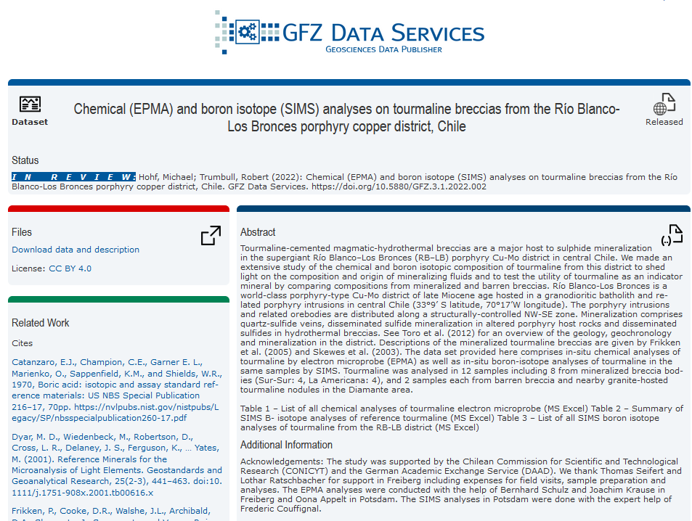

Special Features: „Data in Review“ Links
Link: https://dataservices.gfz-potsdam.de/panmetaworks/review/9c5de649b6b30c588f9fecad56a1c71dd56d1fb4f68ada89b9340002ff84abb7/
Allows access to still unregistered data (for review purposes)
DOI is reserved and citable
Data can still be changed
DOI registration when paper is accepted
JOURNAL REQUIREMENTS

Slide 18

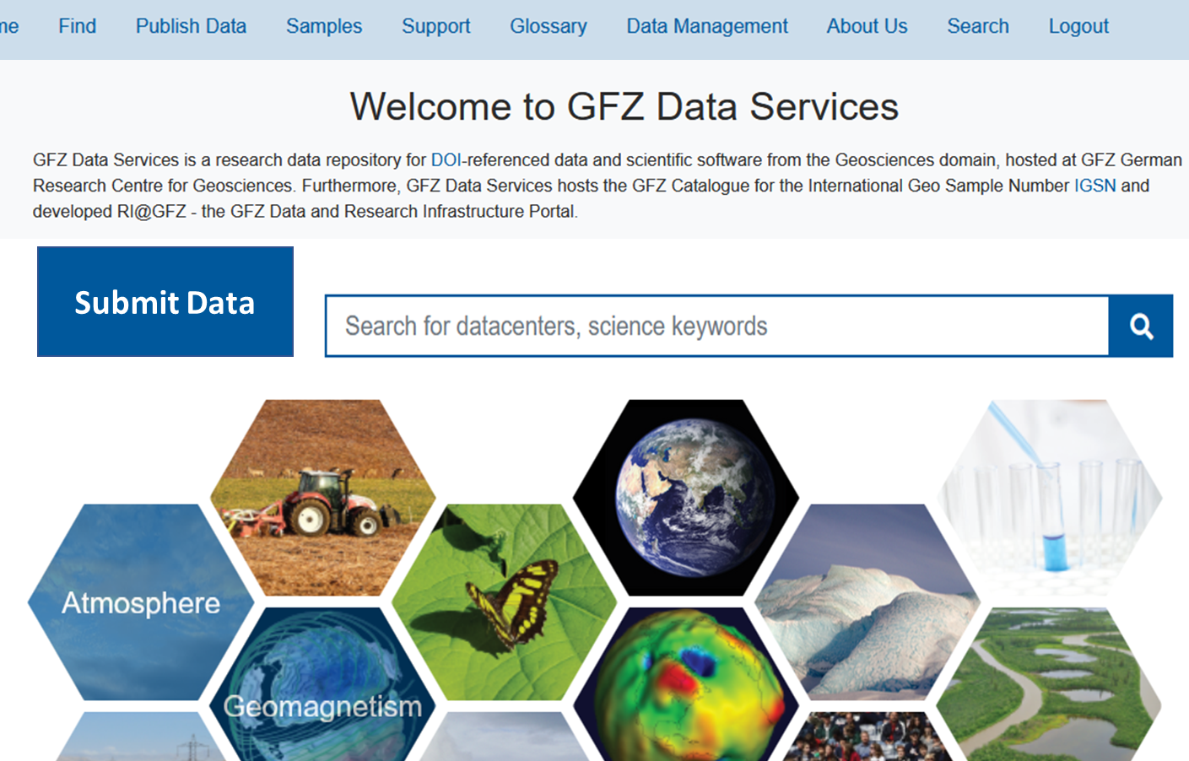








The role of data repositories for Open Science
H-index
https://www.alamy.de/stockfoto-wissenschaftlerin-mit-lupe-163648035.html
Data repositories support researchers to make their data FAIR

Slide 19
Conclusions
Domain repositories enable the provision of well documented data publications
They can (and should) be important partners to researchers and often offer dedicated tools that faciliate metadata collection and data documentation
Domain repositories are data and metadata sources for research infrastructures and can be important partners for metadata and data harmonisation

Slide 21

Where do I find my repository?
Kirsten Elger
GFZ Helmholtz Centre for Geosciences

Slide 22
Repository challenges for researchers
An increasing number of research data repositories are being developed, however…
How do I find them?
Would they be willing/ allowed to publish my research data?
Would I get the required DOI for my data?
Would the funding agency accept my preferred repository?
What are these „domain repositories“ people are speaking about?

Slide 23
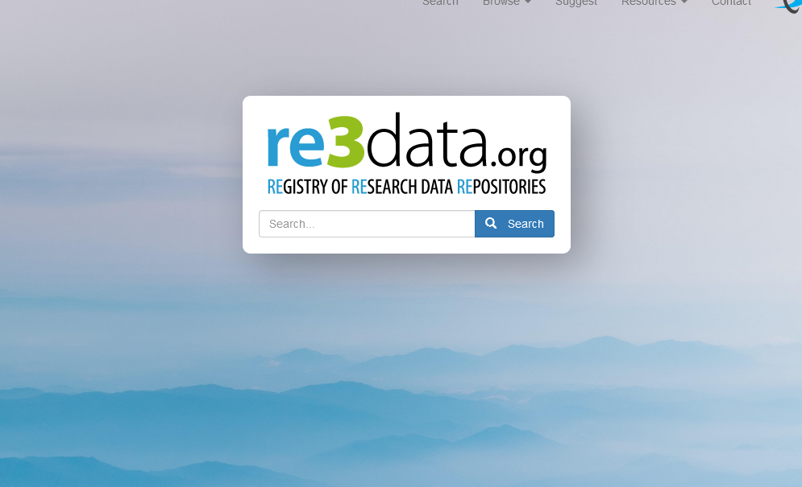


Mission
global registry of research data repositories (>3000)
across all scientific disciplines
(>850 in the Geosciences domain)
… presents repositories, databases and
portals for the permanent storage and access of research data sets to researchers, funding bodies, publishers and scholarly institutions.
…promotes a culture of sharing, increased access and better visibility of research data

Slide 24








History
2012-2015 DFG project (partners: GFZ, Humboldt University Berlin, KIT)
From 2016 on:
  merge with DataBib (new partner: Purdue University)
  official service of DataCite
  re3data Working Group within DataCite (stopped)
  technical maintenance and development by KIT
  International Editorial Board
2020-2022

Slide 25

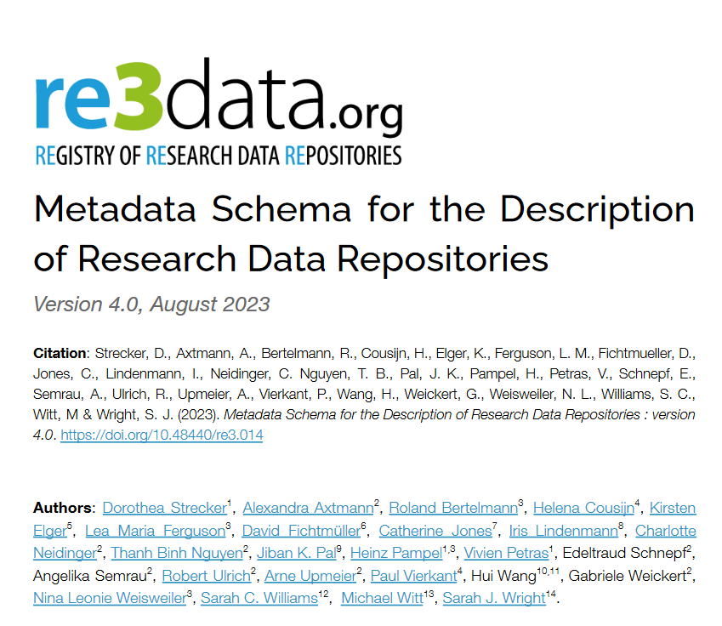
Metadata Schema
Version 4.0 (August 2023)
44 Properties + Sub-properties on
General repository information
Institutions and repository types
Policies, data access and upload, licenses
Technical information, metadata standards, API
DOI for repository descriptions (re3data metadata)
API for automated metadata exchange
ROR identifier for institutions
Repository information in DataCite Commons
Strecker, D., et al. (2023). Metadata Schema for the Description of Research Data Repositories: version 4.0. Re3data. https://doi.org/10.48440/RE3.014

Slide 26
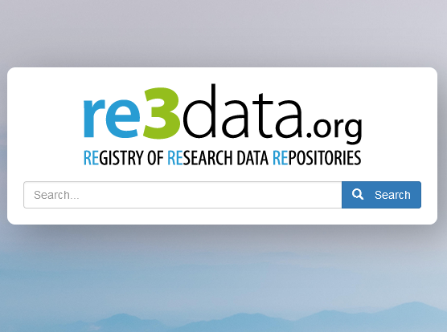
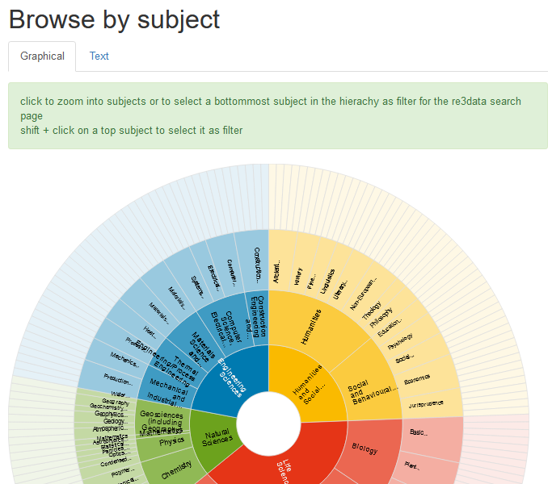
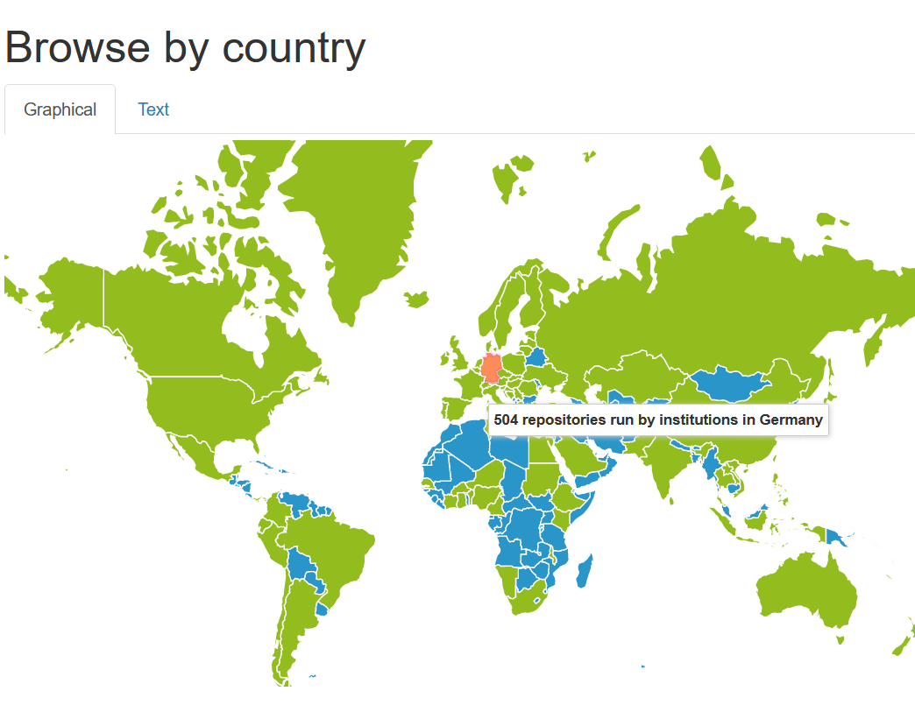
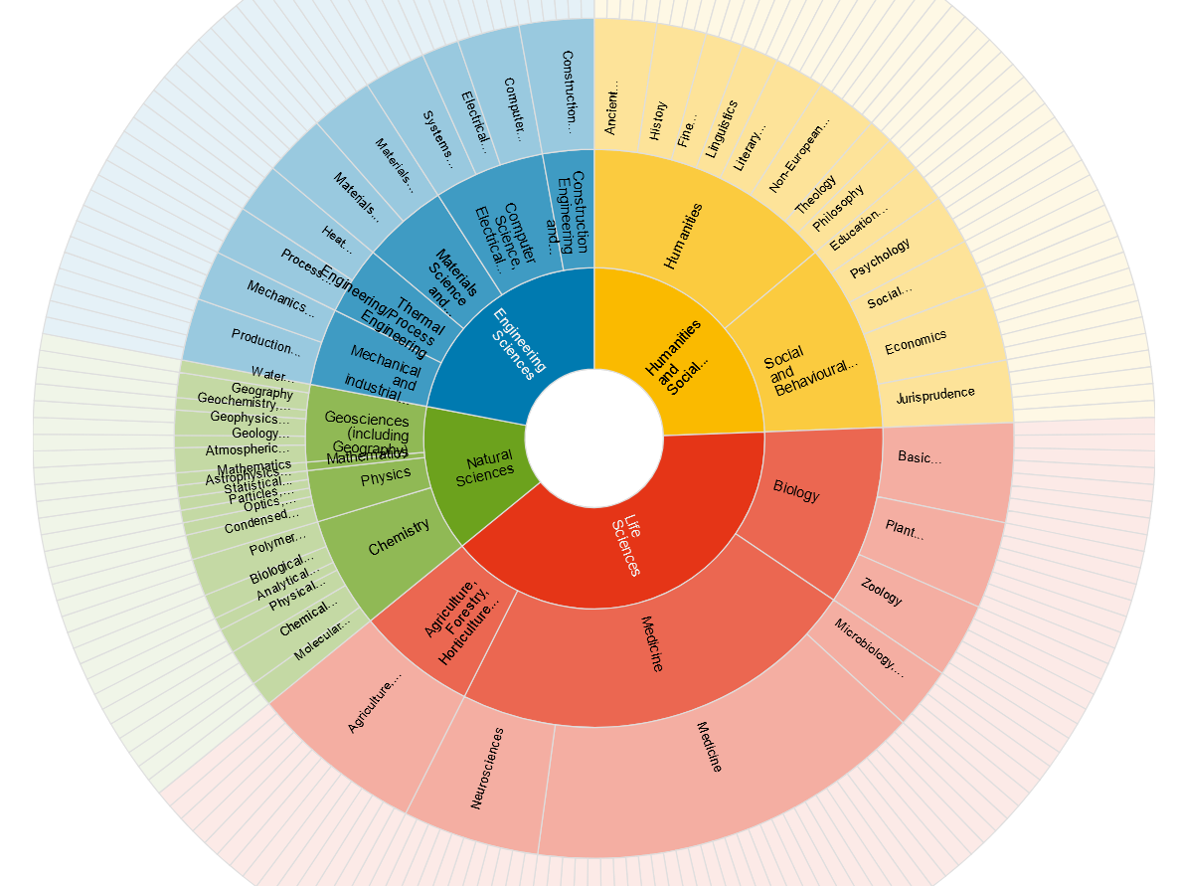
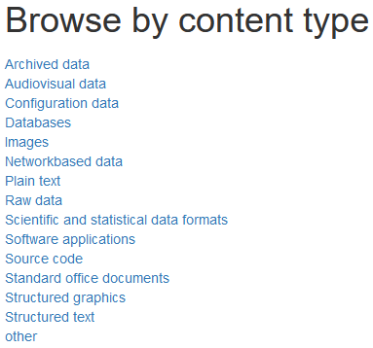
Search options

Slide 27
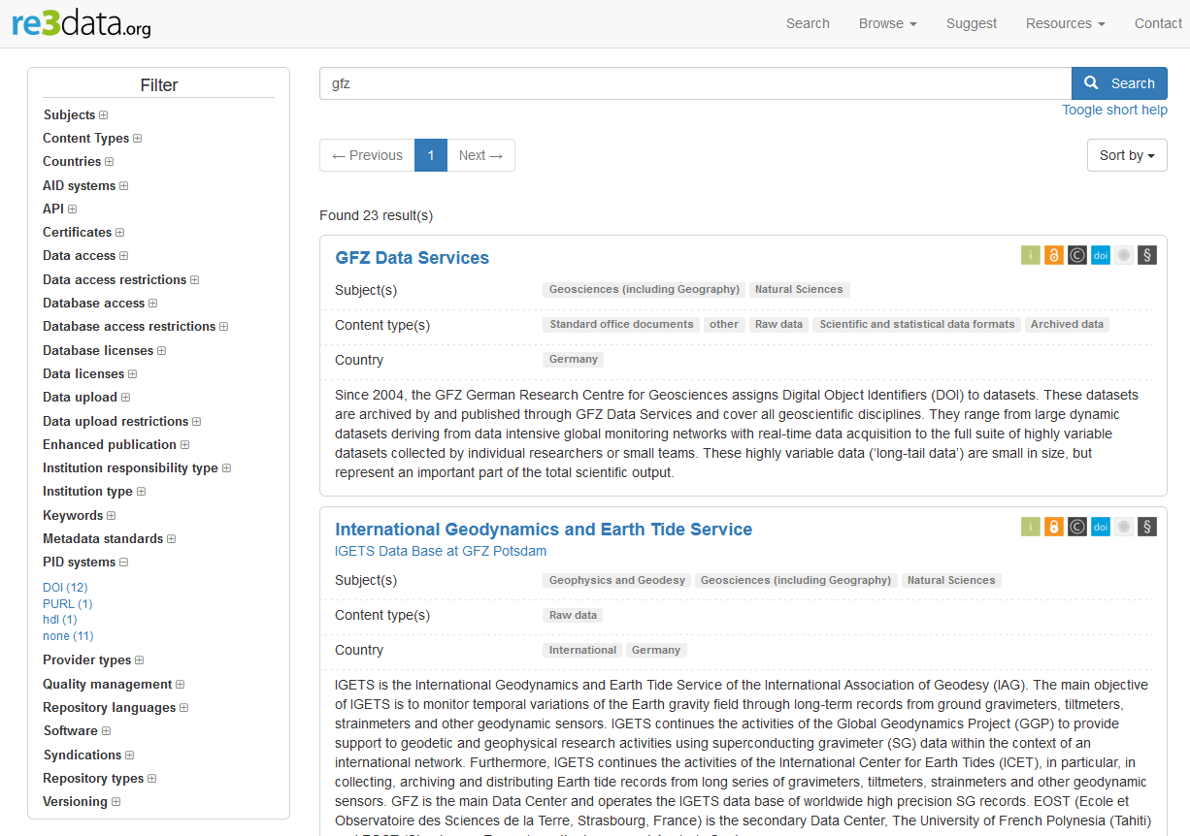
Catalogue
simple search box
icons
Search filters

Slide 28
Icons – facilitating the selection process of appropriate research data repositories

Slide 29
Catalogue
simple search box
icons
Search filters

Slide 30
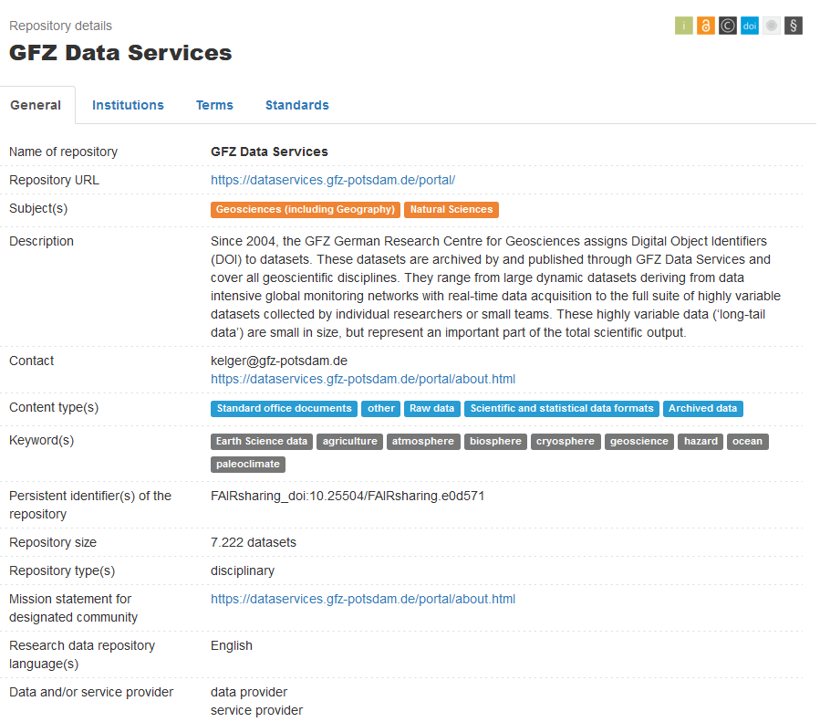
Details: General
Subjects/Disciplines: controlled list: DFG-based
Keywords: free text
Repository types:
Disciplinary
Governmental
Institutional
Multidisciplinary
project-related
other

Slide 31
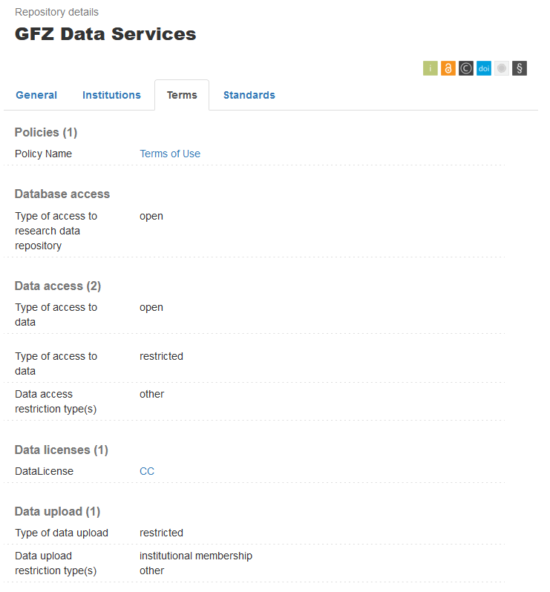

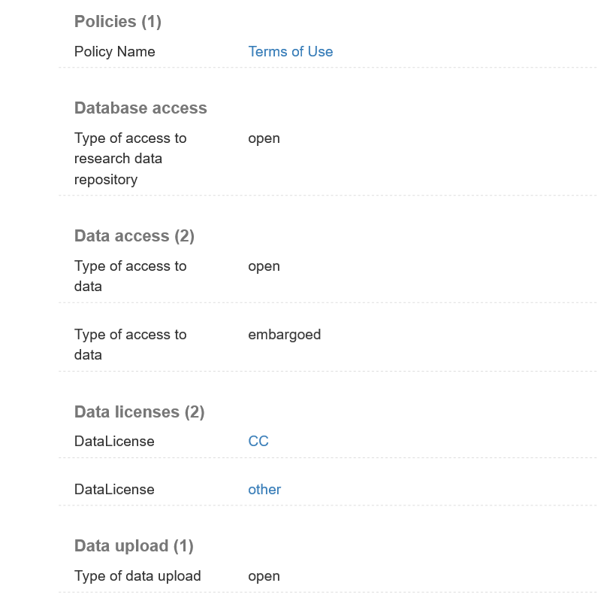
Details: Terms
Database access
open
embargoed
restricted
closed
Data access
open
restricted
closed
Data upload
open
restricted
closed
Fee required
Institutional membership
registration
closed

Slide 32
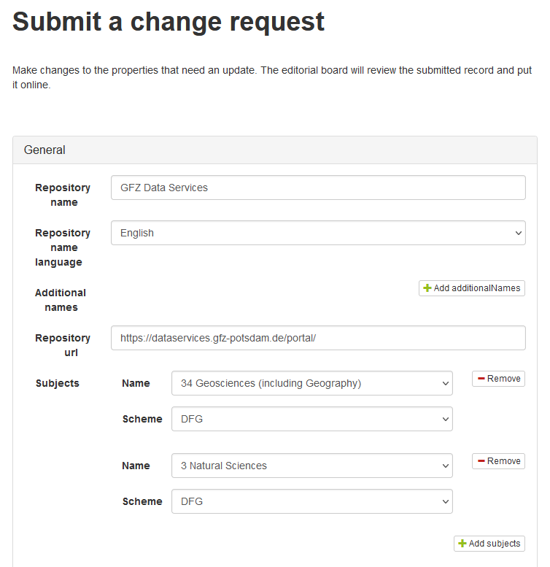
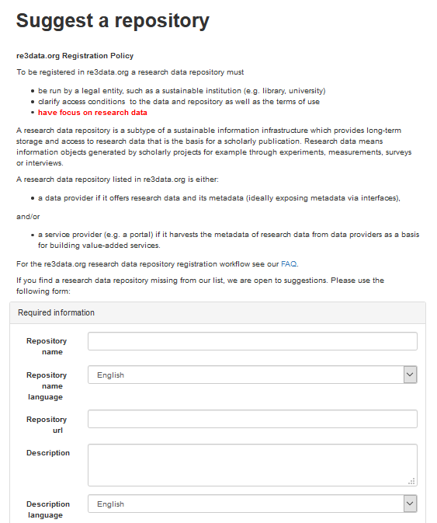
Updates and New Records
update
new
pre-filled metadata fields

Slide 33
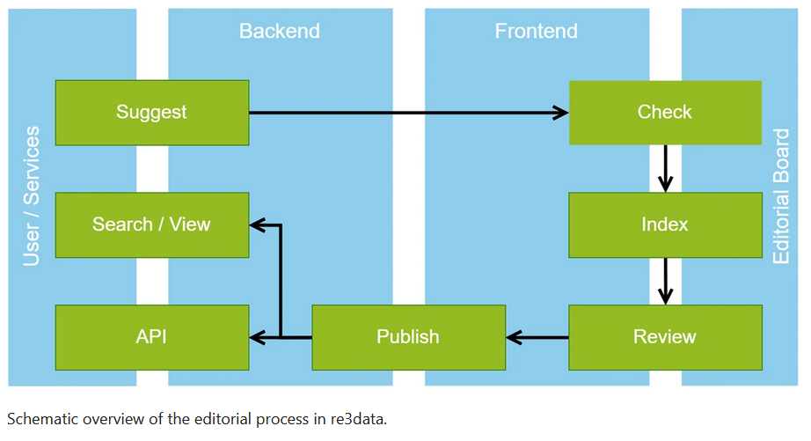
Registration Workflow
Source: Pampel, H., Weisweiler, N.L., Strecker, D. et al. re3data – Indexing the Global Research Data Repository Landscape Since 2012. Sci Data 10, 571 (2023). https://doi.org/10.1038/s41597-023-02462-y

