Slide 1

Stories about Metadata: introduction, types, role, elements
Kirsten Elger| kelger@gfz.de
Notes:
Title slide

Slide 2
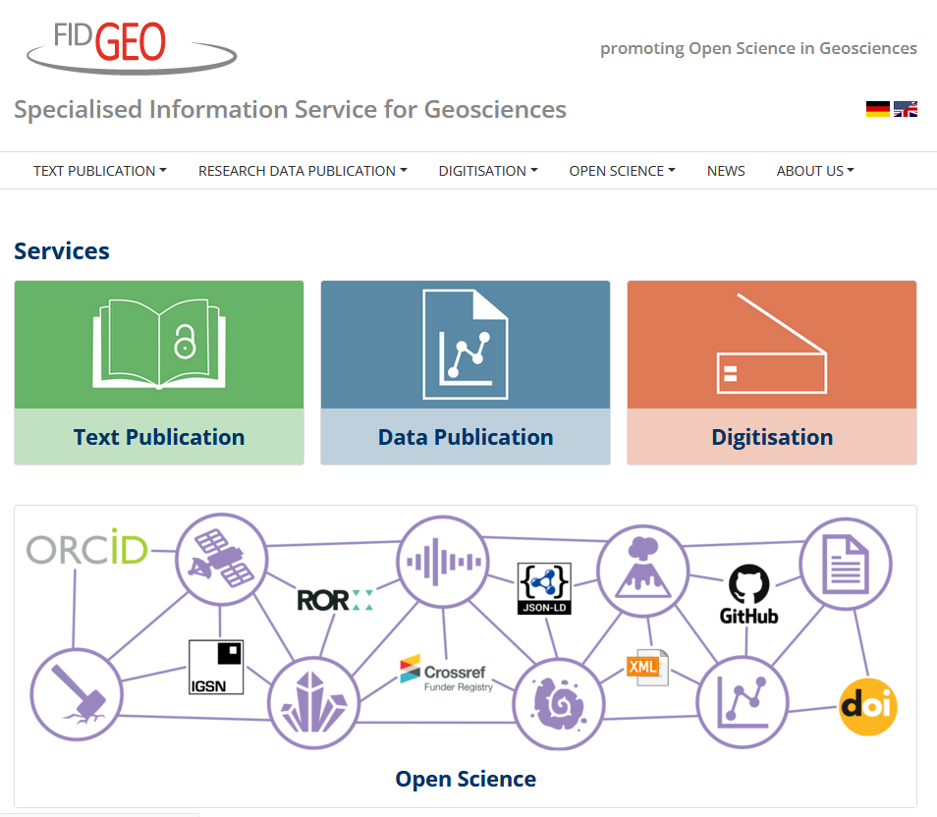



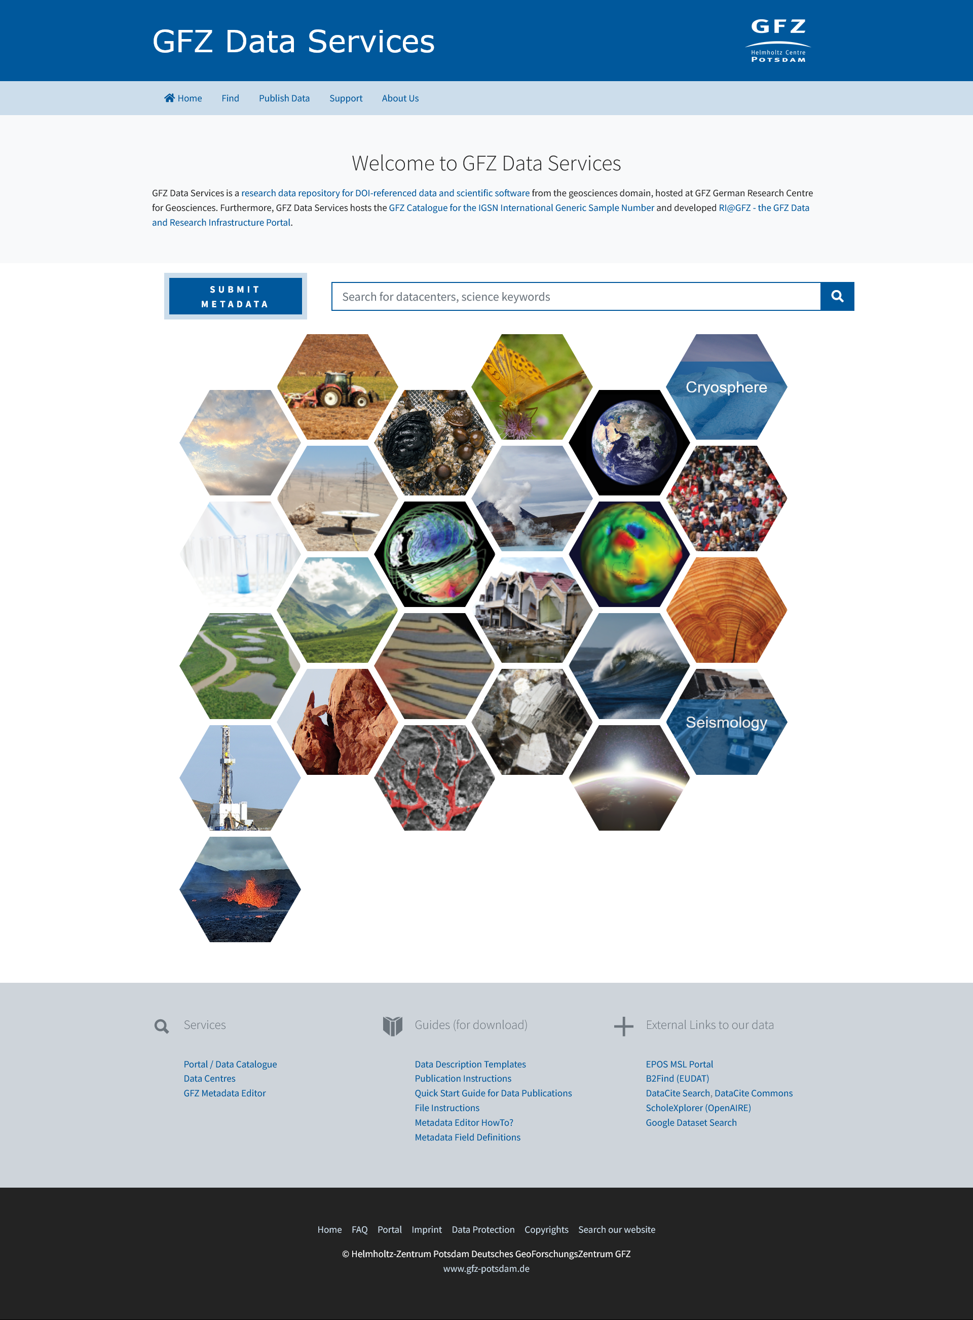


Who am I?
Kirsten Elger: geologist, data and repository manager, editor
Notes:
Content slide

Slide 3
Stories about metadata: outline
What are metadata, why are they important and what types of metadata exist ?
The role of metadata schemes, formats, and standards
Metadata elements for FAIR Data: PIDs, vocabularies and how do these help for making data more visible?

Slide 4
Metadata – some definitions
Metadata are „data about data“ or „information about information *
Metadata are data that describes other data. They are structured in nature and are used to discover, audit, manage, or help identify the attributes of the data that they represent. Metadata can be a by-product of an automated transaction, or can be manually added to describe data. **
*NISO Primer (2017) Understanding Metadata: https://groups.niso.org/apps/group_public/download.php/17443/understanding-metadata
** https://blog.infuseai.io/everything-about-metadata-and-its-meaning-for-machine-learning-practitioners-cd353ca160d1

Slide 5
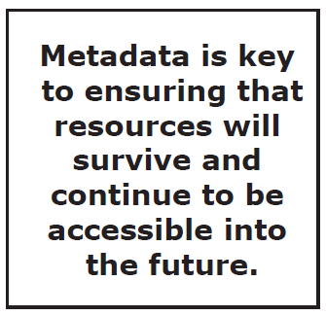
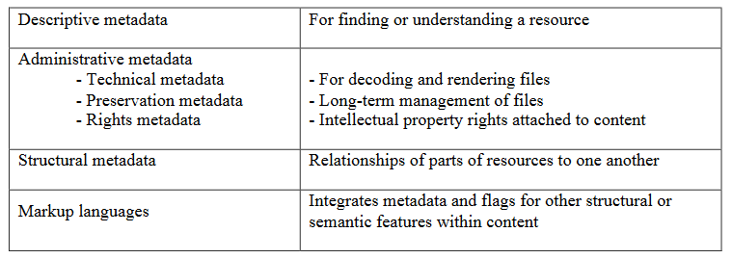
Metadata are everywhere
NISO Primer (2017) Understanding Metadata: https://groups.niso.org/apps/group_public/download.php/17443/understanding-metadata

Slide 6
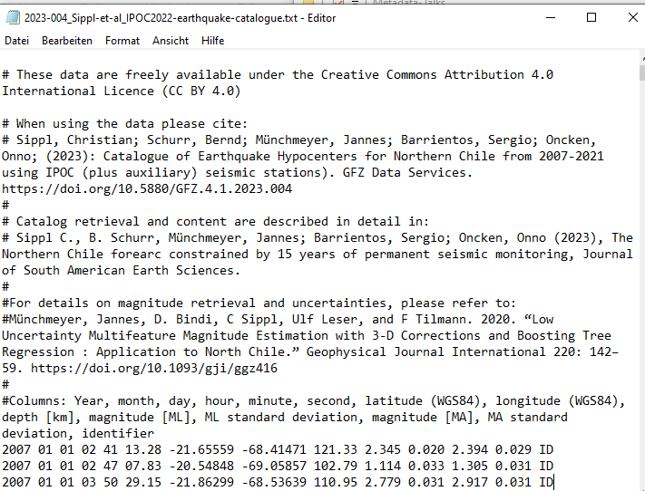
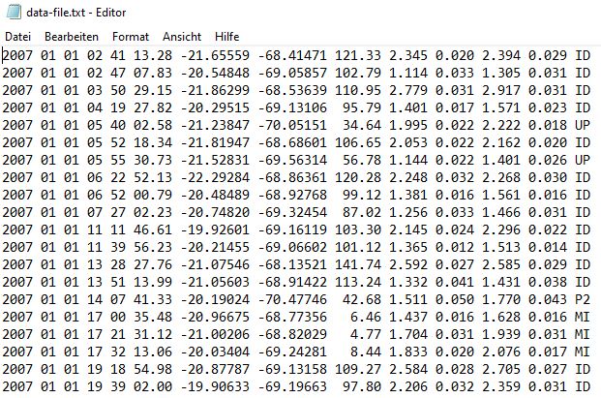
Why are metadata important? An example…
meaningful file name
license information
citation
related articles
What is the content of this table?
definition of colums
After curation by a data steward
Notes:
Title slide for large pictures, tables, maps, plots…

Slide 7
FAIR Principles - Guiding Principles for Findable, Accessible, Interoperable and Re-usable Data
Findable – Data Discovery | Accessible | Interoperable | Reusable
Metadata for data discovey in public domain | Data is accessible by humans and machines | Open formats | Data rights and licences
Metadata catalogues of data repositories | Standard protocols | Machine actionable metadata standards | Full record on data provenance
Metadata harvesting by data portals | Authorisation | Consistent vocabulary/ ontology | Rich metadata enabling to link data with other sources
Persistent Identifier |  | Documented workflows
Data citation
simplified
Wilkinson et al., 2016 https://doi.org/10.1038/sdata.2016.18

Slide 8
FAIR Principles - Guiding Principles for Findable, Accessible, Interoperable and Re-usable Data
Findable – Data Discovery | Accessible | Interoperable | Reusable
Metadata for data discovey in public domain | Data is accessible by humans and machines | Open formats | Data rights and licences
Metadata catalogues of data repositories | Standard protocols | Machine actionable metadata standards | Full record on data provenance
Metadata harvesting by data portals | Authorisation | Consistent vocabulary/ ontology | Rich metadata enabling to link data with other sources
Persistent Identifier |  | Documented workflows
Data citation
simplified
Wilkinson et al., 2016 https://doi.org/10.1038/sdata.2016.18

Slide 9
Metadata are everywhere
NISO Primer (2017) Understanding Metadata: https://groups.niso.org/apps/group_public/download.php/17443/understanding-metadata

Slide 10
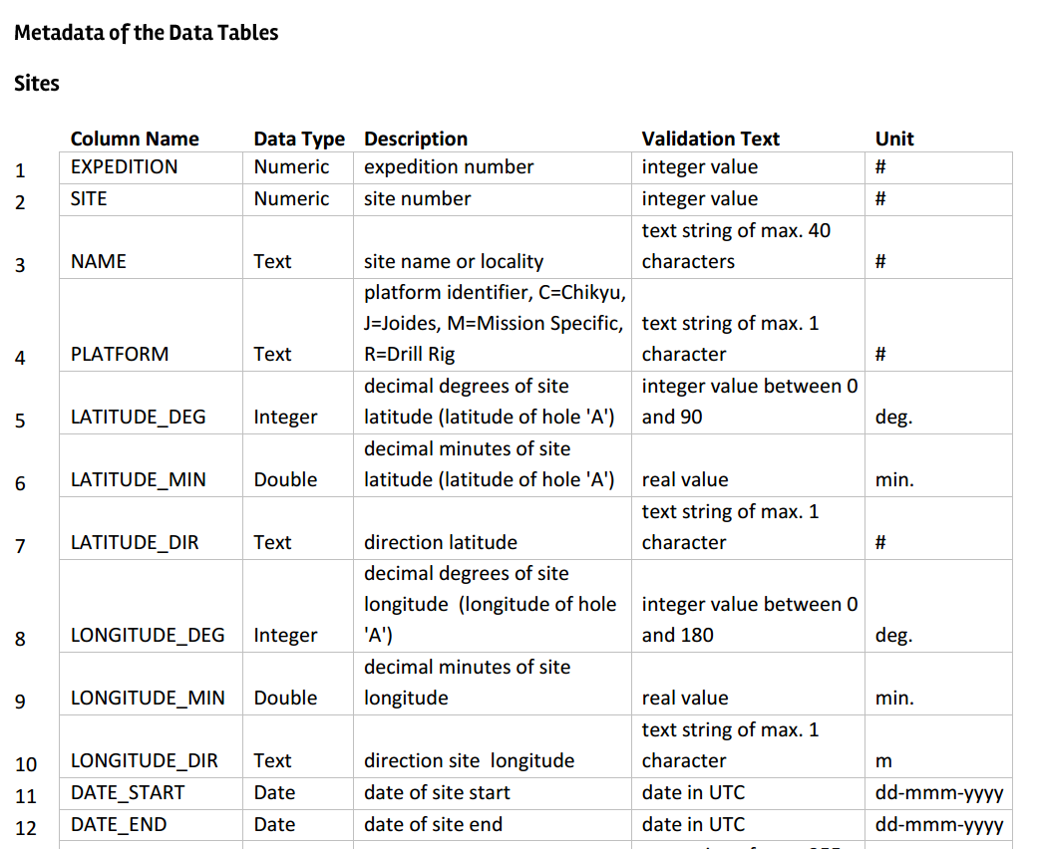
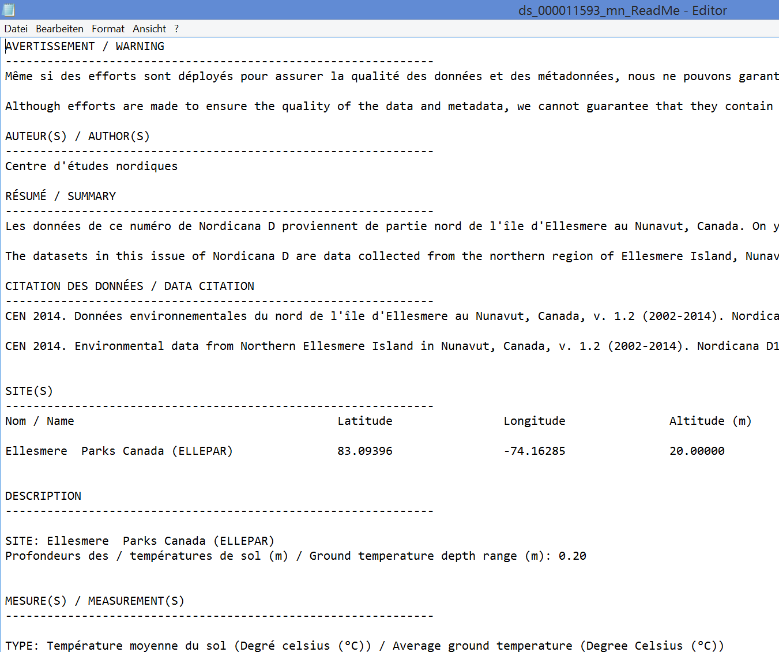

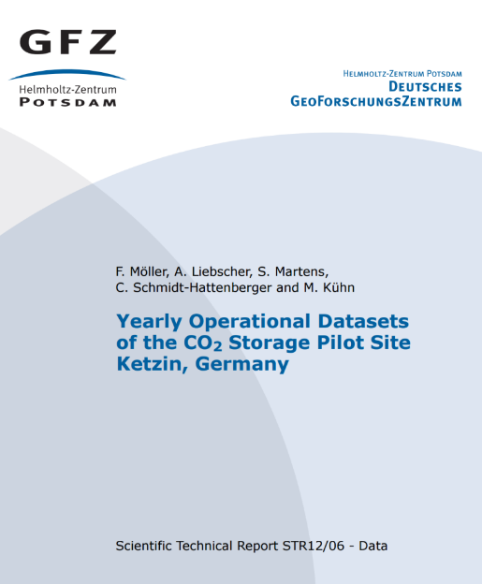
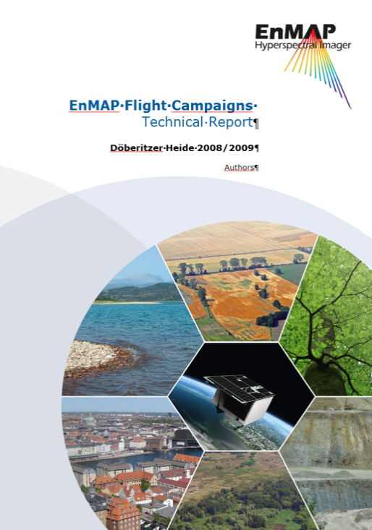
Descriptive Metadata 1: Contextual Metadata
Definition of data labels
  highly variable between the disciplines but key information for data reuse
Data Articles/ Reports
README

Slide 11

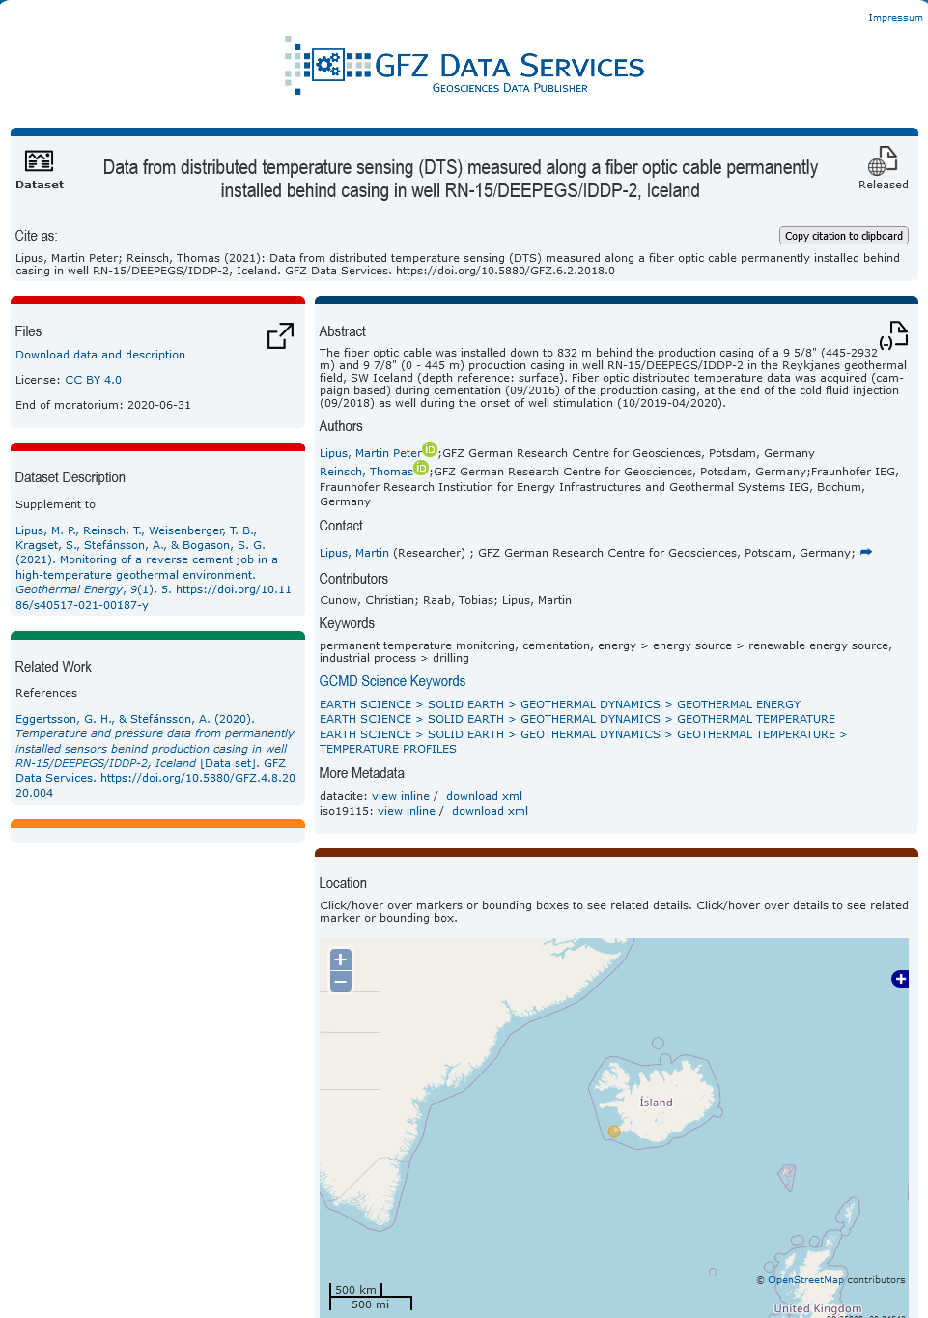

Descriptive Metadata 2: Metadata for data discovery
Who? What? When? Where? Why?
  Essential for data discovery, DOI registration, etc: international standards across all disciplines
title citation
download data
description/abstract
authors/ ORCID
key paper
affiliations/ROR
Typical metadata standards for data discovery: DataCite, ISO19115, Dublin Core
keywords/control-led vocabularies
related work
Example: DOI Landing Page
spatial coverage
Image source: https://www.pnp.de/archiv/1/wer-ist-wer-in-der-sesamstrasse-6851597

Slide 12
The importance of metadata schemas, formats and standards

Slide 13
The role of metadata schemes
Metadata schemes define standards to and provide and exchange information about data (metadata)
Information is provided in machine-readable formats (e.g., XML, JSON)
The definition and construction plan of XML metadata schemes are provided as XSD (XML Schema Definition)
Automated metadata exchange via standard application programming interfaces (API)

Slide 14
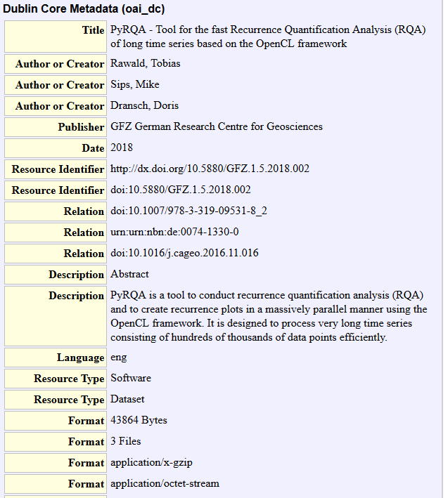
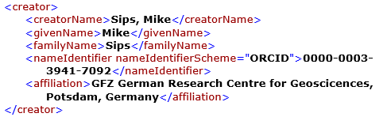
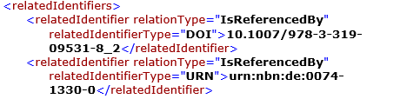
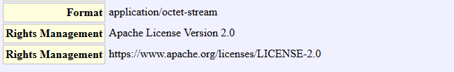
Discovery Metadata Schema
Dublin Core – least common denominator
DataCite – „enriched“ Dublin Core Schema
machine-readable!!

Slide 15


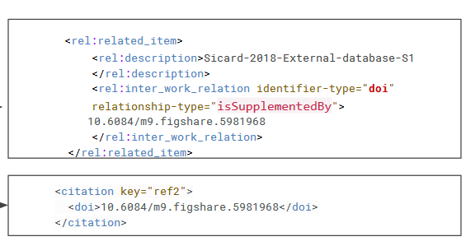
Connecting data and literature via metadata
To make digital connections between data publications and literature, repositories, data centres, and journals provide information about the links between literature and data that they hold to community 'hubs' such as OpenAire, Crossref and DataCite – in the machine-readable metadata (XML, JSON)
metadata schema
metadata schema
<relatedIdentifiers>
<relatedIdentifier relatedIdentifierType="DOI" relationType="Cites">10.1016/j.quaint.2015.03.007
</relatedIdentifier>
<relatedIdentifier relatedIdentifierType="DOI" relationType=„IsSupplementTo">10.2113/gsjfr.47.2.175
</relatedIdentifier>
</relatedIdentifiers>
Paper citation in a data publication
data citation in a paper

Slide 16
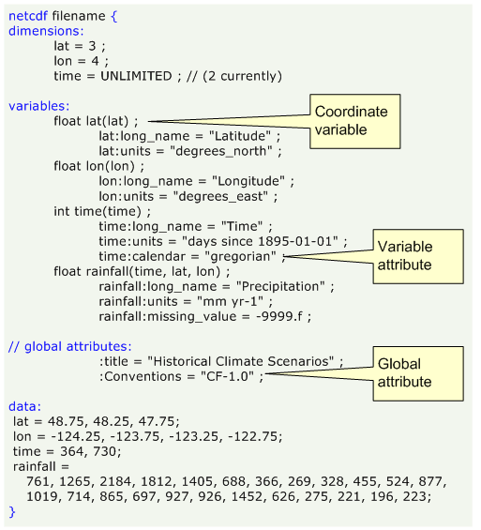
Data formats with metadata - NetCDF
Flexible header plus gridded data
multidimensional, multi-variables
„NetCDF is a great format, I can freely compose the header and use it for so many data types“
Source: https://pro.arcgis.com/de/pro-app/latest/help/data/multidimensional/fundamentals-of-netcdf-data-storage.htm
However….
How much flexibility is reasonable for interdisciplinary, computer-driven data analyses?
How much experience do researchers have with describing their data for external use?

Slide 17
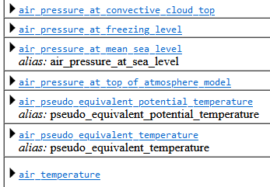
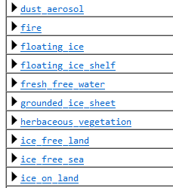
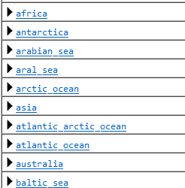
Standards for NetCDF
NetCDF Climate and Forecast (CF) Metadata Conventions
The CF metadata conventions are designed to promote the processing and sharing of files created with the NetCDF API. The conventions define metadata that provide a definitive description of what the data in each variable represents, and the spatial and temporal properties of the data. This enables users of data from different sources to decide which quantities are comparable, and facilitates building applications with powerful extraction, regridding, and display capabilities. The CF convention includes a standard name table, which defines strings that identify physical quantities.
CF Standard Name Table
CF Area Type Table
CF Standardized Region List
https://cfconventions.org/ and subpages

Slide 18
Community-derived metadata standards
SensorML = OGC Sensor Model Language Standard: structured description of sensors and their variables (e.g. hydrology, climate stations…) https://www.ogc.org/standards/sensorml/
FDSN StationXML = structured description of seismic stations according to international conventions (FDSN = Federation of Digital Seismic Networks) https://www.fdsn.org/xml/station/
GeodesyML = structured description of GNSS Stations (will replace existing sitelogs) https://github.com/International-GNSS-Service/GeodesyML

Slide 19
Metadata elements: PIDs, vocabularies and how do these help for making data more visible and reusable?

Slide 20



What is a PID?
A persistent identifier (PID) is a unique code of a digital resource that can be permanently referenced on the Internet. This prevents dead links from being created if, for example, publishers change the Internet address of a server. (modified from Forschungsdaten.info)
URL change due to name change:
https://gfz-potsdam.de
https://gfz.de
URL redirection of the DOI-referenced data publications by the publisher (= repository)
https://doi.org/10.5880/GIPP.201712.1
https://dataservices.gfz-potsdam.de/gipp/showshort.php?id=828c...
https://dataservices.gfz.de/gipp/showshort.php?id=828c...

Slide 21






Common PIDs in the data curation world
for texts, data, software
List of funders with DOIs
https://doi.org/10.5880/fidgeo.2021.049 (Data)
http://doi.org/10.13039/501100001659 (DFG)
uniquely identifying persons
Persistent Identification of Instruments (PIDinst)
https://hdl.handle.net/11708/37B4E3C1-3DCC-4B7B-B475-87A3177F6030 (Broadband seismic sensor @ GIPP, GFZ)
https://orcid.org/0000-0001-5140-8602 (Kirsten Elger)
PID for physical samples, cross references to data with samples
PID for Institutions
https://ror.org/04z8jg394 (GFZ)
https://igsn.org/GFFJH00AD (Rock sample)
→ PIDs are resolvable and machine-actionable

Slide 22
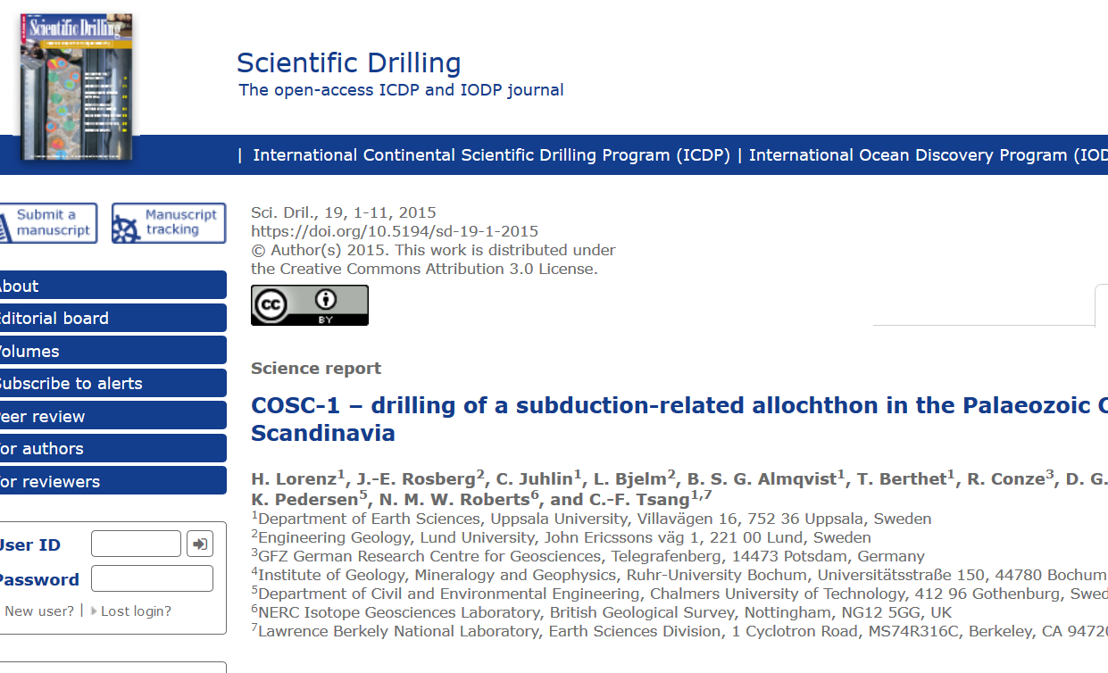
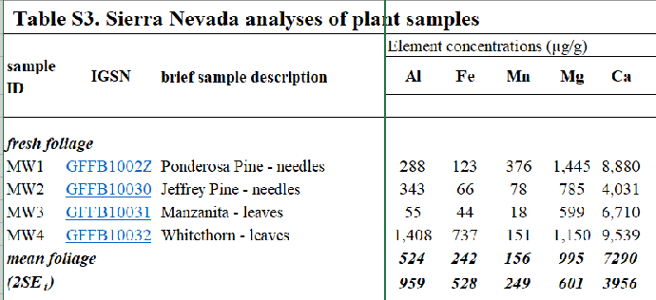



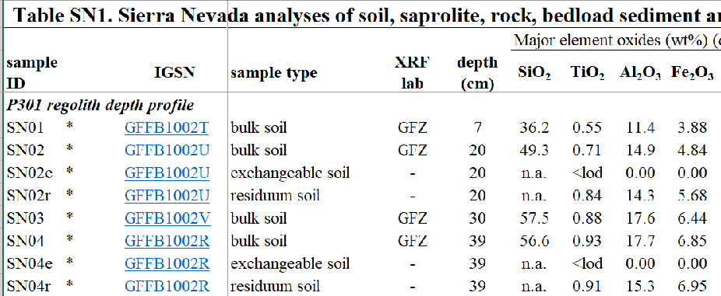
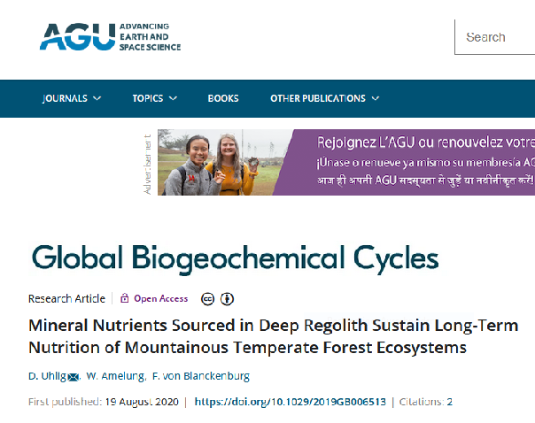
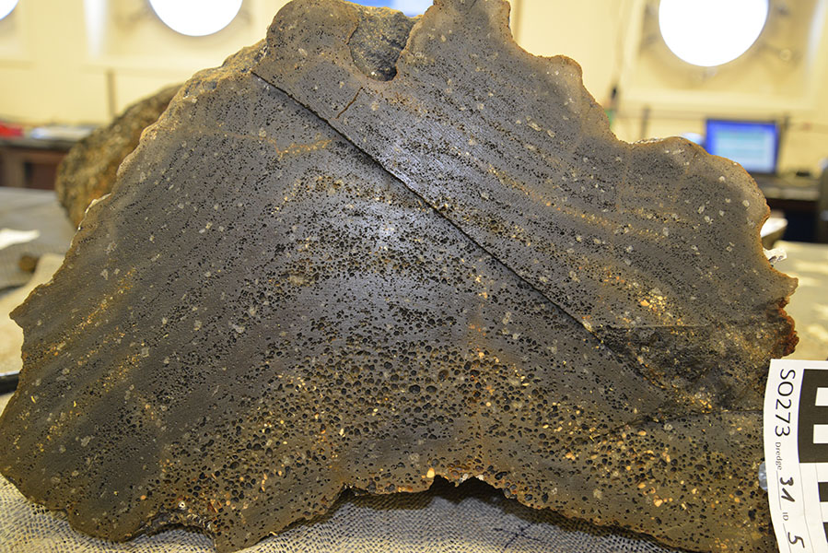
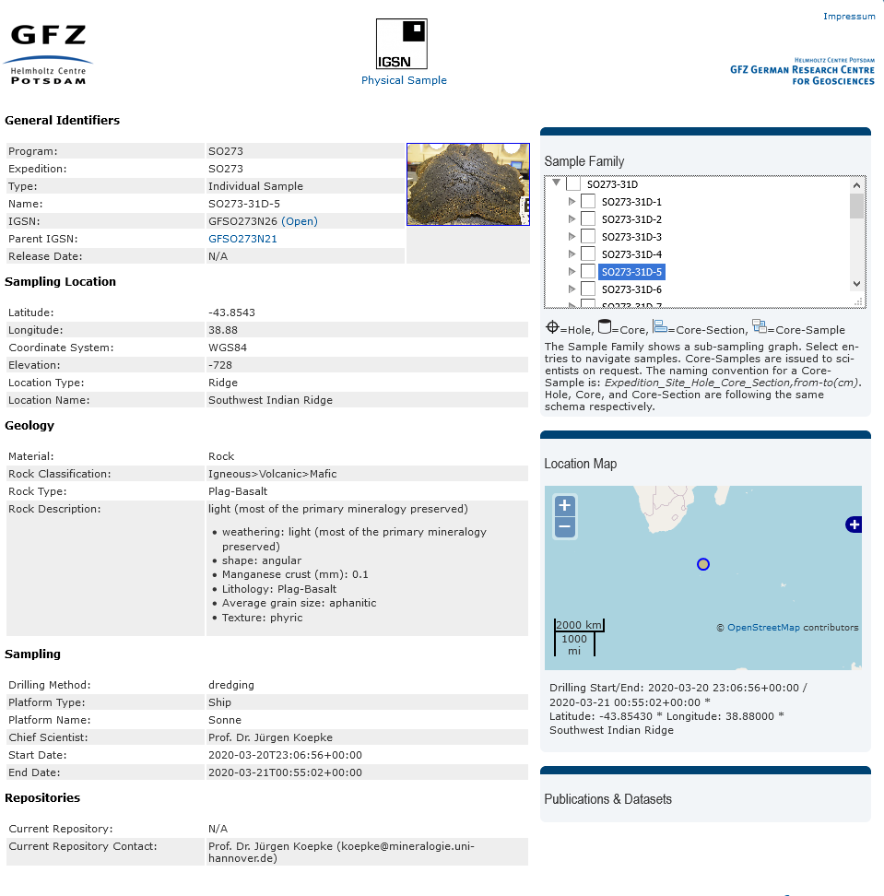
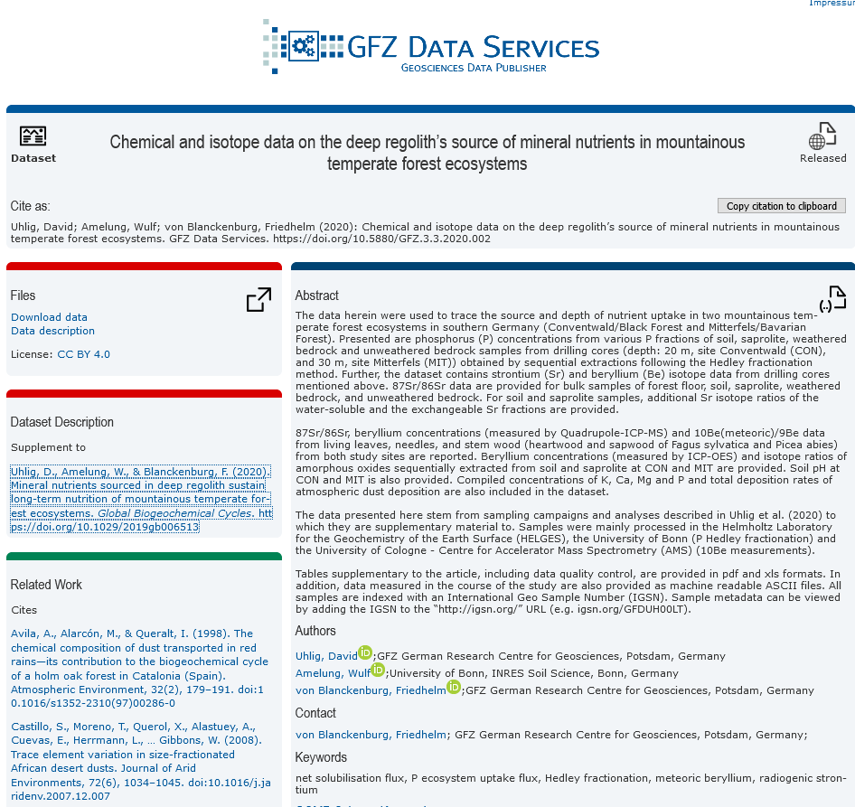
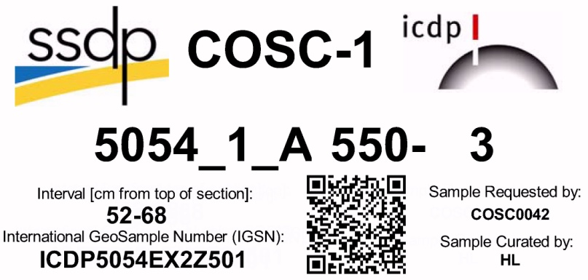

Connecting research outcomes via PIDs
code
data
papers
PIDs connect everything → FAIR
sample
Sample description
Data publication

Slide 23
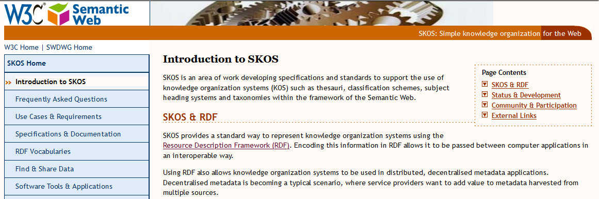
Metadata Elements: Controlled Vocabularies (SKOS/RDF)
In brief:
RDF vocabularies are machine-actionable and provide links to the definitions of each term (sometimes in different languages) → stop endless discussions about who is right
RDF vocabs can be added to XML and JSON metadata

Slide 24

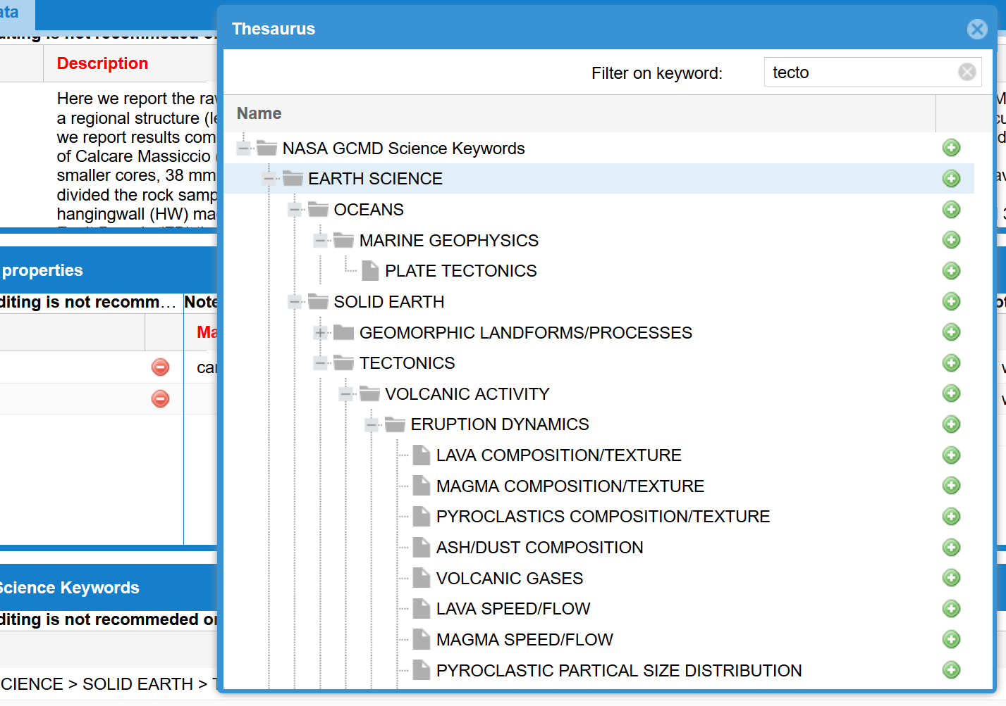


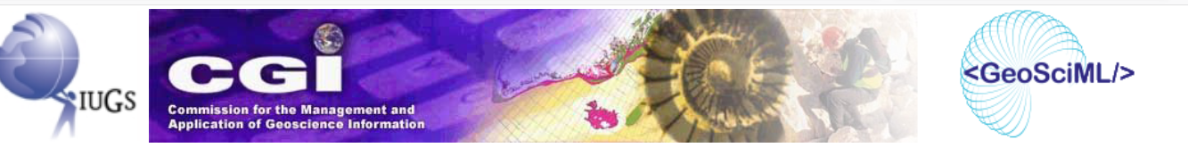
Controlled vocabularies in a metadata editor
NASA Global Change Master Directory (GCMD) Keywords
Example: EARTH SCIENCE > SOLID EARTH > TECTONICS > VOLCANIC ACTIVITY > ERUPTION DYNAMICS
GEMET Keywords
SKOS → definition
GeoSciML: Geoscience Vocabularies
for Linked Data

Slide 25

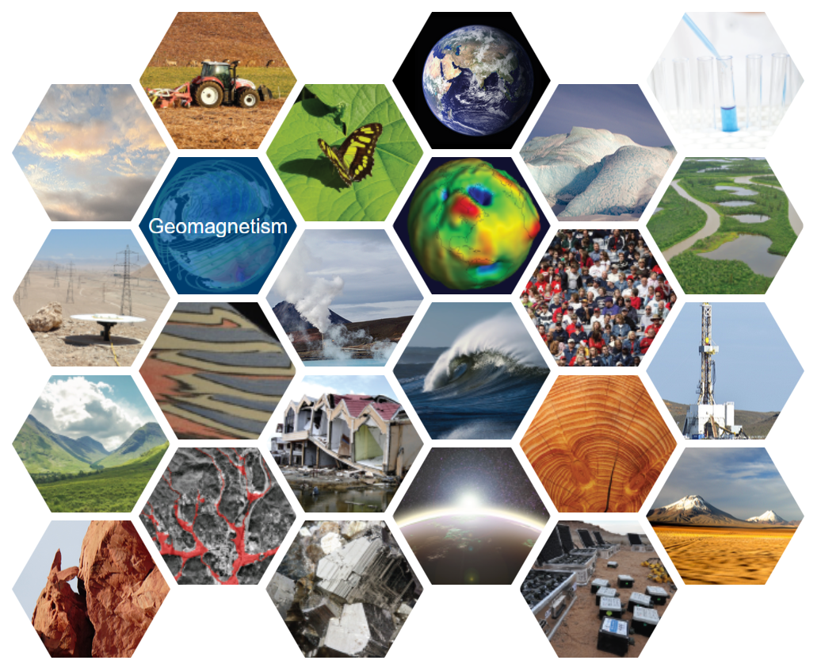

Controlled vocabularies support data discovery
search facettes
Global Change Master Directory (GCMD) Keywords
INSPIRE keywords
GeoSciML: Geoscience Vocabularies for Linked Data

Slide 26
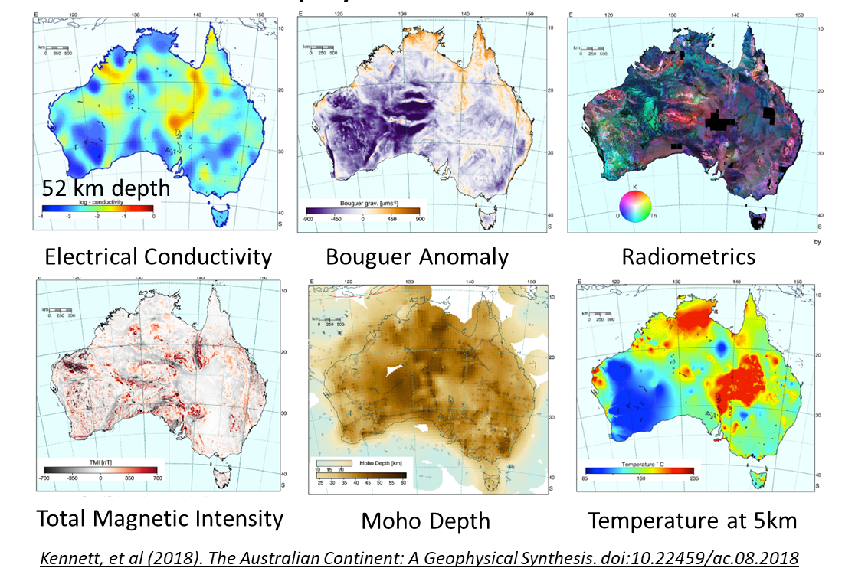
Metadata are required for bringing data together
Harmonisation of data and metadata (machine readable formats)
Controlled vocabularies/ Ontologies
API development
Harvesting of repositories
Metadata aggregation
PIDs
Can we create a collaborative National High Resolution Geophysics Data Platform?
HPC computing: harmonisation of data formats
New methods: Joint inversion of geophysical data
New, highly data-intensive methods (e.g. DAS, GGM)
Courtesy: Lesley Wyborn, ANU, Canberra, AU

Slide 27

Conclusions
Metadata are everywhere and key elements for finding, understanding and connecting data and other research outputs
Metadata standards enable interoperability – but there are many and for different purposes
Persistent identifier and controlled vobcabularies are important metadata elements
If you are planning to make your data available, consult a domain repository – they take care of your data and help you with generating metadata for data discovery and distribution

