Slide 1
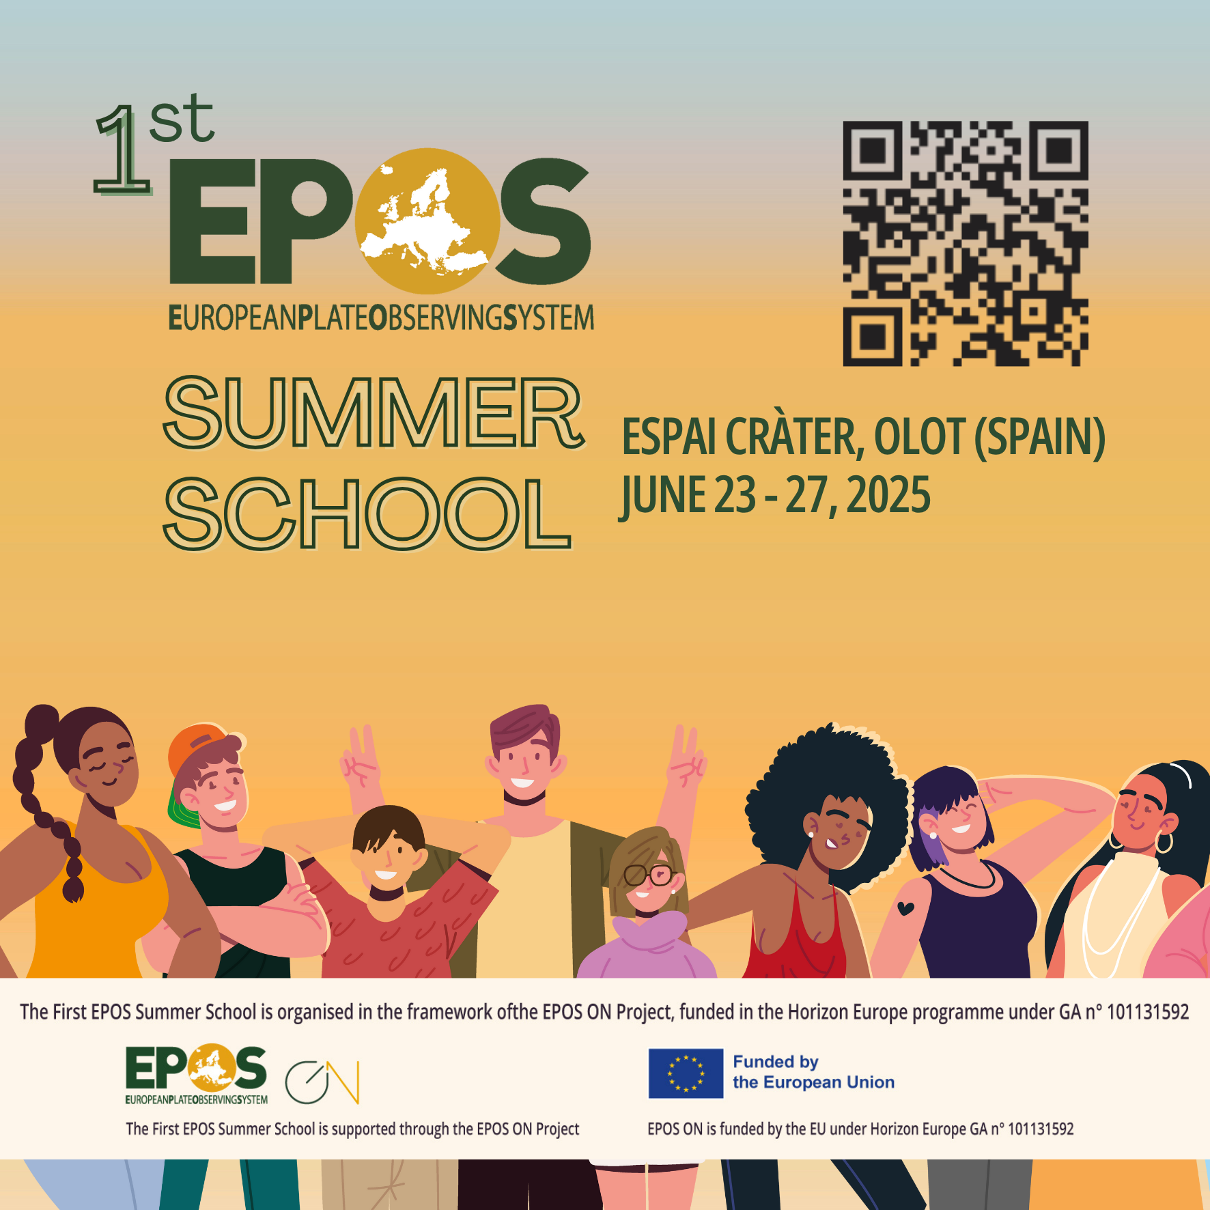
Setting the scene: a short introduction to research data management, FAIR principles and Open Science
Adelina Geyer| ageyer@geo3bcn.csic.es
Notes:
In this presentation I’d like to shortly introduce the concepts of Research Data Management, FAIR principles and Open Science. These are key concepts that will keep returning in the school programme and we’ll have the opportunity to expand on them and see them in real life.

Slide 2
Research Data Management
Notes:
Depending on the context, there can be many definitions of "Data”. In this presentation we will mainly refer to research data, or in other words those data that are used as primary sources to support technical or scientific enquiry.

Slide 3
Research data
Documents in a digital form, other than scientific publications, collected or produced in the course of scientific research activities and used as evidence in the research process, or commonly accepted in the research community as necessary to validate research findings and results.
Source(s): Directive (EU) 2019/1024 of the European Parliament on open data and the re-use of public sector information, http://data.europa.eu/eli/dir/2019/1024/oj ; https://eur-lex.europa.eu/eli-register/glossary.html ; and extracted from https://opendatahandbook.org/glossary/en/
Module 6 – Lecture 1
Adapted from: Data Governance and Legislative Strategies for FAIR Research - Brizioli, S., Cacciaguerra, S., Colcelli, V., Locati, M., Schirru L., 2024
Notes:
One definition that we must take in consideration comes from the European Commission’s Directive (EU) 2019/1024. Here, research data are defined as: “Documents in a digital form, other than scientific publications, collected or produced in the course of scientific research activities and used as evidence in the research process, or commonly accepted in the research community as necessary to validate research findings and results.”
This definition helps clarify the scope of what we mean by research data in Europe. It encompasses a wide range of digital materials and is particularly relevant for shaping policies on data sharing and reuse in publicly funded research.

Slide 4
Research data
Documents in a digital form, other than scientific publications, collected or produced in the course of scientific research activities and used as evidence in the research process, or commonly accepted in the research community as necessary to validate research findings and results.
Source(s): Directive (EU) 2019/1024 of the European Parliament on open data and the re-use of public sector information, http://data.europa.eu/eli/dir/2019/1024/oj ; https://eur-lex.europa.eu/eli-register/glossary.html ; and extracted from https://opendatahandbook.org/glossary/en/
Data that are used as primary sources to support technical or scientific enquiry, research, scholarship, or artistic activity, and that are used as evidence in the research process and/or are commonly accepted in the research community as necessary to validate research findings and results. All other digital and non-digital content have the potential of becoming research data. Research data may be experimental data, observational data, operational data, third party data, public sector data, monitoring data, processed data, or repurposed data.
Source: CODATA Research Data Management Terminology https://vocabs.ardc.edu.au/viewById/685
Module 6 – Lecture 1
Notes:
If you find the EC’s official definition too formal, here’s a less “legalese” one from the CODATA Research Data Management Terminology, that will help clarify the concept:
Research data are defined as data that are used as primary sources to support technical or scientific enquiry, research, scholarship, or artistic activity, and that are used as evidence in the research process and/or are commonly accepted in the research community as necessary to validate research findings and results. All other digital and non-digital content have the potential of becoming research data.
Let us highlight the last part: Research data may be experimental data, observational data, operational data, third party data, public sector data, monitoring data, processed data, or repurposed data.
🔹 Third party data
Definition:
Data that were not generated by the researcher or their team, but rather obtained from external sources, such as:
Other research groups or institutions
Commercial or industrial entities
Government agencies
Public datasets curated by third parties (e.g., satellite data from ESA, health data from WHO)
Example:
A volcanologist using satellite thermal imagery from NASA, or a sociologist analyzing census data from a government agency.
🔹 Processed data
Definition:
Data that have been transformed, cleaned, or analyzed from raw formats to make them usable or interpretable. Processing may include:
Filtering or cleaning raw measurements
Applying statistical methods
Aggregating values
Converting file formats
Normalizing, calibrating, or interpolating
Example:
Raw seismograph output converted into peak ground acceleration values, or raw genomic reads assembled into a gene expression matrix.

Slide 5
Research Data Sharing
The practice of making (research) data available to others
  Direct collaboration
  Depositing in Open Repositories
  Publishing Open Data
Enables transparency reproducibility, and collaboration
  Allows peers to review a scientific work, reuse data from new research questions, and build upon existing results
  Ensures the data collected with public funding provide broader societal value
Notes:
Regardless of the specific definition we choose, data sharing remains a central concept. When we talk about data sharing, we refer to the practice of making research data available to others—whether it's through direct collaboration, depositing datasets in repositories, or publishing them openly.
Data sharing is important because it enables transparency, reproducibility, and collaboration. It allows others to verify your work, reuse data for new research questions, and build upon existing results. In the context of public research, it also ensures that data collected with public funding can provide broader societal value.

Slide 6
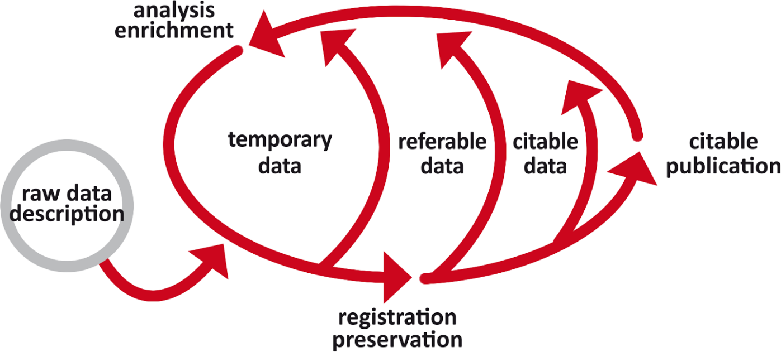
Sharing and publishing a database: the key elements
Data have a life cycle
Harmonised descriptions of the data, and interoperability.
Make data discoverable and referrable.
Cite and reuse datasets appropriately: this is done through licensing.
Adapted from: Basili, R. - Building and using databases in Earth Sciences - Creazione e uso dei database nelle Scienze della Terra - Corso di Dottorato in Scienze Della Terra - Sapienza Università di Roma, 2024
DMP to take care of the entire life cycle of the data!
Notes:
. Data are not static objects but have a life cycle - this means that between putting our data in a database and being able to share and publish them there are other steps that should be taken. And once we publish, we’re not finished, as the data will likely evolve over time and require curation. So how do we move to referable and citable data? And which aspects should we take into consideration?
The first elements are those that allow different systems to work together: harmonised descriptions of the data we want to share, and interoperability not only at the level of data but also services.
Then, we should consider the elements that allow data and other digital objects to be discoverable and referrable.
Then, we must be able to cite and reuse datasets appropriately: this is done through licensing.
Finally, we need a DMP to take care of the entire life cycle of the database.
We have now introduced one of the most challenging facts about research data: that is, they’re not static but have a life cycle. Taking care of them throughout their life cycle in a way that supports their optimal preservation and usage is the object of Research data management.

Slide 7
Research Data Management (RDM)
The organization, storage, preservation, and sharing of data in a research environment throughout the entire data lifecycle (and beyond)
REUSE
PLAN
SHARE
GENERATE
Each phase is well-documented and aligned with FAIR principles!!
VISUALISE
ARCHIVE
INTERPRET
PROCESS
ANALYSIS
Adapted from: Data Governance and Legislative Strategies for FAIR Research - Brizioli, S., Cacciaguerra, S., Colcelli, V., Locati, M., Schirru L., 2024
Image by Nuthawut Somsuk at https://www.vecteezy.com/
Notes:
Research Data Management, or RDM for short, encompasses the organization, storage, preservation, and sharing of data in a research environment. It covers the entire data lifecycle, from planning and generation to archiving, processing, analysing, interpreting, visualizing, sharing, and even reuse. Good RDM ensures each phase is well-documented and aligned with FAIR principles – which we’ll see in a moment. RDM is crucial for ensuring the efficiency, transparency, and reproducibility of research. It involves practices and policies that aim to improve the quality and value of research data, ultimately making them more useful, trustworthy, and impactful.

Slide 8
Research Data Management (RDM)
The organization, storage, preservation, and sharing of data in a research environment throughout the entire data lifecycle (and beyond)
Ensures the efficiency, transparency, and reproducibility of research
Includes practices and policies that aim to improve the quality and value of research data.
REUSE
PLAN
SHARE
GENERATE
VISUALISE
ARCHIVE
INTERPRET
PROCESS
ANALYSIS
Adapted from: Data Governance and Legislative Strategies for FAIR Research - Brizioli, S., Cacciaguerra, S., Colcelli, V., Locati, M., Schirru L., 2024
Image by Nuthawut Somsuk at https://www.vecteezy.com/
Notes:
Research Data Management, or RDM for short, encompasses the organization, storage, preservation, and sharing of data in a research environment. It covers the entire data lifecycle, from planning and generation to archiving, processing, analysing, interpreting, visualizing, sharing, and even reuse. Good RDM ensures each phase is well-documented and aligned with FAIR principles – which we’ll see in a moment. RDM is crucial for ensuring the efficiency, transparency, and reproducibility of research. It involves practices and policies that aim to improve the quality and value of research data, ultimately making them more useful, trustworthy, and impactful.

Slide 9
Research Data Management (RDM)
The organization, storage, preservation, and sharing of data in a research environment throughout the entire data lifecycle (and beyond)
Ensures the efficiency, transparency, and reproducibility of research
Includes practices and policies that aim to improve the quality and value of research data.
REUSE
PLAN
SHARE
GENERATE
VISUALISE
ARCHIVE
INTERPRET
PROCESS
ANALYSIS
Making data more useful, trustworthy, and impactful!
Adapted from: Data Governance and Legislative Strategies for FAIR Research - Brizioli, S., Cacciaguerra, S., Colcelli, V., Locati, M., Schirru L., 2024
Image by Nuthawut Somsuk at https://www.vecteezy.com/
Notes:
Research Data Management, or RDM for short, encompasses the organization, storage, preservation, and sharing of data in a research environment. It covers the entire data lifecycle, from planning and generation to archiving, processing, analysing, interpreting, visualizing, sharing, and even reuse. Good RDM ensures each phase is well-documented and aligned with FAIR principles – which we’ll see in a moment. RDM is crucial for ensuring the efficiency, transparency, and reproducibility of research. It involves practices and policies that aim to improve the quality and value of research data, ultimately making them more useful, trustworthy, and impactful.

Slide 10
Research Data Management (RDM)
REUSE
PLAN
A complex process involving many actors:
Scientific community: Data
Managers, Data Curators…
Research support staff:
Data Stewards, IT experts…
Management
SHARE
GENERATE
VISUALISE
ARCHIVE
To work, RDM requires financial, human and IT resources and different skills and competencies!
INTERPRET
PROCESS
ANALYSIS
Adapted from: Data Governance and Legislative Strategies for FAIR Research - Brizioli, S., Cacciaguerra, S., Colcelli, V., Locati, M., Schirru L., 2024
Image by Nuthawut Somsuk at https://www.vecteezy.com/
Notes:
. When we talk about Research Data Management, we refer to a complex process that involves many actors, including the scientific community, research support staff, and management. Its development actually fostered the creation of a host of new professional figures who specialise in the complexities of Research Data Management in its different phases: Data managers, curators, stewards, and IT experts all play a role in ensuring that data is managed effectively. Unfortunately, not all these figures are equally well established yet in academic and research institutions.
But it is important to remember that RDM requires resources – financial, human, and IT. It also demands a diverse set of skills and competencies.

Slide 11
Research Data Management (RDM)
REUSE
PLAN
A complex process involving many actors:
Scientific community: Data
Managers, Data Curators…
Research support staff:
Data Stewards, IT experts…
Management
NO FREE LUNCHES IN RDM!!!!
SHARE
GENERATE
Implementing effective RDM strategies requires investment and commitment from all stakeholders.
RDM – in particular Open and FAIR RDM has benefits for everyone: researchers, organisations and the society at large.
VISUALISE
ARCHIVE
To work, RDM requires financial, human and IT resources and different skills and competencies!
INTERPRET
PROCESS
ANALYSIS
Adapted from: Data Governance and Legislative Strategies for FAIR Research - Brizioli, S., Cacciaguerra, S., Colcelli, V., Locati, M., Schirru L., 2024
Image by Nuthawut Somsuk at https://www.vecteezy.com/
Notes:
. And this leads us to an important point: there are no free lunches in RDM. Implementing effective RDM strategies requires investment and commitment from all stakeholders. However, we should not see Research Data Management – and in particular Open and FAIR research data management - as just another obligation and time- and resource-consuming activity. It has benefits for everyone: researchers, organisations and the society at large. So when you dedicate your time and effort to RDM activities, see them as eating your greens: you must do it because it’s good for you!

Slide 12
Open Science and FAIR(R) principles
Notes:
We have just introduced Open Science and FAIR Principles… Let’s now see what we mean by these terms and why they are important in the context of Geosciences - and beyond!

Slide 13
Open Science
«
Open Science represents a new approach to the scientific process based on cooperative work and new ways of diffusing knowledge by using digital technologies and new collaborative tools (European Commission, 2016b:33).
“to make the primary outputs of publicly funded research results – publications and the research data – publicly accessible in digital format with no or minimal restriction” (OECD, 2015:7)
«
Bailo, D, Cocco, M. , Tanlongo, F. - EPOS Data Portal: the practice of FAIR principles in Solid Earth Sciences - 11/01/2024 – CC by 4.0 Int
Notes:
Open Science represents a new approach to the scientific process, based on cooperative work and new ways of disseminating knowledge using digital technologies and collaborative tools. The goal is to make the primary outputs of publicly funded research – publications and research data – publicly accessible in a digital format with minimal or no restrictions. Here you can see two of the many definitions of Open Science, and there are many others out there. While nobody dissents with the principles, interpretations differ regarding how to implement it. In EPOS, for instance, since the beginning we focussed on two operative aspects: cooperative work and access in digital formats.

Slide 14
Open Science
«
Open Science represents a new approach to the scientific process based on cooperative work and new ways of diffusing knowledge by using digital technologies and new collaborative tools (European Commission, 2016b:33).
“to make the primary outputs of publicly funded research results – publications and the research data – publicly accessible in digital format with no or minimal restriction” (OECD, 2015:7)
«
Bailo, D, Cocco, M. , Tanlongo, F. - EPOS Data Portal: the practice of FAIR principles in Solid Earth Sciences - 11/01/2024 – CC by 4.0 Int
Notes:
Open Science represents a new approach to the scientific process, based on cooperative work and new ways of disseminating knowledge using digital technologies and collaborative tools. The goal is to make the primary outputs of publicly funded research – publications and research data – publicly accessible in a digital format with minimal or no restrictions. Here you can see two of the many definitions of Open Science, and there are many others out there. While nobody dissents with the principles, interpretations differ regarding how to implement it. In EPOS, for instance, since the beginning we focussed on two operative aspects: cooperative work and access in digital formats.

Slide 15
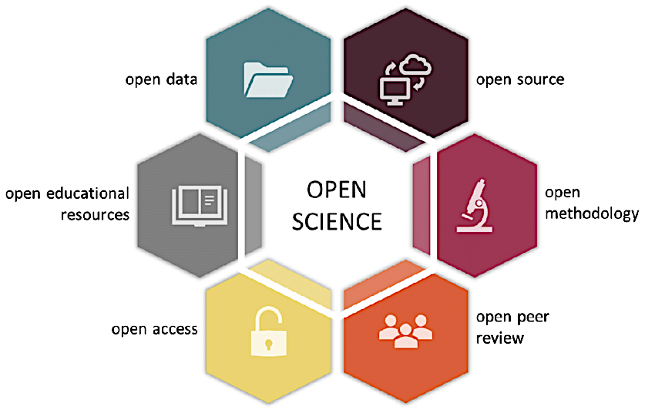
Open Science
All these aspects should be seen as a system, not as isolated elements, and all together concur to build a new, more collaborative and efficient way to do science.
Picture from: Gallagher, R.; Falster, D.; Maitner, B.; Salguero-Gómez, R; Vandvik, V.; Pearse, W.; Schneider, F.; Kattge, J. Alroy, J.; Ankenbrand, M.; Andrew, S.; Balk, M.; Bland, L.; Boyle, B.; Bravo Avila, C.; Brennan, I.; Carthey, A.; Catullo, R.; Cavazos, B.; Enquist, B.. (2019). The Open Traits Network: Using Open Science principles to accelerate trait-based science across the Tree of Life. 10.32942/osf.io/kac45.
Notes:
You probably have seen this picture already, but I always show it anyways because it dispels one of the most common misconceptions about open science, which, for many people, is still connected to open access to publications.
While open access is of course a very important aspect of open science, the picture helps contextualize it and see it as one of the pieces of a wider ecosystem that includes open data, open source software, open methodologies, open peer review processes and last but not least open educational resources (such as this presentation). All these aspects should be seen as a system, not as isolated elements, and all together concur to build a new, more collaborative and efficient way to do science.

Slide 16

Open Science: benefits…
Easier & more timely access to data and scientific products
Verifiability
Reproducibility
Efficient use of research resources (no need to reinvent the wheel)
Open methodologies & algorithms
😊
Michalek, J., Nedrebø, H. Tanlongo, F. – Open Science, FAIR and EPOS – EPOS pilot training 25/01/2024
Notes:
Open Science offers numerous benefits for the different stakeholders involved in research, from individuals like scientists or students, to organisations and whole communities. These include easier and more timely access to data and scientific products, improved verifiability and reproducibility – potentially leading to reinforce trust in science -, a more efficient use of research resources, with less overlaps and duplications, faster progresses in terms of scientific results and their practical applicability, and last but not least and the promotion not just of open data but also of open methodologies and algorithms (something that can impact on all the previous points).

Slide 17

Open Science: benefits and barriers
Easier & more timely access to data and scientific products
Verifiability
Reproducibility
Efficient use of research resources (no need to reinvent the wheel)
Open methodologies & algorithms
Different standards & vocabularies
Fragmentation
Communication between scientists and IT experts
Overhead needed to make data open and FAIR
IPR (perceived) issues
Legal and ethical issues
🫠
Michalek, J., Nedrebø, H. Tanlongo, F. – Open Science, FAIR and EPOS – EPOS pilot training 25/01/2024
Notes:
There are, however, also many barriers to overcome, including the challenges of different standards and vocabularies, fragmentation of data and resources, communication gaps between scientists and IT experts, the overhead needed to make data open and FAIR, IPR issues, and legal and ethical considerations.
Some of these barriers, if we look at them more closely, have more to do with old habits and with the perception from the individual researchers’ and the organisations’ side, but that does not make them less real.

Slide 18
Open Science: benefits and barriers
Easier & more timely access to data and scientific products
Verifiability
Reproducibility
Efficient use of research resources (no need to reinvent the wheel)
Open methodologies & algorithms
Different standards & vocabularies
Fragmentation
Communication between scientists and IT experts
Overhead needed to make data open and FAIR
IPR (perceived) issues
Legal and ethical issues
Some of these barriers have more to do with old habits and with the perception from the individual researchers’ and the organisations’ side.
🤨
Michalek, J., Nedrebø, H. Tanlongo, F. – Open Science, FAIR and EPOS – EPOS pilot training 25/01/2024
Notes:
There are, however, also many barriers to overcome, including the challenges of different standards and vocabularies, fragmentation of data and resources, communication gaps between scientists and IT experts, the overhead needed to make data open and FAIR, IPR issues, and legal and ethical considerations.
Some of these barriers, if we look at them more closely, have more to do with old habits and with the perception from the individual researchers’ and the organisations’ side, but that does not make them less real.

Slide 19
Open Science: benefits and barriers
Easier & more timely access to data and scientific products
Verifiability
Reproducibility
Efficient use of research resources (no need to reinvent the wheel)
Open methodologies & algorithms
Different standards & vocabularies
Fragmentation
Communication between scientists and IT experts
Overhead needed to make data open and FAIR
IPR (perceived) issues
Legal and ethical issues
Michalek, J., Nedrebø, H. Tanlongo, F. – Open Science, FAIR and EPOS – EPOS pilot training 25/01/2024
Notes:
There are, however, also many barriers to overcome, including the challenges of different standards and vocabularies, fragmentation of data and resources, communication gaps between scientists and IT experts, the overhead needed to make data open and FAIR, IPR issues, and legal and ethical considerations.
Some of these barriers, if we look at them more closely, have more to do with old habits and with the perception from the individual researchers’ and the organisations’ side, but that does not make them less real.

Slide 20
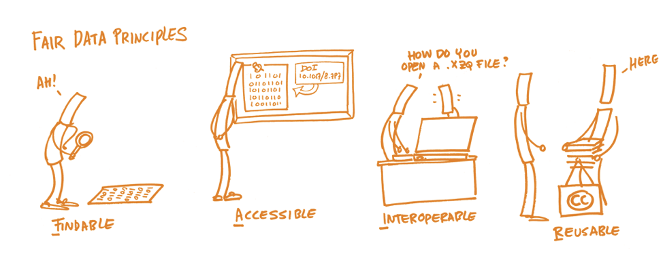
FAIR Principles
Agreed-upon, practical rules to make data and scientific outputs Findable, Accessible, Interoperable and Reusable - ultimately promoting scientific collaboration and innovation.
Picture: https://book.fosteropenscience.eu/
Notes:
Connected to the concept of Open Science (and sometimes confused with it) are the FAIR principles: agreed-upon, practical rules to make data and scientific outputs Findable, Accessible, Interoperable and Reusable - ultimately promoting scientific collaboration and innovation. Let’s now dive into what each of the letters in the acronym stands for, starting with F.

Slide 21
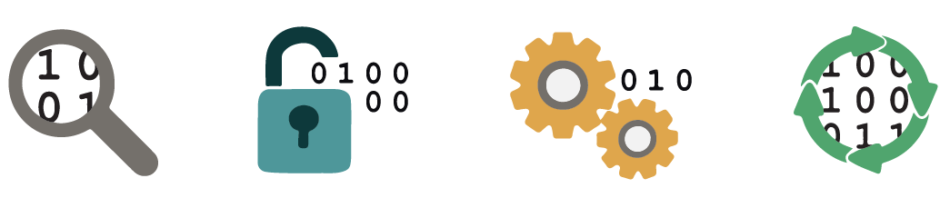
F: Findable Data
Metadata and data should be easy to find for both humans and computers.
F1: (Meta)data must have a global, unique and persistent identifier.
F2: The data should be accompanied by a rich set of quality metadata.
F3: Metadata must clearly include the identifier of the data they describe
F4: (Meta)data must be registered or indexed in a search resource.
Adapted from: Geyer Traver, A., Dorado Garcia, O. EPOS-ES Summer School 2024 Geosciencias En Abierto 098/07/2024
Notes:
The first step in (re)using data is to find them. Metadata and data should be easy to find for both humans and computers. Machine-readable metadata are essential for automatic discovery of datasets and services, so this is an essential component of the FAIRification process. For data to be findable, it must have a globally unique and persistent identifier, be accompanied by rich metadata, and be registered or indexed in a searchable resource.

Slide 22
A: Accessible Data
A1: (Meta)data must be retrievable by its identifier via a standardised communication protocol.
  A1.1: The protocol should be open, free and universally implementable.
  A1.2: The protocol must allow authentication and authorisation procedures if necessary.
A2: Metadata must be accessible even when data is no longer available (e.g. obsolete, changed location, discarded or deleted).
Adapted from: Geyer Traver, A., Dorado Garcia, O. EPOS-ES Summer School 2024 Geosciencias En Abierto 098/07/2024
Notes:
Once users find the required data they need to know how they can be accessed, possibly including authentication and authorisation. Accessible data means that it can be retrieved by its identifier using a standardized communication protocol, which should be open, free, and universally implementable. Even when the data itself is no longer available, the metadata should remain accessible.

Slide 23
I: Interoperable Data
Data usually need to be integrated with other data and tp interoperate with applications or workflows for analysis, storage, and processing.
I1: (meta)data should use a formal, accessible, shared and widely applicable language.
I2: (Meta)data should use vocabularies that follow FAIR principles (e.g. COAR, DataCite).
I3: (meta)data should include qualified references to other (meta)data.
Adapted from: Geyer Traver, A., Dorado Garcia, O. EPOS-ES Summer School 2024 Geosciencias En Abierto 098/07/2024
Notes:
The data usually need to be integrated with other data. In addition, the data need to interoperate with applications or workflows for analysis, storage, and processing.
Interoperability is essential for enabling data exchange and integration. Interoperable data uses a formal, accessible, shared, and widely applicable language and vocabularies that follow FAIR principles. It also includes qualified references to other metadata, facilitating connections and knowledge discovery.

Slide 24
R: Reusable Data
R1: (Meta)data should be richly described with a wide range of accurate and relevant attributes.
  R1.1: (Meta)data must be published with a clear and accessible data use licence.
  R1.2: (Meta)data must be associated with a detailed provenance.
  R1.3: (Meta)data must comply with EU standards.
+ (R)machineReadable: data must be usable not only by humans but also by automated systems! (→adequate formats and protocols!)
Adapted from: Geyer Traver, A., Dorado Garcia, O. EPOS-ES Summer School 2024 Geosciencias En Abierto 098/07/2024
Notes:
The ultimate goal of FAIR is to optimize the reuse of data. To achieve this, reusable data is richly described with a wide range of accurate and relevant attributes, published with a clear and accessible data use license, and associated with detailed provenance. It also complies with EU standards and is machine-readable, ensuring that it can be used not only by humans but also by automated systems
In today’s programme we will explore in detail how these principles translate into to practice and how we can achieve optimal FAIRness for our data and scientific product.

Slide 25

Thank you for your attention!
ageyer@geo3bcn.csic.es
www.epos-eu.org/on | social media #EPOSon
Notes:
Thank you slide

