Slide 1
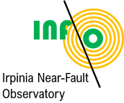
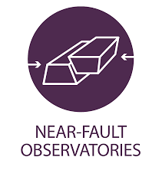
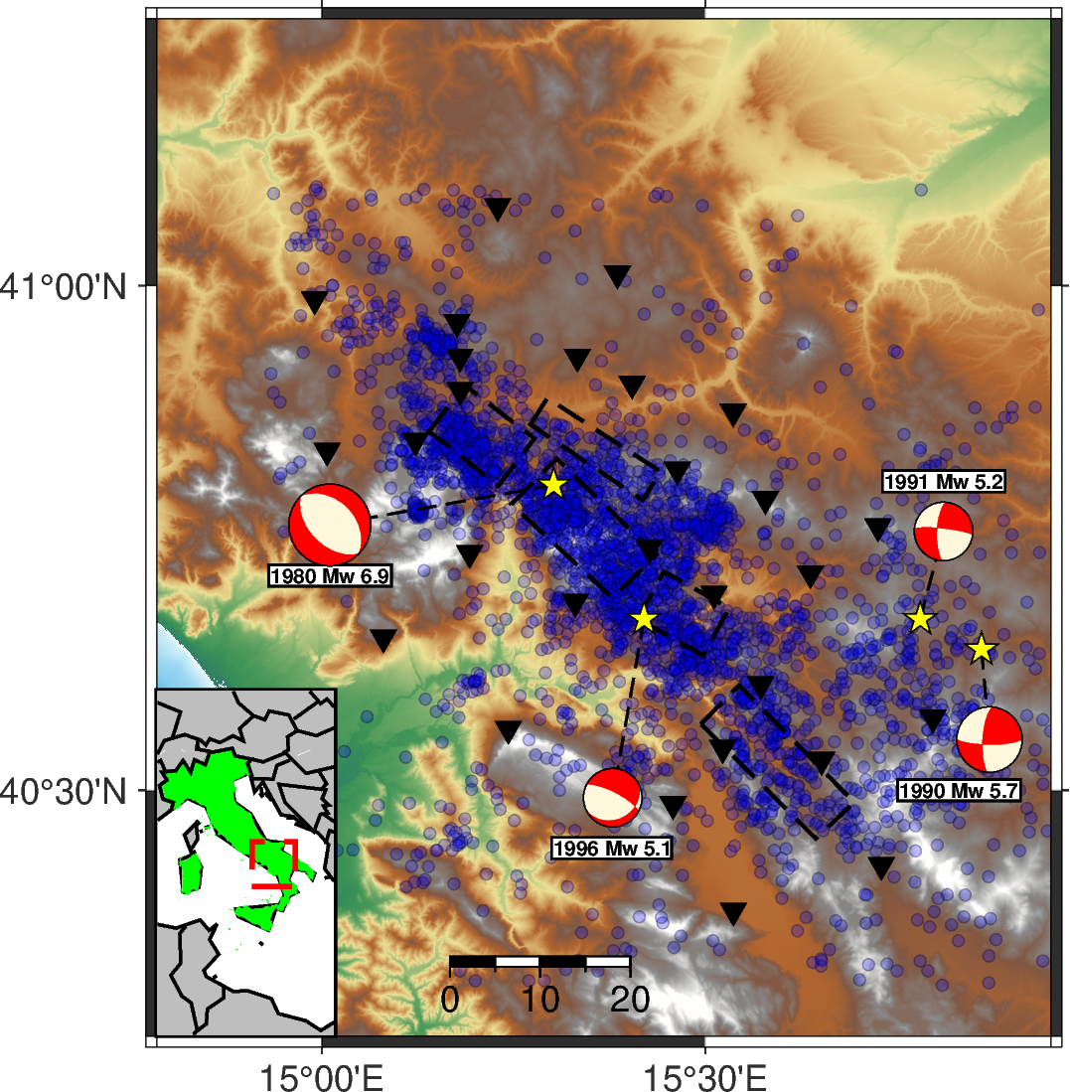
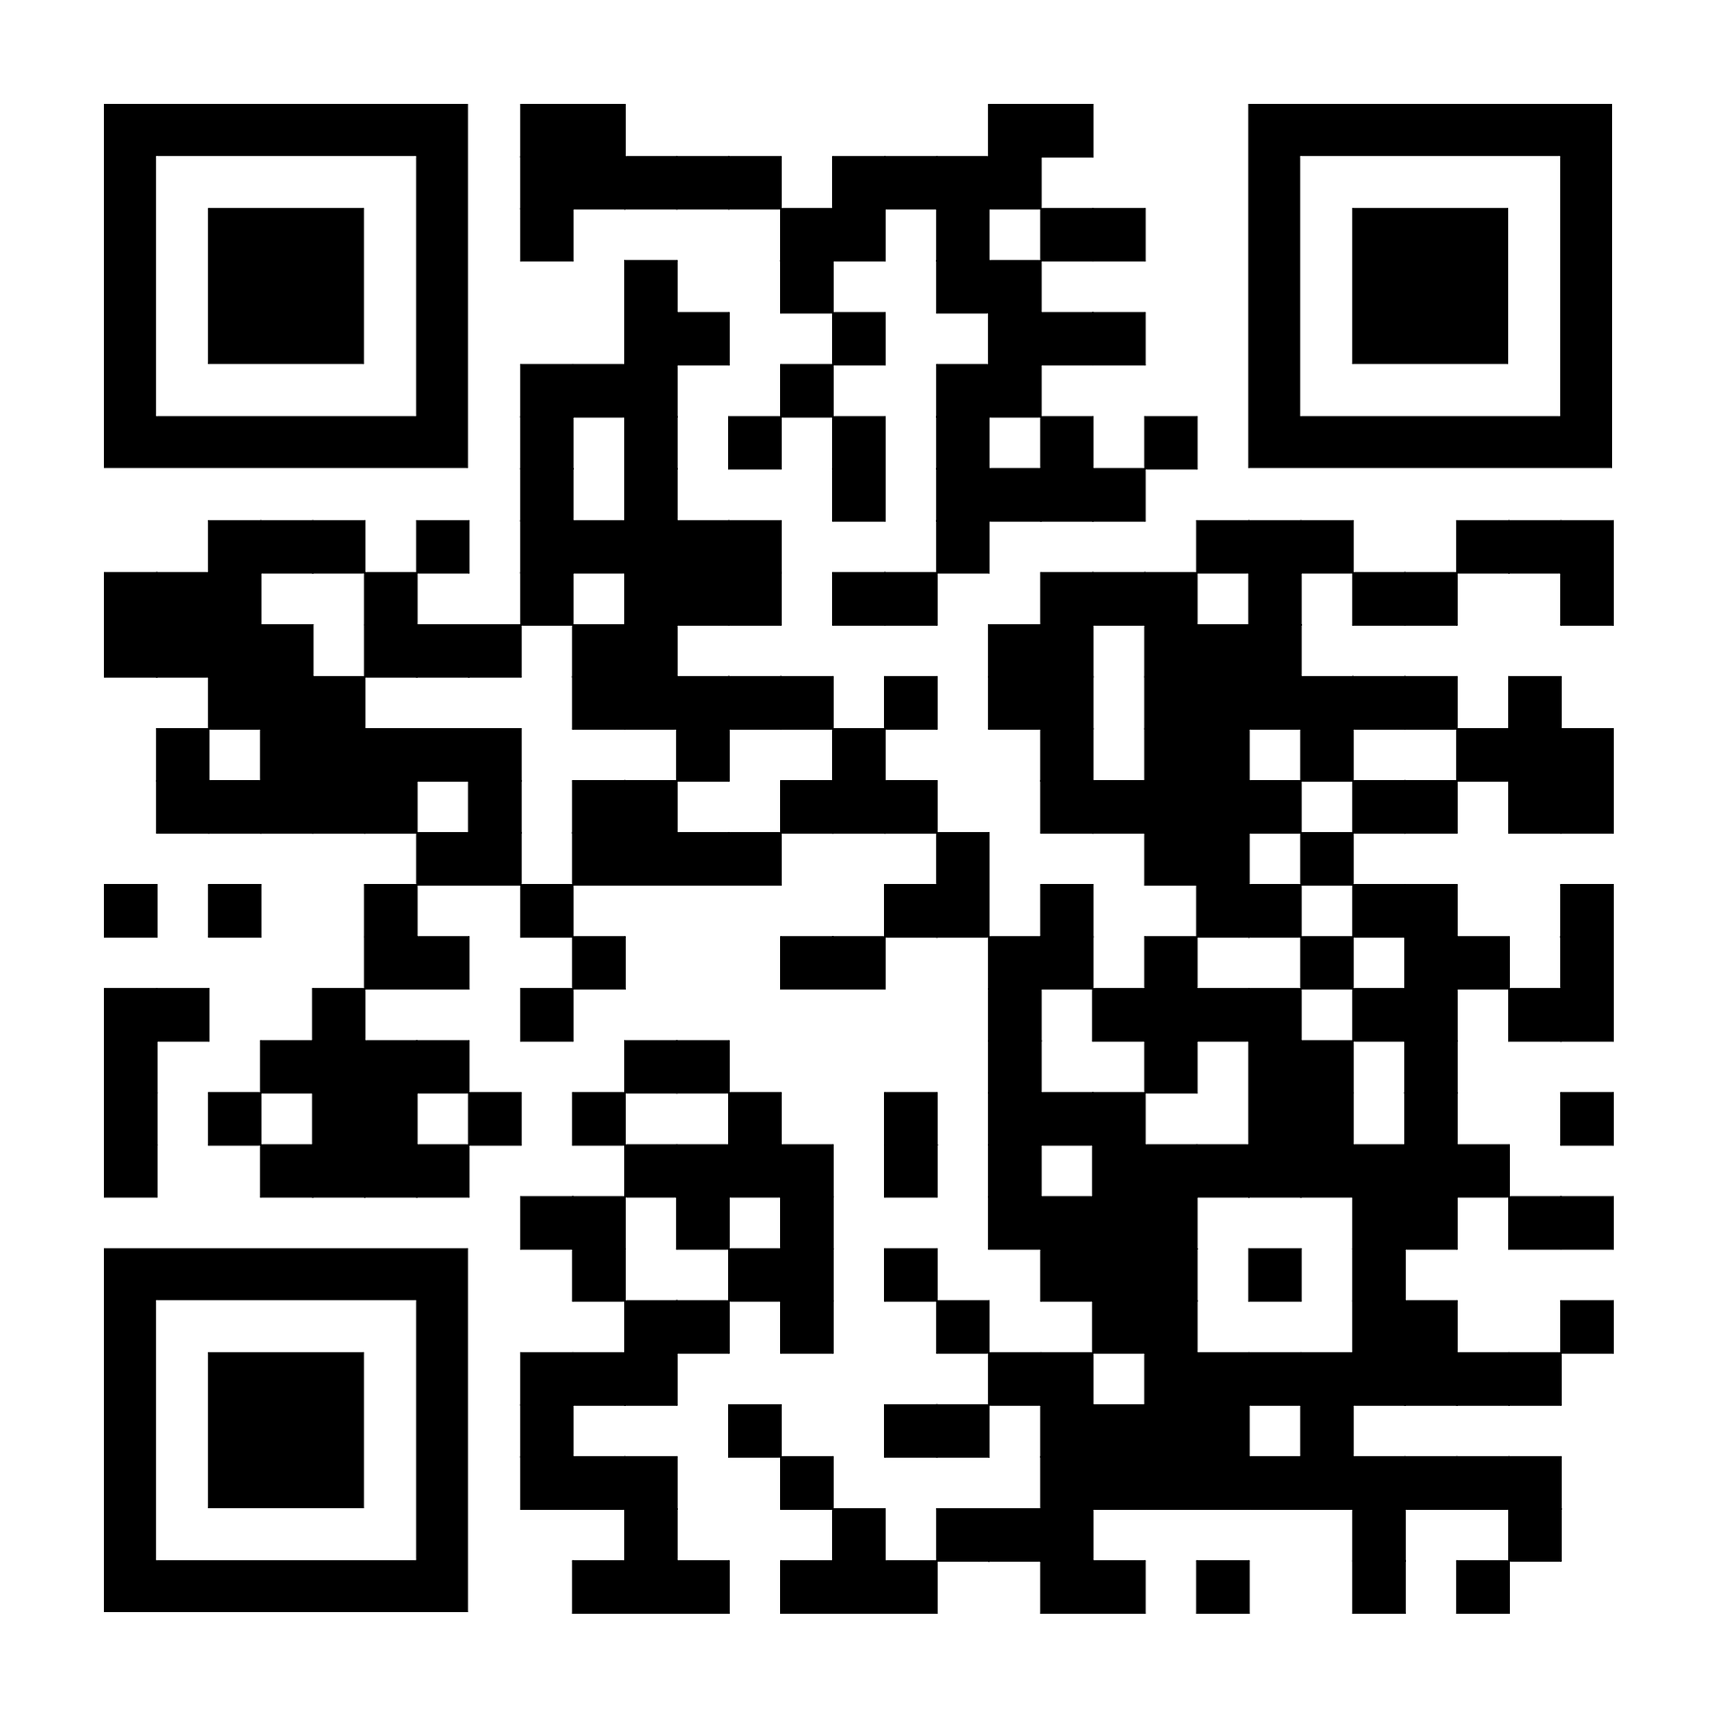
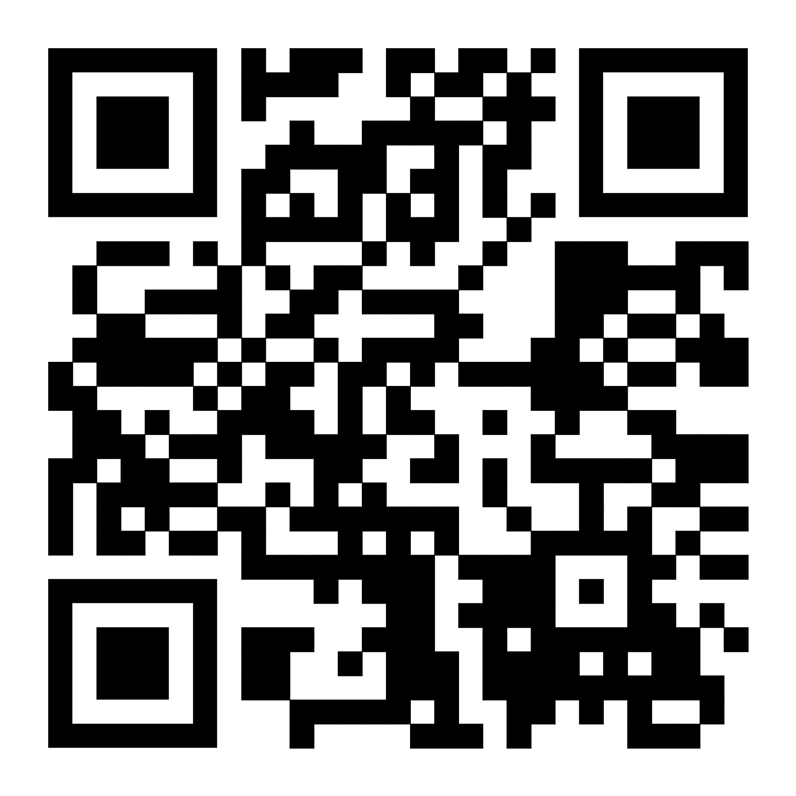
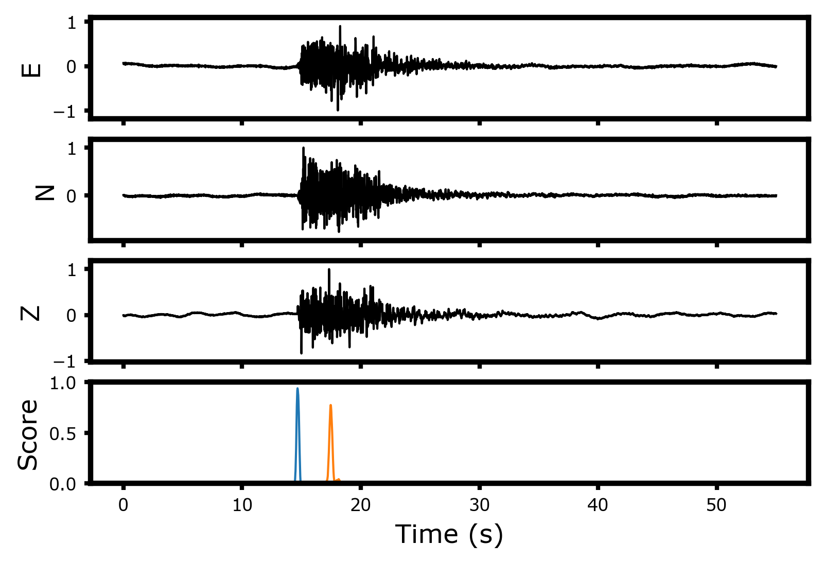
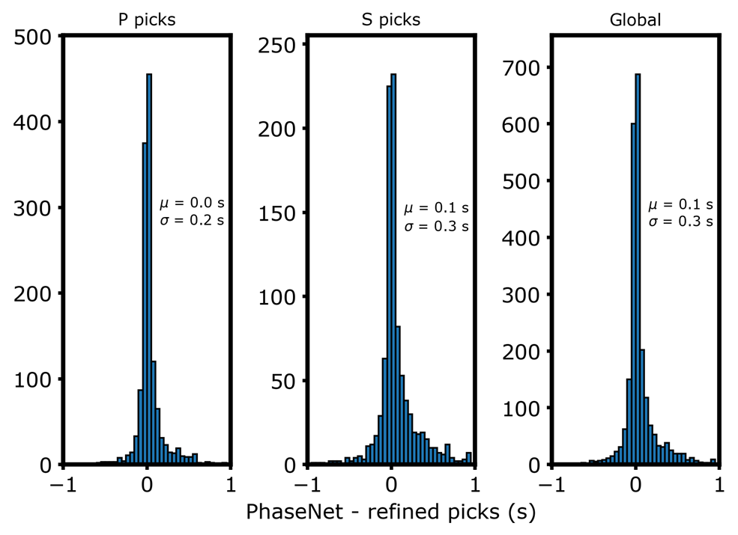
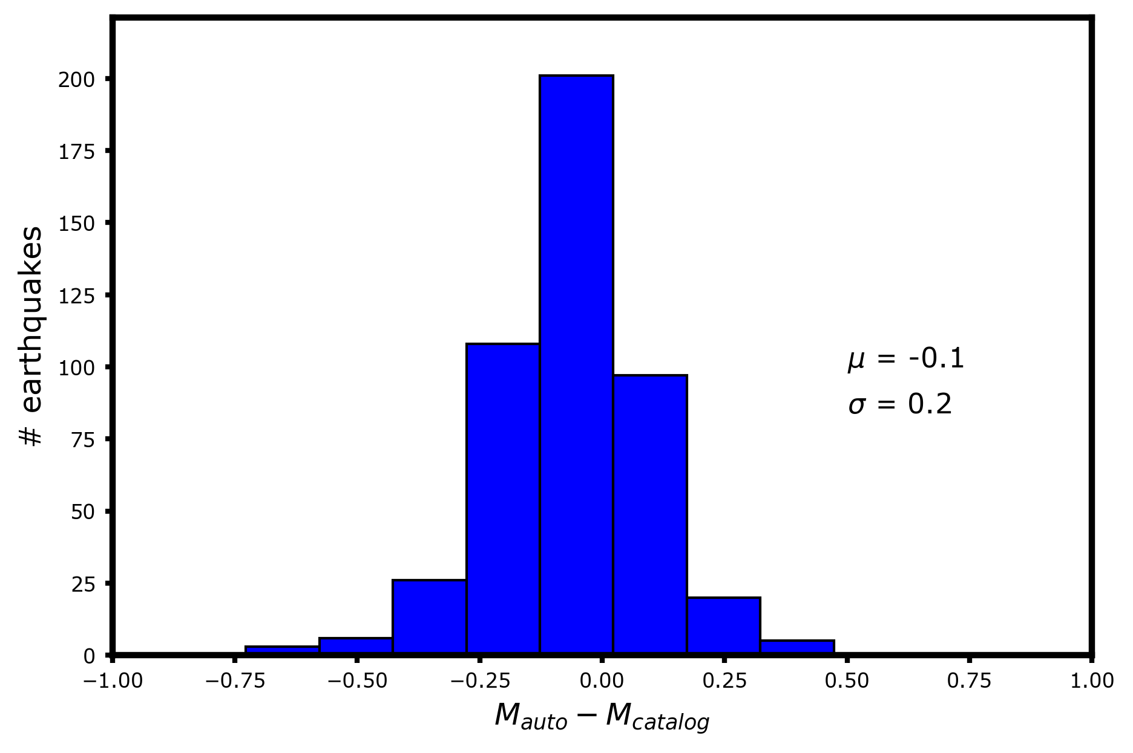
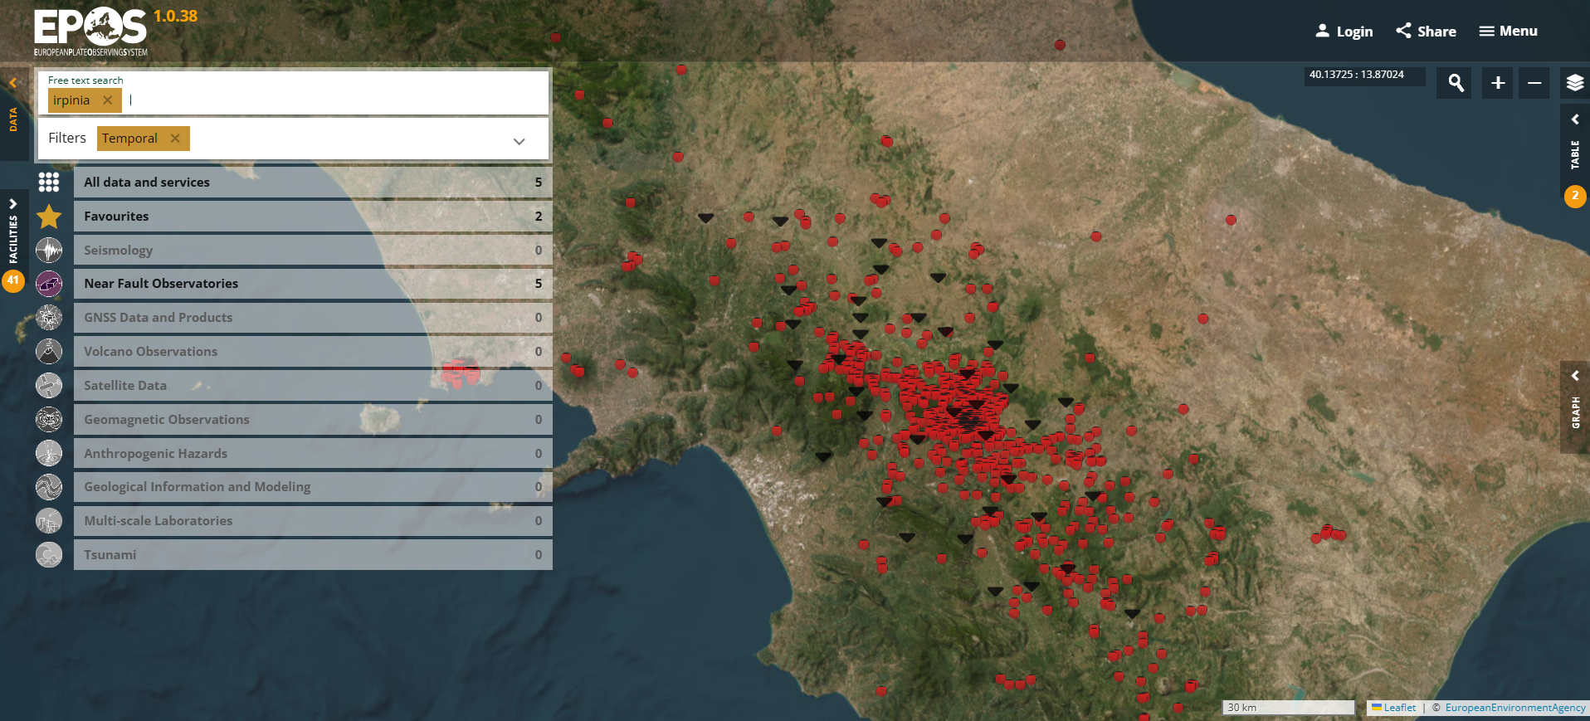
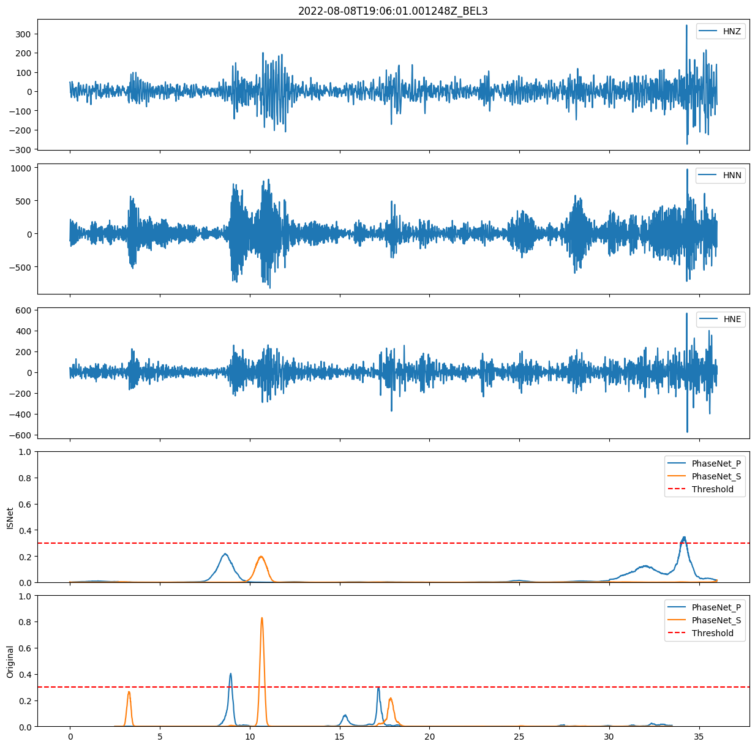
DAYS
2025
An automatic ML workflow for microseismicity characterization at the Irpinia NFO
Francesco Scotto di Uccio, Gaetano Festa, Luca Elia, Antonio Scala, Claudio Strumia
Microseismicity characterization
INFO:The Irpinia Near Fault Observatory
Microseismicity characterization can provide insights into the mechanical state of faults systems, with low magnitude earthquakes continuously occurring within the interseismic time between large magnitude events.
However, they are typically characterized by amplitude at the noise level and emerge at the closest stations to the epicenter. There is a need to integrate advanced monitoring infrastructures and innovative techniques.
INFO operates a dense seismic network, ISNet (Irpinia Seisimic Network) in Southern Italy, composed of 31 stations along the normal fault system that generated the 1980, M_{w} = 6.9, Irpinia earthquake. The area hosts microseismic activity ($M_{lmax }$𝟑.𝟗), featuring low seismicity rate (~4k earthquakes in 15 y), with depths of [8-15] km.
years
days
Background microseismicity
Event preparation
Automatic workflow and integration in EPOS
SCIENTIFIC TARGETS Automatic workflow for event characterization Enhancing catalog using ML techniques in near real-time Generation of local NFO-trained models
INTERESTED IN ML EARHTQUAKE CHARACTERIZATION? GIVE A LOOK TO SOME OF MY FORMER ACTIVITIES!
OPERATIONAL SINCE 1 YEAR
UNDER TESTING
Access to daily continuous records
Earthquake detection and determination of phase arrival times (PhaseNet + REAL)
Determination of hypocentral coordinates and local magnitude
Estimation of source parameters and focal mechanisms
Revised catalog and arrival times converge into the EPOS portal. Manual catalogs enhanced by a factor $\sim 3$, ($\sim$1k earthquakes)
Accurate automatic phase arrival times and$M_{L}$ However, false positive rate close to $\sim$20%. Do NFO-trained models limit false detections ?
TRAINING LOCAL MODELS
We trained PhaseNet on INFO dataset since 2007. False positive drops to 5 %.
EPOS portal hosts standardized catalog, extension to other Near Fault Observatories
EPOS DAYS 17 - 21 March 2025, Perugia | Congress Centre "Hotel Giò"
EPOS ON | info@epos-eric.eu | epos@epos-eu.org/on
Funded by
the European Union
EPOS ON is funded by the European Union. Views and opinions expressed are however those of the author(s) only and do not necessarily reflect those of the European Union. Neither the European Union nor the granting authority can be held responsible for them

