Slide 1
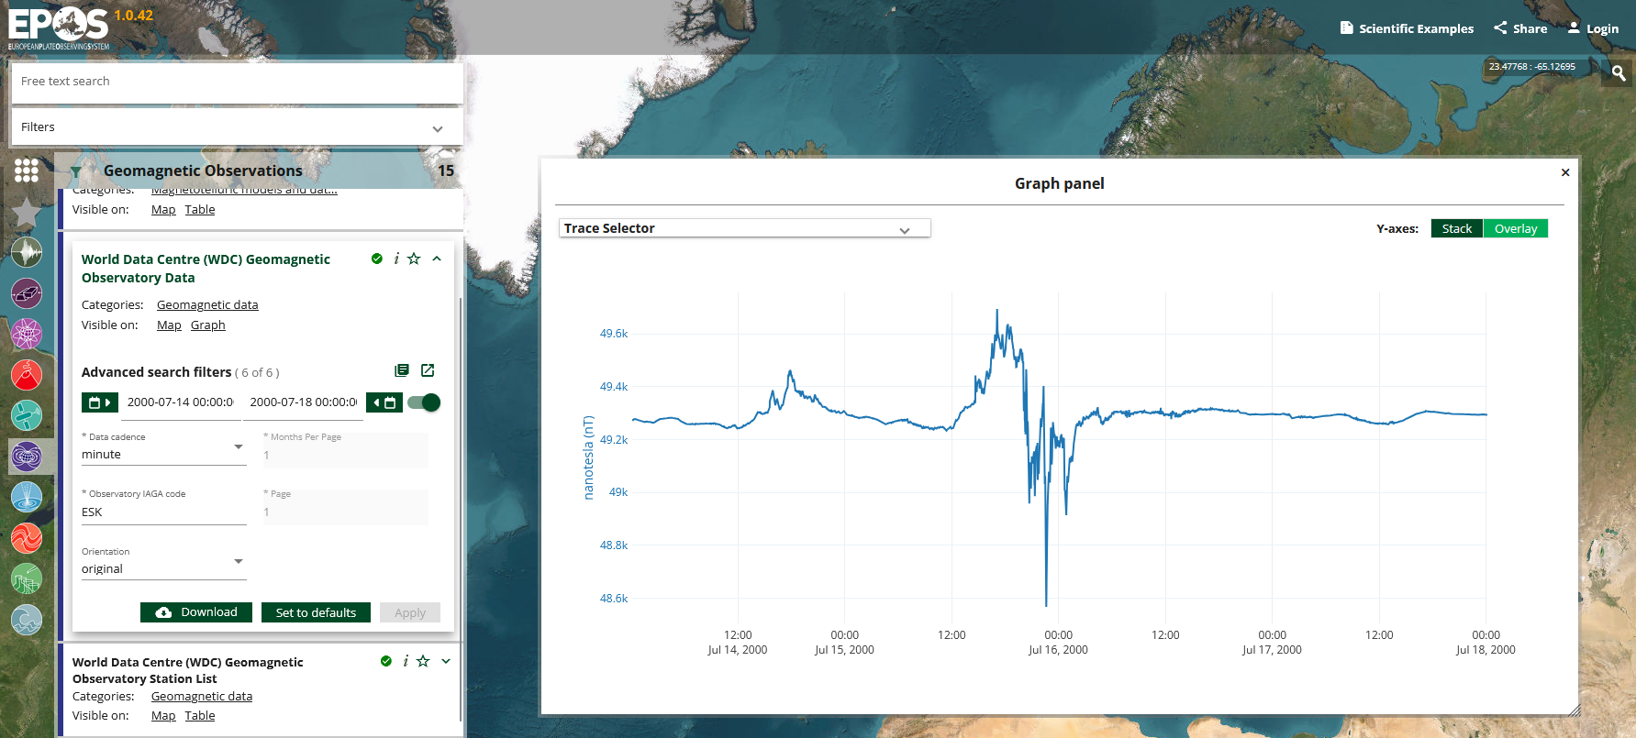
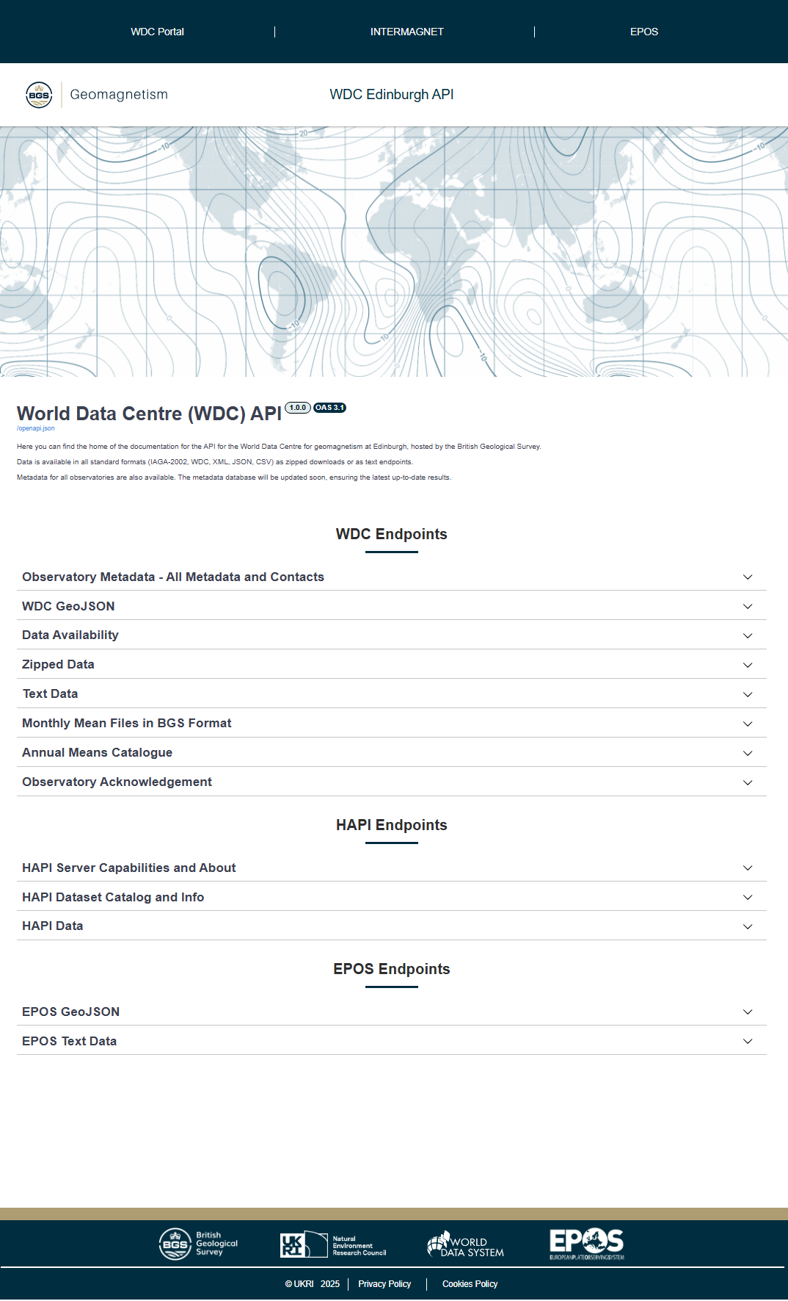
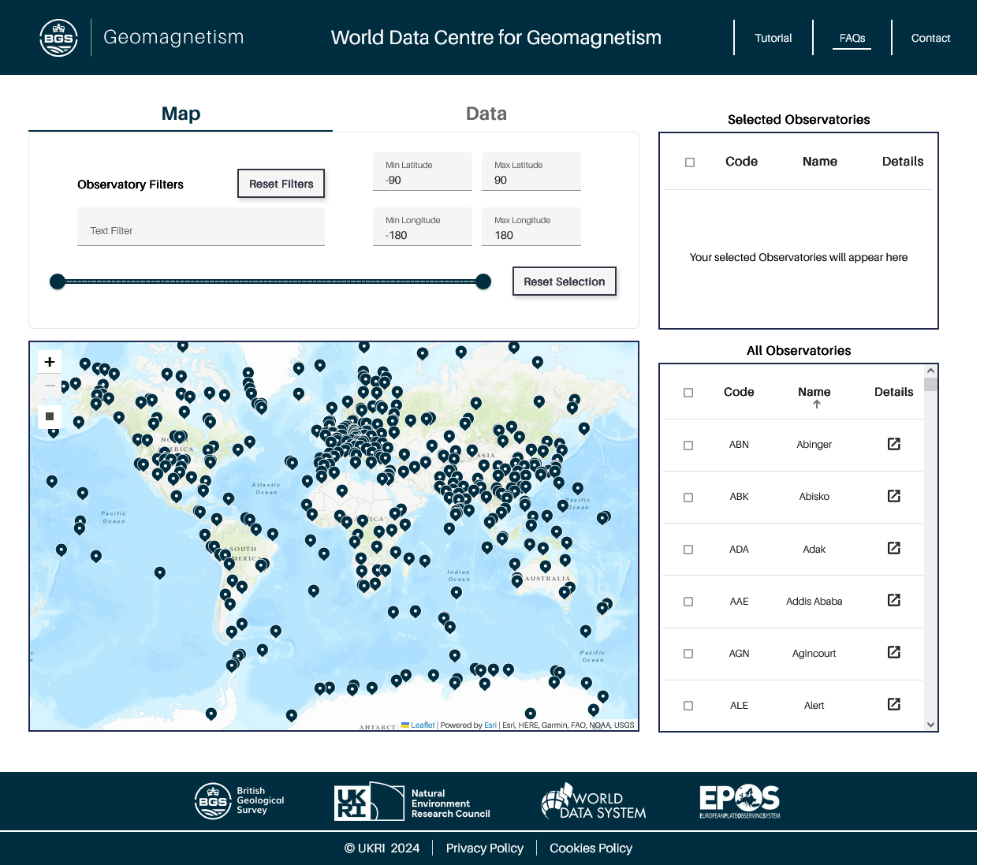
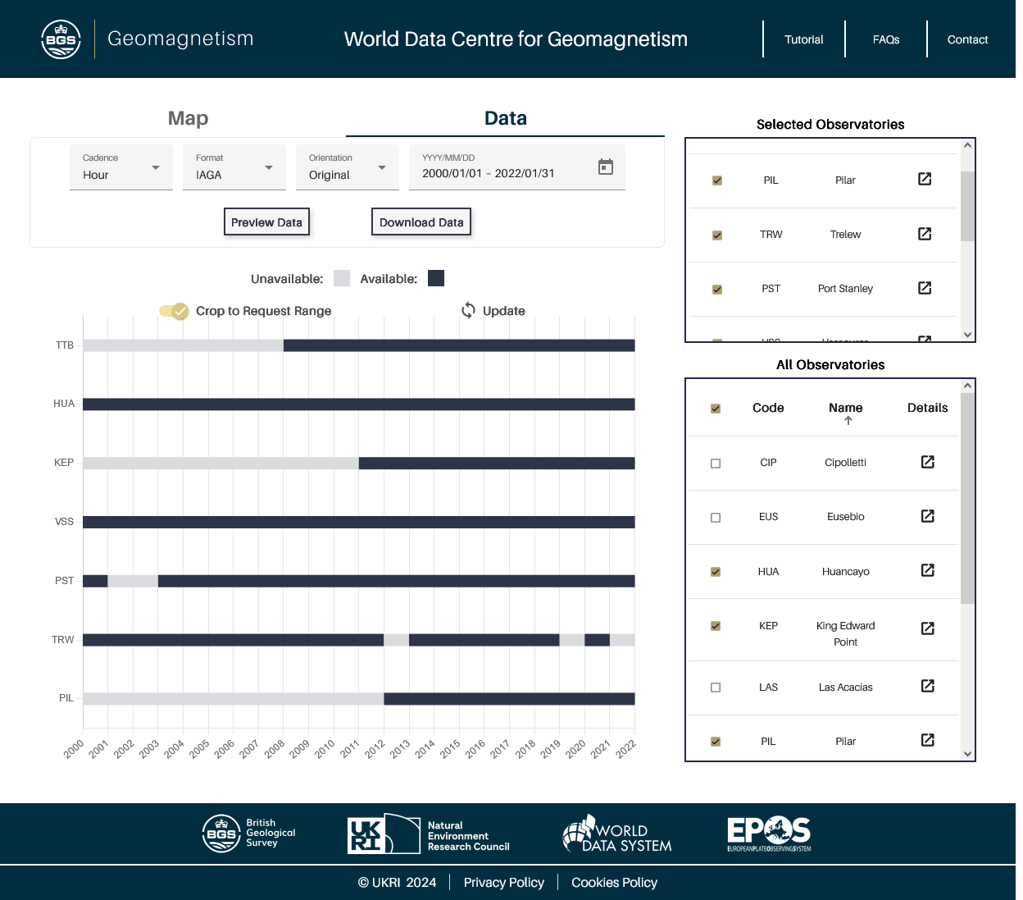
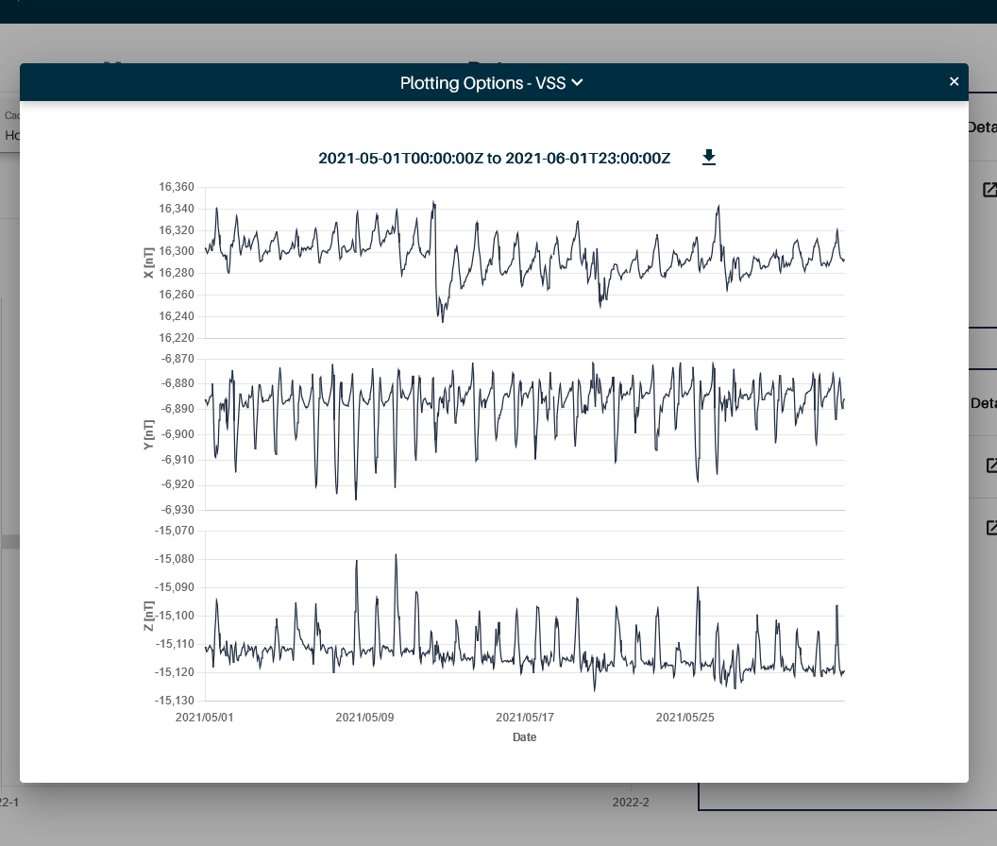
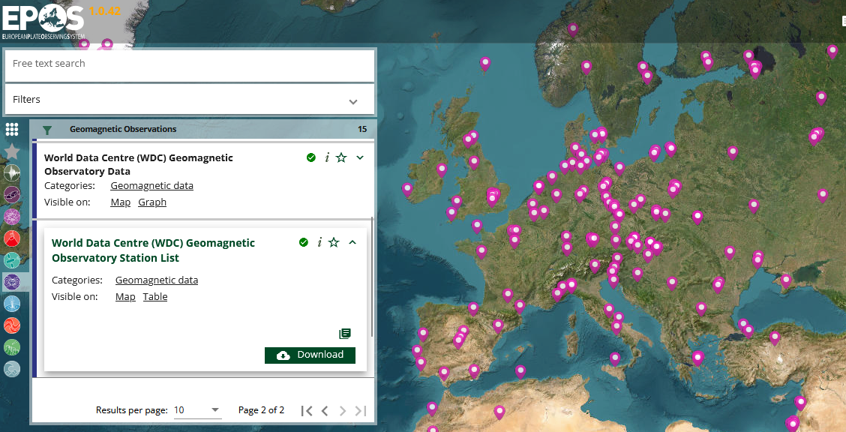
Connecting The World Data Centre For Geomagnetism To EPOS And The World
Chambers, O., Reay, S.J., Huebert, J., Emsley, A., Lawrence, E., Williamson, J., Collins, A., Brown, W.J., Exton, J., Wang, G., Thompson, V., Lewis, S.
British Geological Survey, The Lyell Centre, Edinburgh, United Kingdom
WDC: Try it out! Feedback welcome!
Introduction
The World Data Centre (WDC) for Geomagnetism, Edinburgh holds geomagnetic data and information from over 500 geomagnetic observatories around the world. It provides a reliable and free access point for users and is directly connected to the EPOS platform.
WDC is a regular member of the World Data System (WDS), a community of trusted scientific data repositories. Over the past year several improvements were made to make WDC data access easier online and more visible to the scientific community.
Figure: Screenshot of magnetic data measured during the Bastille day geomagnetic storm (15 July 2000) provided by WDC and accessed through the EPOS data portal.
The New WDC Application Programming Interface (API)
A new API to deliver WDC data programmatically to endpoints including EPOS (wdcapi.bgs.ac.uk/docs) has been developed using the FastAPI Python framework deployed on a Kubernetes cluster. The API has been optimised to allow larger/faster downloads as well as responsive load balancing. Additionally, we have made four new datasets (daily, monthly, annual means and the Kp index) accessible, which are now available to download in a variety of formats including IAGA-2002, WDC and covJson.
Built-in parsing ensures data with the highest precision is delivered by default.
We have also added geomagnetic observatory metadata to the API. Users can now easily access the location history, on-site instruments and contact information of related institutes for each individual observatory.
Figure: Screenshot of the WDC API landing page https://wdcapi.bgs.ac.uk/docs
Updates to the WDC Data Portal
To utilise the full power of the new API, a new front-end data portal has also been developed.
(wdc-dataportal.bgs.ac.uk)
This provides users with easier access to search for and download observatory data.
The map tab allows users to select geomagnetic observatories of interest. They can filter observatories by text for name, location and operation date, or by using the draw tool.
Once observatories have been selected the data tab shows an in-depth view of the data available since the observatory opened. This makes it easier to identify which observatories provide data for a given time period.
Data Portal front page with filter options.
Data availability chart for selected observatories.
Plot of selected observatory data.
Users can also see a visual preview of the data before download. Previews can show 1-month, 6-months, 1-year timeseries (or everything depending on the chosen cadence).The front end uses the Angular framework and again is deployed on a Kubernetes cluster.
EPOS Connectivity
The new WDC API provides data for two services on the EPOS platform (ics-c.epos-eu.org): World Data Centre (WDC) Geomagnetic Observatory Data and World Data Centre (WDC) Geomagnetic Observatory Station List.
The API has two dedicated endpoints which provide additional EPOS specific data to make use of the platform’s visualisation features. The Station List uses geoJson to plot observatory locations on the map. Observatory Data uses covJson to display timeseries in the graph tab.
These endpoints completed a 30-day testing period to ensure they are capable of handling EPOS traffic.
Figure: Screenshot of the EPOS platform showing WDC Observatory locations in Europe
CONTACT US or SEND YOUR DATA TO: wdcgeomag@bgs.ac.uk

