Slide 1
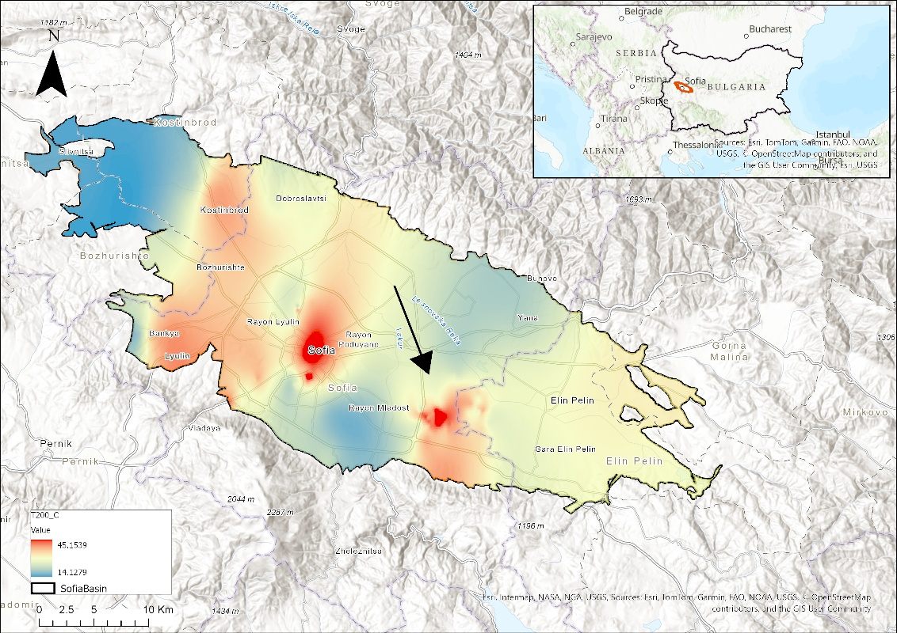
DAYS
2025
Tectonic Structures and Hydrothermal Systems in the Sofia Basin, Bulgaria
European Fault Source Model 2020 - Crustal Faults (OGC WFS)
Dilyana Hristova
dilyana.m.hristova@gmail.com
National Institute of Geophysics, Geodesy and Geography,
Bulgarian Academy of Sciences
Acad. G. Bonchev Str., Bl. 3, 1113 Sofia, Bulgaria
EPOS Data Portal
Study Area: Sofia Basin, Bulgaria
This study aims to investigate subsurface tectonic structures and assess the geothermal potential of the Sofia Basin using the magnetotelluric method. The research is currently in its early stages, focusing on the collection and analysis of various geophysical and geological data. This includes temperature distribution across Bulgaria, borehole-derived temperature profiles at depth, regional and local magnetic data, and magnetic anomalies in the study area.
Additionally, geological information from boreholes and geological maps is being examined. The upcoming magnetotelluric surveys will provide further insights into the basin’s structure, contributing to a more comprehensive geophysical characterization and supporting future geothermal exploration.
Temperature anomaly at 200 m depth based on borehole data
Magnetic Anomalies in the Study Area
Magnetic Map of Bulgaria
Geological-Geothermal Profile
Trifonova, P. ,Simeonova, S., Solakov, D., Metodiev, M. (2012) Exploring seismicity in Bulgaria using geomagnetic and gravity data, Comptes Rendus de L'Academie Bulgare des Sciences, 65(5), pp. 661–668
"Prepared by P. Petrov, Geological Institute, Bulgarian Academy of Sciences"
Participation in EPOS Days 2025 is supported by the National Geoinformation Center (NGIC)
EPOS DAYS 17 - 21 March 2025, Perugia | Congress Centre "Hotel Giò"
EPOS ON | info@epos-eric.eu | epos@epos-eu.org/on
Funded by
the European Union
EPOS ON is funded by the European Union. Views and opinions expressed are however those of the author(s) only and do not necessarily
reflect those of the European Union. Neither the European Union nor the granting authority can be held responsible for them

