Slide 1
Cross-TCS collaboration ideas as gathered from discussions during the Day 1 TCS Meet & Greet
A. Babeyko, F. Jalayer, O. Lange
EPOS Days | 17-20 March 2025 | Perugia
Notes:
Content slide
1

Slide 2
A reflection on cross-TCS collaboration
Slide borrowed from Otto’s M&G wrap-up session Day 1
The multiple dimensions of cross-TCS collaboration
Data: cross-disciplinary (TCS) use cases (e.g., ICS-D, sharing data through other TCS’s services, multi-disciplinary project engagement)
Best practices: (FAIR) data management (e.g., vocabulary management)
Harmonization: e.g., essential variables, vocabularies, data harmonization
Resources: shared infrastructure tools (e.g., FAIR assessment pipelines, Jupyter notebooks, multi-domain repositories, workflows)
Outreach: cross-community engagement beyond TCS
The end-user perspective
To what extent do I feel connected to a single TCS?
To what extent are TCS-specific paradigms for data discovery aligned with the ‘EPOS way’?
Notes:
Content slide
2

Slide 3
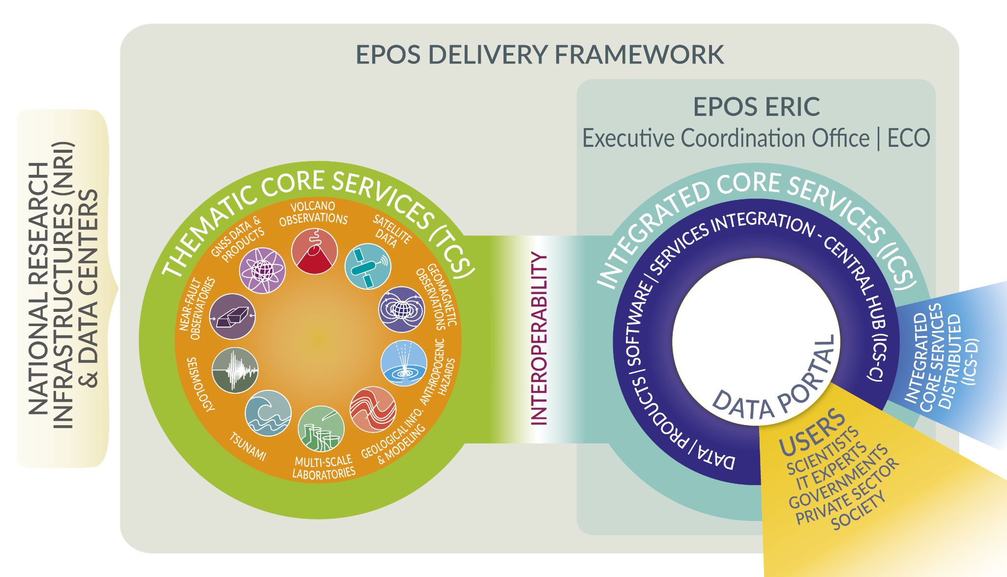
“Cross-TCS collaboration? Hmm… What is this collaboration about?”
Sure, we could declare collaboration as broad as possible including e.g. harvesting of data from TCS-1 and TCS-2 by an external (or even EPOS-affiliated) ECR to do something. Classical example: joint interpretation.
But for now I suggest to severely “shrink the perimeter” for collaboration definition:
Let’s call (for today) cross-TCS collaboration when:
Service of TCS-1 is supported by data/methods from TCS-2;
New EPOS product necessarily requires multi-TCS coordination and efforts incl. establishment of some cross-TCS governance elements like e.g. Working Group or Task Force. Example: multi-hazard risk
Maybe we could call this ‘shrinked’ collaboration as: “cross-TCS collaboration for service functionality”
Notes:
Content slide
3

Slide 4
Trying to set Categories of cross-TCS collaboration for service provision
‘D’ Data sharing: clear, no comments
‘M’ Methods sharing: incl. tools, best-practices, harmonization as applied to both research applications and data management, also includes facility sharing
‘R’ Cross-community engagement beyond TCS: like multi-hazard risk products which require principally multi-TCS coordination not available at the moment. Currently one practical idea is multi-hazard risk which meets SO3 of EPOS-ON, so let’s use letter ‘R’ for this category.
‘O’ To indicate Overlapping
Important remarks:
Harmonization or best-practices inside the “EPOS-IT perimeter” like joint activity on vocabularies is here excluded from cross-TCS categories as it is anyway our ‘must’ and is not community-driven.
Same for resources sharing like HPC which should likely be “provided” to TCS’s from EPOS IT (even if resources could be generated by communities themselves)
Notes:
Content slide
4

Slide 5
Cross-TCS collaboration screening excercise
(Letters are Categories, see previous slide)
 | AH | GEOM | GIM | GNSS | MSL | NFO | SATD | SEIS | TSU | VOLC
AH |  |  | D | D | DO |  | D | DR
GEOM |  |  | D |  | D | D |  |  |  | D
GIM | D | D |  |  | D | D |  | ? |  | D
GNSS | D |  |  |  |  | D | D | D | D | DO
MSL | DO | D | D |  |  |  |  |  |  | M
NFO |  | D | D | D |  |  | ? | DMO | D | DM
SATD | D |  |  | D |  | ? |  | D | ? | D
SEIS | DR |  | ? | D |  | DMO | D |  | DMR | DOR
TSU |  |  |  | D |  | D | ? | DMR |  | DMR
VOLC |  | D | D | DO | M | DM | D | DOR | DMR
Let’s discuss!

Slide 6
Multi-hazard Risk Products ‘R’ as an opportunity for Cross-TCS collaboration
Risk products are concerned with consequences on people or physical assets at risk. These consequences are inherently multi-hazard, since “people or physical asset at risk” become a “container”, through which hazards interact.
As a result, the multi-hazard risk products need to be developed through an interdisciplinary collaboration which involves both the hazard and risk modellers and brings together scientists, engineers, and social scientists. Indeed, this is a perfect example of a cross-TCS collaboration opportunity.
Development of risk products goes in line with the EPOS-ON Strategic Objectives SO2 “Cultivate multidisciplinary research” and SO3 “Enhance and disseminate the EPOS societal value”.
Question: If we see ‘R’ as an opportunity to interact and collaborate, then how can we formalize such collaboration? Cross-TCS WG, SRA to start with?

