Slide 1



ECRs Feedback
Helena Ciechowska (TCS AH)
EPOS Days 2025, Perugia, Italy
hciechowska@igf.edu.pl

Slide 2

EPOS Days
2024
(Rome)
2025
(Perugia)
  19 ECRs,
  flash talks and posters,
  significant increase in effort to involve ECRs,
  Attractive form of participation,
  Fresh ideas,
  Good for networking
  ~10 ECRs
  EPOS Data Portal training,
  No ECR studies-dedicated session
2

Slide 3

ECRs and EPOS Platform
Using the Data
Providing the Data
Not using the Platform
Using single datasets or multiple datasets from (more than) one TCS (EPOS Platform or TCS websites - applications or datasets).
ECRs prepare the data to be integrated with EPOS.
More data is needed for studies of some ECRs.
3

Slide 4
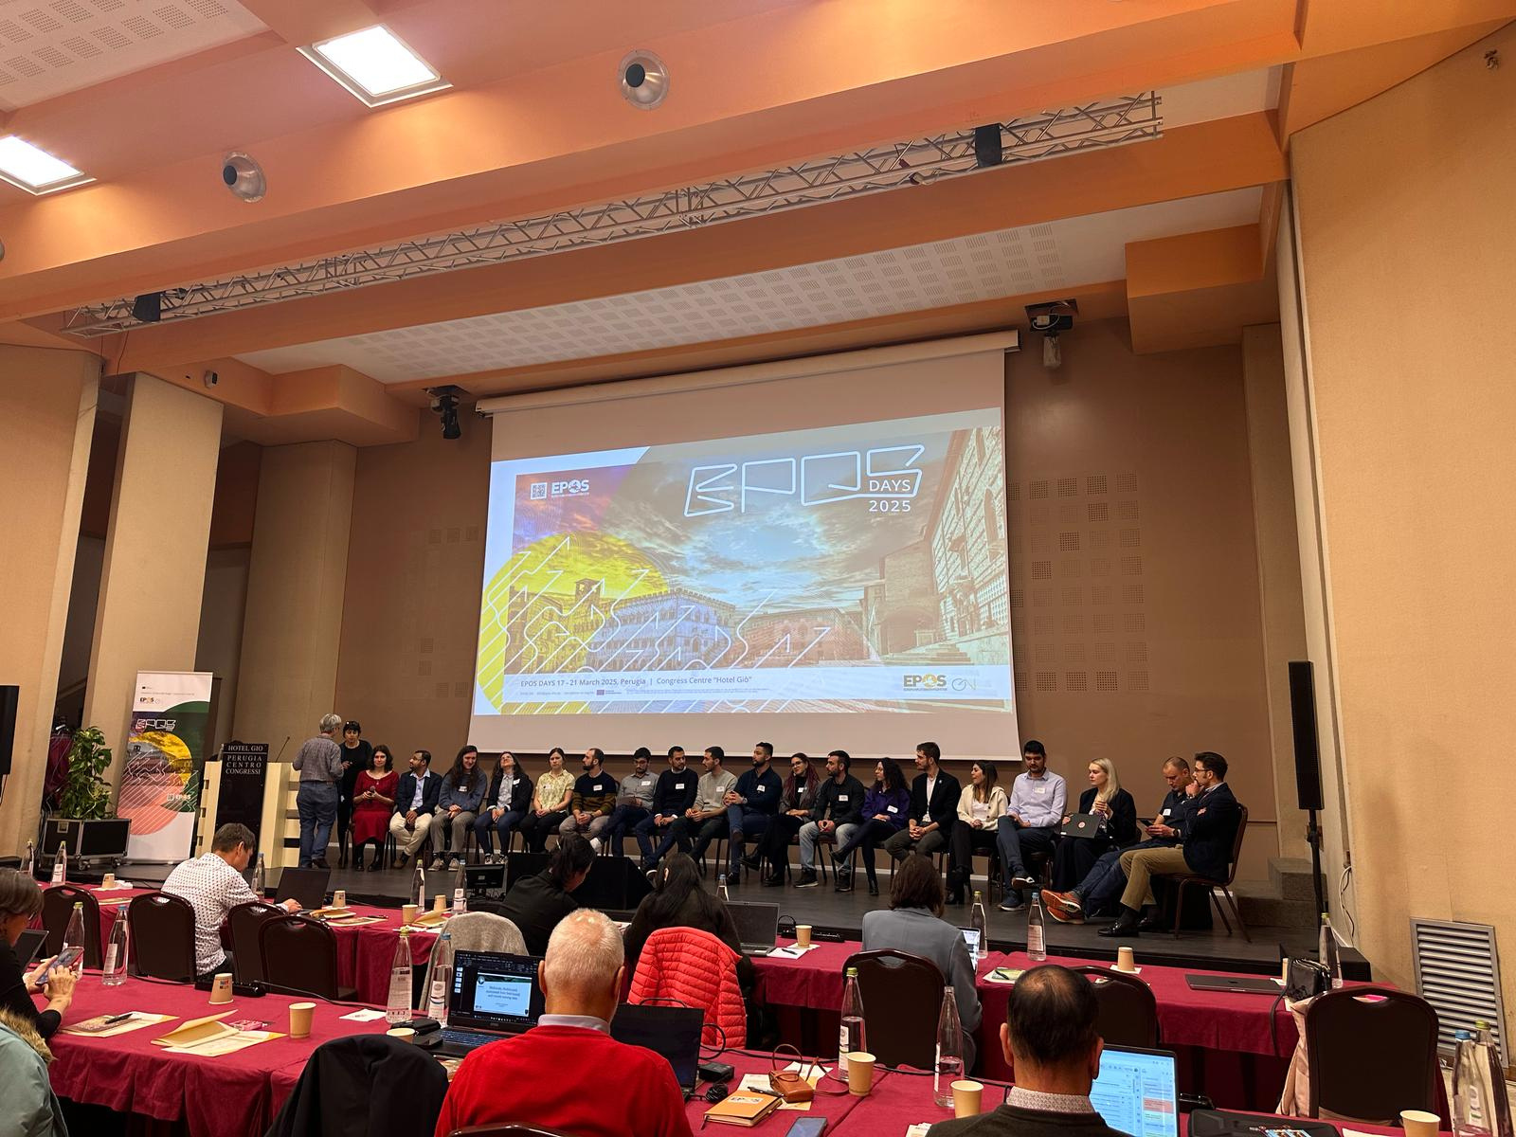
Did EPOS Platform make your research easier or harder? How?
4

Slide 5

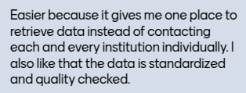
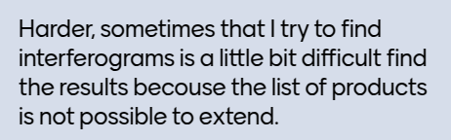
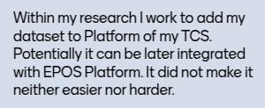
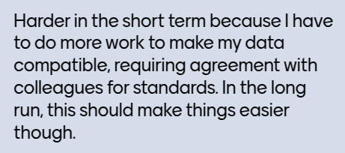
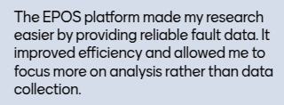

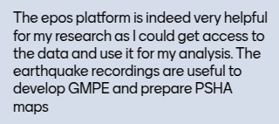
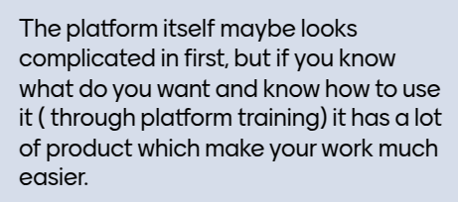
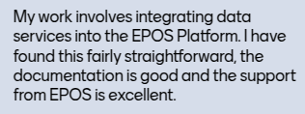
Received Feedback
5

Slide 6
Received Feedback
Did EPOS Platform make your research easier or harder? How?
Responses: 16
Easier: 11
Neutral: 3
Harder: 2
✓Easy access to the data,
✓Standarization,
✓No need for getting permits,
✓support from EPOS,
What is still needed:
✘More data,
✘Training sessions,
✘Clarity.
6

Slide 7
Thanks for your attention!
hciechowska@igf.edu.pl

