Slide 1
Insights from the User Feedback collected in training sessions
Jan Michálek and EPOS Team | University of Bergen, Norway | EPOS Days, 20 March 2025
Notes:
Title slide

Slide 2
Statistics from EPOS Platform trainings
Training events | Location | Date | Audience | Registered participants | Attendance | Feedback provided
Nordic Geological Winter meeting, Nordic EPOS booth | Göteborg, Sweden | 10.-12.01.2024 | Scientists | - | 110 | 30
EPOS Data Portal Training | Virtual | 25.01.2024 | Scientists and lecturers | 399 | 182 | 69
EPOS Days Training Event | Rome, Italy | 14.03.2024 | Early career scientists | - | 8 | 8
EGU 2024, booth and Short Course session | Vienna, Austria | 18.04.2024 | Early career scientists | - | 20 | 15
ICS Hackathon, EPOS Hybrid Training Event | Edinburgh, Scotland | 24.05.2024 | Scientists | 105 | 68 | 33
12th Congress of the Balkan Geophysical Society, EPOS Hybrid Training Event | Kopaonik, Serbia | 28.05.2024 | Scientists | - | 10 | 4
18th World Conference on Earthquake Engineering, EPOS Demonstrations | Milan, Italy | 30.06.-05.07.2024 | Scientists and industry | - | - | -
Young Seismologist Training Course associated with European Seismological Commission GA | Corfu, Greece | 16.-20.10.2024 | Early career scientists | - | 23 | 23
EPOS Data Portal Training | Virtual | 16.10.2024 | Early career scientists | 72 | 37 | 24
Geo-INQUIRE Summer School, EPOS Data Portal Training | Corinth, Greece | 22.10.2024 | Early career scientists | - | 23 | 7
ICS Hackathon, EPOS Data Portal Demonstration | Rome, Italy | 29.11.2024 | Master students | - | 20 | -
EPOS Data Portal Training | Virtual | 12.03.2025 | Scientists | 92 | 37 | 17
Total 668 538 230

Slide 3
EPOS Platform trainings and feedback collection
Standard training structure
Introduction of the EPOS ecosystem (15 min)
Demonstration of EPOS Data Portal by following scientific user story (15 min)
Hands-on training by following a scientific use case & feedback collection through an online form (60 min)
Walk-through (15 min)
Discussion (15 min)
Collecting feedback about the portal performance, user experience and suggestions for improvements => transferred to EPOS Issue Tracker
We have summary report from each training.

Slide 4
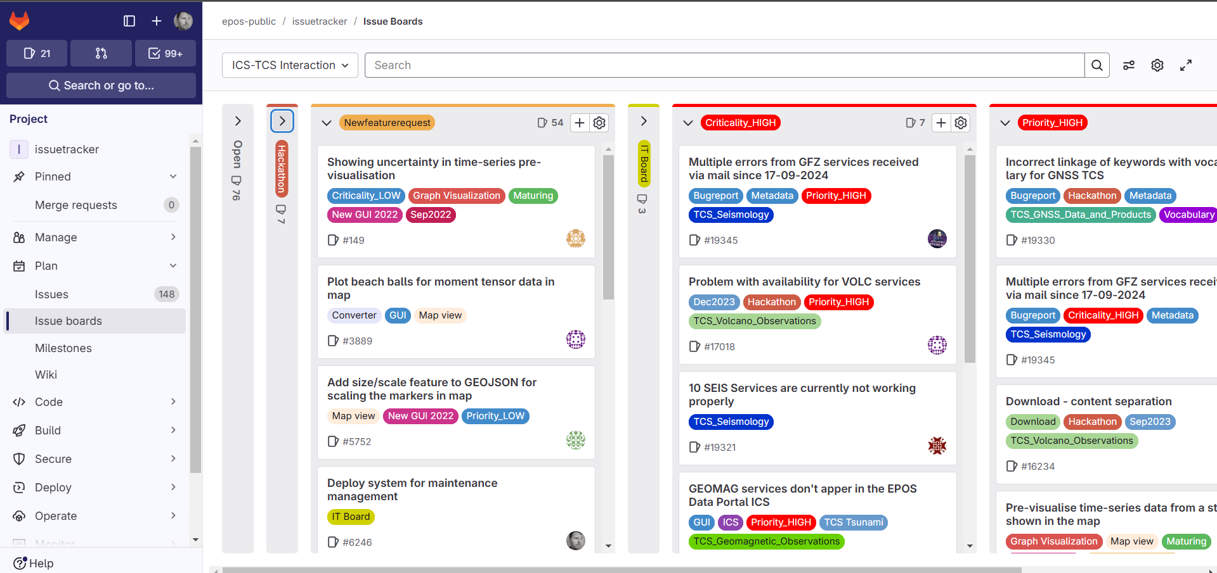
New feature requests – issue tracker
Label: Newfeaturerequest
54 open
59 closed

Slide 5
Most frequent requests
Add more DATA
From other scientific domains: Gravimetry, Bathymetry, Resistivity measurements, Lidar, Landslides, (Meteorological), Geophysical surveys, Geotechnical data
From existing domains: more Satellite data, more WMS layers (Geology)
Improve spatial coverage: There are areas with sparse or no data (Balkan, Scandinavia, Ukraine, Romania, …)
Make the search more intuitive + add history tracking
Indicate connection to other services for efficient usage
Improve response time of the portal (January 2024; ca 180 participants)

Slide 6
Feedback on the training event
Generally, very positive!
Improve DEMO – make it slower
Improve HANDS-ON
Provide better hints – annotation of screenshots + description
Explanation of concepts (for wide audience)

Slide 7
Have you used the EPOS Data Portal before?
January 2024 – 71 responses
September 2024 – 23 responses, ECR
October 2024 – 24 responses, ECR
March 2025 – 17 responses

Slide 8
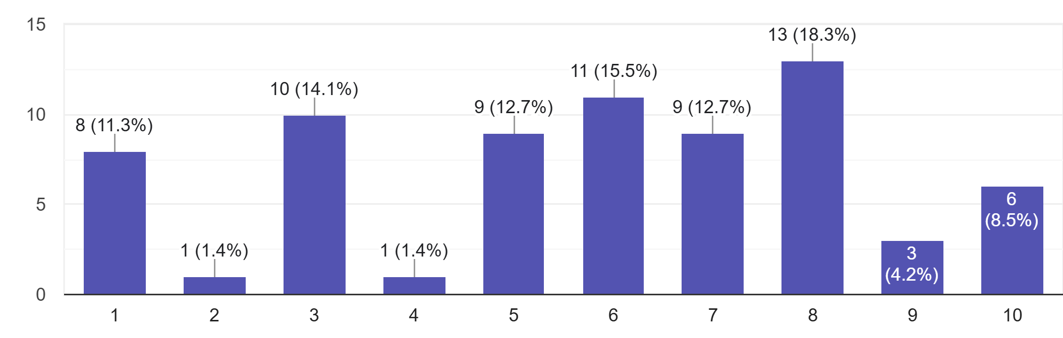
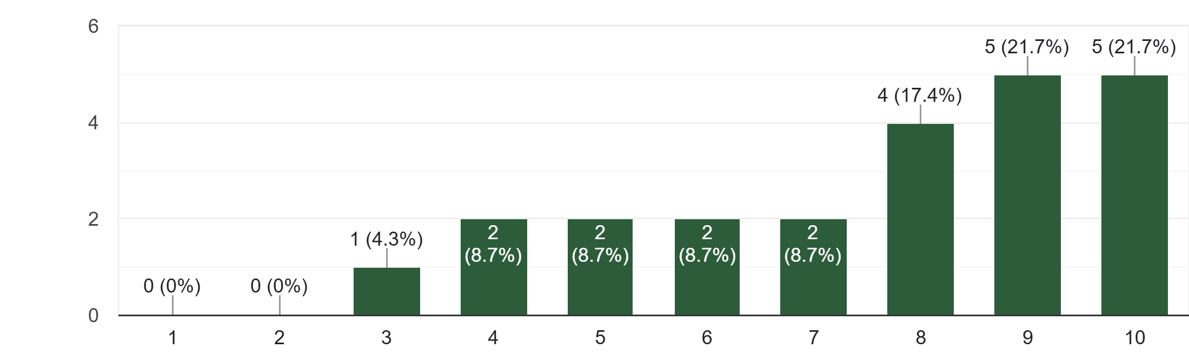
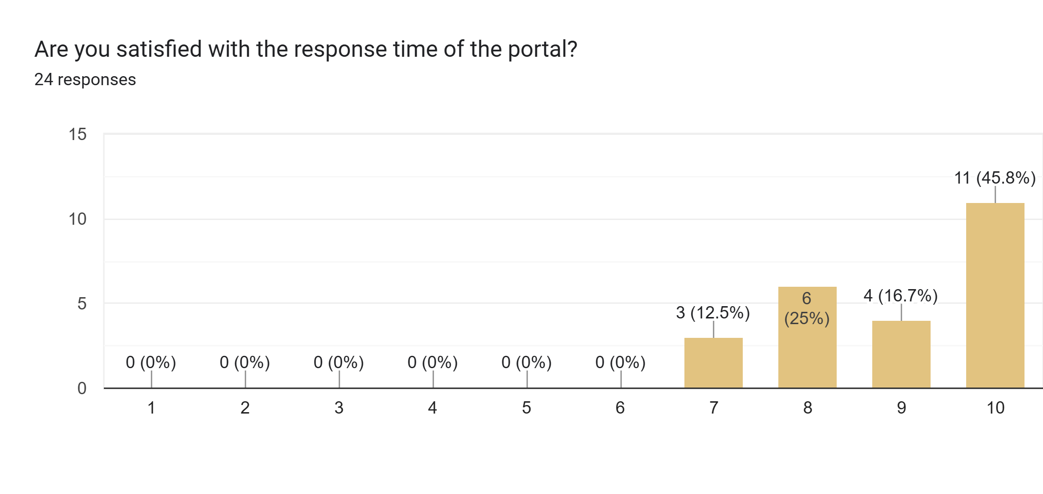
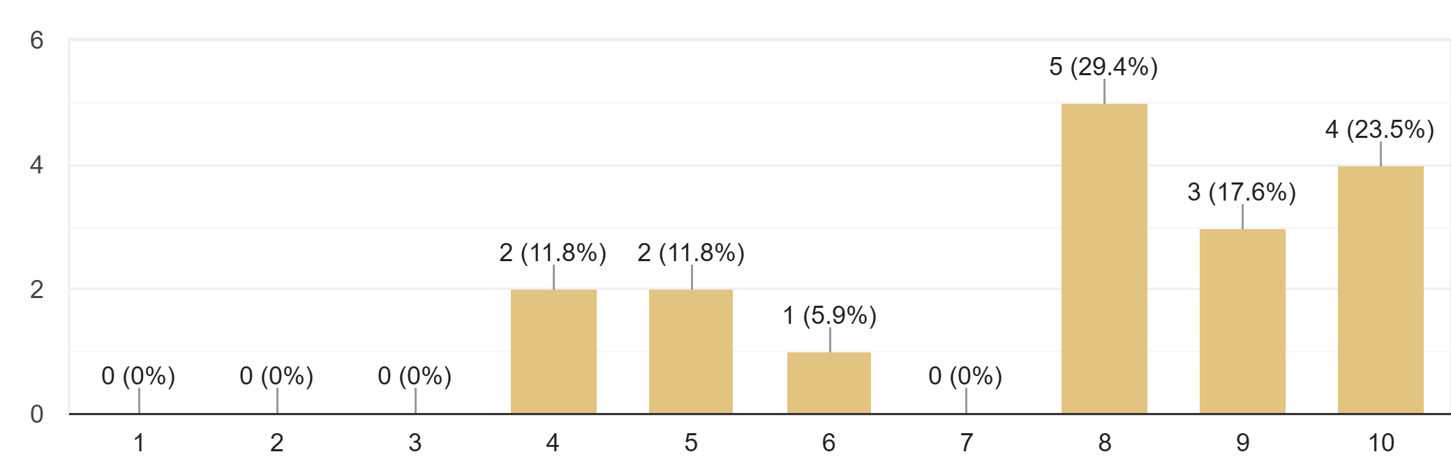
Are you satisfied with the response time of the portal?
January 2024 – 71 responses
September 2024 – 23 responses, ECR
1 = Very slow 10 = Faster than expected
October 2024 – 24 responses, ECR
March 2025 – 17 responses

Slide 9
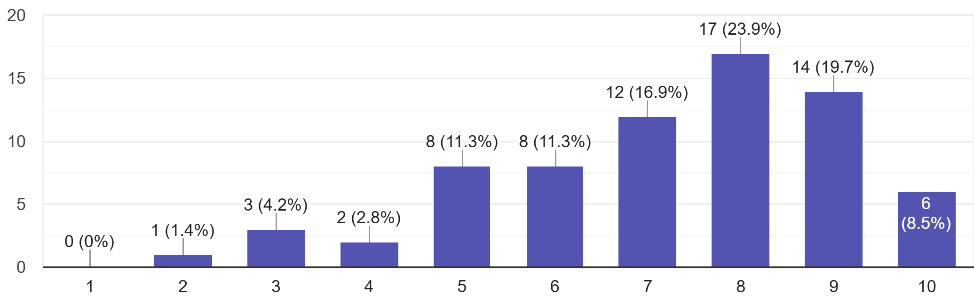
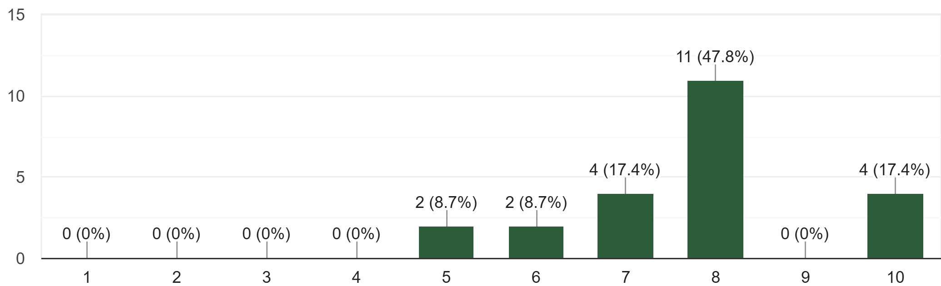
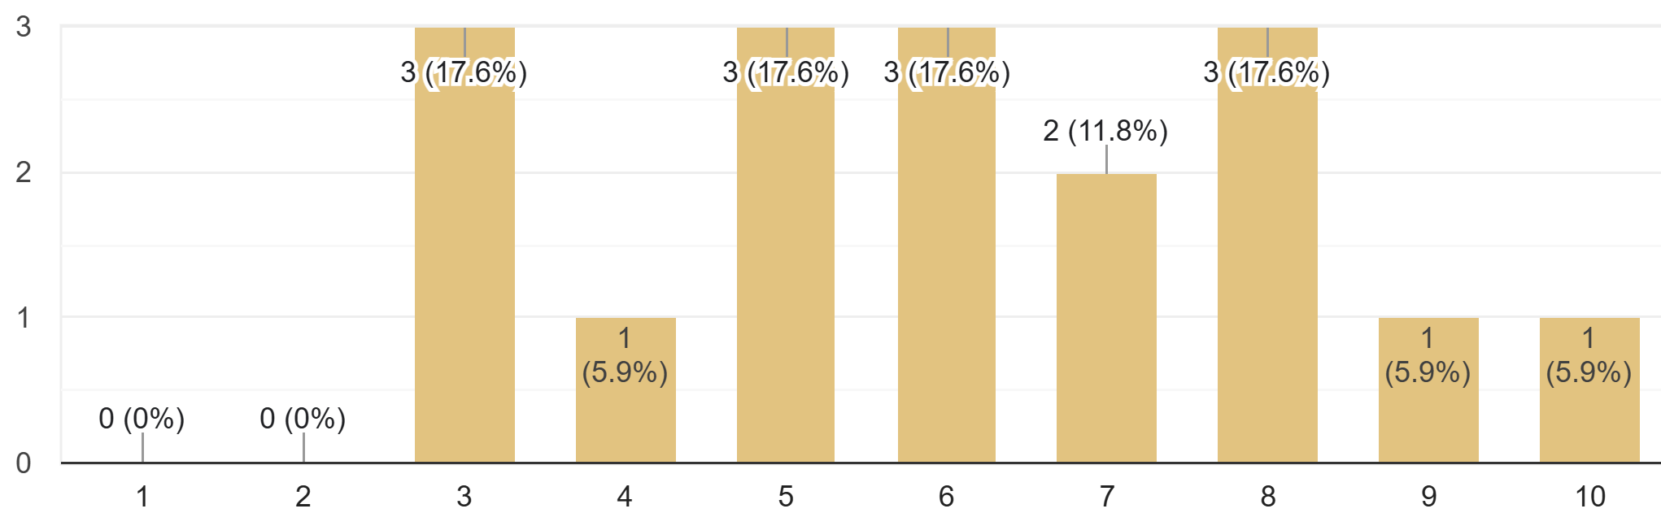
Do you consider the portal easy to understand and navigate through?
January 2024 – 71 responses
September 2024 – 23 responses, ECR
1 = Very difficult 10 = Very easy
October 2024 – 24 responses, ECR
March 2025 – 17 responses

Slide 10
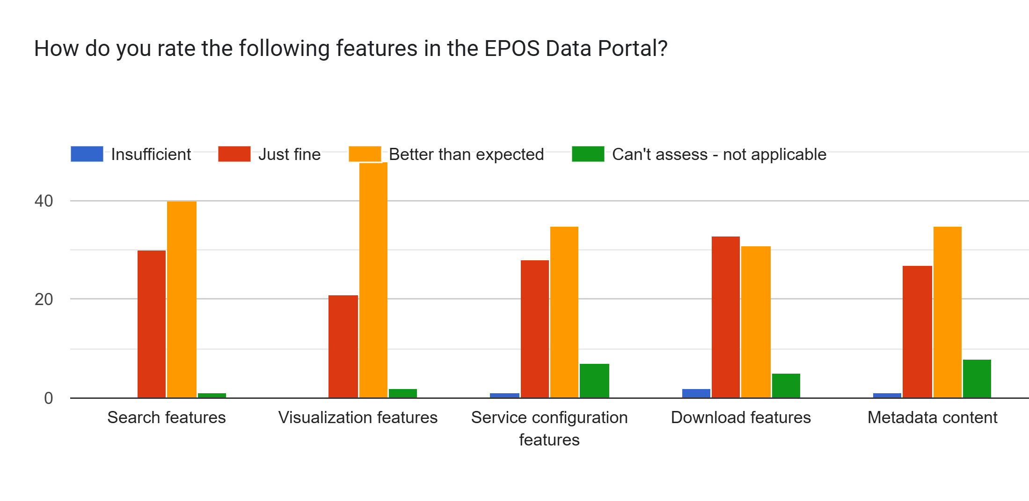
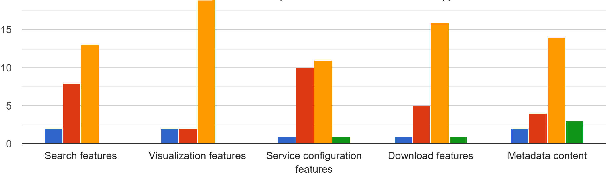
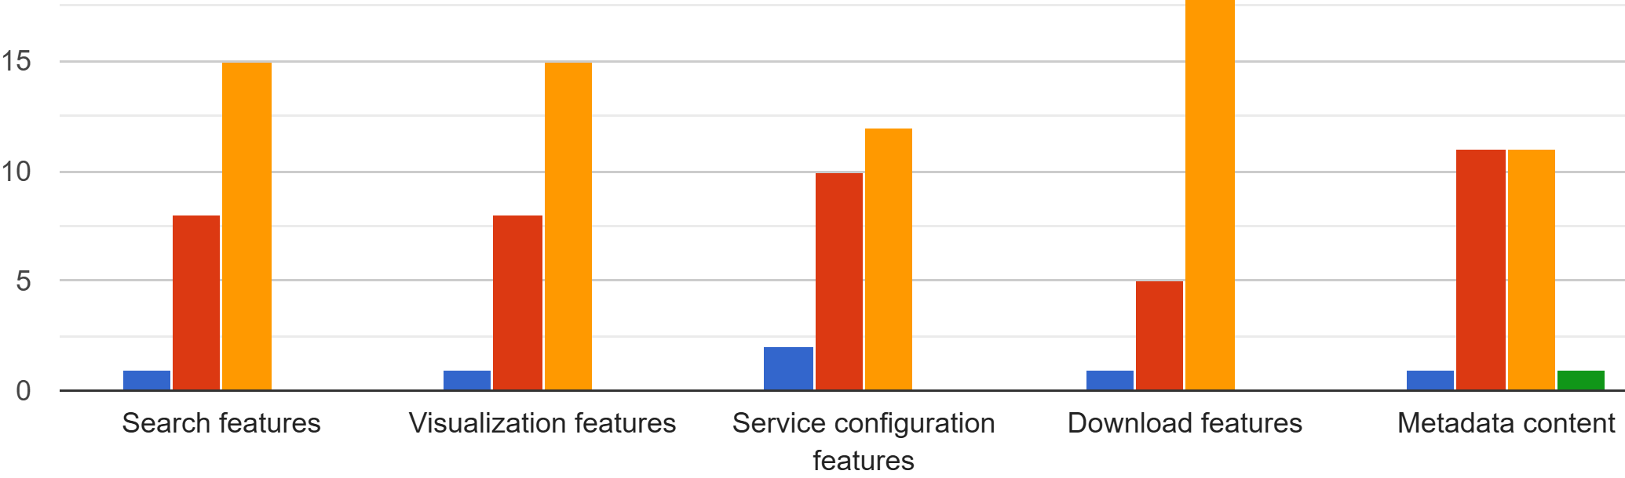
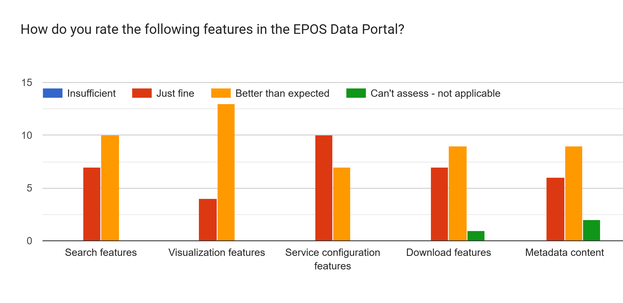
How do you rate the following features in the EPOS Data Portal?
January 2024 – 71 responses
September 2024 – 23 responses, ECR
October 2024 – 24 responses, ECR
March 2025 – 17 responses

Slide 11
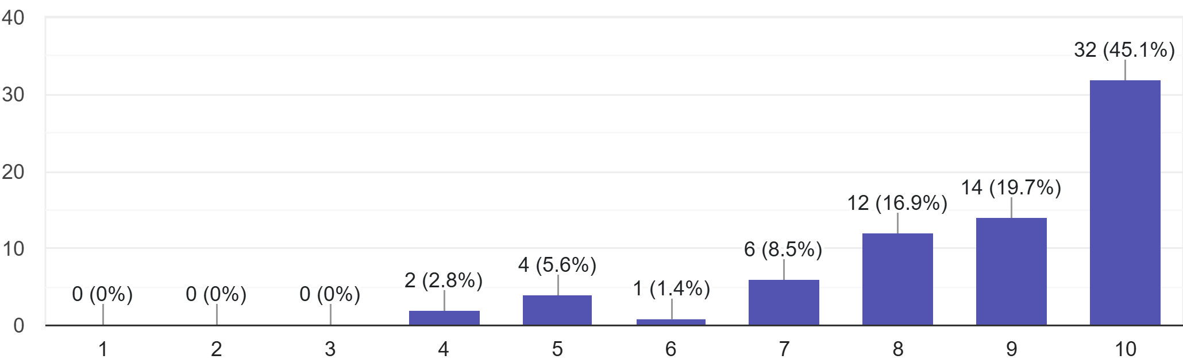
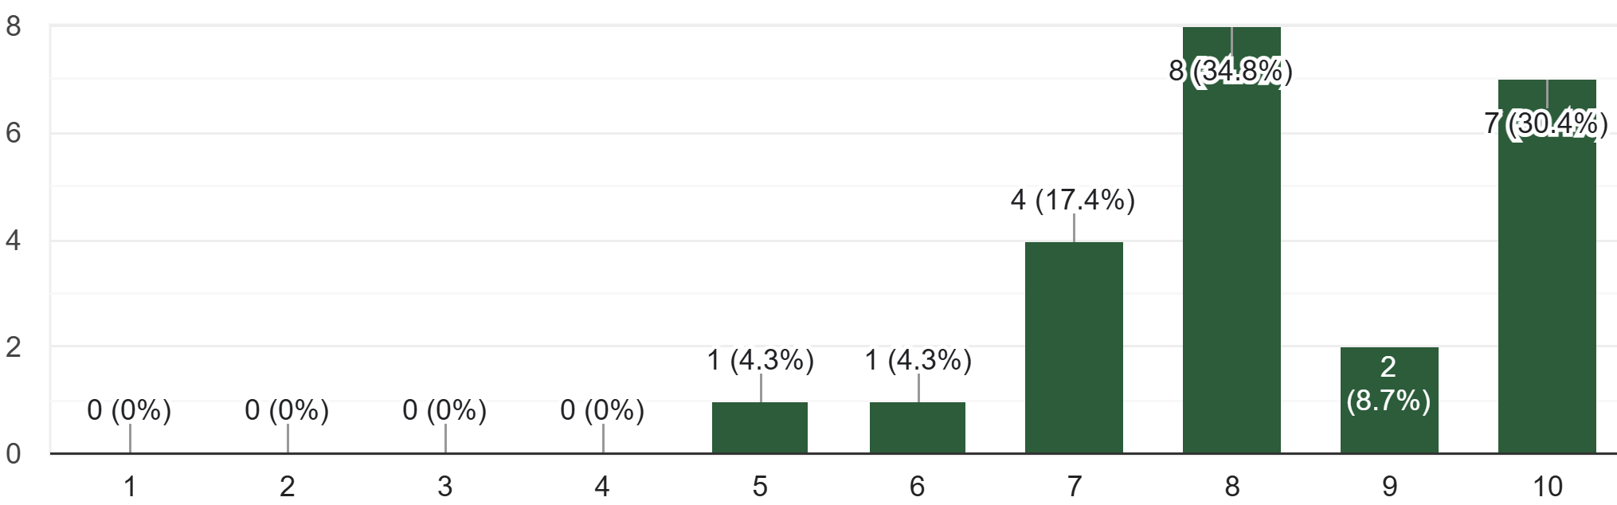
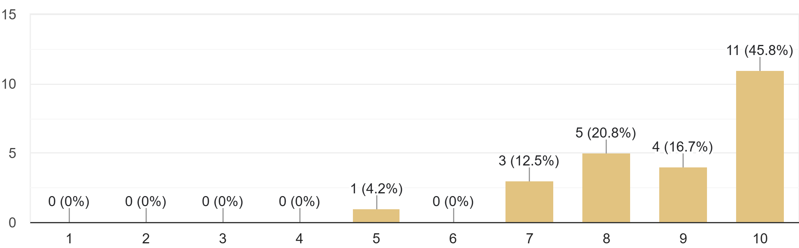
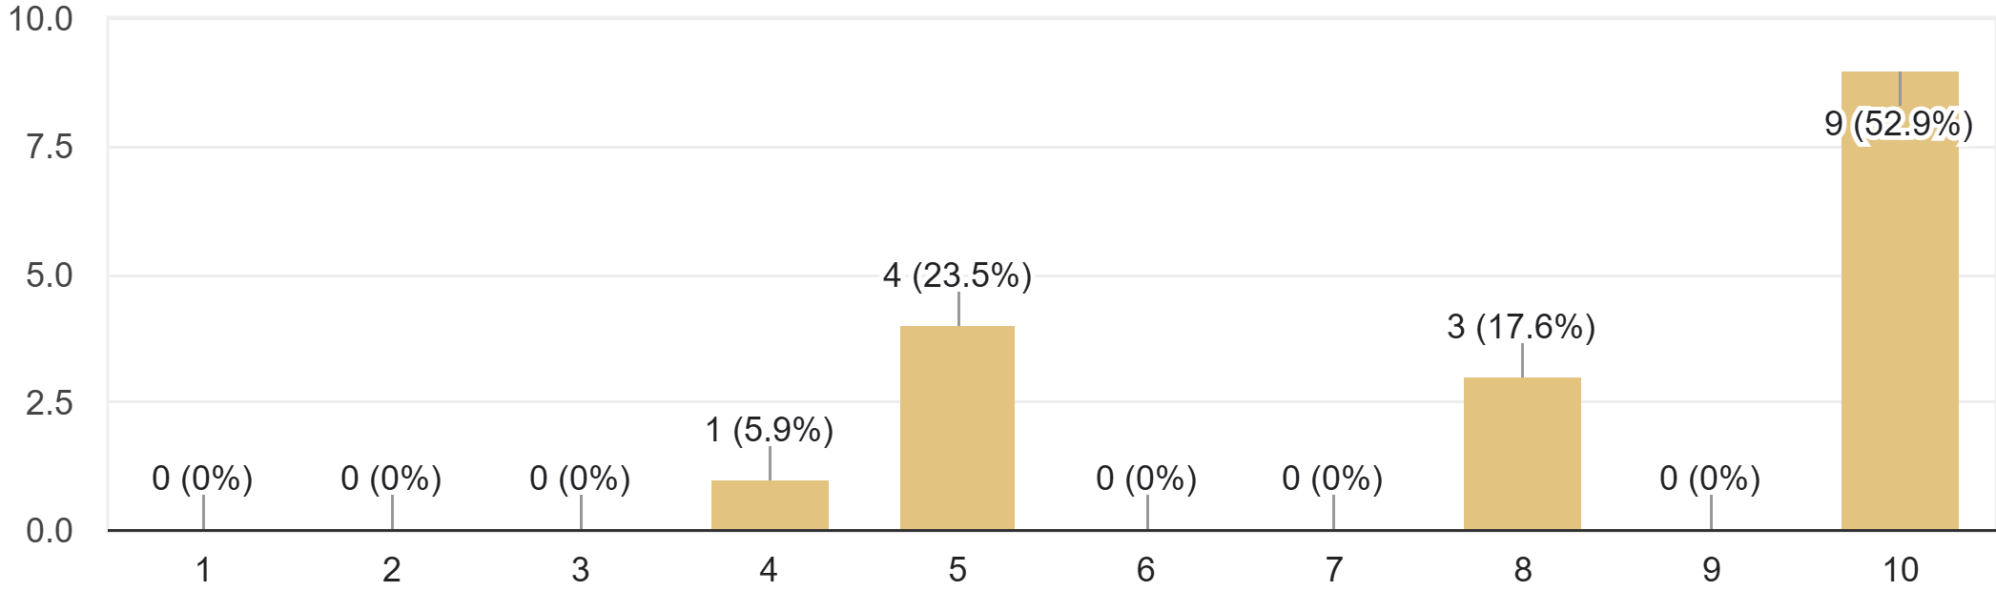
Do you think you will use the EPOS Data Portal again?
January 2024 – 71 responses
September 2024 – 23 responses, ECR
1 = No 10 = Yes, definitely
October 2024 – 24 responses, ECR
March 2025 – 17 responses

Slide 12
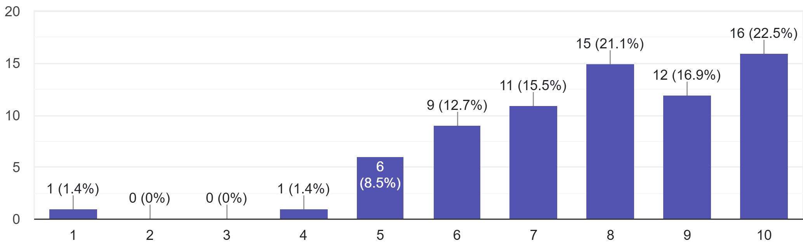
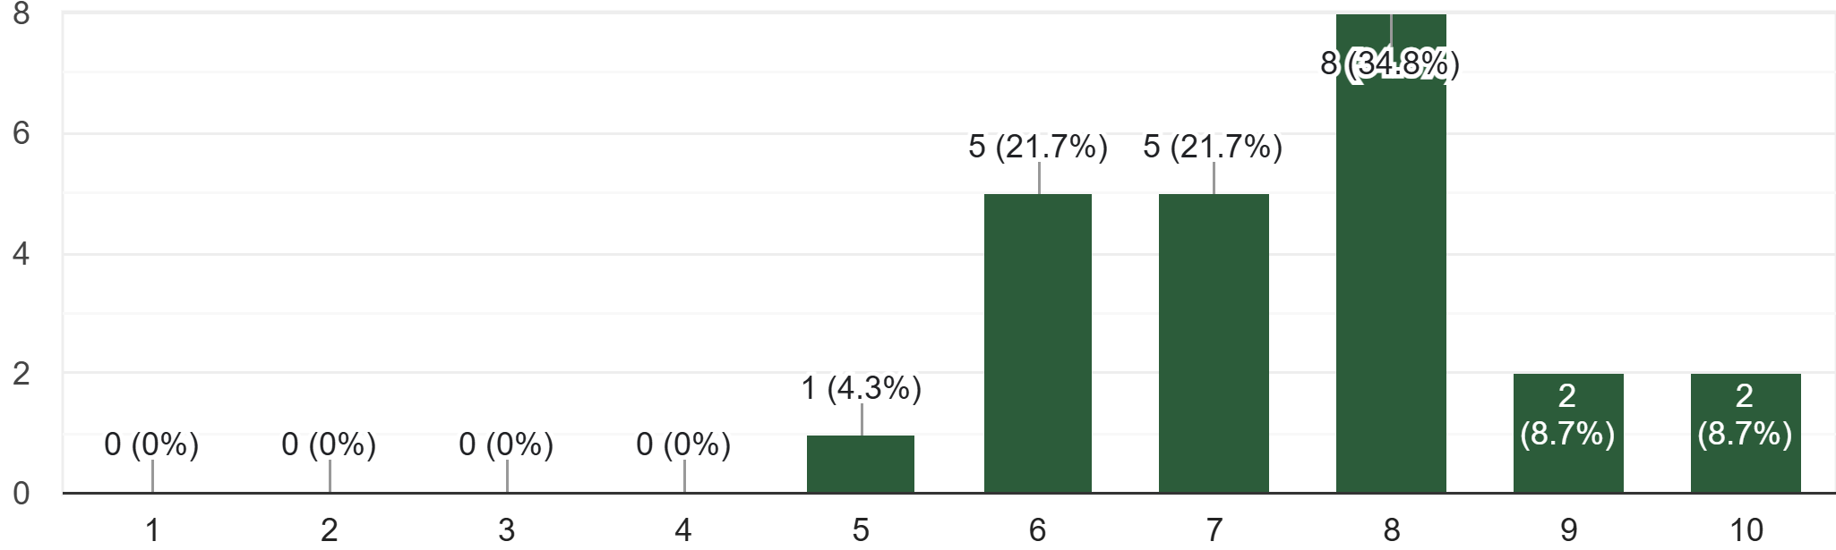
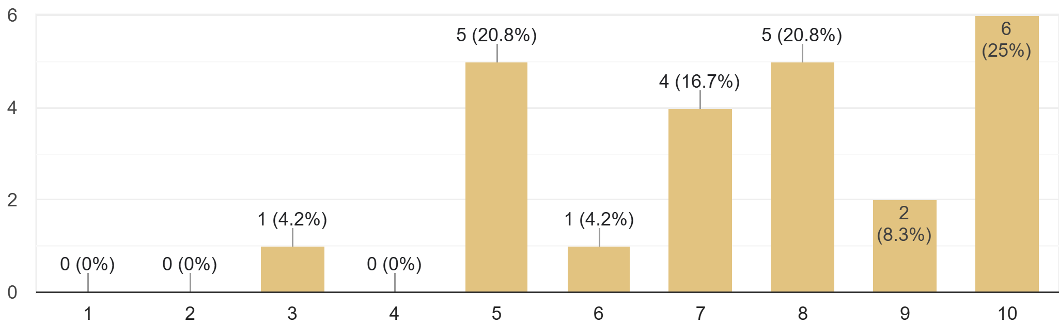
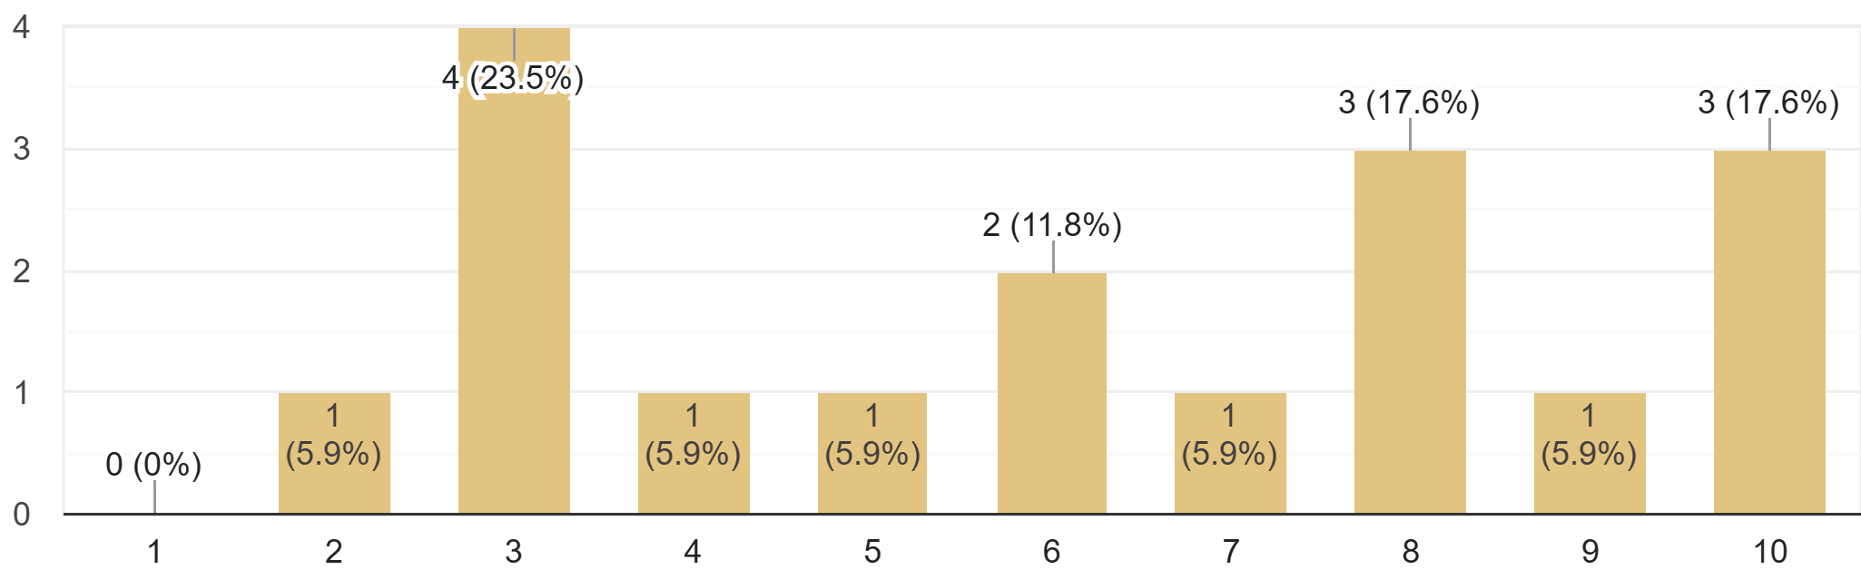
Does the EPOS Data Portal cover data you could use for your research?
January 2024 – 71 responses
September 2024 – 23 responses, ECR
1 = Not at all 10 = Fully
October 2024 – 24 responses, ECR
March 2025 – 17 responses

Slide 13
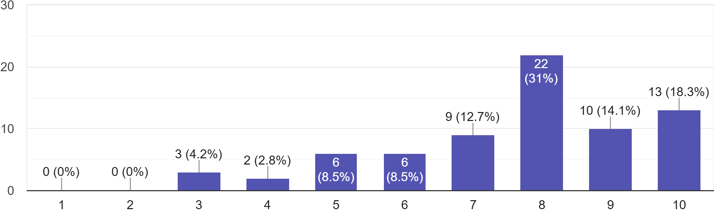
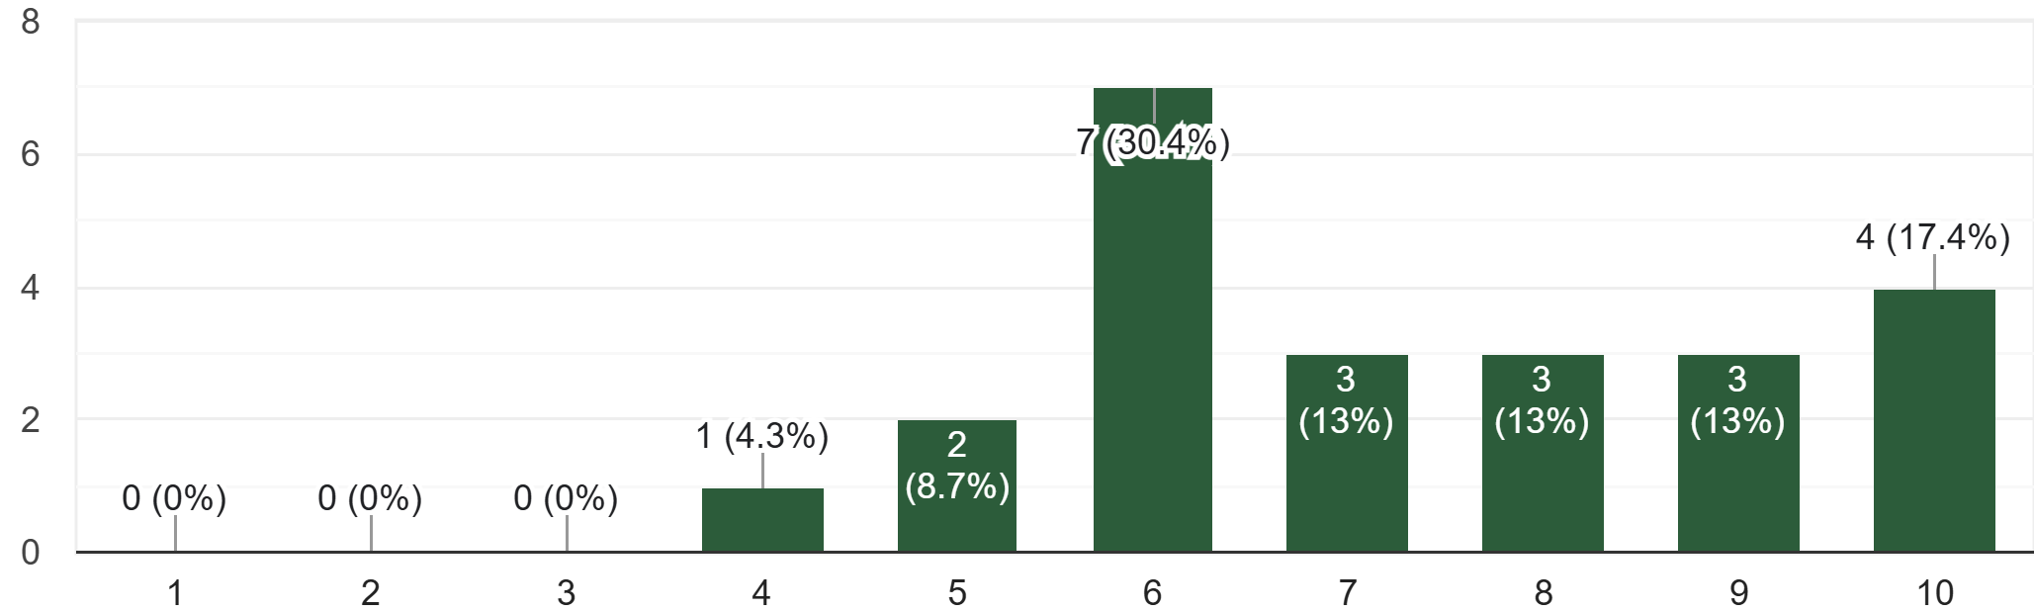
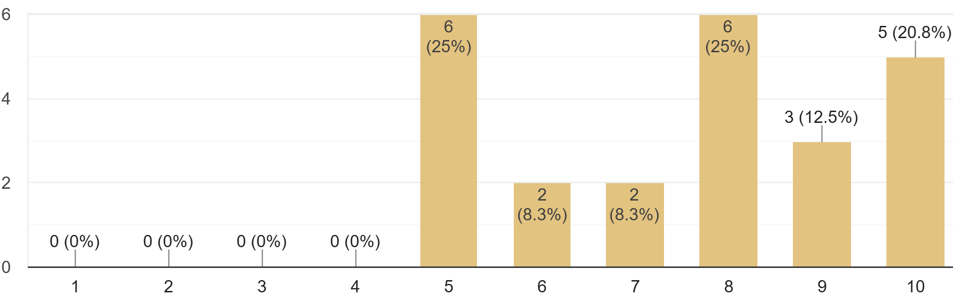
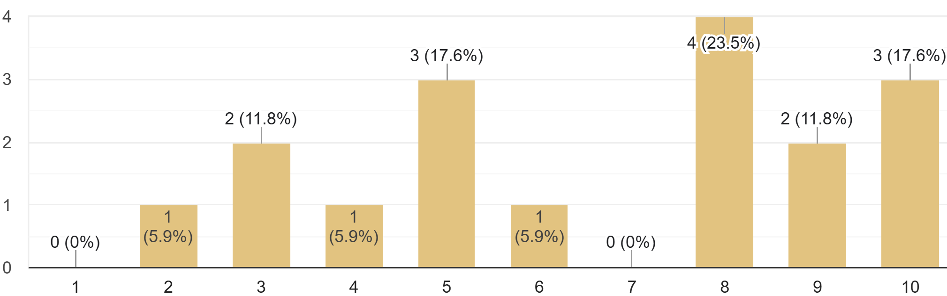
Is data quality in EPOS Data Portal sufficient for your research?
January 2024 – 71 responses
September 2024 – 23 responses, ECR
1 = Not sufficient at all 10 = Fully sufficient
October 2024 – 24 responses, ECR
March 2025 – 17 responses

Slide 14
Do you feel that after the training you acquired the skills to use the portal?
January 2024 – 71 responses
September 2024 – 23 responses, ECR
October 2024 – 24 responses, ECR
March 2025 – 17 responses

Slide 15
User Feedback Group
UFG

Slide 16
Use Feedback Group in EPOS
First UFG established in 2019 (EPOS-IP) consisting of 24 researchers (2@each TCS + ECS)
Purpose: internal testing of EPOS Platform (ICS-C) for further improvement before public release
Two testing sessions arranged (one in person, 2 days; one online)

Slide 17
User Feedback Group – goals in 2019
to test the available functionality of the EPOS ICS-C portal through the execution of use cases collected during the February TCS-ICS workshop by domain experts,
to monitor the interaction of the experts (you) with the system, and collect feedbacks on the usability (appearance, functionality, performance, bugs, etc.) by filling in an evaluation form,
to collect a list of deliverables for improving the system and to prioritize these toward the September milestone.

Slide 18
New Use Feedback Group in EPOS
Objective: Evaluate EPOS Platform – usability, data content, provide suggestions for improvements
Commitment: UFG meetings 1-2 per year – collect feedback immediately
Members: one person @TCS, preferably ECR with multi-disciplinary interests
In-person meetings to be collocated with other events/conferences

Slide 19
Thank you for your attention!
communication@epos-eric.eu
www.epos-eu.org/on | social media #EPOSon
Notes:
Thank you slide

