Slide 1
Summary of development topics
Jan Michálek and EPOS Team | University of Bergen, Norway | EPOS Days, 20 March 2025
Notes:
Title slide

Slide 2
The goal is to improve user interaction!
HOW?

Slide 3
Statistics
Usage of EPOS Platform – on average 180 users weekly

Slide 4
How to improve?
Enhance data discovery (make it intuitive; linking services)
Improve visualizations (map, table, graph)
Enable interoperability (common VRE)
Based on requests from users (trainings, scien. communities)
Changes to be aligned with EPOS ERIC Strategy for 2024-2028
Science Program
Sustainability Plan

Slide 5
Process of new feature selection
1. Feedback from trainings
2. Requests from scientific communities
3. Feedback from users
Evaluation by ICS-TSC Interaction Team
Reviewed during ICS Hackathon
Prioritization of selected features
Collection of requests
1. Unification of topics
Technical assessment
Alignment with EPOS technical architecture
Assessment of required resources
Voting by communities
Assessment of available human resources
2. Transfer to public EPOS issue tracker
Quarterly, during ICS-TCS Interaction Workshops

Slide 6
Improvements in EPOS Platform (1/2)
Integrated during last year
Show keyword’s definitions – if exist
Scientific Examples
Share link to pre-configured EPOS Platform
Overview of Facilities and equipment (to be improved)
New visualizations
Image gallery
Graph view for more services (new convertor plugins) – MT, FDSN Event
Better acknowledgement of Service Providers (logo, reference)
Improved documentation, STATISTICS

Slide 7
Improvements in EPOS Platform (2/2)
In progress
BackOffice tool
Linking services
Support for Processing Services
Integration of Virtual Research Environment
Machine Learning
Jupyter Notebooks
Explain service usage
Demonstrate multi-disciplinarity
FAIRness assessment tool

Slide 8
Overview of integrated improvements

Slide 9
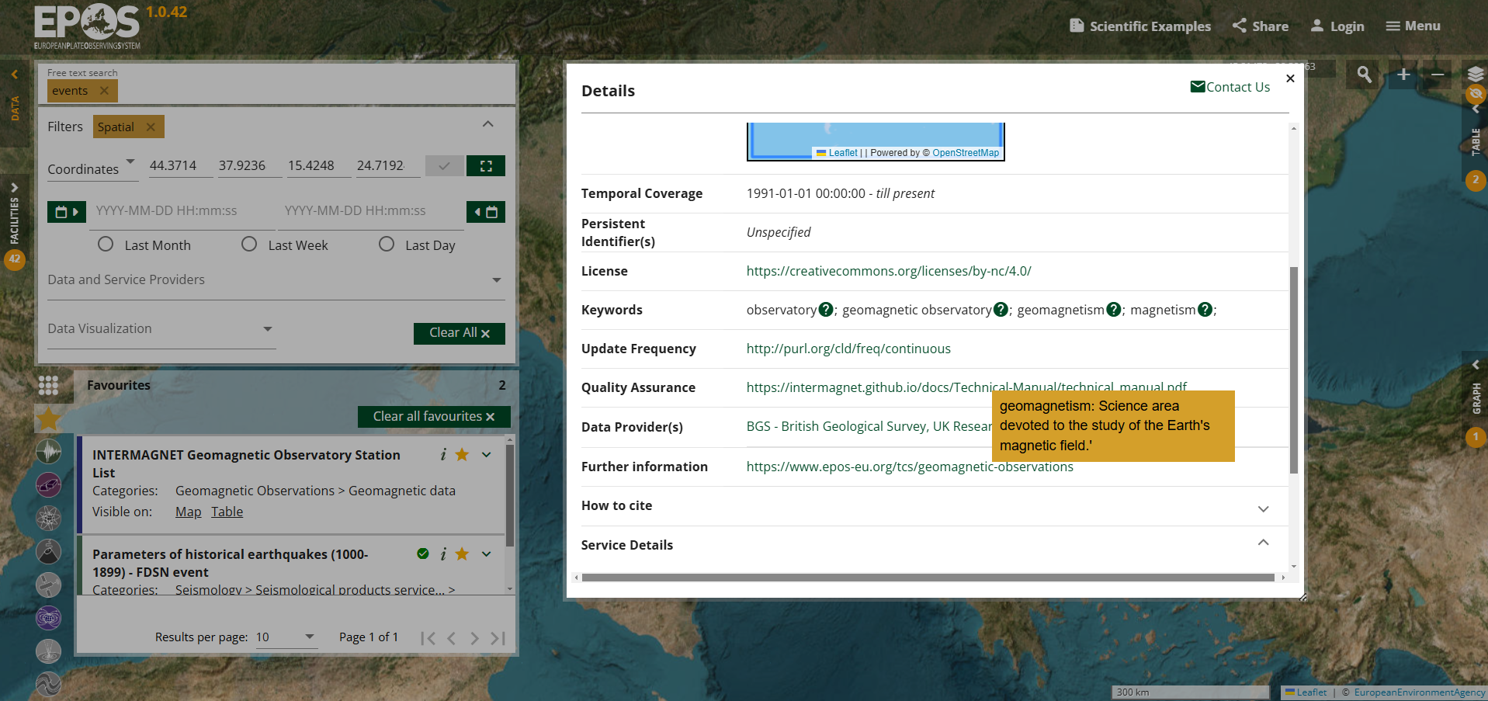
Show keyword’s definition

Slide 10
Vocabulary status (NCL tool)
TCS | Number of keywords | Number of existing definitions | Difference
AH | 56 | 52 | 4
GEOM | 81 | 73 | 8
GIM | 6 + 3 external vocabularies | 4 | 2+
GNSS | 33 | 33 | 0
NFO | 72 | 0 | 72
MSL | 696 | Only URIs, not explicit definitions | 696
SATD | 36 | 3 | 33
SEIS | 101 | 101 | 0
TSU | 105 | 105 | 0
VOLC | 201 | 1 | 200

Slide 11
Vocabulary status (NCL tool)

Slide 12
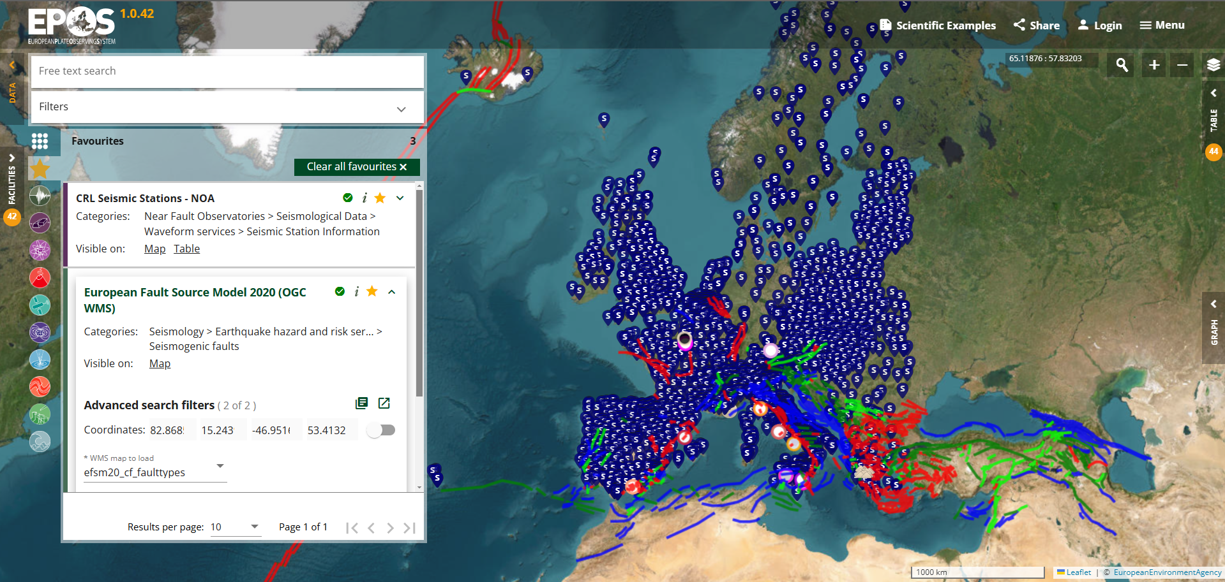
Share – create permanent URL

Slide 13
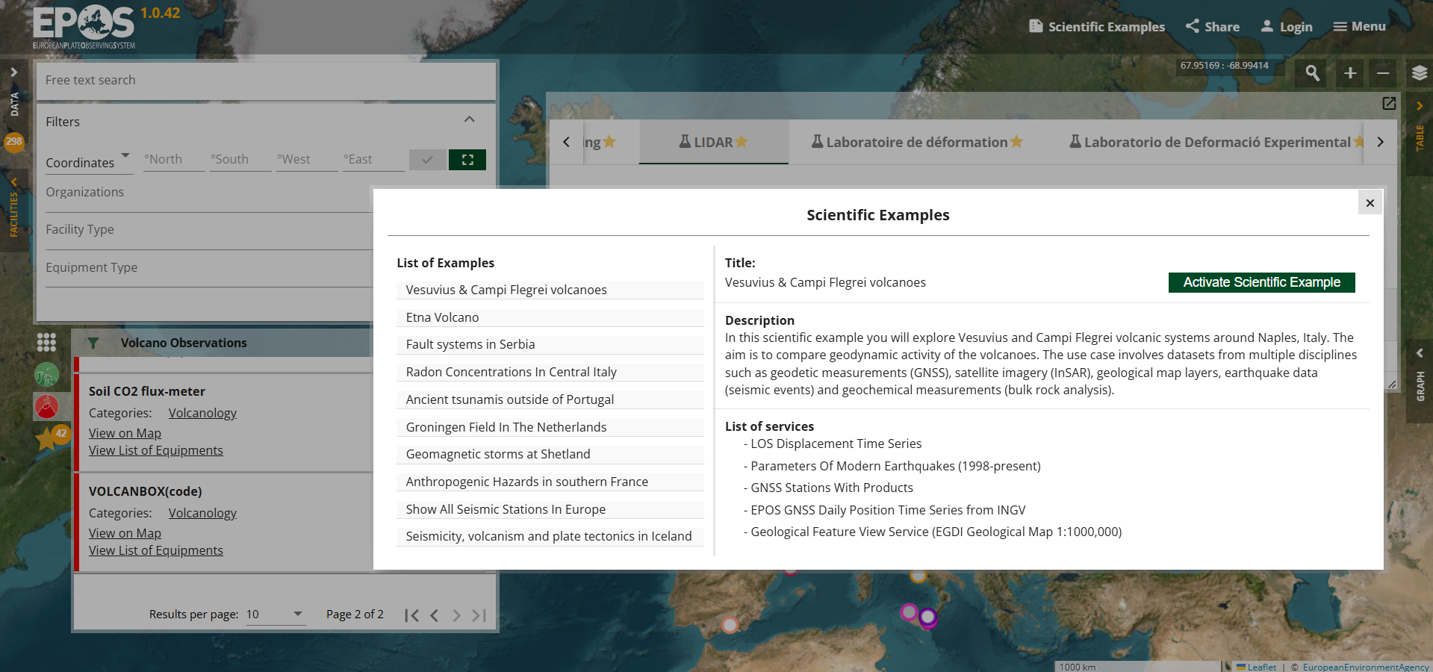
Scientific Examples

Slide 14
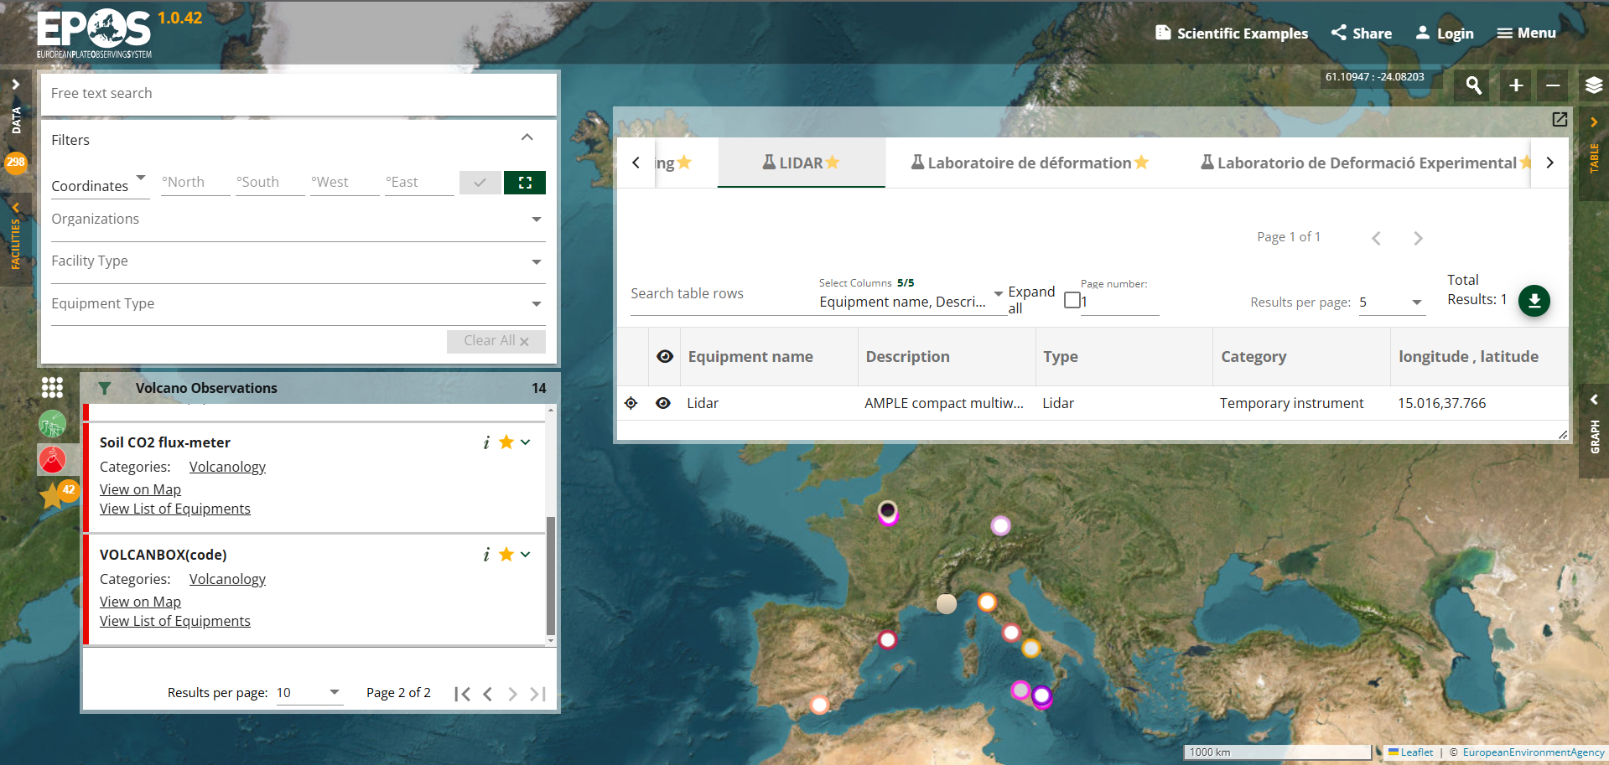
Facilities and Equipment

Slide 15
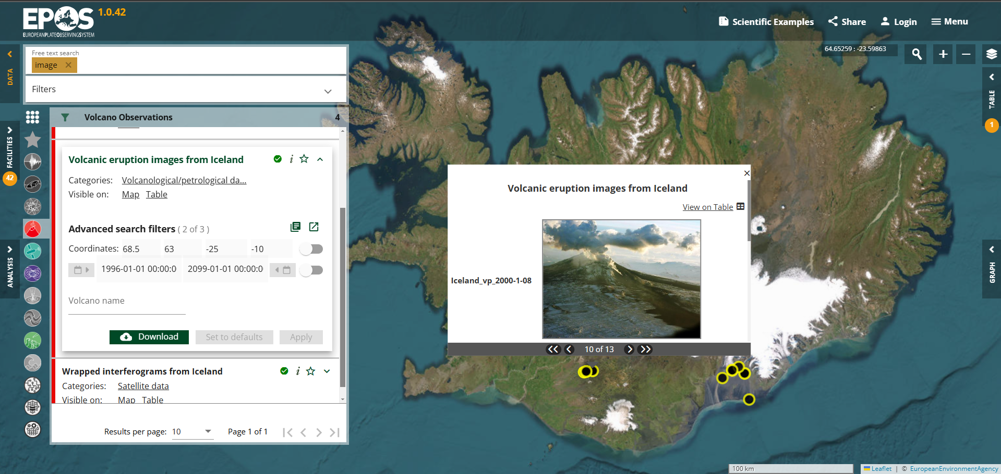
New visualizations – images

Slide 16
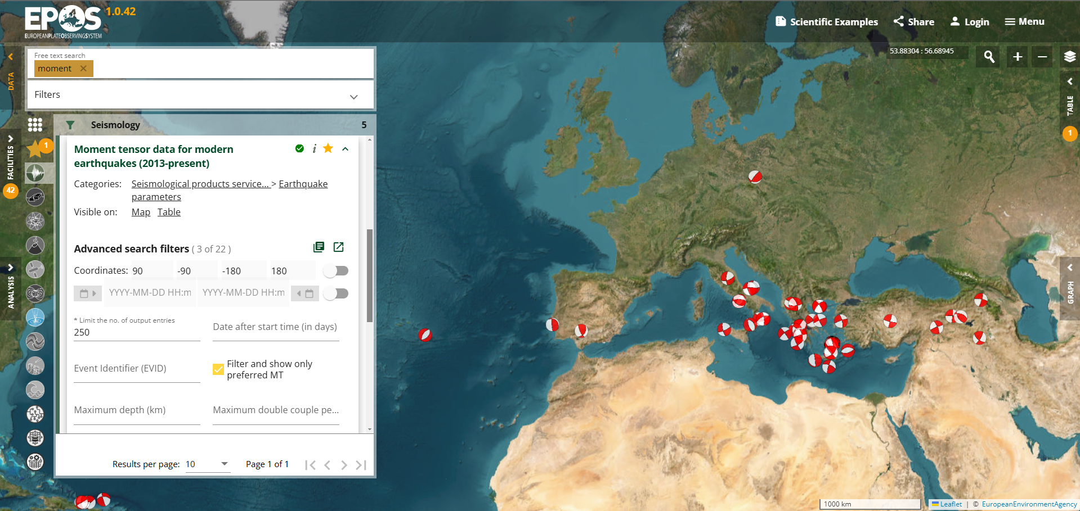
New visualizations – focal mechanisms

Slide 17
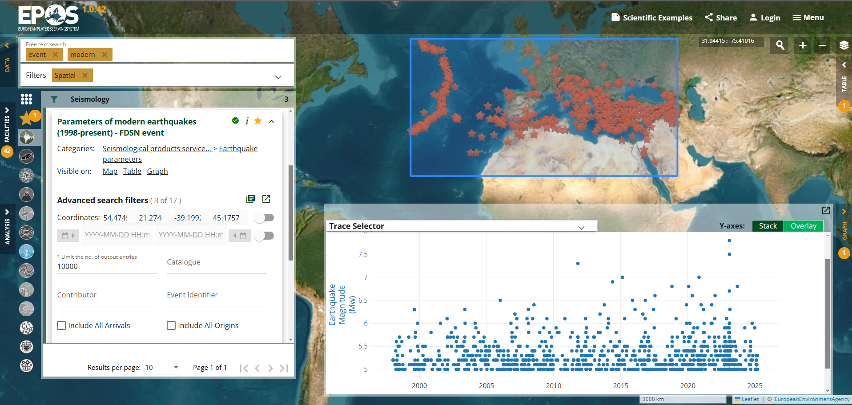
New visualizations – EQ catalogue (FDSN Event)

Slide 18
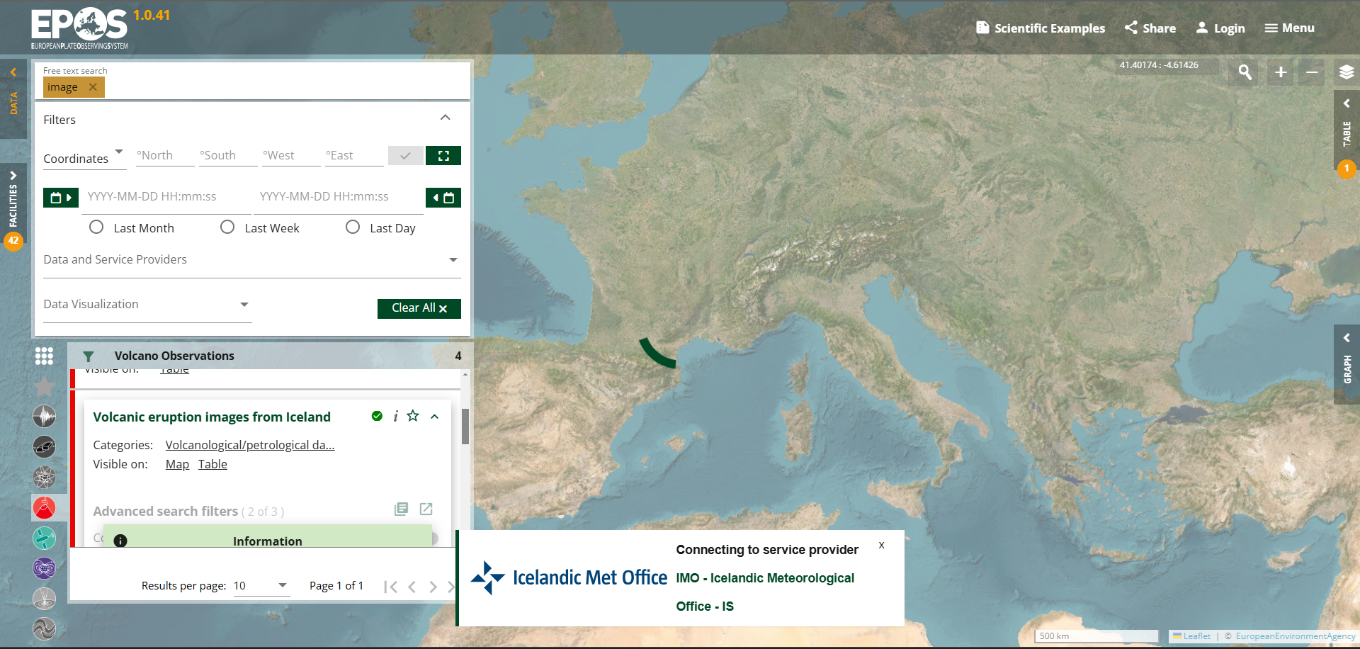
Show Service Provider’s logo - loading

Slide 19
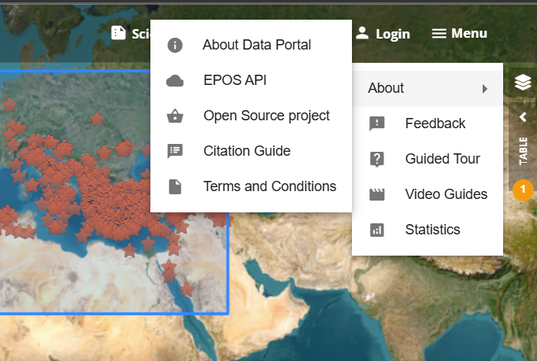
Improved documentation

Slide 20
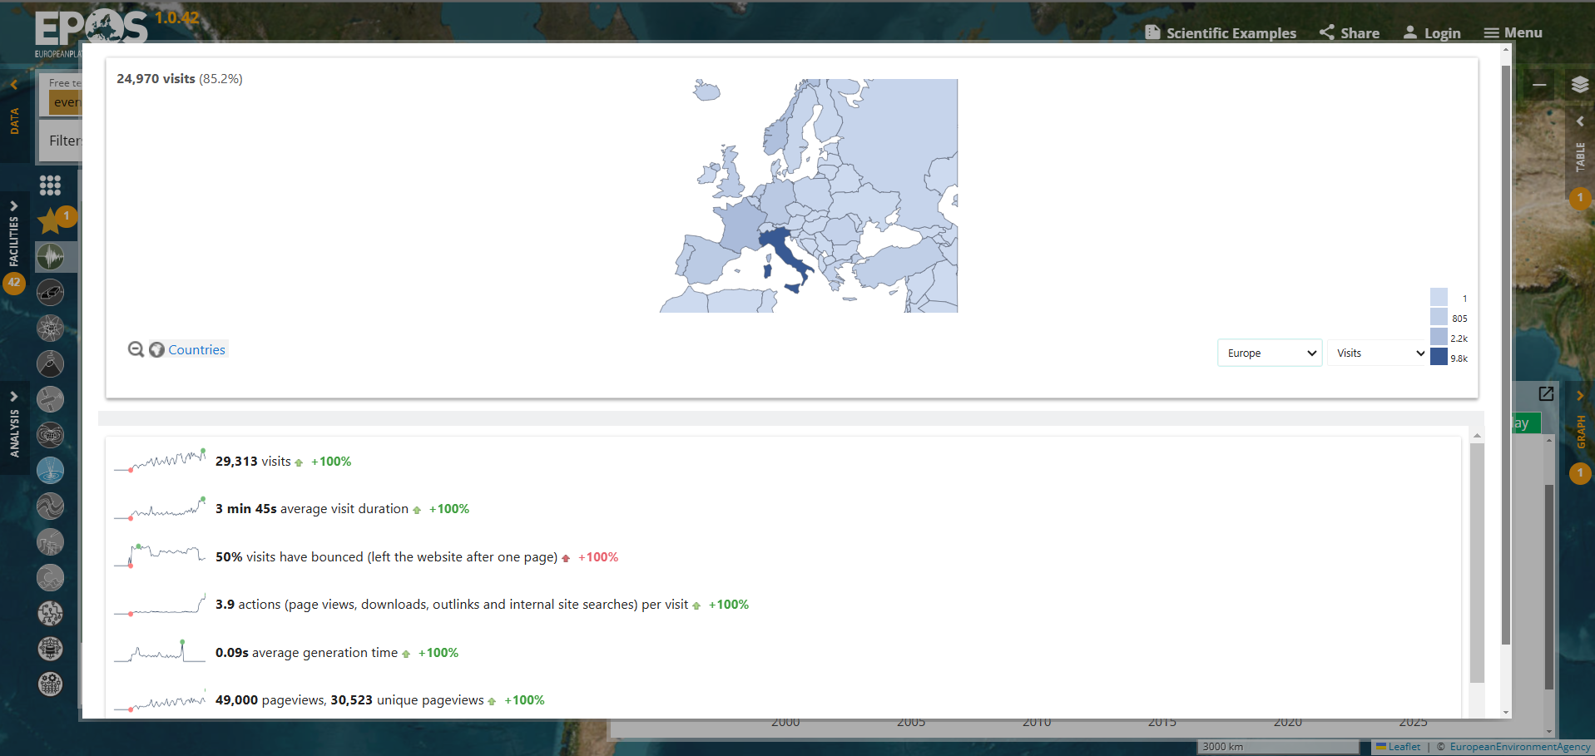
Improved documentation - STATISTICS

Slide 21
Thank you for your attention!
jan.michalek@uib.no
www.epos-eu.org/on | social media #EPOSon
Notes:
Thank you slide

Slide 22
TCS Service Availability
From GEUS monitoring
Nov 2024 – Feb 2025

Slide 23
TCS Service Availability

Slide 24
TCS Service Availability - corrected

