Slide 1
HPC use-case: Scenario and Probabilistic Tsunami Forecasting
TCS Tsunami
Stefano Lorito | stefano.lorito@ingv.it | 20/3/2025 – EPOS Days, Perugia, Italy
Notes:
Title slide

Slide 2
Examples of services from light web service to computationally-intensive
TS-Gauss web service → cloud enhanced version with simulations
PTF web service → enhanced version with HPC simulation ensemble
PTHA HPC → TA in Geo-INQUIRE
Notes:
Content slide

Slide 3
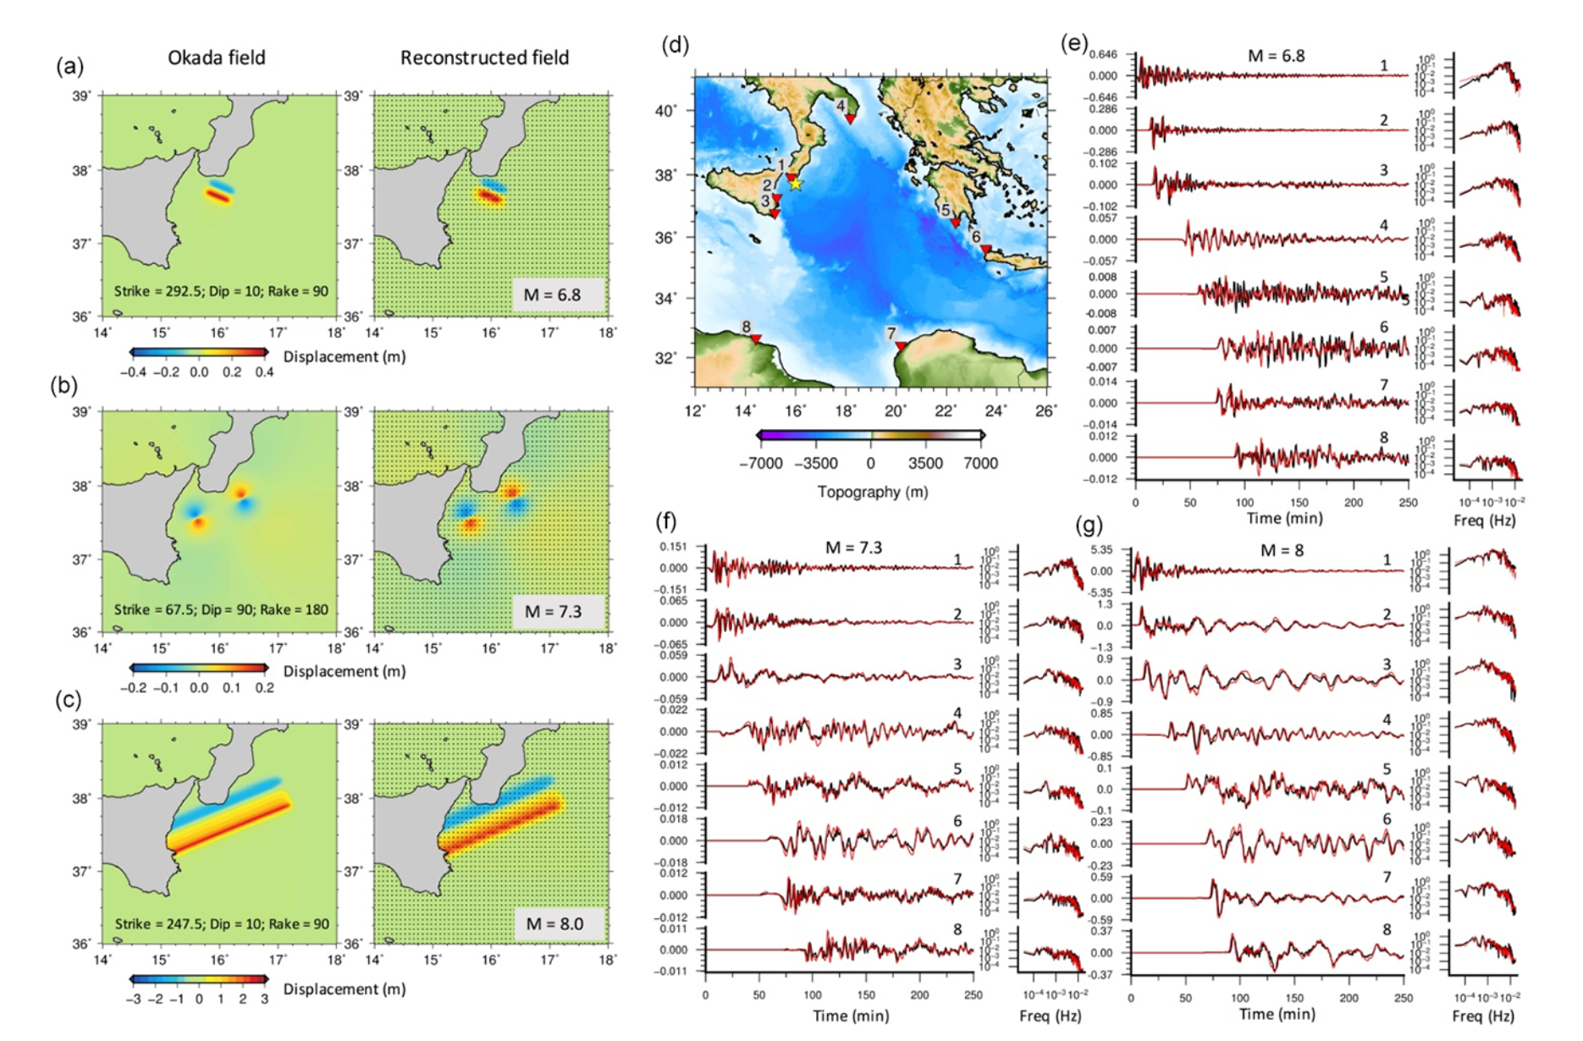
TS-Gauss: a seismic tsunami scenario calculator
Molinari et al., GJI, 2016
Notes:
Title slide for large pictures, tables, maps, plots…

Slide 4
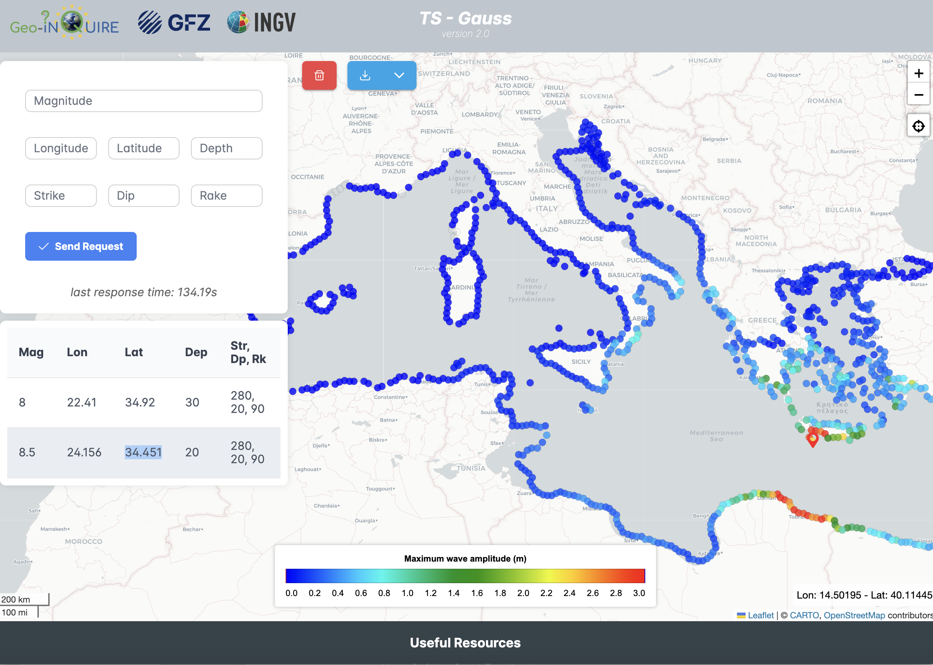
TS-Gauss: a seismic tsunami scenario calculator
TCS Tsunami web service
developed by GFZ and INGV
funded by Geo-INQUIRE
Notes:
Title slide for large pictures, tables, maps, plots…

Slide 5
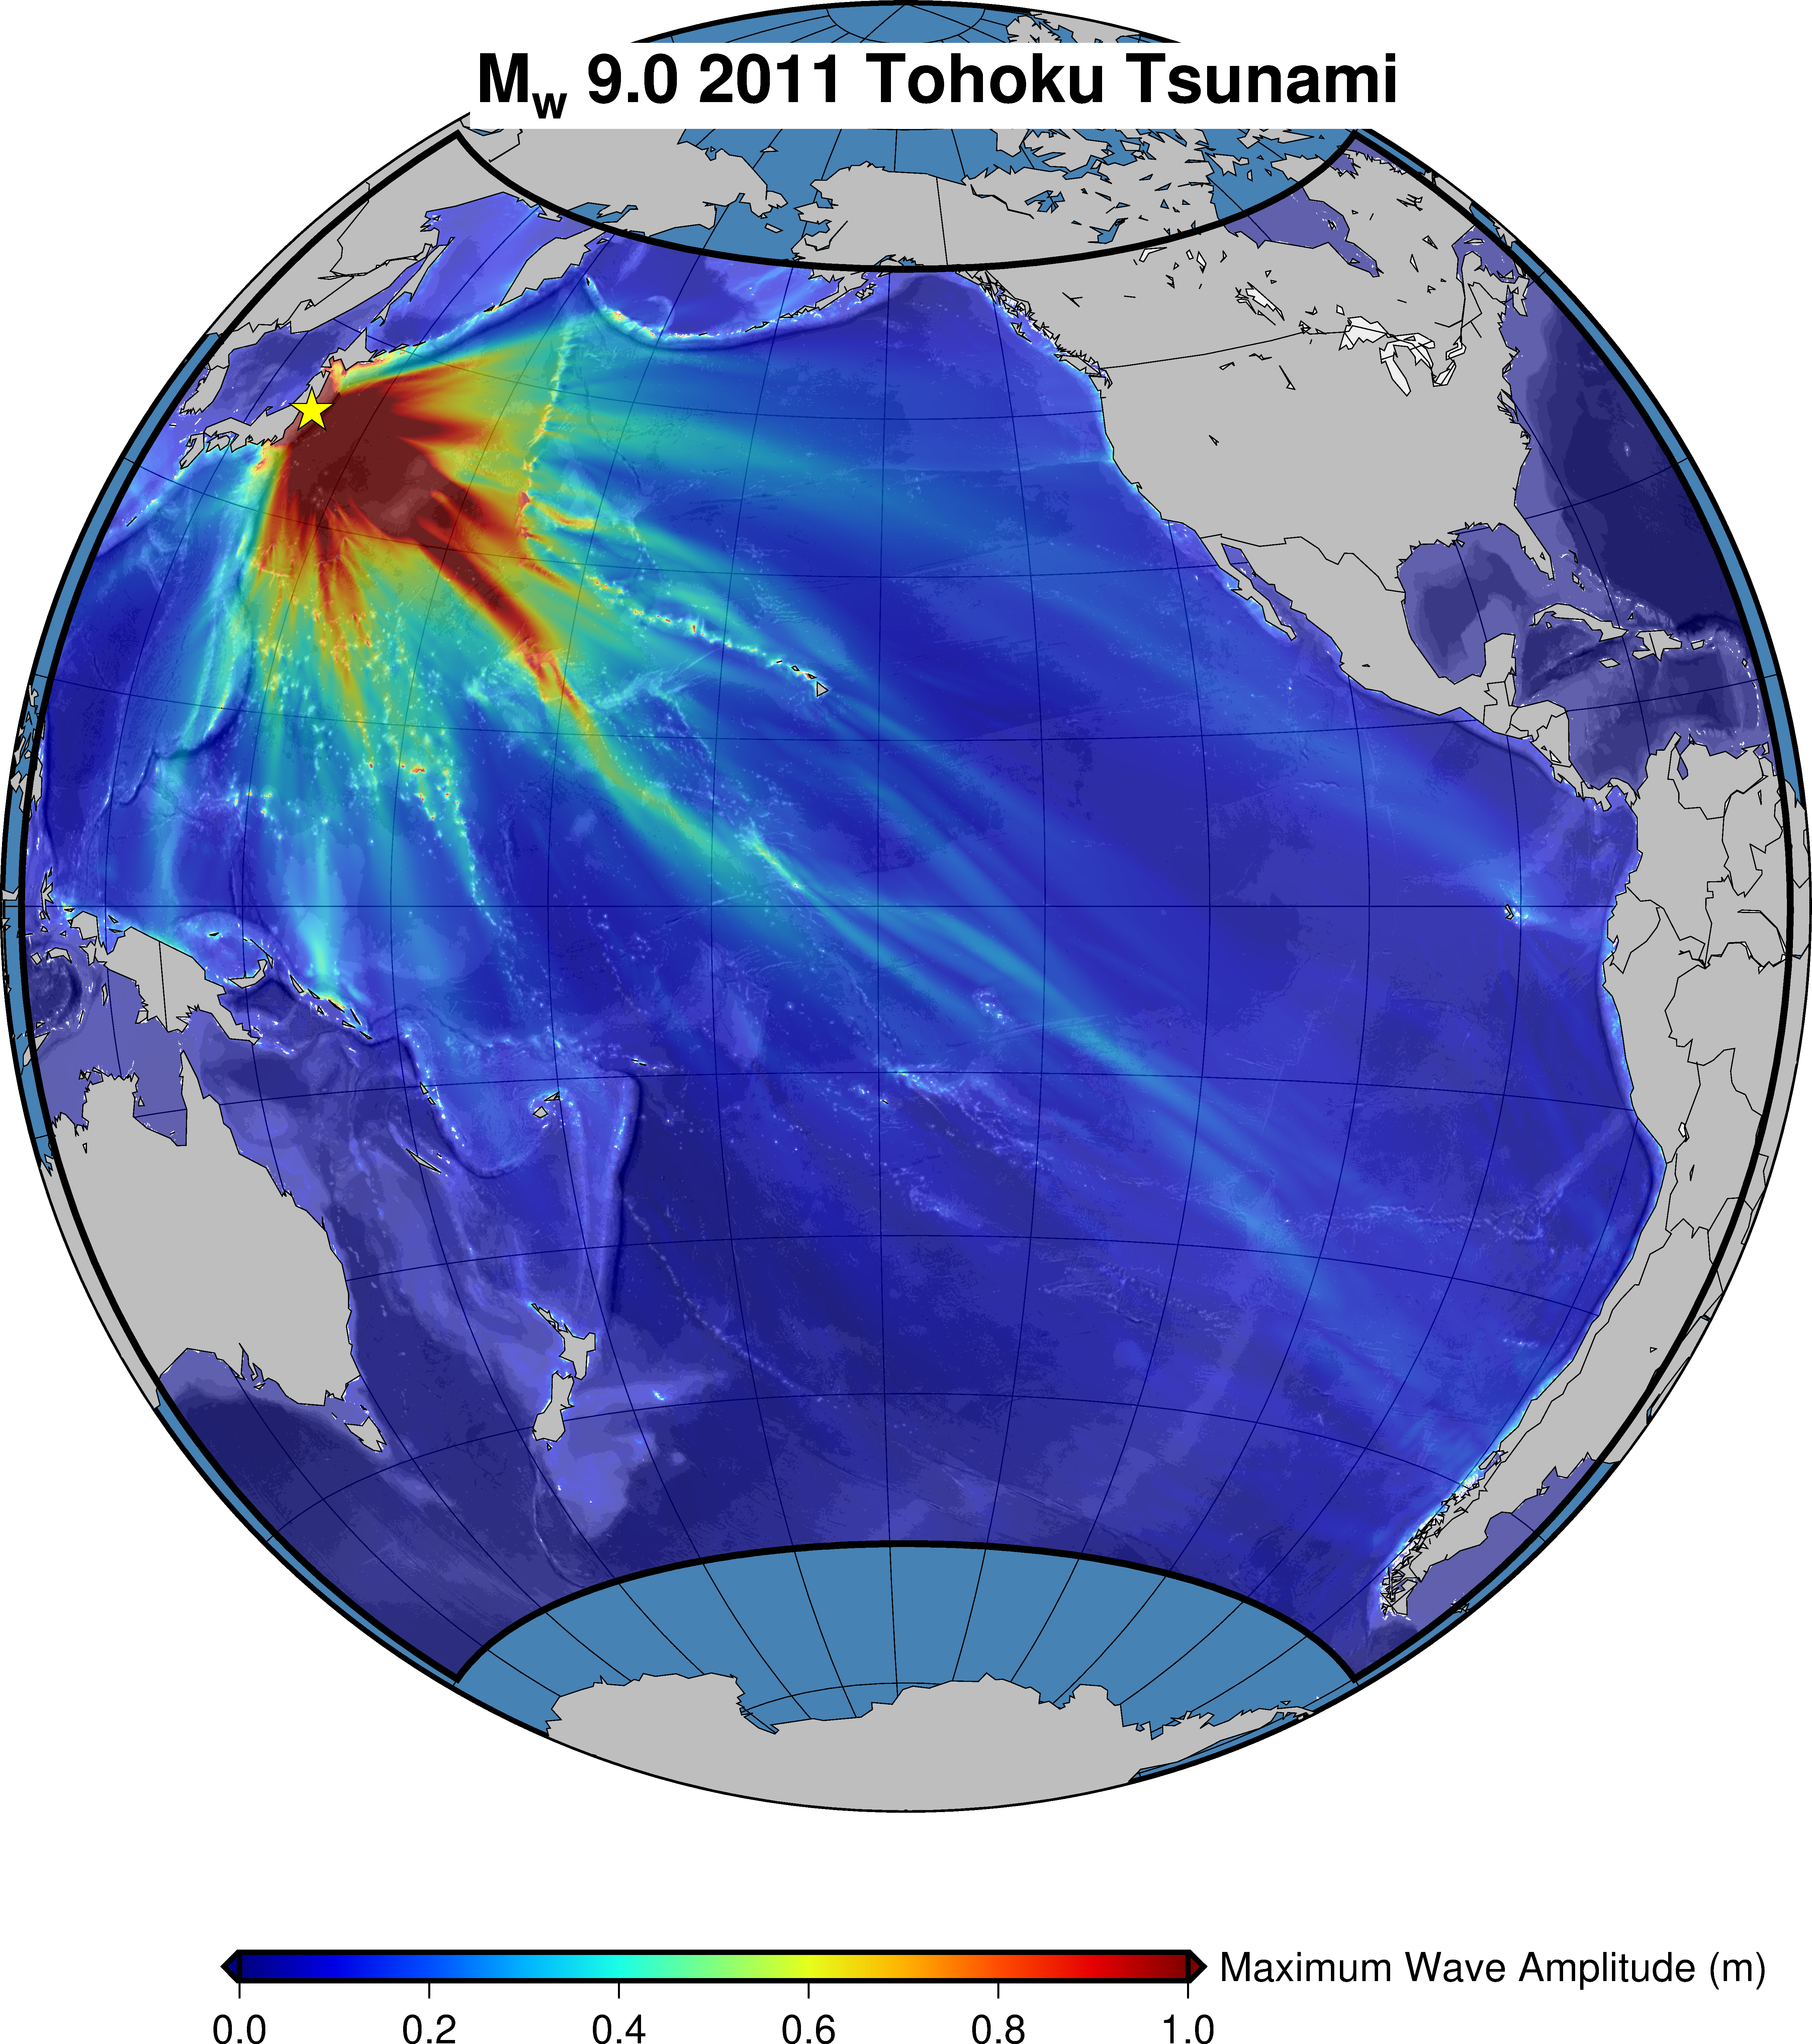
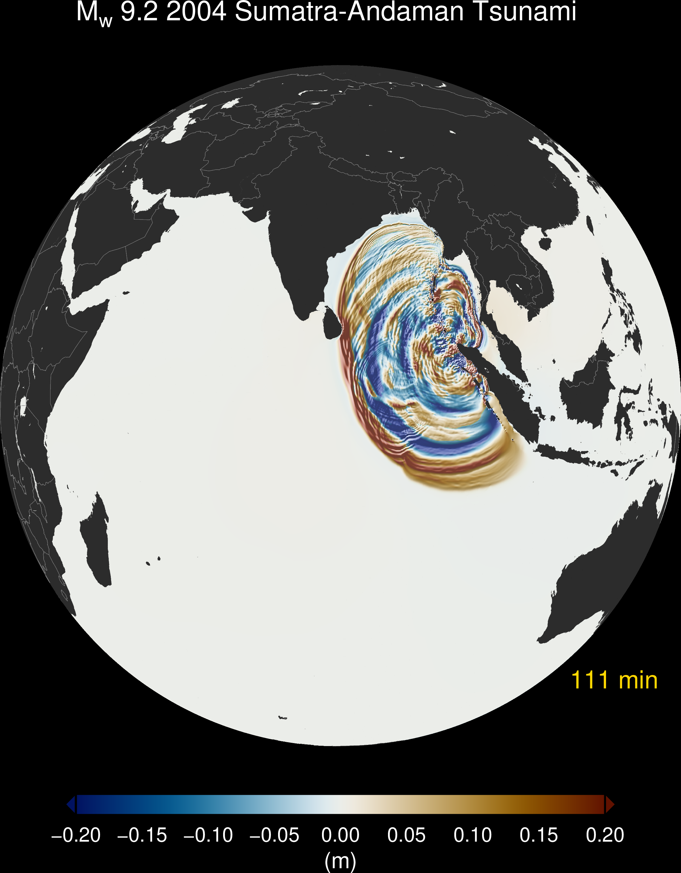
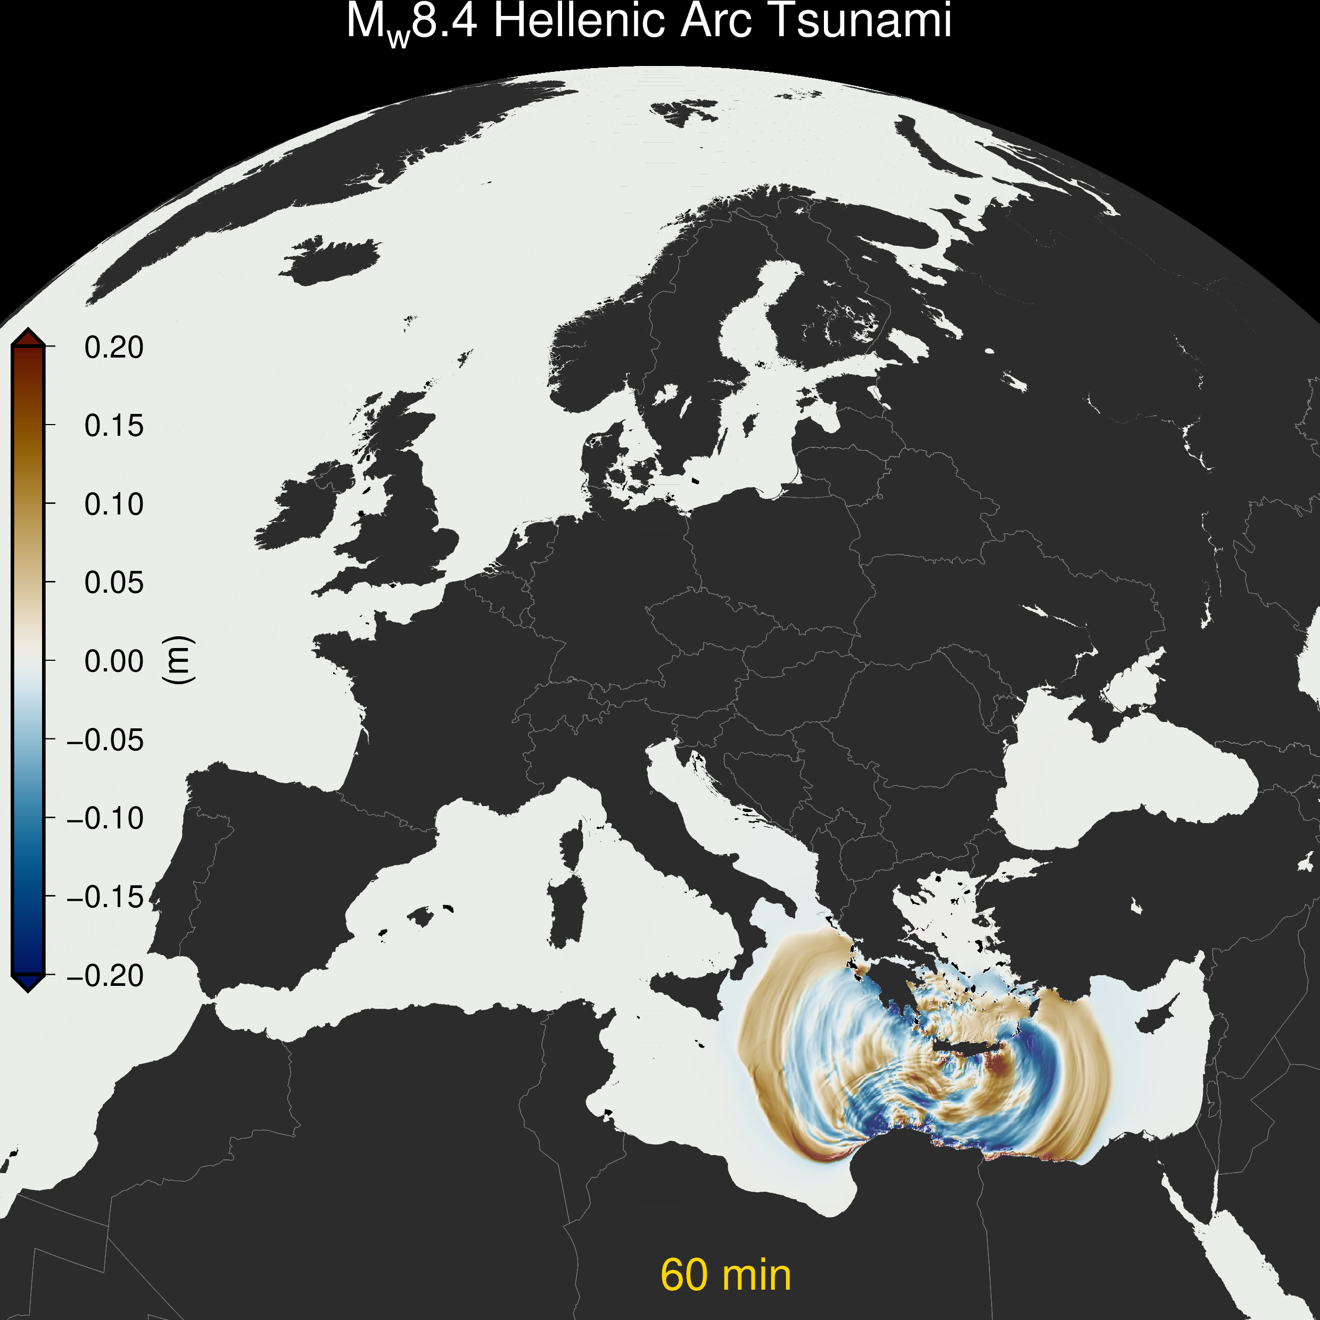
Next gen TS-Gauss: direct tsunami simulations – few GPUs
Tsunami-HySEA GPU-based simulation code – Developed by University of Malaga
Notes:
Title slide for large pictures, tables, maps, plots…

Slide 6
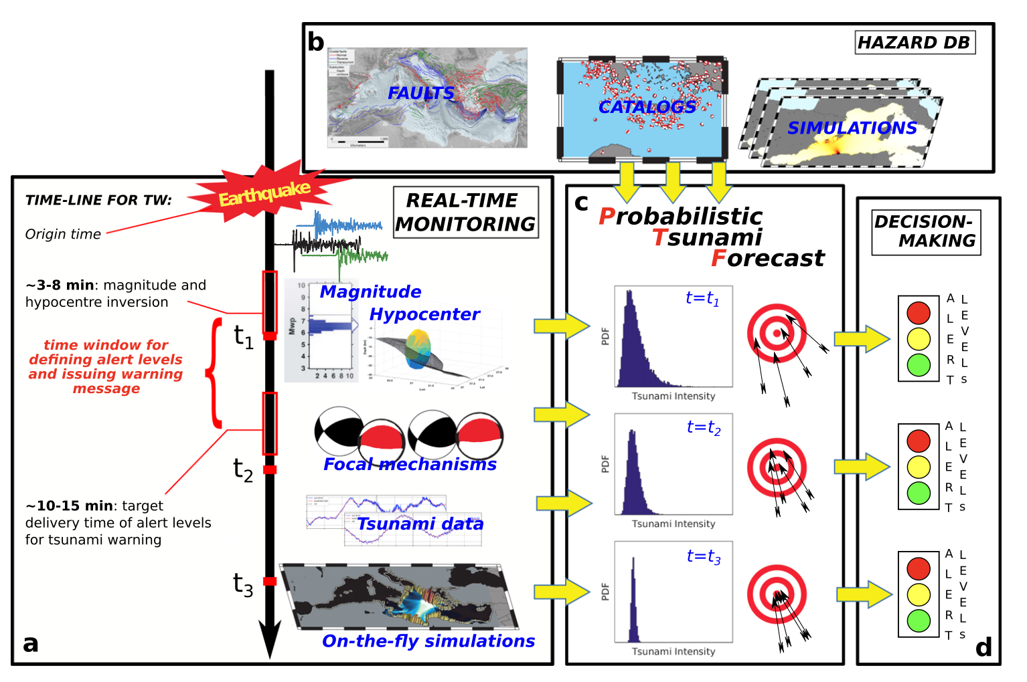
PTF: Probabilistic Tsunami Forecasting
Selva et al., Nature Communications, 2021
Notes:
Title slide for large pictures, tables, maps, plots…

Slide 7
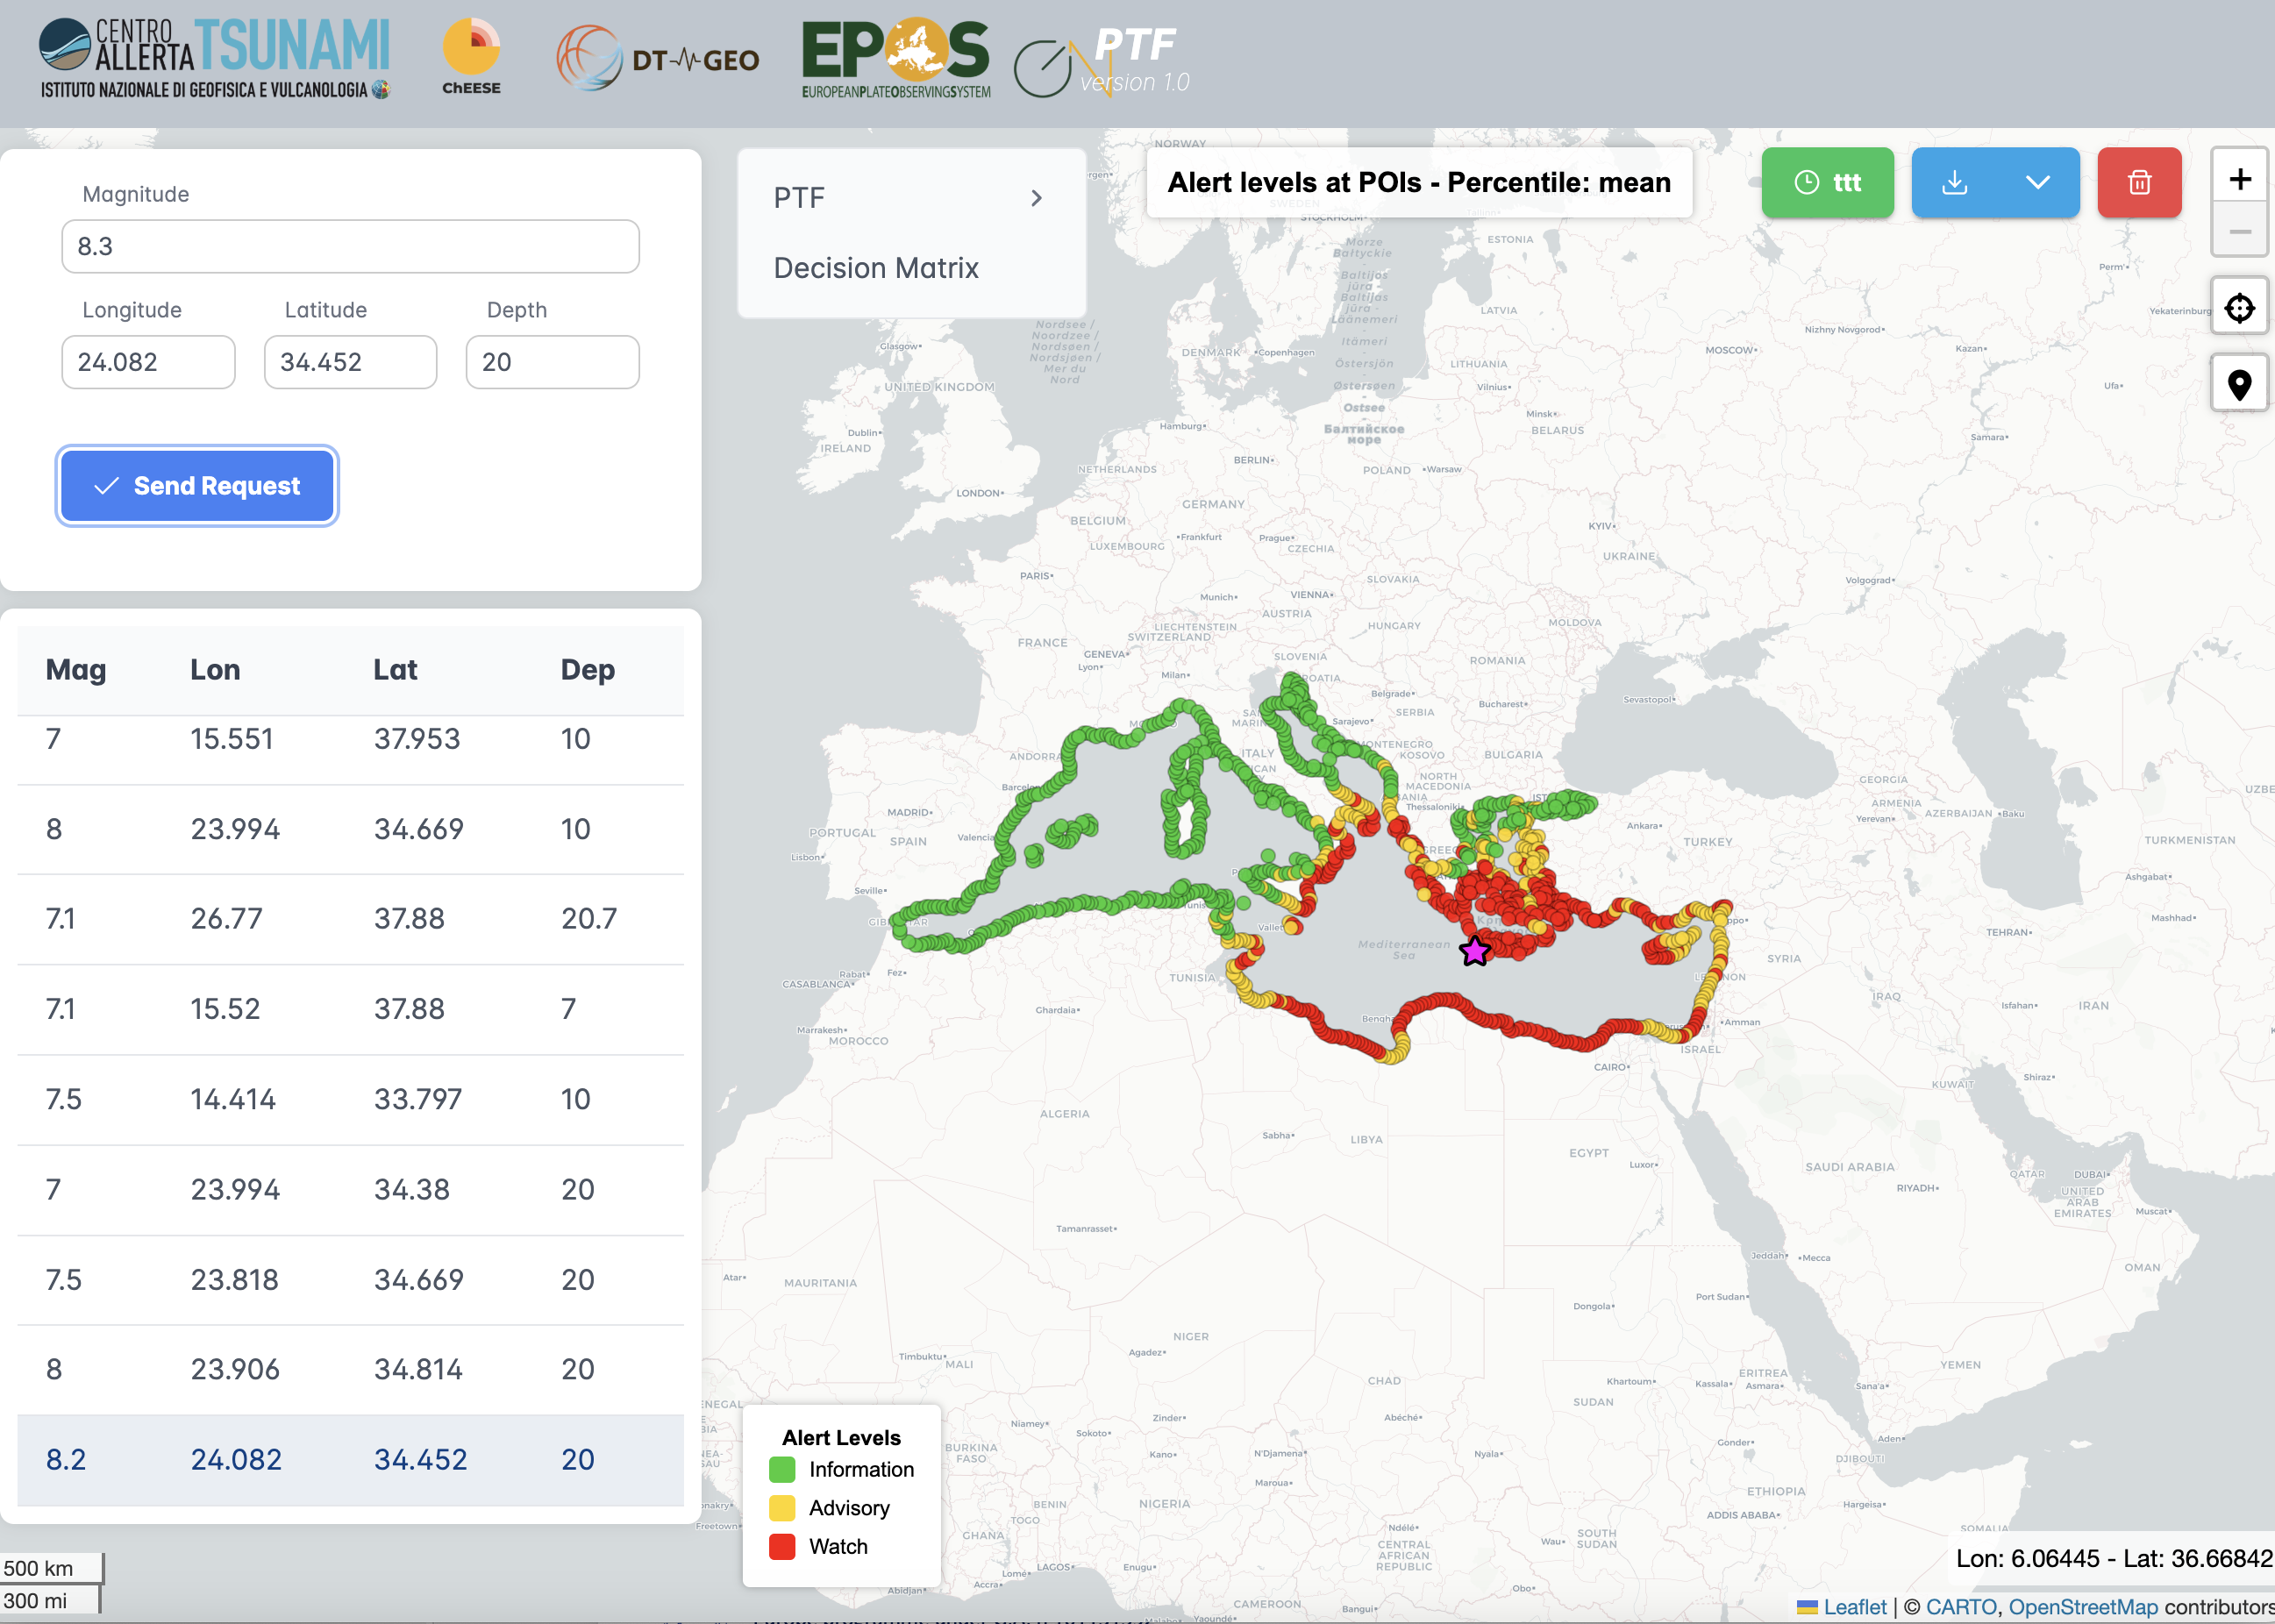
PTF: Probabilistic Tsunami Forecasting
CAT INGV (non public) web service
Based on pre-calculated tsunami scenarios
developed by GFZ and INGV
partially funded by DT-GEO, ChEESE
Now by EPOS-ON
Notes:
Title slide for large pictures, tables, maps, plots…

Slide 8
PTF: Probabilistic Tsunami Forecasting
Notes:
Title slide for large pictures, tables, maps, plots…

Slide 9
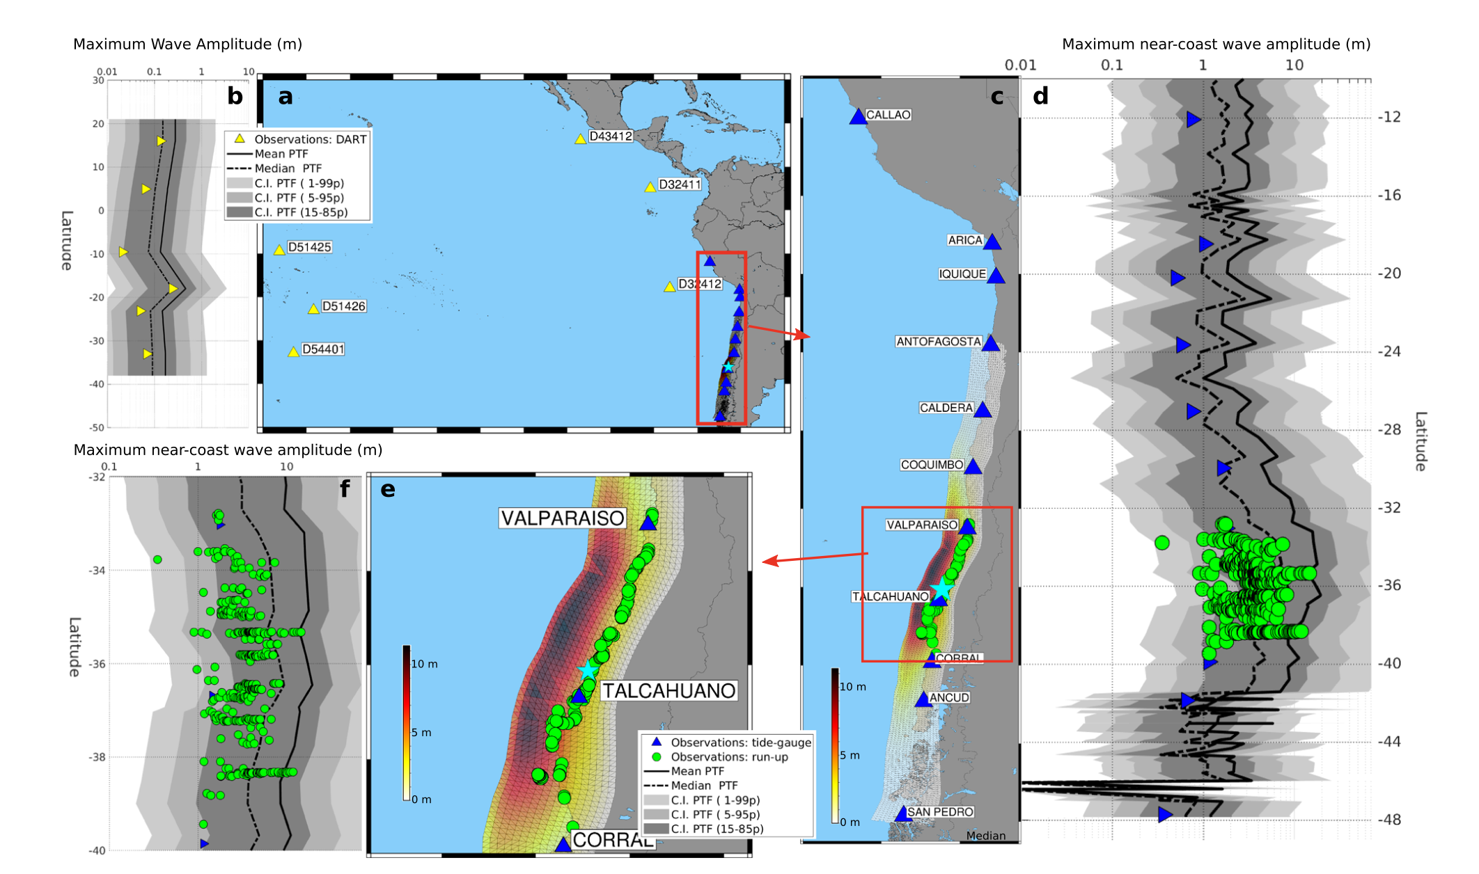
PTF: Probabilistic Tsunami Forecasting
Example for the Maule 2010 Mw 8.8 Earthquake and Tsunami
Notes:
Title slide for large pictures, tables, maps, plots…

Slide 10
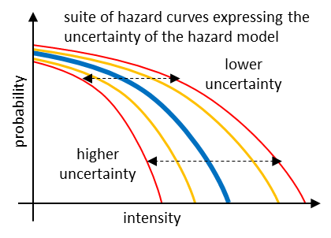
High-resolution PTHA workflow – TA (or TNA)
Information flux
Step-1: Probabilistic earthquake model
Step-2: Tsunami generation & modeling in deep water
Step-3: Shoaling and inundation
Step-4: Hazard aggregation & uncertainty quantification
Gibbons et al., FEART, 2020;Basili et al., FEART, 2021
Notes:
Title slide for large pictures, tables, maps, plots…

Slide 11
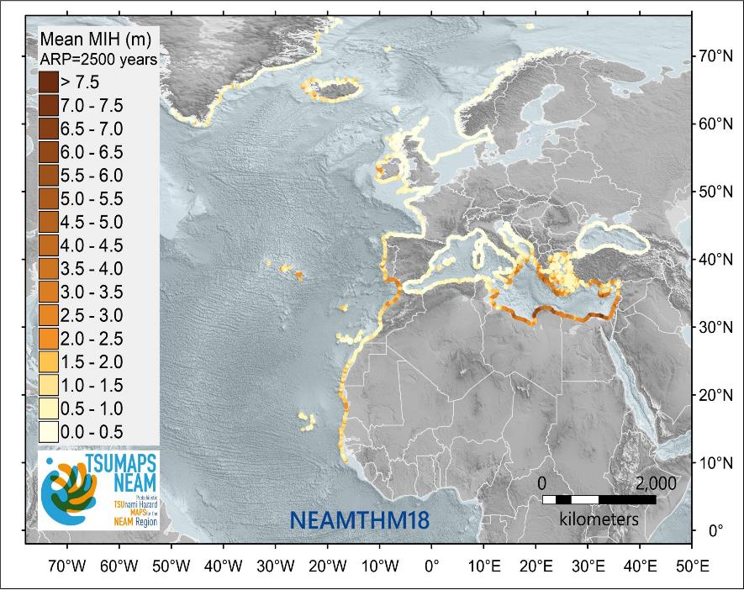
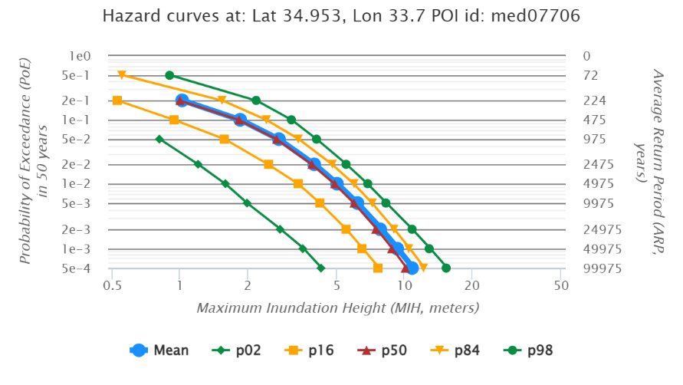
High-resolution PTHA workflow – TA (or TNA)
https://tsumaps-neam.eu/
Notes:
Title slide for large pictures, tables, maps, plots…

Slide 12
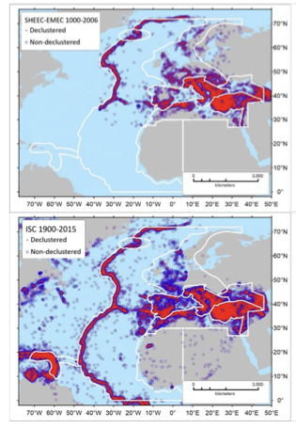
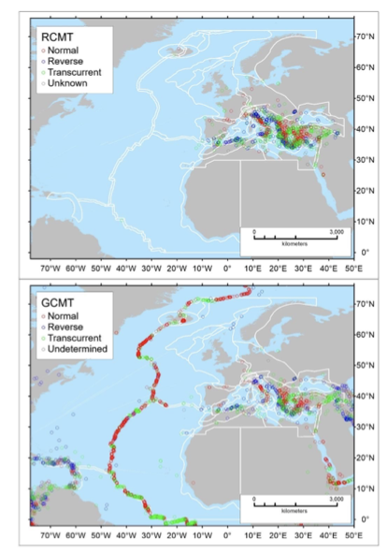
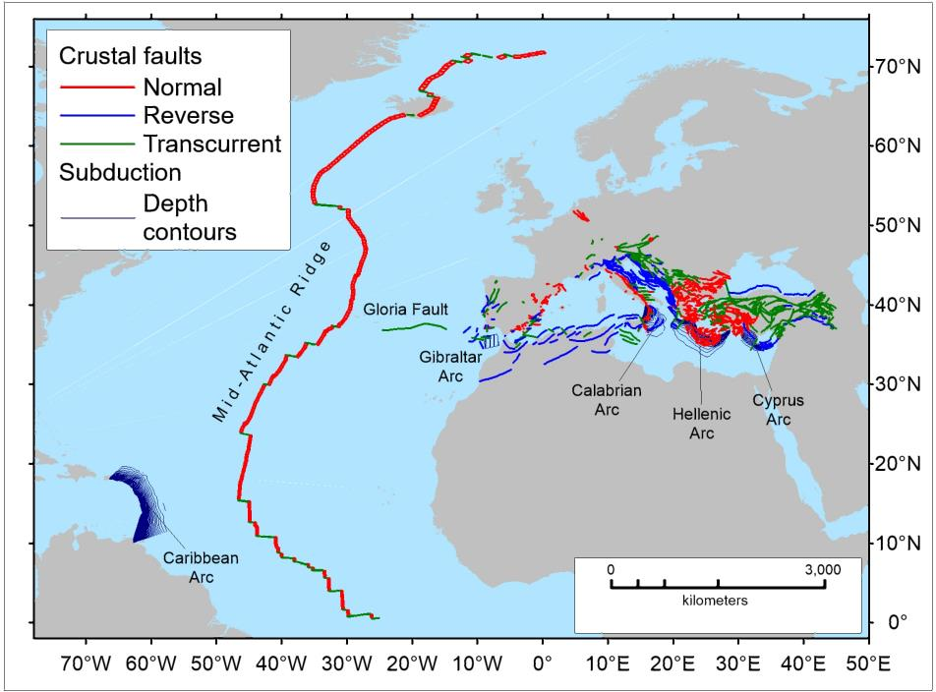
High-resolution PTHA workflow – TA (or TNA)
https://tsumaps-neam.eu/
Notes:
Title slide for large pictures, tables, maps, plots…

Slide 13
High-resolution PTHA workflow – TA (or TNA)
Notes:
Title slide for large pictures, tables, maps, plots…

Slide 14
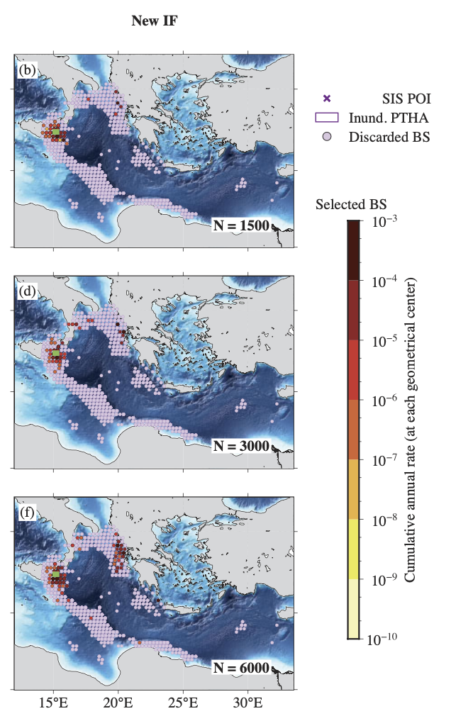
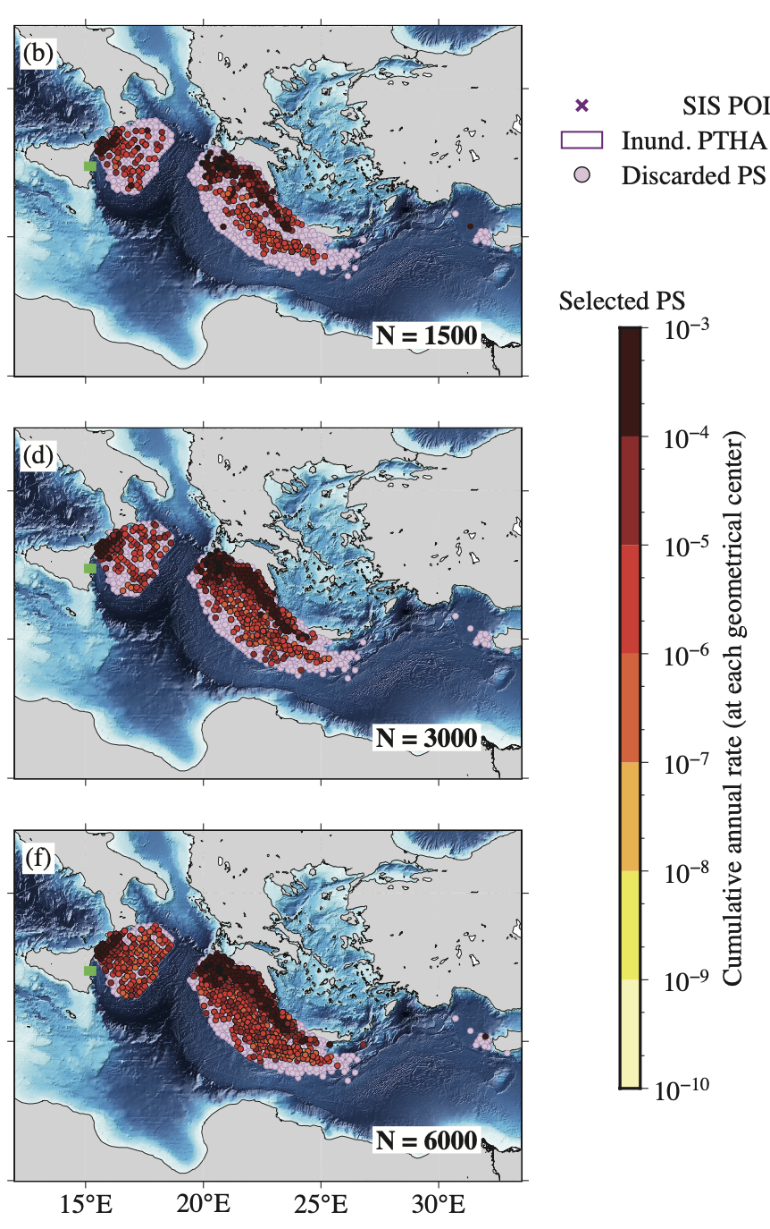
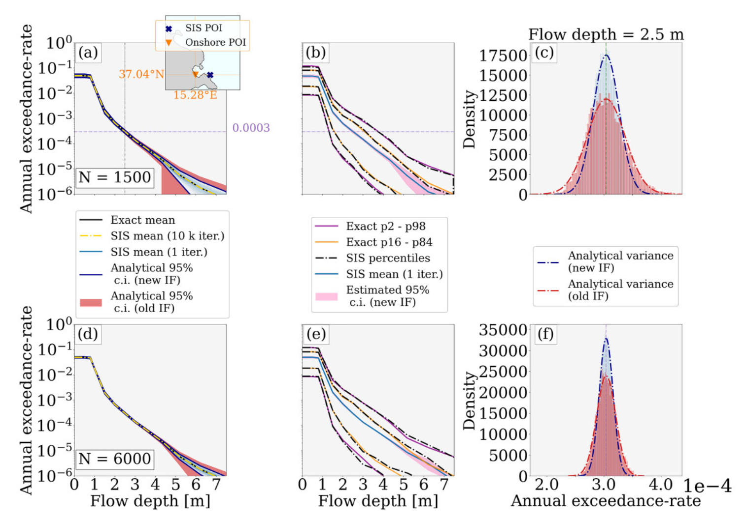
High-resolution PTHA workflow – TA (or TNA)
Importance sampling Davies et al., 2022 (GJI); Abbate et al., 2025 (GJI)
Notes:
Title slide for large pictures, tables, maps, plots…

Slide 15
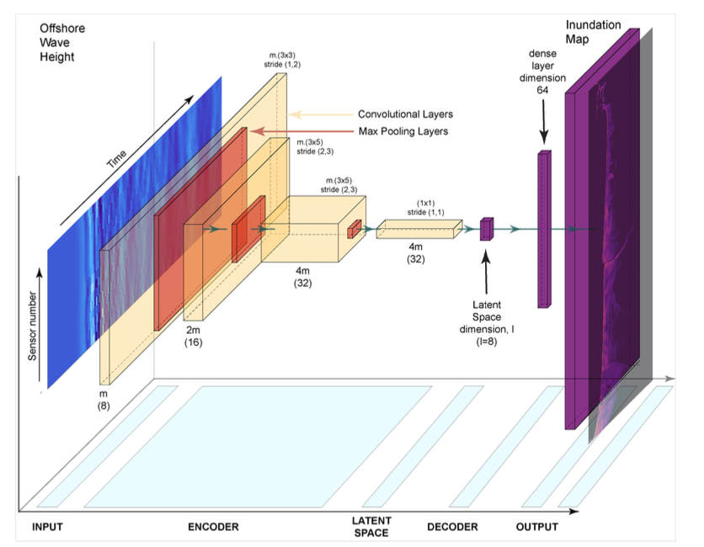
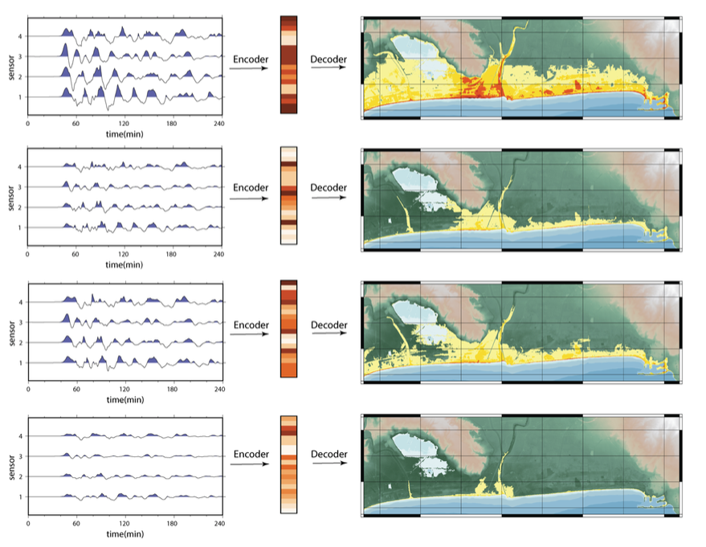
High-resolution PTHA workflow – TA (or TNA)
Machine Learning Emulation of High-Resolution Inundation Maps.
Storrøsten et al., 2024 (GJI)
Notes:
Title slide for large pictures, tables, maps, plots…

Slide 16
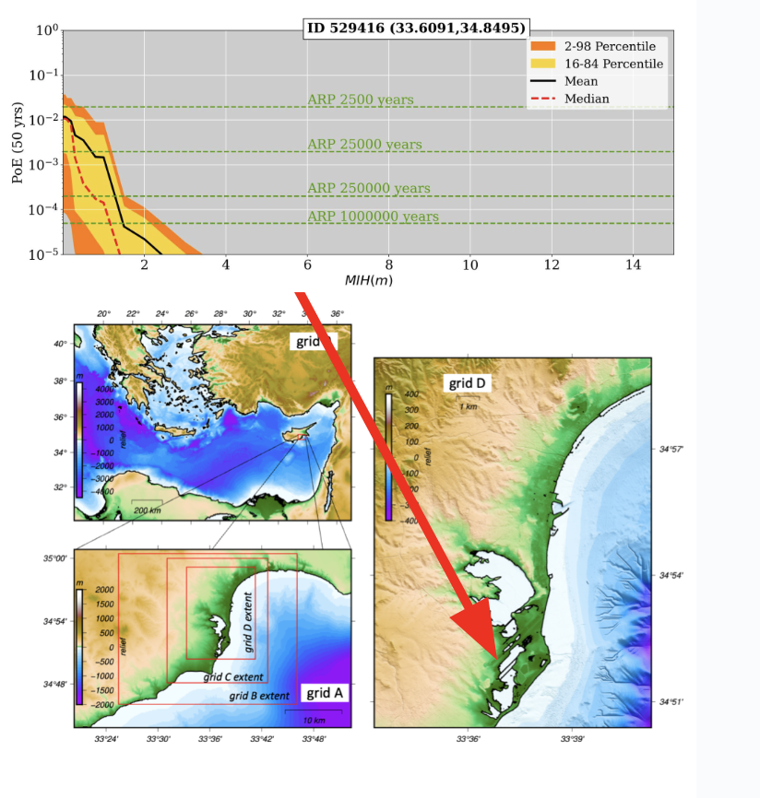
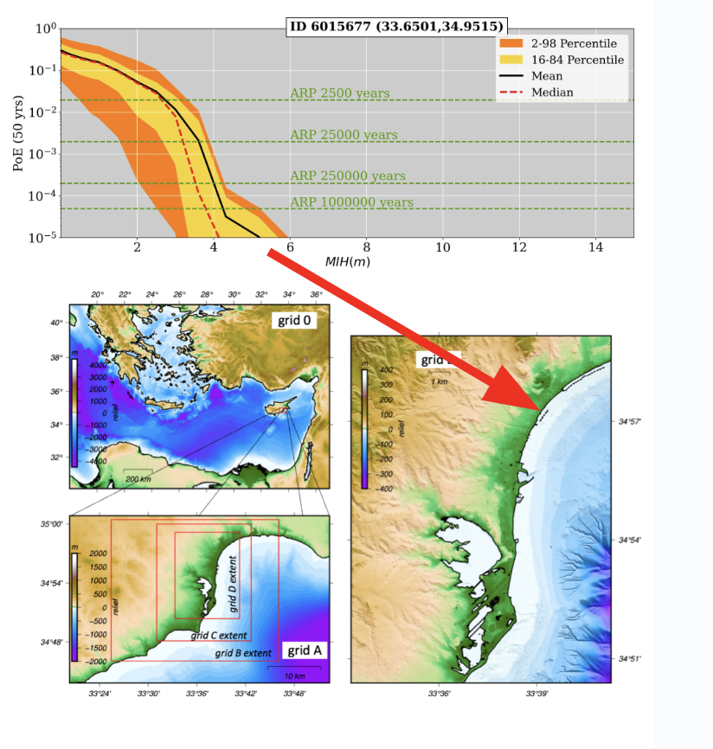
High-resolution PTHA workflow – TA (or TNA)
Notes:
Title slide for large pictures, tables, maps, plots…

Slide 17
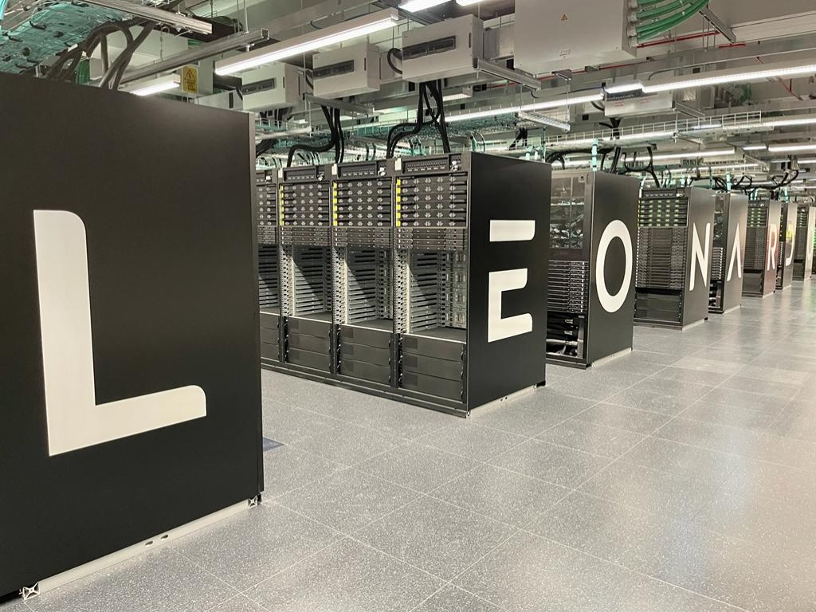
High-resolution PTHA workflow – TA (or TNA)
4 projects were awarded by Geo-INQUIRE to use this Workflow (Spain, Chile, Pakistan+Iran, Morocco)
CINECA provided computational resources to run the GPU-based HySEA code on the Leonardo supercomputer
Notes:
Title slide for large pictures, tables, maps, plots…

Slide 18
Thank you for your attention!
stefano.lorito@ingv.it
www.epos-eu.org/on | social media #EPOSon
Notes:
Thank you slide

