Slide 1
Computational Workflows in the EPOS Platform
Marco Salvi | marco.salvi@ingv.it | 20/03/2025 EPOS DAYS
Notes:
Title slide

Slide 2
The Need for FAIR Workflows
Within the DT-GEO and Geo-INQUIRE projects, many simulations are being developed as computational workflows
A key goal of the projects is to make these workflows accessible and reusable by the community
The challenge: finding a method to represent complex workflows in a FAIR way
Notes:
Content slide

Slide 3
Describing Complex Workflows
What is RO-Crate?
A community-driven standard for packaging research data with its metadata
Uses JSON-LD to describe data, software, and other research outputs in a light, portable, machine-readable format
The Challenge:
Initial attempts using only RO-Crate were not sufficient for complex workflows
Need to capture both metadata and the internal structure of multi-step processes
Notes:
Content slide

Slide 4
A Dual-Standard Approach
Common Workflow Language (CWL):
An open standard for describing computational workflows
Details how software tools connect and interact to perform a series of tasks
Enhances reproducibility and portability of workflows
Combined Approach:
RO-Crate handles the metadata
CWL captures the workflow structure (steps, data flow, software dependencies)
Many community-made tools are available for working with these standards
Notes:
Content slide

Slide 5
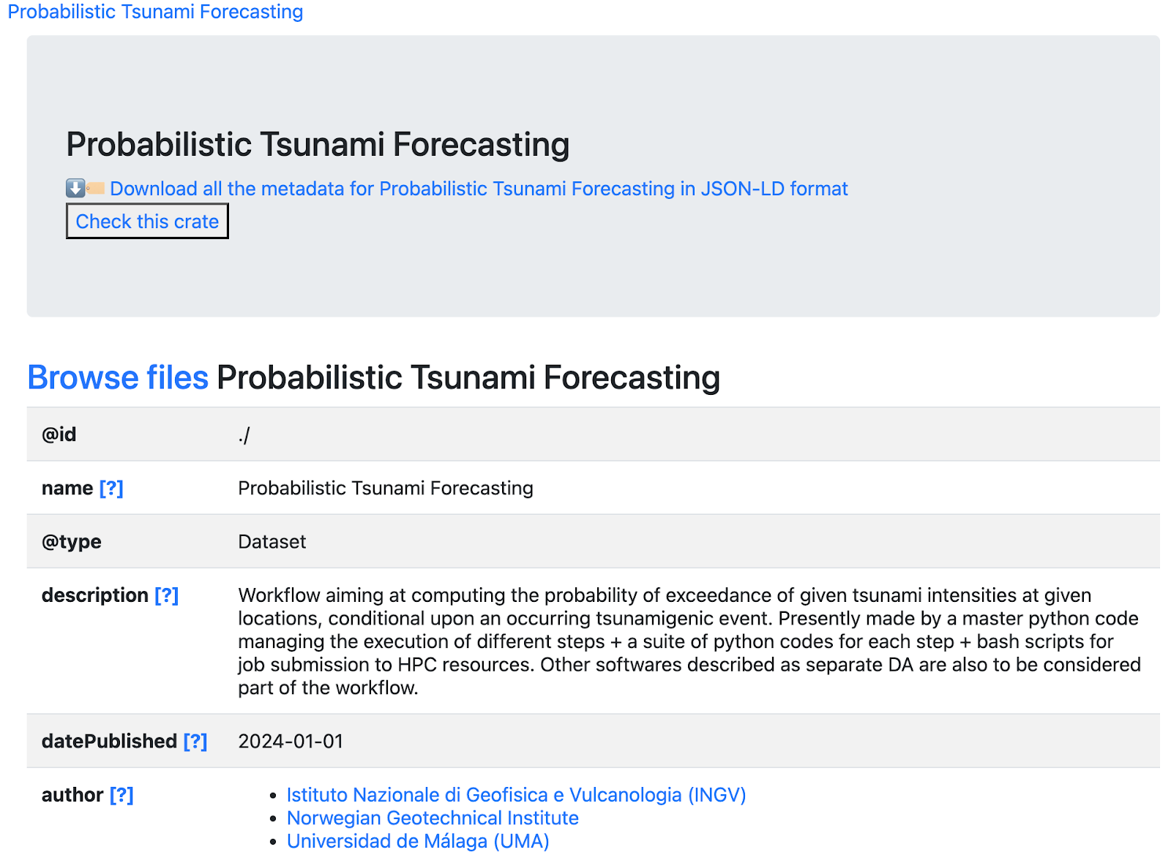
A Dual-Standard Approach
Graph generated from a CWL description of the DT-GEO project
Dynamic HTML preview of the associated RO-Crate
Notes:
Content slide

Slide 6
Beyond DT-GEO: A Generic Approach
The developed format is generic and applicable beyond DT-GEO workflows
Ideal Scenario:
CWL descriptions are directly executable
In Practice:
For workflows built with other Workflow Management Systems (e.g. PyCOMPSs), refactoring into fully executable CWL can be challenging
We can use an “abstract” CWL representation that focuses on workflow structure without explicit execution details
Notes:
Content slide

Slide 7
Bringing FAIR Workflows to EPOS
Notes:
Content slide

Slide 8
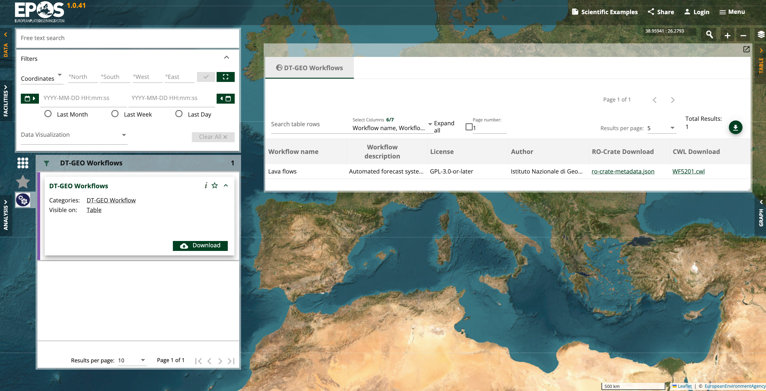
Bringing FAIR Workflows to EPOS
Workflows become discoverable and visually accessible on the EPOS Platform
Users can explore workflow graphs and metadata summaries
Demonstrates a proof of concept for seamless integration of FAIR workflows
Notes:
Content slide

Slide 9
Looking Ahead
Further integration with the EPOS Platform to enhance user interaction
Possibility of tracking retrospective provenance using tools like cwltool and other WMS
Long-term vision: enabling direct execution of workflows from the portal
Adoption by other projects, e.g., Geo-INQUIRE
Notes:
Content slide

Slide 10
Summary
FAIR representation of workflows using the combination of CWL and RO-Crate
Flexibility to work with various workflow tools through abstract descriptions
Improved discoverability and visualization on the EPOS Platform
Notes:
Content slide

Slide 11
Thank you for your attention!
marco.salvi@ingv.it
www.epos-eu.org/on | social media #EPOSon
Notes:
Thank you slide

