Slide 1
Simulation Data Lake
Laura Lampariello – Davide Crisante | sdl@cineca.it| 20 March 2025 - EPOS Days 2025

Slide 2
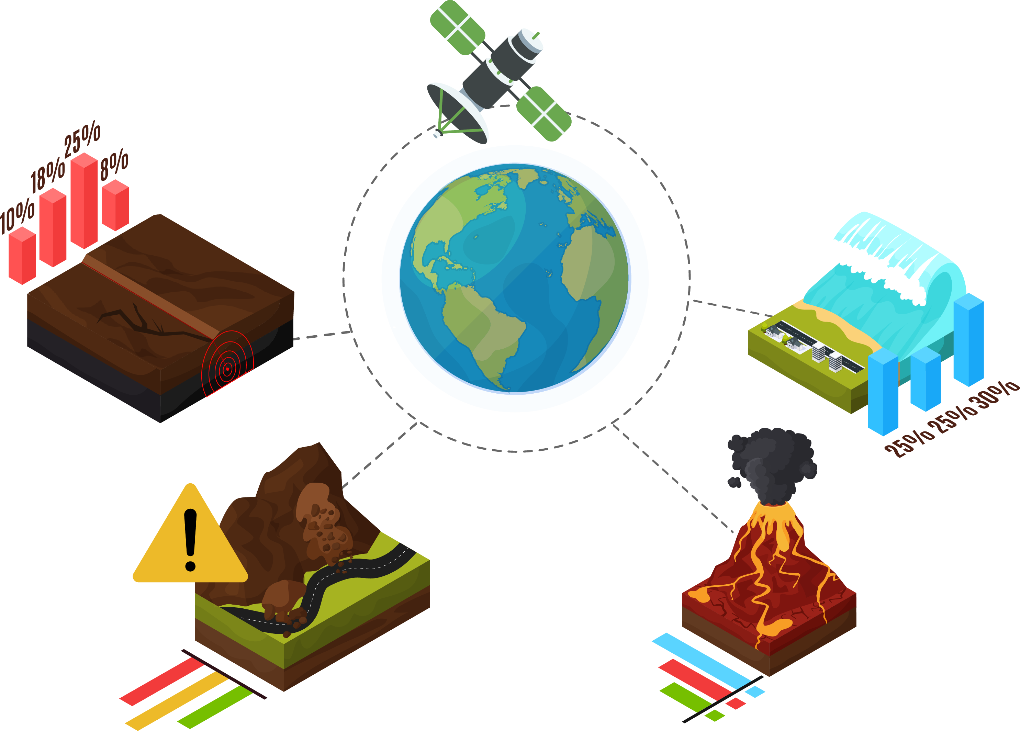
Simulation Data Lake
Data platform for:
Storing large amounts of simulation data
Allowing access to data in order to facilitate reusability
Providing search capabilities to find data more efficiently
Geo-INQUIRE Project: european research initiative advancing scientific knowledge in:
Computational seismology
Volcanology
Tsunami science
Geo-hazard analysis

Slide 3
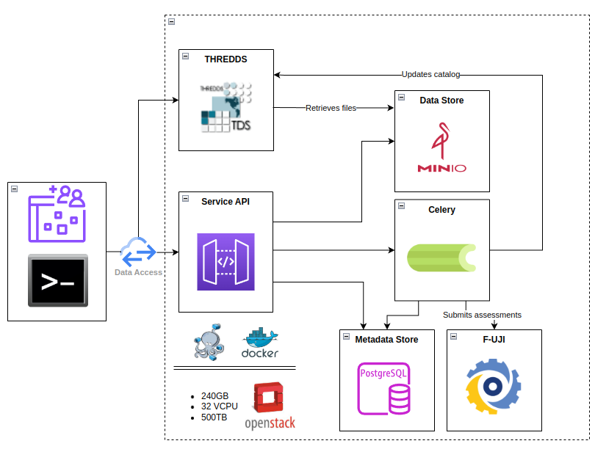
SDL Architecture
Modular architecture and Object Storage
Hosted on CINECA's Cloud Infrastructure
Restful APIs
Containerized services: IAM, Catalog, Async Processing
Data Store: MinIO
Compatible with S3
Object Storage
Metadata Store: PostgreSQL - PostGIS
Data model
Enable data search
IaaS & Container
Docker, Docker-Compose
OpenStack

Slide 4
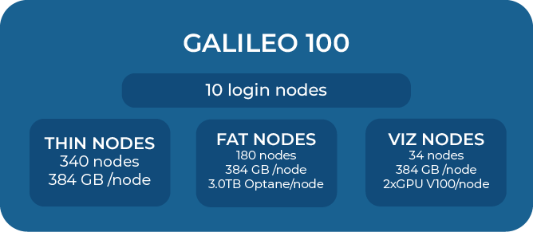
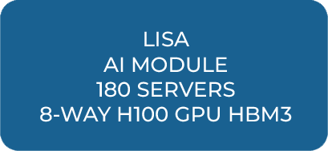
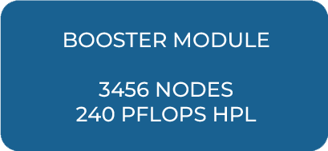
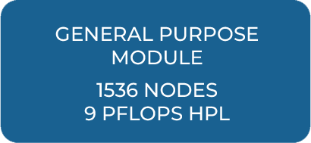
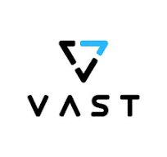
CINECA HPC Cloud infrastructure
#9
LEONARDO – EuroHPC pre-exascale
CINECA NEW STORAGE : 50 PB based-on Full-Flash
GAIA (new cloud)
100k-150k
CPUs for cloud
technology
Geosciences SDL
150 + GPUs
Interface + Training

Slide 5
Data Model
Main Entities:
Experiment
Simulation
Workflow
Dataset
A Dataset can be of the following types:
Input
Output
Data product
Input parameter
A Simulation is the execution of a Workflow and contains input data and the result of that specific workflow run.
Simulation
Experiment
Dataset 1
Dataset …
Sim 1
…
Dataset
type: input
Sim …
Dataset …
…
Dataset n
Sim …
Sim n
Dataset …
Dataset …

Slide 6
Simulation Data Lake Functionalities
Advanced search functionalities including search by spatial and temporal coverage
Experiment publication: Restricted, Open access, Embargoed
DOI minting and management
Integration with EPOS Data Portal
OGC Services
Uploading and downloading both data and metadata (RO-Crate,…)
Workflow management (CWL files and diagram visualisation)
Dashboard of KPIs: automated FAIR assessment with F-UJI tool
Data proximity and integration with CINECA HPC systems
Migration to the new storage system based on SSD (VAST)

Slide 7
How to access the SDL
WEB PORTAL
User friendly interface
Simple access to data
For non-technical users
Command Line Interface
For large quantities of experiments, simulations and datasets
For technical users
API
Interact programmatically
Integration with other services
For technical users

Slide 8
Useful information
Dev: https://sdl-dev.hpc.cineca.it
Development environment with 1T of storage
It is the most updated environment with features in development
Prod: https://sdl.hpc.cineca.it
Production environment with 500T of storage
Contacts: sdl@cineca.it
Request an SDL account using the following link: https://sdl-userguide.readthedocs.io/tutorials/Introduction/
Documentation
Web Portal: https://sdl-userguide.rtfd.io
Command Line Interface: https://sdlctl.rtfd.io

Slide 9
Thank you for your attention!
sdl@cineca.it
www.epos-eu.org/on | social media #EPOSon

