Slide 1
Processing Services
Francesco Martinelli, Kety Giuliacci, Joanna Kocot, Jan Michalek, Alessandro Turco
Contacts: francesco.martinelli@ingv.it 20 March 2025 - EPOS Days 2025 Perugia
Notes:
Title slide

Slide 2
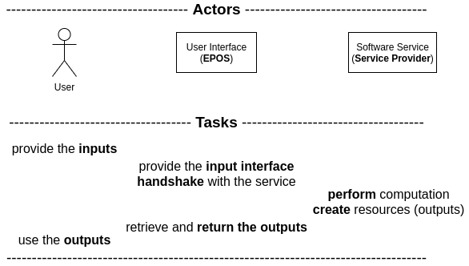
Processing Services (web) services to perform computational tasks
The investigated Software Service communicate over a RESTful protocol
Notes:
Title slide for large pictures, tables, maps, plots…

Slide 3
Processing Services
status of EPOS integration
The investigated Software Service adhere to a standard:
OGC API - Processes - Part 1: Core (version 1.0.0)
Adhering to the above standard allows automated metadata retrieval.
To get the metadata required by the EPOS back-end only the entry point to the service is required.
Entry points for: service description, job submission, job status, job results,
are derived from the service API, according to the standard.
Notes:
Content slide

Slide 4
Processing Services
status of EPOS integration/2
ADDITIONALLY
Further information defined by the standard provides:
data type and format
support for complex data structure
user description (short and long)
data constraints (optional, value range, ecc.)
Notes:
Content slide

Slide 5
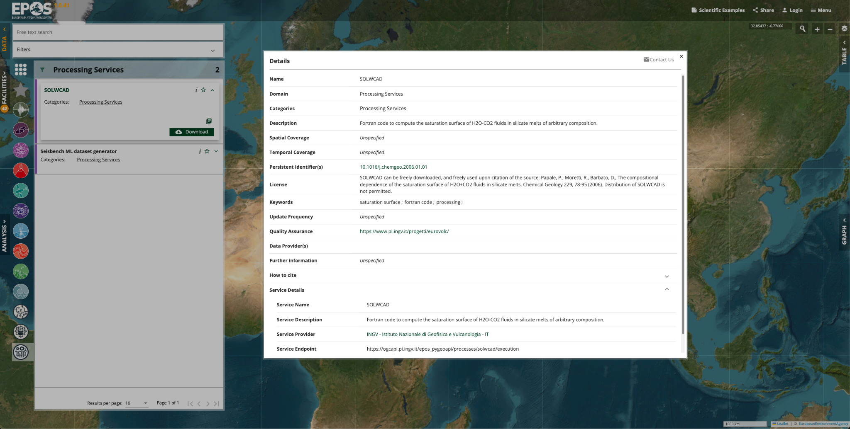
Software Services
prototype implementation
Notes:
Empty slide for large pictures, tables, maps, plots…

Slide 6
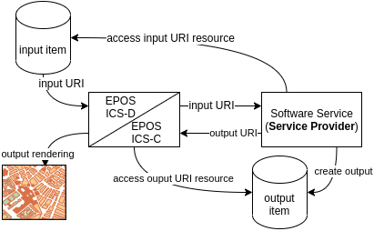
Software Services
proposals for EPOS integration/1
Input passed by reference
Output stored by Provider, rendered according to service description, possibly returned by reference
Notes:
Content slide – 2 boxes

Slide 7
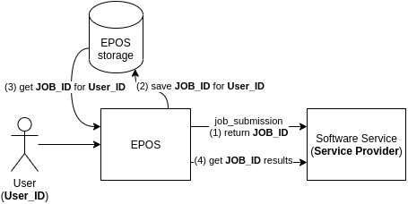
Software Services
proposals for EPOS integration/2
Authentication
Asynchronous execution for longer execution (requires EPOS saving locally the JOB_ID)
Notes:
Content slide – 2 boxes

Slide 8
Thank you for your attention!
francesco.martinelli@ingv.it
www.epos-eu.org/on | social media #EPOSon
Notes:
Thank you slide

