Slide 1



Jupyter Notebooks for Visualising Tsunami Vulnerability Models
F. Jalayer (UCL, UK), H. Ebrahimian (UNINA, IT) and the ETRiS Team

Slide 2
TCS Tsunami JN Development 2025
Two types of JN-wrapped service development is currently planned in TCS Tsunami:
Notebooks which make use of data and web-services already present at EPOS Portal.
JN-wrapped guide or cookbook explaining and illustrating with examples how to use various software in Pillar 3. No real-time simulations, just a well illustrated user manual with examples (each Notebook could be accompanied by its local or remote datasets).
The TCS envisions 8-9 new JNs to be developed in 2025.
A JN networking event is planned in the summer.

Slide 3
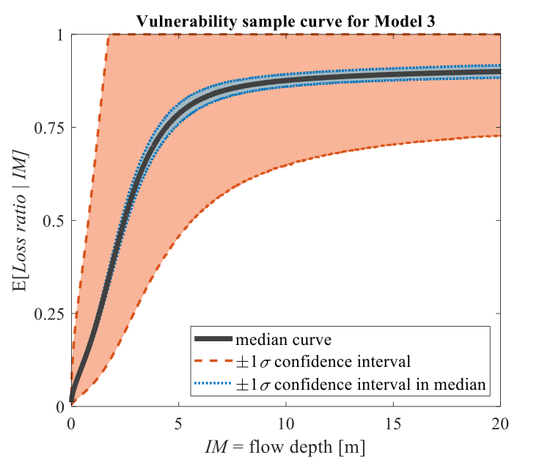

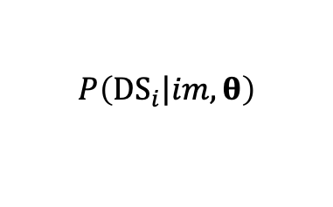

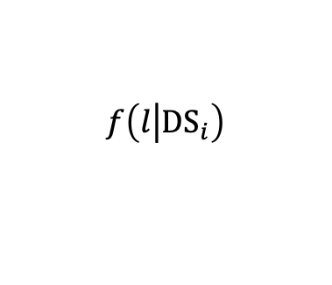

Probabilistic Tsunami Hazard and Risk Analysis (TCS Tsunami, Pillar 4)
Empirical fragility
Vulnerability function
Risk Curve
Probabilistic Tsunami Hazard Analysis (PTHA)
Fatalities and injuries
Direct Loss (repair)
Indirect Loss (downtime)
$$λ_{IM}=λ\left(IM>im\right)$$
$$P\left({DS}_{i}\left|im,θ\right.\right)$$
$$f\left(l\left|{DS}_{i}\right.\right)$$
$$λ\left(L>l\right)$$
(Hazard Curve)
(Fragility Function)
(Consequence Function)
(Risk Curve)
Intensity Measure (IM)
e.g., Flow depth, Flow velocity, and Momentum flux
Damage Measure
e.g., Damage states DS_{i}
Decision Variable
e.g., Fatalities, Loss
Risk
Loss Exceedance Curve LEC
Behrens J, Løvholt F, Jalayer F, Lorito S, et al. (2021). Probabilistic tsunami hazard and risk analysis: A review of research gaps. Frontiers in Earth Science 9:628772. https://doi.org/10.3389/feart.2021.628772.

Slide 4
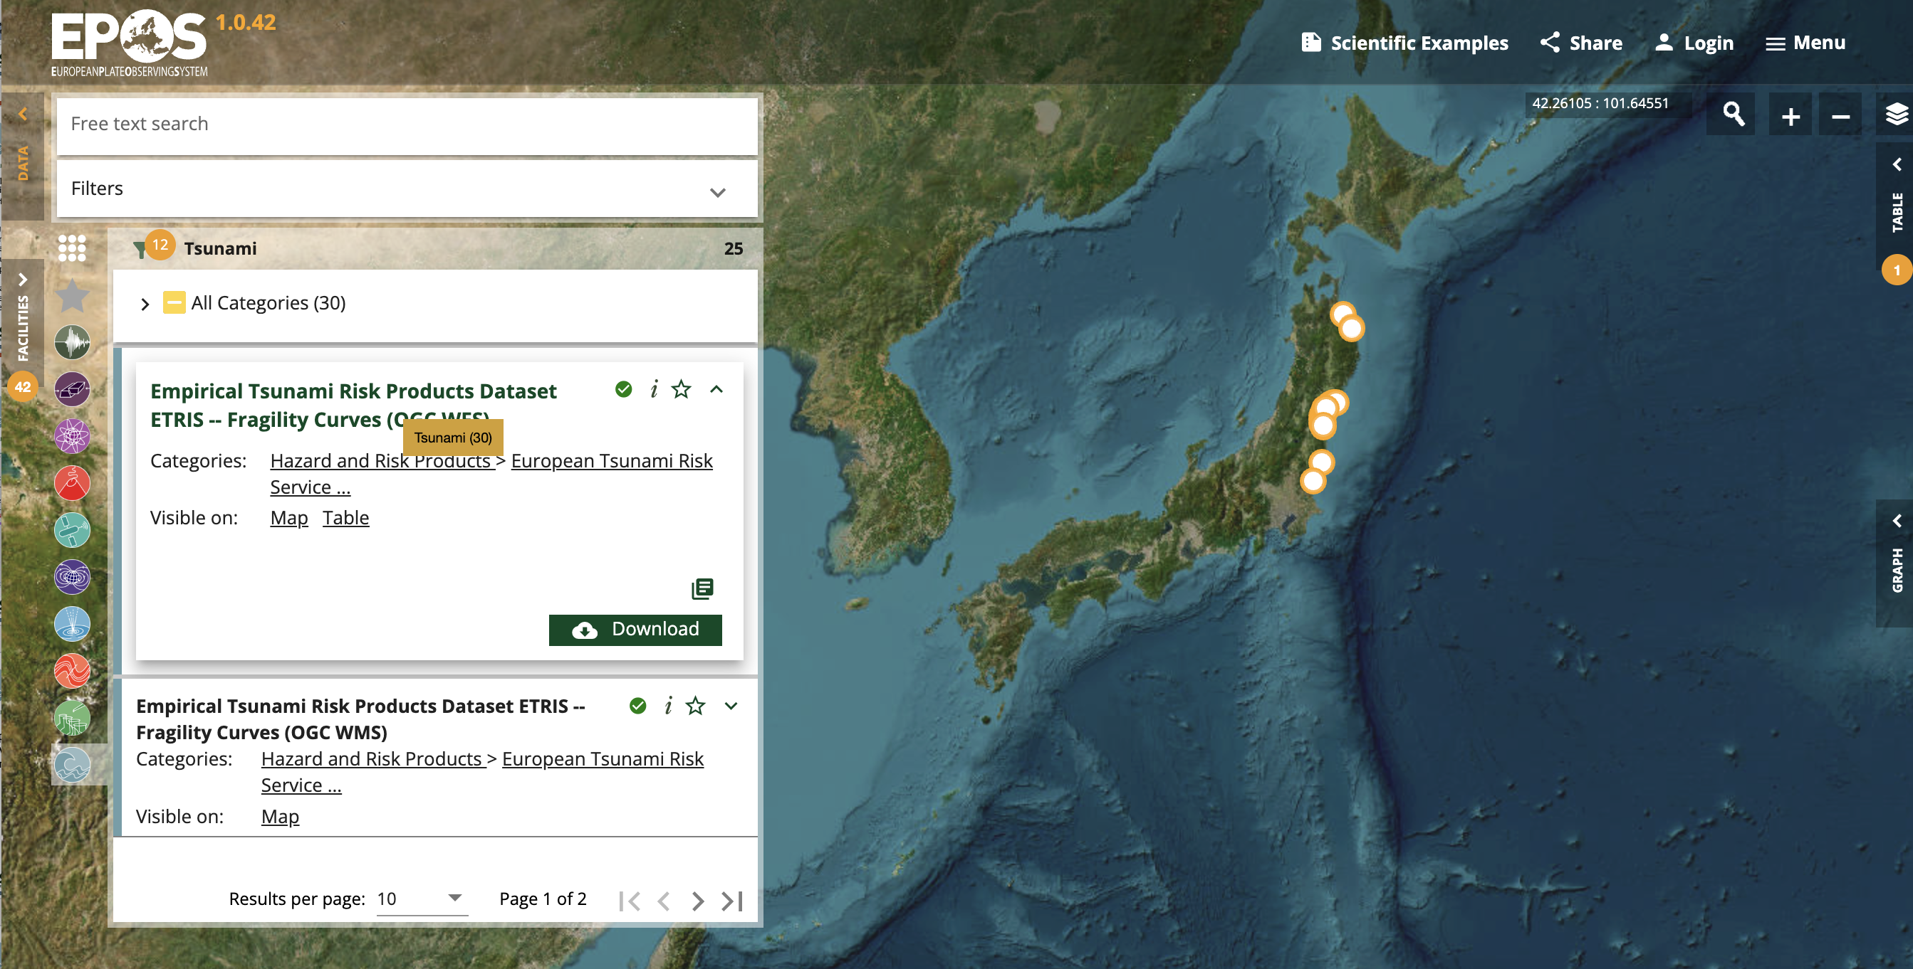
The European Tsunami Risk Service (ETRiS) https://eurotsunamirisk.org/
The Jupyter notebook “VisualizeFragility.ipynb” describes how the fragility data in EPOS-ICS-C portal in the layer entitled “Empirical Tsunami Risk Products Dataset (ETRiS v0)” can be visualised and interpreted.
Jalayer F, Ebrahimian H, Trevlopoulos K, Bradley B (2023) Empirical tsunami fragility modelling for hierarchical damage levels.
Natural Hazards and Earth System Sciences 23(2):909-931. https://doi.org/10.5194/nhess-23-909-2023.

Slide 5
The European Tsunami Risk Service (ETRiS) https://eurotsunamirisk.org/
Similarly, the Jupyter notebook “Visualize Vulnerability.ipynb” serves for visualising the vulnerability curves available on this service.
https://eurotsunamirisk.org/tsunamirisktoolkit/
Jalayer F, Ebrahimian H, Trevlopoulos K, Bradley B (2023) Empirical tsunami fragility modelling for hierarchical damage levels.
Natural Hazards and Earth System Sciences 23(2):909-931. https://doi.org/10.5194/nhess-23-909-2023.

Slide 6
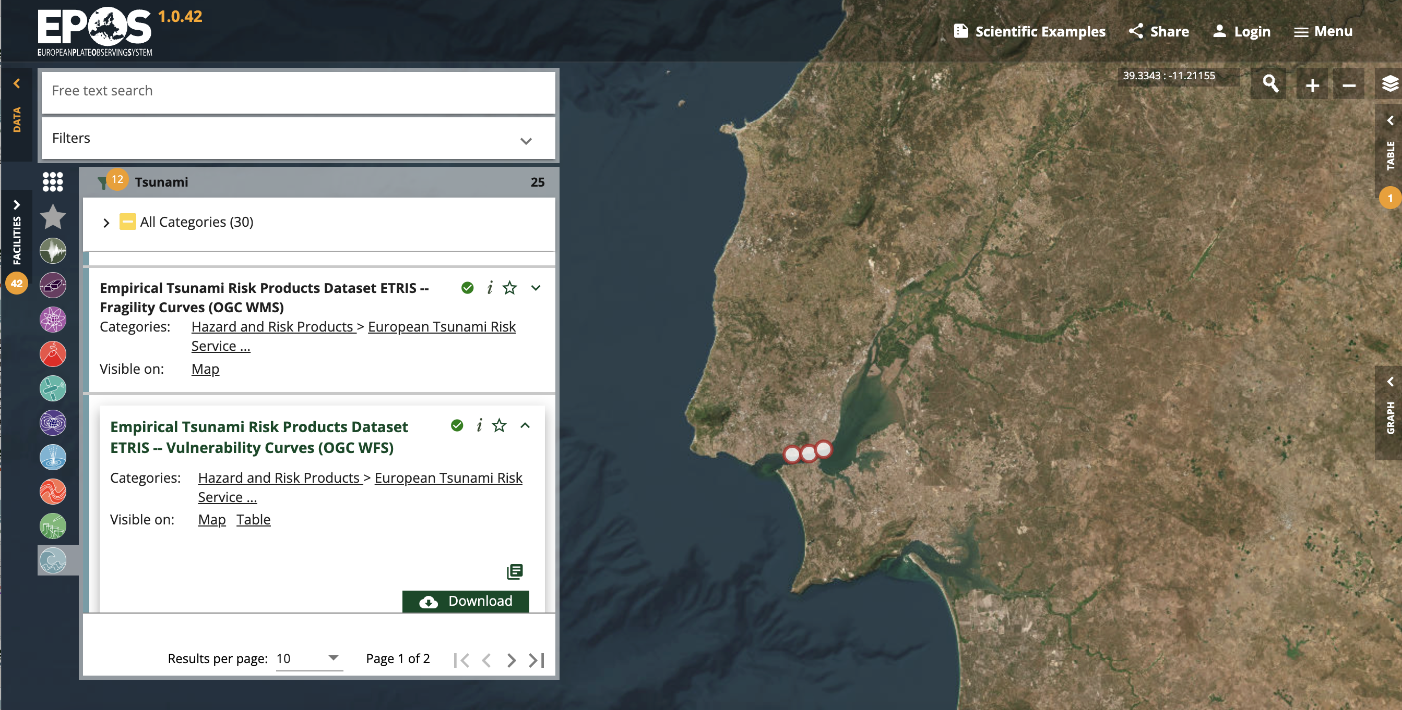
The European Tsunami Risk Service (ETRiS) https://eurotsunamirisk.org/
The Jupyter notebook “Visualize Fatality.ipynb” serves for visualising the Fatality curves available on this service.
https://eurotsunamirisk.org/tsunamirisktoolkit/
Jalayer F, Ebrahimian H, Trevlopoulos K, Bradley B (2023) Empirical tsunami fragility modelling for hierarchical damage levels.
Natural Hazards and Earth System Sciences 23(2):909-931. https://doi.org/10.5194/nhess-23-909-2023.

Slide 7
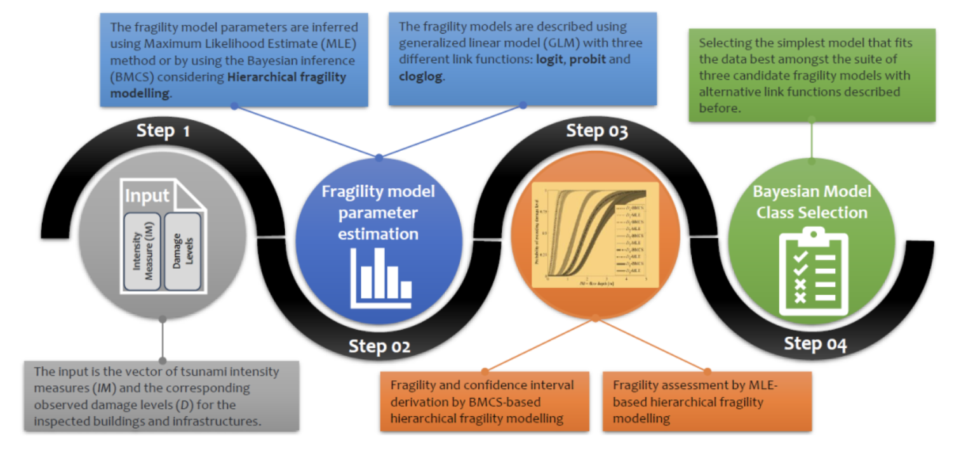
The European Tsunami Risk Service (ETRiS) https://eurotsunamirisk.org/
ComputeFrag (Version 1.0): Code for Bayesian empirical fragility modelling for a class of buildings or infrastructure (Hierarchical, Model Selection).
https://eurotsunamirisk.org/tsunamirisktoolkit/
Jalayer F, Ebrahimian H, Trevlopoulos K, Bradley B (2023) Empirical tsunami fragility modelling for hierarchical damage levels.
Natural Hazards and Earth System Sciences 23(2):909-931. https://doi.org/10.5194/nhess-23-909-2023.

Slide 8
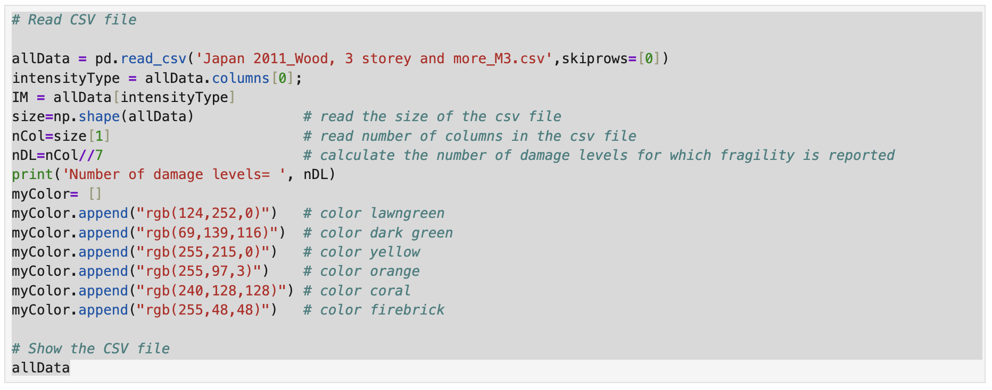
Jupyter Notebook: Visualise Fragility
Step 1: Read the CSV File, Assign Colours to damage levels

Slide 9
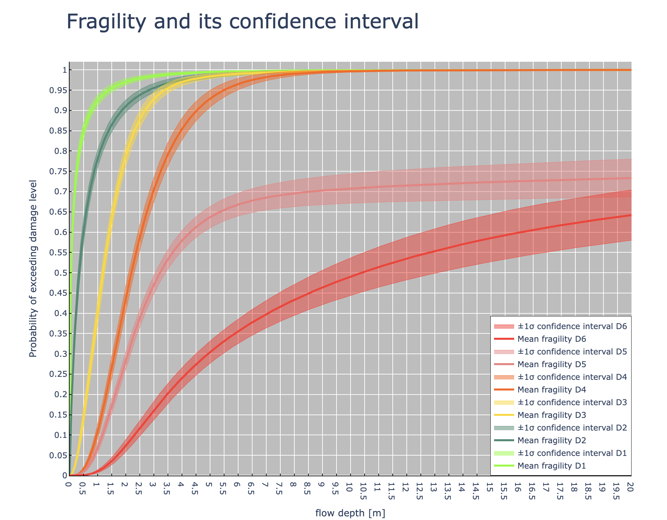
Jupyter Notebook: Visualise Fragility
Step 2: Plot the Fragility Curve for Different Damage Levels

Slide 10
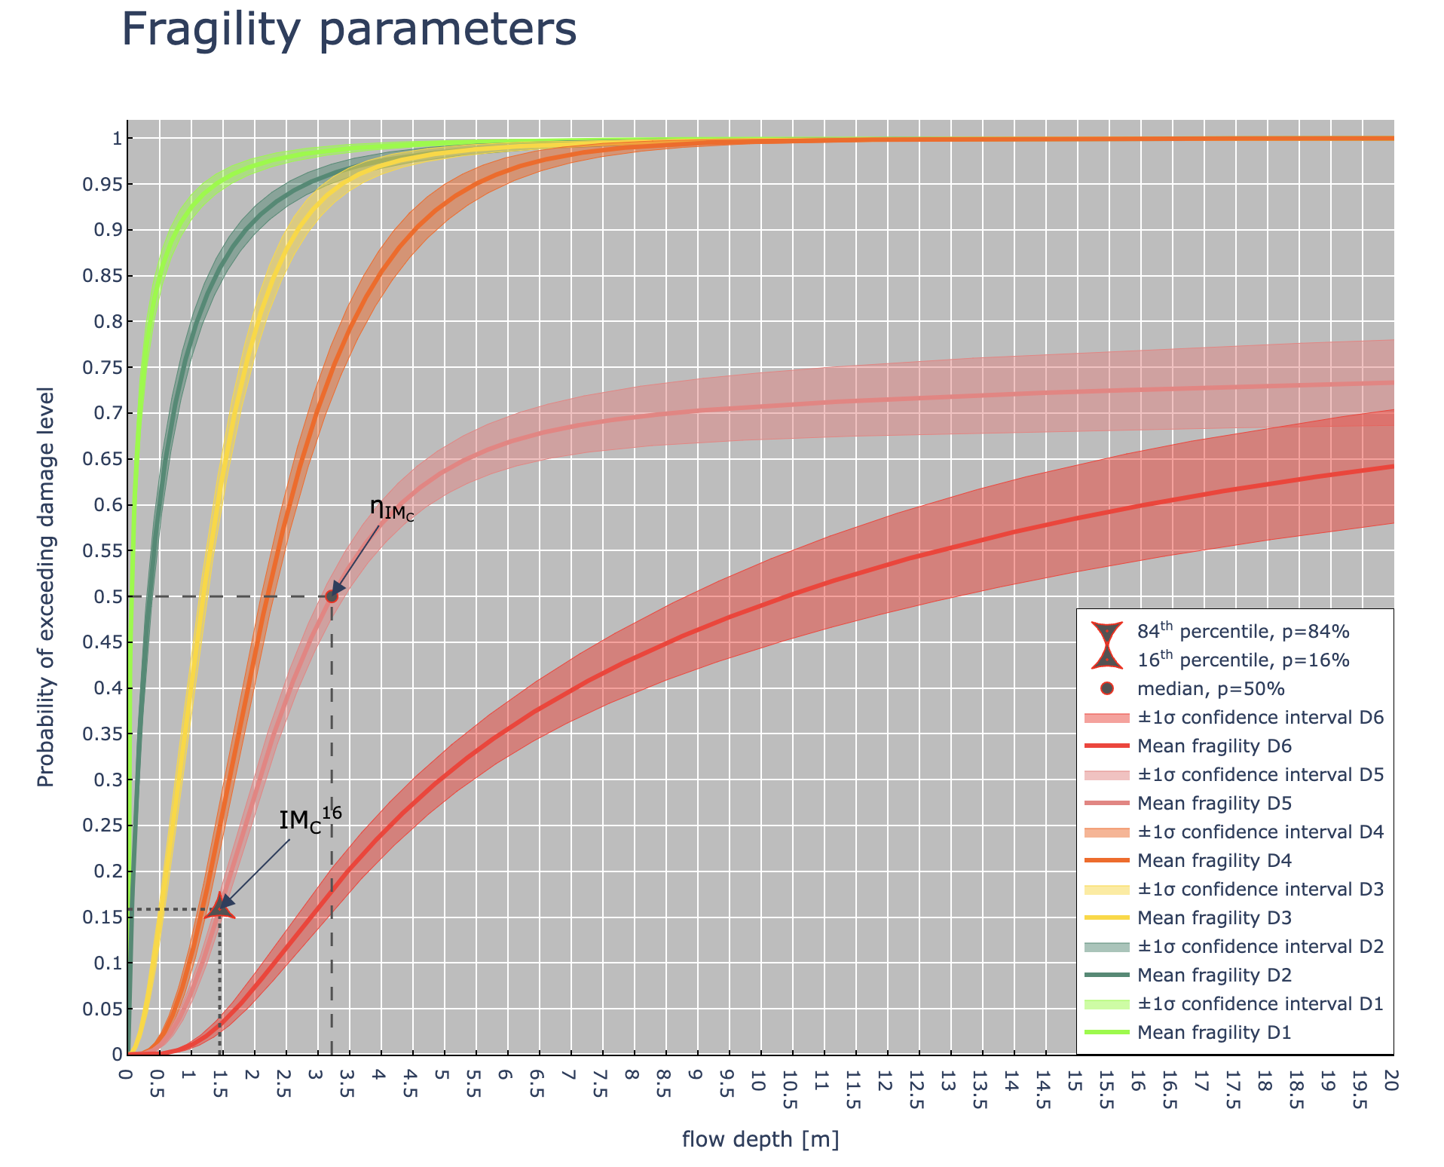
Jupyter Notebook: Visualise Fragility
Step 3: Estimating the parameters of the fragility curve
Step 4: Visualising the parameters of the fragility curve, for a specific damage level
The damage level for which to view statistics= 5
84th percentile cannot be defined on the fragility curve!

Slide 11
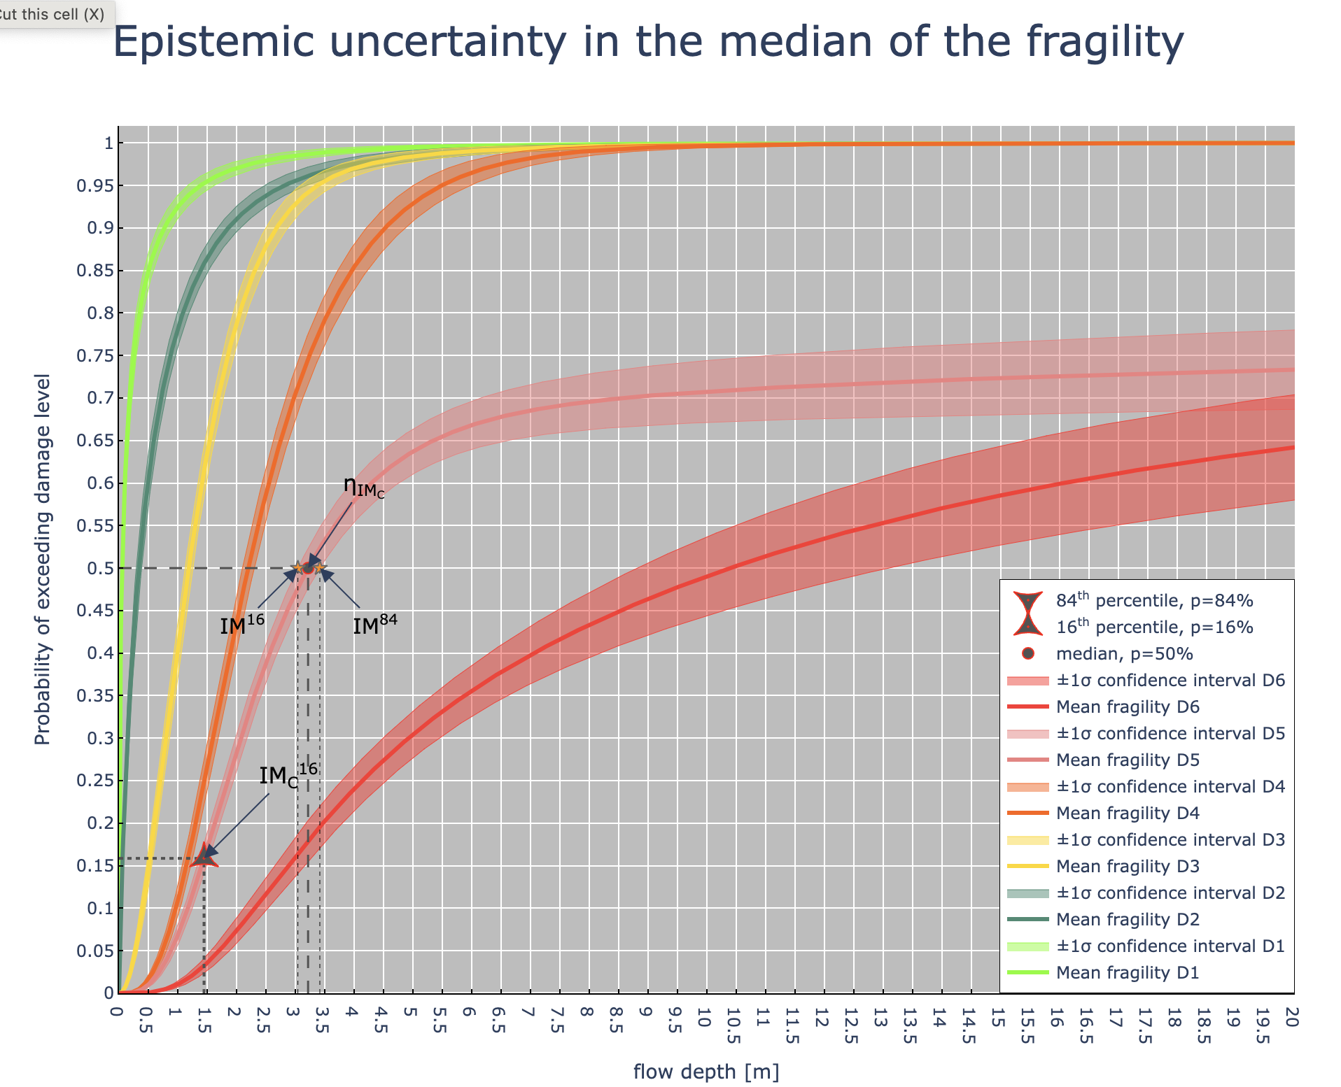
Jupyter Notebook: Visualise Fragility
Step 5: Estimating the parameters used for calculating the epistemic uncertainties
Step 6: Show the epistemic uncertainties
Fragility statistics for damage level = 5 median = 3.2165211057659735 meters logarithmic standard deviation = 0.7991027610863293 epistemic uncertainty = 0.05784323626957611

Slide 12
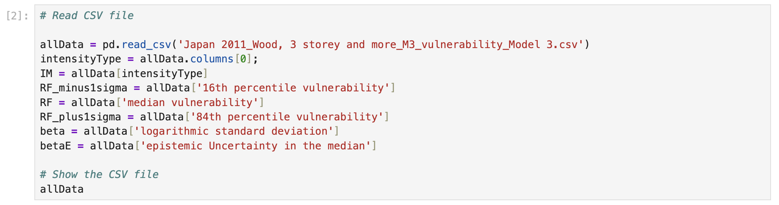
Jupyter Notebook: Visualise Vulnerability
Step 1: Read the CSV File

Slide 13
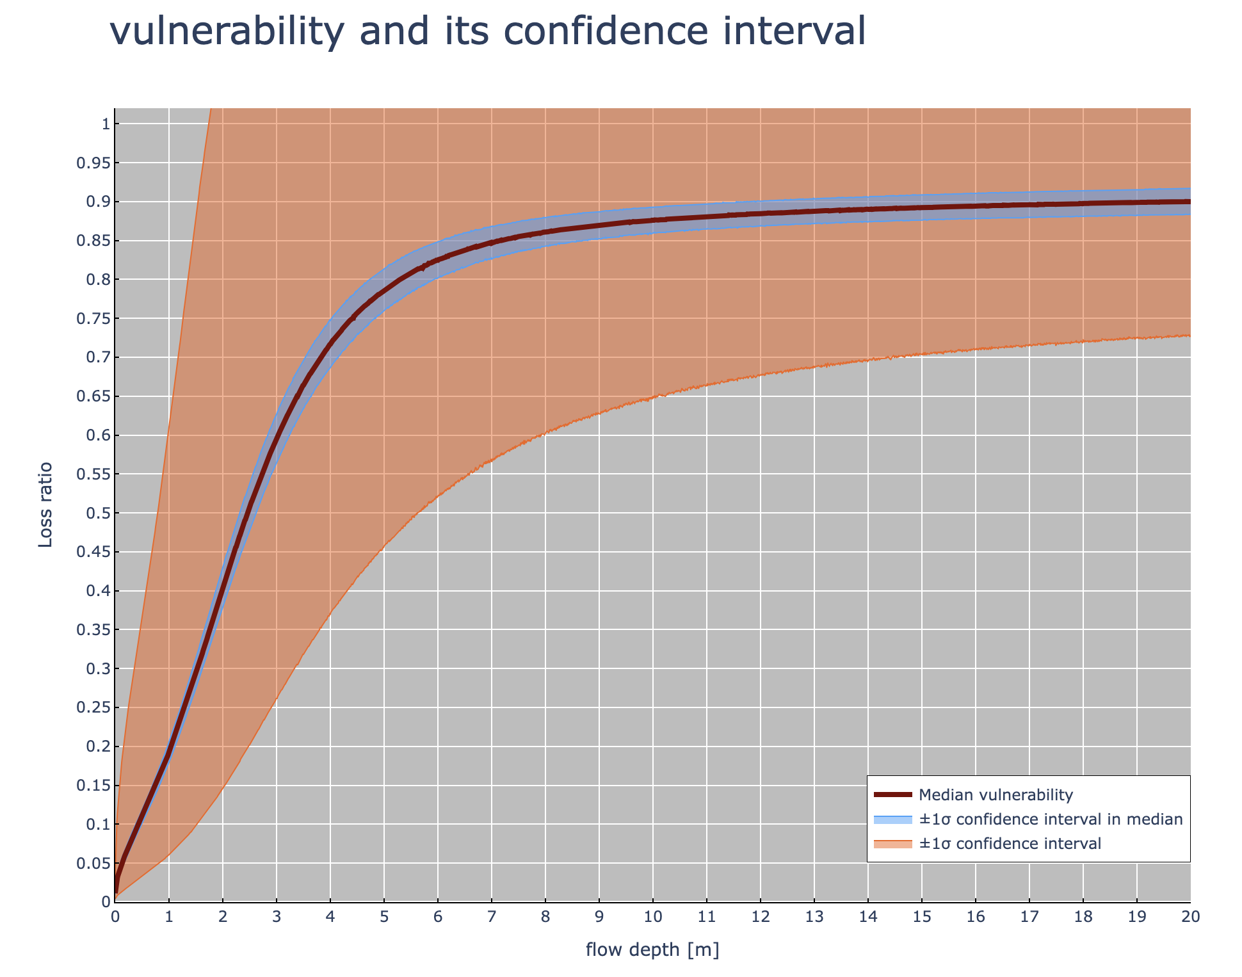
Jupyter Notebook: Visualise Vulnerability
Step 2: Plot the vulnerability curve

Slide 14
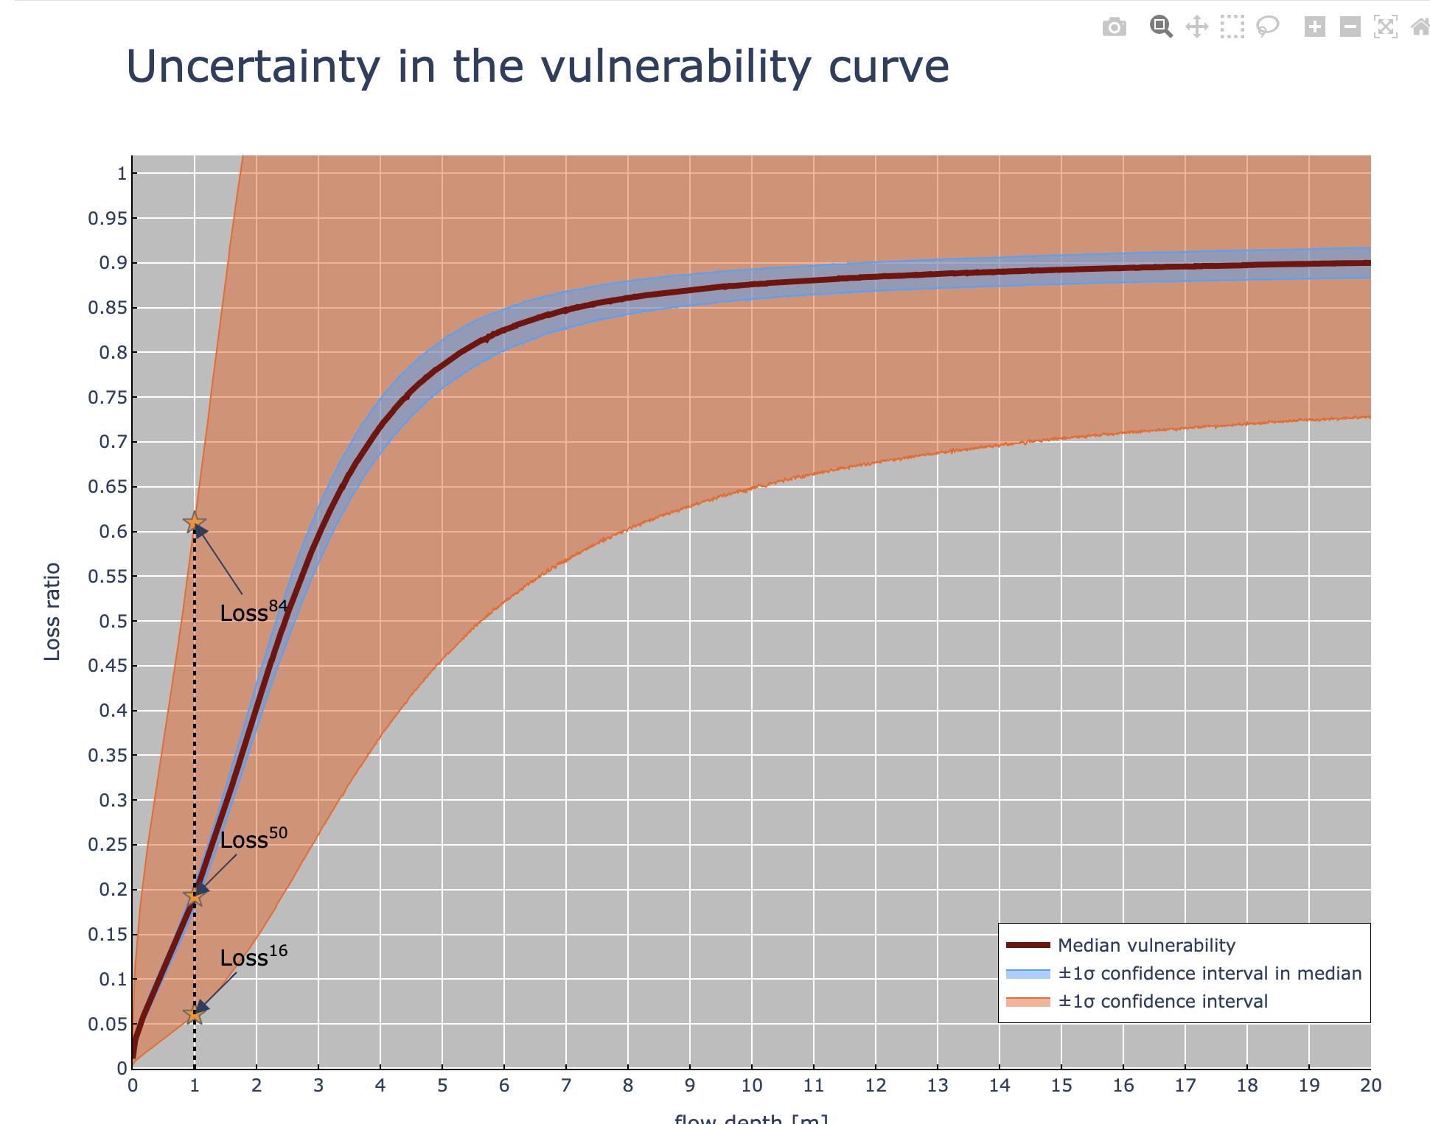
Jupyter Notebook: Visualise Vulnerability
Step 3: Estimating the 16th and 84th Loss Ratio Curves
Step 4: Plotting the 16th and 84th Loss Ratio Curves
median at flow depth 1.0m = 0.19259392228246 logarithmic standard deviation at flow depth 1.0m = 1.15215067264169 Epistemic uncertainty at flow depth 1.0m = 0.0692024019020181

Slide 15
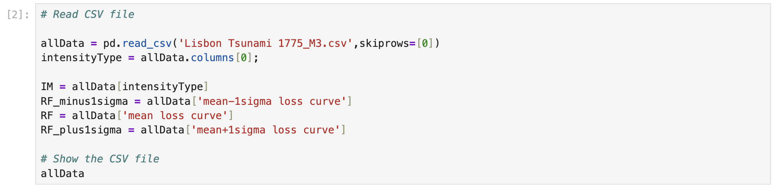
Jupyter Notebook: Visualise Fatality
Step 1: Read the CSV File

Slide 16
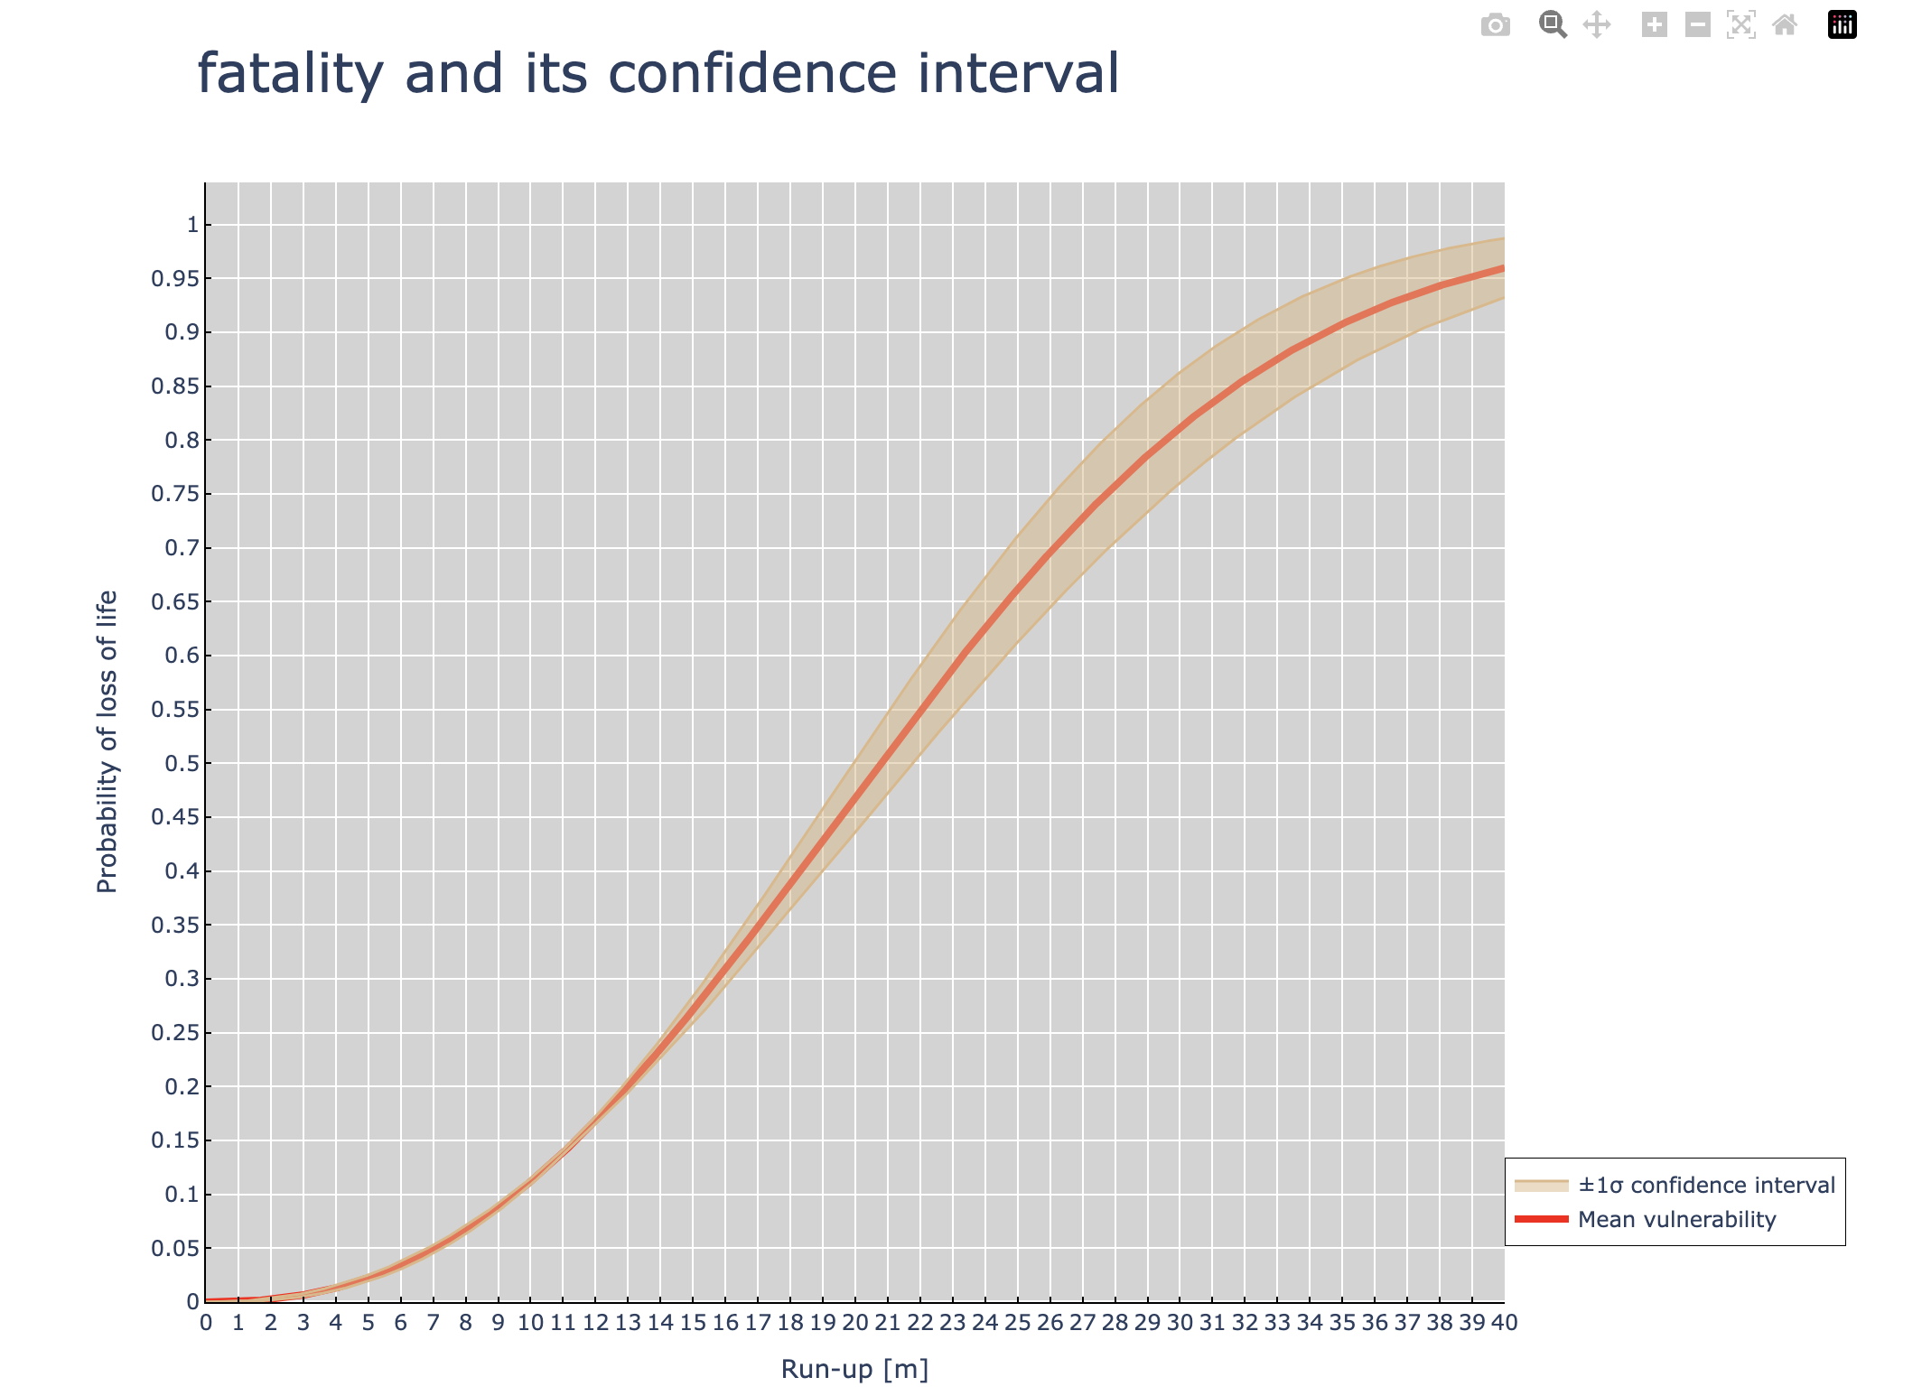
Jupyter Notebook: Visualise Fatality
Step 2: Plot the fatality curve

Slide 17
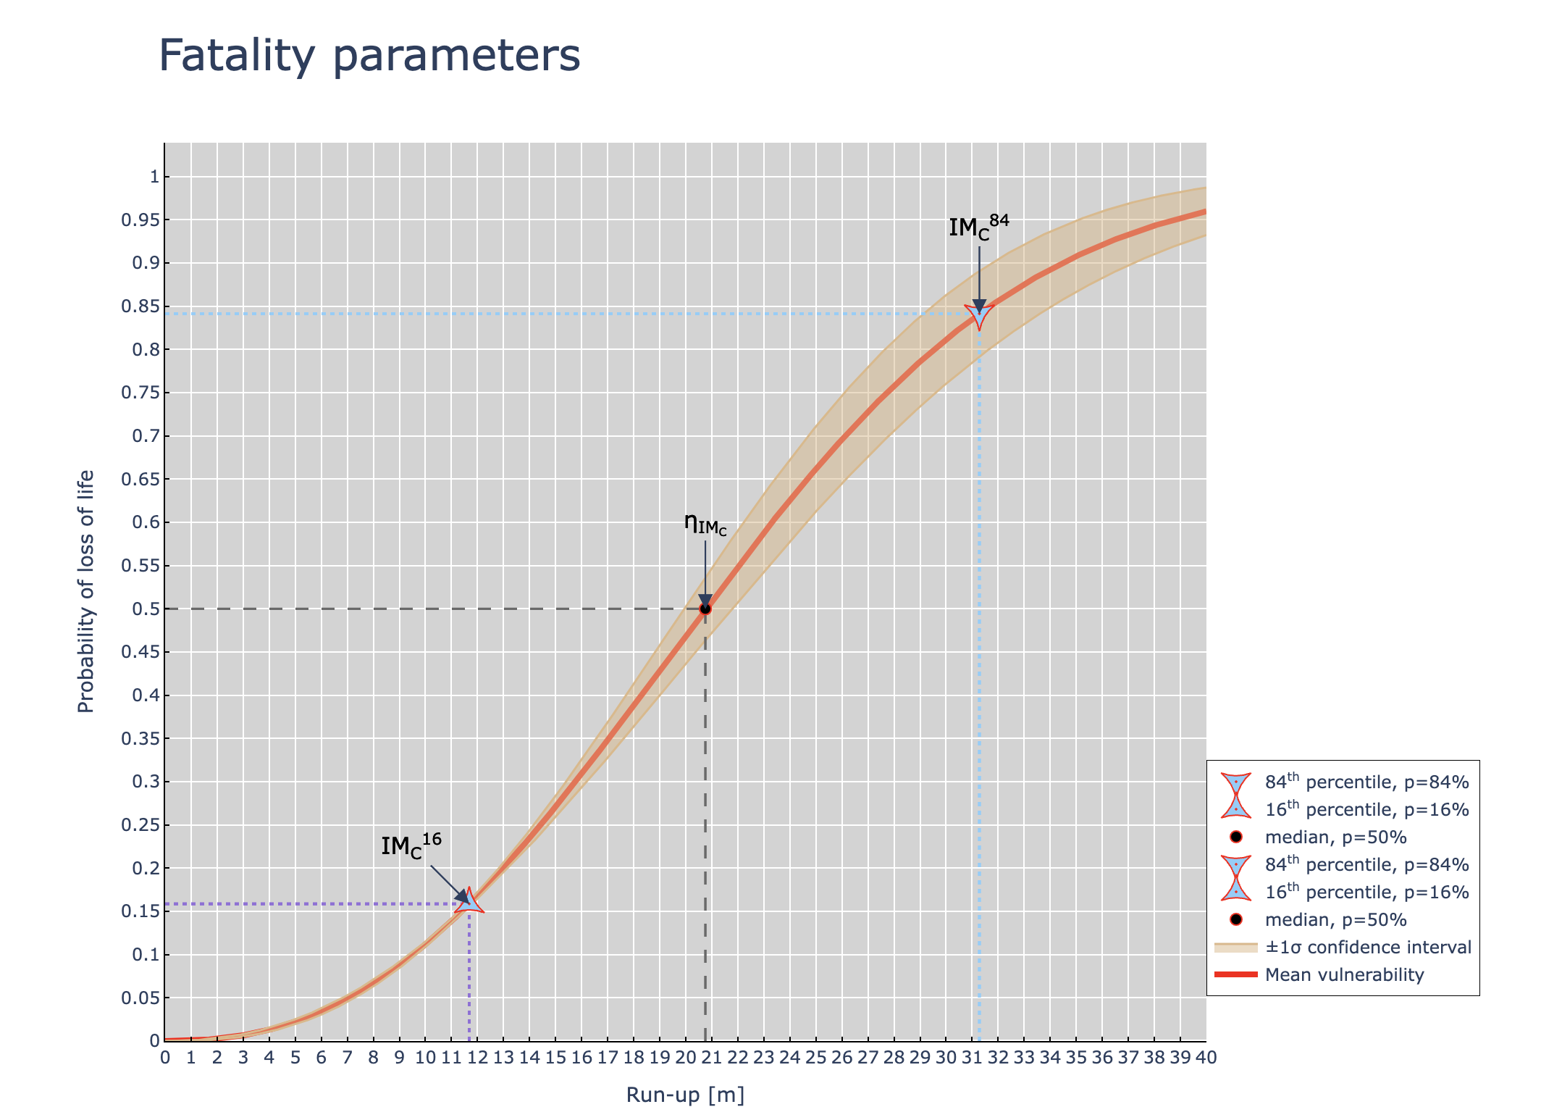
Jupyter Notebook: Visualise Fatality
Step 3: Read the fatality curve parameters
Step 4: Plot the fatality curve parameters

Slide 18
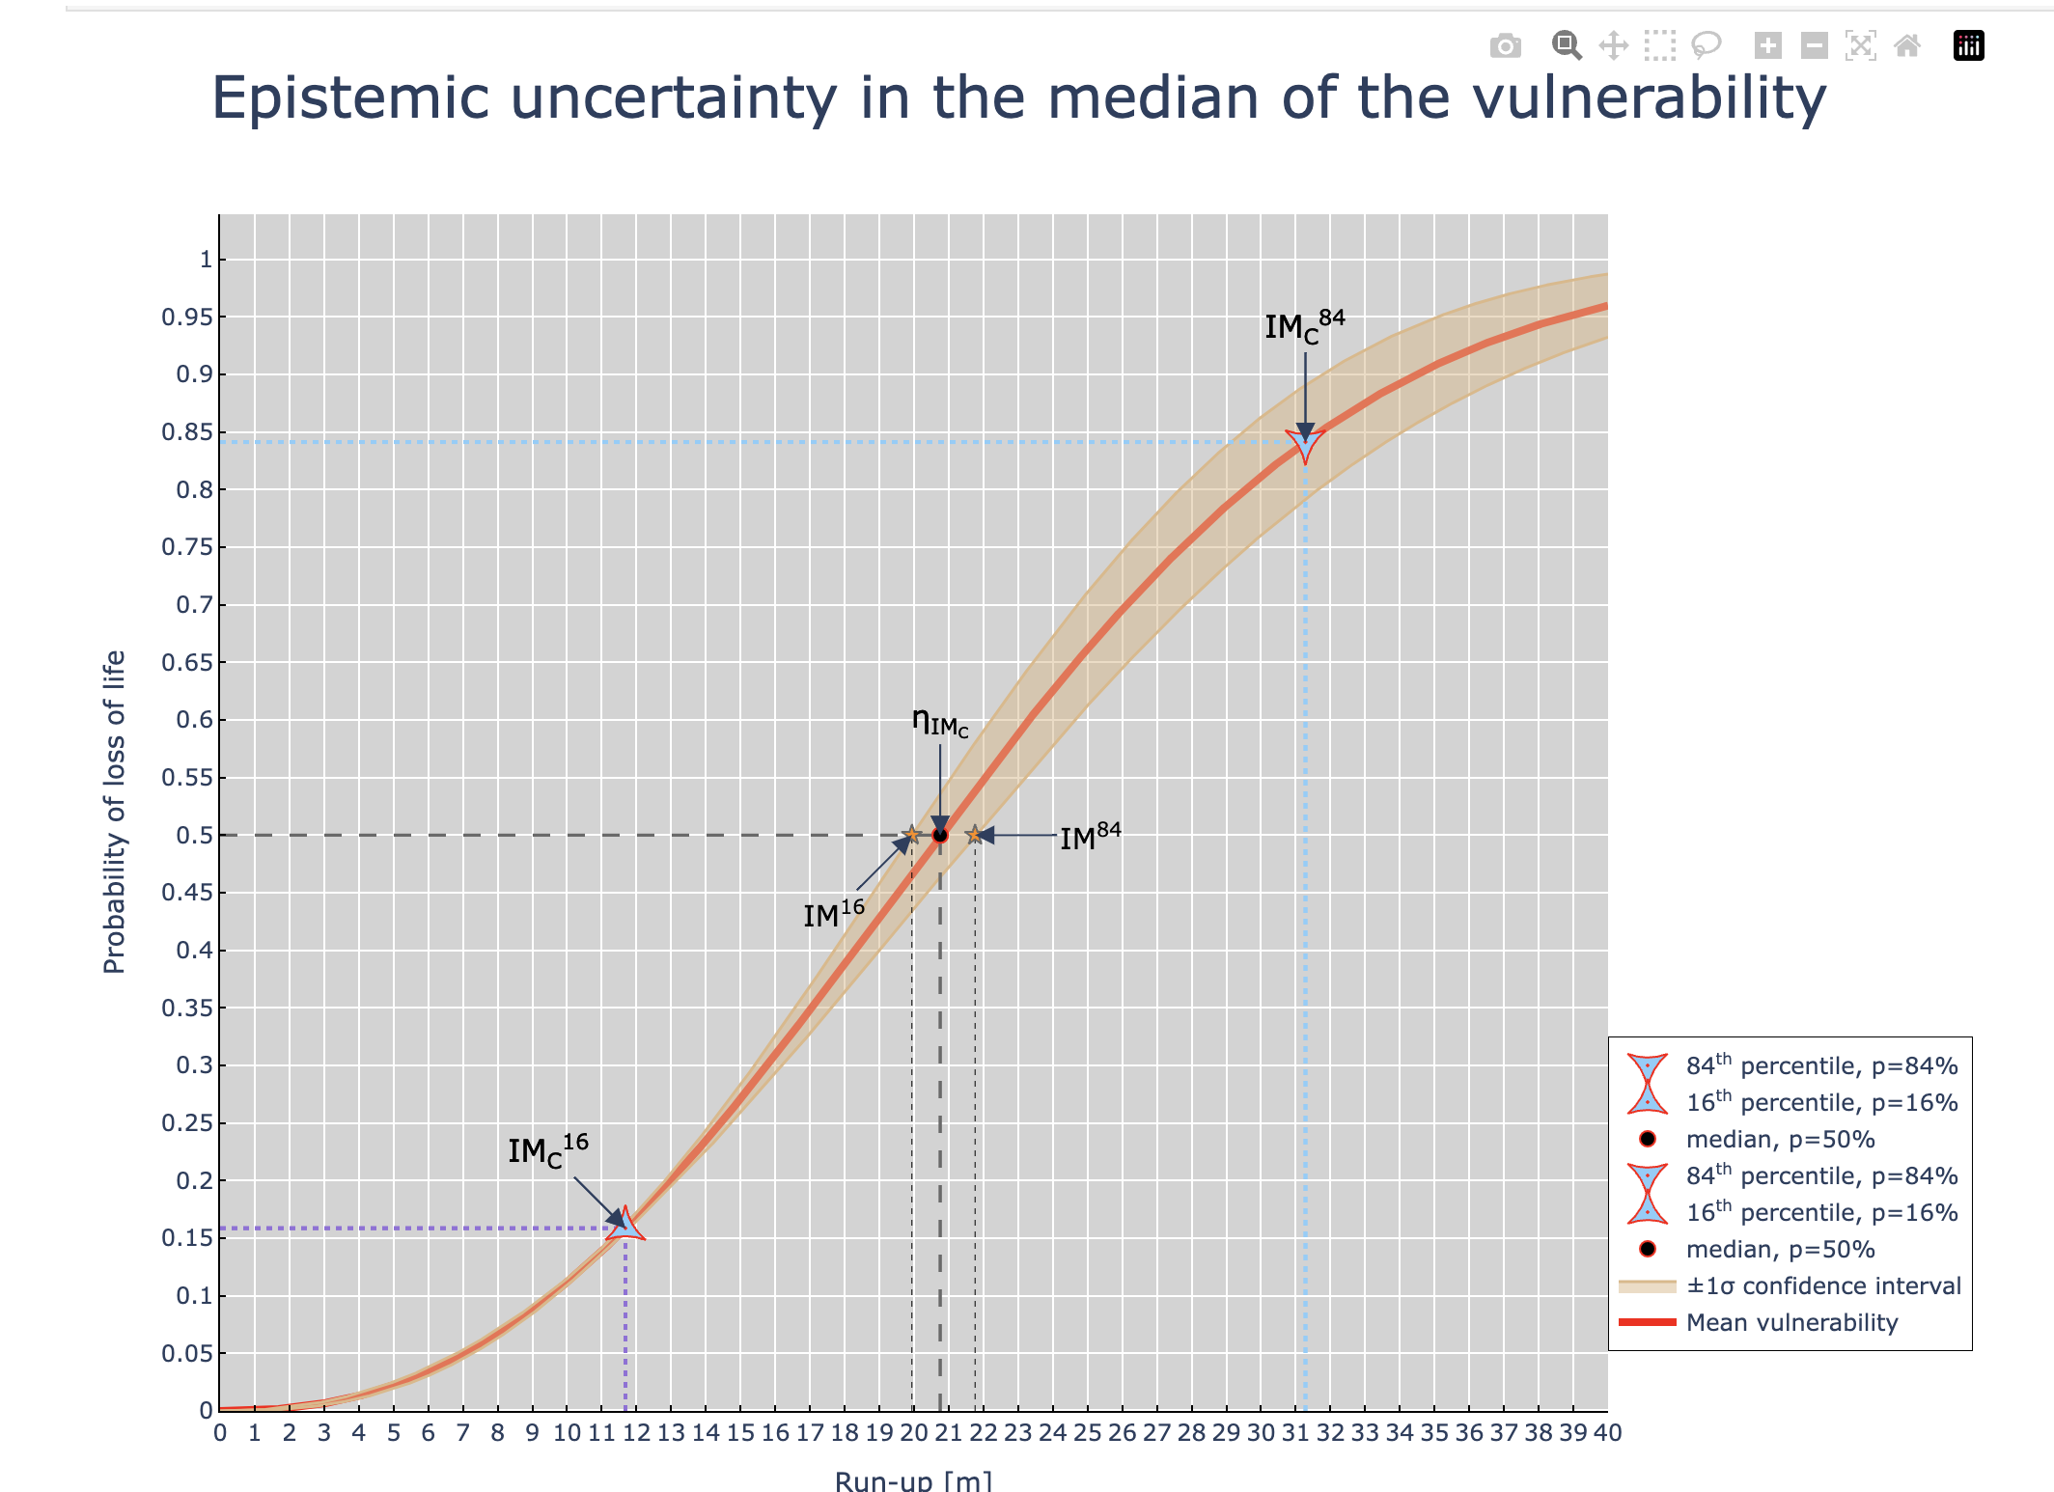
Jupyter Notebook: Visualise Fatality
Step 5: Read the epistemic uncertainty parameters
Step 6: Plot the epistemic uncertainty parameters

Slide 19


The Tsunami Risk Modeller’s Toolkit
Software and tools for tsunami risk analysis
Thank you!

