Slide 1
EPOS-RO a multidisciplinary National Research Infrastructure

Slide 2
History
EPOS
Implementation Phase
EPOS
Sustainability Phase
EPOS
Preparatory Phase
EPOS
Optimisation and EvolutioN
2010-2014
2015-2019
2020-2023
2024-2026
Romania, represented by the Romanian National Institute for Research and Development for Earth Physics (INCDFP), has been involved in the EPOS project from the beginning and participated in all phases of the project (Preparation Phase, Implementation Phase and Sustainability Phase) along with other Universities and European research institutions.
During the 8th EPOS ERIC General Assembly remote meeting organized on 15-16 December 2020, Romania joined the EPOS ERIC as official member.

Slide 3
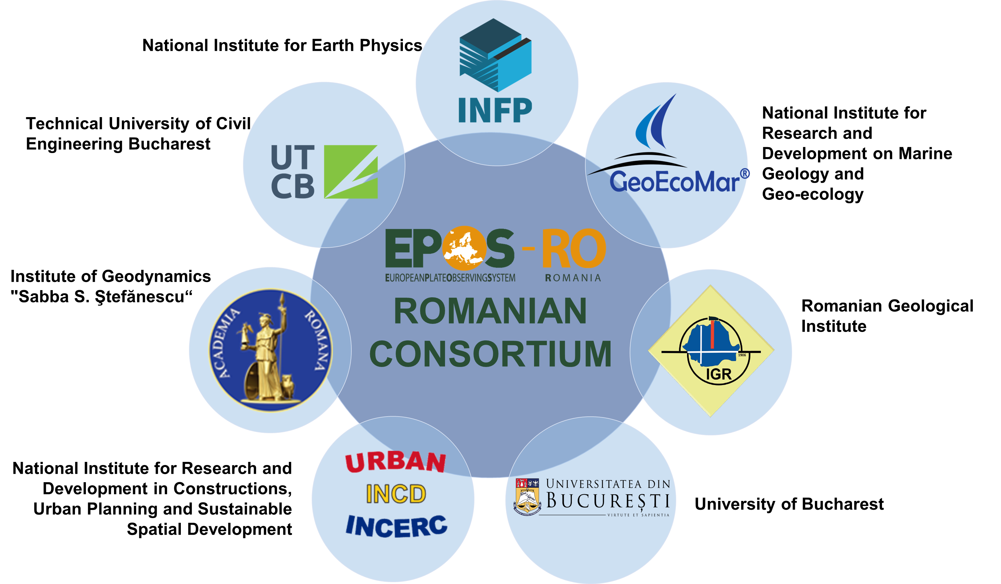
General Background

Slide 4
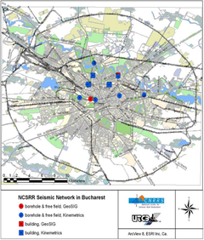
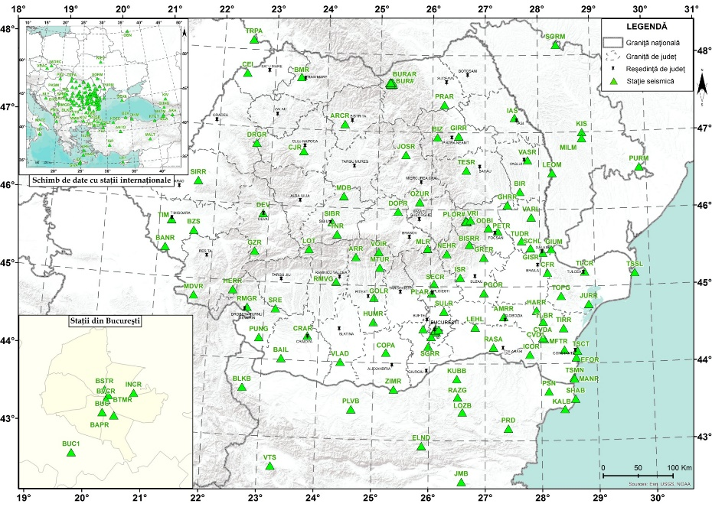
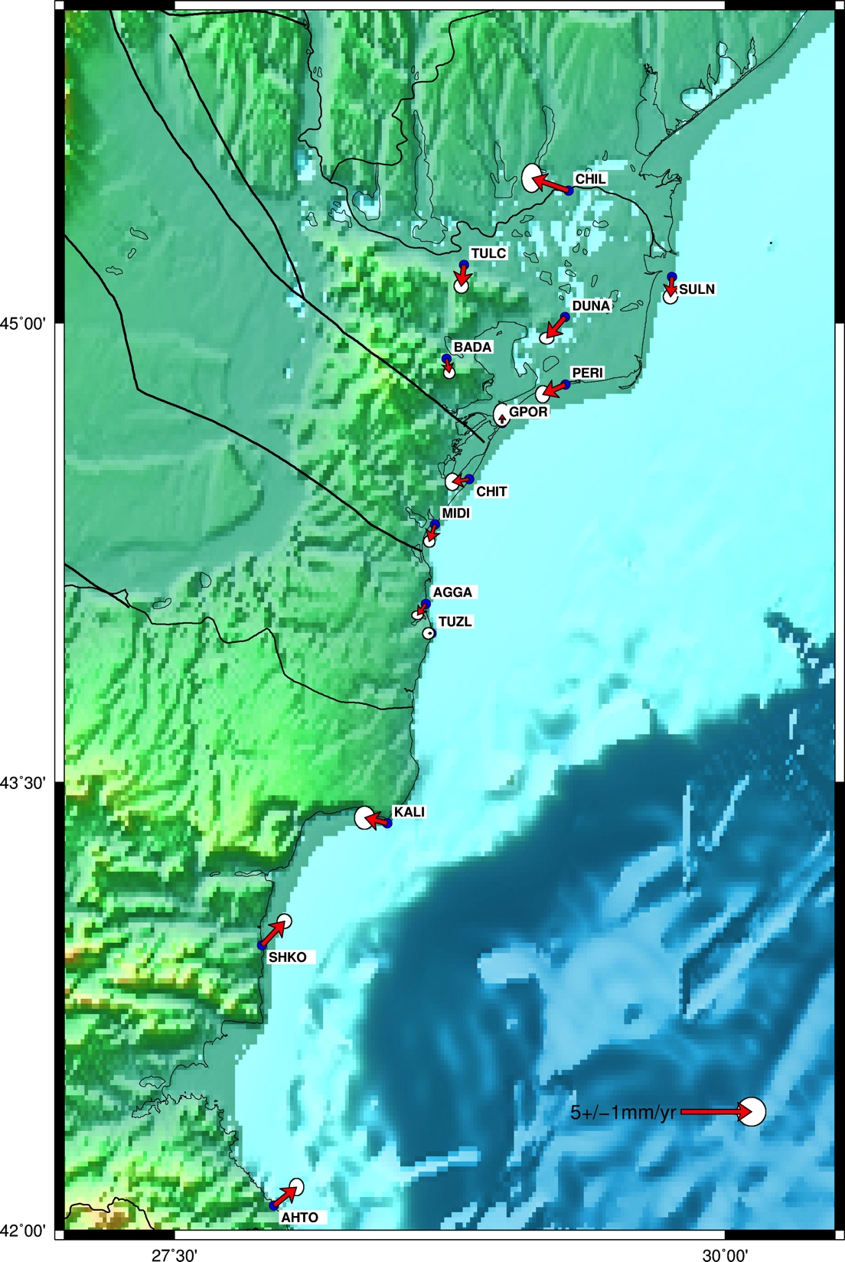
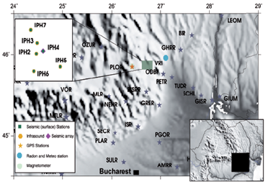
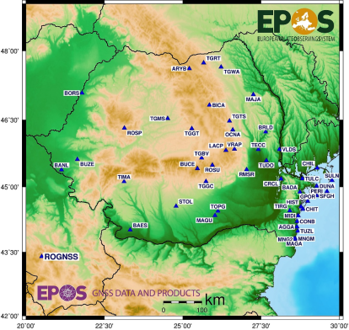
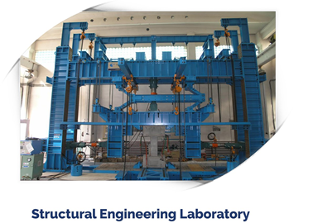
EPOS-RO Architecture
THEMATIC CORE SERVICES
ROMANIAN RESEARCH INFRASTRUCTURE & DATA CENTRE

Slide 8
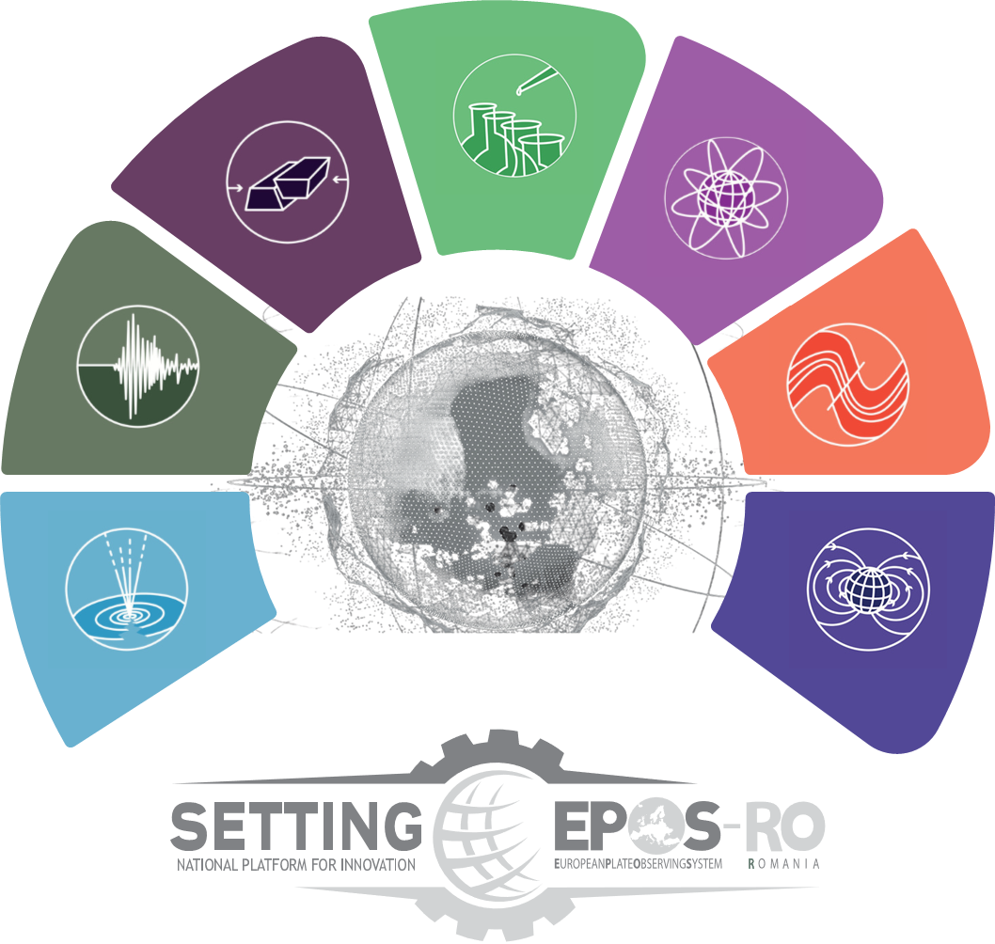
Integrated thematic services in the field of Earth observation - a national platform for innovation (SETTING) 2021-2023
Strengthen research and innovation in Earth Sciences and increase participation in European research in this field by:
Ensuring visibility and access to interoperable multi-disciplinary data available at the national and international level
Coordinating and operating a distributed infrastructure capable of providing services, facilitating new research, and generating new products
Developing and implementing modern IT tools to facilitate standardization, integration, and access to large volumes of data

Slide 9
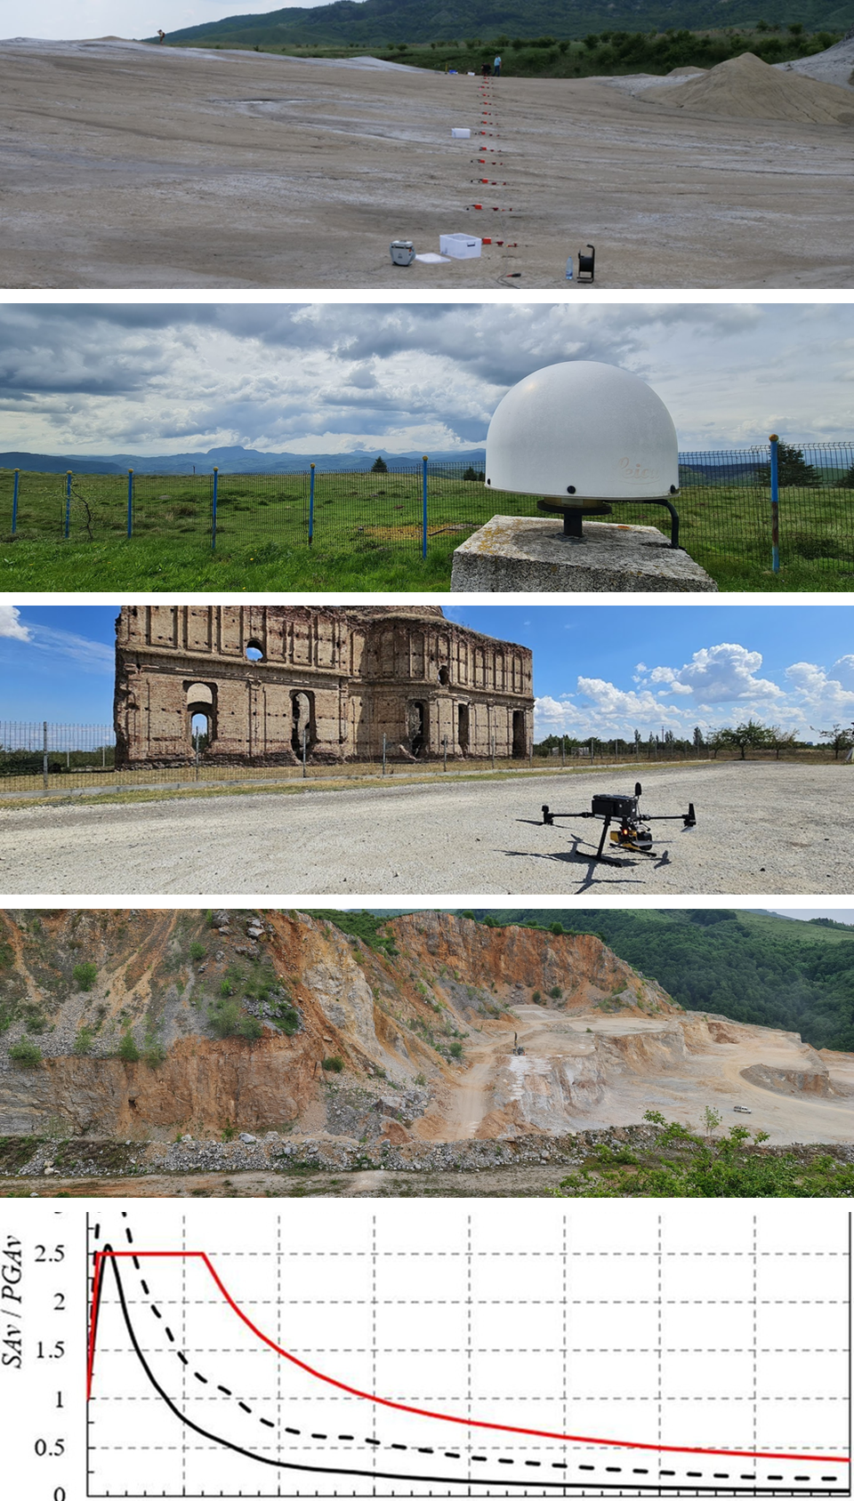
Research study cases integrated into the SETTING portal
Case studies resulting from multidisciplinary measurement campaigns will be presented. The data collected and the products generated were integrated into the SETTING platform and opened by publication in scientific articles to the scientific community for reuse.
A Compact Mobile Seismic Network Using Wireless Seismic Units for Various Geophysical Investigations
Unconventional sensors and new technology integration in SETTING framework for the monitoring of active tectonics and geodynamics of the Romanian territory
Multi-Data Integration in Near-Surface Geophysics and Close Range Remote Sensing Applied to Cultural Heritage, Chiajna monastery study case
Broadband characteristics of the quarry blasts at Suseni (Romania) exploitation site from temporary and permanent seismic stations’ recordings
An investigation of vertical response spectra of ground motions from Vrancea seismic source

Slide 10
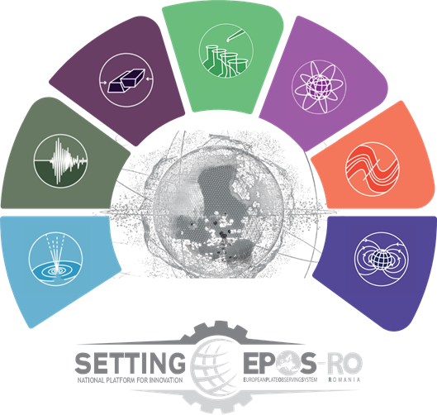
FUTURE PERSPECTIVES:
ROMANIAN RESEARCH
IN SUPPORT FOR EPOS
Preparing data, products and services to be integrated in
EPOS-RO, SETTING and EPOS portal
Using the new instruments to collect new and valuable data (e.g absolute gravimeter and Mobile instrument pool)
portal.epos-ro.eu
Submitting a new proposal (national support) for developing new and multidisciplinary studies to the framework of the EPOS-RO
eposeu
EPOSeu
epos-eu.org/dataportal

