Slide 1
Epos-France
Engagement with the funders: a case study

Slide 2
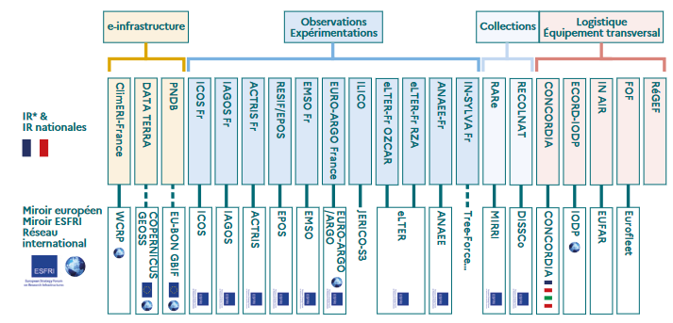
Roadmap of RI’s of the French Ministry for Research

Slide 3
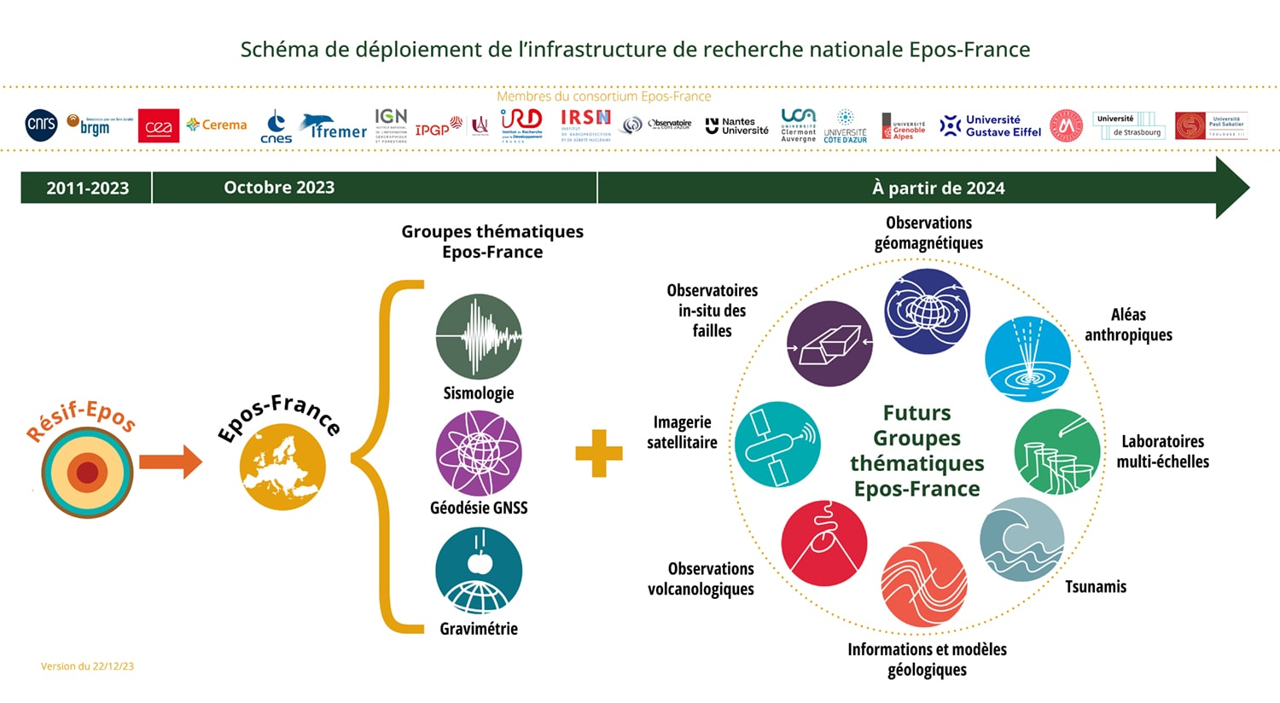
Epos-France was launched in Nov. 2023

Slide 4
Coordinator of Epos-France is CNRS-INSU
Consortium of 19 organisms: 9 universities, 2 observatories with special status (IPGP, OCA) and 8 public organisms with commercial interest (BRGM, CEA, Cerema, Cnes, Ifremer, IGN, IRD, IRSN)

