Slide 1
The European Plate Observing System EPOS
EPOS-PL: infrastructure, achievements and prospects
Presentation based on:
Polish Research Infrastructure Roadmap : EPOS 2020-24
Overview for the Ministry of Science and Higher Education, Jan. 21st 2025
Marek Lewandowski
EPOS National Node (since Dec. 16th, 2024, VEC)
EPOS Days
Perugia, March 2025

Slide 2
Epos
A type of poem,
focusing on the tales of national heroes and their histories.
Homer, the Father of Epos
Iliad and Odyssey

Slide 3
EPOS - what does it mean today for me?
EPOS is the biggest European infrastructural programme in solid Earth sciences.
The goal of EPOS is to organize an open exchange of scientific and monitoring data for joint analysis and interpretation within the framework of European scientific cooperation for the better understanding of geological and environmental processes occurring within the European plate.
In the future, EPOS is going to expand globally, becoming rather an European System for the Earth Observation (ESEO)

Slide 4
EPOS-PL infrastructure
The infrastructure of EPOS-PL is supported by the following members of the EPOS-PL consortium:
Academic Computer Centre Cyfronet AGH (CYFRONET)
Central Mining Institute-National Research Institute (GIG-PIB)
Institute of Geodesy and Cartography (IGiK)
Institute of Geological Sciences, PAS (ING PAS)
Institute of Geophysics, PAS (IG PAS, consortium leader)
Military Technical Academy (WAT)
Space Research Center, PAS (CBK PAS)
Wrocław University of Environmental and Life Sciences (UPWr)

Slide 5
EPOS-PL Research Infrastructure Centers
CBK PAS+UPWr+WAT: GNSS data repository and sharing
CBK PAS: atomic time calibration and distribution
CYFRONET: access point to TCS AH data, database services, computing and programming support
GIG-PIB+other RICs: seismic episodes data repository for the Upper Silesian mining area
IG PAS+IGS PAS: multi-scale analytical laboratories (paleomag Warsaw, geochemistry Cracow)
IG PAS: geomagetic and magnetotelluric data repository
IG PAS: induced seismicity, anthropogenic hazard (TCS AH)
IG PAS: lithospheric seismic data repository
IGiK: gravimetric data repository

Slide 6
EPOS-PL achievements 2020-2024
Bibliometric data
research articles based on the EPOS-PL database, published in JCR journals = 97
positively concluded PhD dissertations based on the EPOS-PL database = 14
Financial resources amounts 30+ Ma €
Purchased scientific instruments, computers and software = 5+ Ma €
Multilateral international cooperation
Societal values
increasing safety in the exploitation of natural resources
reinforcing reference satellite geodetic network and spatial reference systems
public access to many observational data

Slide 7
EPOS-PL a new edition from 2025 onward
Solid earth geophysics: from the crust down to the earth’s core
Geohazard induced by the anthropogenic and natural seismicity (raw material mining, landslides, fault-related methane emissions, glaciers dynamics)
GNSS and satellite imaging of the earth for environmental sciences
Data science in geosciences: big data acquisition, storage and mining
Contribution toward creation of a TCS gravimetry
Multiscale laboratories: from radiogenic elements and magnetic domains to environmental change and geotectonics
Development of autonomic and automatic geophysical instruments for remote areas

Slide 8
Extraterrestial research
Before we embark on astrobiological research,
let us practice in the remote, rocky oases of Antarctica,
which serve as geological analogues for early Mars,
as well as the most underexplored continent on Earth.
Rocky oases are regions devoid of human interference, serving as ideal testing grounds for autonomous scientific instruments
(e.g. Bunger Hills, East Antarctica).

Slide 9
During the expedition in 2021/2022 to the Bunger Hills,
we performed test measurements in the fields of meteorology, ionosphere dynamics, geomagnetism, magnetotelluric,
and seismology (next slides)

Slide 10
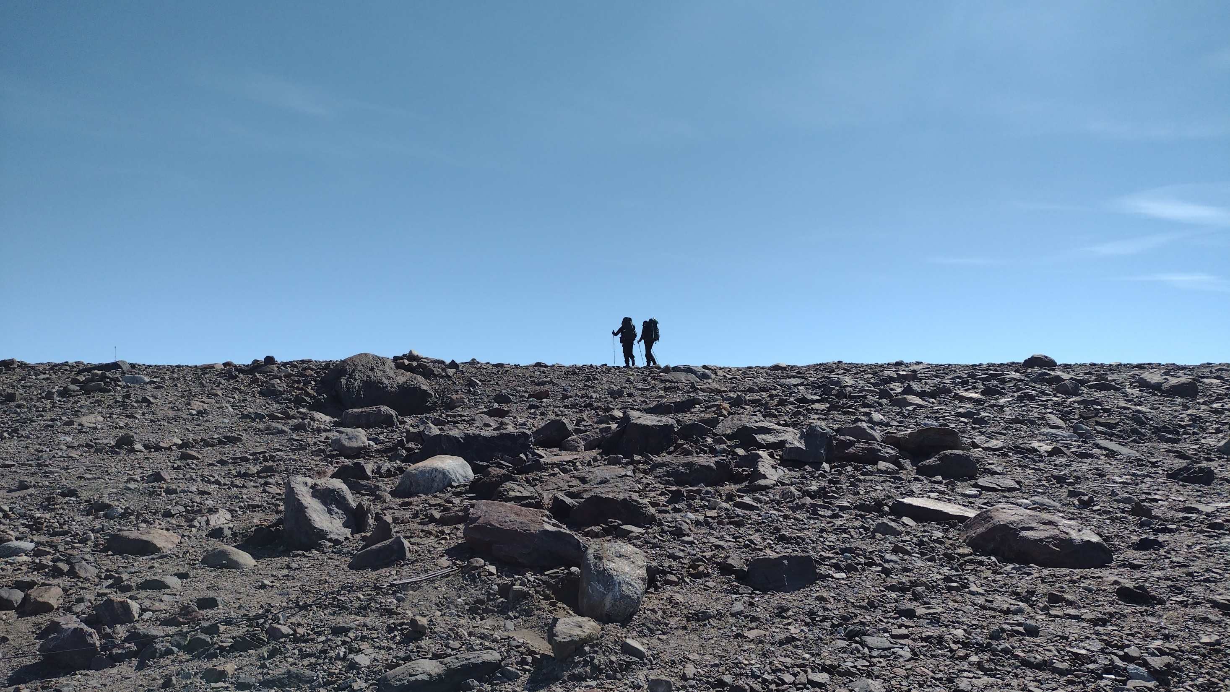
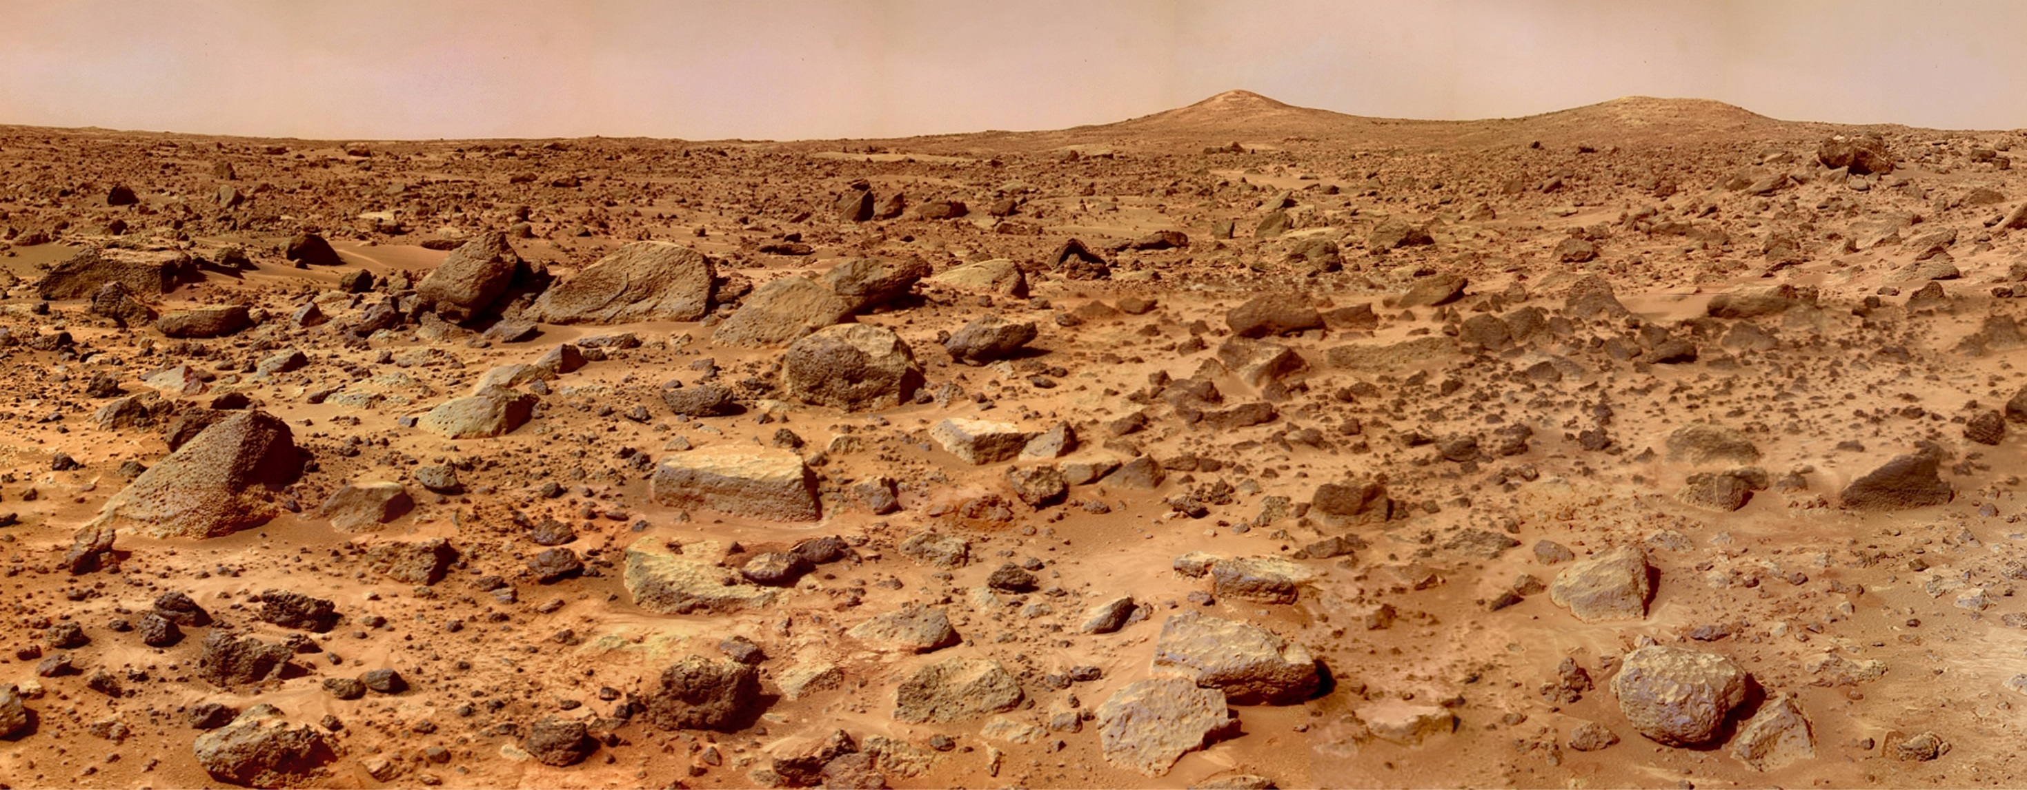
Similarities to Mars: temperature, winds, geomorpholgy, surface rocks properties

Slide 11
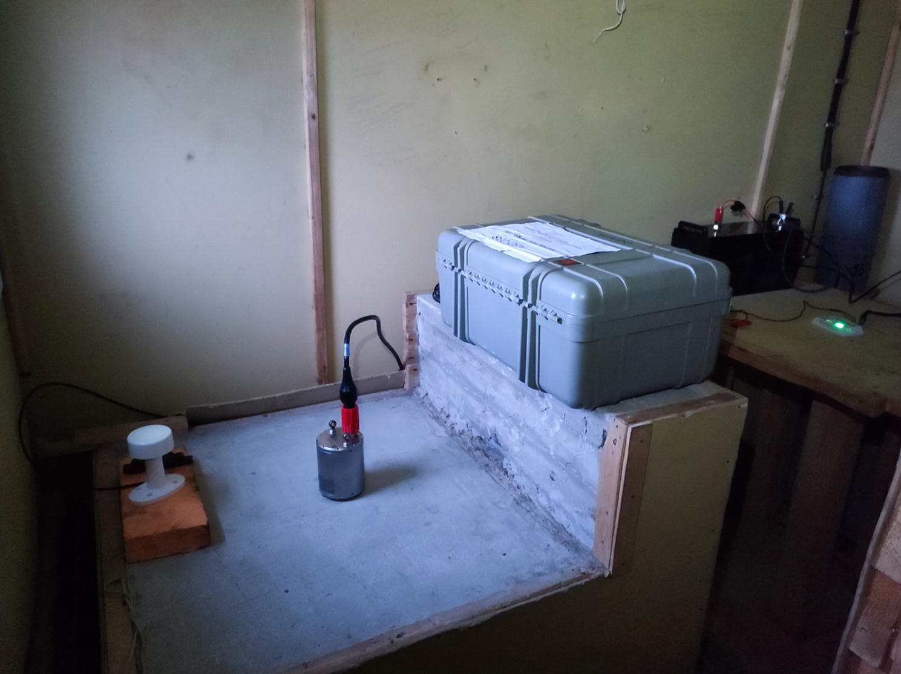
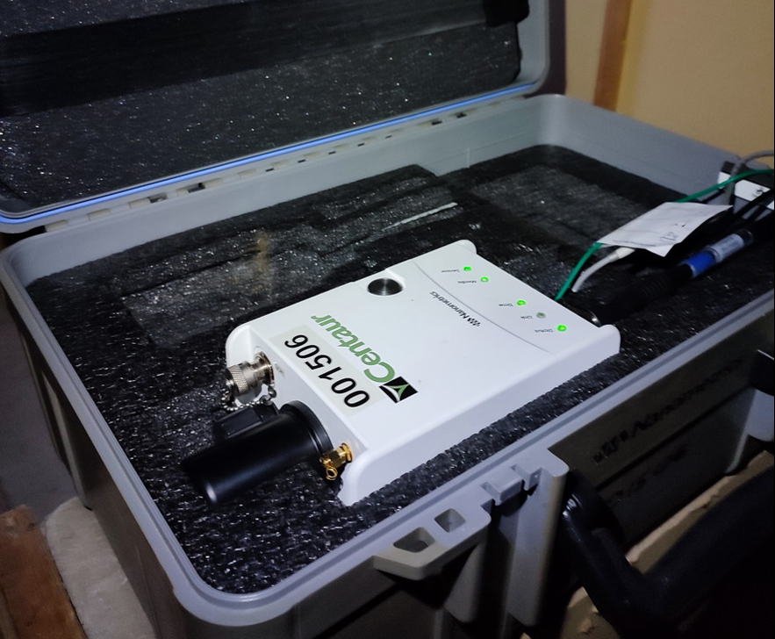
Nanometrics
broadband seismic station
Battery loaded
by solar cells
Recorder box
GPS
Trillium seismometer
Centaur 001506
seismic digital recorder
Concrete pedestal

Slide 12
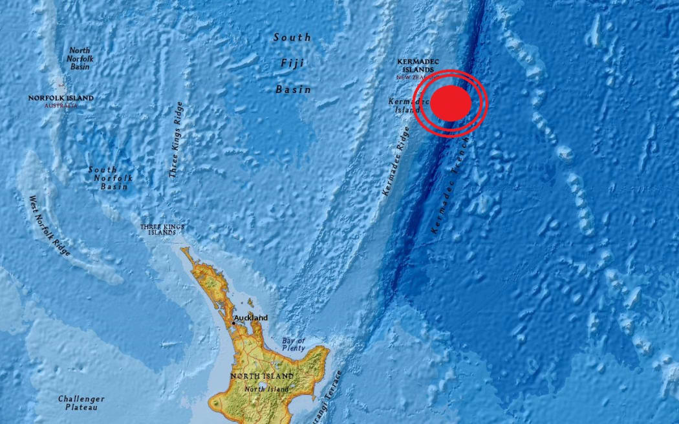
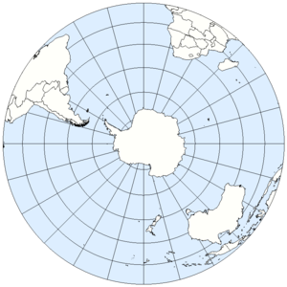
USGS DATA:
M 6.5 - Kermadec Islands region Time 2022-01-29 02:46:39 Location 29.564°S 176.722°W Depth 8.0 km
The islands are volcanic arc, formed at the convergent boundary, where the Pacific Plate subducts under the Indo-Australian Plate.

Slide 13
EPOS-PL thank you for your attention
Summary
Interested in conducting scientific research?
Establish the necessary infrastructure.

