Slide 1
EPOS-SI consortium and Slovenian Research and Innovation Agency March 19, 2025 – National Nodes and Consortia (Case Histories)
Authors: Stanka Šebela, Uroš Novak and Magdalena Năpăruş-Aljančič
ZRC SAZU, Karst Research Institute, Postojna, Slovenia
EPOS DAYS, March 17-21, 2025, Perugia, Italy
Notes:
Title slide

Slide 2
EPOS Slovenia
In 2011 EPOS was included in the Slovene national roadmap for the development of research infrastructure (NRRI, Ministry of Science, Republic of Slovenia, 2011 – 2020) with status as future extension project https://www.gov.si/assets/ministrstva/MVZI/Znanost/do-2020-Strategije-predpisi-in-drugi-dokumenti/Nacrt-razvoja-raziskovalnih-infrastruktur-2011-do-2020-revizija-2016.pdf. In 2016 after the review of NRRI, EPOS become a full member project of NRRI | In 2013 October 23th, Slovenian Ministry of Education, Science and Sports signed the Letter of Intent for Slovenia‘ cooperation in EPOS consortium.
Notes:
3 slides describing the background of EPOS, explaining importance of open science. Research supported by public funds should be made available to public again.

Slide 3
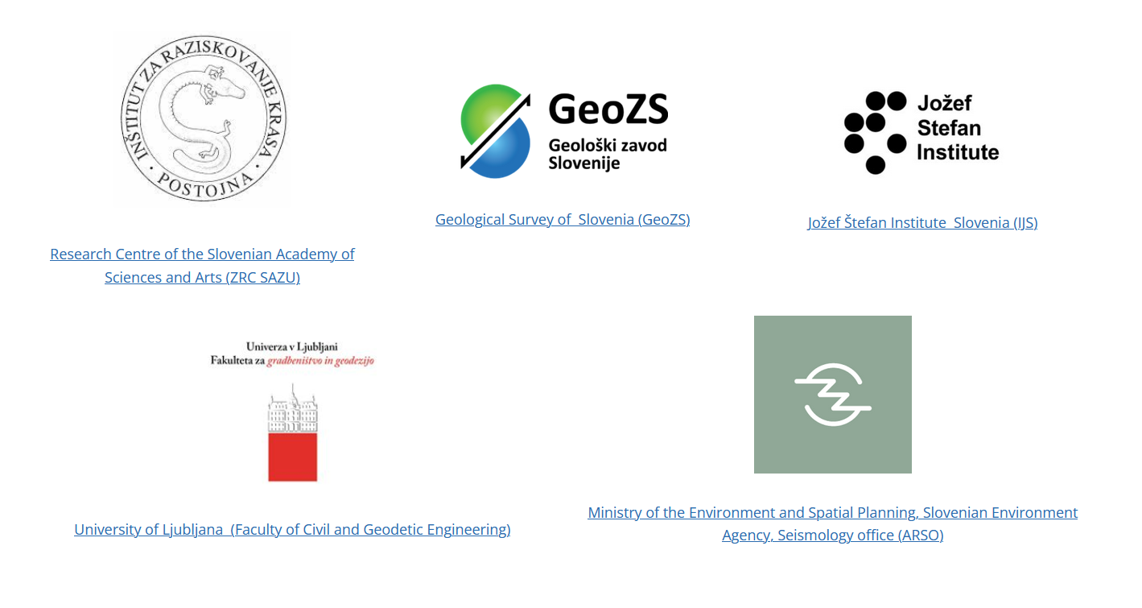
EPOS Slovenia consortium (https://epos-ip.zrc-sazu.si/):
Karst Research Institute ZRC SAZU – leading partner and national coordinator;
Geological Survey Slovenia (GeoZS)
University of Ljubljana (Faculty of Civil and Geodetic Engineering, UL-FGG)
Jožef Stefan Institute Slovenia (IJS)
Ministry of the Environment and Spatial Planning, Slovenian Environment Agency, Seismology office (ARSO)
Dr. Albin Kralj: Member of the EPOS ERIC General Assembly. He works at the Slovenian Ministry of Higher Education, Science and Innovation and is a national delegate in ESFRI.
Dr. Stanka Šebela: the coordinator of the EPOS Slovenia National coordinator.
In 2016 May 4th - the national consortium EPOS-SI was established.
Notes:
3 slides describing the background of EPOS, explaining importance of open science. Research supported by public funds should be made available to public again.

Slide 4
EPOS Slovenia
In 2018 October 30th, the European Commission granted the legal status of European Research Infrastructure Consortium (ERIC) to EPOS. Slovenia is one of the countries in establishment of EPOS-ERIC starting from 1st November 2018.
Notes:
3 slides describing the background of EPOS, explaining importance of open science. Research supported by public funds should be made available to public again.

Slide 5
EPOS Slovenia
Since 2015 Slovenian Research and Innovation Agency is annually funding EPOS Slovenia Research Infrastructure project (in 2015 – 2021 directly to ZRC SAZU). From this sum in 2021 to 4 EPOS SI partners financial support was granted for participation at www site (https://epos-ip.zrc-sazu.si/). | http://www.aris-rs.si/sl/
Notes:
3 slides describing the background of EPOS, explaining importance of open science. Research supported by public funds should be made available to public again.

Slide 6
EPOS Slovenia
EPOS is full member project in the new Slovene national roadmap for research infrastructures NRRI (2020 – 2030) with ZRC SAZU as national coordinator.
Notes:
3 slides describing the background of EPOS, explaining importance of open science. Research supported by public funds should be made available to public again.

Slide 7
EPOS Slovenia
For the period 2022 to 2027 Slovenian Research and Innovation Agency granted to ZRC SAZU and EPOS-SI partners 6-yr long research infrastructure project I0-E017 (Co-financing of the International Research Infrastructure project EPOS) https://izrkp.zrc-sazu.si/sl/programi-in-projekti/sofinanciranje-izvajanja-mednarodnega-infrastrukturnega-projekta-epos. | Finances are for employment, material costs, scientific equipoment and travel costs.
Notes:
3 slides describing the background of EPOS, explaining importance of open science. Research supported by public funds should be made available to public again.

Slide 8
Co-financing of the International Infrastructure project EPOS
(https://izrkp.zrc-sazu.si/en/programi-in-projekti/co-financing-of-international-infrastructure-project-epos)
Programme ID I0-E017
Slovenian Research And Innovation Agency, Ministry of Higher Education, Science and Innovation
Planned activities of NRRI ESFRI project EPOS for the period 2022 to 2027:
Goal 1: Development of research community in Slovenia that works in the field of geosciences.
Goal 2: Maintainance and development of research infrastructure in Slovenia in the field of geosciences.
Goal 3: Direct cooperation in EPOS-ERIC activities.
Goal 4: To make aware researchers, academic communities and wider public about news related to geosciences.
Goal 5: Participation of RI EPOS activities at university studies.
Notes:
3 slides describing the background of EPOS, explaining importance of open science. Research supported by public funds should be made available to public again.

Slide 9
Current activities
ZRC SAZU – geological, seismological and environmental data, https://metadata.izrk.zrc-sazu.si , KarstDB , through EPOS ON (FRIDGE EPOS NFO https://fridge.ingv.it/)
GeoZS – geological data, https://egeologija.si/; Geological field observatories
ARSO – seismological data, https://potresi.arso.gov.si/
UL FGG – GNSS data, https://gu-signal.si/gnss/
IJS – radon and carbon dioxide data
Notes:
3 slides describing the background of EPOS, explaining importance of open science. Research supported by public funds should be made available to public again.

Slide 10
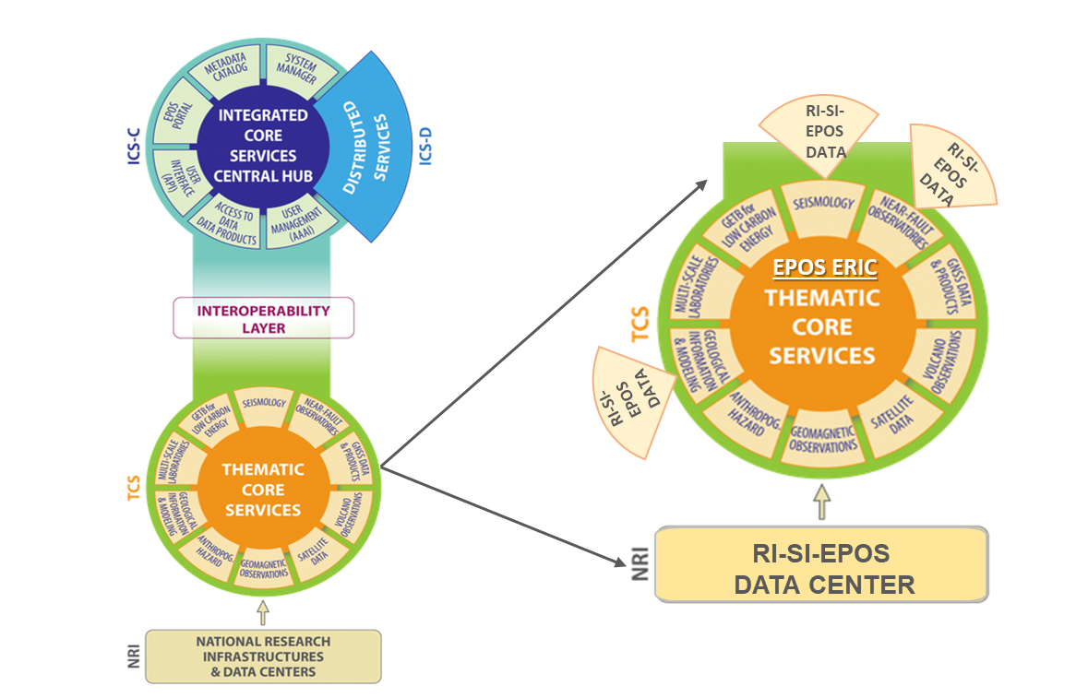
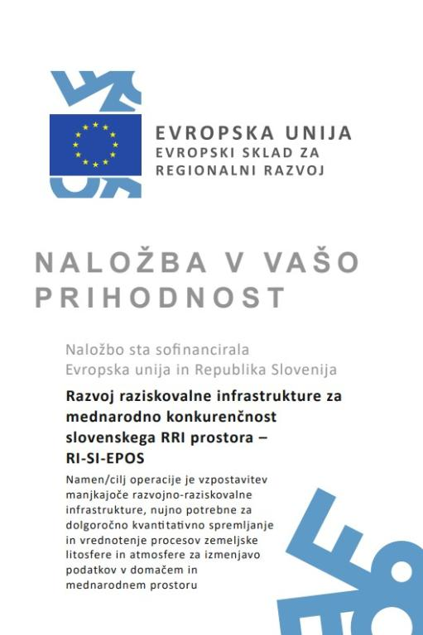
2019: July 1st, start of the project (funded by European Regional Development Fund) Development of Research Infrastructure for the International Competitiveness of the Slovenian Development of Research Infrastructure Space (RI-SI-EPOS). Project was completed in August 2021.
Out of 1.826.964,08 EUR, project realization was
1.527.596,94 EUR, mostly for scientific equipment and 10% for employment.
Notes:
3 slides describing the background of EPOS, explaining importance of open science. Research supported by public funds should be made available to public again.

Slide 11
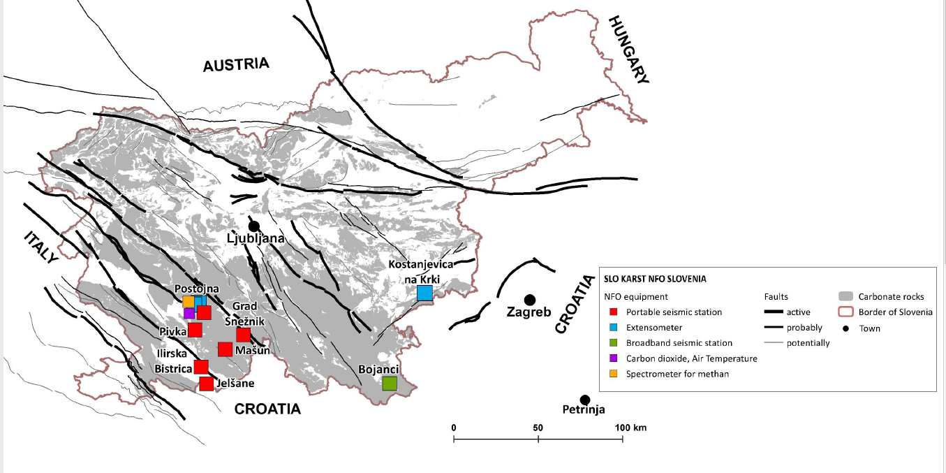
2021 - June - the SLO KARST NFO managed by ZRC SAZU was accepted as observer in EPOS NFO community.
2024 - ZRC SAZU is a member of EPOS ON and TRANSFORM² projects
Research Centre of the Slovenian Academy of Sciences and Arts, & Slovenian Environment Agency (2020): Slovenian Karst NFO Network. ZRC SAZU and Slovenian Environmental Agency. Dataset/Seismic Network. https://doi.org/10.7914/7w0j-ge89
Notes:
3 slides describing the background of EPOS, explaining importance of open science. Research supported by public funds should be made available to public again.

Slide 12
ZRC SAZU was/is member of EU projects:
EPOS PP
EPOS IP
EPOS SP
EPOS ON
TRANSFORM 2
Notes:
3 slides describing the background of EPOS, explaining importance of open science. Research supported by public funds should be made available to public again.

Slide 13
EPOS Slovenia
Stanka Šebela, PhD.
National representative for EPOS Slovenia
Karst Research Institute ZRC SAZU
Web: https://epos-ip.zrc-sazu.si
E-mail: sebela@zrc-sazu.si
Twitter: @EPOS_Slovenia
EPOS Slovenia Data & Sites
Notes:
3 slides describing the background of EPOS, explaining importance of open science. Research supported by public funds should be made available to public again.

Slide 14
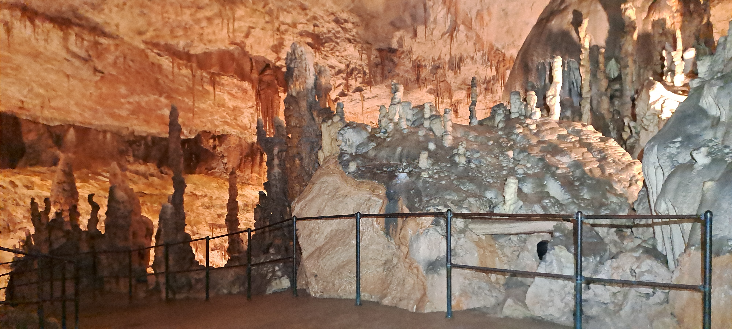
Thank you for your attention!
sebela@zrc-sazu.si
Postojna Cave
www.epos-eu.org/on | social media #EPOSon
Notes:
Thank you slide

