Slide 1
EPOS-eNLarge: building further on the Dutch infrastructure for solid Earth sciences
André Niemeijer, Martyn Drury, Ronald Pijnenburg, Susanne Laumann, Richard Wessels, Jarek Bieńkowski, Otto Lange, Laurens Samshuijzen, Almar de Ronde, Maik Nothbaum, Nemanja Krstekanić, Wen Zhou, Mark Jefferd, Liliana Vargas-Meleza, Reinoud Sleeman, Veerle Cnudde, Phil Vardon, Evert Slob, David Bruhn, Guy Drijkoningen, Alexandros Daniildis, Auke Barnhoorn, Anne Pluymakers, Suzanne Hangx, Oliver Plümper, Ernst Willingshofer, Amir Raoof, Alissa Kotowski, Liviu Matenco, Fred Beekman, Maarten Kleinhans, Veerle Cnudde, Frank van Bergen, Rob van der Krogt, Eva de Boever, Stephan Gruijters

Slide 2
Research into our subsurface

Slide 3
Scientific challenges:
“Physics based”
& “Multi-scale”
e.g.

Slide 4
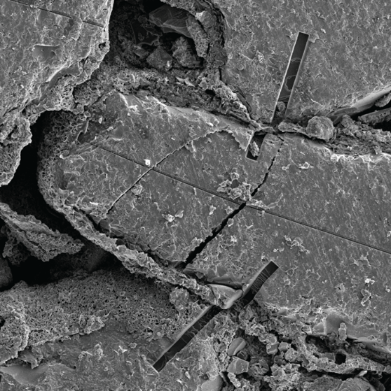
Friction?
Elastic?
Thermo-plastic?
Fracture?
Permeable?
Physics based understanding
…starts at the grain-scale
Conductive properties?
Microphysics?
Porosity?
Time-dependent processes?

Slide 5
5km = 25 million grains wide
2km = 10 million grains deep
Physics based understanding
…best not stay at the grain-scale
A field-scale model courtesy: Alexandros Daniildis

Slide 6
Physics based understanding
…best not stay at the grain-scale
cm-scale lab research applicable at the size of a model grid cell?
Grid cell size: 1-30 m
= ~50 thousand grains
= ~100 lab samples!

Slide 7
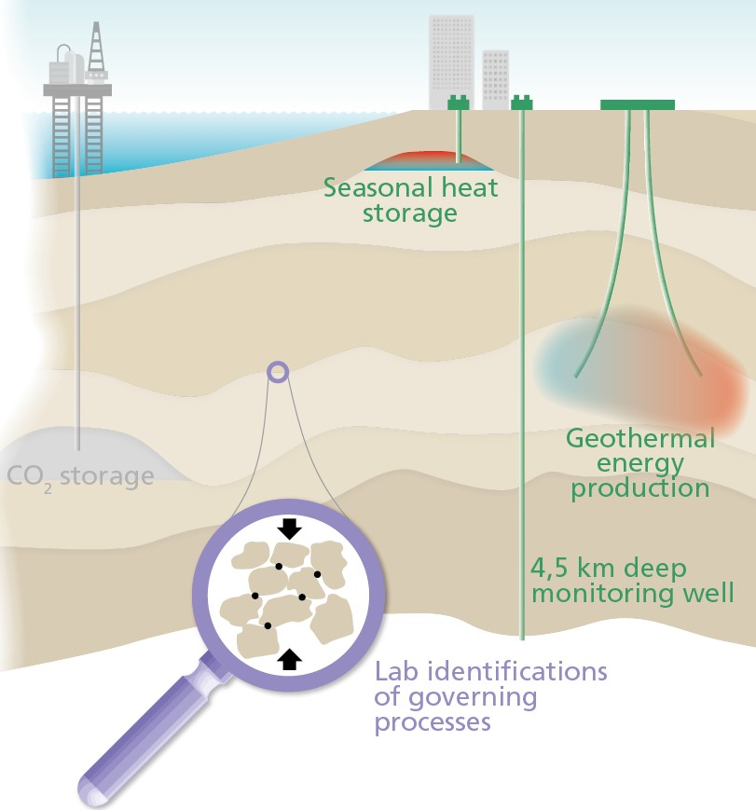
What is needed?
Infrastructure to study Earth scientific processes from the smallest (nm) to the largest (>km) scale
Easy access to facilities and data

Slide 8
Building a national infrastructure for research into our subsurface

Slide 9
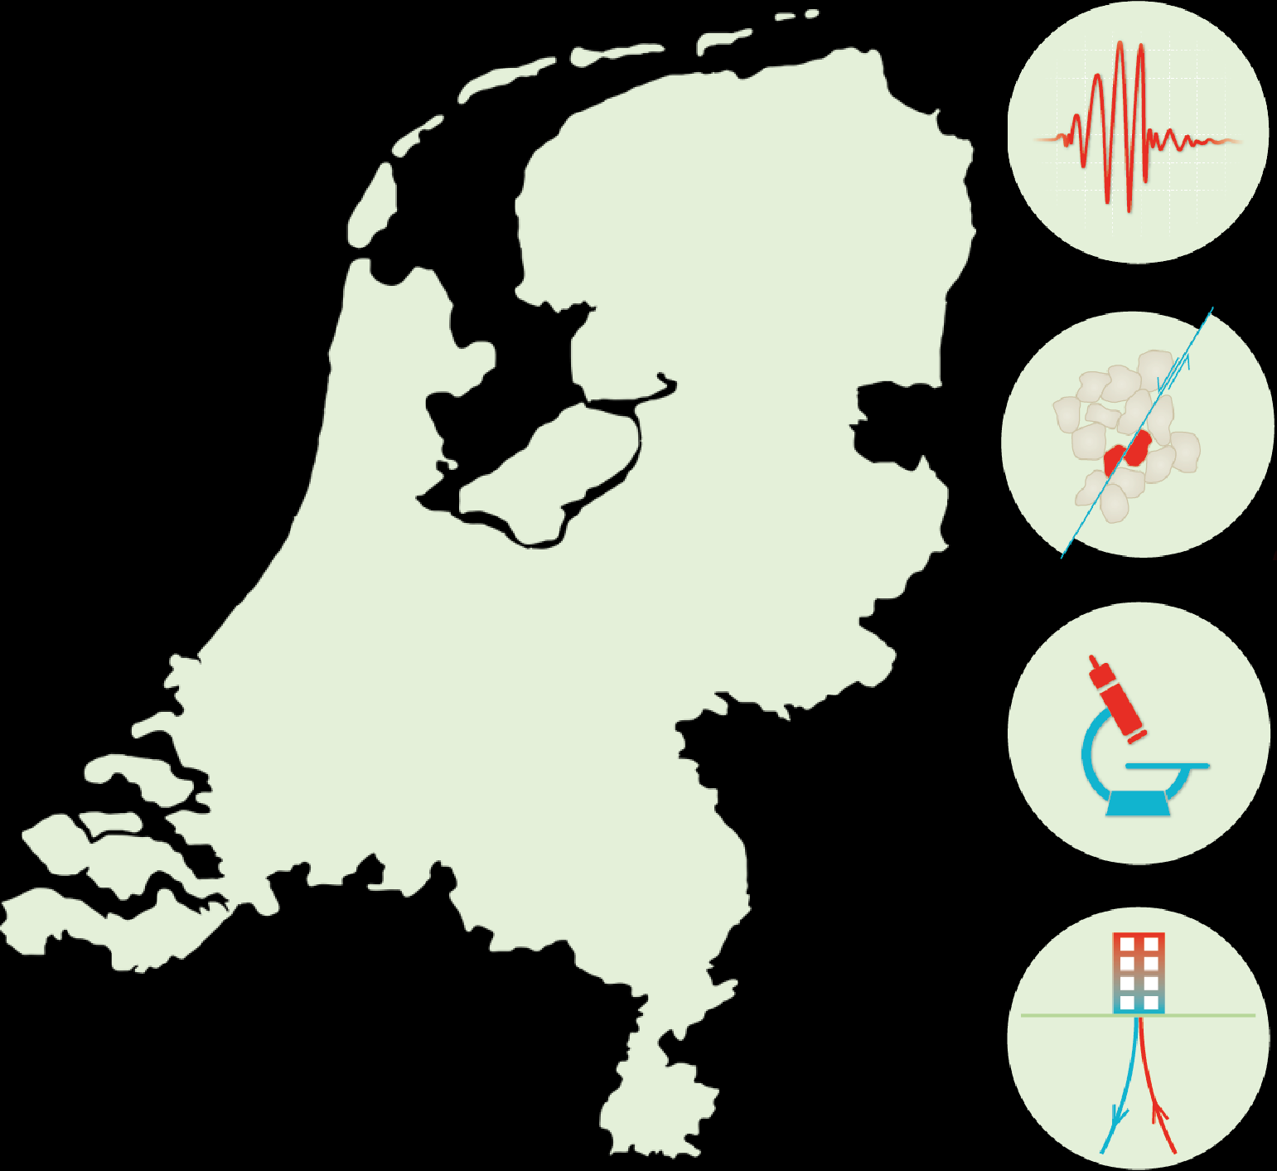
KNMI and NAM networks
Multi-scale Imaging & Tomography
(MINT)
KNMI and ORFEUS data centers
Improves the means for subsurface research
UU Earth Simulation Lab
TUD geothermal well
EPOS-eNLarge 18 M€ in 2023-2028
EPOS-NL 12 M€ in 2019-2024
Tsunami Japan, 2011

Slide 10
KNMI and NAM networks
Multi-scale Imaging & Tomography
(MINT)
Geological Survey
KNMI and ORFEUS data centers
Improves the means for subsurface research
Rijswijk Lab
UU Earth Simulation Lab
TUD geothermal well
GeoLab
EPOS-eNLarge 18 M€ in 2023-2028
EPOS-NL 12 M€ in 2019-2024
< 4.5 km deep monitoring well
Tsunami Japan, 2011
Notes:
GeoLab addition:
PM Lab (investments and Facility Access)
NanoSIMS (Facility Access)
EPMA (Facility Access)

Slide 11
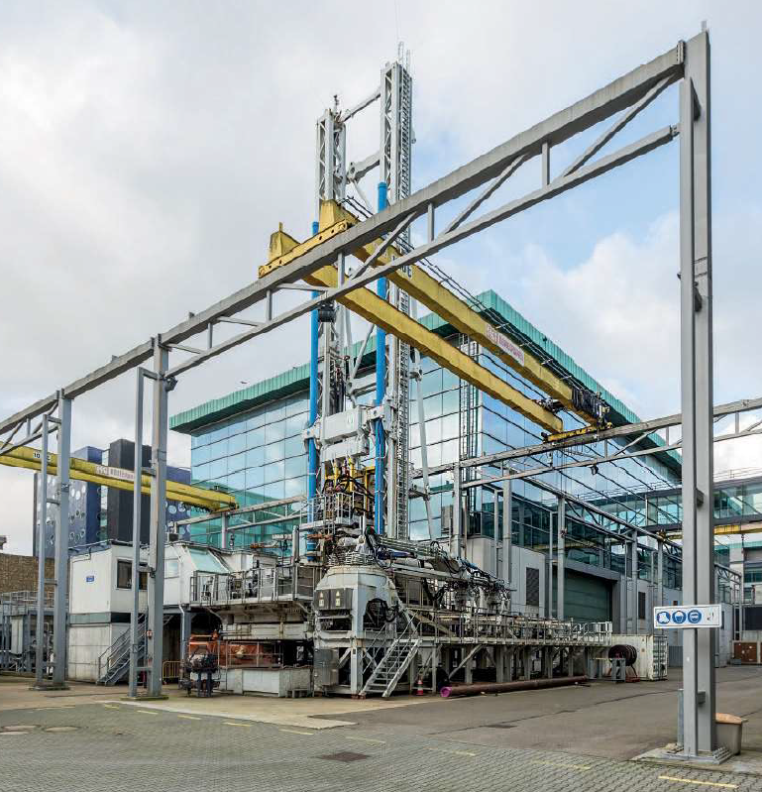
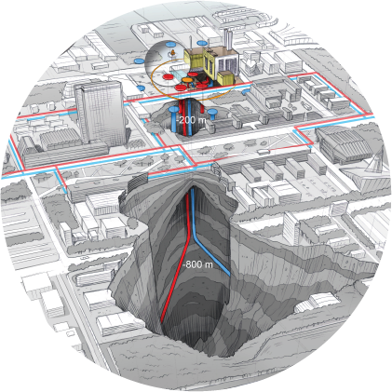
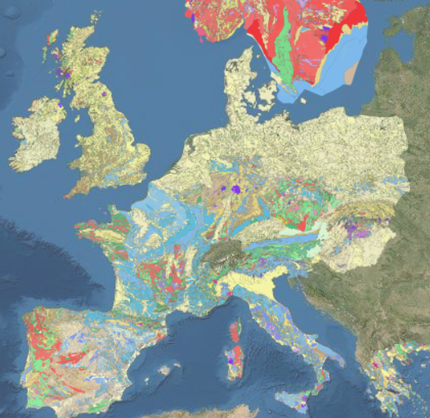
Identification of dynamic micro-physics governing subsurface behavior
nm-dm
Informed upscaling of micro-physics to field-scale models
dm-hm
Infrastructure to
bridge lab to field scales
Field scale validation at key subsurface operations in NL hm-km
Physics-based understanding at the scale of the operating system
Data sharing, for efficient, multi-disciplinary research global
Notes:
We will enable scientific breakthroughs in terms of:
Say something about the individual facilities:
Earth Simulation Lab and the Multi-scale Imaging and Tomography facility (MINT)
Rijswijk Centre for Sustainable Geo-energy (RCSG)
Delft Subsurface Urban Energy Lab (DSUEL)
Data sharing is vital

Slide 12
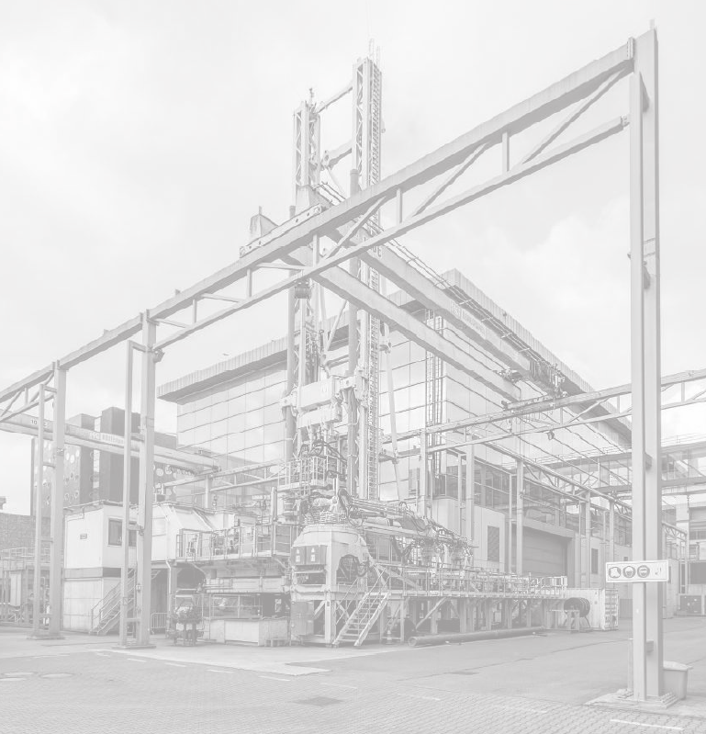
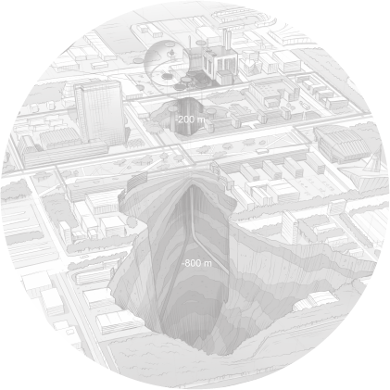
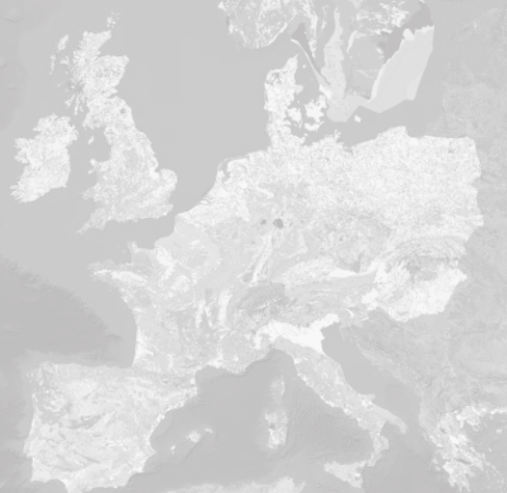
Identification of dynamic micro-physics governing subsurface behavior
nm-dm
Informed upscaling of micro-physics to field-scale models
dm-hm
Infrastructure to
bridge lab to field scales
Field scale validation at key subsurface operations in NL hm-km
Data sharing, for efficient, multi-disciplinary research global
Notes:
We will enable scientific breakthroughs in terms of:
Say something about the individual facilities:
Earth Simulation Lab and the Multi-scale Imaging and Tomography facility (MINT)
Rijswijk Centre for Sustainable Geo-energy (RCSG)
Delft Subsurface Urban Energy Lab (DSUEL)
Data sharing is vital

Slide 13
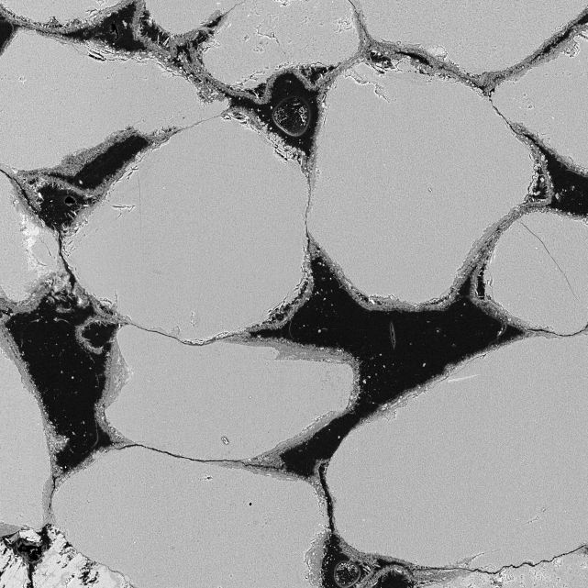
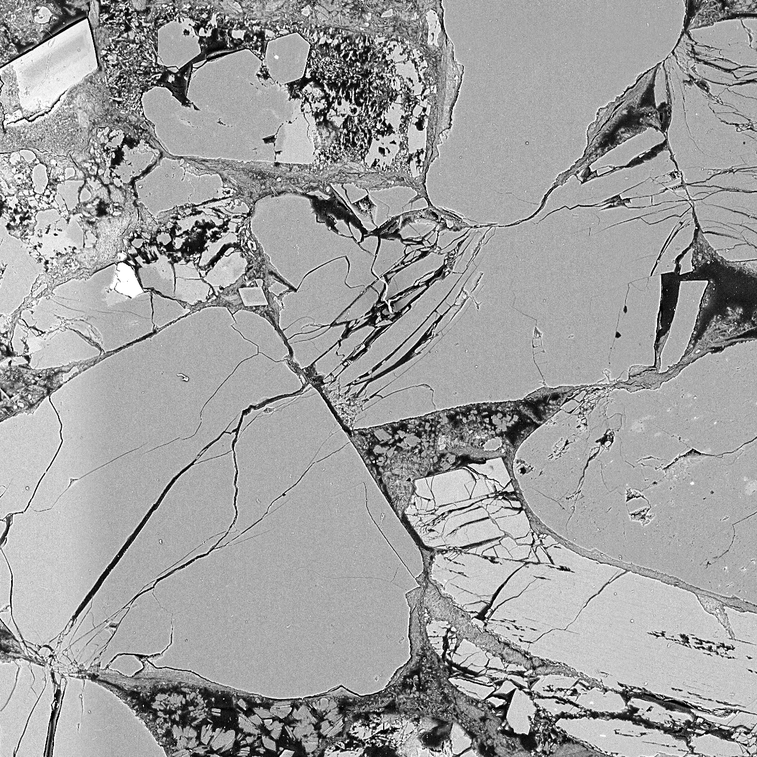
Before testing
?
New infrastructure for identifying dynamics
During testing?
Acoustic methods for deformation monitoring (Tec- and HPT lab UU)
Nano-indentor (EM group, UU)
High pressure and temperature testing equipment for microfluidics (PM lab, UU)
Tidal/fluvial system evolution during active deformation (Flumetank-TecLab)
Rapid, syn-deformation, X-ray tomographic imaging (Ghent University)
After testing
NB: no time to go over all these methods listed on this slide. This is meant to just say there’s a whole bunch of techniques coming up in eNLarge, at various labs. 2 examples in the following
Notes:
We will enable scientific breakthroughs in terms of:
Say something about the individual facilities:
Earth Simulation Lab and the Multi-scale Imaging and Tomography facility (MINT)
Rijswijk Centre for Sustainable Geo-energy (RCSG)
Delft Subsurface Urban Energy Lab (DSUEL)
Data sharing is vital

Slide 14
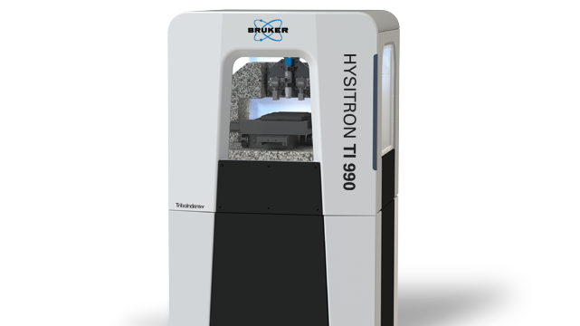
Nanoindentation – a technique that measures material hardness and induces Low-Temperature Plasticity
First one in Europe!
Tribo-indentor
Kotowski, Drury

Slide 15
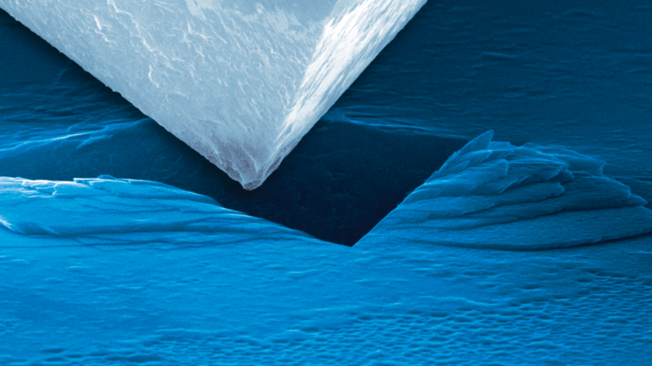
Nanoindentation – a technique that measures material hardness and induces Low-Temperature Plasticity
Tribo-indentor
Property mapping (hardness, modulus, elastic vs plastic)
Dynamic nanoindentation (continuous stiffness)
Testing on thin sections
Generates confining pressure which suppresses brittle fracture
Modular enclosure with customizable panels – we have a heating stage! 800˚C

Slide 16
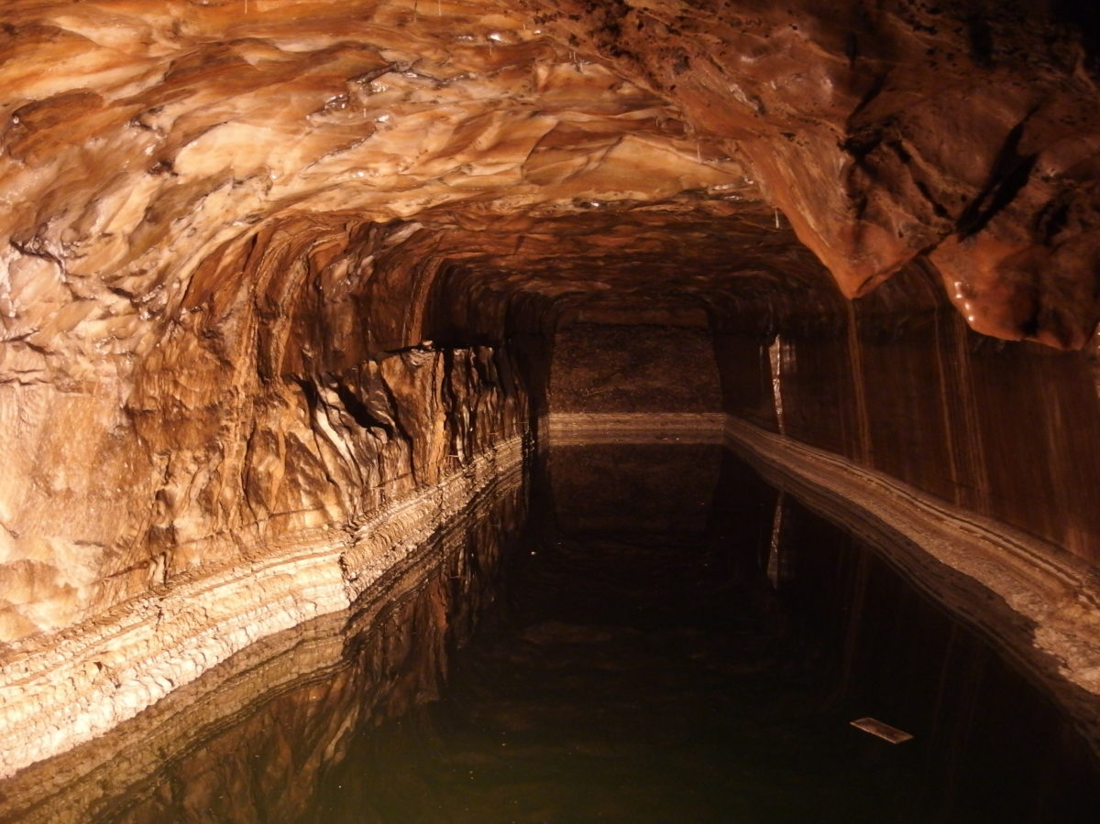
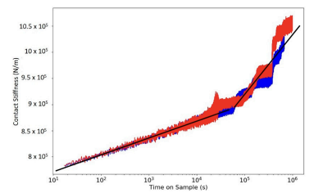
Creep behavior of salt
from Thom and Goldsby 2019
Tribo-indentor
Property mapping (hardness, modulus, elastic vs plastic)
Dynamic nanoindentation (continuous stiffness)
Testing on thin sections
Generates confining pressure which suppresses brittle fracture
Modular enclosure with customizable panels – we have a heating stage! 800˚C
Important for hydrogen storage in salt caverns
Notes:
Thom and Goldsby 2019 Figure 6. Plot of indentation strain rate vs. hardness for a 3600-s test (derived from the data shown in Figures 4 and 5). The hardness and strain rate for the blue data are determined from the displacement data from the first 10 s of the test, a time scale too short for significant thermal drift. For the remainder of the test, the hardness and strain rate are determined from the contact stiffness, shown in red, which is independent of thermal drift

Slide 17
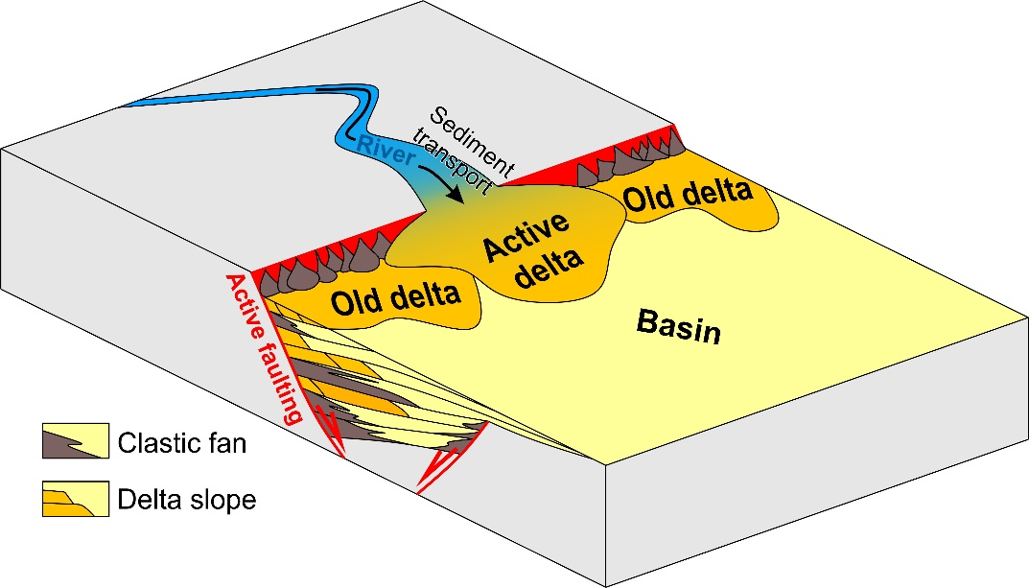
A new analogue model coupling tectonics and river dynamics
Krstekanić, Willingshofer, Kleinhans, Matenco

Slide 18
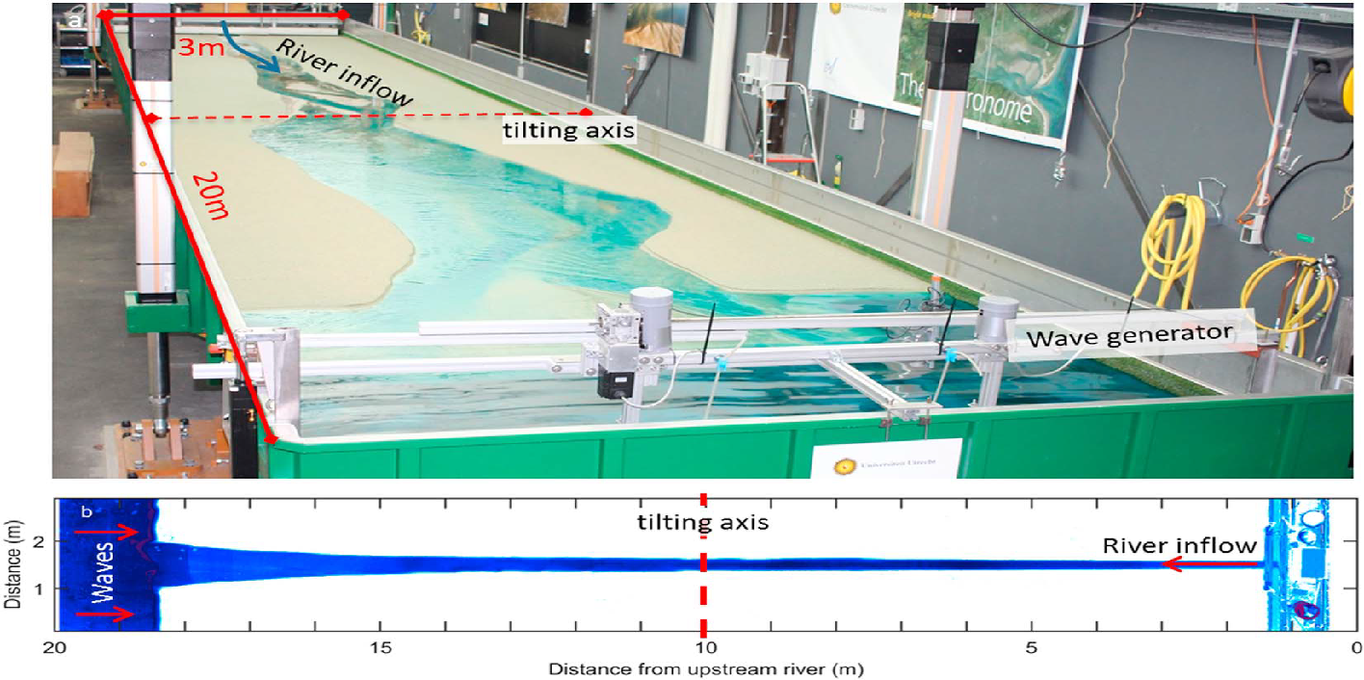
TecLab: Modelling of faulting and basin formation
&
A new analogue model coupling tectonics and river dynamics
Metronome: Modelling of fluvial processes
Krstekanić, Willingshofer, Kleinhans, Matenco

Slide 19
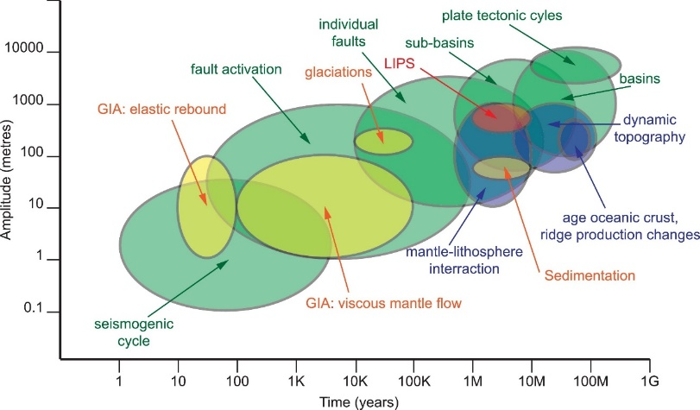
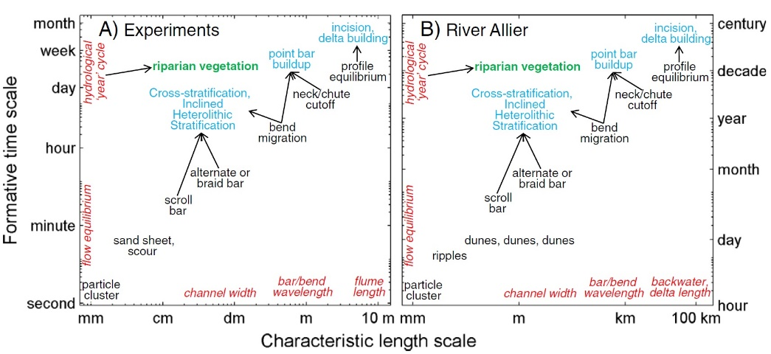
Tectonics scaling
Matenco and Haq, 2020
A new analogue model coupling tectonics and river dynamics
?
Rivers scaling
Krstekanić, Willingshofer, Kleinhans, Matenco
Kleinhans et al., 2015

Slide 20
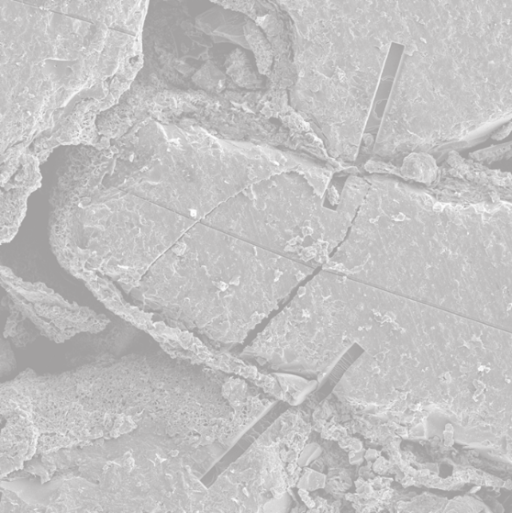
Identification of dynamic micro-physics governing subsurface behavior
nm-dm
Informed upscaling of micro-physics to field-scale models
dm-hm
Infrastructure to
bridge lab to field scales
Field scale validation at key subsurface operations in NL hm-km
Data sharing, for efficient, multi-disciplinary research global
Notes:
We will enable scientific breakthroughs in terms of:
Say something about the individual facilities:
Earth Simulation Lab and the Multi-scale Imaging and Tomography facility (MINT)
Rijswijk Centre for Sustainable Geo-energy (RCSG)
Delft Subsurface Urban Energy Lab (DSUEL)
Data sharing is vital

Slide 21
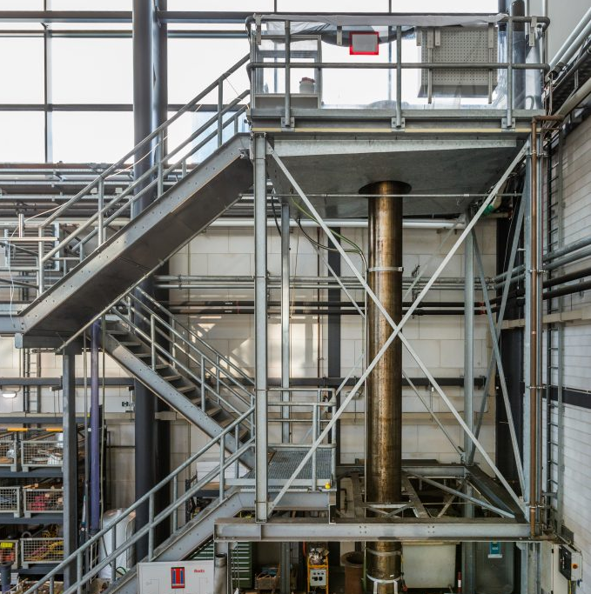
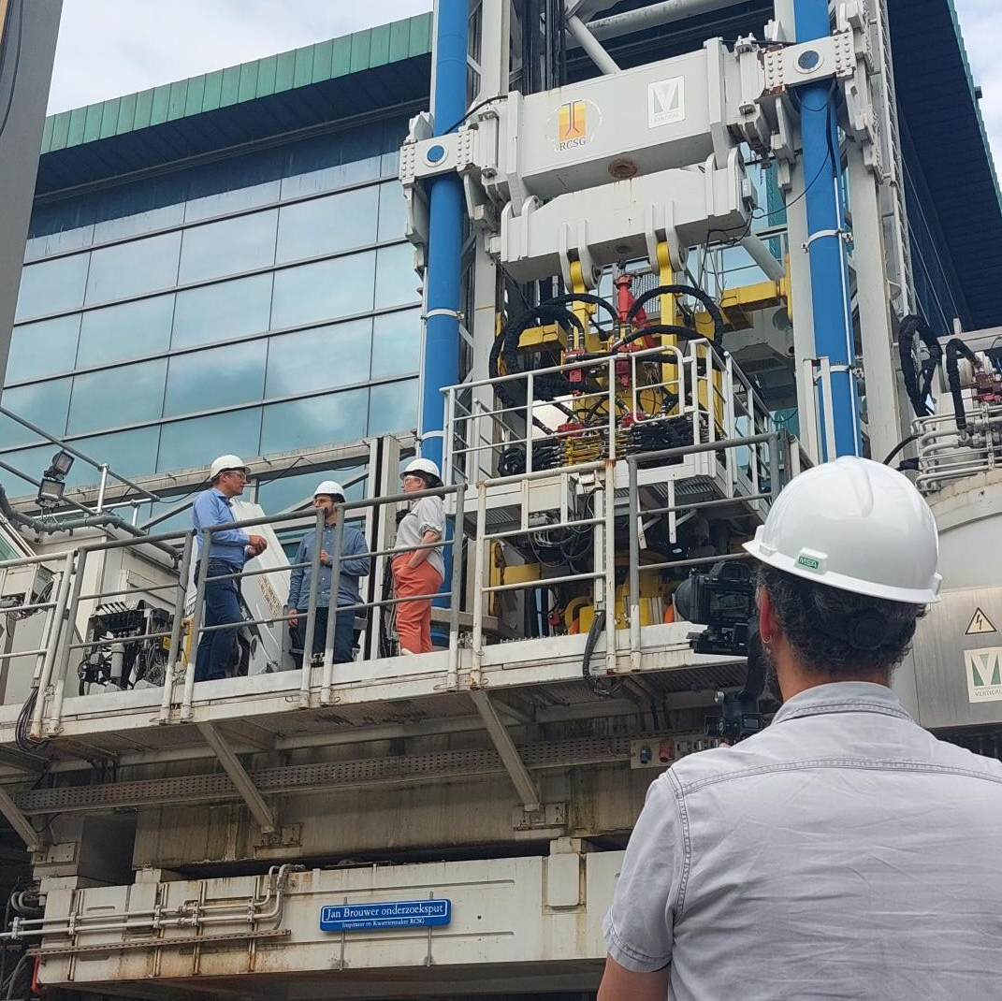
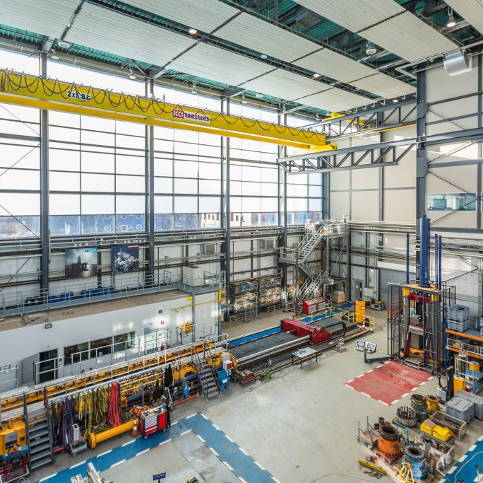
Includes infrastructure for informed upscaling
Rijswijk Lab:
30m long fluid transport testing and particle tracking
Upscaling rock mechanics:
Hydrostatic compression of 6m samples
Axial compression of 0.5m diameter samples
Drilling simulation (physical)
Notes:
We will enable scientific breakthroughs in terms of:
Say something about the individual facilities:
Earth Simulation Lab and the Multi-scale Imaging and Tomography facility (MINT)
Rijswijk Centre for Sustainable Geo-energy (RCSG)
Delft Subsurface Urban Energy Lab (DSUEL)
Data sharing is vital

Slide 22
Identification of dynamic micro-physics governing subsurface behavior
nm-dm
Informed upscaling of micro-physics to field-scale models
dm-hm
Infrastructure to
bridge lab to field scales
Field scale validation at key subsurface operations in NL hm-km
Data sharing, for efficient, multi-disciplinary research global
Notes:
We will enable scientific breakthroughs in terms of:
Say something about the individual facilities:
Earth Simulation Lab and the Multi-scale Imaging and Tomography facility (MINT)
Rijswijk Centre for Sustainable Geo-energy (RCSG)
Delft Subsurface Urban Energy Lab (DSUEL)
Data sharing is vital

Slide 23
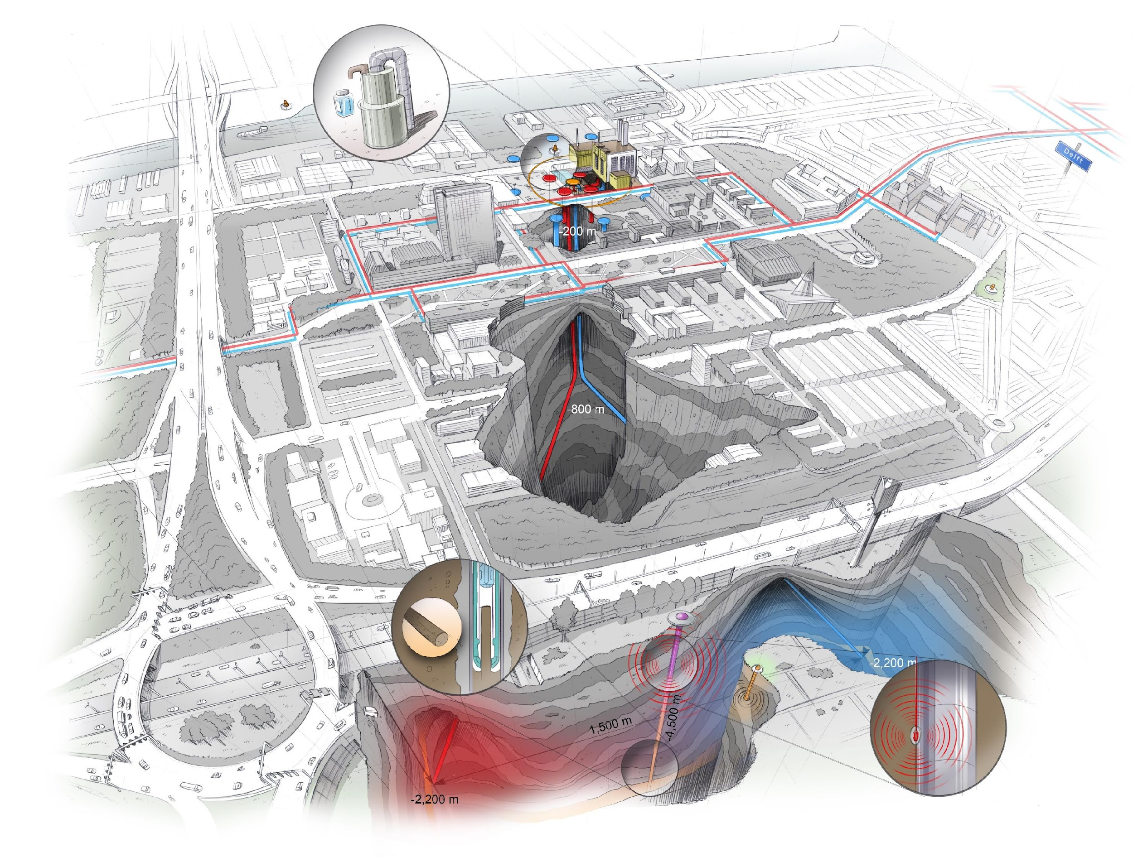
Includes field sites for validation
Seismic monitoring (KNMI)
Fibre optics data service (KNMI)
Delft Subsurface Urban Energy Lab (TU Delft)
<4.5 km deep exploration + monitoring well (~2028)

Slide 24
Identification of dynamic micro-physics governing subsurface behavior
nm-dm
Informed upscaling of micro-physics to field-scale models
dm-hm
National infrastructure to
bridge lab to field scales
Physics-based understanding at the scale of the operating system
Field scale validation at key subsurface operations in NL hm-km
How to get people to use it in full? Not ‘just components’?
Data sharing, for efficient, multi-disciplinary research global
Notes:
We will enable scientific breakthroughs in terms of:
Say something about the individual facilities:
Earth Simulation Lab and the Multi-scale Imaging and Tomography facility (MINT)
Rijswijk Centre for Sustainable Geo-energy (RCSG)
Delft Subsurface Urban Energy Lab (DSUEL)
Data sharing is vital

Slide 25
Fragmented data availability in Europe
All data findable in one place

Slide 26
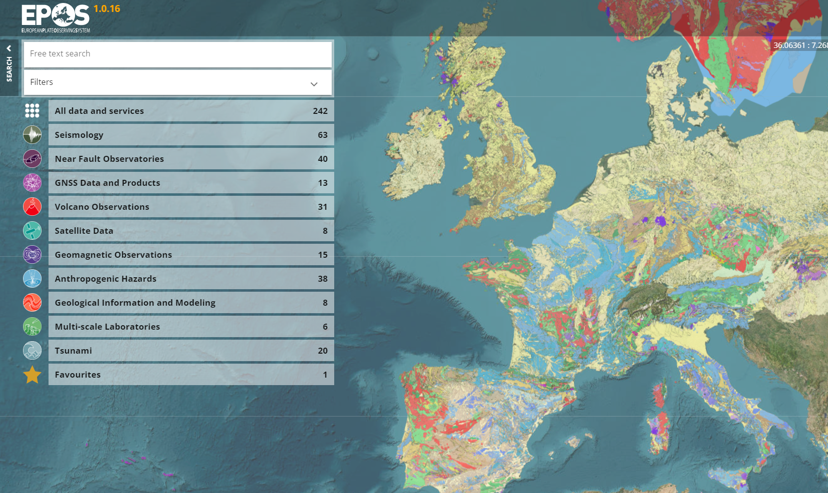
Central access to Earth scientific data
epos-eu.org/dataportal

Slide 27
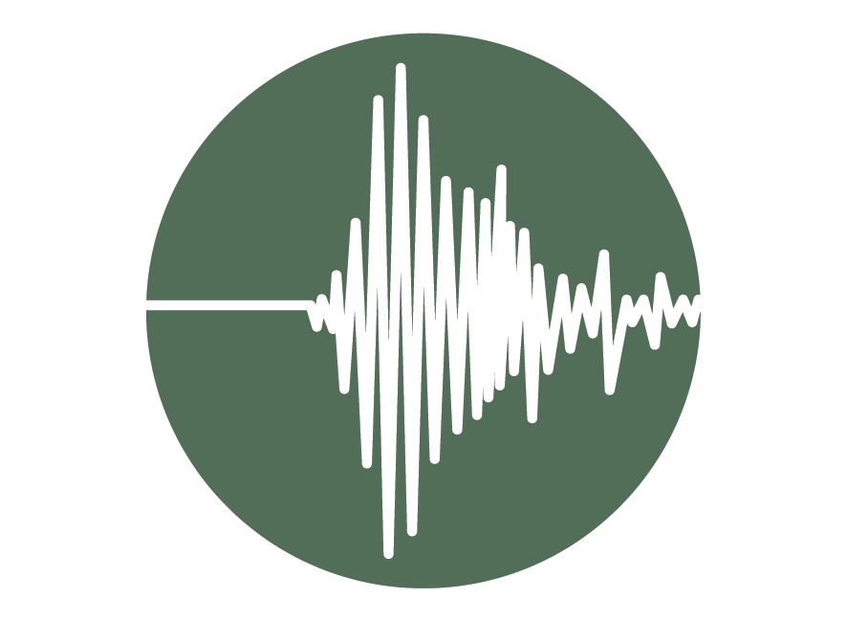
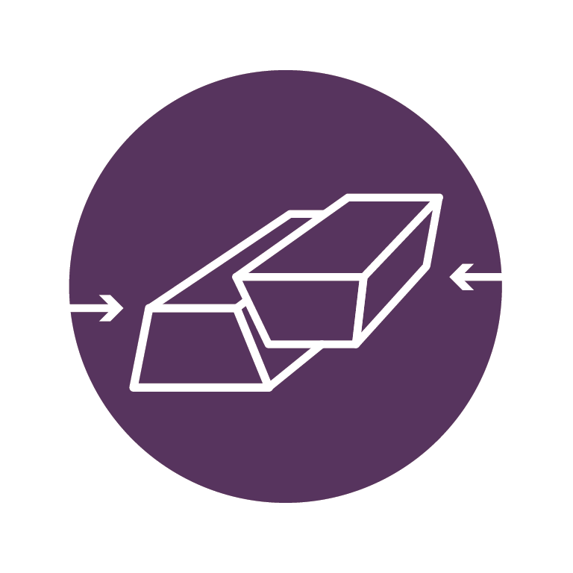
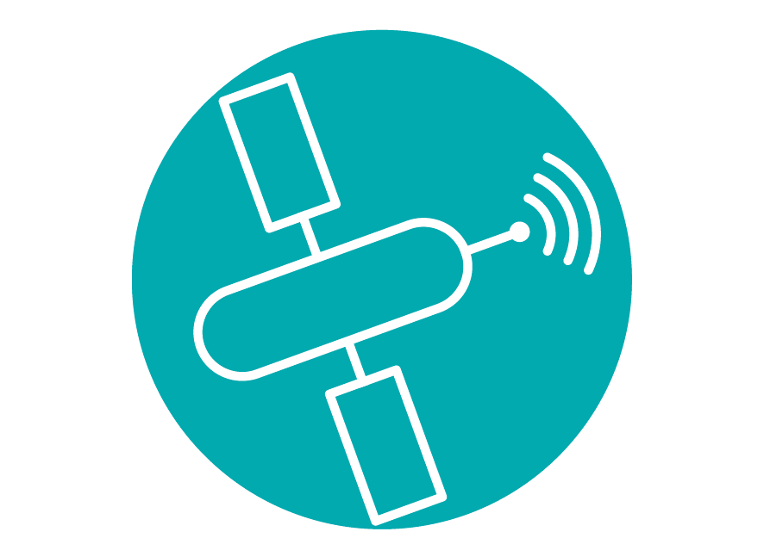
Central access to Earth scientific data
Seismology
Near Fault Observatories
GNSS Data & Products
Volcano Observations
Satellite data
Geomagnetic Observations
Anthropogenic Hazards
Coordinated in NL
Multi-Scale Laboratories
epos-eu.org/dataportal
Geological Information and Modelling
Tsunami

Slide 28
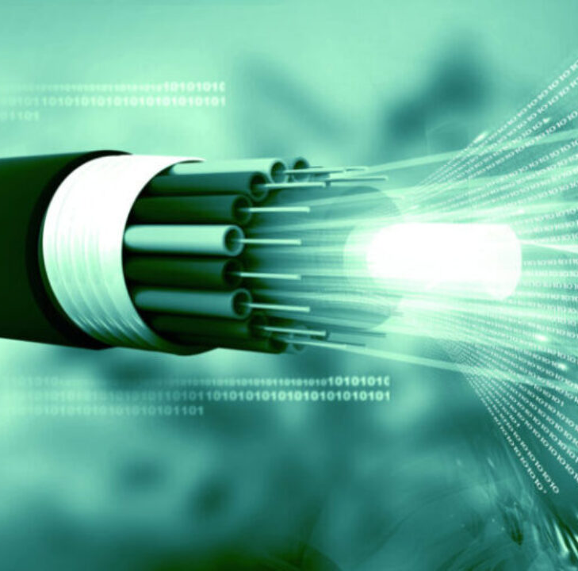
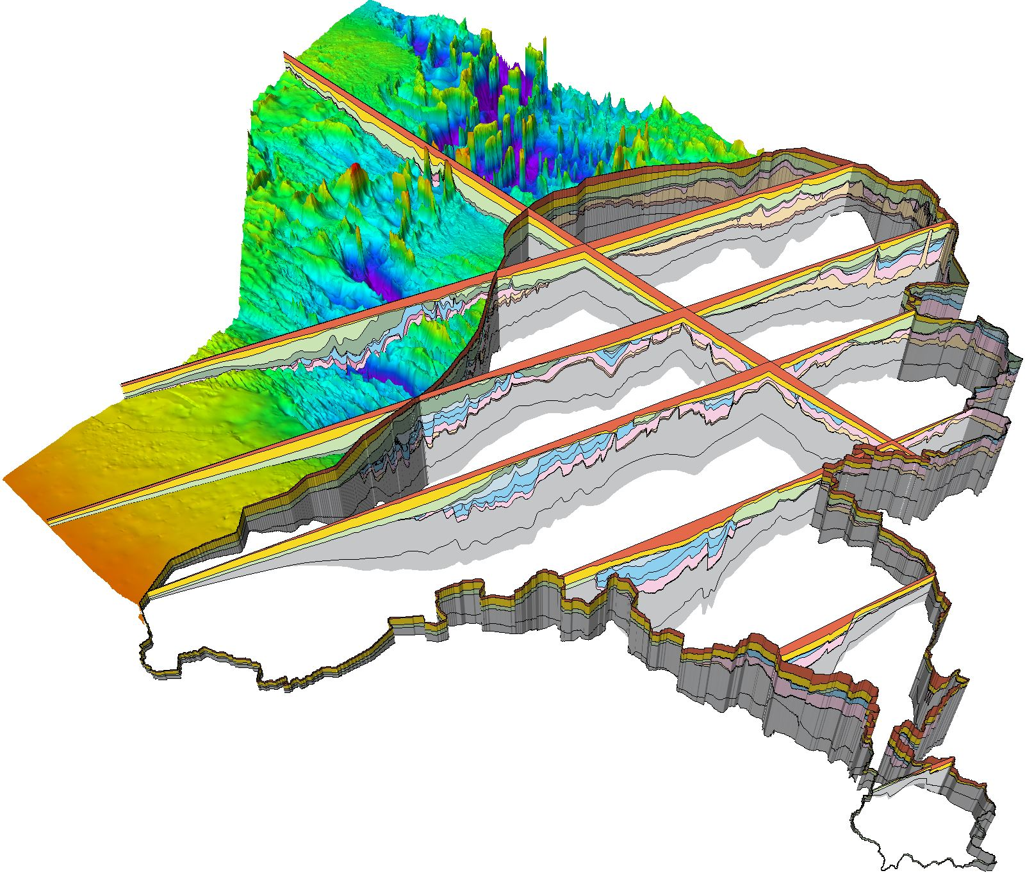
Central access to Earth scientific data
Seismology
Near Fault Observatories
GNSS Data & Products
Volcano Observations
Satellite data
Geomagnetic Observations
Anthropogenic Hazards
Multi-Scale Laboratories
epos-eu.org/dataportal
Geological Information and Modelling
Tsunami

Slide 29
Perspectives – future plans
NL infrastructure to integrate?
Research groups to join?
NWO Roadmap for large-scale research infrastructure: 2026-2030
Future topics?
Your thoughts are welcome!
First call expected: ~Q1 2027
Proposals: 10-25 M€
Requires university support – matching
Critical elements?
Deep Earth?
Subsidence?
Climate?
Glacial activity?
Notes:
We will enable scientific breakthroughs in terms of:
Say something about the individual facilities:
Earth Simulation Lab and the Multi-scale Imaging and Tomography facility (MINT)
Rijswijk Centre for Sustainable Geo-energy (RCSG)
Delft Subsurface Urban Energy Lab (DSUEL)
Data sharing is vital

Slide 30
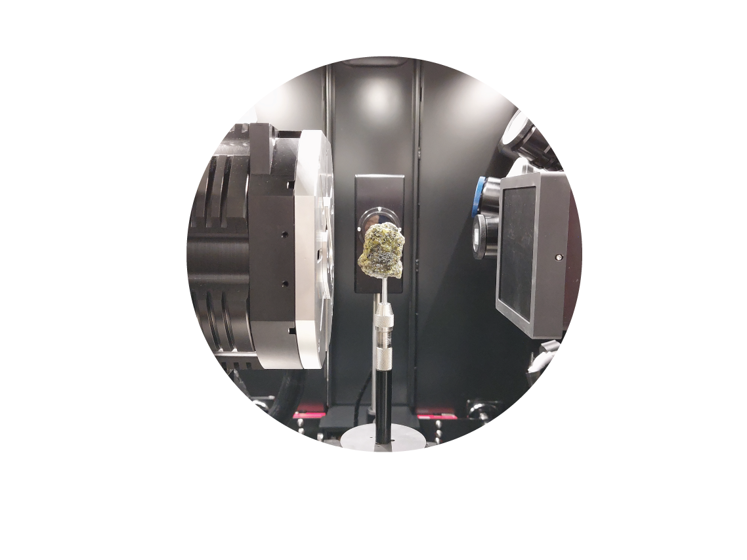
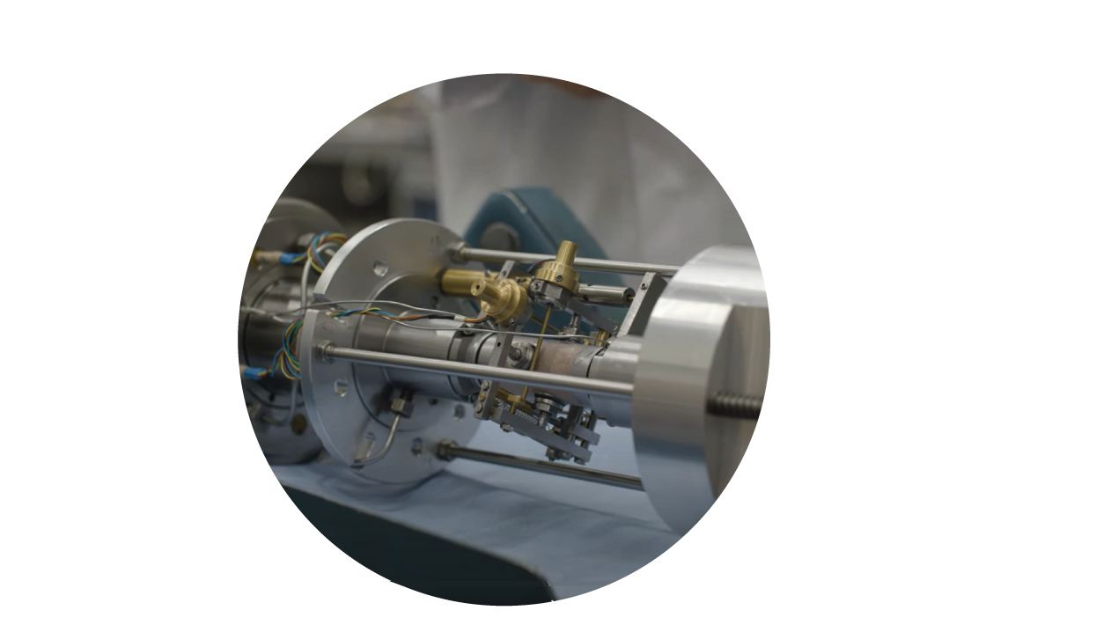
Facility Access
Apply to our next call
Dutch labs: rock deformation, fluid transport, analogue modelling, microscopy and tomography
Next call: July 2025
www.EPOS-NL.nl
www.EXCITE-network.eu
Next call: Spring 2025
>24 European microscopy & tomography facilities

Slide 31
The Dutch infrastructure for solid Earth sciences
www.EPOS-NL.nl
info@EPOS-NL.nl

