Slide 1

EPOS – FINLAND
- a path to the FInnish Research Infrastructure (FIRI) Roadmap for the Solid Earth Sciences
EPOS DAYS |Perugia|March, 2025
Annakaisa Korja

Slide 2








FINNSIP
mobile instrument pool
Council Office
Partners
ISUH: Seismic observatory
HelLabs: Geophysical and Geochemical laboratories
SGO:
Seismic and geomagnetic observatory
KMI: Kallio Labs
OMS: AH node
Geomagnetic observatory: IMAGE
Metsähovi Geodetic Research Station
and
FinnRef Network:
GNSS, Gravimetry
UTC laboratory
National time
Geophysics labs
MT observations
Geological map data
Fairdata
Services
LUMI
EUDAT
EOSC
NRIs
National research infrastructure connected to EPOS
  Included in Roadmap for Finnish research infrastructures FIRI
    2014-2020, 2021–2024, 2025-2029
Community of universities & national research institutes
  Coordination office at Institute of Seismology, University of Helsinki
The national geophysical, geodetic, geomagnetic observatories, data portals & laboratories
  Open & free data available
Enhance Finnish role and data delivery to EPOS
  Finland foreseen to join in EPOS ERIC in 2026
  Develop RI projects

Slide 3
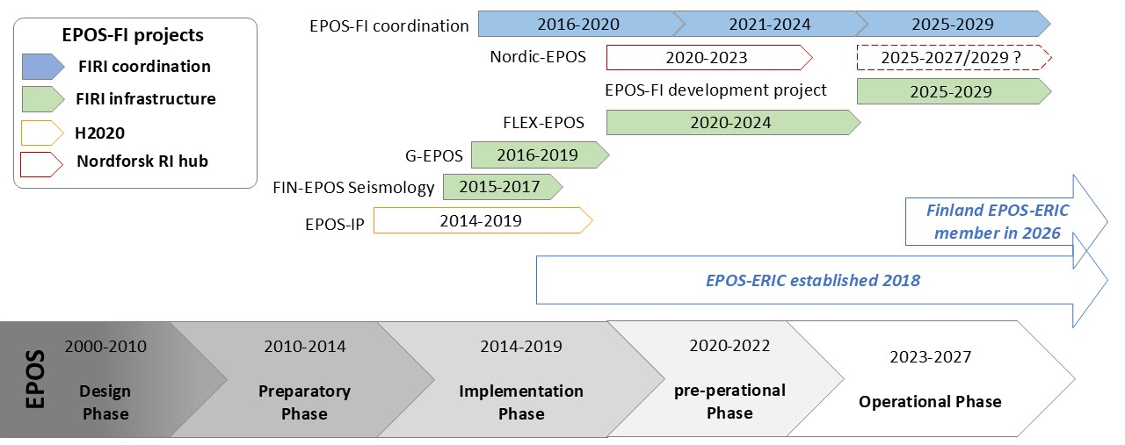

Slide 4
Direct funding from the Research Council of Finland to FIRI road map projects
year | project | organization | RCF 70% | own funding 30% | total 100%
2015-2017 | FIN-EPOS Seismology | UH, UOULU | 420374 | 148347 | 568721
2016-2020 | Coordination of FIN-EPOS and membership | UH+ consortium | 561000 | 241000 | 802000
2016-2018 | GEPOS Geophysical laboratory and observatory infrastructure | FMI, VTT, UH, UOULU, FGI, Aalto | 510938 | 218973 | 729911
2021-2024 | National coordination of International memberships | UH+ consortium | 395000 | 169000 | 564000
2021-2024 | FLEX-EPOS mobile instrument pool | UH,AALTO, UOULU,GTK, UT, FGI, FMI, VTT | 2877594 | 1242224 | 4119818
2025-2029 | EPOS-Finland Development project, including coordination | UH, UOULU, GTK, FGI, FMI, VTT, CSC | 3154368 | 1351872 | 4506240
 | grand total |  | 7919274 | 3371416 | 11290690
FIRI road map 2014-2020
FIRI road map
2021-2024
FIRI road map
2025-2029

Slide 5
EU associated EPOS funding and indirect funding by MinEdu and RCF
year | project | partners | FUNDING ORGANIZATION | external | own funding | total 100%
2015-2019 | EPOS-IP WP Legal, Anthropogenic hazard, magnetism | UH, UOULU, FMI | EU Intradev 58/42 | 129050 | 92100 | 221150
2016-2017 | FIRE-ATT, OPENFIRE | UH | MinEdu 80/20 | 198000 | 49400 | 247400
2020-2023 | Nordic EPOS | UH, UOULU, UiB, UU, GEUS, IMO | NordForsk 30/70 | 250000 | 580000 | 830000
2022-2024 | EPOS-ON Muography | UOULU | EU Intradev 50/40 | 175000 | 116667 | 291667
2023-2028 | National university Profiling , InterEarth (EPOS, ACTRIS, ICOS, LTER), 2 positions; data scientist for EPOS data, University researcher in environmental seismology | UH | RCF 100% | 1489975 |  | 1489975
 | grand total |  |  | 2242025 | 838167 | 3080192
Total funding:
11.3 M€ + 3.1M€= 14.4 M€

Slide 6
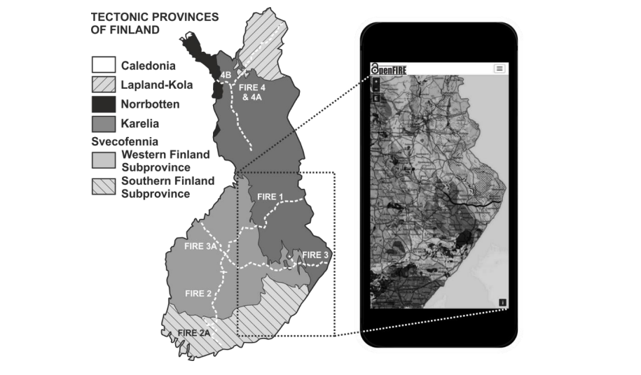
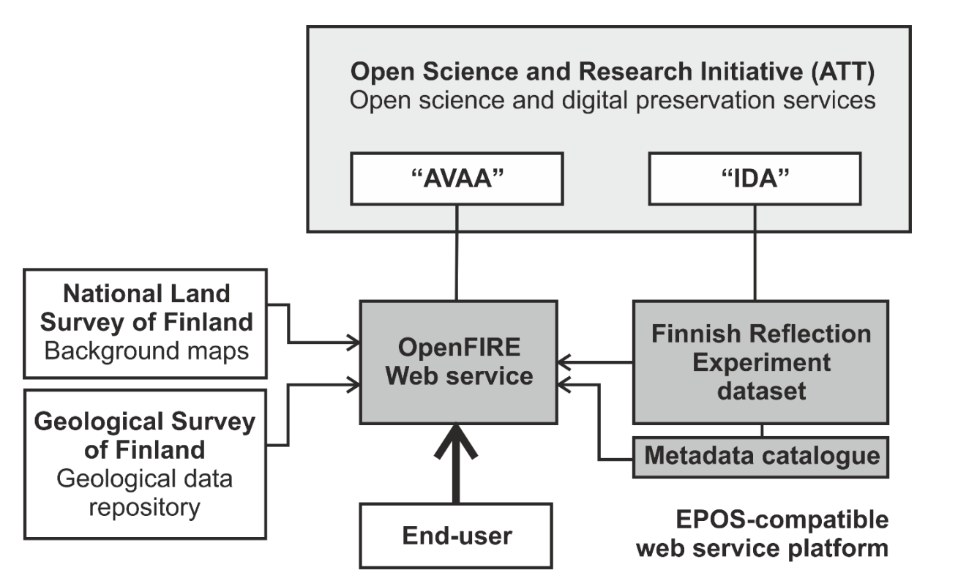
FIRE data - a DSS database
The Finnish Reflection Experiment (FIRE) dataset consists of 2104 km of seismic CMP reflection data.
https://www.helsinki.fi/en/institute-seismology/research/data/finnish-reflection-experiment
The OpenFIRE service provides open access to
all original seismic reflection data
processed data products
summaries of geological descriptions
scientific references
Data can be downloaded at
https://etsin.fairdata.fi/
An EPOS compatible web service
Potential data set for DSS metadata portal

Slide 7
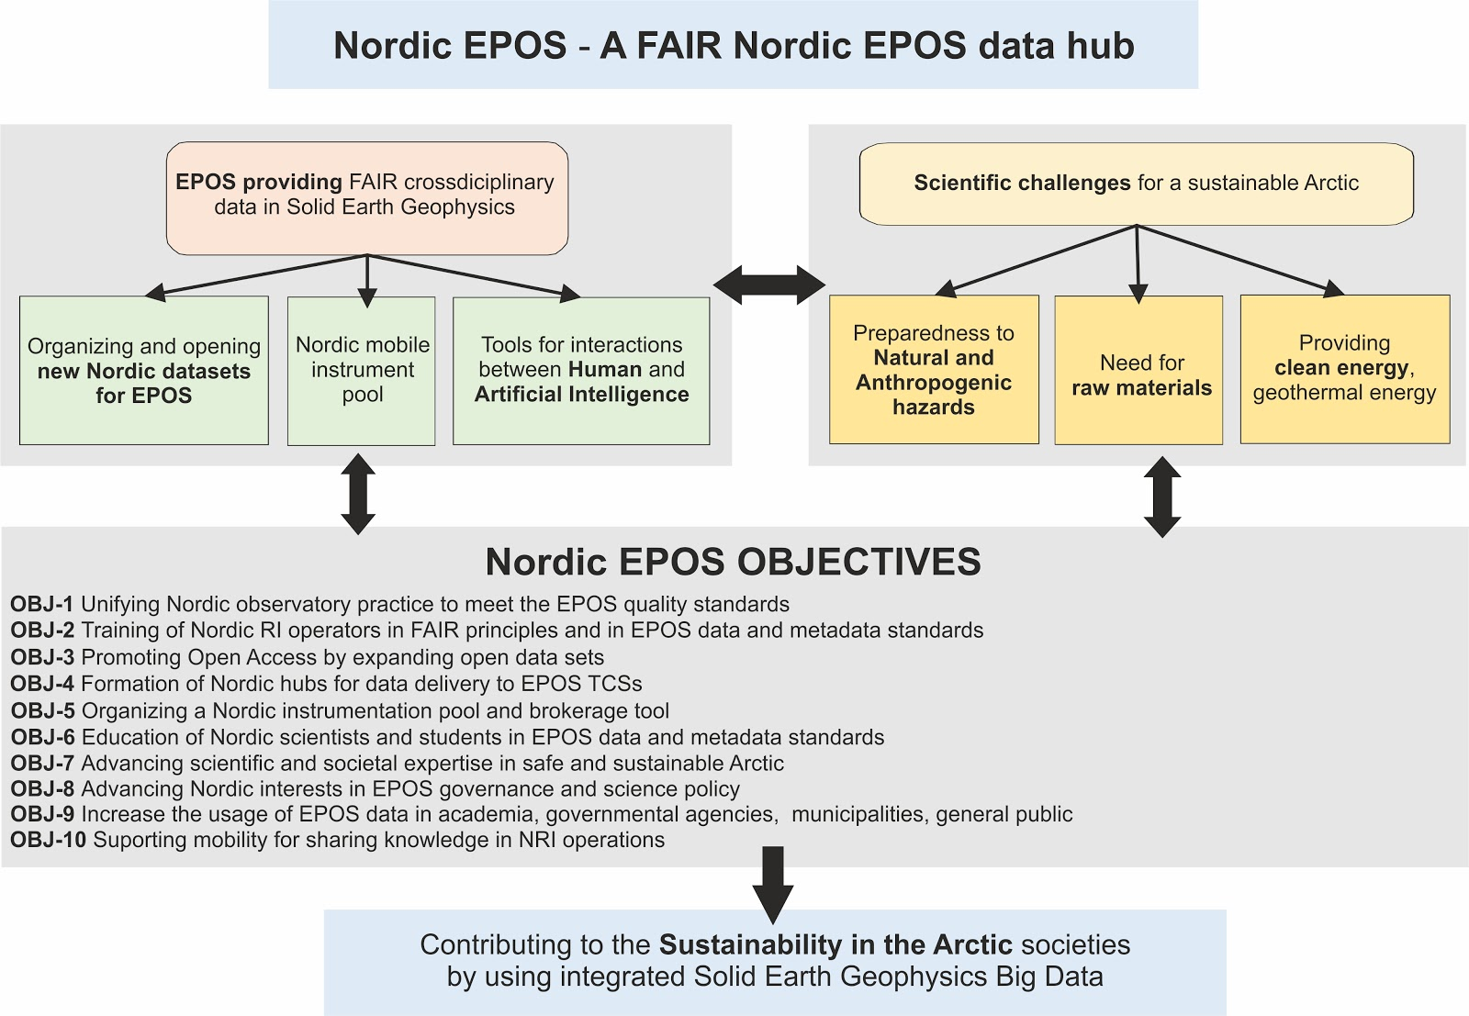
NordForsk
2020-2023
Training for
Technical expertise
Open data
Seismic hazard
Volcanic observations videos
PR among
the Nordic funding agencies
New call open for
Nordic RI hubs

Slide 8
FIRI Roadmap 2020: Superstations
 | Geophysical superstations | Current instrumentation | Instrumentation planned in 5, 10 years
MET | Metsähovi (FGI, Aalto) | Seismometer (UH), FGI geodetical research station (GNSS,VLBI,SLR, superconductive gravimeter), groundwater monitoring, weather station, magnetometer
KEV | Kevo (Turku) | Seismometer (UH), gravity pillar (FGI), IMAGE station (FMI), pulsation magnetometer (SGO)
KIF | Kilpisjärvi (UH) | Seismometer (UH), biological research station (UH), IMAGE station (FMI), pulsation magnetometer (SGO), gravity pillar (FGI, not measuring currently)
 | Interdiciplinary hyperstations | Current instrumentation | Instrumentation planned in 5, 10 years
SOD | Sodankylä (SGO) | SGO Geomagnetic observatory (IMAGE, pulsation magnetometer), Seismometer (SGO), gravity pillar (FGI)
VRF | Värriö (UH) | Seismometer (UH), gravity pillar (savukoski, FGI), SMEAR instrumentation (SMEAR I, UH), subarctic research station (UH)
- | Hyytiälä (UH) | Gravity pillar (Orivesi, FGI), SMEAR II instrumentation (SMEAR II, UH), forestry field station (UH) | Seismometer (UH)
TVF | Tvärminne (UH) | Seismometer (UH), zoological research station (UH)

Slide 9
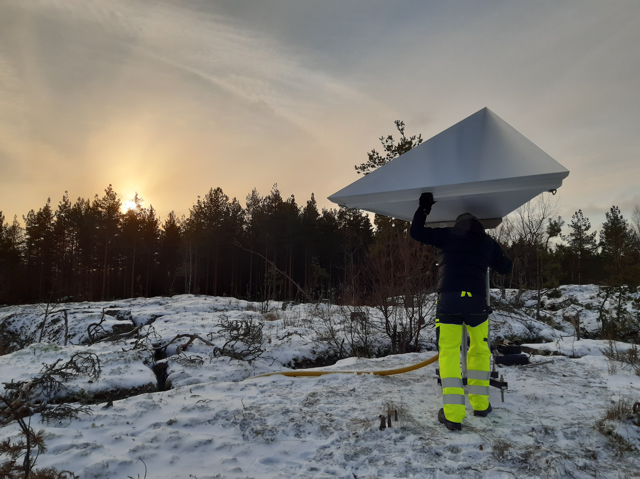
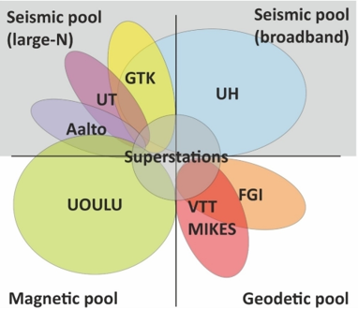
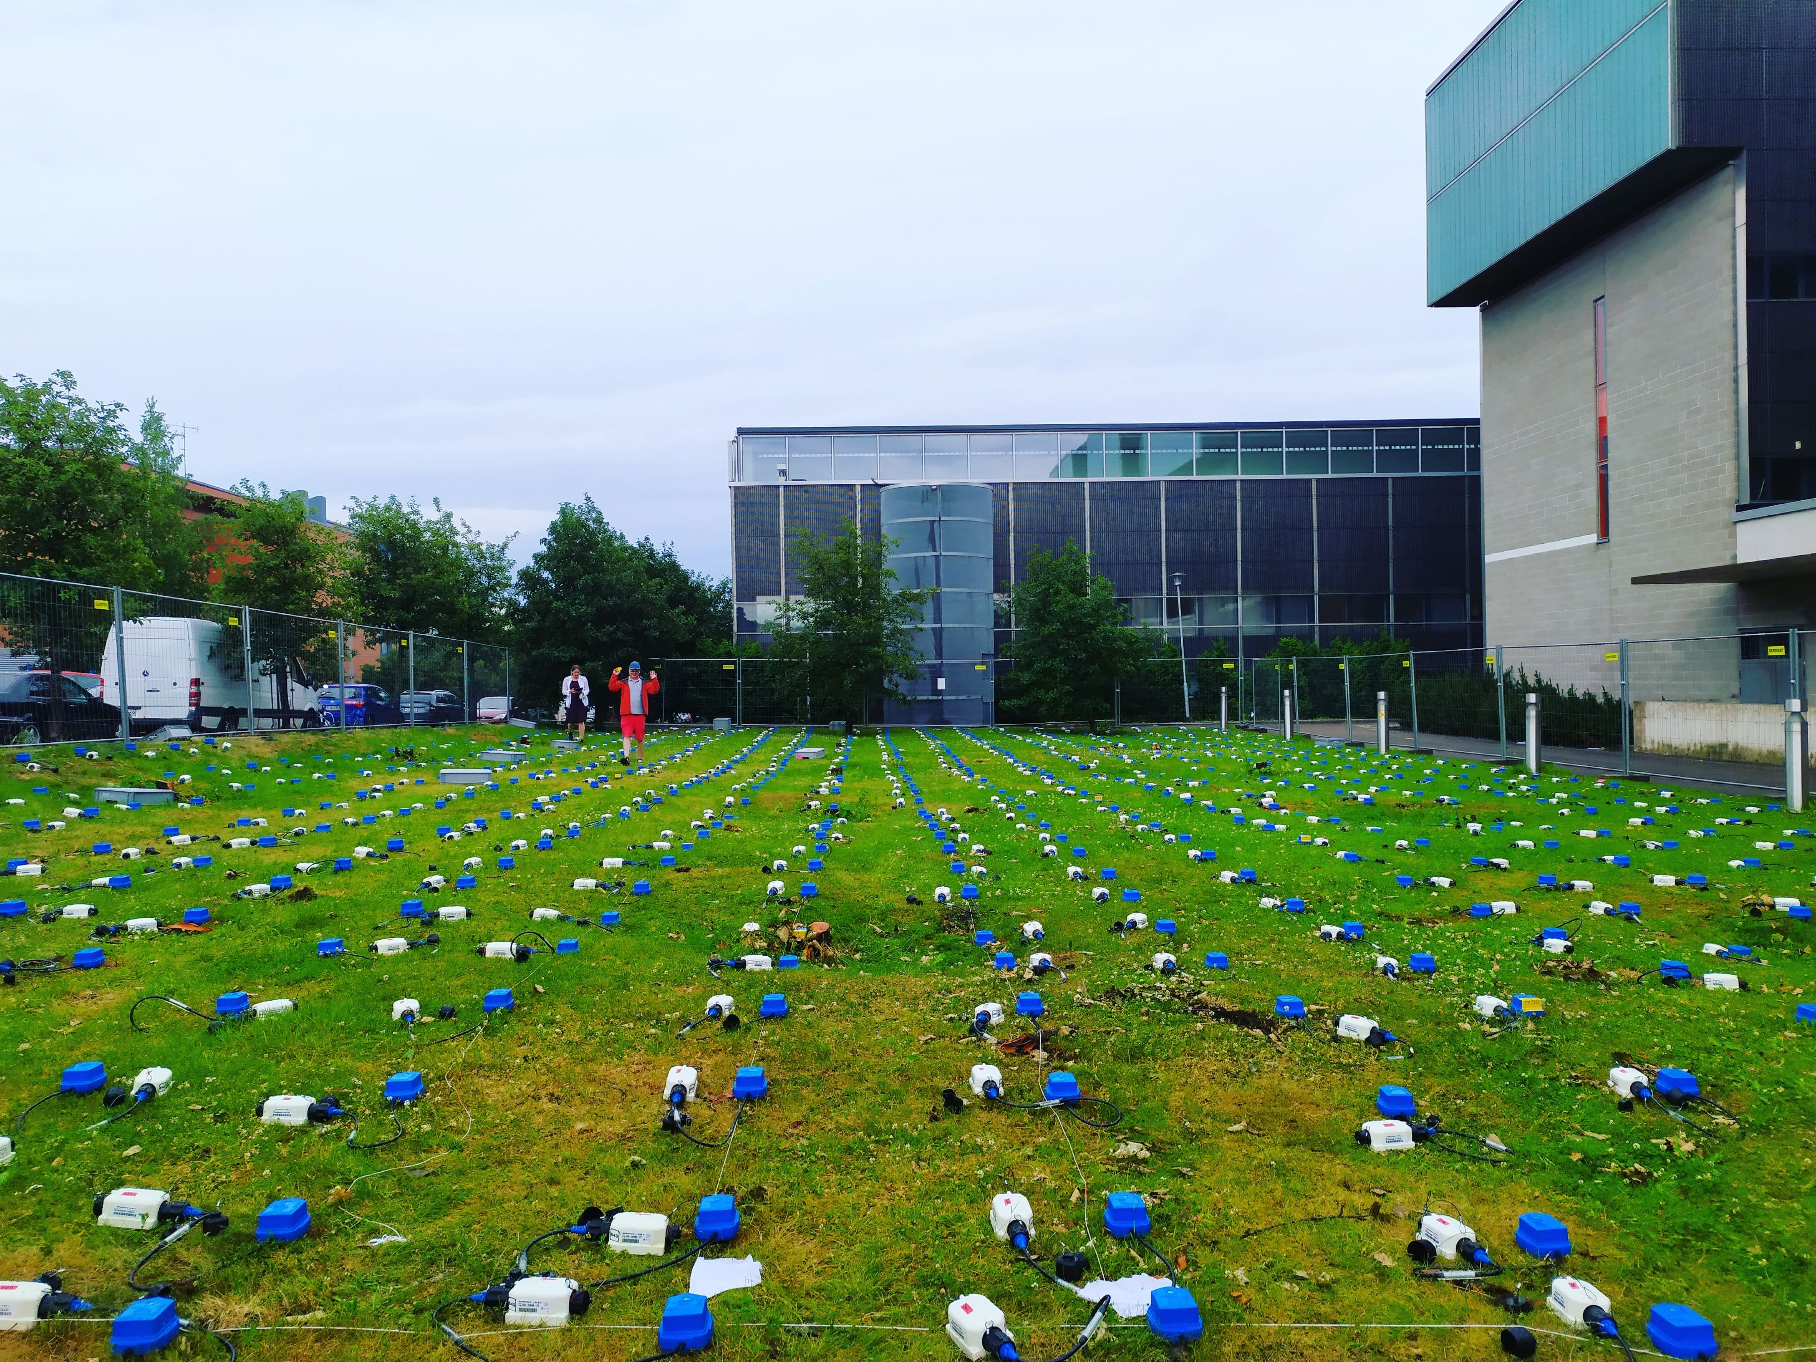
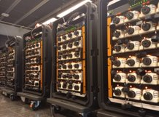
FLEX-EPOS 2021-2024
FLEX-EPOS Home - XWiki (helsinki.fi)FLEX-EPOS Home - XWiki (helsinki.fi)
Flexible instrument network for enhanced geophysical observations and multi-disciplinary research (FLEX-EPOS) –project
  One of the progressing projects under FIN-EPOS in 2021-2024
  4,1 M€ FIRI funding from Academy of Finland
A national pool of geophysical instruments
Instruments can be used in collaboration with one of the pool partners.
2 open calls annually

Slide 10
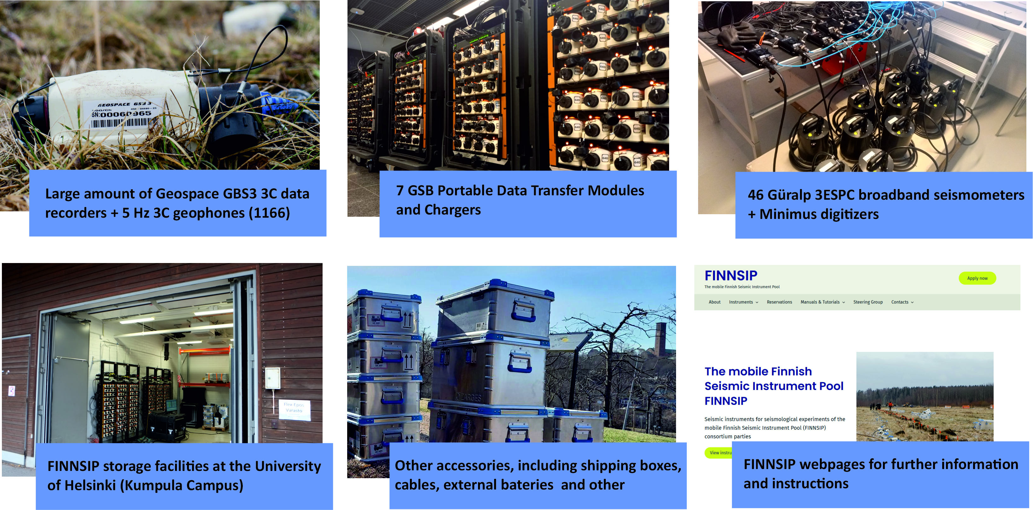
Created, maintained, and operated in by national co-operation
Universities of Helsinki, Turku, Oulu, Aalto and Geological Survey of Finland
FINNSIP host and coordinator: Institute of Seismology, University of Helsinki
  PI Gregor Hillers,
  Coordinator Romeo Courbis https://finnsip.fi/
The Mobile Finnish Seismic instrument
pool (FINNSIP)

Slide 11
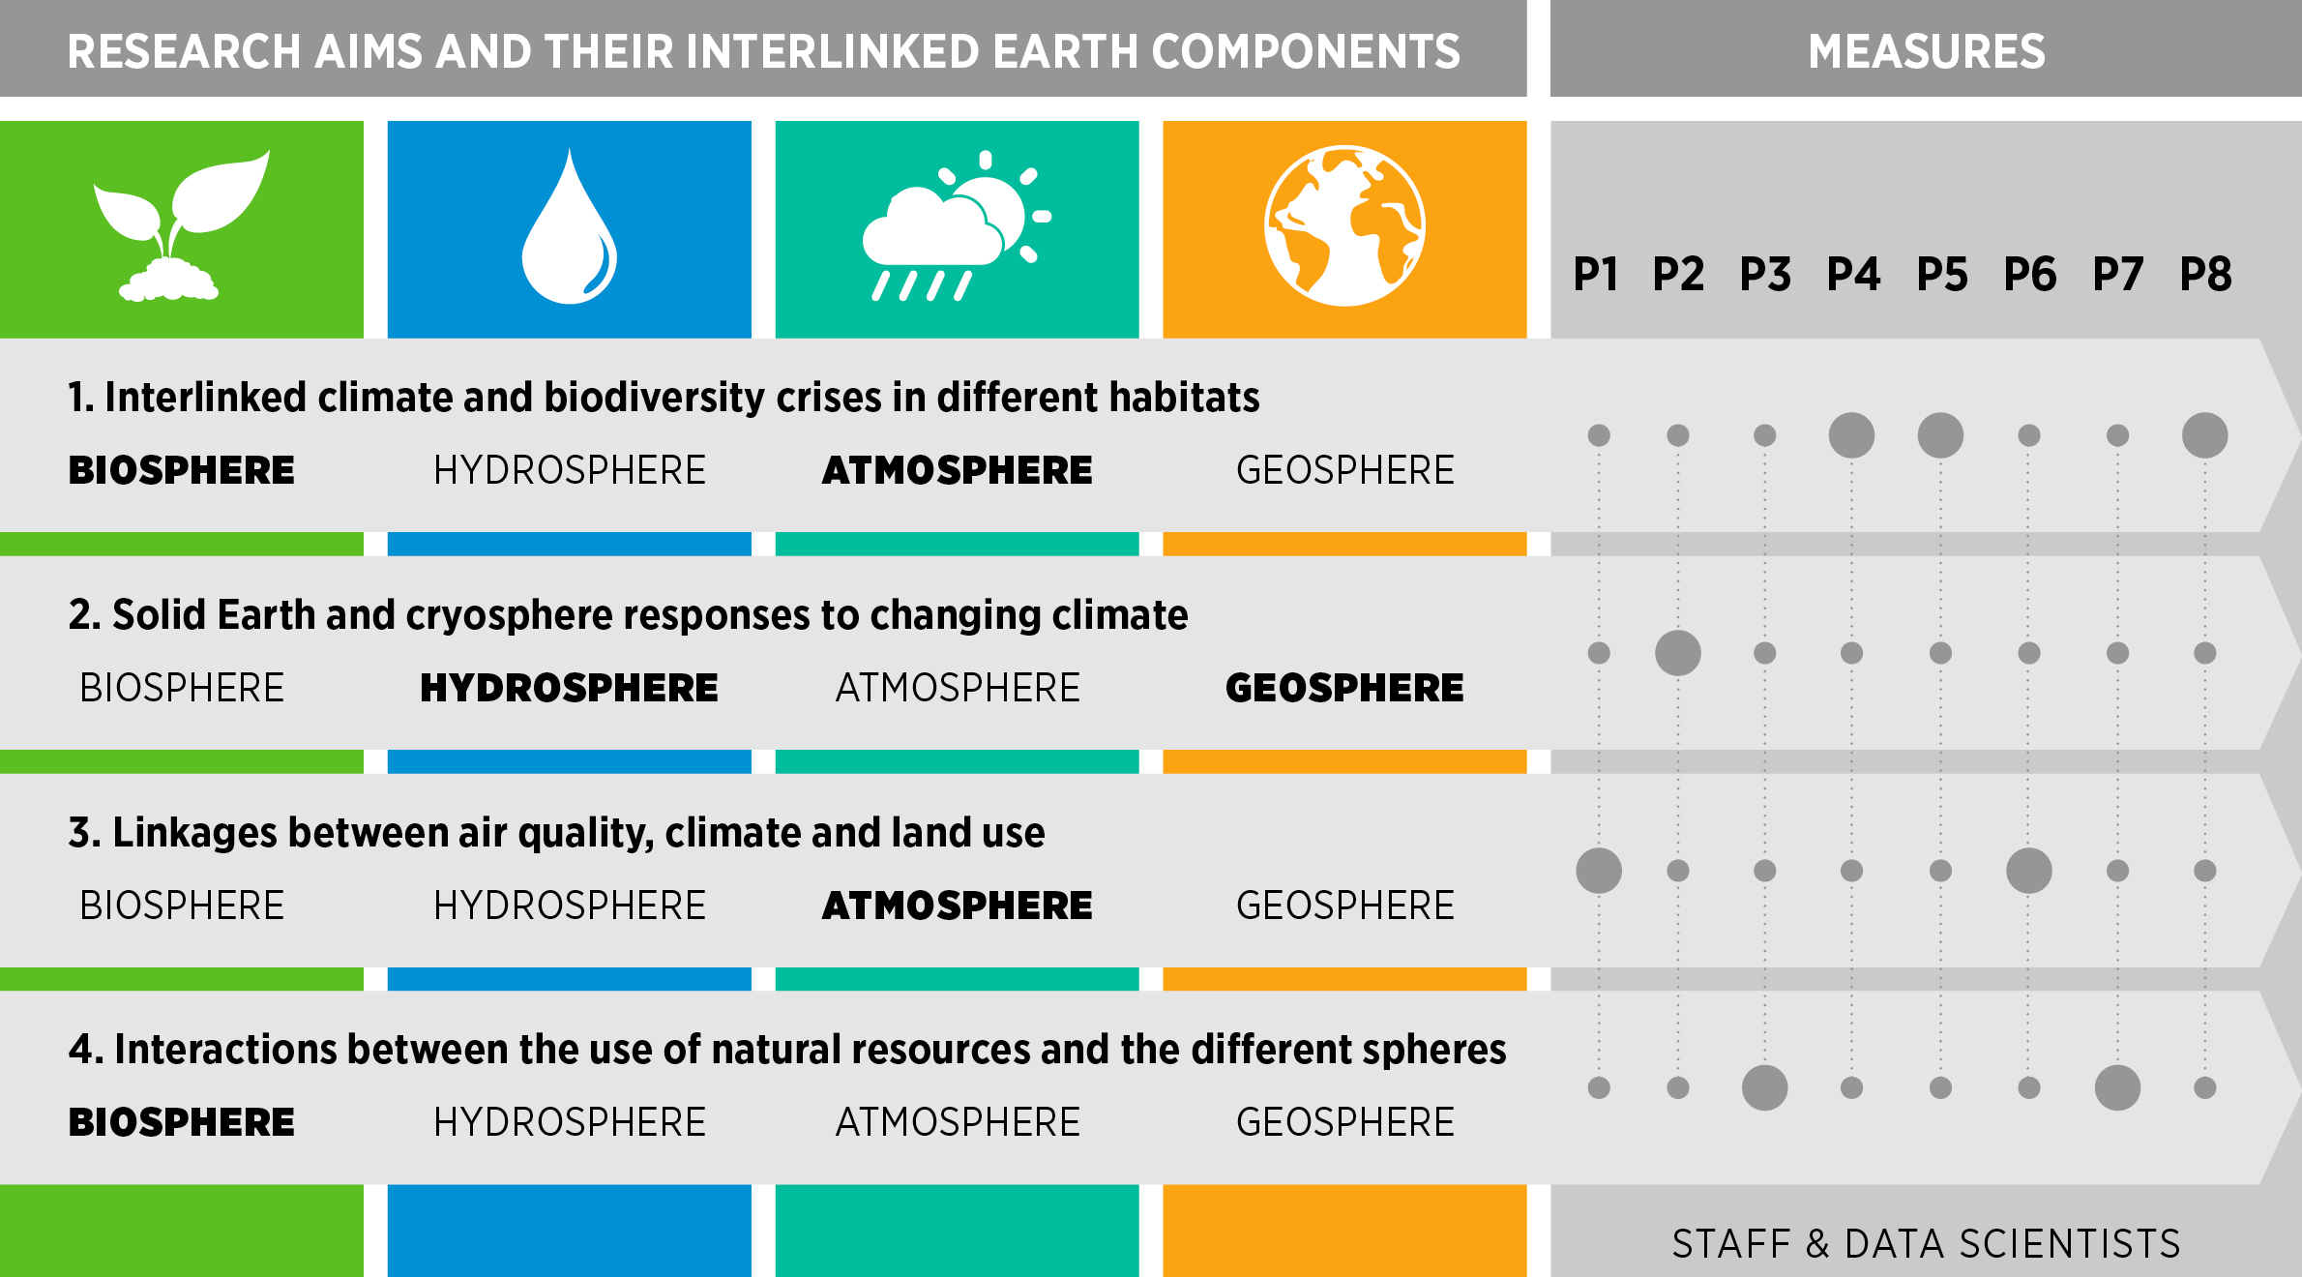
Superstation idea emerges again! EPOS, ICOS, ACTRIS, LTER
National
university profiling action
InterEarth 2023-2028
InterEarth – Interactions between Earth components
OBJECTIVE
To establish a top-level interdisciplinary research environment producing new knowledge and science-based solutions on the interactions and feedbacks between the components of the Earth system
FACULTIES
Science, Agriculture & Forestry, Biological & Environmental Sci. and Luomus
COLLABORATORS
Universities of Eastern Finland (climate change) & Tampere (air quality), Finnish Meteorological Institute (climate change), National Land Survey (remote sensing), CSC IT Center for Science (computing)
CURRENT STRENGHTS
6 national nodes of European Research Infrastructures generating open data across Earth components (biosphere, hydrosphere, atmosphere & geosphere)
Outstanding research (incl. Flagship status) on atmospheric sciences & artificial intelligence
A HIGHLIGHT We build on our excellent infrastructures and track record (incl. 5 Clarivate Highly Cited Researchers & various ERC Stg, CoG and AdG) to generate outstanding societal impact both nationally (e.g. spin-off companies, coordinating the Climate University network) and globally (e.g. IPCC reports)

Slide 12
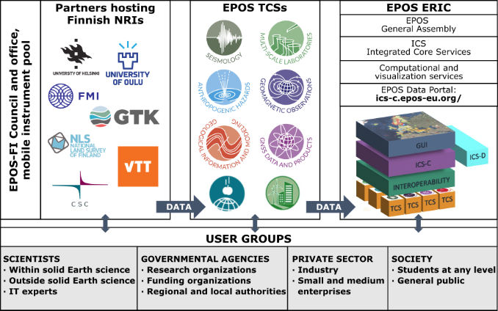
Road map application 2025-2029
MISSION OF EPOS-FI​
To enhance geoscientific research through the development and maintenance of infrastructure, data services, data products, and collaborative Research Infrastructure initiatives in Finland.​

Slide 13
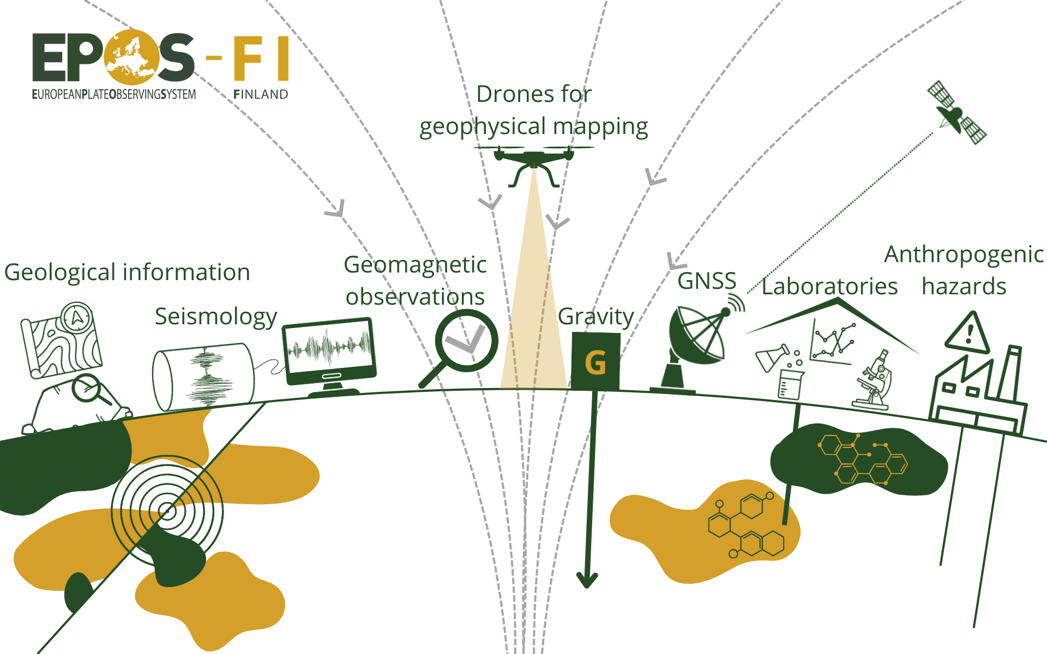
EPOS –Finland development project 2025-2029
Eeight (8) work packages or subprojects:
    WP1 National EPOS-FI metadata portal– the EPOS-FI hub
    WP2 EPOS-FI Data and computing center
    WP3 Legacy data
    WP4 Magnetotelluric (MT) instruments
    WP5 Quantum gravimetry
    WP6 Optical atomic clock infrastructure
    WP7 Solid Earth Geophysics laboratory
    WP8 EPOS-FI office
TOTAL Funding allocated is 4.5 M€

Slide 14
A short history of EPOS-Finland and lessons learnt
Strategic long-term planning for scientific renewal is needed to be on the national RI roadmap.
Quantum gravimeters and other high profile initiatives (profi) have been needed for the renewal of science.
White papers and strategic documents as well as risk management plans and data policy documents at EPOS level ar needed for the national level applications.
Decision makers of the Research Council of Finland and Ministry of Education have been rather supportive of funding EPOS Finland RI projects.
BUT
Althought the scientific reasoning has been clear from the start, the financial benfit to Finland from EU side has not been so clear.
FIRI funding decisions have been off-phase with EPOS-ERIC planning.
Let´s hope that the processes are now synchonized.

Slide 15
Thank you!
EPOS-FI https://www.helsinki.fi/en/infrastructures/epos-fi

