Slide 1
EPOS Days, Perugia, 19th March 2025

Slide 2
Built Environment Data: previously
There is a growing societal demand for geohazard risk assessment information
And, indeed, risk services are already being provided in both the Seismology and Tsunami TCSs
Nonetheless, there is a need to continue to develop increasingly more advanced and comprehensive risk services, whilst avoiding duplication of efforts
This led to the idea of proposing a new TCS that would be focused on the FAIR provision of data, data products, services and software (DDSS) related to buildings and urban infrastructure, i.e. the built environment

Slide 3
Built Environment Data: previously
The proposed TCS will involve leading engineering research groups from across Europe that work together in the provision of services regarding, e.g.:
hazard-agnostic exposure databases (buildings, infrastructure and population);
dynamic models of exposure evolution;
access to structural testing facilities;
access to experimental data.
In addition to the engineering research community, it is expected that such a TCS would also see the involvement of other disciplines, such as social sciences, urban planning, climate adaptation etc., so that data on social, economic and environmental aspects can also be integrated in the developed services.

Slide 4
Built Environment Data: initial developments
The Built Environment Data (BED) candidate thematic core service (TCS) was presented at EPOS Days 2024
It initially comprised some tentative services led by different institutions:
Experiments (EUCENTRE)
SimDesign (UPORTO)
Embodied Carbon (GEM)
www.builtenvdata.eu
Experiments
SimDesign
Embodied
Carbon
more services

Slide 5
Built Environment Data: initial developments
These services were further developed with collaboration from different institutions across Europe
Additional services have also been added:
Experiments (EUCENTRE)
RESSLab-Hub (EPFL)
SimDesign (UPORTO/IUSS)
Embodied Carbon (GEM)
URM Data (EPFL)
Stone Masonry Data (EPFL)
The scope is to extend and grow these services in the context of risk assessment of the built environment
www.builtenvdata.eu
Experiments
RESSLab-hub
SimDesign
Embodied
Carbon
URM Data
Stone Masonry
Data
even more services!

Slide 6
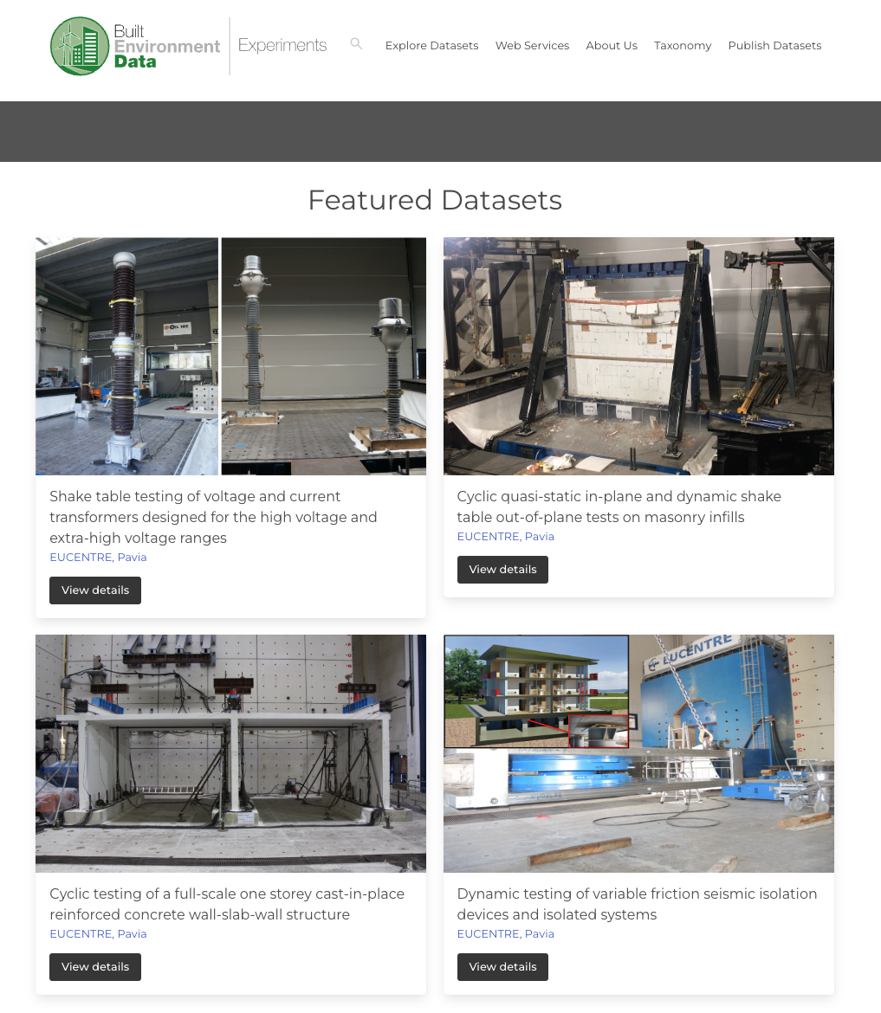
Built Environment Data: Experiments
Progress to date
A total of 54 datasets from 13 laboratories now present on the platform
34 new datasets were added to the platform
Performance optimisation has improved the platform's speed
UI enhancements include minor design and usability improvements
Accessible at: https://experiments.builtenvdata.eu/

Slide 7
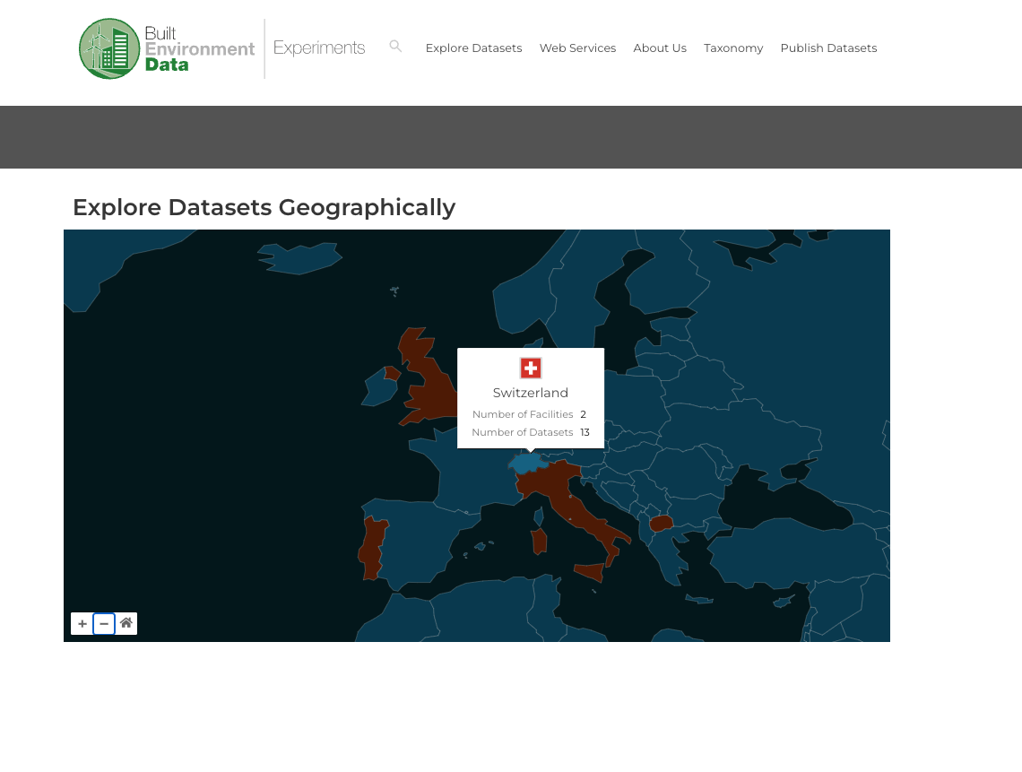
Built Environment Data: Experiments
Progress to date
A total of 54 datasets from 13 laboratories now present on the platform
34 new datasets were added to the platform
Performance optimisation has improved the platform's speed
UI enhancements include minor design and usability improvements
Accessible at: https://experiments.builtenvdata.eu/
A world-map page and individual country pages now display the number of datasets (automatically updated based on dataset entries) and participating institutions per country

Slide 8
Built Environment Data: Experiments
Progress to date
A total of 54 datasets from 13 laboratories now present on the platform
34 new datasets were added to the platform
Performance optimisation has improved the platform's speed
UI enhancements include minor design and usability improvements
Accessible at: https://experiments.builtenvdata.eu/
A world-map page and individual country pages now display the number of datasets (automatically updated based on dataset entries) and participating institutions per country
FAIR score improvements: Dataset DOIs have been moved to DataCite for better FAIRness, but room for improvement…

Slide 9
Built Environment Data: Experiments
Planned activities
FAIR score enhancement: Improving the F-UJI FAIR score by updating website metadata, including better headers and search engine optimisations for improved findability, which involved migrating the backend technologies from Vuetify to Nuxt
New pages and profiles: Introducing personalised profiles for laboratories and individuals, enhancing both visual presentation and service functionality while supporting statistical data retention
Thumbnail improvements: Collaborators of dataset providers will be contacted to provide better thumbnail images based on specific guidelines
Metadata updates: The metadata requirements document will be updated to include thumbnail specifications and new entries aimed at further improving the FAIR score
API documentation: Swagger documentation will be introduced alongside the existing web services page - it is currently available at https://experiments.builtenvdata.eu/api/v1/docs/. The goal is to ensure APIs are seamlessly and dynamically accessible directly through the webpage

Slide 10
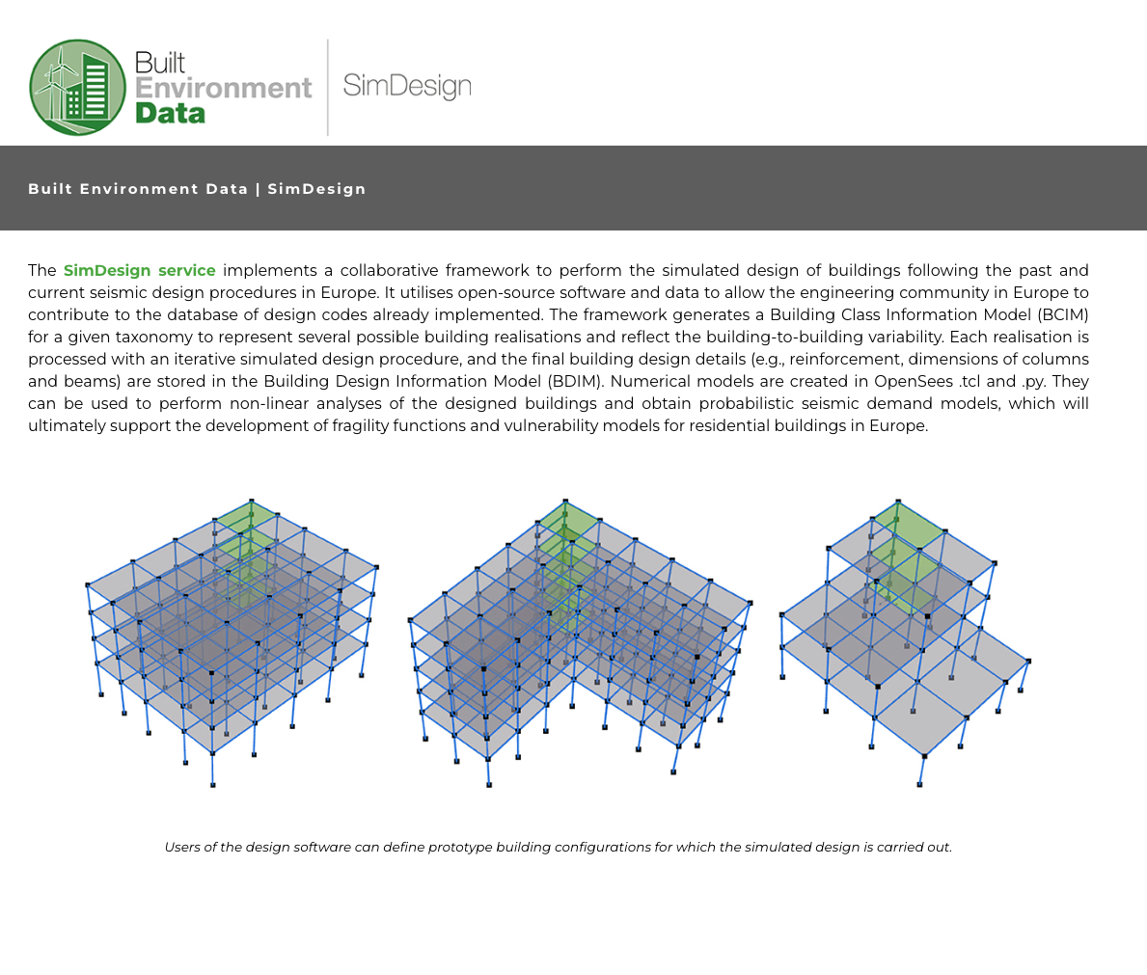
Built Environment Data: SimDesign
Progress to date
The framework has been implemented in Python using object-oriented programming. The source-code is well-commented for encouraging community contributions and formatted by following PEP 8 style guide
Accessible at: https://simdesign.builtenvdata.eu/

Slide 11
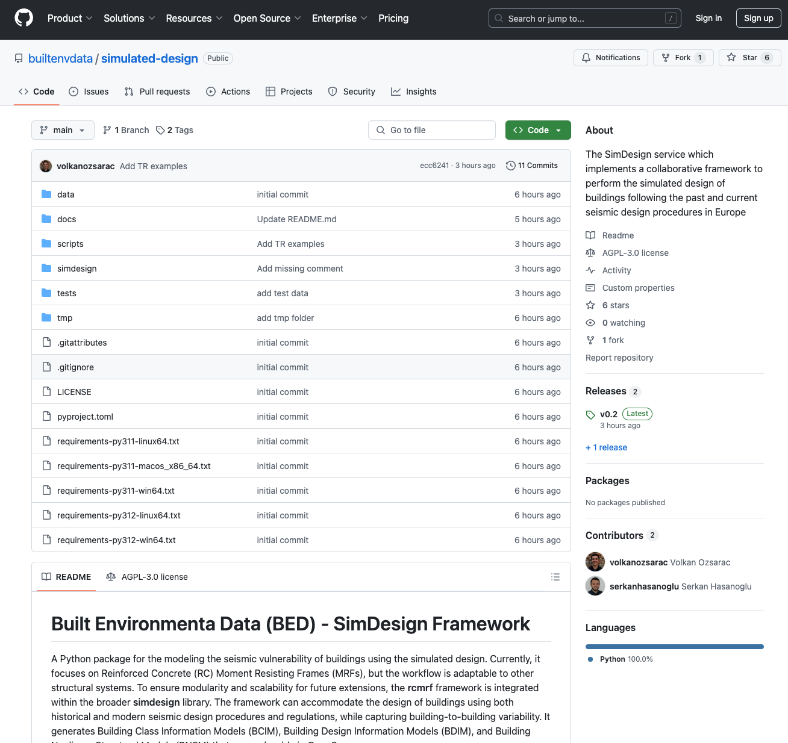
Built Environment Data: SimDesign
Progress to date
The framework has been implemented in Python using object-oriented programming. The source-code is well-commented for encouraging community contributions and formatted by following PEP 8 style guide
Accessible at: https://simdesign.builtenvdata.eu/
The source-code has been made available on GitHub for community contributions: https://github.com/builtenvdata/simulated-design
Interactions with the Tsunami TCS have fostered collaboration and synergistic research interests

Slide 12
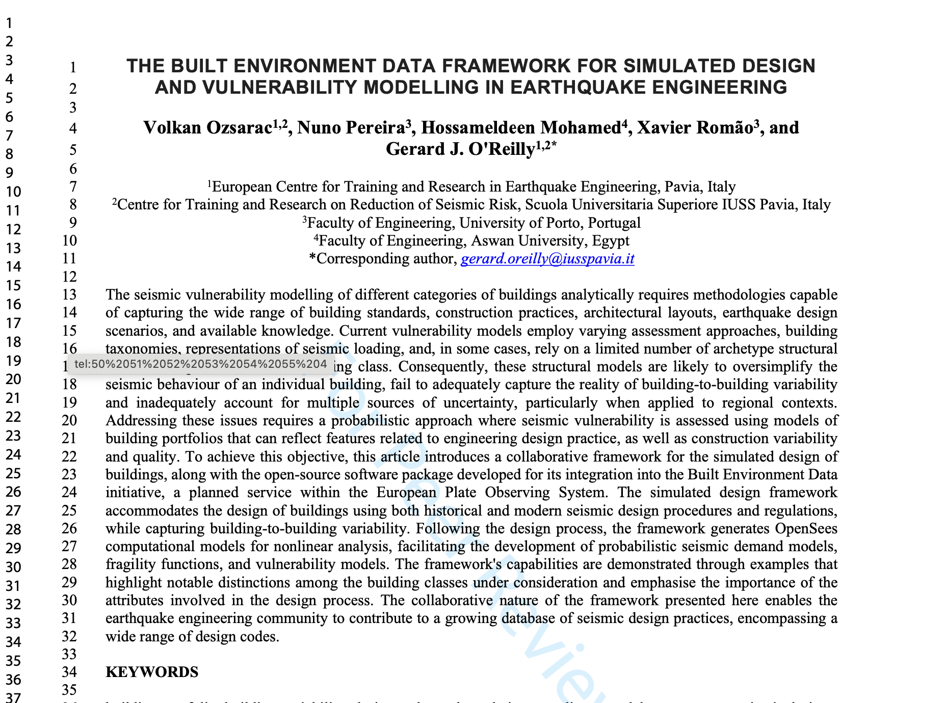
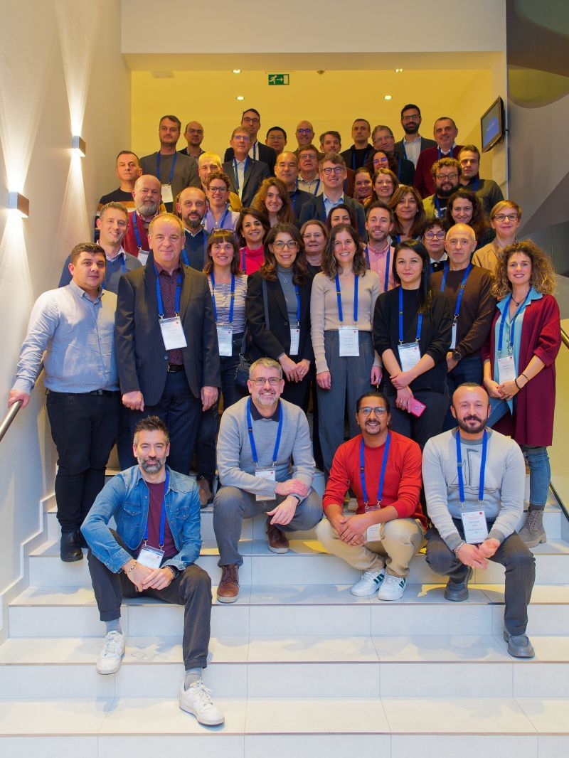
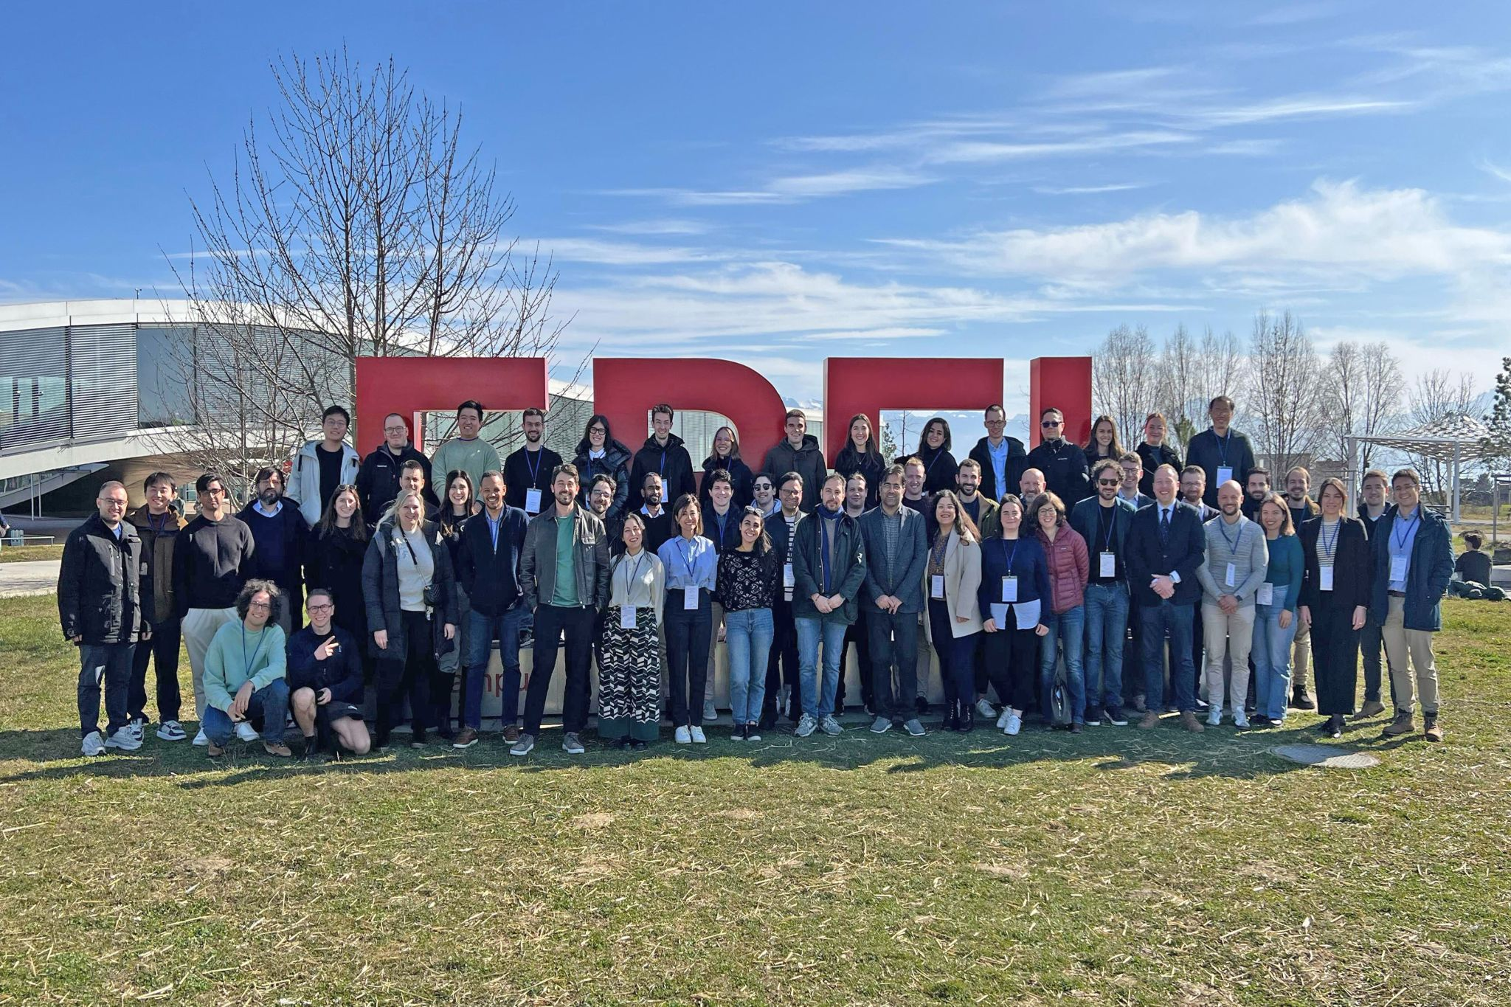
Built Environment Data: SimDesign
Progress to date
There has been good outreach and community reaction for this collaborative framework
A paper has been prepared and submitted
The first version of the service has enjoyed successful usage as a teaching tool at a PhD course at IUSS Pavia, Italy
The development and collaborative nature of the service as presented and well-received at some international events:
102nd Journées Luxembourgeoises de Géodynamique (JLG) & EFEHR Scientific Session 2024 in Luxembourg
9th International Course on Seismic Analysis of Structures using OpenSees (2025) in Lausanne, Switzerland

Slide 13
Built Environment Data: SimDesign
Planned activities
Integration of alternative numerical modelling approaches for more flexibility (e.g., distributed plasticity)
Integration of alternative structural systems (e.g., steel moment frames)
Integration of design practices for other seismically active countries (e.g., Italy)
A Web-App development which can be integrated into EPOS for easy use of the framework

Slide 14
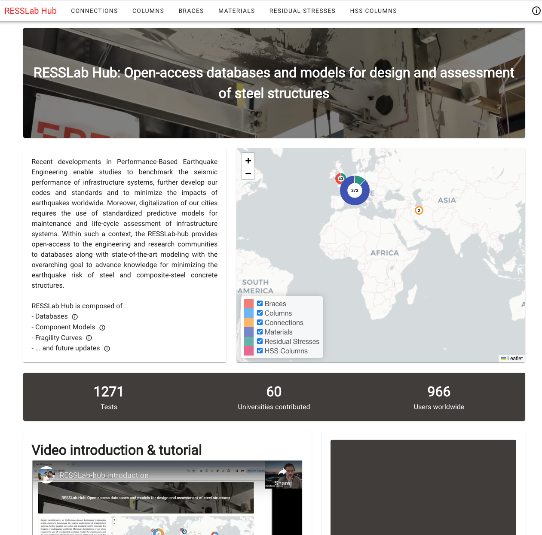
Built Environment Data: RESSLab-hub
Current activities
A further service RESSLab-hub was added based on research developed by the Resilient Steel Structures Laboratory (RESSLab) at École Polytechnique Fédérale de Lausanne (EPFL), Switzerland
It provides open-access structural performance databases along with state-of-the-art interactive component modeling and fragility functions
Overarching goal to advance knowledge for minimizing the earthquake risk of steel structures
The available data can facilitate studies to benchmark the seismic performance of infrastructure systems, to develop standardized predictive models for maintenance and life-cycle assessment of our built environment and to further develop our codes and standards

Slide 15
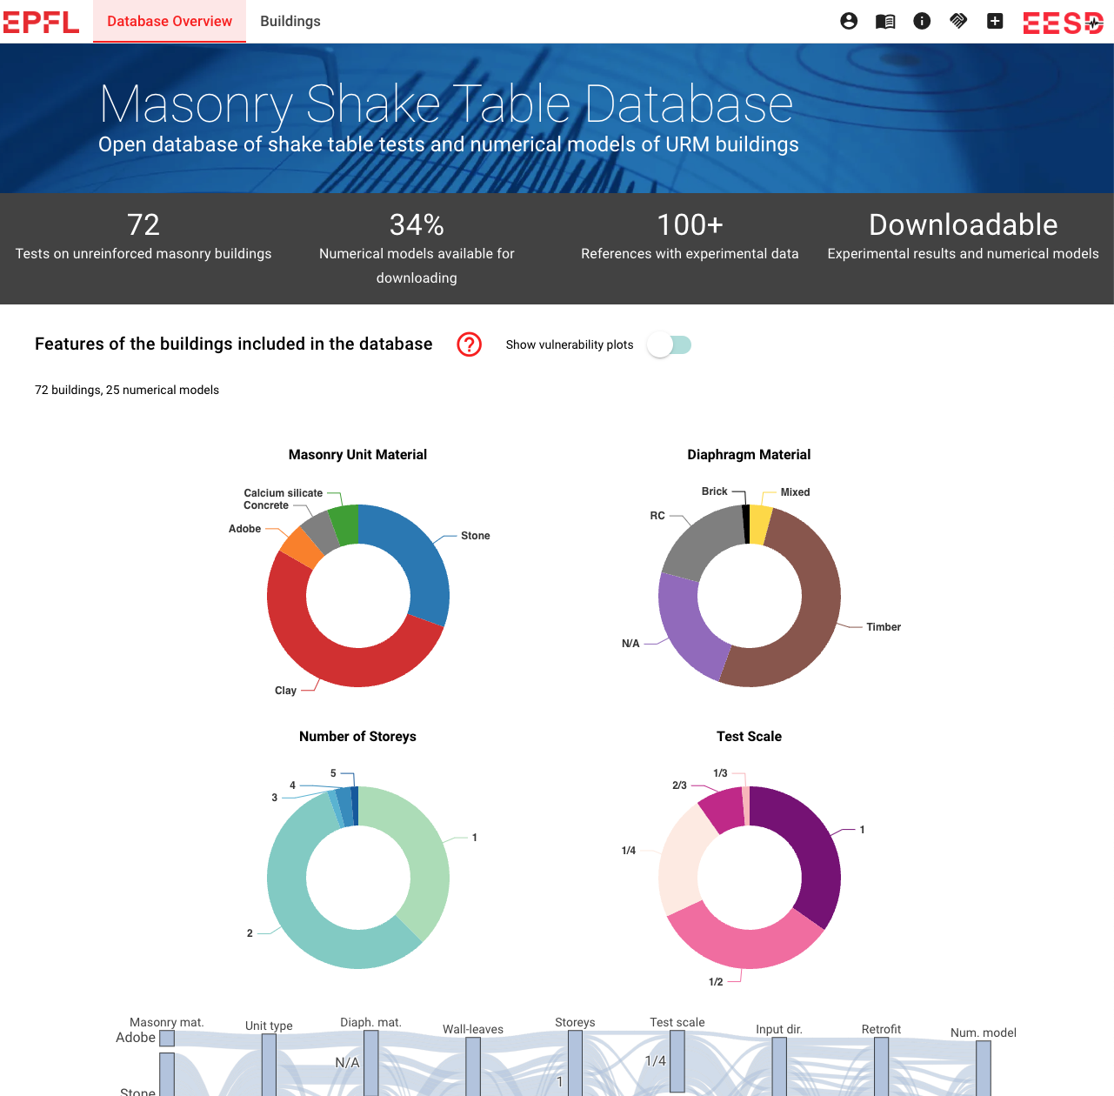
Built Environment Data: URM Data
Current activities
A further service URM Data was added based on research developed by the Earthquake Engineering and Structural Dynamics (EESD) group at École Polytechnique Fédérale de Lausanne (EPFL)
Comprises a database of shake table tests on full unreinforced masonry (URM) buildings
Open-access, web-based interactive platform enables users to quickly identify and access shake table test data for brick and stone masonry structures
Additionally, the platform offers ready-to-use numerical models in OpenSees, supporting model validation and uncertainty quantification studies for the seismic assessment of URM buildings

Slide 16
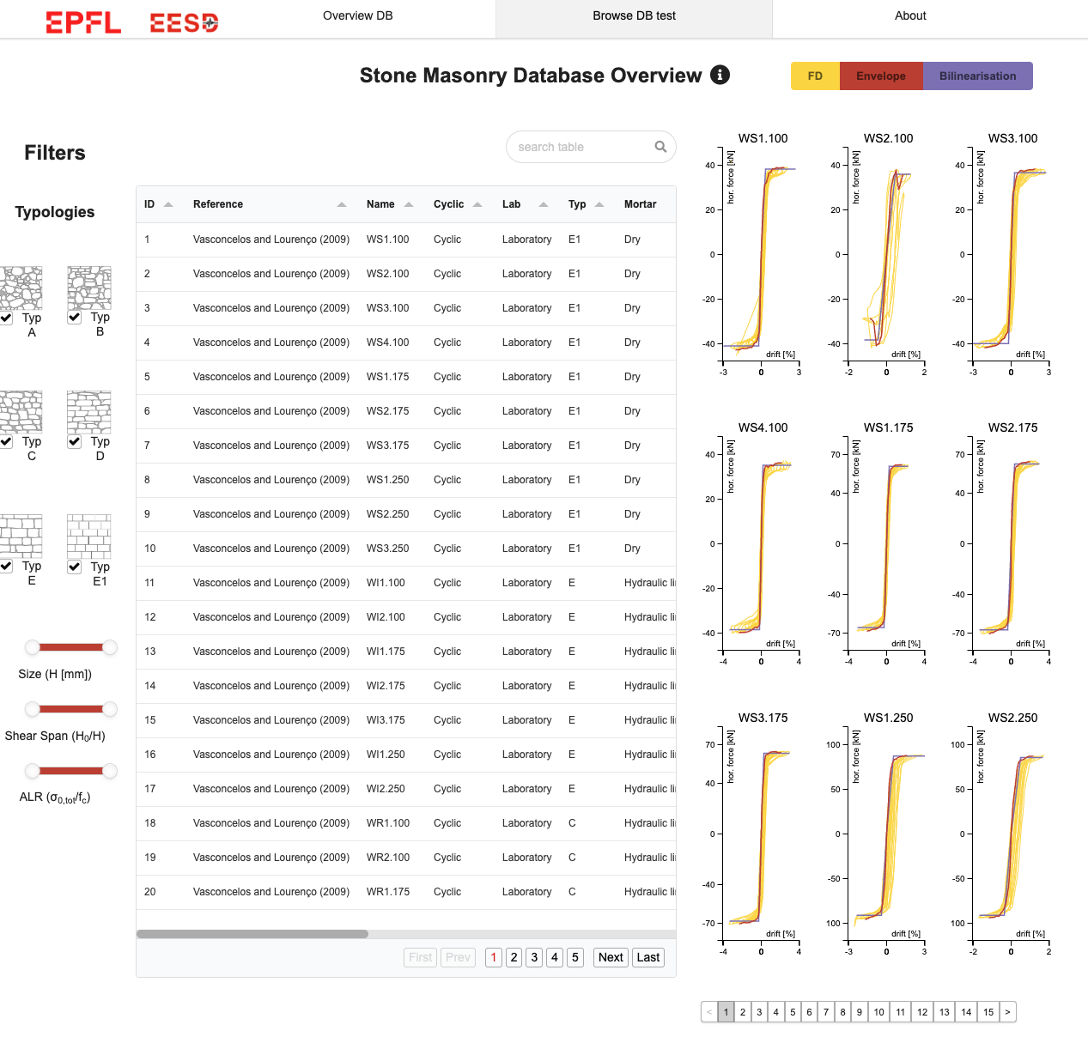
Built Environment Data: Stone Masonry Data
Current activities
A further service Stone Masonry Data was added based on research developed by the Earthquake Engineering and Structural Dynamics (EESD) group at École Polytechnique Fédérale de Lausanne (EPFL)
Database of shear-compression tests on stone masonry walls
This open-access, web-based interactive platform enables users to quickly identify and access test data for all stone masonry typologies
Material test data on mortar, stone and masonry is included in the database where available

Slide 17
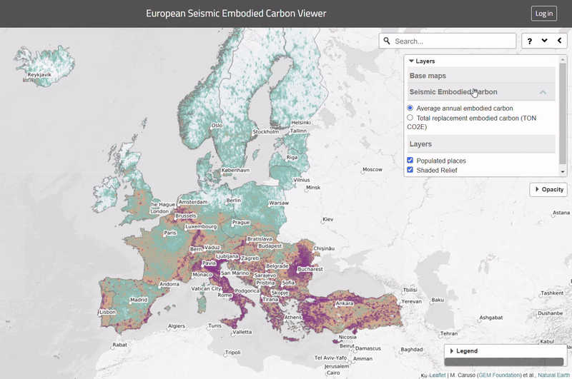
Built Environment Data: Embodied Carbon
Current activities
Embodied Carbon is a service maintained and developed by the Global Earthquake Model (GEM) Foundation
It provides access to data and maps of the embodied carbon associated with the seismic damage repair and replacement of residential, commercial and industrial buildings worldwide

Slide 18
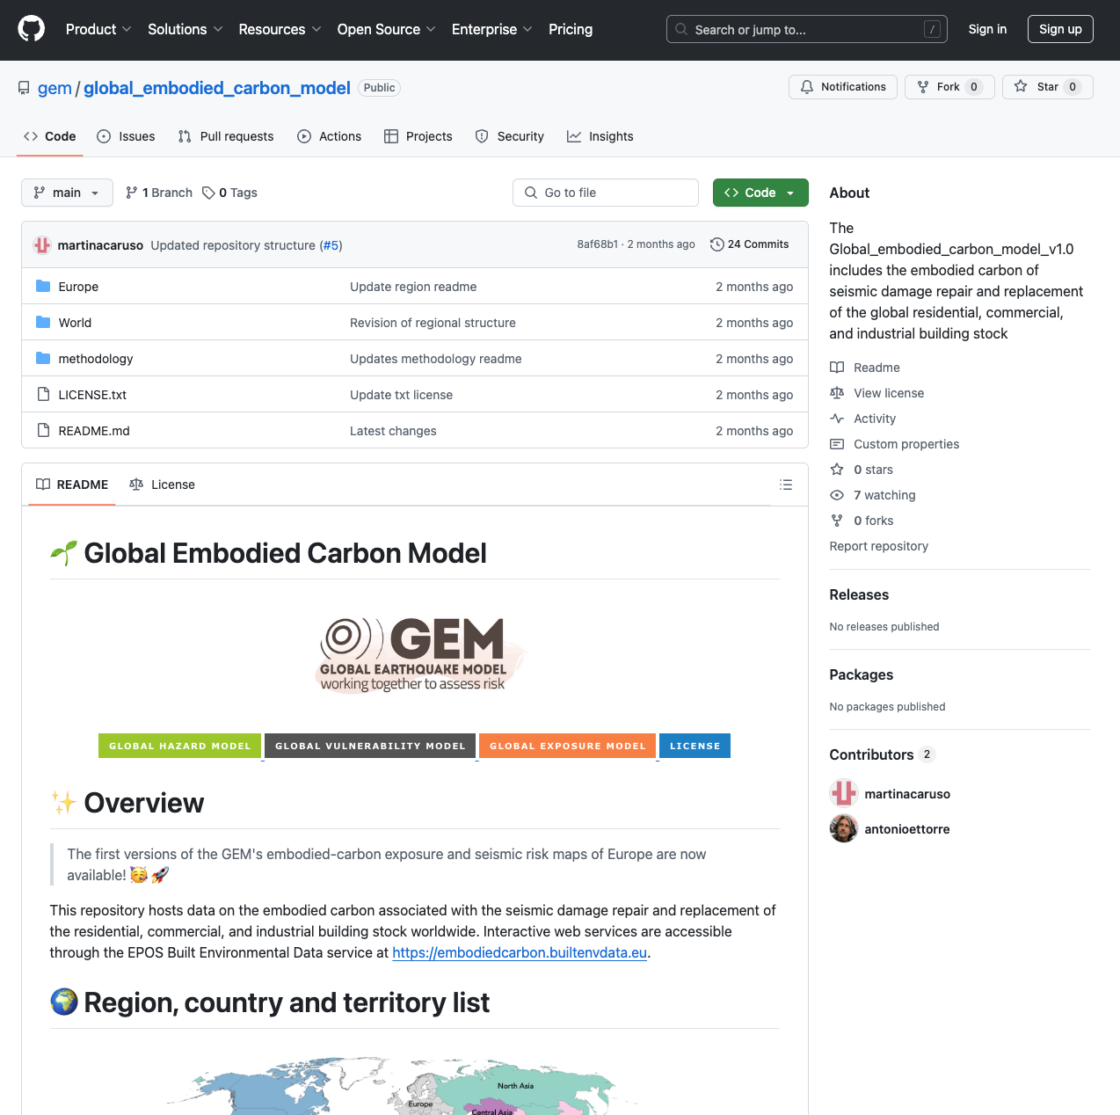
Built Environment Data: Embodied Carbon
Current activities
Embodied Carbon is a service maintained and developed by the Global Earthquake Model (GEM) Foundation
It provides access to data and maps of the embodied carbon associated with the seismic damage repair and replacement of residential, commercial and industrial buildings worldwide
Available at: https://github.com/gem/global_embodied_carbon_model/tree/main

Slide 19
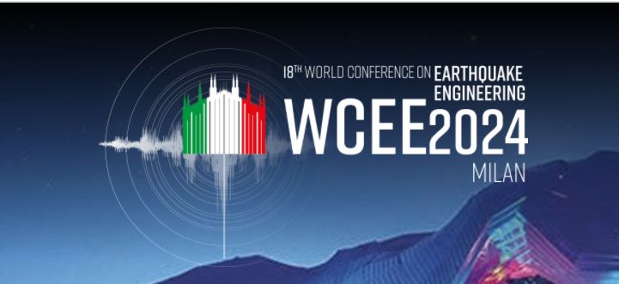
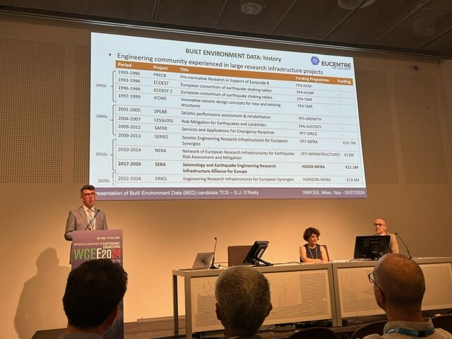
Built Environment Data
Ongoing activities
A meeting was held at the 18th World Conference on Earthquake Engineering in Milan, Italy.
An overview of EPOS and the Data Portal’s current capabilities were presented to approximately 40 attendees
The BED initiative and its current services was then presented to the community
Overview of EPOS – Lilli Freda, EPOS
Introduction to Data Portal – Rossana Paciello
Presentation of BED candidate TCS – Gerard J. O’Reilly
Brief intro to current BED services:
BED: Experiments – Davit Shahnazaryan, Eucentre Foundation
BED: SimDesign – Xavier Romão, University of Porto
BED: Embodied Carbon – Martina Caruso, Global Earthquake Model Foundation

Slide 20
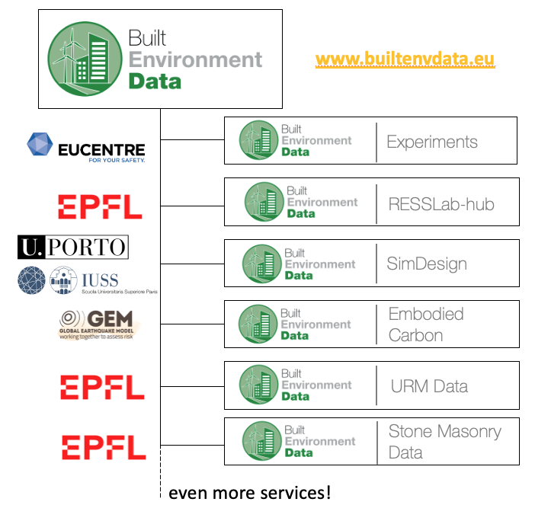
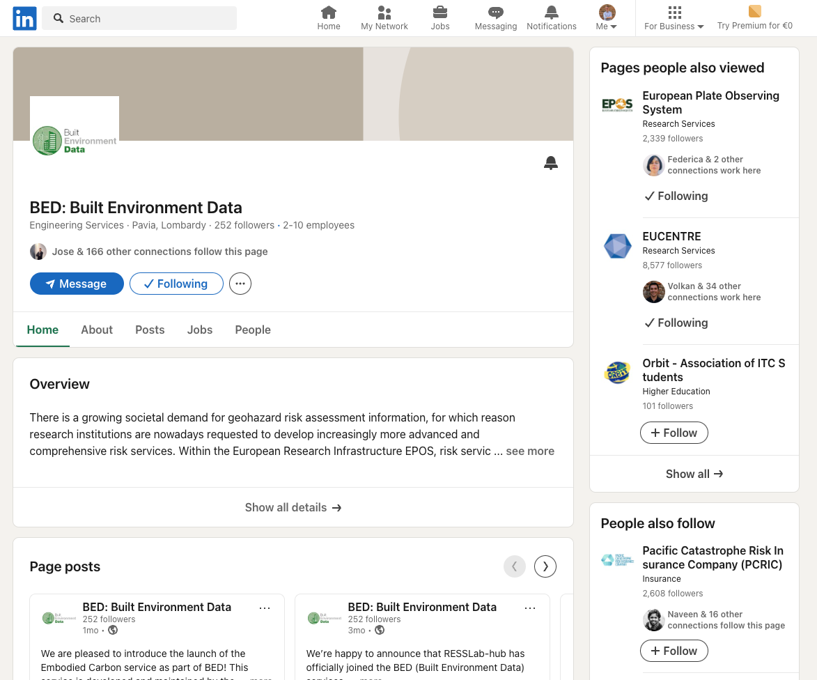
Built Environment Data: Future Outlook
Planned activities
The BED community has grown considerably, both in terms of services available, as well as with regards to the “richness” of these services/databases
Community outreach has been a focus, with several meetings/workshops including the creation of a social media page on LinkedIn
Additional services and data will be added in 2025, whilst functionality and FAIR-ness improvements will also be introduced in the initially setup services
We are thus aiming at submitting the application to become a Candidate TCS by the end of 2025

Slide 21
Built Environment Data: a growing community

