Slide 1
European QUantum Infrastructure Project for Gravimetry

Slide 2
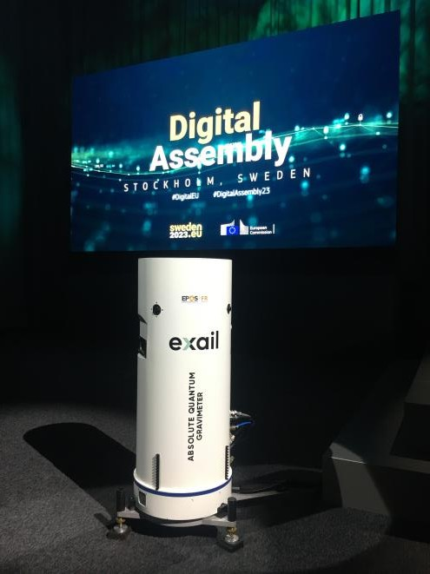
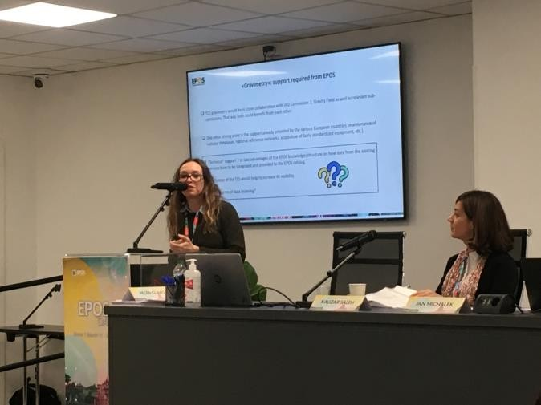
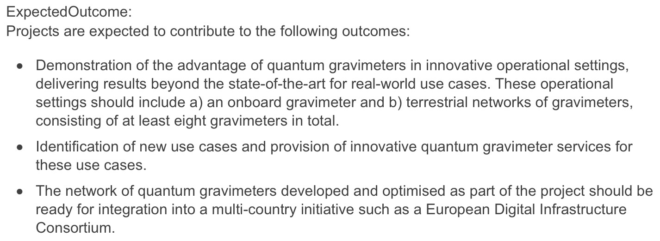
EU Project
2023
2024

Slide 3
EU Project

Slide 4
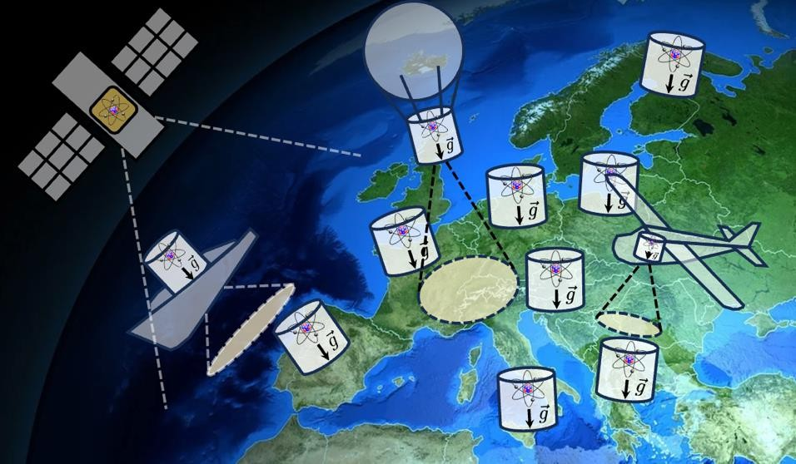
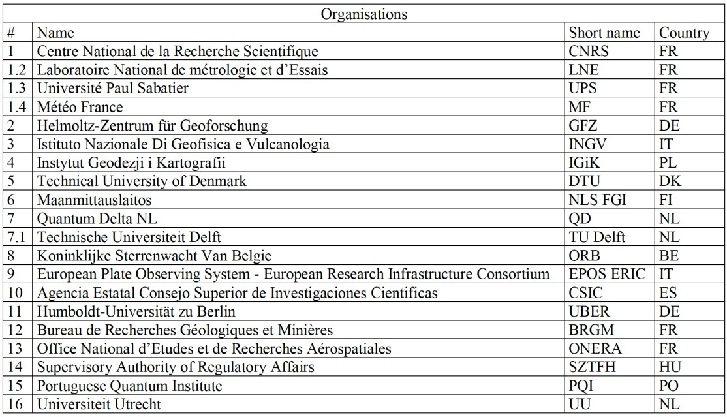
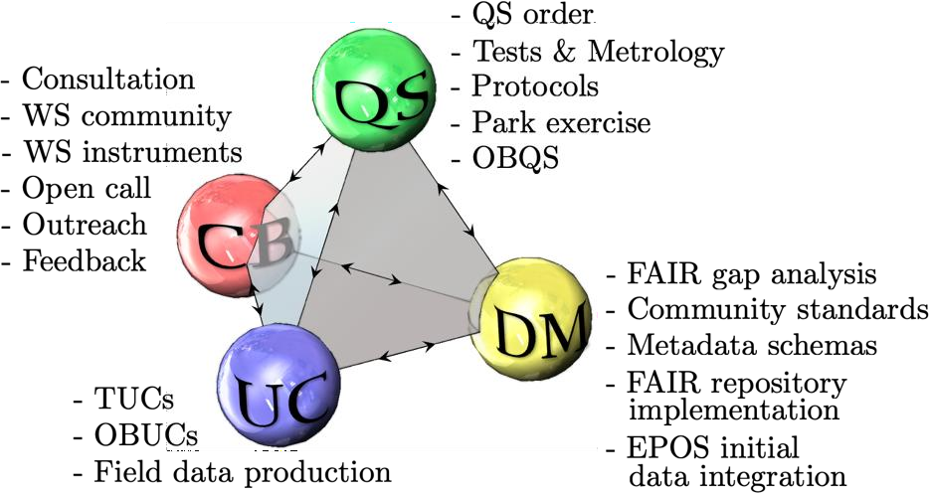
A consortium proposed EQUIP-G project
20 from 11 countries
4 activities
The main objective and ambition of EQUIP-G is to develop and deploy a network of quantum gravimeters in Europe, that will ultimately lead to a long-term entity managing a shared park of quantum gravimeters. We aim at fostering a large European community and at demonstrating to decision makers the advantages offered by the multi-country perennial initiative.
For this purpose, EQUIP-G will pursue the following sub-objectives:
Creating a park of quantum gravimeters composed of nine terrestrial devices and one onboard gravimeter.
Deploying the quantum gravimeters in networks and carrying out field use cases, involving innovative and
challenging applications.
Demonstrating the advantages offered by quantum gravimeters with respect to hitherto established technologies. Developing and democratizing the European quantum gravimeter network, through which devices, results, data and capabilities will be shared across to the gravimetry community members.
Preparing an EPOS Thematic Core Service for gravimetry.
-
-
Through the achievement of the above objectives, EQUIP-G will lay the cornerstone for the ground
segment of the European quantum gravimetry infrastructure.

Slide 5
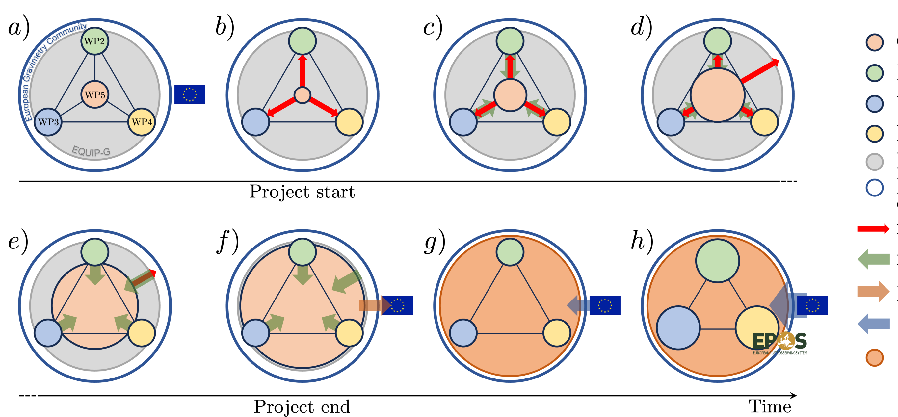
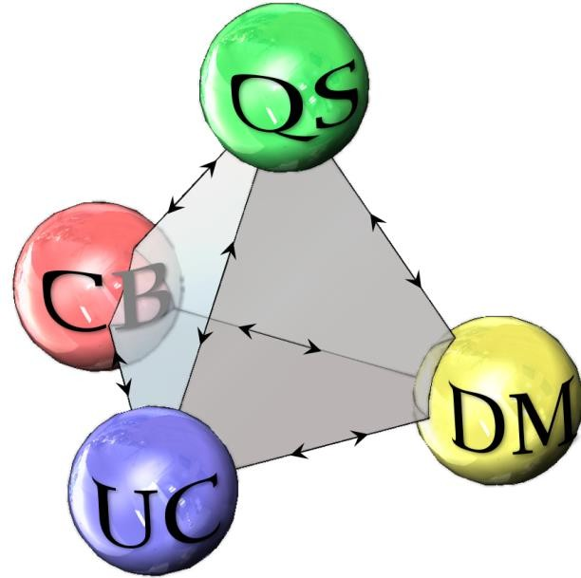
Community Building, methodology and time schedule

Slide 6
Community Building, methodology and time schedule

Slide 7
Community Building, methodology and time schedule

Slide 8
Community Building, methodology and time schedule

Slide 9
Community Building, methodology and time schedule
Impacts

Slide 10
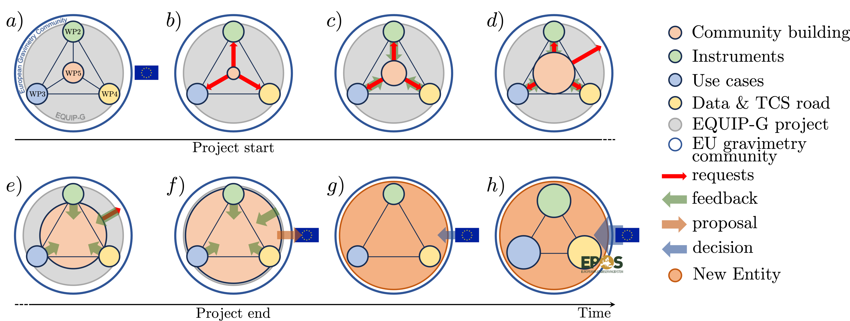
Community Building, methodology and time schedule

Slide 11
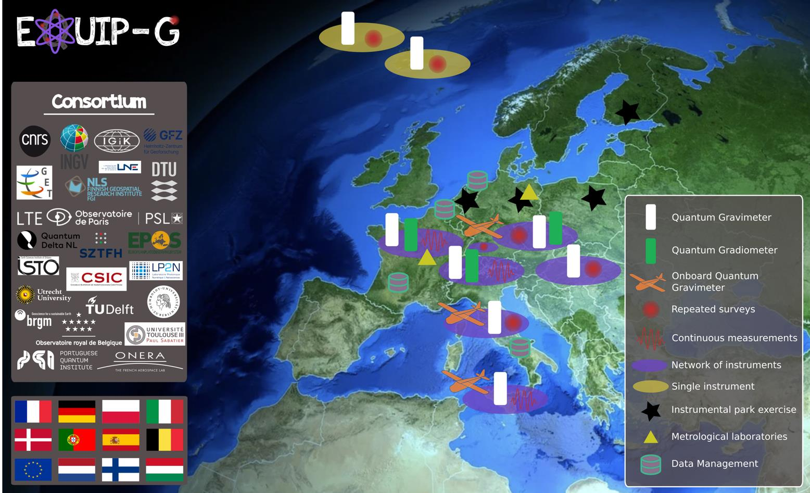
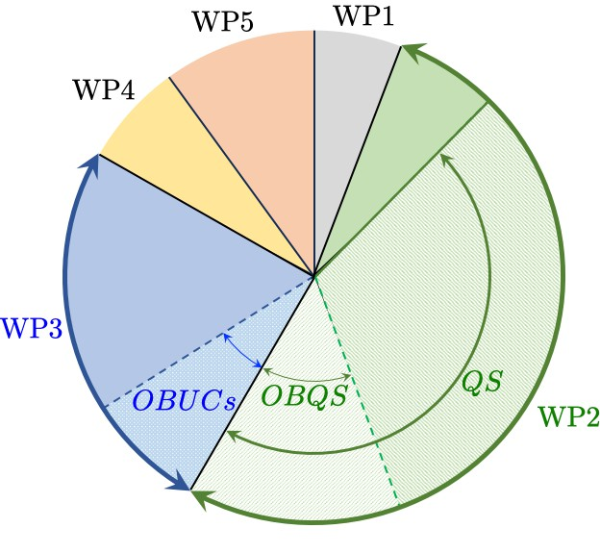
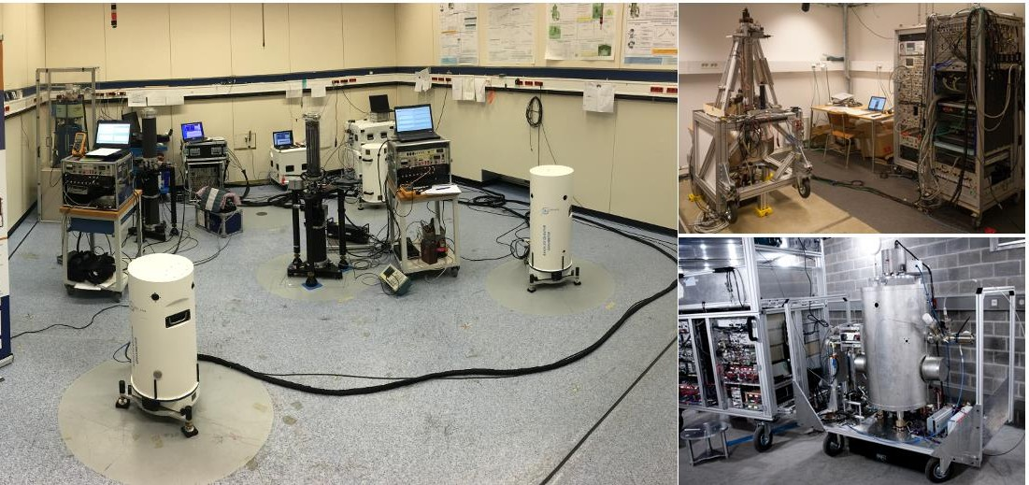
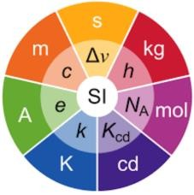
EQUIP-G consortium invited to prepare GA

Slide 12
EQUIP-G, a great opportunity
WS
WS instruments
Training
Open calls
Open data
Need your help
Need your support
Need your involvment
Join
More sensors ?
Not only gravimeters ?

Slide 13
EQUIP-G, a great opportunity
WS
WS instruments
Przemyslaw Dykowski
Training
Open calls
Marvin
Reich
Open data
Need your help
Need your support
Need your involvment
Lucia
Seoane
Daniele Carbone
Join
More sensors ?
Not only gravimeters ?

Slide 14
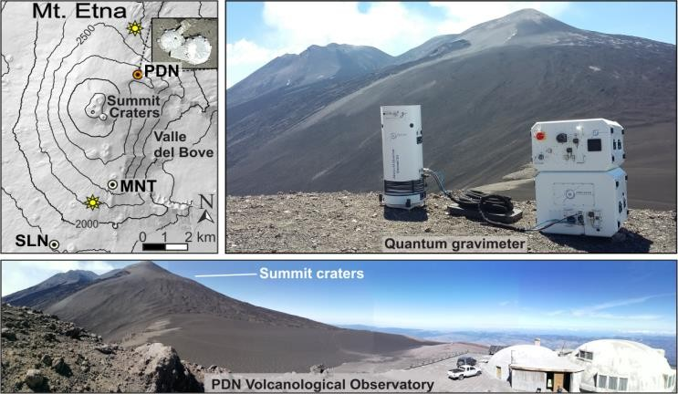
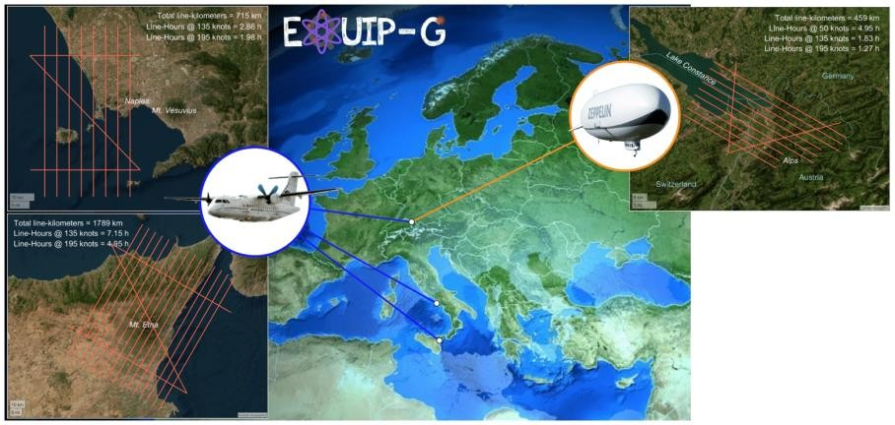
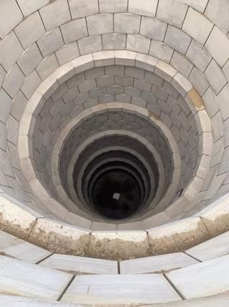
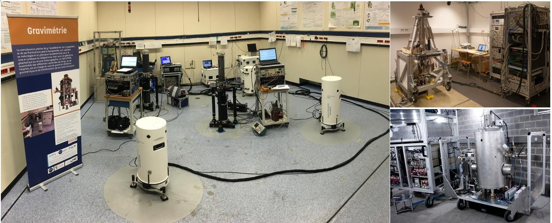
Community Building, methodology and time schedule

Slide 15
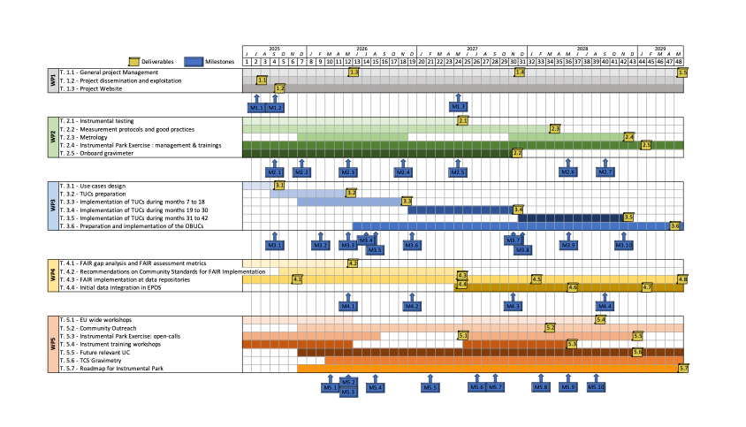
EQUIP-G Gantt Chart

