Slide 1
11 Aprile 2013
Natural Field Laboratories as a tool for ground instabilities AI-Twins
Prof. Salvatore Martino
Perugia, 19 March 2025
salvatore.martino@uniroma1.it

Slide 2
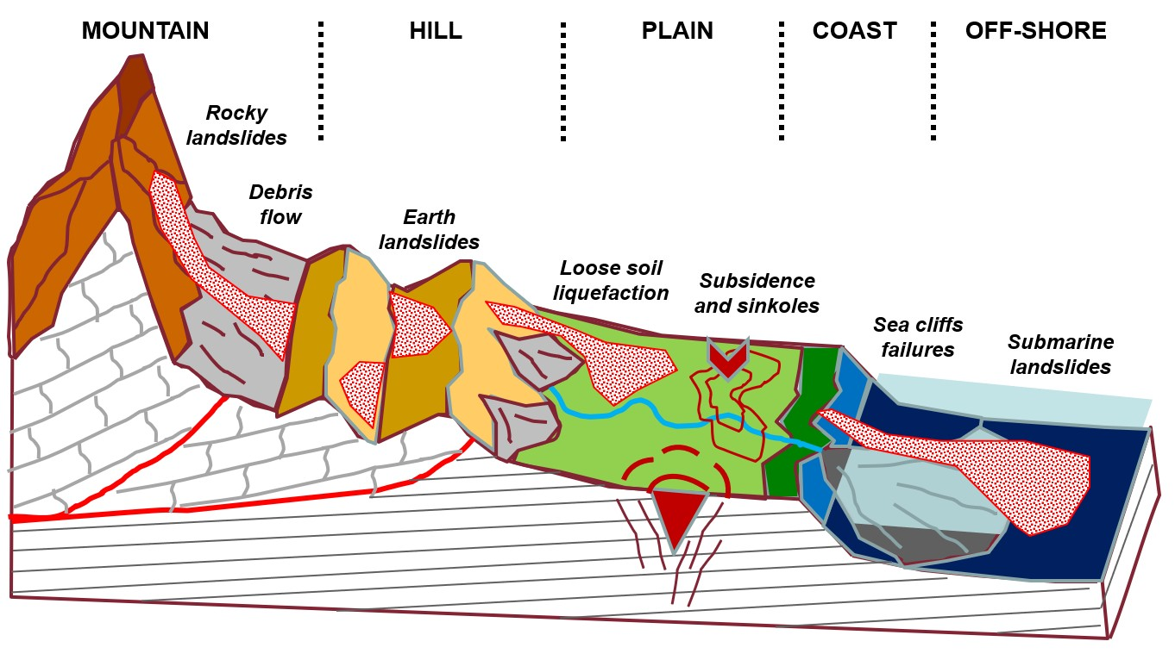
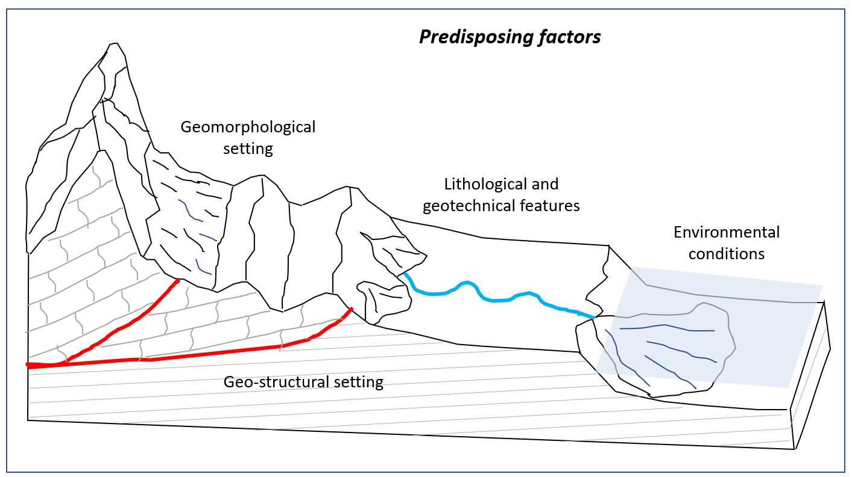
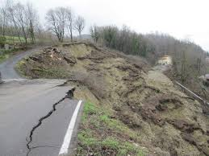
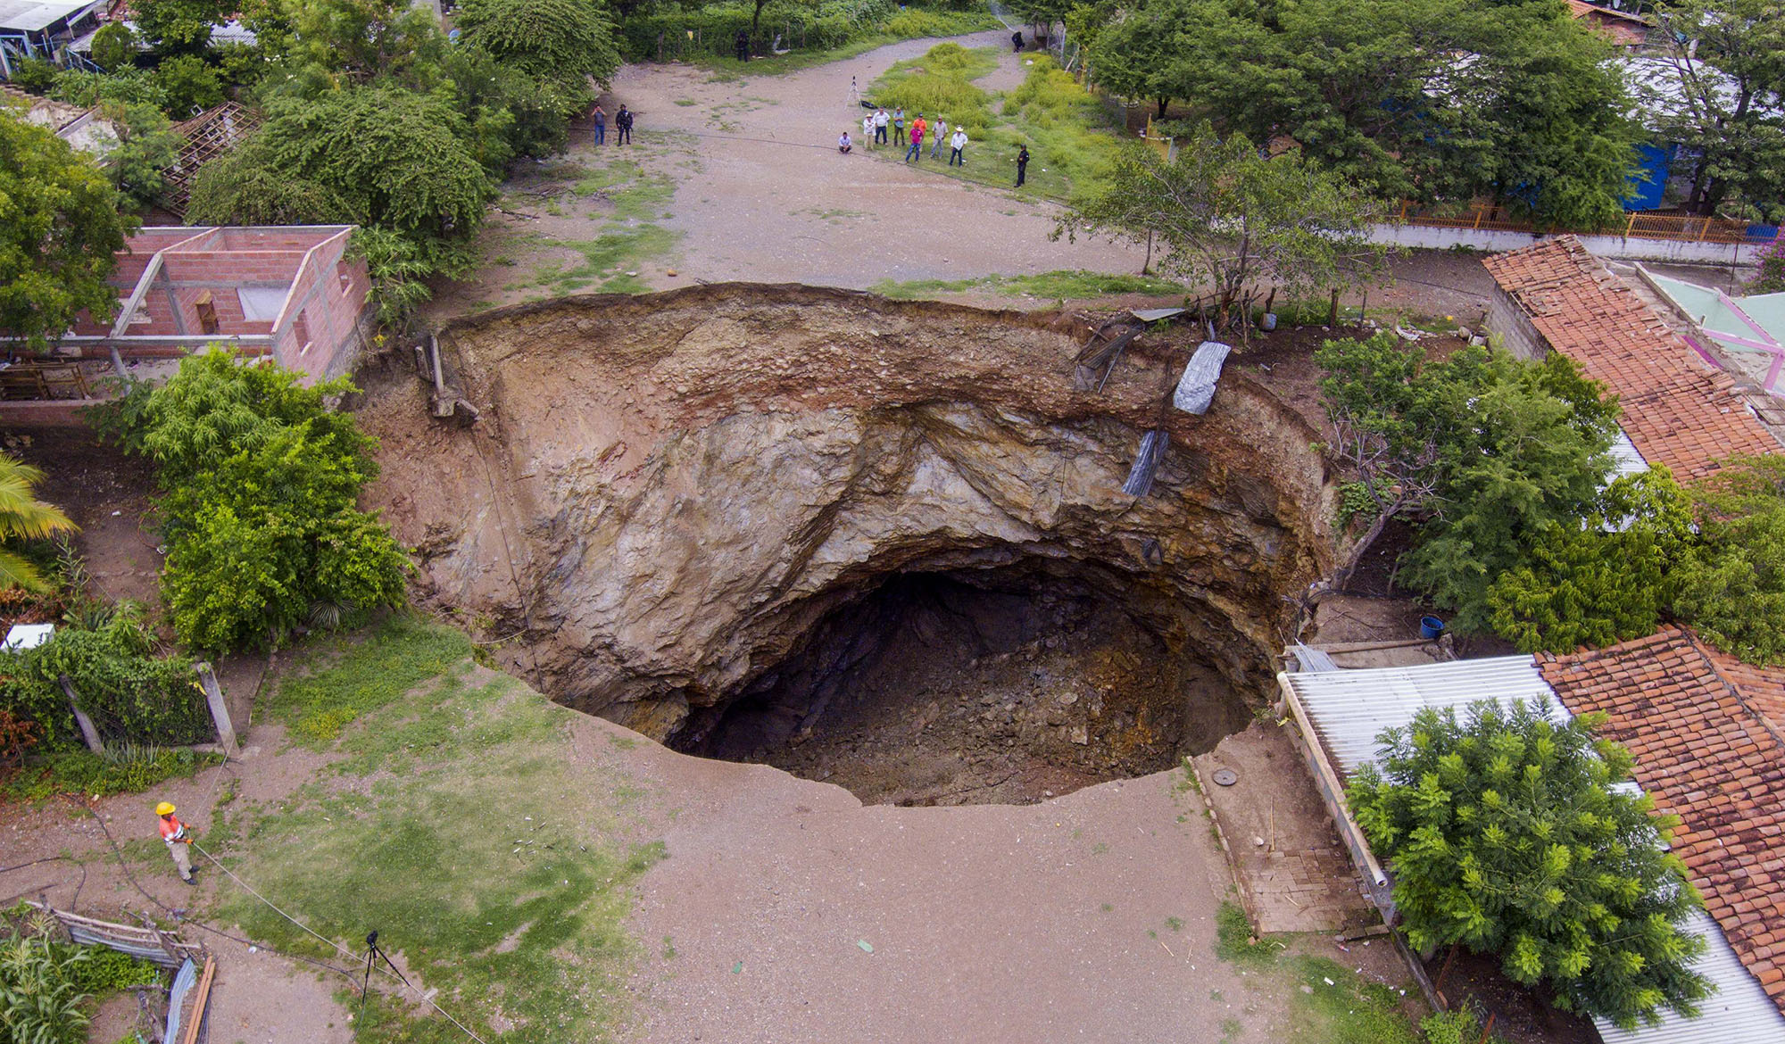
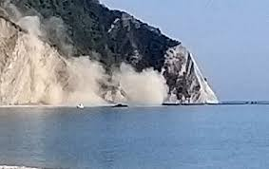
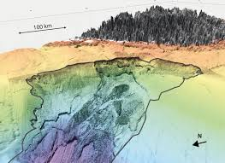
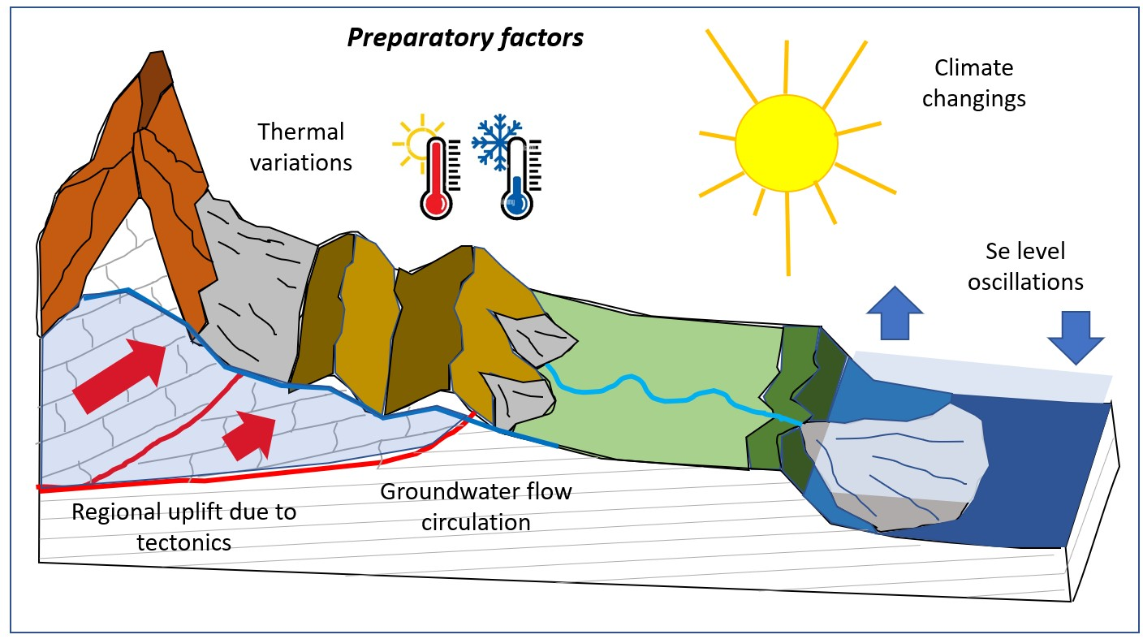
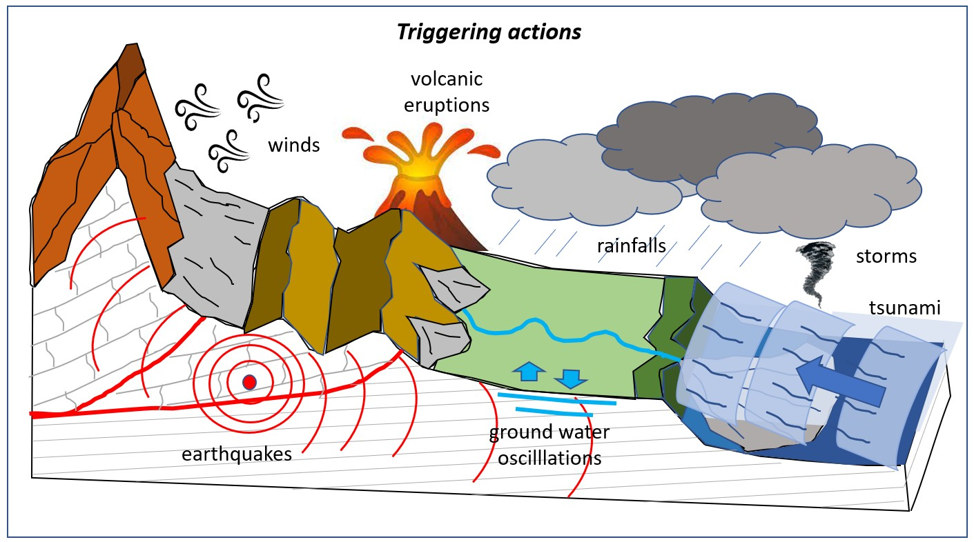
Dealing with «Ground Instabilities»
TIME INDEPENDENT
Predisposing factors (geological, morphodynamic and geotechnical)
IMPULSIVE
CLIMATE DEPENDENT
Preparatory processes (climatic actions, river dynamics, anthropic pressure)
Triggering actions (earthquakes, volcanic activity, intense rainfall, rapid melting of snow, human interventions)
Natural Field Laboratories for Ground Instabilities
Salvatore Martino

Slide 3
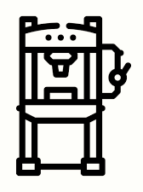
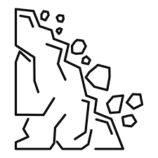
Concept of in-house/natural field labs
IN-HOUSE LABORATORIES include systems to "represent" site conditions in standard or prototype devices by applying principles of physical-mechanical analogy or relationships and scaling functions of site properties.
Physics-Informed Neural Networks
(PINNS)
NATURAL FIELD LABORATORIES represent sites which are used for the experimentation of real-scale processes that are caused by natural or forced conditions, in both cases kept under monitoring by sensors installed on site.
Artificial Intelligence trained Twins (AI-Twins)
Natural Field Laboratories for Ground Instabilities
Salvatore Martino

Slide 4
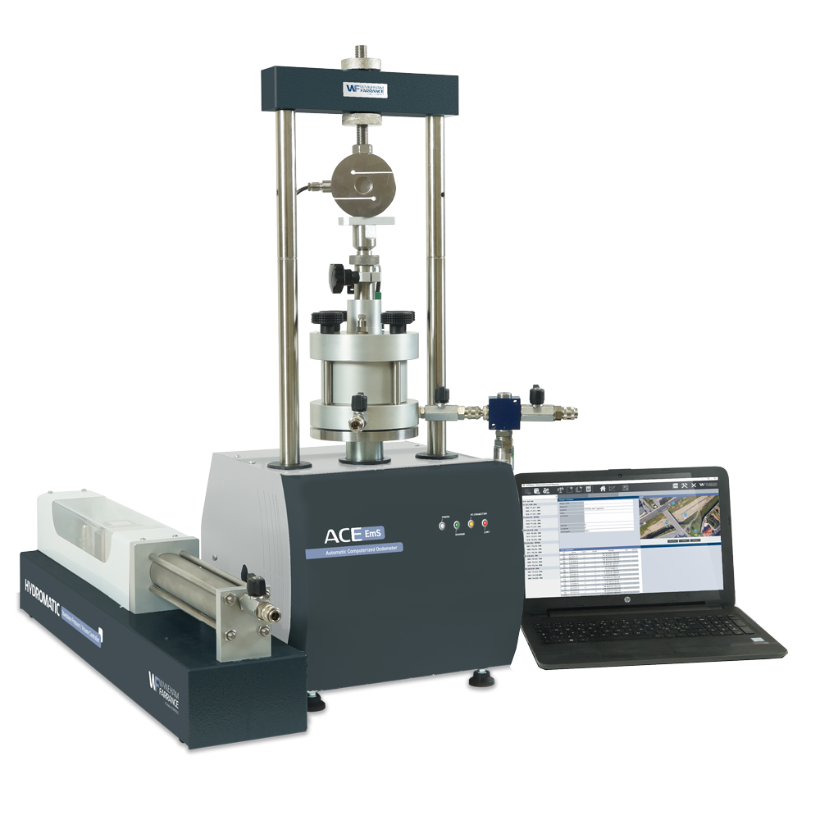
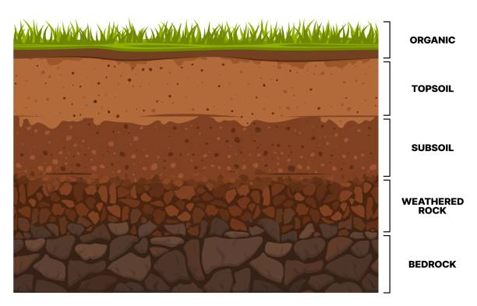
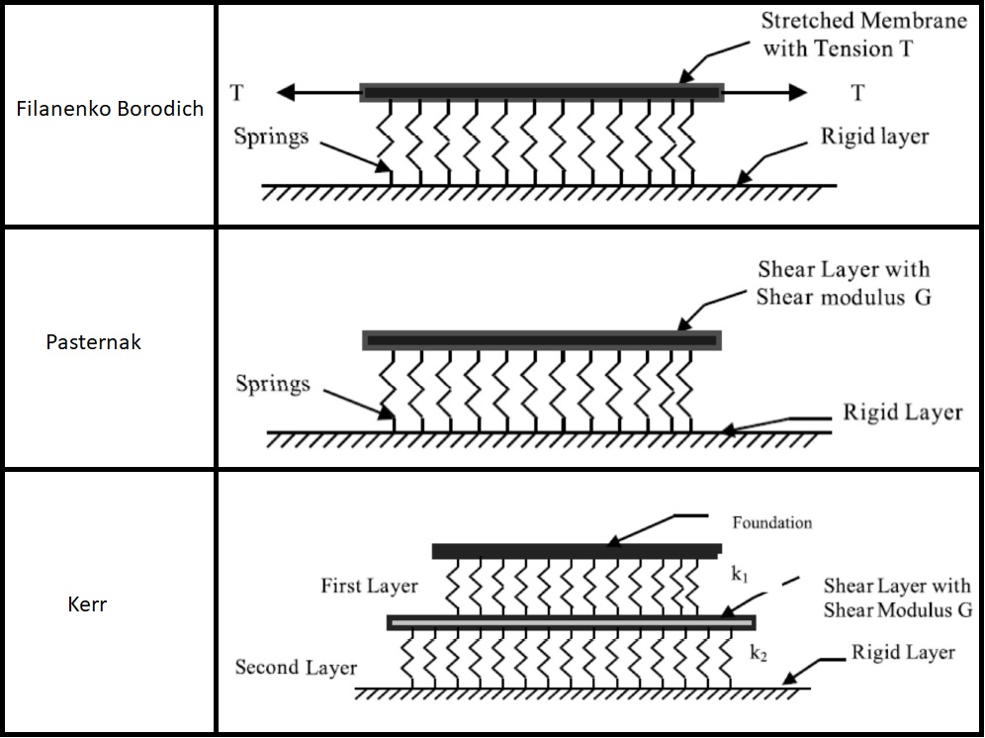
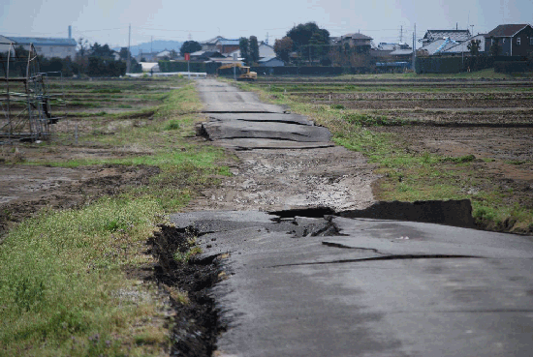
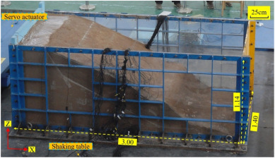
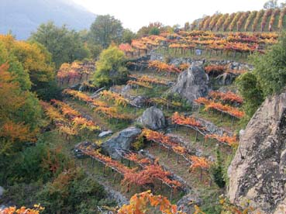
Examples of «in house» laboratories
Physic-analogue: reality transposition
Standard or Prototype devices: reality transposition
Down-scaled modelling: reality reproduction
Natural Field Laboratories for Ground Instabilities
Salvatore Martino

Slide 5
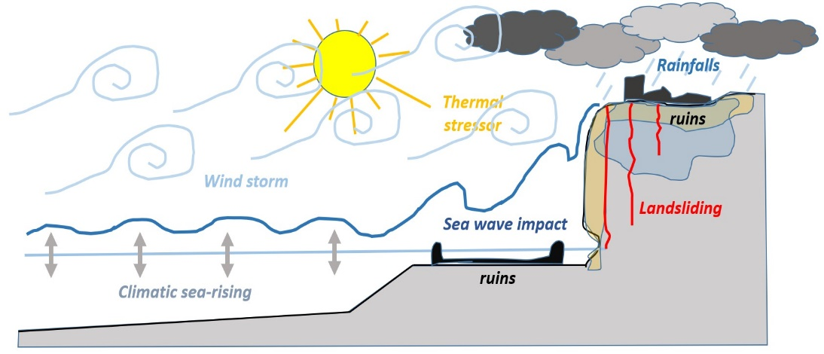
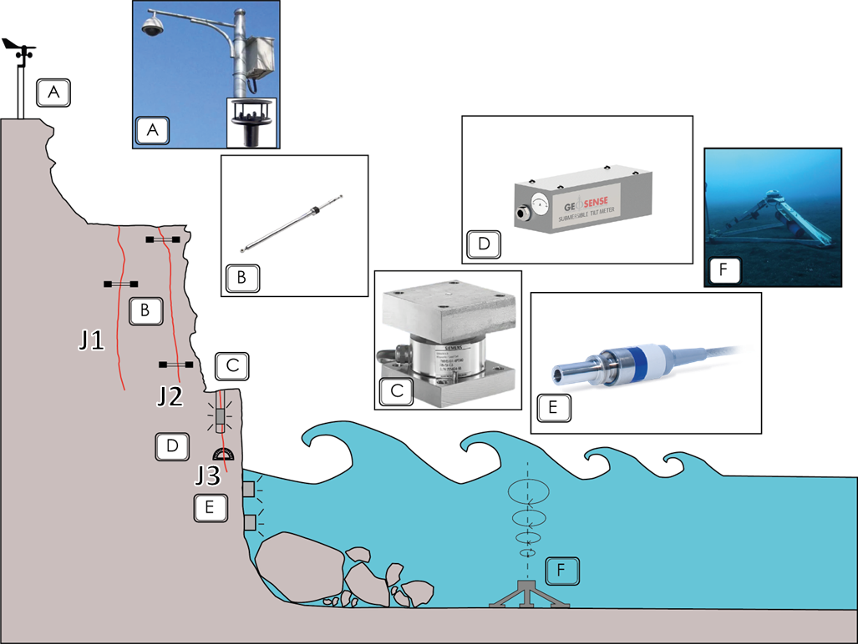
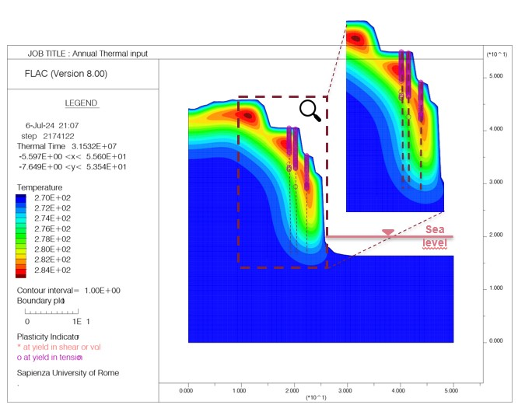
Rationale of a «natural-field» laboratory
A series of natural processes that include predisposing factors, preparatory factors and possible triggering actions are RATIONALIZED respect to a representative site….
1
....rationalization translates into a DESIGN that is functional in collecting, in time and space, data from the natural system and at real scale…
3
2
....this drives toward the construction of an AI-TWIN which allows projecting the expected effects in the future.
Natural Field Laboratories for Ground Instabilities
Salvatore Martino

Slide 6
Toward a natural field laboratory
Lab design
Concept idea
Forward scenarios
AI-Twin
Data analysis
Data recovery
Natural Field Laboratories for Ground Instabilities
Salvatore Martino

Slide 7
Toward a natural field laboratory
Lab design
Concept idea
Forward scenarios
AI-Twin
Data recovery
Data analysis
Natural Field Laboratories for Ground Instabilities
Salvatore Martino

Slide 8
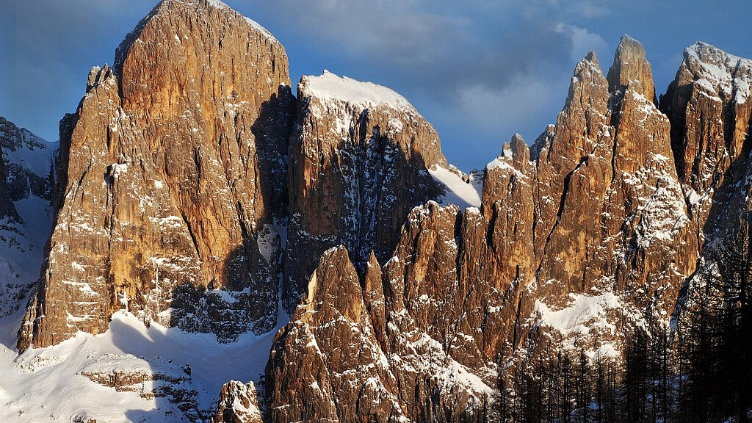
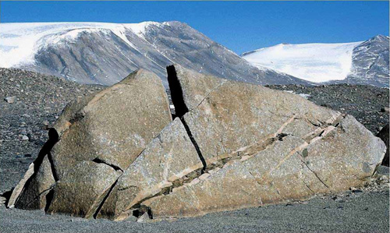
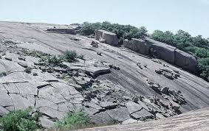
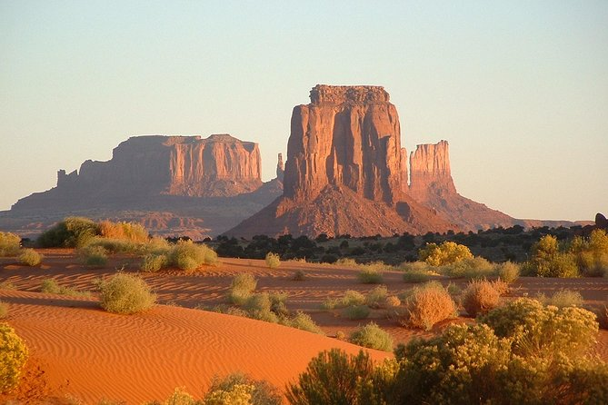
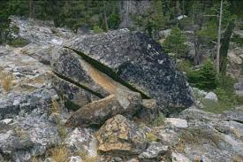
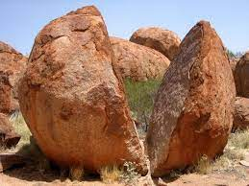
Ideas and their rationalization from reality
Pale di S.Martino (Dolomiti)
From observation to processes
Monument Valley (Navaho Tribal Park – Arizona)
Natural Field Laboratories for Ground Instabilities
Salvatore Martino

Slide 9
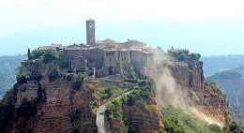
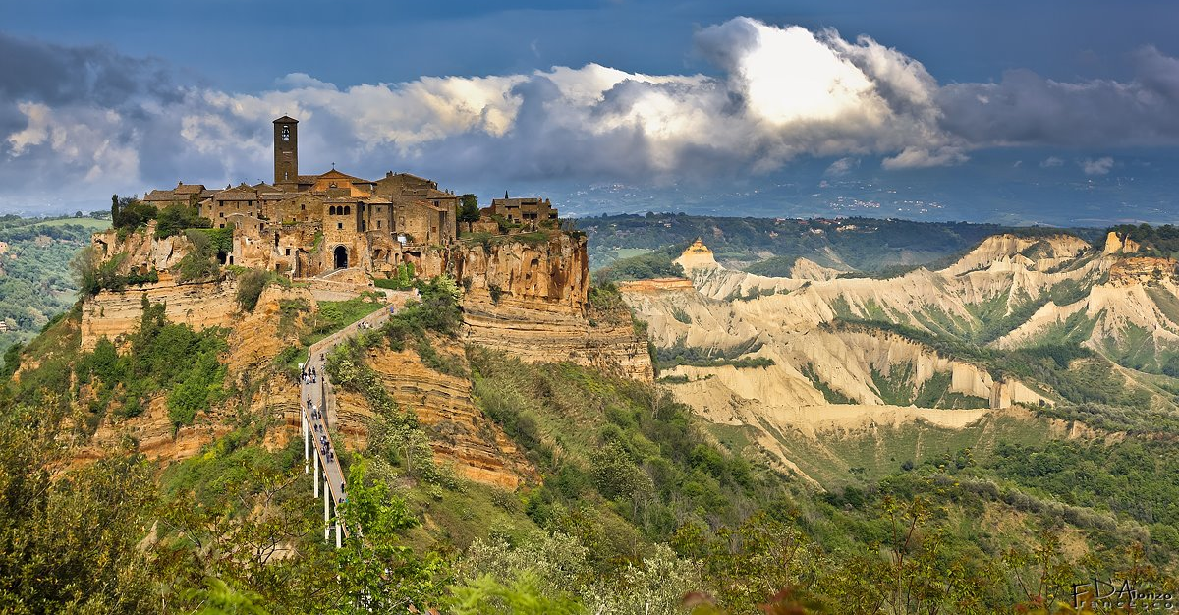
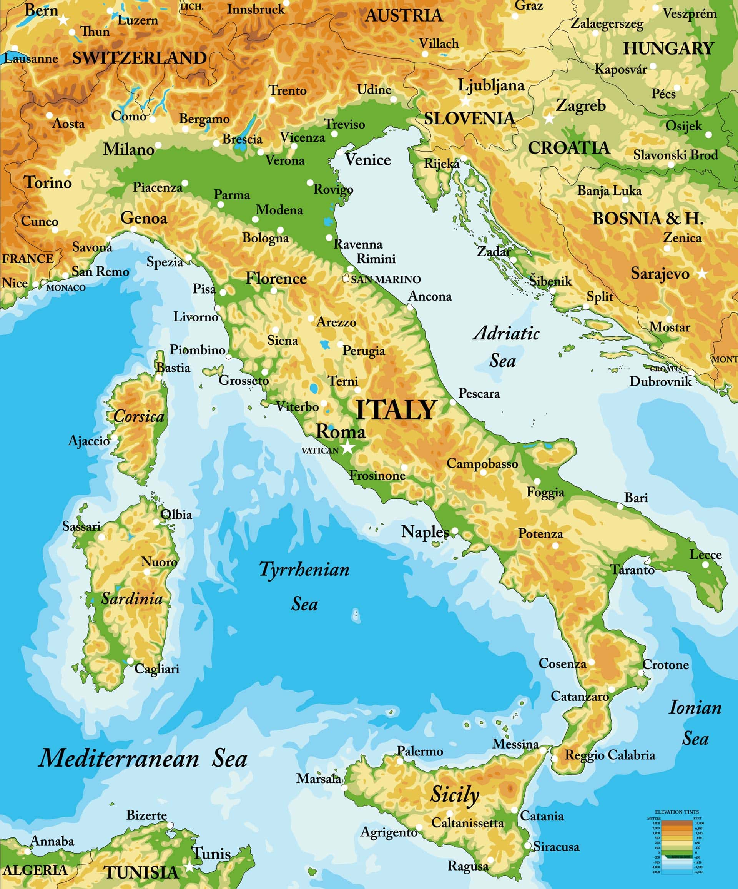
Ideas and their rationalization from reality
Civita di Bagnoregio (VT)
Natural Field Laboratories for Ground Instabilities
Salvatore Martino

Slide 10
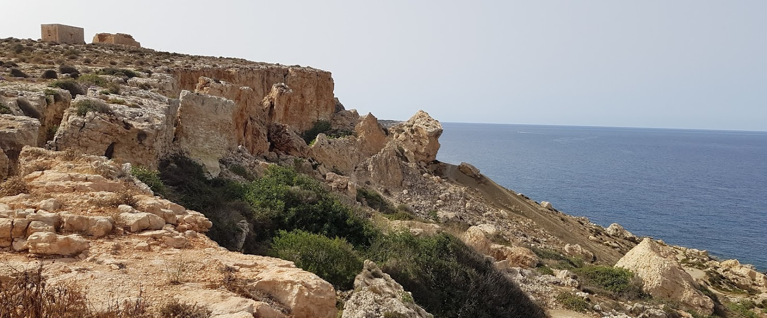
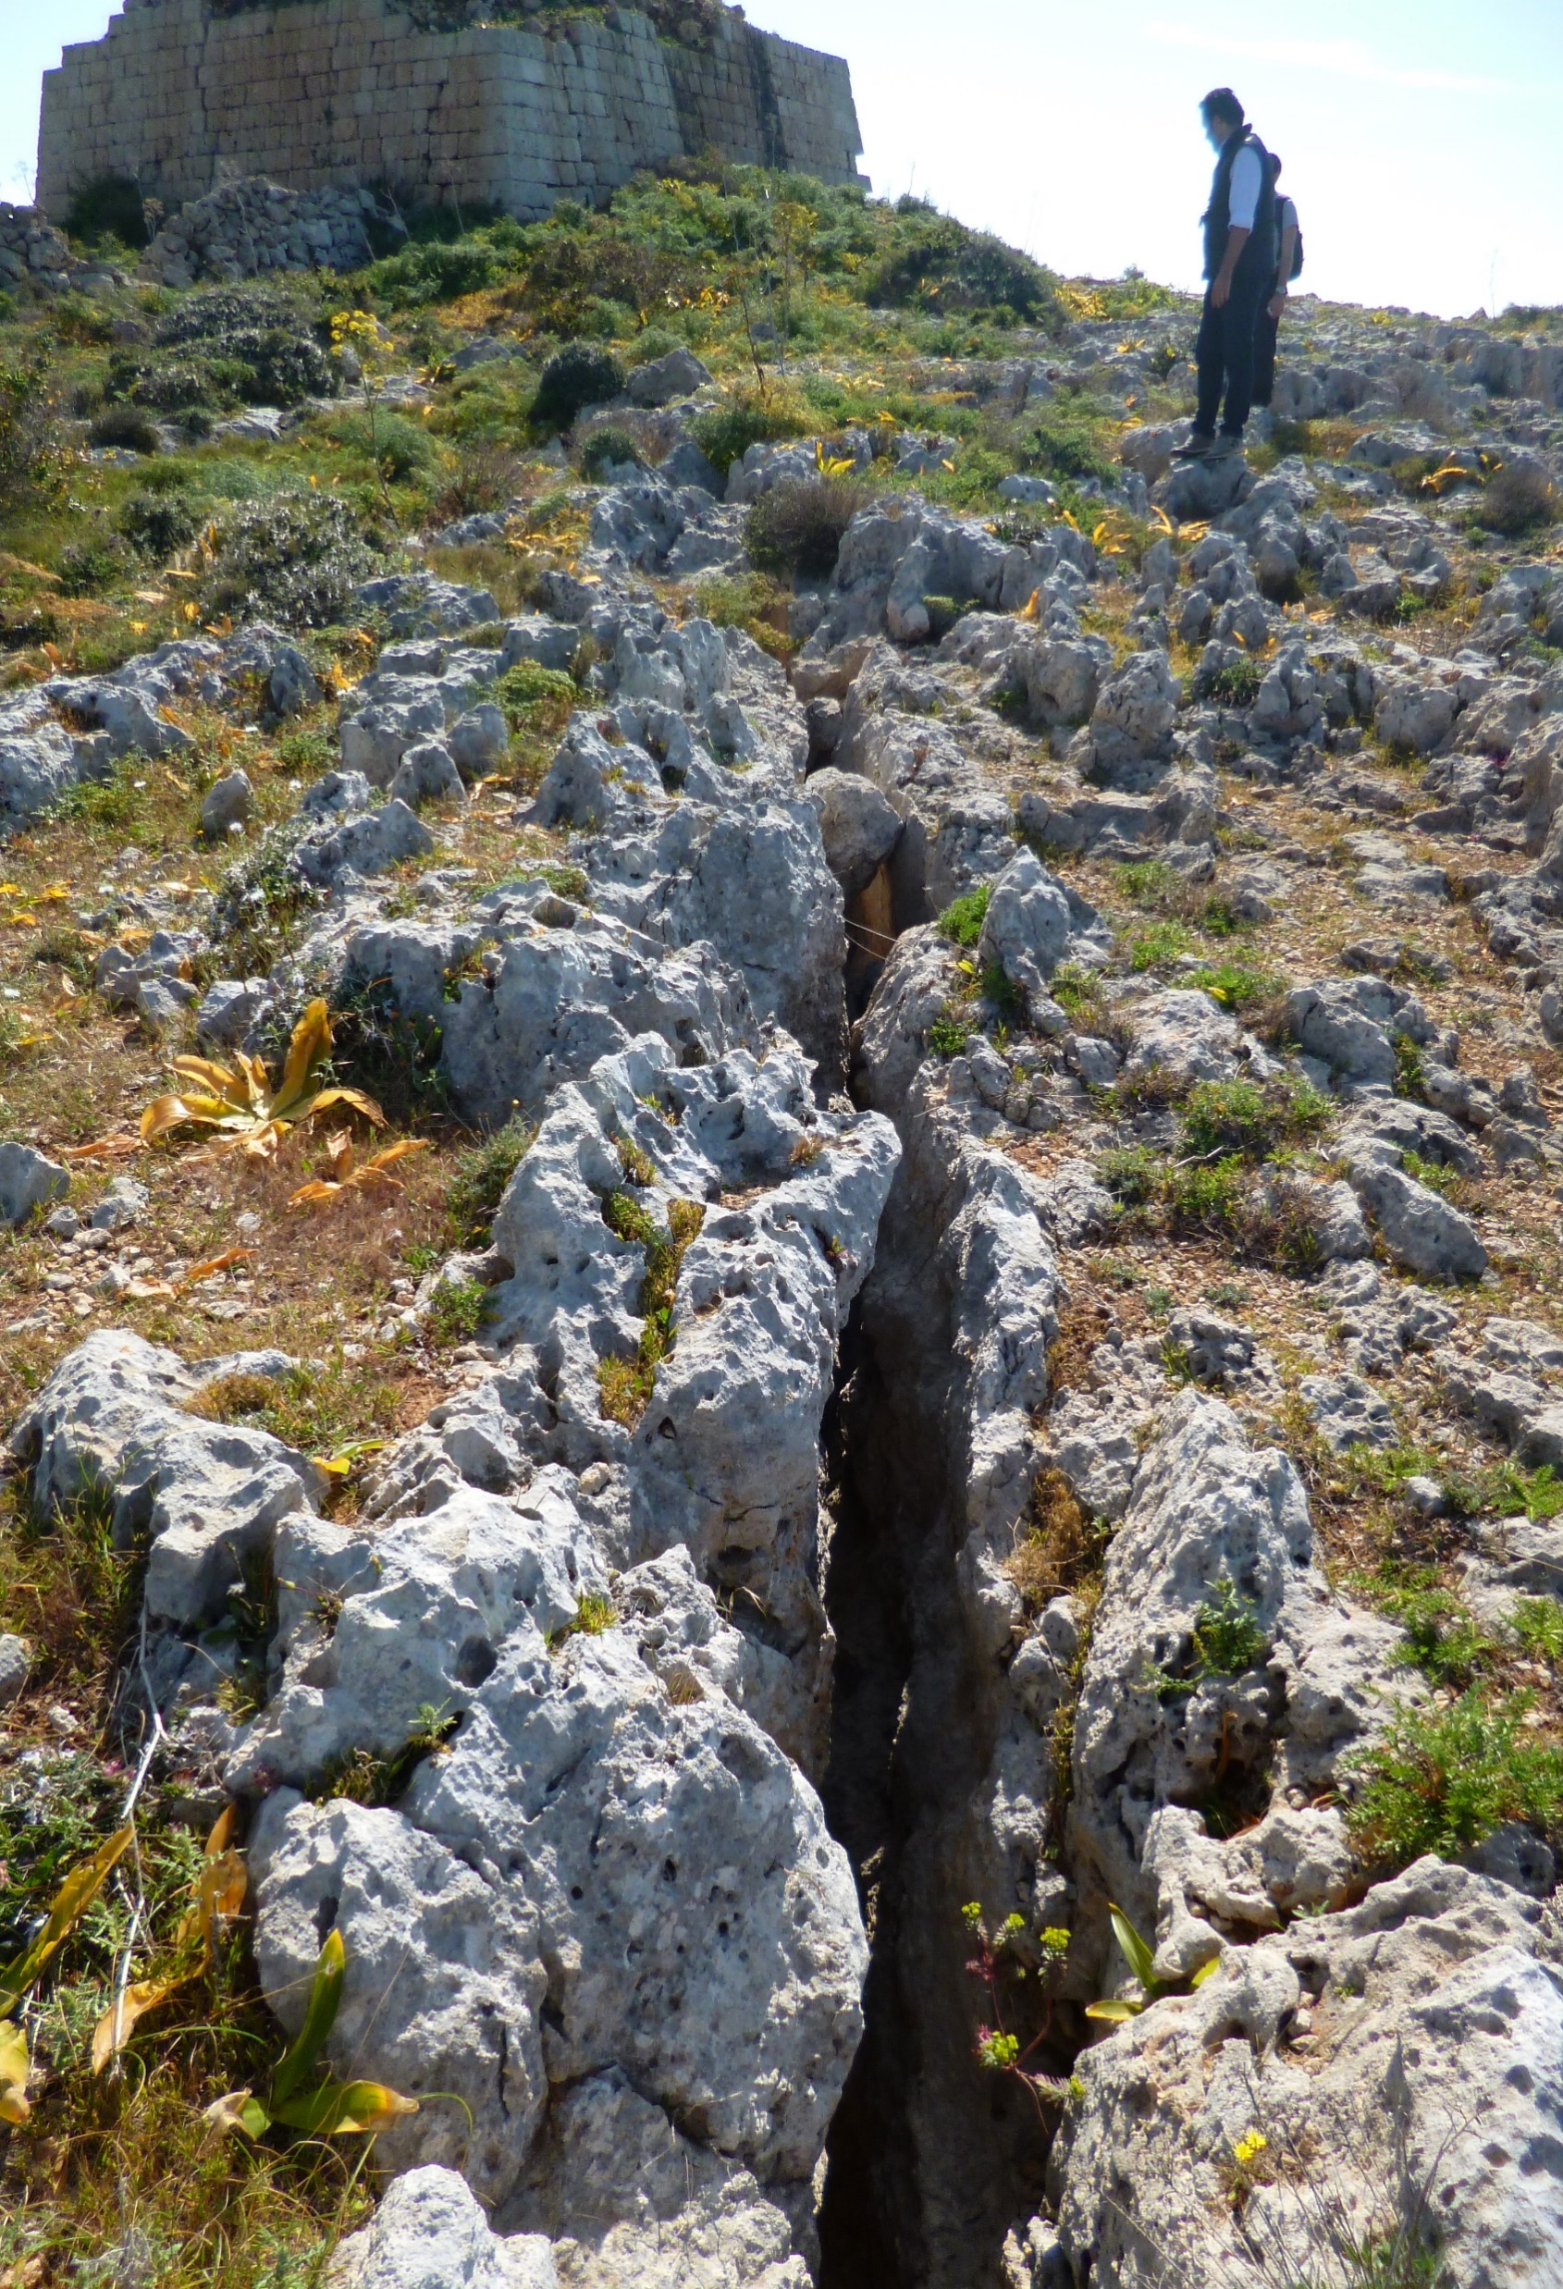
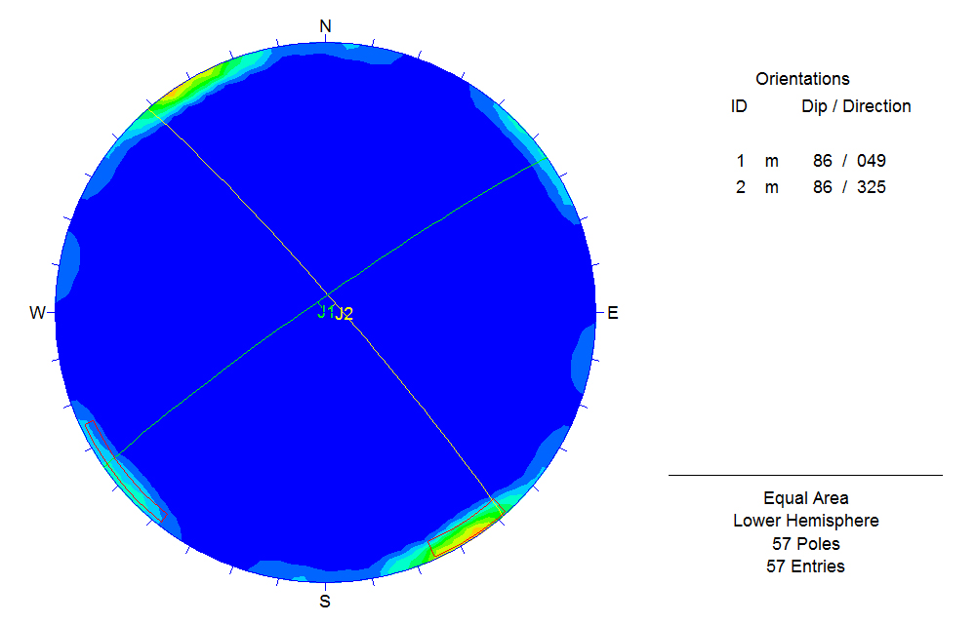
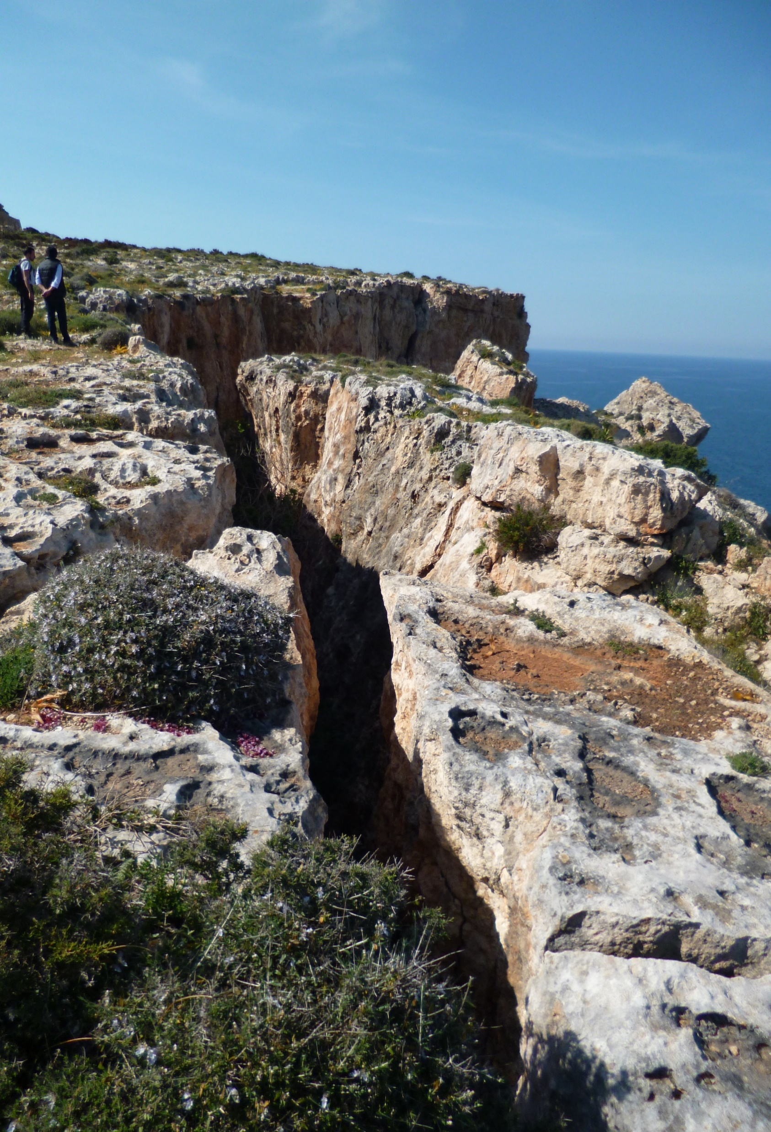
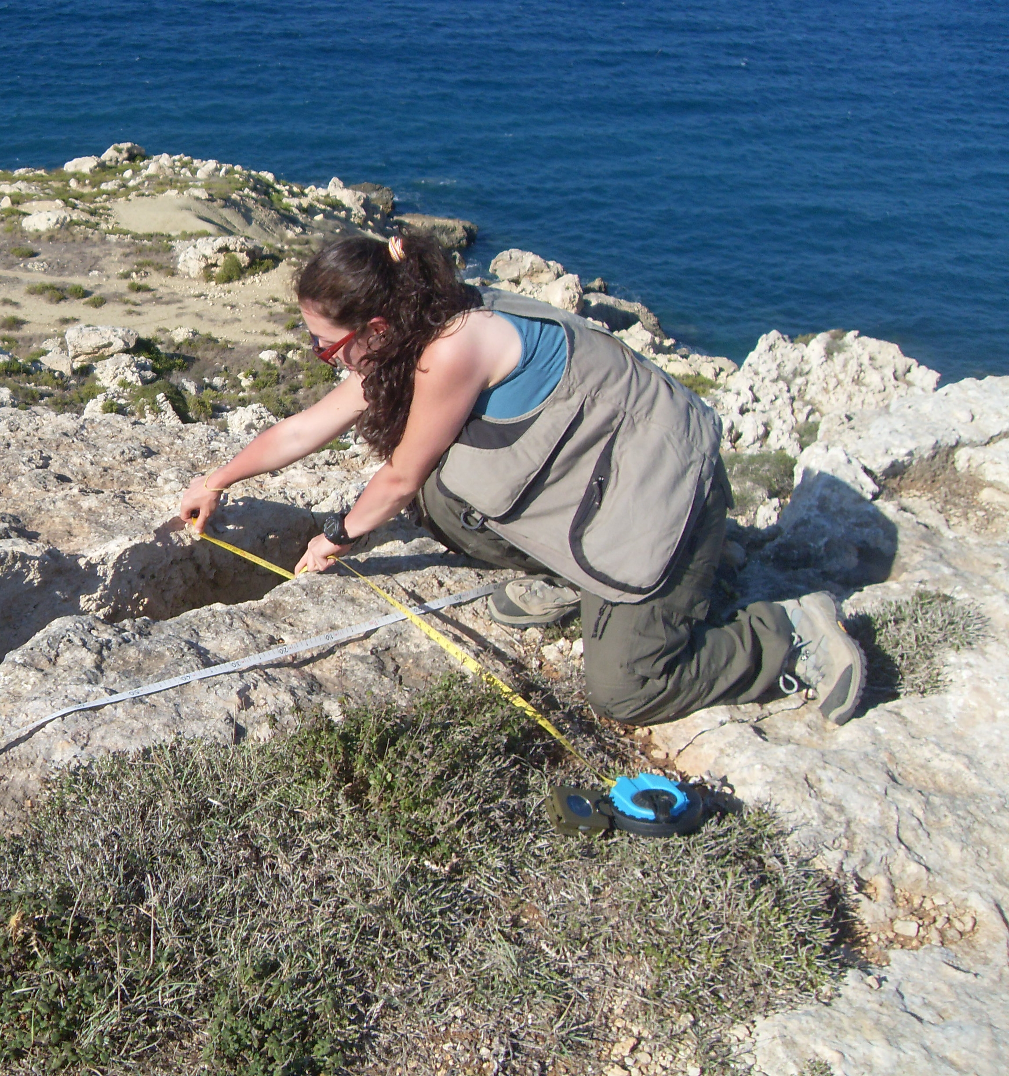
Ideas and their rationalization from reality
~20 cm
~40 cm
Natural Field Laboratories for Ground Instabilities
Salvatore Martino

Slide 11
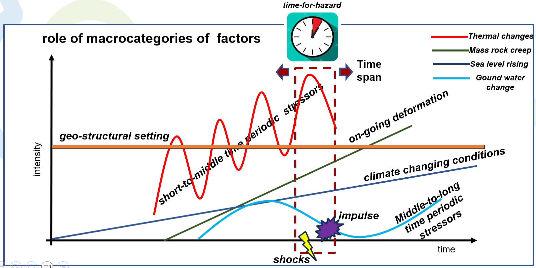
Ideas and their rationalization from reality
Martino, 2023
FIELD LABORATORY OBSERVATION TIME SPAN
Natural Field Laboratories for Ground Instabilities
Salvatore Martino
Page 11

Slide 12
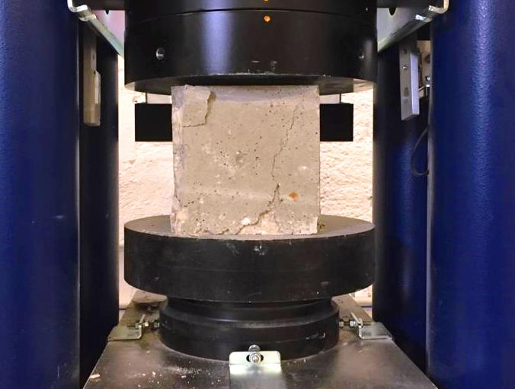
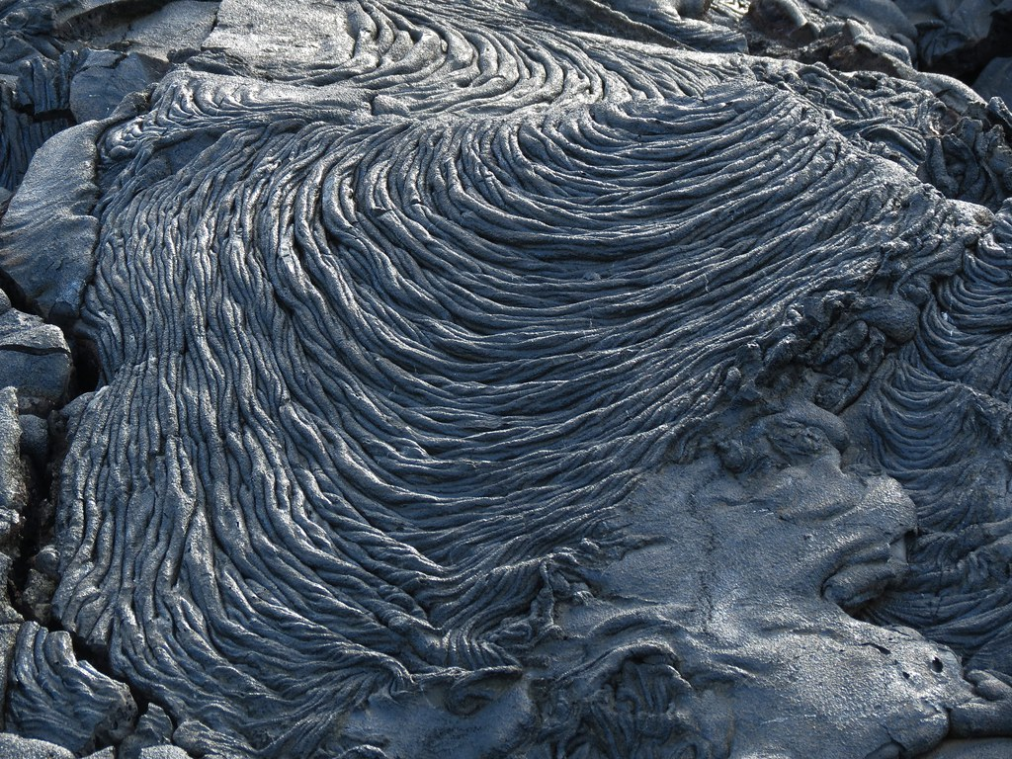
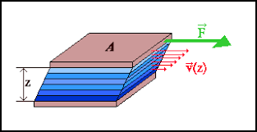
Ideas and their rationalization from reality
FORCE DRIVEN ground instability effects
VISCOSITY DRIVEN ground instability effects
Natural Field Laboratories for Ground Instabilities
Salvatore Martino

Slide 13
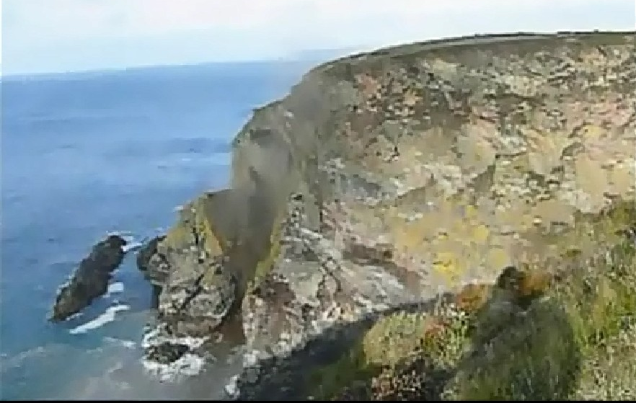
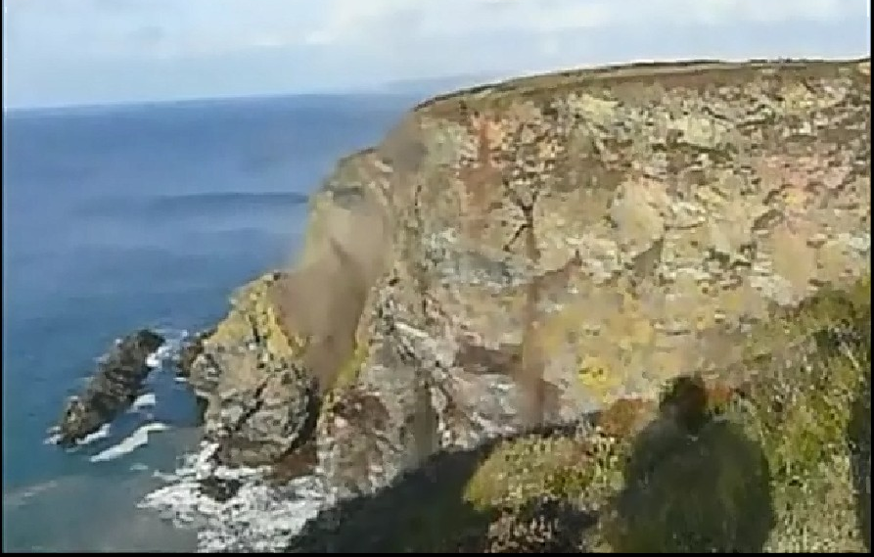
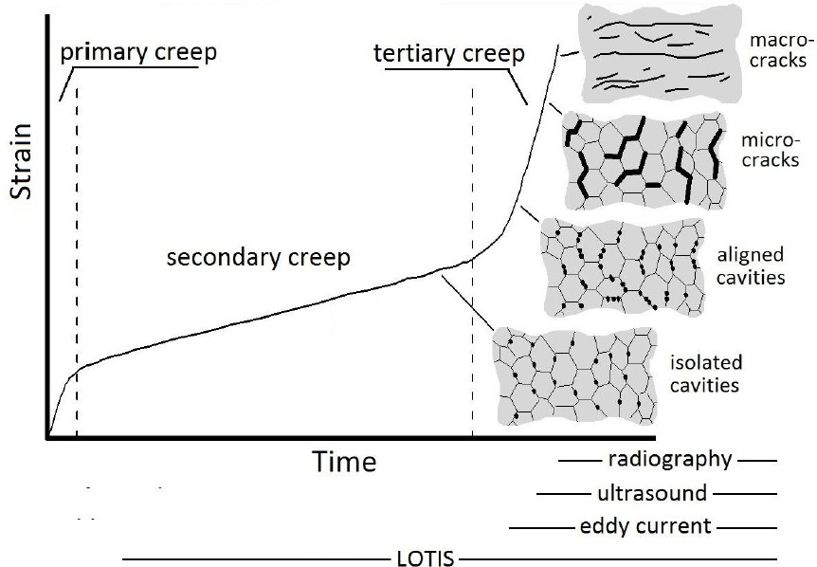
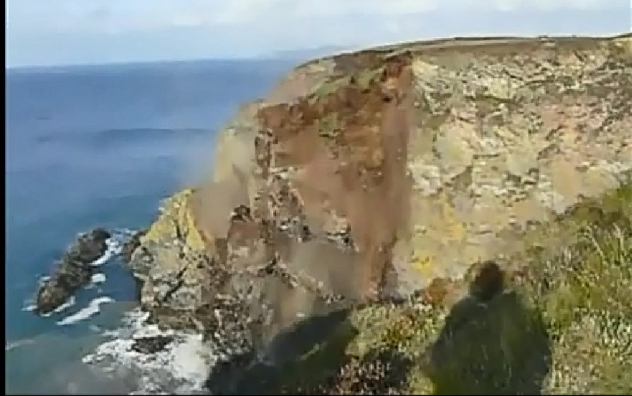
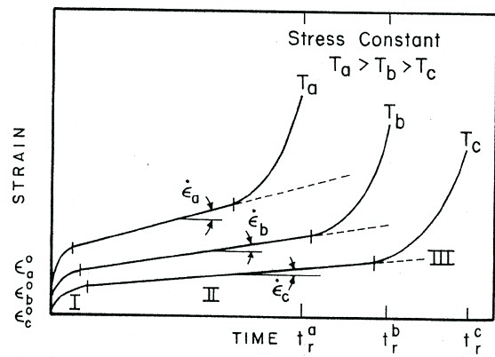
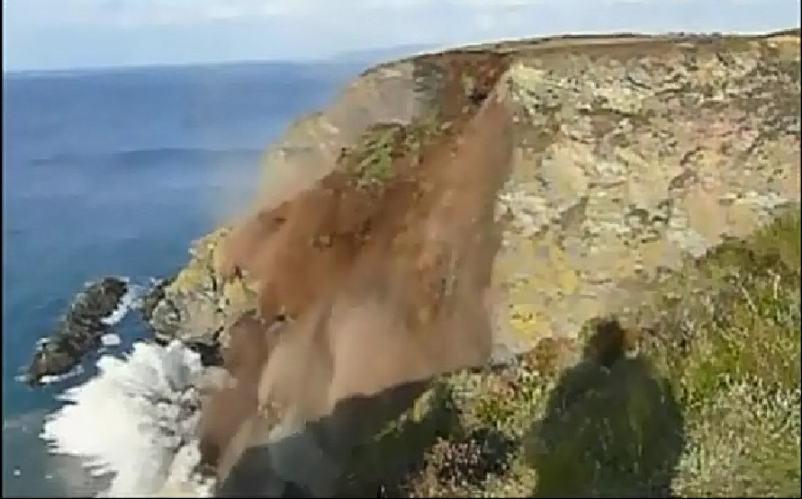
Ideas and their rationalization from reality
Surprise effect (???)
failure
less than 5 minutes
Natural Field Laboratories for Ground Instabilities
Salvatore Martino

Slide 14
Toward a natural field laboratory
Lab design
Concept idea
Forward scenarios
AI-Twin
Data analysis
Data recovery
Natural Field Laboratories for Ground Instabilities
Salvatore Martino

Slide 15
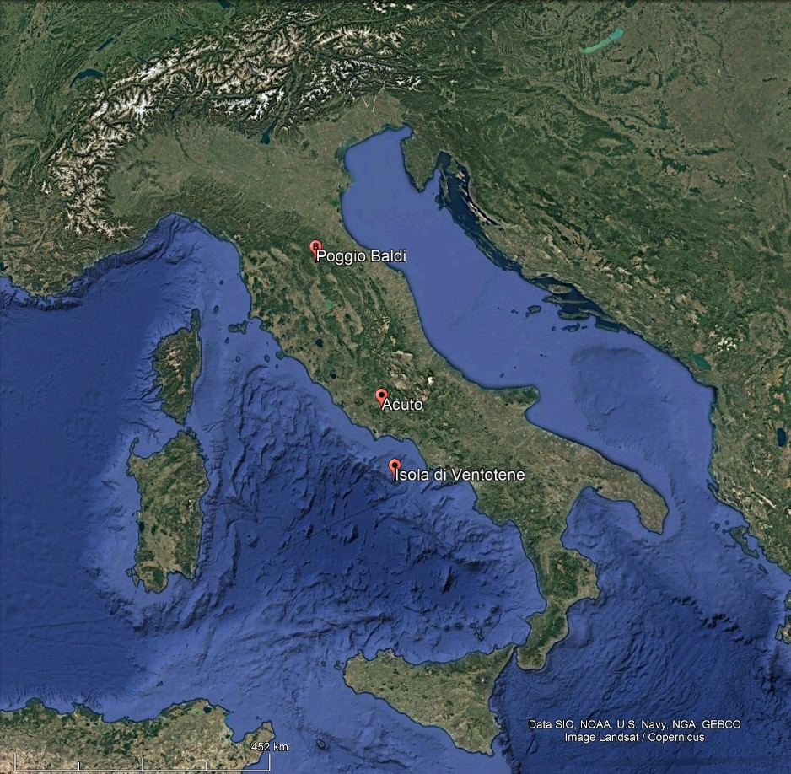
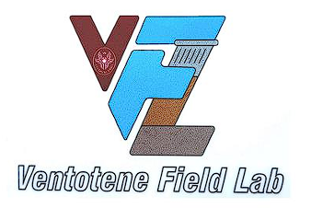
Create a “natural field laboratory”
https://dst.web.uniroma1.it/it/laboratorio-naturale-di-poggio-baldi
https://dst.web.uniroma1.it/it/acuto-field-laboratory
https://dst.web.uniroma1.it/it/ventotene-field-laboratory
Natural Field Laboratories for Ground Instabilities
Salvatore Martino

Slide 16
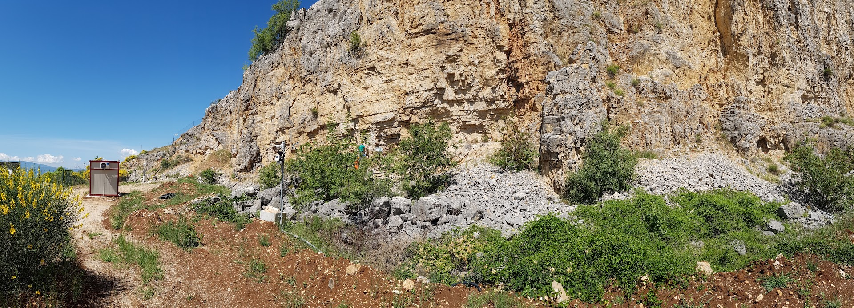
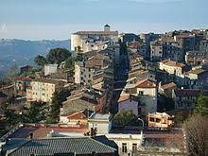
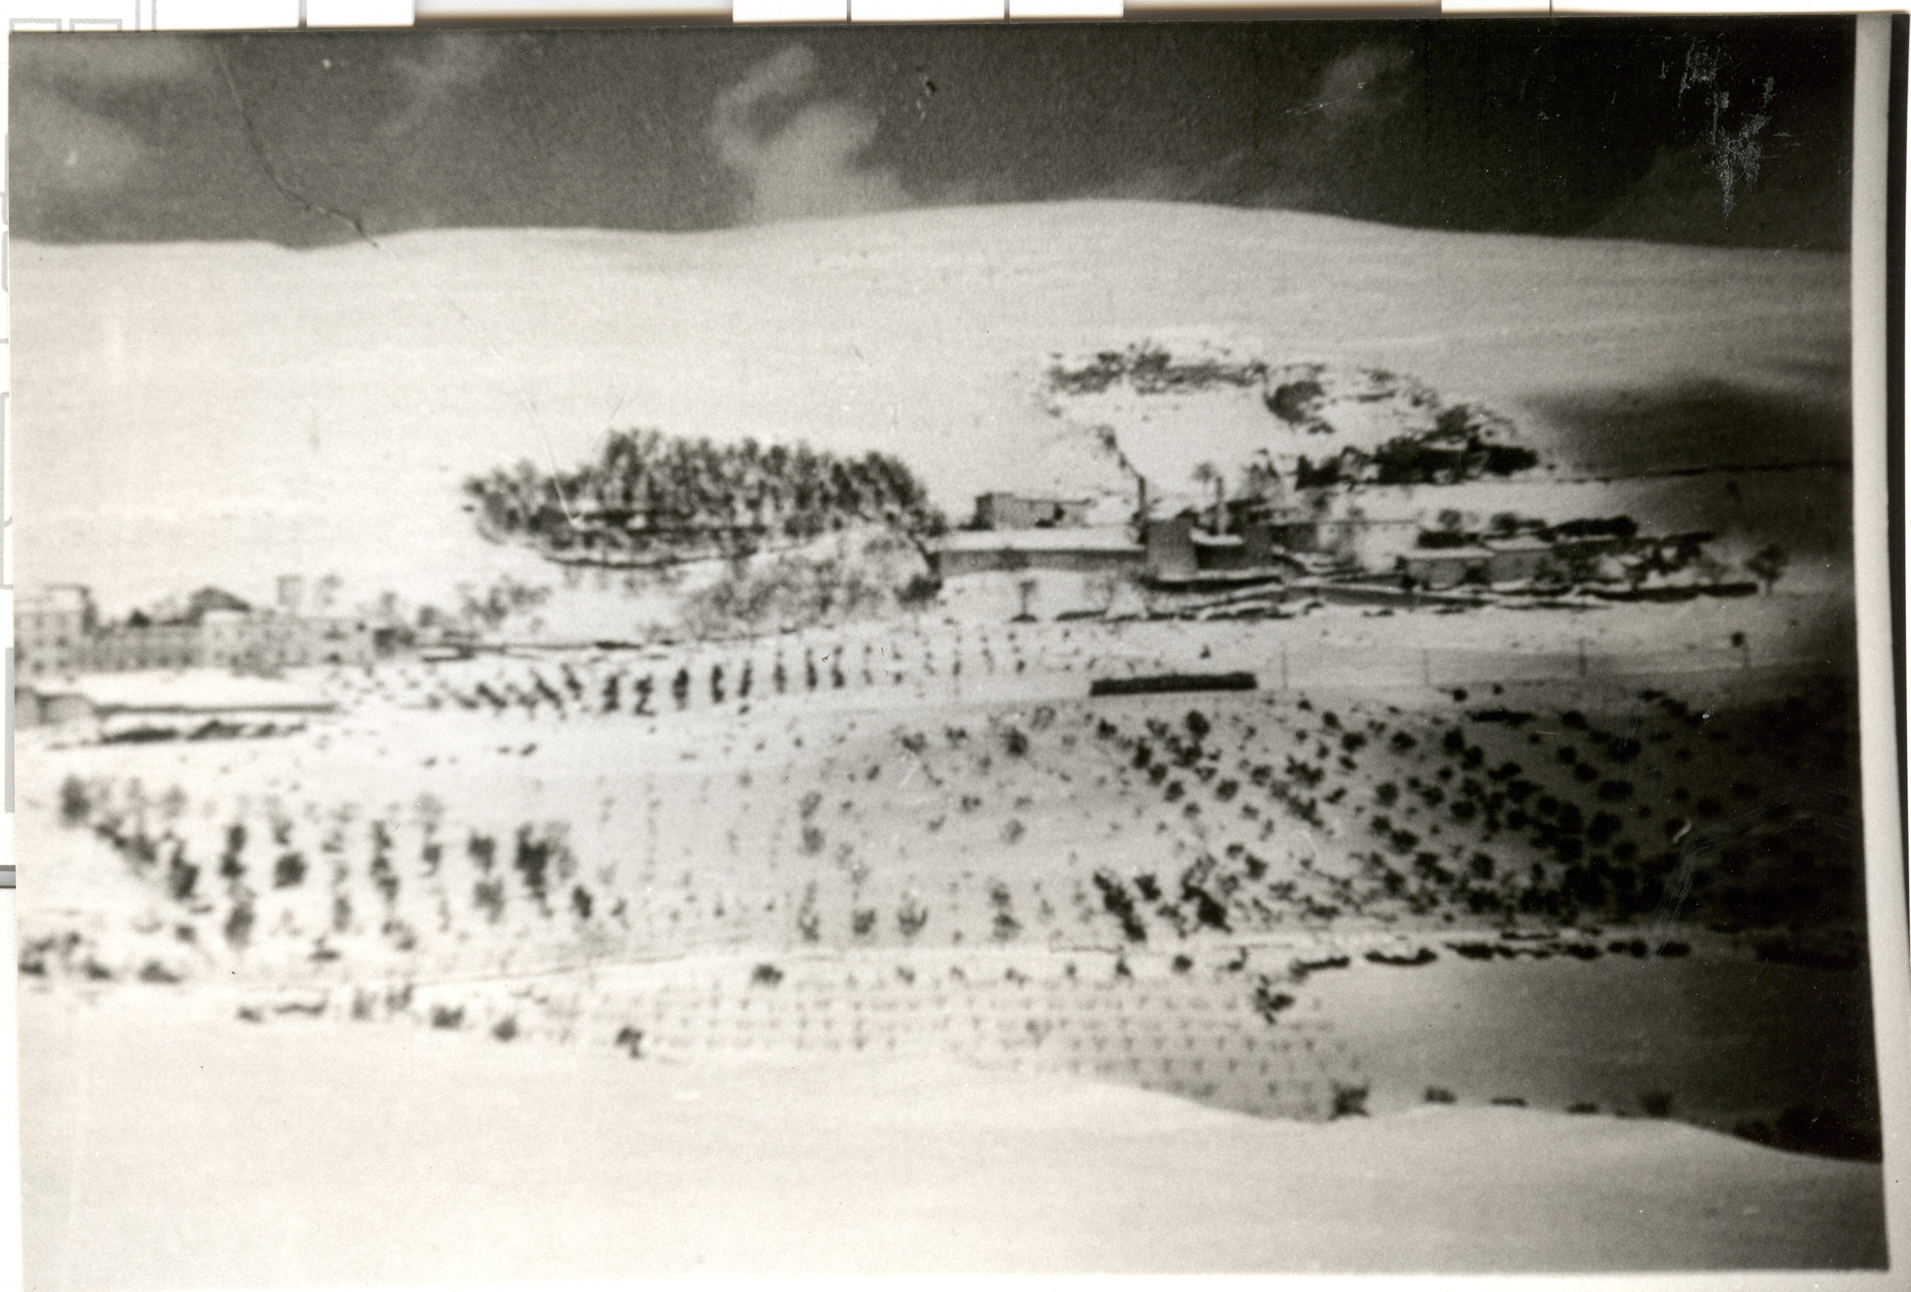
Create a “natural field laboratory”
Today view
Comune di Acuto (FR)
Prenestina Quarry (’50 of XX century)
Natural Field Laboratories for Ground Instabilities
Salvatore Martino

Slide 17
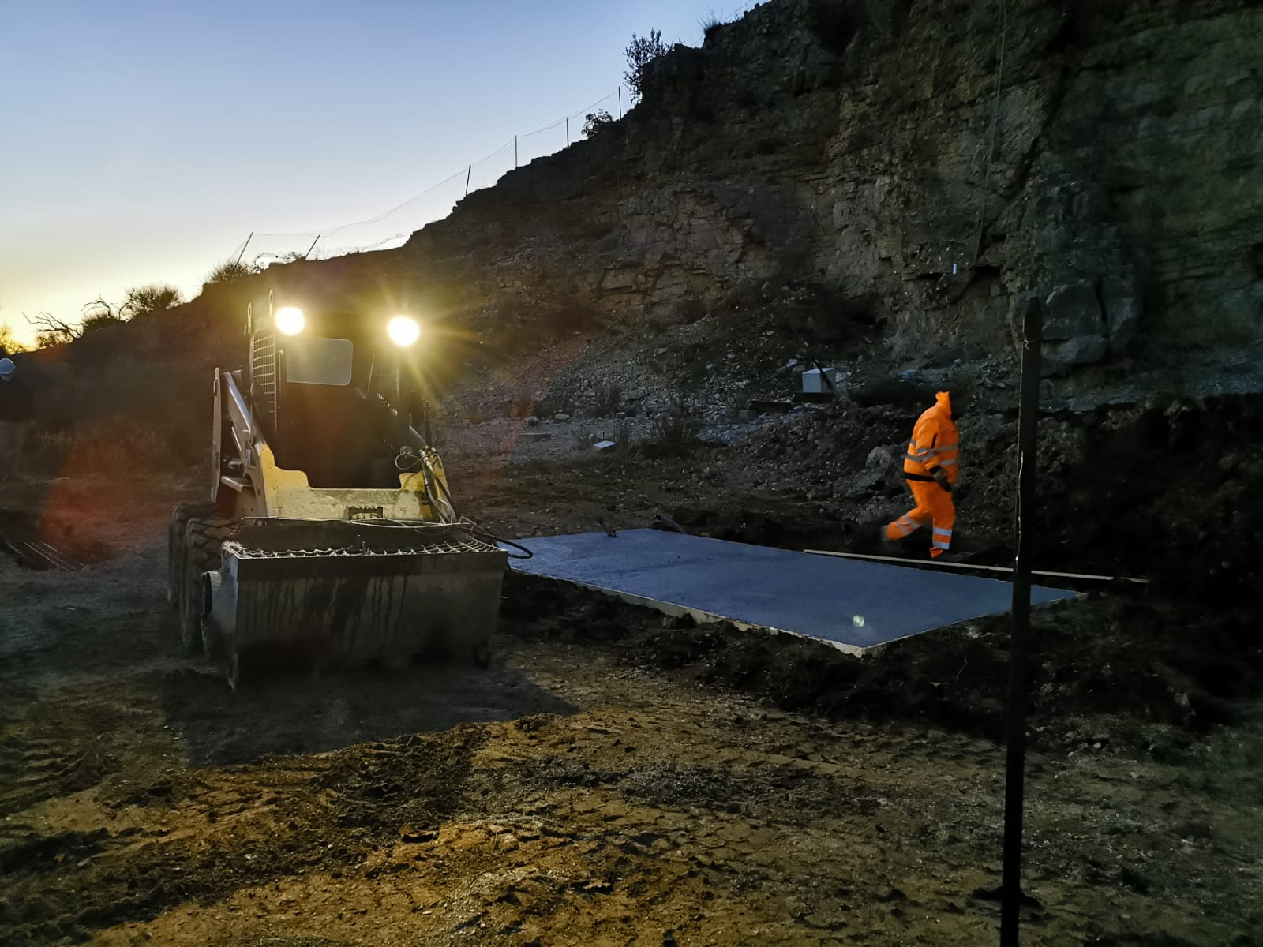
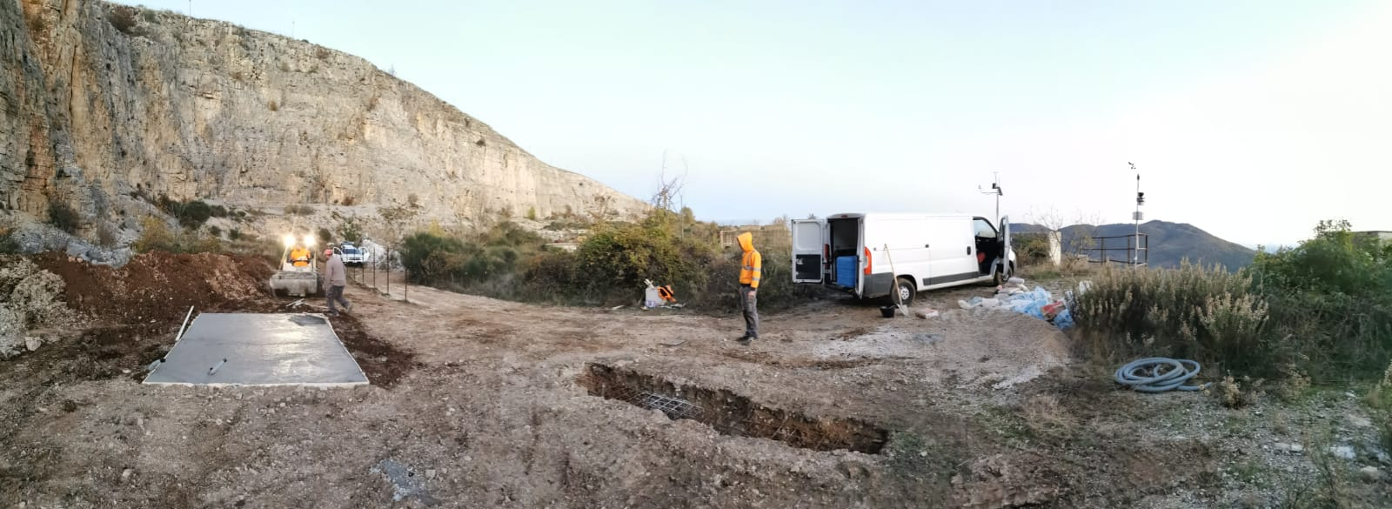
Create a “natural field laboratory”
Equipment works at the Acuto Quarry Experimental Field (2019-2022)
Natural Field Laboratories for Ground Instabilities
Salvatore Martino

Slide 18
Create a “natural field laboratory”
Acuto field laboratory
C
The actual experiments:
Block
Wall
Tower
A
B
Natural Field Laboratories for Ground Instabilities
Salvatore Martino

Slide 19
Create a “natural field laboratory”
Natural Field Laboratories for Ground Instabilities
Salvatore Martino

Slide 20
Create a “natural field laboratory”
BLOCK
TOWER
Natural Field Laboratories for Ground Instabilities
Salvatore Martino
WALL
WALL

Slide 21
Create a “natural field laboratory”
Historical landslide activations date back to March 1914 and March 2010. The former was a large-scale wedge failure, which was inferred by the geometric features of the scar area. The latter involved the previous landslide's body mobilizing approximately 4 million of cubic meters of material.
Corniolo Member (lower-middle Miocene)
Natural Field Laboratories for Ground Instabilities
Salvatore Martino

Slide 22
Create a “natural field laboratory”
Data types
3D point clouds
RGB and thermal images
Noise tracks
Weather time series
Seismic data
Radar interferometry
Natural Field Laboratories for Ground Instabilities
Salvatore Martino

Slide 23
Create a “natural field laboratory”
Natural Field Laboratories for Ground Instabilities
Salvatore Martino

Slide 24
Create a “natural field laboratory”
BEFORE…
AFTER…
3D model of Punta Eolo
Natural Field Laboratories for Ground Instabilities
Salvatore Martino

Slide 25
Create a “natural field laboratory”
1. Solar Panels
6. Rock Thermometer
2. DAU and Camera
2. DAU and Camera
10. Tide gauge
Natural Field Laboratories for Ground Instabilities
Salvatore Martino

Slide 26
Create a “natural field laboratory”
22 May 2024
Natural Field Laboratories for Ground Instabilities
Salvatore Martino

Slide 27
Toward a natural field laboratory
Lab design
Concept idea
Forward scenarios
AI-Twin
Data recovery
Data analysis
Natural Field Laboratories for Ground Instabilities
Salvatore Martino

Slide 28
Data collection and dataset construction
Natural Field Laboratories for Ground Instabilities

Slide 29
Data collection and dataset construction
Senceive FlatMesh 4G
TimeLapse
TLA8
Mobotix S74
Mastrantoni G., Santicchia G., Cosentino A., Molinari A., Marmoni G. M. & Mazzanti P. (2024). Automatic photomonitoring analysis for spatiotemporal evaluation of rockfall failure hazard. Engineering Geology, 339, https://doi.org/10.1016/j.enggeo.2024.107662
Natural Field Laboratories for Ground Instabilities
Salvatore Martino

Slide 30
Data collection and dataset construction
Senceive FlatMesh 4G
TimeLapse
TLA8
Mobotix S74
Automatic acquisition
Mastrantoni G., Santicchia G., Cosentino A., Molinari A., Marmoni G. M. & Mazzanti P. (2024). Automatic photomonitoring analysis for spatiotemporal evaluation of rockfall failure hazard. Engineering Geology, 339, https://doi.org/10.1016/j.enggeo.2024.107662
Natural Field Laboratories for Ground Instabilities
Salvatore Martino

Slide 31
Data collection and dataset construction
Natural Field Laboratories for Ground Instabilities
Salvatore Martino

Slide 32
Data collection and dataset construction
F1
F2
T1
F3
Tilt
LC
F4
Natural Field Laboratories for Ground Instabilities
Salvatore Martino

Slide 33
Toward a natural field laboratory
Lab design
Concept idea
Forward scenarios
AI-Twin
Data recovery
Data analysis
Natural Field Laboratories for Ground Instabilities
Salvatore Martino

Slide 34
Data analysis and results
Marmoni G.M., Fiorucci M., Grechi G., Martino S. (2020). Modelling of thermo-mechanical effects in a rock quarry wall induced by near-surface temperature fluctuations. INTERNATIONAL JOURNAL OF ROCK MECHANICS AND MINING SCIENCES, vol. 134, ISSN: 1365-1609, doi: 10.1016/j.ijrmms.2020.104440
The presence of processes involving heat propagation and phase change (e.g. freezing) in the fractured system significantly affects its vibrational response and with it its evolution towards phases of greater instability.
Marmoni et al., 2020
Grechi et al., 2023
Natural Field Laboratories for Ground Instabilities

Slide 35
Data analysis and results
D’Angiò D., Fantini A., Fiorucci M., Iannucci R., Lenti L., Marmoni G.M., Martino S. (2021). Environmental forcings and micro‑seismic monitoring in a rock wall prone to fall during the 2018 Buran winter storm. NATURAL HAZARDS, vol. 106, p. 2599-2617, ISSN: 1573-0840, doi: 10.1007/s11069-021-04556-5
D’Angiò et al., 2020
Natural Field Laboratories for Ground Instabilities
Salvatore Martino

Slide 36
Data analysis and results
D’Angiò D., Fantini A., Fiorucci M., Iannucci R., Lenti L., Marmoni G.M., Martino S. (2021). Environmental forcings and micro‑seismic monitoring in a rock wall prone to fall during the 2018 Buran winter storm. NATURAL HAZARDS, vol. 106, p. 2599-2617, ISSN: 1573-0840, doi: 10.1007/s11069-021-04556-5
Natural Field Laboratories for Ground Instabilities
Salvatore Martino

Slide 37
Data analysis and results
Source Sector | Process | Estimated Surface (m²) | Estimated Volume (m³)
Z1 | Rockfalls | 1441 | - 620
Z2 | Rockfalls | 1805 | - 475
Z3 | Rockfalls | 2795 | - 817
Z4 | Rockfalls | 1479 | - 1196
Toe | Debris accumulation | 4572 | + 5160
Robiati, C.; Mastrantoni, G.; Francioni, M.; Eyre, M.; Coggan, J.; Mazzanti, P. Contribution of High-Resolution Virtual Outcrop Models for the Definition of Rockfall Activity and Associated Hazard Modelling. Land 2023, 12, 191. https://doi.org/10.3390/land12010191
Natural Field Laboratories for Ground Instabilities
Salvatore Martino

Slide 38
Toward a natural field laboratory
Lab design
Concept idea
Forward scenarios
AI-Twin
Data analysis
Data recovery
Natural Field Laboratories for Ground Instabilities
Salvatore Martino

Slide 39
Toward an AI-Twin
Marmoni G.M., Fiorucci M., Grechi G., Martino S. (2020). Modelling of thermo-mechanical effects in a rock quarry wall induced by near-surface temperature fluctuations. INTERNATIONAL JOURNAL OF ROCK MECHANICS AND MINING SCIENCES, vol. 134, ISSN: 1365-1609, doi: 10.1016/j.ijrmms.2020.104440
Natural Field Laboratories for Ground Instabilities

Slide 40
Toward an AI-Twin
Marmoni G.M., Fiorucci M., Grechi G., Martino S. (2020). Modelling of thermo-mechanical effects in a rock quarry wall induced by near-surface temperature fluctuations. INTERNATIONAL JOURNAL OF ROCK MECHANICS AND MINING SCIENCES, vol. 134, ISSN: 1365-1609, doi: 10.1016/j.ijrmms.2020.104440
Thermal modelling
Thermo-mechanical modelling
Natural Field Laboratories for Ground Instabilities

Slide 41
Toward an AI-Twin
Numerical modelling through finite difference element method
Natural Field Laboratories for Ground Instabilities
Salvatore Martino

Slide 42
Toward an AI-Twin
Thermo-mechanical approach
Daily thermal input
Sea level
Yearly thermal input
Monthly thermal input
Natural Field Laboratories for Ground Instabilities
Salvatore Martino

Slide 43
Toward an AI-Twin
Average Sea Wave of 2 m and 6s of period
Natural Field Laboratories for Ground Instabilities
Salvatore Martino

Slide 44
Toward a natural field laboratory
Lab design
Concept idea
Forward scenarios
AI-Twin
Data recovery
Data analysis
Natural Field Laboratories for Ground Instabilities
Salvatore Martino

Slide 45
Scenarios of ground instability effects in a forward perspective
Natural Field Laboratories for Ground Instabilities
Salvatore Martino

Slide 46
Scenarios of ground instability effects in a forward perspective
Mastrantoni, G., Santicchia, G., Cosentino, A., Molinari, A., Marmoni, G. M., & Mazzanti, P. (2024). Automatic photomonitoring analysis for spatiotemporal evaluation of rockfall failure hazard. Engineering Geology, 339, 107662
Natural Field Laboratories for Ground Instabilities
Salvatore Martino

Slide 47
Scenarios of ground instability effects in a forward perspective
Mastrantoni, G., Santicchia, G., Cosentino, A., Molinari, A., Marmoni, G. M., & Mazzanti, P. (2024). Automatic photomonitoring analysis for spatiotemporal evaluation of rockfall failure hazard. Engineering Geology, 339, 107662
Natural Field Laboratories for Ground Instabilities
Salvatore Martino

Slide 48
Scenarios of ground instability effects in a forward perspective
% (ε_{p}>ε_{range})
Training an ANN for prediction using machine learning approaches of inelastic event scenarios (wall block detachments)
Training
Prediction
The neural network has 50 neurons in the hidden layer, the «ReLU» (Rectified Linear unit) function is used as the transfer function
The output layer is a "softmax layer", where the outputs are normalized to probability values ​​proportional to the exponential of the input values.
The network is trained by minimizing the "cross entropy loss function" through the Broyden-Fletcher-Goldfarb-Shanno quasi-Newton algorithm (LBFGS).
To limit the overfitting effect, we adopted the "early stop by validation" training criterion.
0 (ε_{m} In range)
1 (ε_{m} Out of Range)
Probability
(ε≠ ε_{range})
Natural Field Laboratories for Ground Instabilities
Salvatore Martino

Slide 49
Scenarios of ground instability effects in a forward perspective
Local weather dataset (100 nets)
Natural Field Laboratories for Ground Instabilities
Salvatore Martino

Slide 50
Scenarios of ground instability effects in a forward perspective
Air Force-provided weather data (100 nets)
Natural Field Laboratories for Ground Instabilities
Salvatore Martino

Slide 51
Scenarios of ground instability effects in a forward perspective
Really occurred event at Castrocielo on 21 /11/2023
Natural Field Laboratories for Ground Instabilities
Salvatore Martino

Slide 52
….to conclude
The aim of the NATURAL FIELD LABORATORIES within the current lines of research and which perspective for risk mitigation strategies consists in supporting the creation of tools for the generation of scenarios of ground instability effects. However, the knowledge base represented by datasets deriving from monitoring systems already operational for years can represent a product that can be transferred into the EPOS project
Lab design
Concept idea
Forward scenarios
Data recovery
AI-Twin
Data analysis
Natural Field Laboratories for Ground Instabilities
Salvatore Martino

Slide 53
11 Aprile 2013
Thanks for your attention
salvatore.martino@uniroma1.it
Natural Field Laboratories for Ground Instabilities
Salvatore Martino

