Slide 1
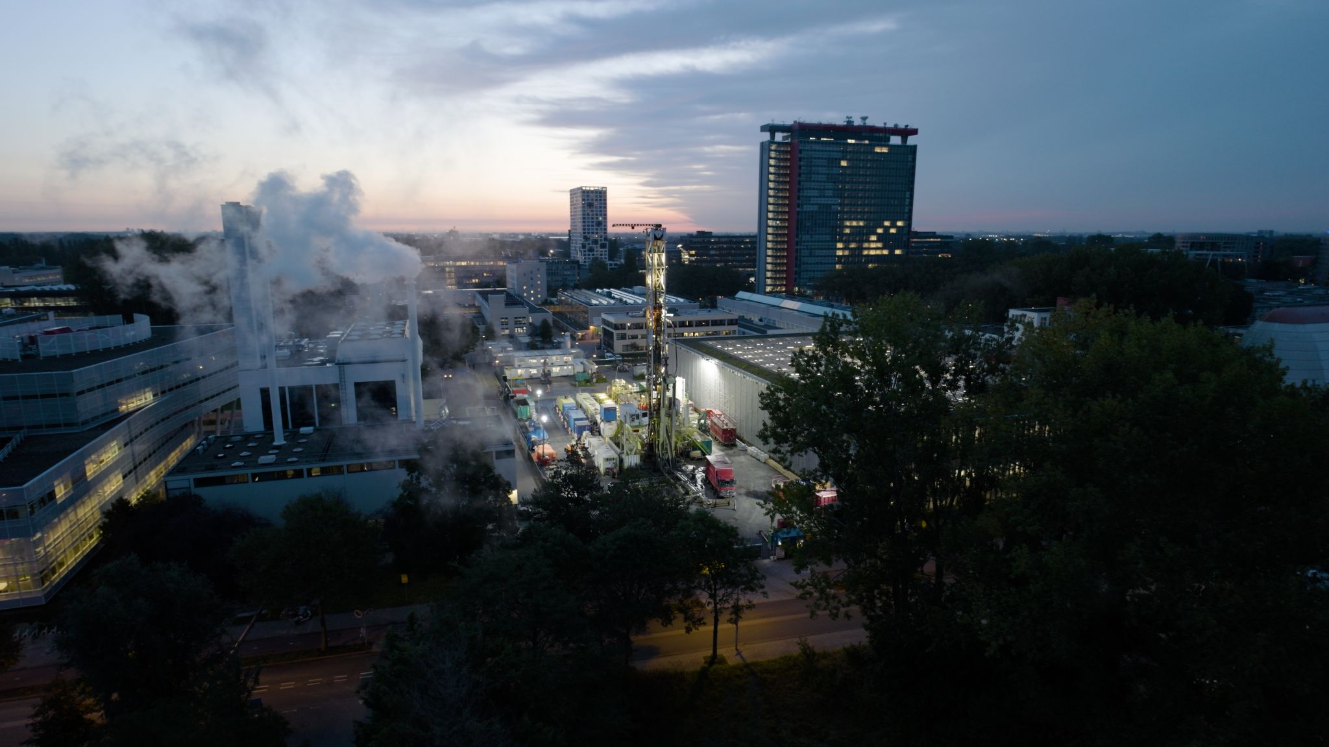
Big is beautiful!
Geo-Energy Test Beds
Susanne Laumann, Liliana Vargas Meleza, Phil Vardon
A subdomain of the TCS Multi-Scale Laboratories

Slide 2
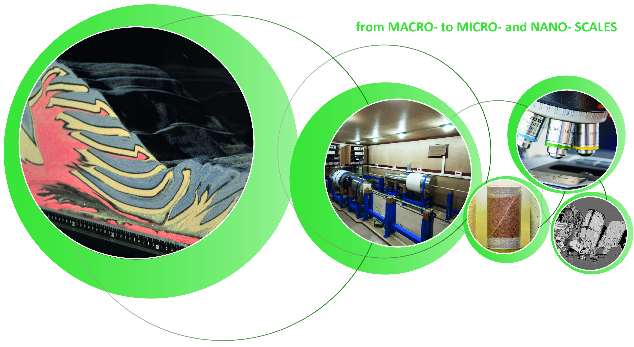
controlled at small scale
Large-scale behavior…
Porosity?
During energy production?
Reservoir heterogeneity?
Subsurface storage?
Deformation behavior?
Earthquakes?
Governing processes?
Assessment of subsurface behavior requires Multi-Scale understanding

Slide 3
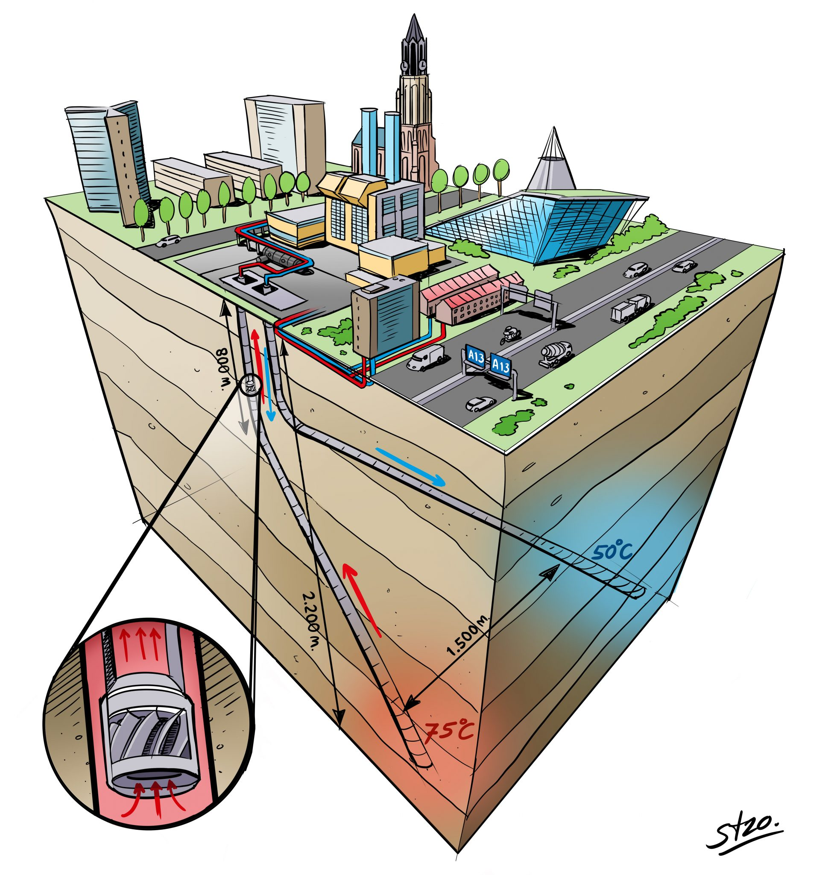
What are Geo-Energy Test Beds?
Field-scale testing and monitoring facilities developed to understand the subsurface processes associated with power and heat generation technologies.
Bridging of scales
Monitoring of operating systems
In-situ monitoring
Field-scale testing
Geothermal well on TU Delft campus
Notes:
What is a Geo-Energy test bed definition (done) → scale/ monitoring/in situ

Slide 4
Geo-Energy Test Beds - Research Infrastructures
Engagement of facilities in the following domains
Shallow & deep geothermal
Carbon capture and storage (CCS)
Geological storage of radioactive waste
Underground hydrogen storage
Technische Zentrum der RUB © Fraunhofer IEG

Slide 5
Geo-Energy Test Beds - Research Infrastructures
Facilities are instrumented with multi-scale and multi-disciplinary sensor networks, including:
Seismic background networks
Shallow & deep injection and monitoring boreholes
Borehole sensors (permanent and temporary)
Fibre optics for distributed sensing (acoustic DAS, temperature DTS, strain DSS, pressure DPS)
(Near) Real time monitoring (flow, strain)
Bedretto Underground Lab © ETH Zurich

Slide 6
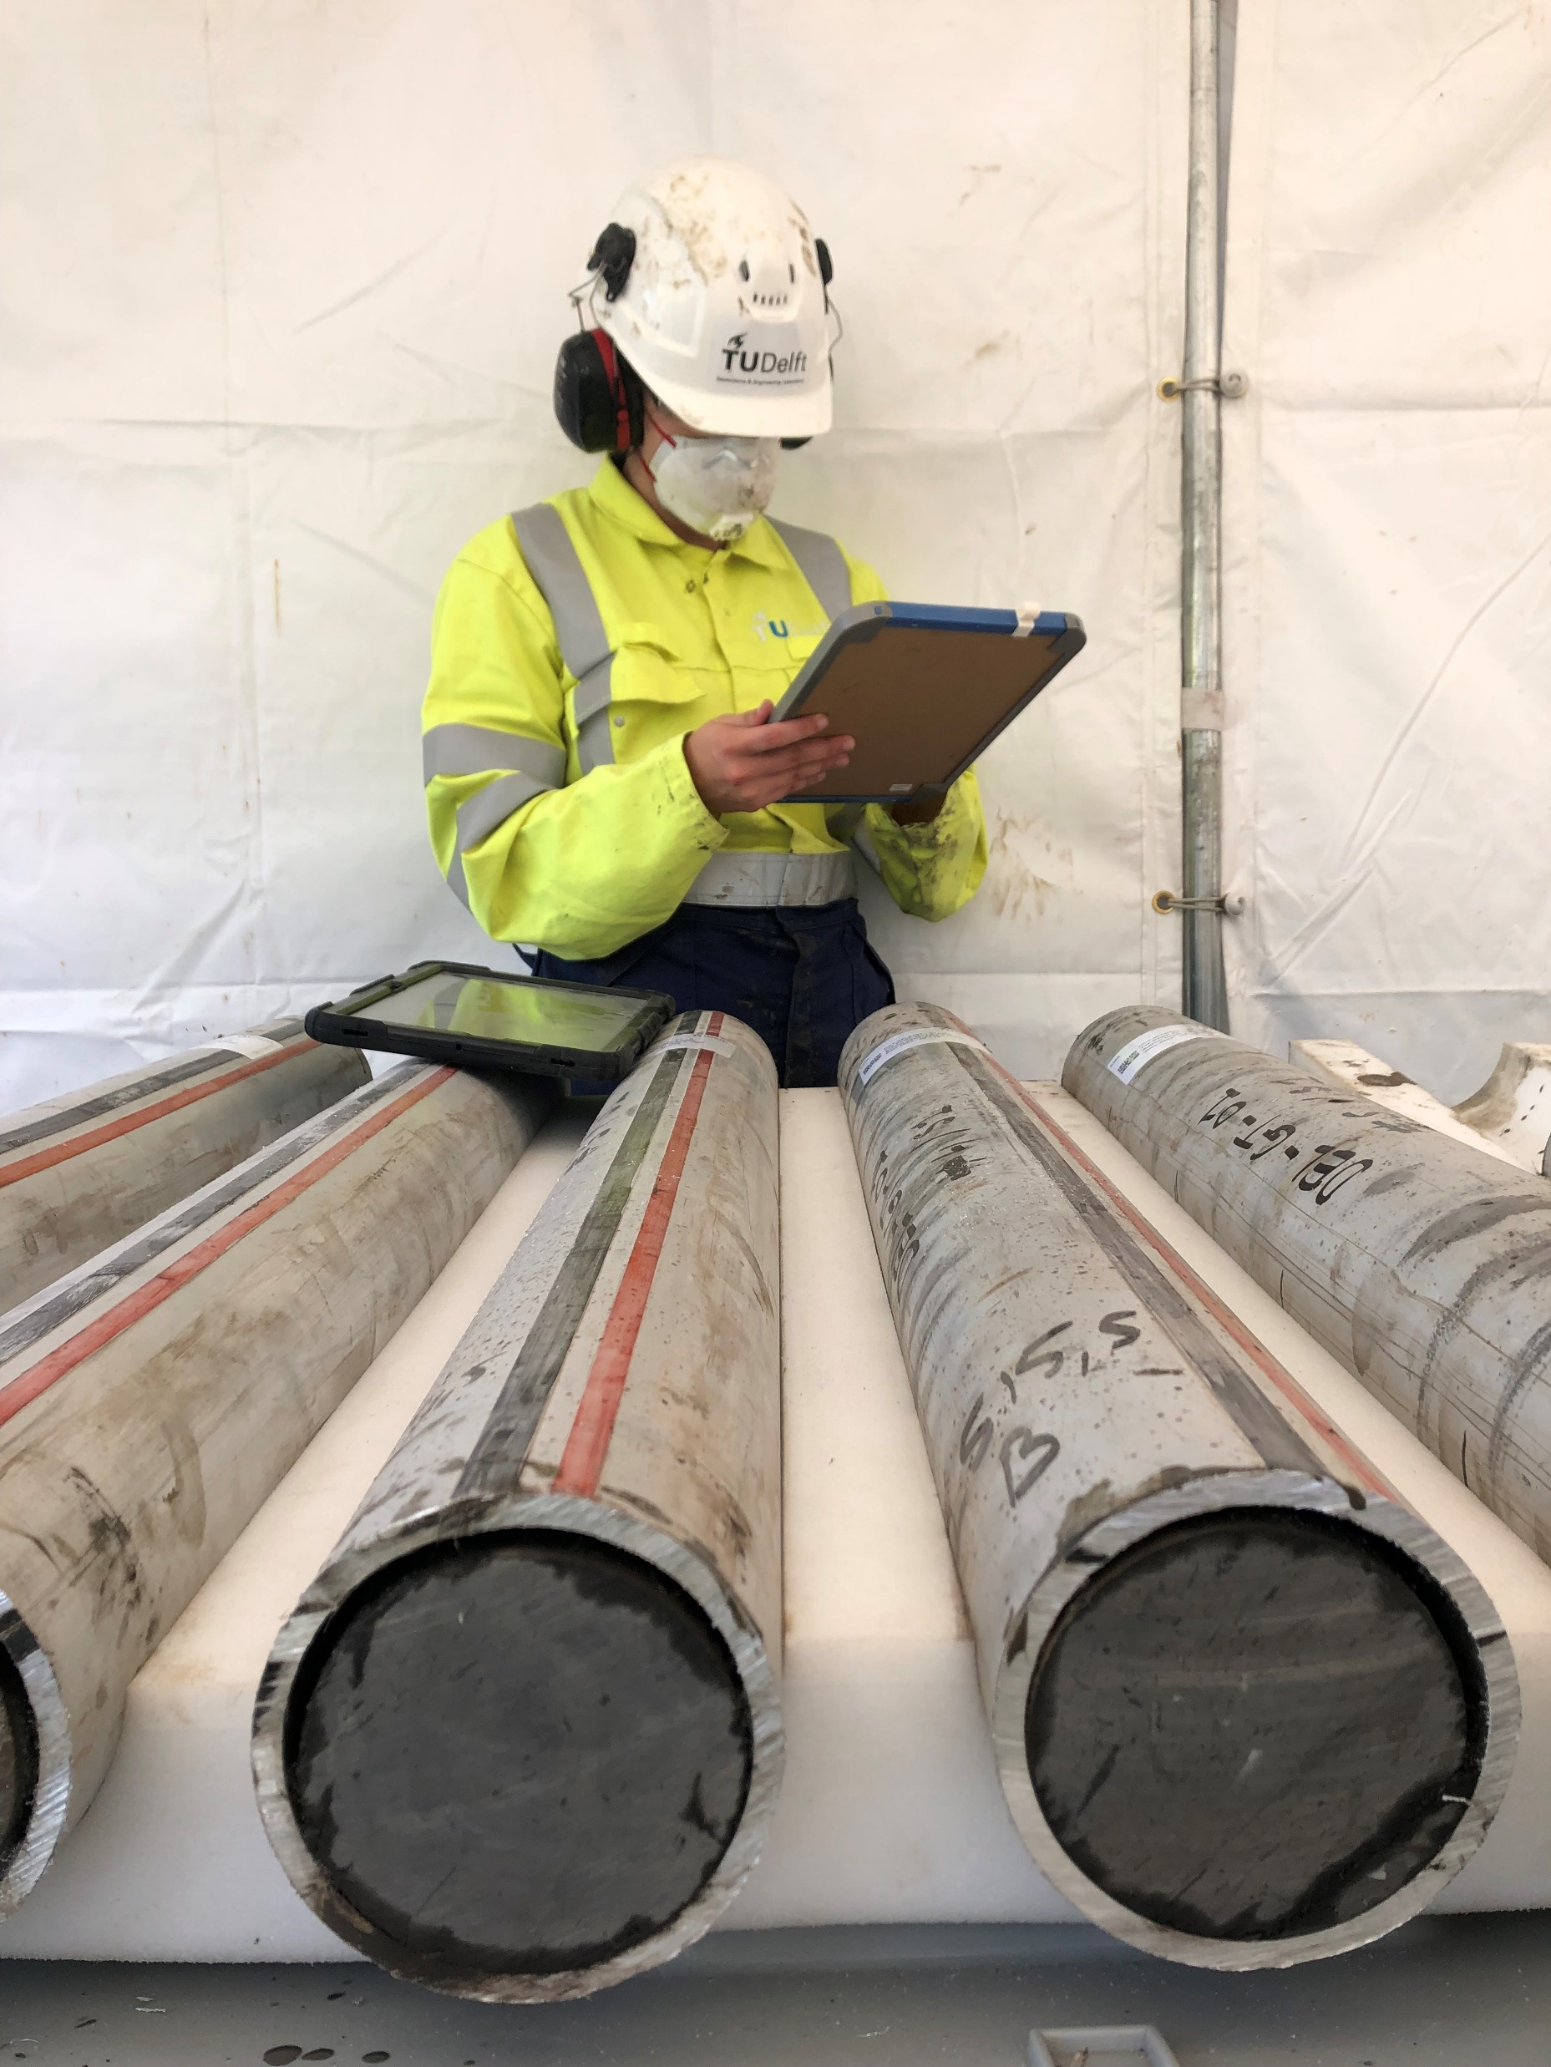
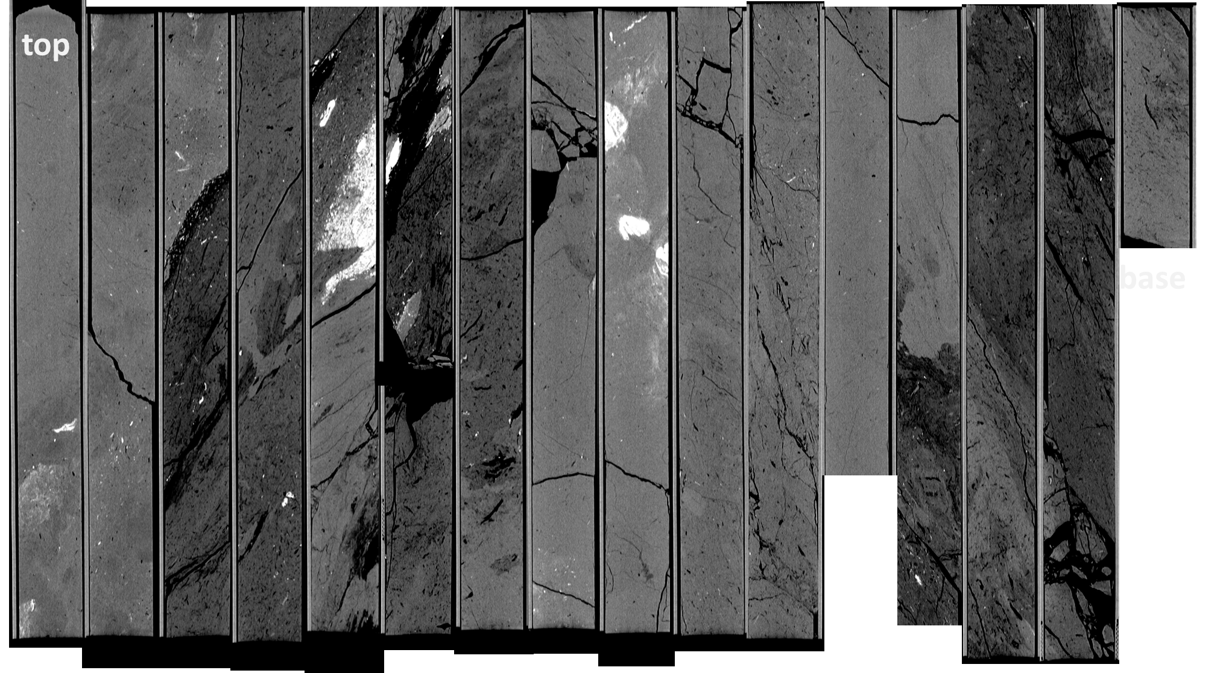
Geo-Energy Data and Data Products
Data types:
Data on past and future field experiments
hydraulic, geophysical, geochemical, geological
Borehole data: physical samples, well logs
Distributed sensing (DTS, DAS, DSS, DPS)
Data products:
Multi-scale & multi-resolution models
basin, reservoir, reactive transport, …
Numerical simulations
Notes:
Pictures data campus well
EPOS ON link - doc sent by Ronald

Slide 7
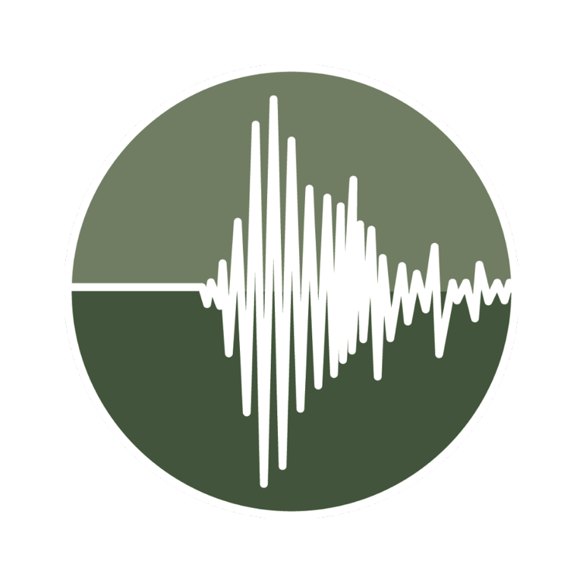
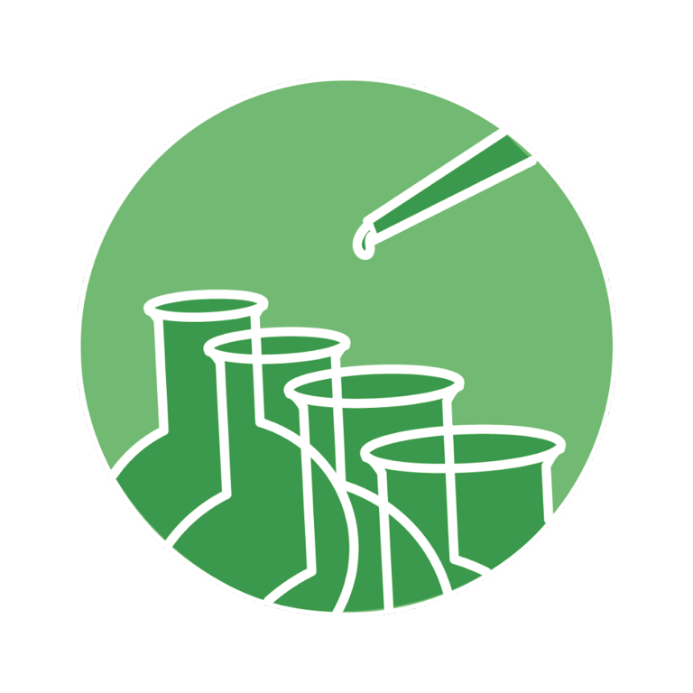
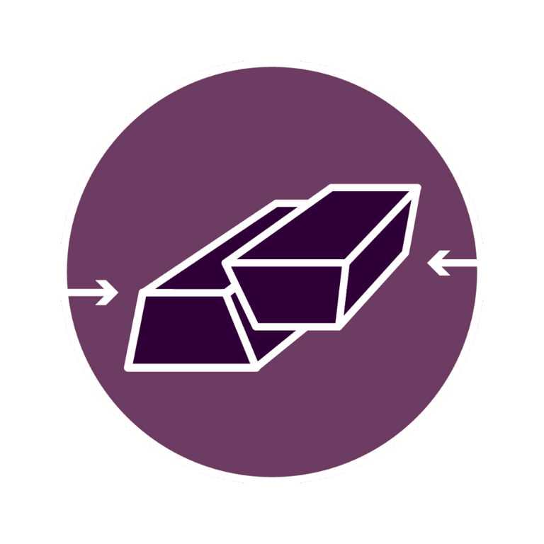
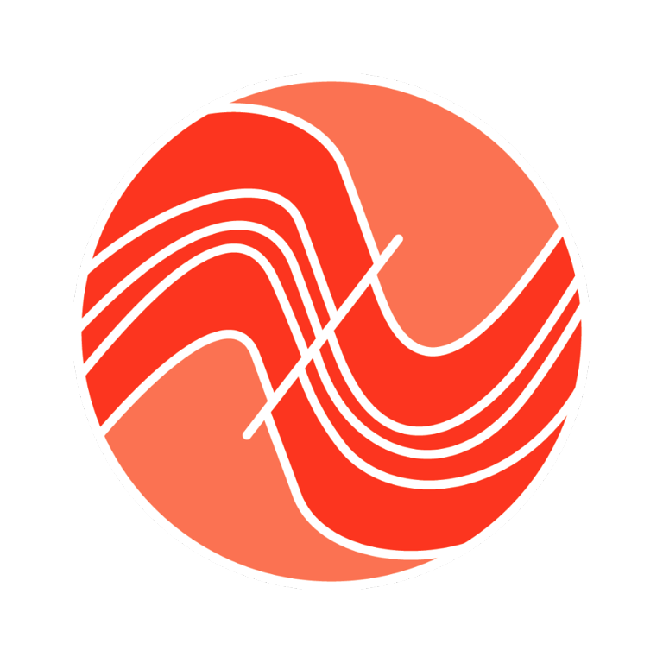
Geo-Energy Data and Data Products
Data types across multiple TCS’s and MSL subdomains:
Seismic catalogues and DAS data > TCS Seismology
Hydraulic data, strain, temperature, pressure > MSL subdomain Geo-Energy Test Beds
Sample analysis; rock physics > MSL subdomain Rock and Melt Physics
Geochemical > TCS Near Fault Observatories > MSL subdomain Geochemistry
Geological data, CT scans > TCS Geological Information and Modeling > MSL microscopy & tomography
Large-volume data: a DAS dataset may be up to several TB
Unique one-off datasets: every test bed produces their own unique data

Slide 8
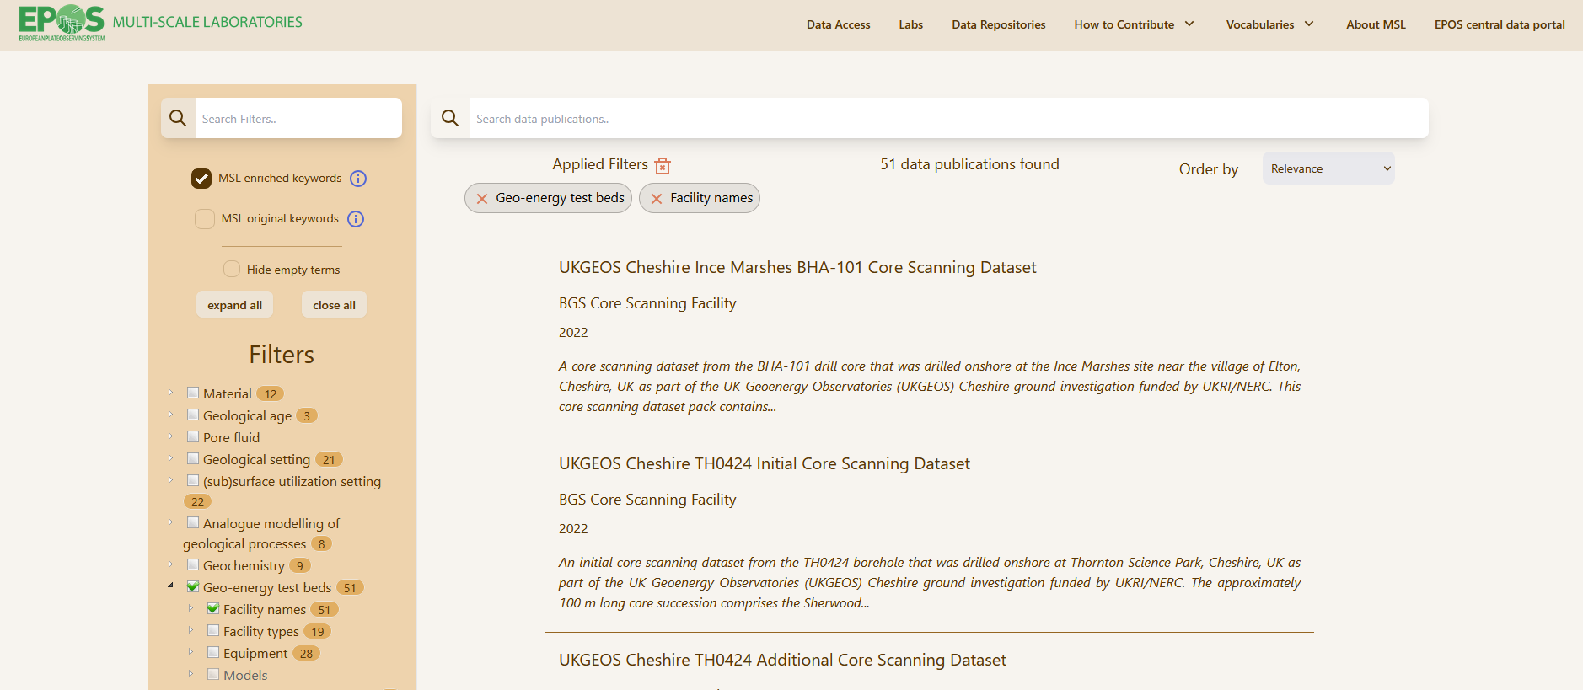
Geo-Energy Test Beds Data Sets via MSL data catalogue
Notes:
EPOS on aim; GETB is in MSL catalogue; EPOS portal update is coming (screenshot with info where GETB can be found)

Slide 9
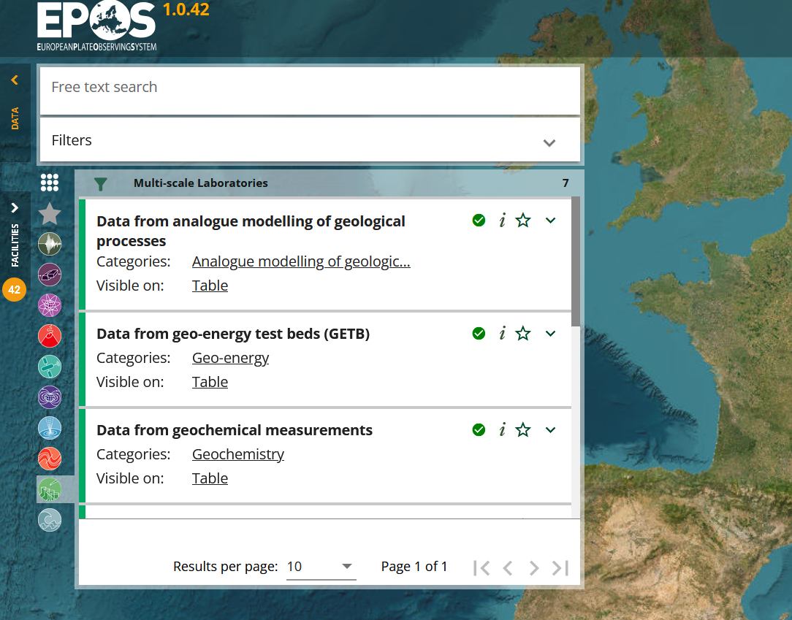
Geo-Energy Test Beds Data Sets via EPOS portal
Notes:
EPOS on aim; GETB is in MSL catalogue; EPOS portal update is coming (screenshot with info where GETB can be found)

Slide 10
A growing geo-energy community
Campus geothermal project at TU Delft
UKGEOS - 3 UK observatories on heat / geothermal / geosciences,
Gross Schoenebeck (in-situ geothermal lab),
Ketzin (CO2 storage pilot site, abandoned),
Fraunhofer Field Scale Lab Geo³ for Geothermal Energy, Geotechnologies and Georesources
Fraunhofer Field Scale Lab TRUDI underground laboratory and Rhineland,
ETHZ Bedretto Underground Lab for Geosciences and Geoenergies,
Rijswijk Centre for Sustainable Geo-energy, TNO
ECCSEL ERIC - CO2 storage facilities
Krafla Magma Test Bed
Notes:
Krafla - data set is available through EPOS (done)

Slide 11
A growing geo-energy community
The purpose of this community is:
To make highly valuable unique datasets publicly available
We do this via:
Knowledge exchange (community-approved vocabulary)
Resource sharing
Opportunities for synergy and collaboration
Funding opportunities
Linking with industry and society
Notes:
Link with industry/society // scientific benefits - scale/model validation

Slide 12
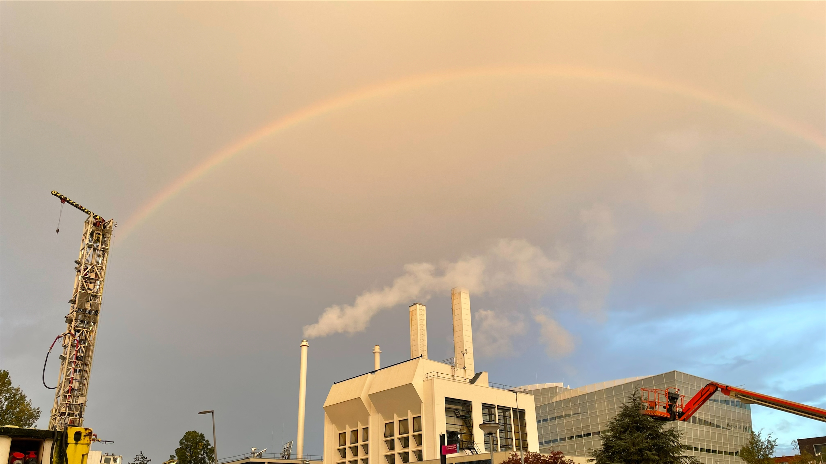
A growing geo-energy community
We need you!
What can you do?
Make contacts between the GETB community and projects;
add your own data; use the vocabulary or add to it

