Slide 1
Ignacio Lázaro Roche On behalf of LSBB & Muographers community

Slide 2
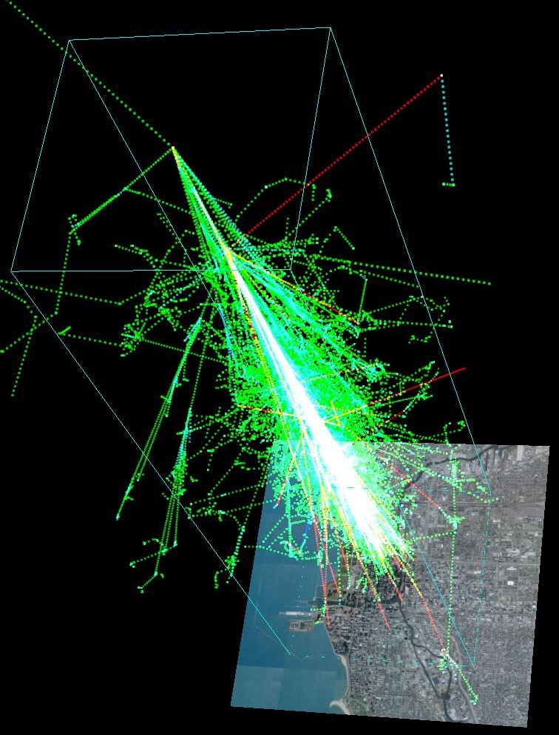
Muography : Principle
Ignacio Lázaro Roche
EPOS days 2025
17-21 March
The muon flux decreases progressively, with an absorption correlated with the medium opacity*
Cosmic muons can penetrate several hundreds of meters underground
Muographic measurements in transmission do not require a direct contact between the target volume and the detector
Provides complementary insights to other techniques
Cosmic muons are a natural, permanent, passive source
Muons average flux at sea level ~10.000 μ/(m² · min)
*Opacity is the density integrated over the path length
Animation from U. of Chicago.
Cosmic shower originated by a 1TeV particle.

Slide 3
Different techniques and technologies
Ignacio Lázaro Roche
EPOS days 2025
17-21 March
Muon flux attenuation
Muon scattering
Two main of approaches depending on how muons interact with matter
Both interactions take place simultaneously, but…
Their relative contribution varies depending on the case
transmission is often used when imaging big volumes
scattering is better suited for small targets with high density contrasts
Matter
Matter
Main technologies
Visual technologies
Nuclear emulsion
Cherenkov telescopes
Muon detection
Scintillators
Hodoscopes
TPC
Gaseous detectors
Source: https://doi.org/10.1038/nature24647
Multilayer

Slide 4
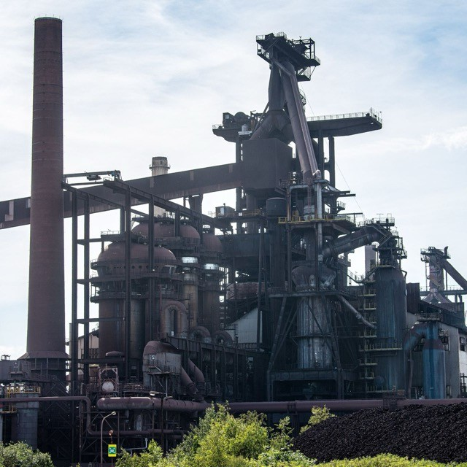
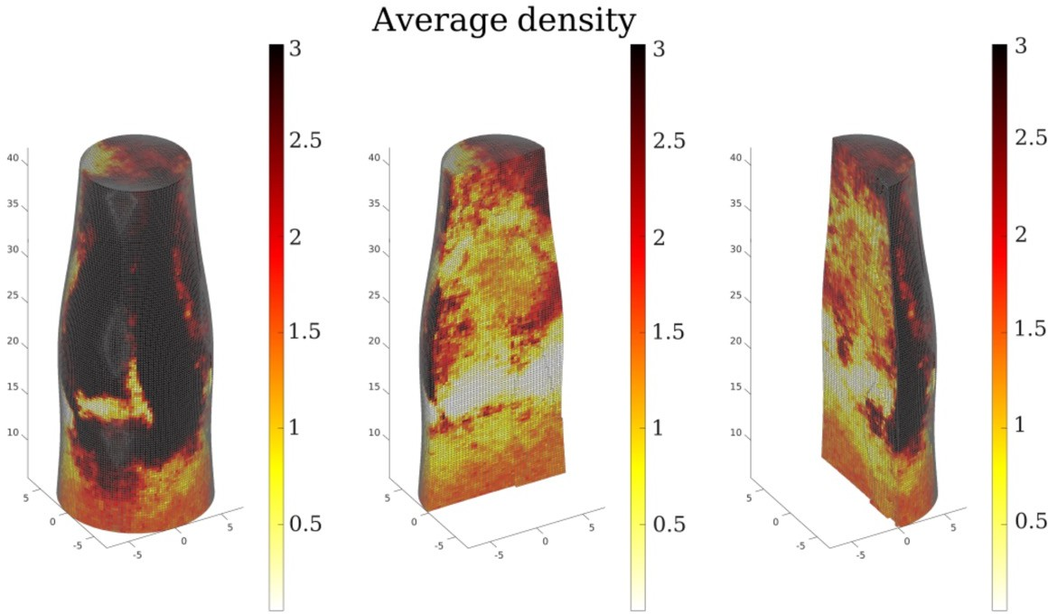
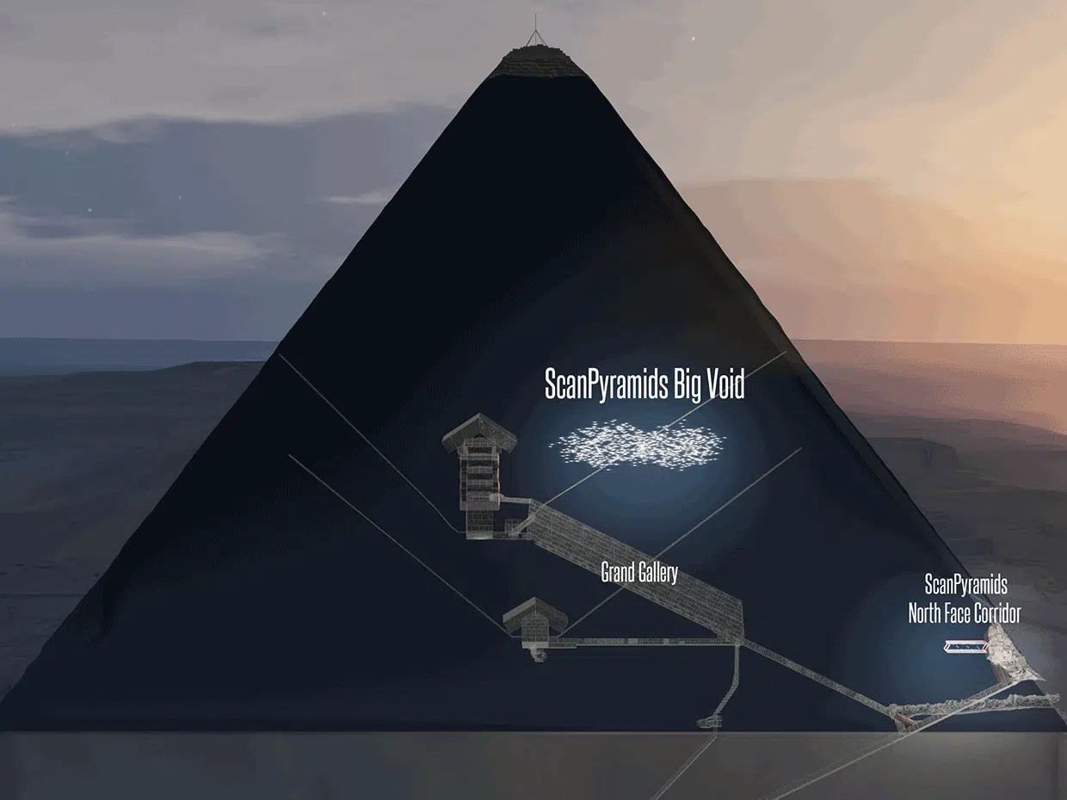
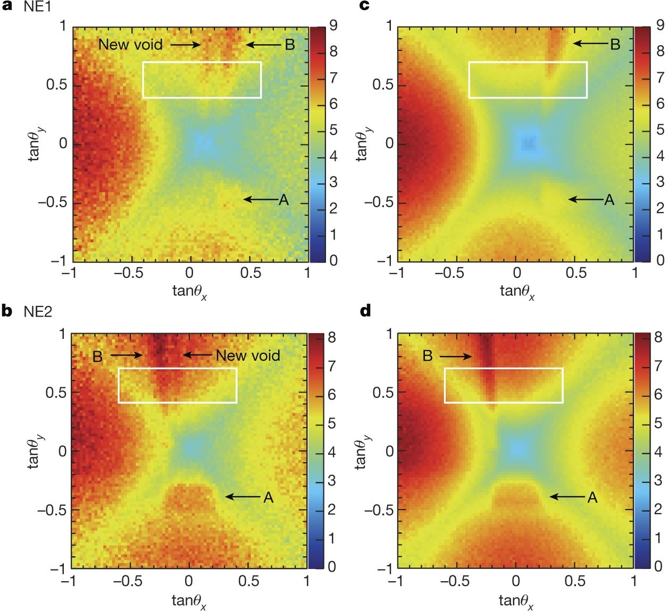
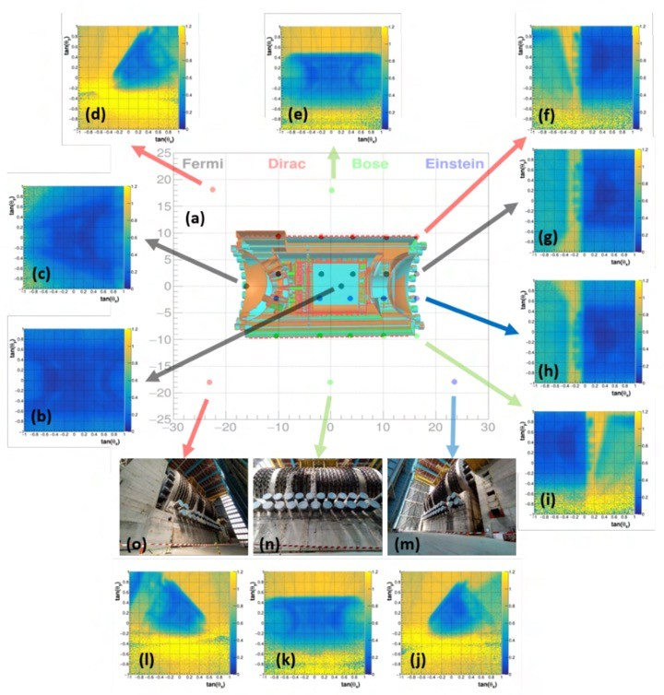
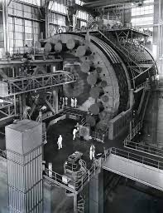
Broad scope of applications
Ignacio Lázaro Roche
EPOS days 2025
17-21 March
Volcanology
Industry
Mount Vesuvius
Archeology
And many more…
Risk & safety

Slide 5
Community
Ignacio Lázaro Roche
EPOS days 2025
17-21 March
Periodical meetings (1-2 years) since 2015.
Pioneer communities in Italy, France, USA and Japan but currently well spread.
Gathers different profiles:
Instrument development, simulations, detector physics, data analysis…
Increasing number of spin-off companies:
Prospection, nuclear safety, civil engineering…

Slide 6
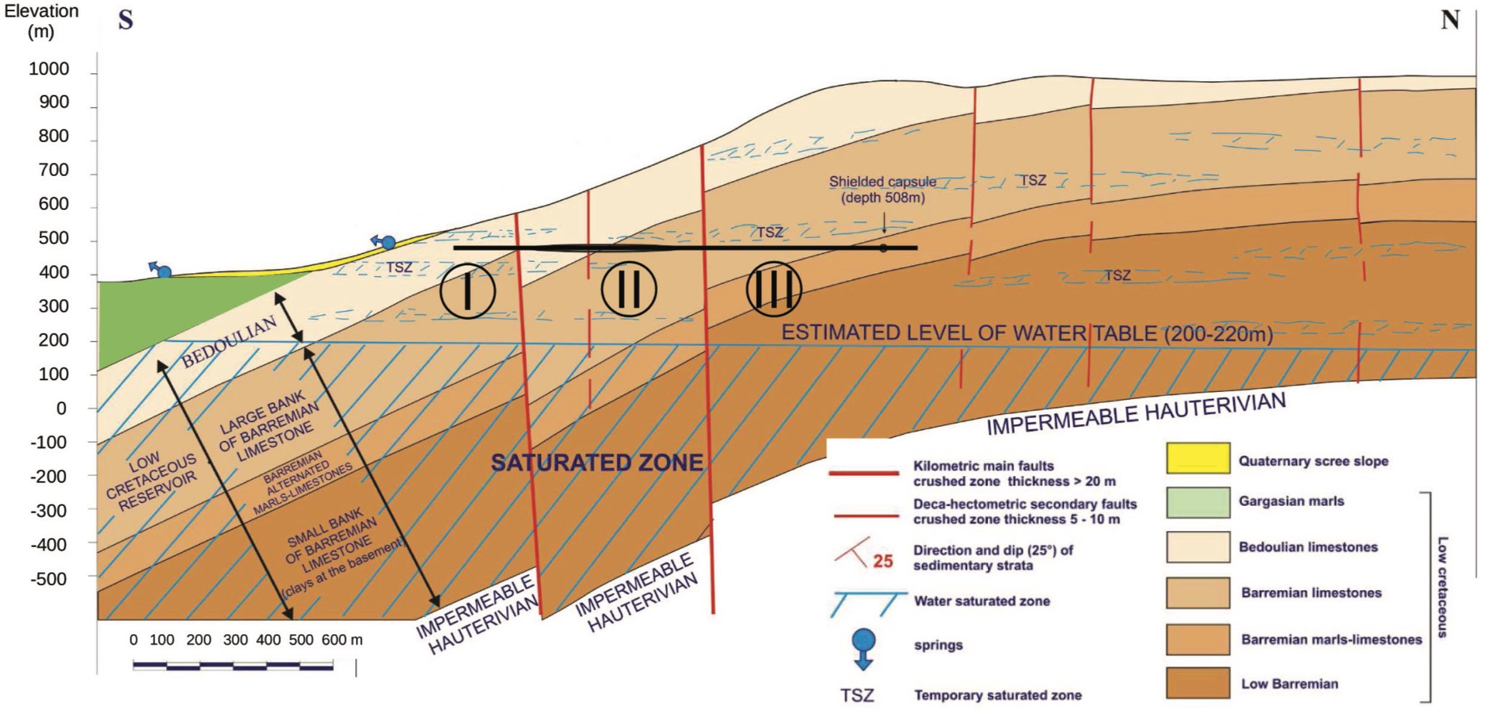
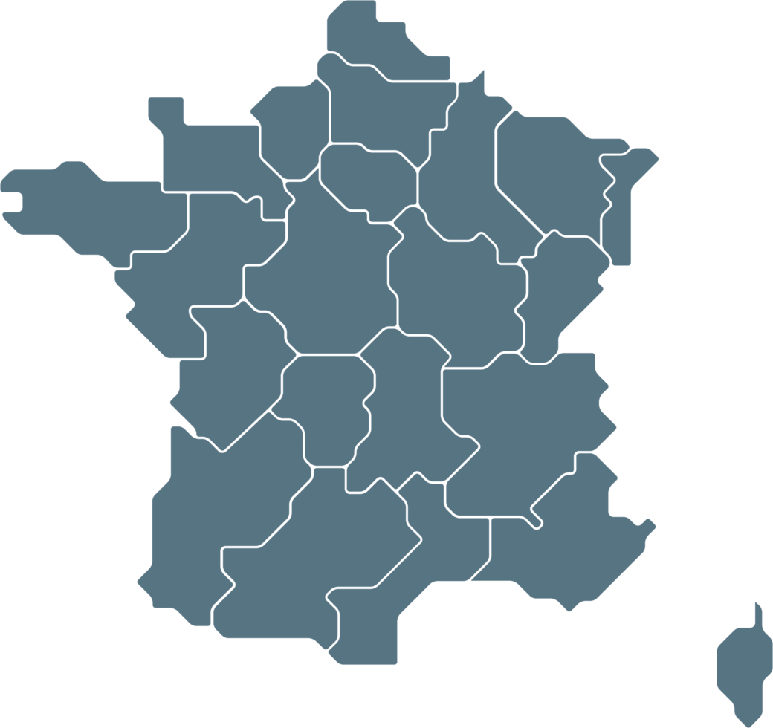
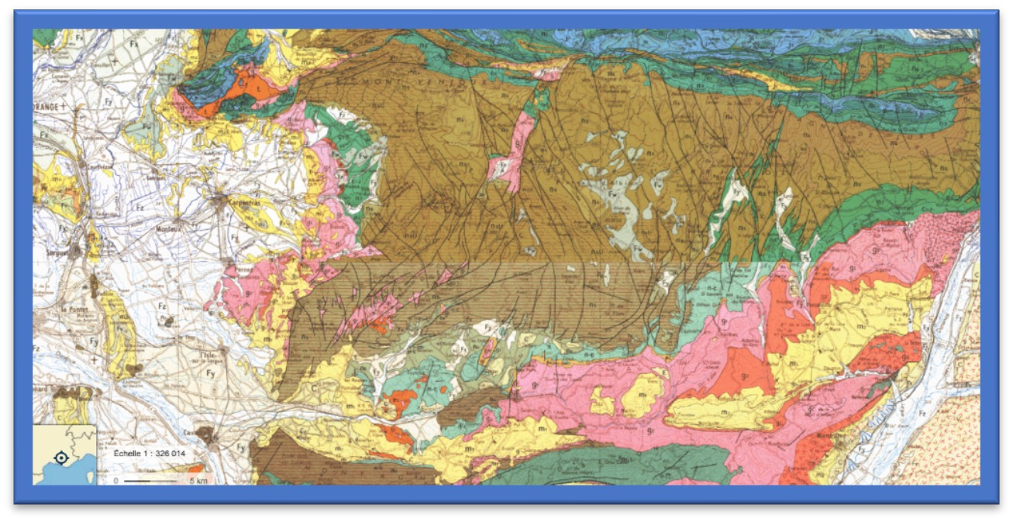
Muography for groundwater monitoring
Ignacio Lázaro Roche
EPOS days 2025
17-21 March
Figure from Sénéchal, (2013)
Plateau of Albion
Experimental site: carbonate reservoir
LSBB
140 years of flow measurements at Fontaine-de- Vaucluse water catchment
17 years of hydrochemical simultaneous
measurements at both LSBB and Fontaine-de-
Vaucluse
Easy and « random » access to LSBB flows in the unsaturated area of the karstic aquifer and within the saturated zone towards boreholes

Slide 7
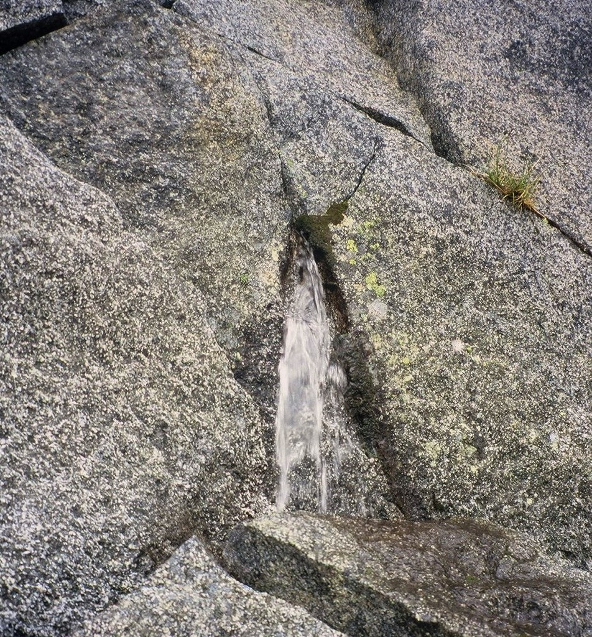
An invisible, yet remarked, presence
Ignacio Lázaro Roche
EPOS days 2025
17-21 March
Effect | Technique
Spring formation | Water composition analyses (age, pollutants, etc.) Use of tracers for groundwater mapping
Chemical changes | Neutron spectrometry Magnetic Resonance Sounding
Density fluctuations | Gravimetry Muography Acoustic propagation
Ground deformation | Clinometry GPS monitoring of deformation Interferometric synthetic aperture radar Extensometry Photogrammetry
Changes in conductivity | Magnetometry Electrical resistivity Ground penetrating radar
Great scenario for benchmarking

Slide 8
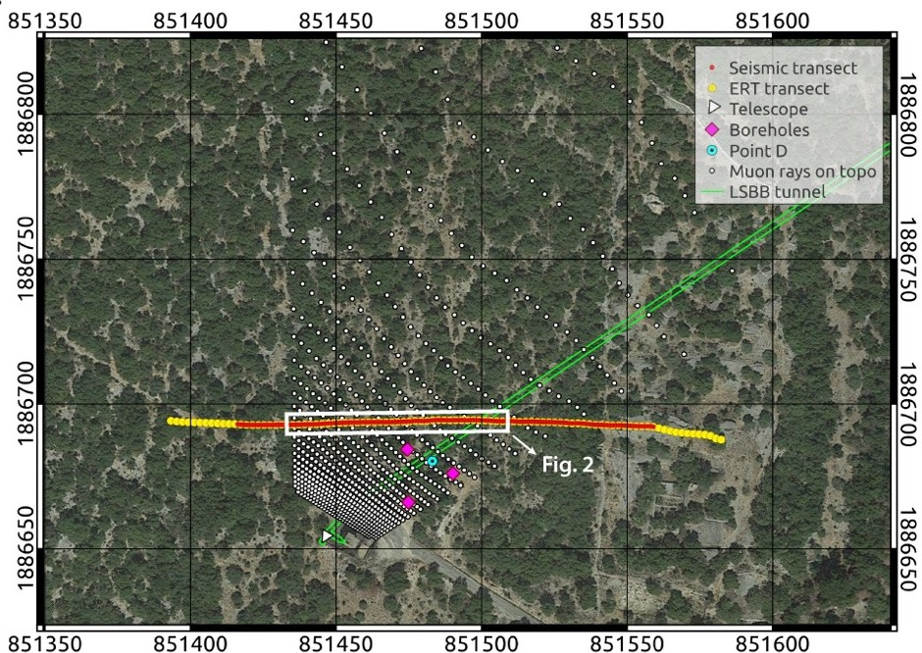
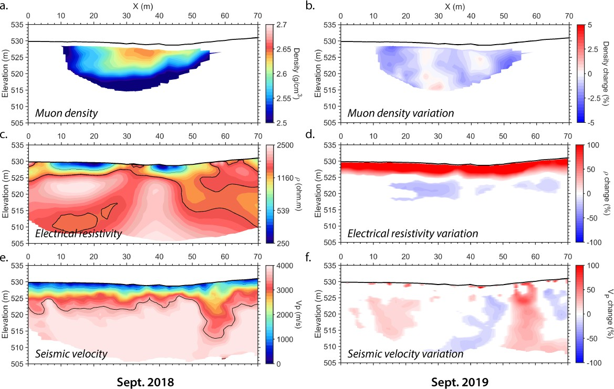
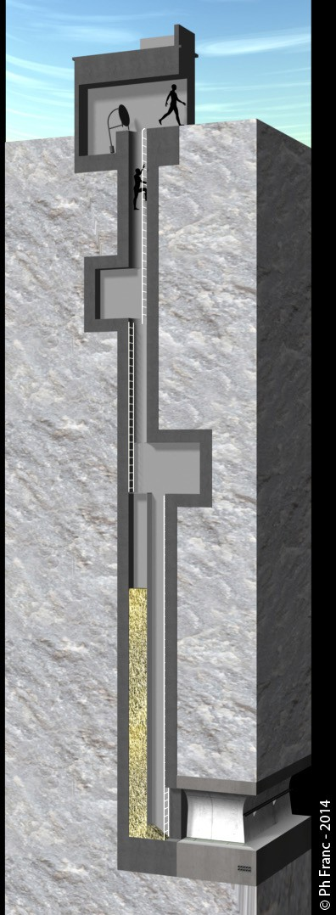
Multi-technique example #1
Ignacio Lázaro Roche
EPOS days 2025
17-21 March
30m
*LSBB emergency exit
Ref: Lázaro Roche, I.; Pasquet, S.; Chalikakis, K.; Mazzilli, N.; Rosas-Carbajal, M.; Decitre, J.B.; Batiot-Guilhe, C.; Emblanch, C.; Marteau, J.; et al.
Water resource management: The multi-technique approach of the Low Background Noise Underground Research Laboratory of Rustrel, France, and its muon detection projects.
In Muography: Exploring Earth’s Subsurface with Elementary Particles. 2021, Geophysical Monograph Series; Oláh, L., Tanaka, H., Varga, D., Eds. American Geophysical Union , USA. DOI:10.1002/9781119722748.ch10

Slide 9
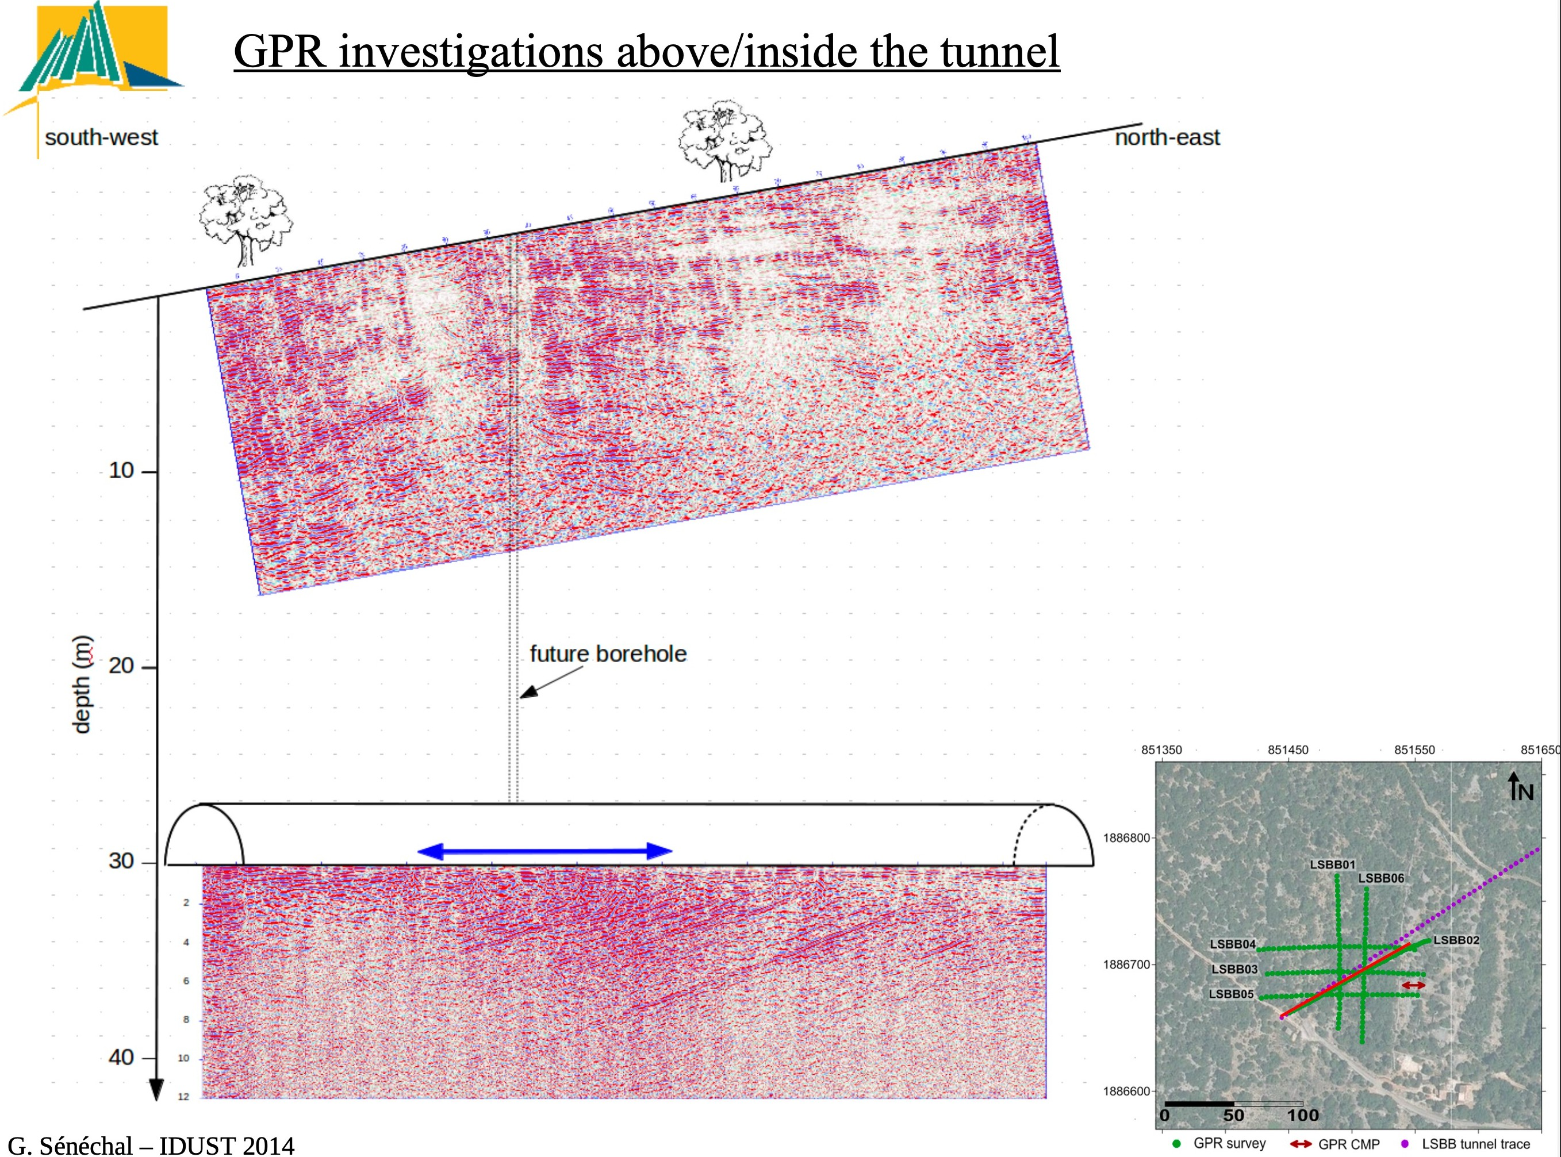
Multi-technique example #2
Ignacio Lázaro Roche
EPOS days 2025
17-21 March
IMOPRES
New Ground-Penetrating Radar measurements
High resolution underground data
Insight on water presence few tens of m
Muon tomography
Extended reach
Slower measurements
Ref: G. Sénéchal, Dominique Rousset, Simon Carrière, Konstantinos Chalikakis, Charles Danquigny, et al.
Imaging the LSBB environment form GPR Data, along the tunnel and from the surface. 2014, I-Dust - Inter-Disciplinary
Underground Science & Technology. https://hal.science/hal-01816792

Slide 10
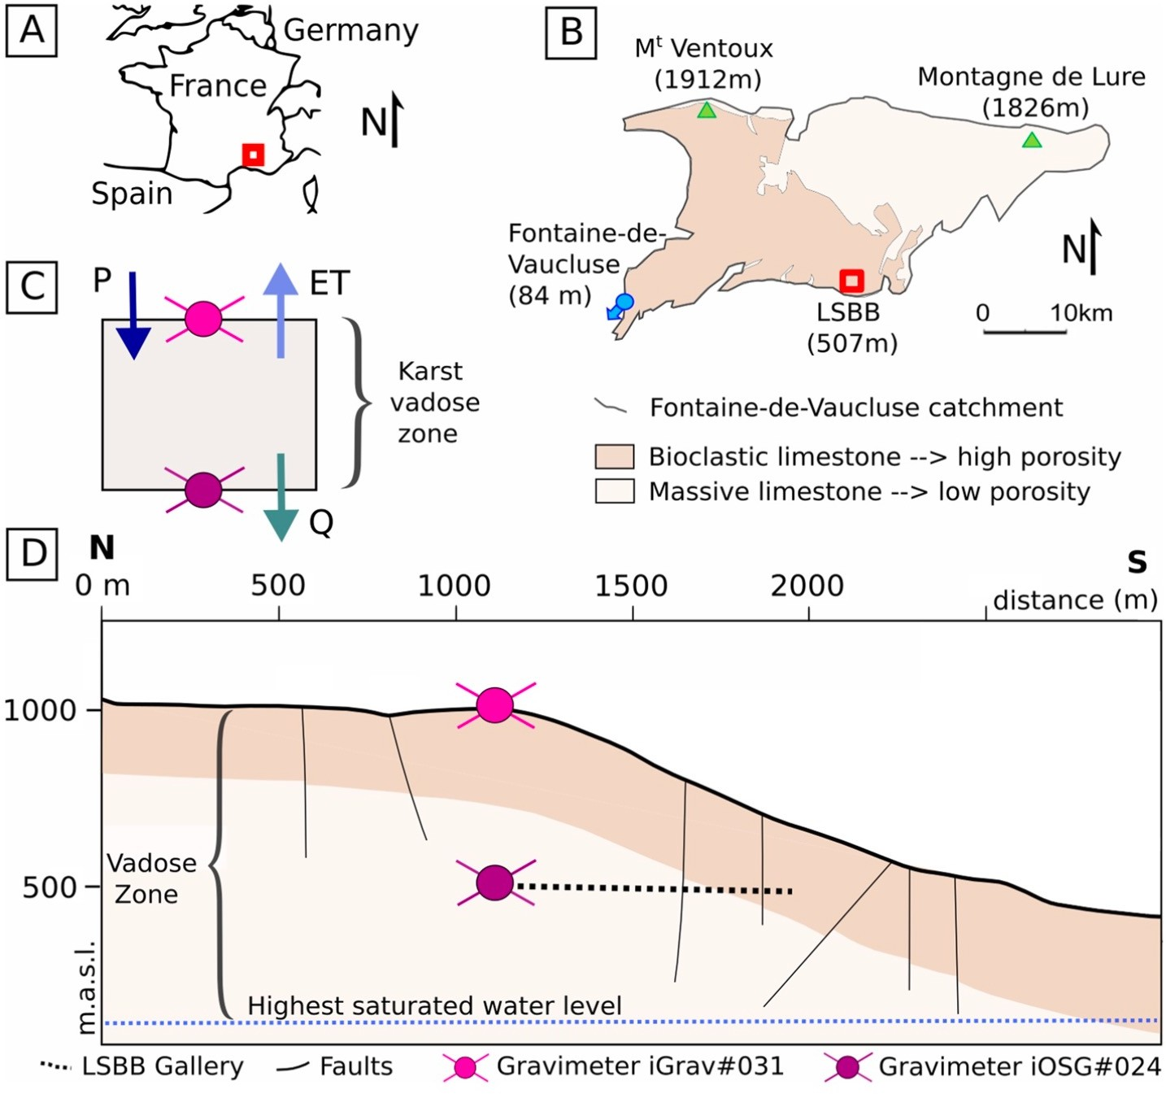
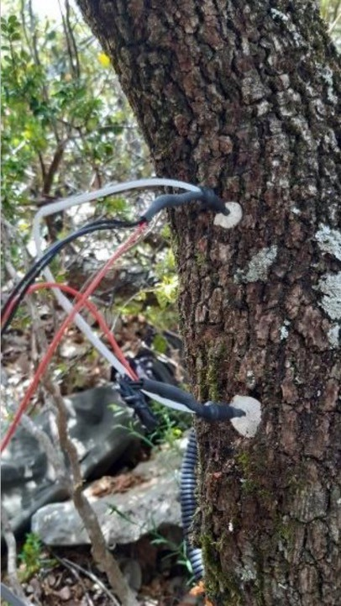
Multi-technique example #3
Ignacio Lázaro Roche
EPOS days 2025
17-21 March
Correlation Between Evapotranspiration and Differential gravimetry
Ref: Simon D. Carrière, Bertille Loiseau, Cédric Champollion, Chloé Ollivier, Nicolas K. Martin-StPaul, Nolwenn Lesparre, Albert Olioso, Jacques Hinderer and Damien Jougnot.
First evidence of correlation between evapotranspiration and gravity at a daily time scale from two vertically spaced superconducting gravimeters. In Geophysical Research Letters. 2021, 48, https://doi. org/10.1029/2021GL096579

Slide 11
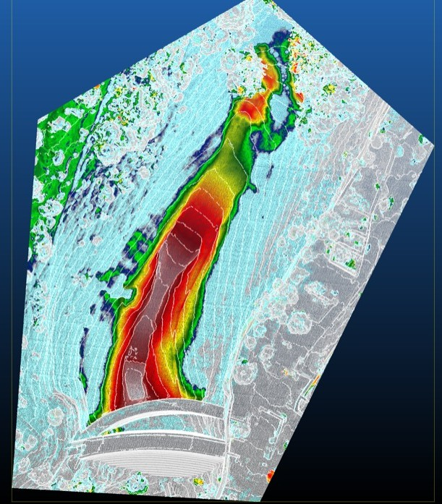
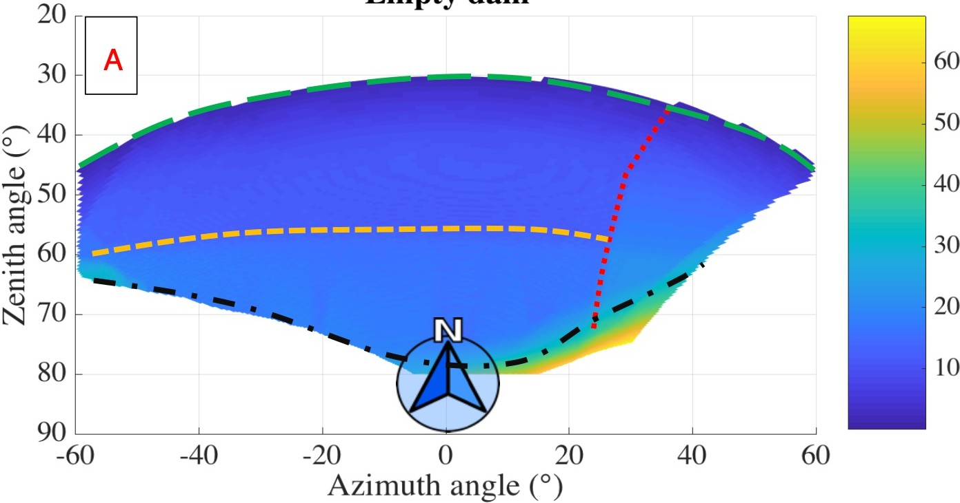
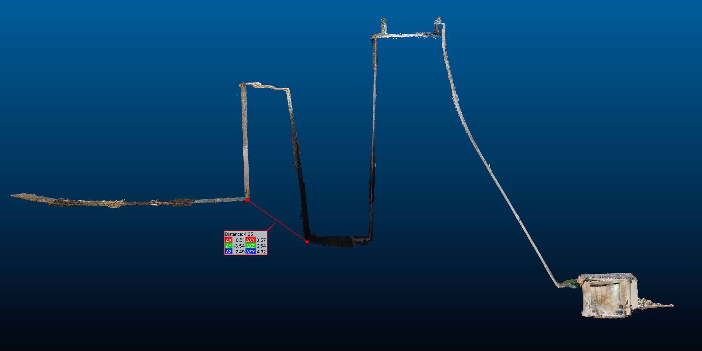
Multi-technique example #4
Ignacio Lázaro Roche
EPOS days 2025
17-21 March
Apparent thickness (m) of the dam from the detector
Ref: Lázaro Roche, I. A compact muon tracker for dynamic tomography of density based on a thin time projection chamber with Micromegas readout. Particles 2021, 4, 333-342. https://doi.org/10.3390/particles4030028
Cross-section of double dam
Sediment thickness cartography
11

Slide 12
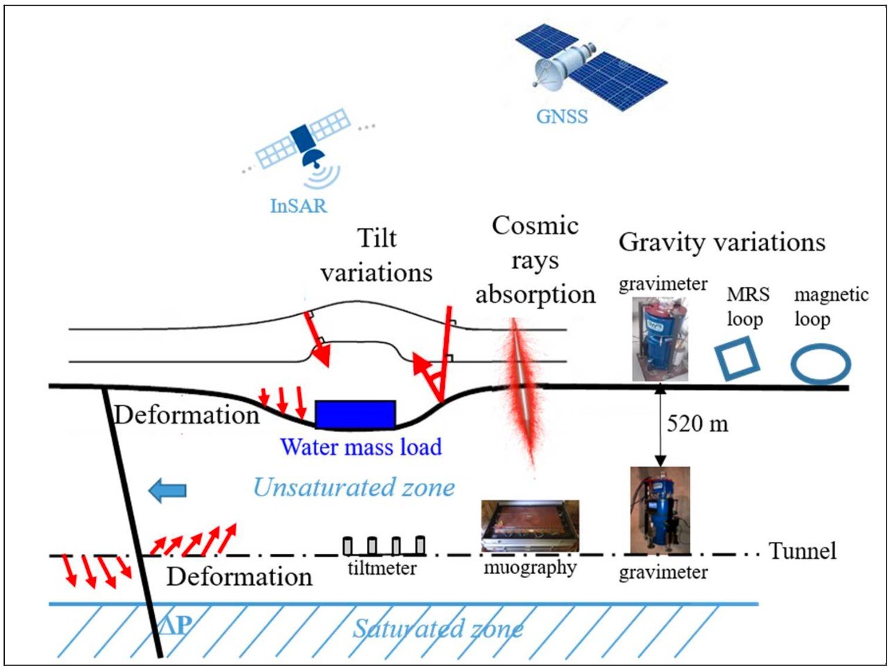
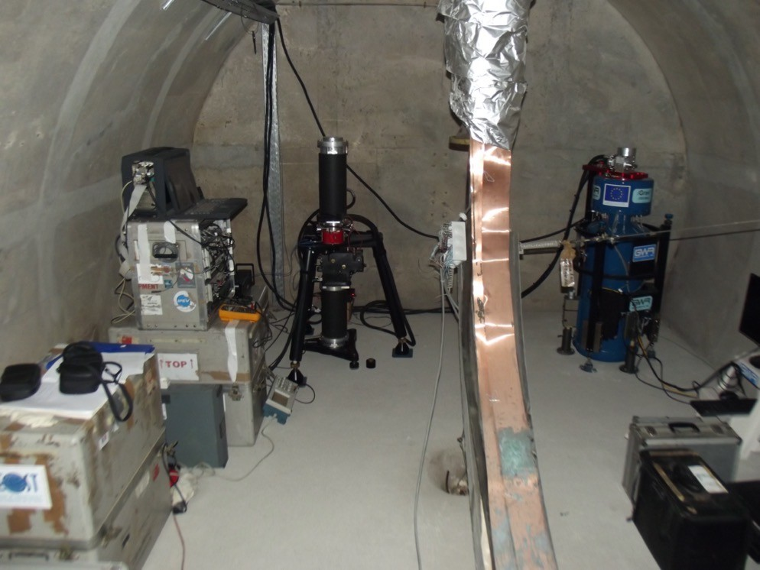
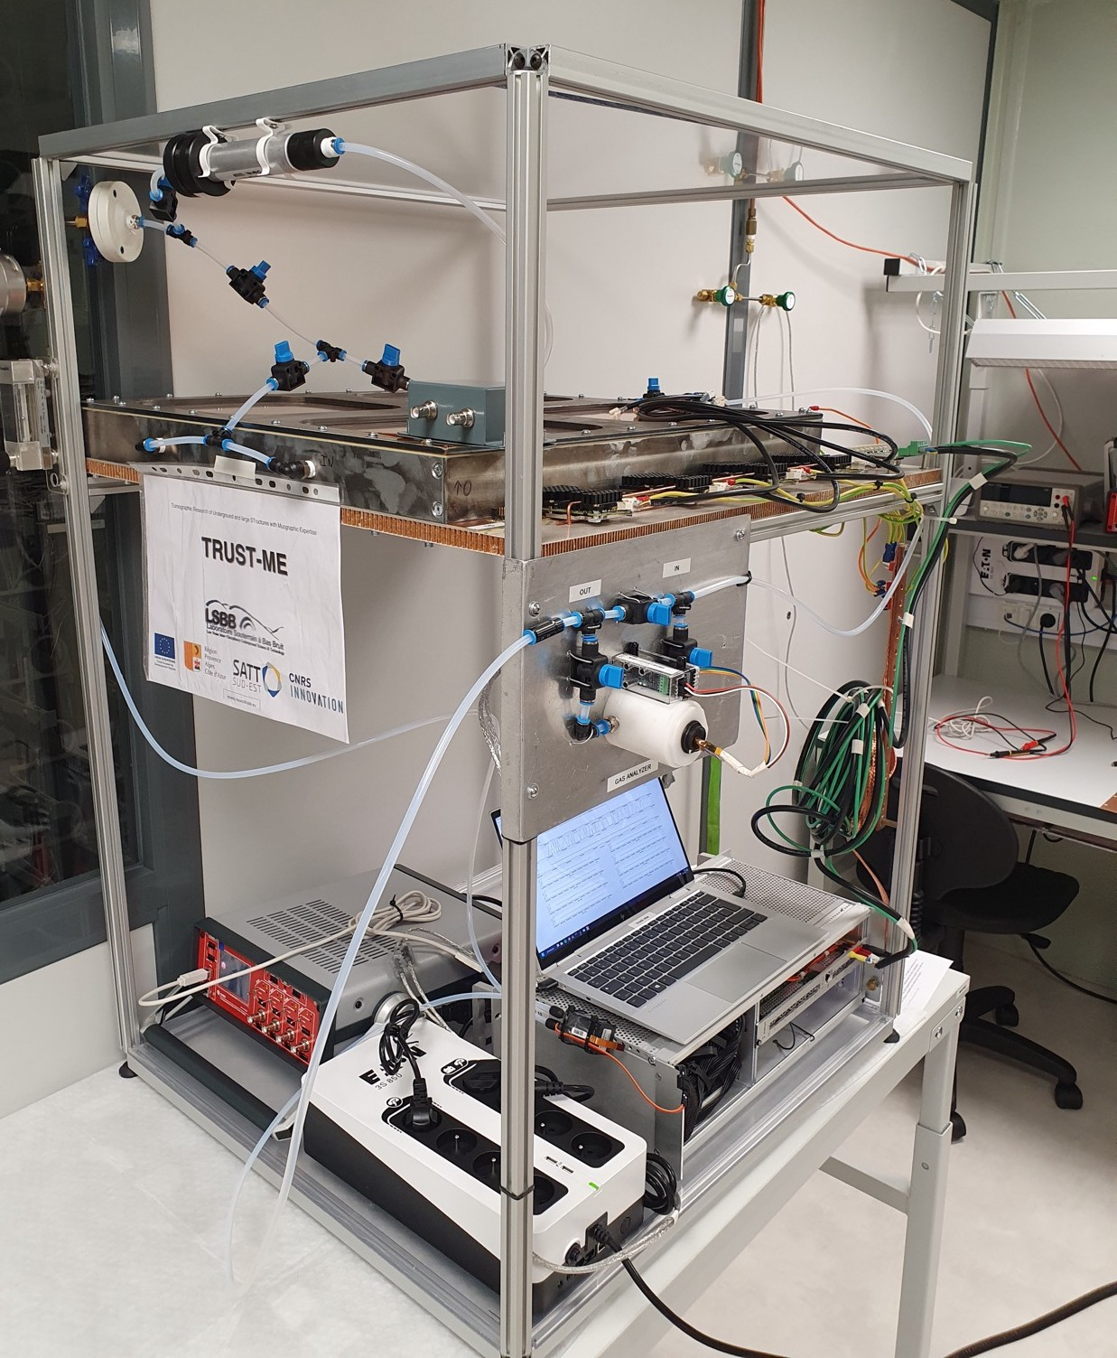
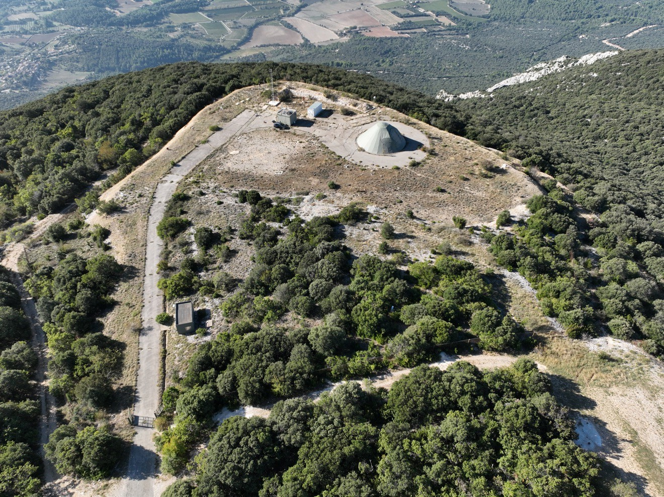
Multi-technique example #5
Ignacio Lázaro Roche
EPOS days 2025
17-21 March
Multitechnique, multiscale collaboration to monitor the different signatures of groundwater
Absolut Gravimeter
Muon tracker
Relative gravimeter
Magnetic loop
PI: Séverine Rosat

Slide 13
The take home message
Ignacio Lázaro Roche
EPOS days 2025
17-21 March
Muography…
provides original information with application-oriented detectors
can be combined with classic geophysics techniques to enhance results
has a well-organized, growing community - yet it is quite heterogenous.
The LSBB is…
a multidisciplinary platform in a remarkable and well-known environment
highly equipped with unique infrastructure for terrestrial, atmospheric and astrophysical observation

Slide 14
Thank you for your attention

