Slide 1
EuroGeographics: Connecting you to maps, geospatial and land information for Europe
Carol Agius
Head of Representation and Stakeholder Engagement
EPOS Days 2025 Perugia, Italy 17- 21 March 2025

Slide 2
Content
Who are EuroGeographics?
EuroGeographics Pan European Data
Open Maps for Europe project
OME2

Slide 3
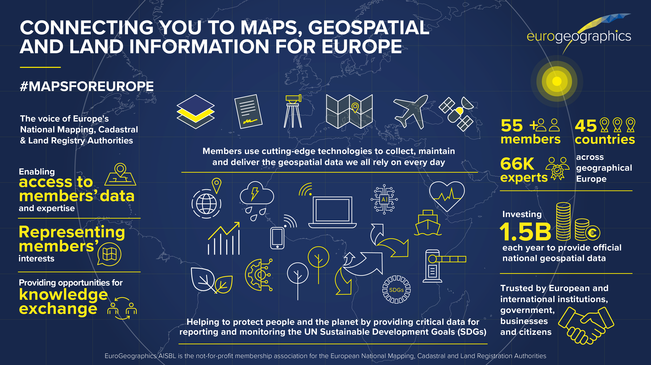

Slide 4

EuroGeographics – Pillars of Activity

Slide 5
“positioning EuroGeographics as an enabler that allows users and key stakeholders easy access to members data”

Slide 6
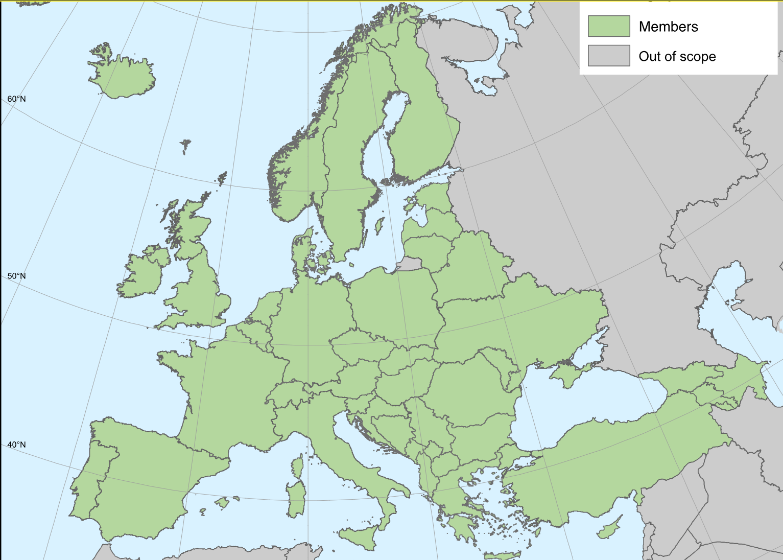



Pan European Datasets
Updated Yearly
Authoritative
Geographical Europe coverage
Key Themes
Harmonised & edge-matched

Slide 7



Open Maps For Europe Project 2020-2022
Open Maps For Europe

Slide 8
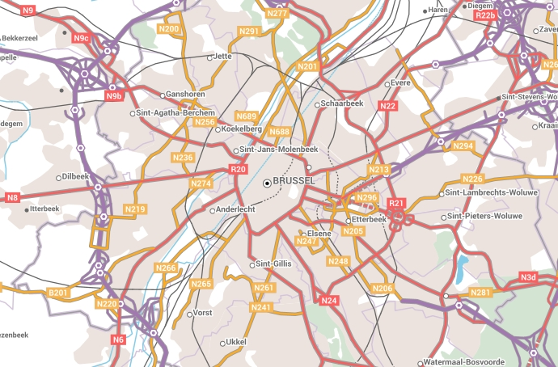


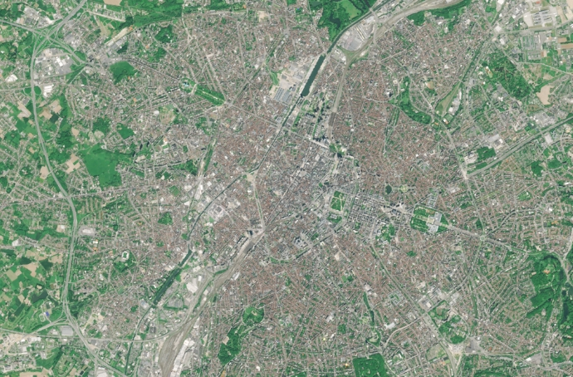
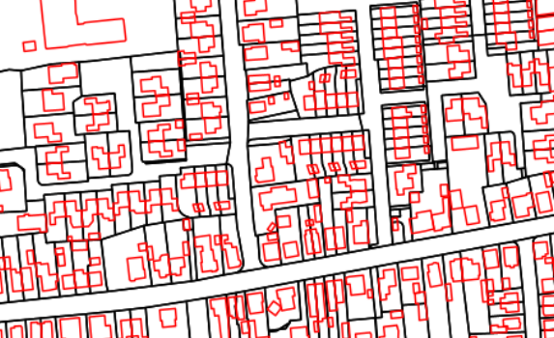
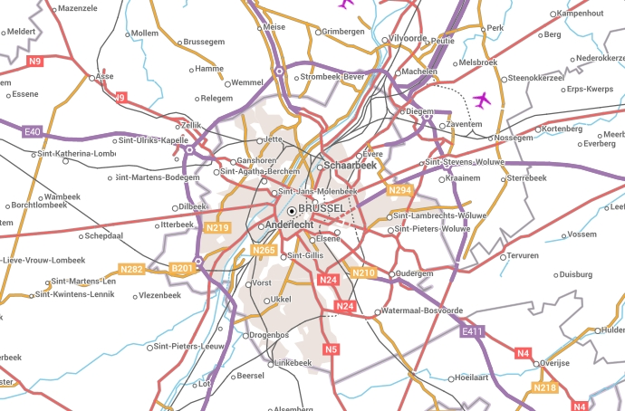
Products
Pan-European Products
EuroRegionalMap
EuroDEM
Open Gazetteer
EuroGlobalMap
Imagery Service
Open Cadastral Map

Slide 9

User requirements
OME2
Large scale
Key Themes
Life-cycle management
Harmonised & edge-matched
Authoritative
Geographical Europe coverage

Slide 10



Open Maps For Europe 2 Project 2023-2025
OME2

Slide 11



HVLSP Production Objectives
OME2
To set up a workflow to create and maintain:
  A central pan-European high-value large-scale prototype (HVLSP)
  3 themes:
    Administrative units (AU)
    Transport network (TN)
    Hydrography (HY)
  10 countries by 2025 (to be extended afterwards)
The OME2 approach:
Centralised process
Minimal additional workload for national producers
Re-use results from previous projects
A technical and practical approach to harmonisation:
  Take into account feedback from users
  Technical (not political) solutions
  Highly automated

Slide 12
New production process
OME2
Automatic harvesting
Harmonisation
Edge-Matching
Conversion
1:10k - 1:25k
Life-Cycle Management
Upload

Slide 13
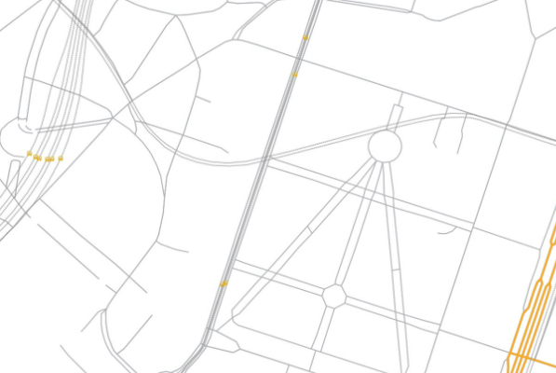
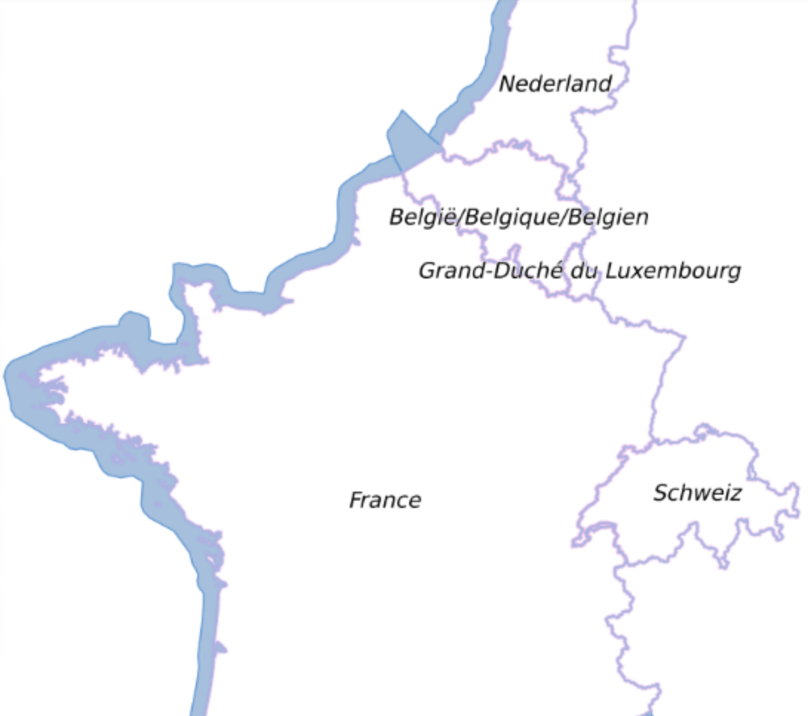
High-Value Large-Scale Prototype v1.0
MapsForEurope.org

Slide 14
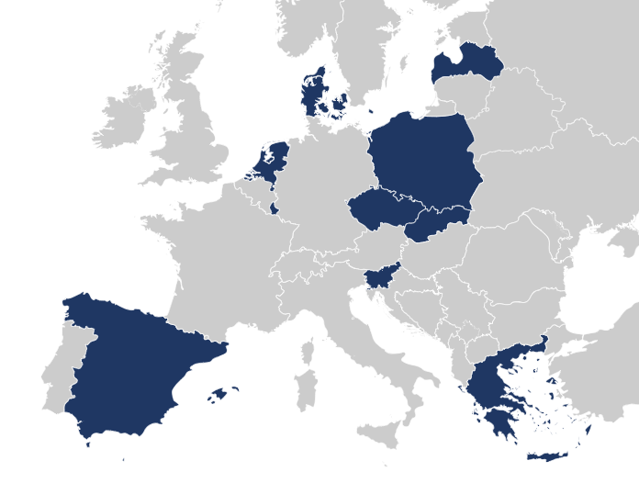
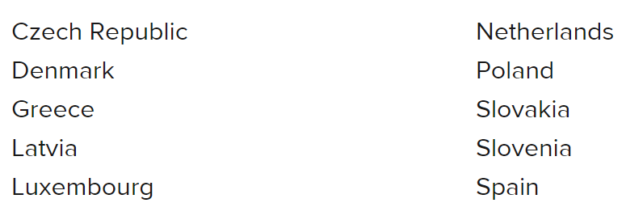
The Open Cadastral Map
OME2
  HVD: Cadastral Parcels, Buildings, Addresses and Administrative Units
  Sustain: Currently data from 10 countries provided through the OME interface
  Extend: 5 additional countries
  Enhance: New functionalities

Slide 15
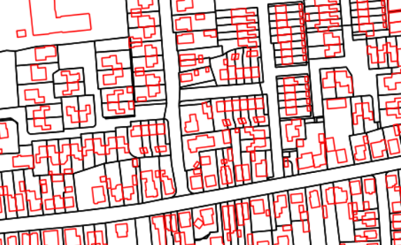
Sustain - Enhance - Extend
OME2
EGM

Slide 16
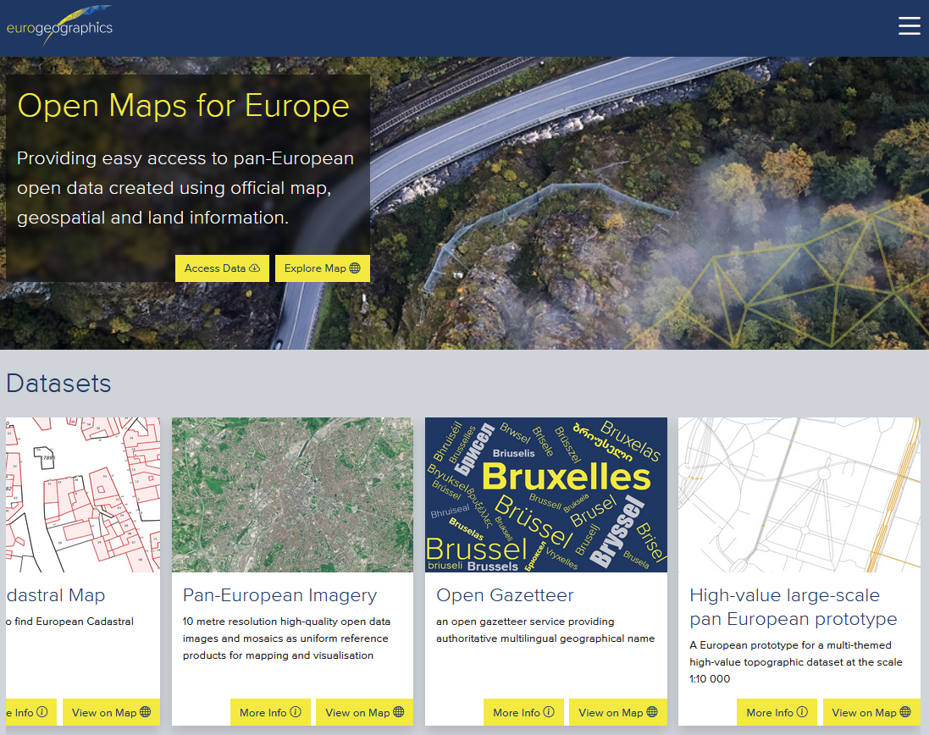
Benefits of OME2
Addresses the challenges of finding, easily accessing and licensing
Saves users time, effort and resources
Supports NMCAs
Demonstrates how to meet demand
https://www.mapsforeurope.org/

Slide 17
Thank you
Any questions?
carol.agius@eurogeographics.org

