Slide 1
WP2 and 3: overview of new communities and services in EPOS ON
O.A. Lange, J. Michalek, F. Romano, A. Scala | 17-20 March 2025 – EPOS Days, Perugia, Italy
Notes:
Title slide

Slide 2
WP2 – enhancing services for science
New communities and services in EPOS ON
19 March 2025 | EPOS DAYS| Perugia
Otto Lange, Jan Michalek, Andrey Babeyko, Joanna Kocot
Notes:
Title slide
2

Slide 3
TASK 2.1 – Enhanced EPOS catalogue of services for science
D2.1 (submitted): Roadmap for integration of new services
Webinar for new EPOS participants: the EPOS methodology for integration
Service integration procedure (what needs to be done to get integrated):
Preparation and Planning
Technical Integration
Testing and Validation
Deployment and Maintenance
Documentation and Training
Progress to be tracked through Implementation Level Matrix (online spreadsheet)
Notes:
Content slide
3

Slide 4
New and already existing services to be integrated: covered in roadmap D2.1
Service title | Dev until | Test and integrate | Integrated
Multidisciplinary data: Micro-climatic data from Slovenian Karst (2.1.1) | 2026-Q2 | 2026-Q4 | 2027-Q2
Multidisciplinary data: Seismic data from Slovenian Karst (2.1.1) | 2026-Q1 | 2026-Q3 | 2027-Q1
Real-time and Discrete Geochemical Data Repository (2.1.2) | 2026-Q3 | 2027-Q1 | 2027-Q2
Machine learning-driven Data Validation and Predictive Maintenance System (2.1.2) | 2026-Q3 | 2027-Q1 | 2027-Q2
Automatic Alert System for Geochemical Anomalies (2.1.2) | 2026-Q3 | 2027-Q1 | 2027-Q2
A new MSL service for site-specific GETB data (2.1.3) | 2026-Q1 | 2026-Q3 | 2026-Q4
Services for multi-domain GETB data dissemination (2.1.3) | 2026-Q4 | 2027-Q1 | 2027-Q2
Enhance magnetotelluric data and models (2.1.4) | 2025-Q4 | 2026-Q2 | 2026-Q4
Muography data (2.1.5) | 2025-Q4 | 2026-Q2 | 2027-Q1
Development of the new WSM database infrastructure MaRS (2.1.6) | 2025-Q2 | 2025-Q4 | 2026-Q1
New WSM database 2025 release (2.1.6) | 2025-Q2 | 2025-Q4 | 2026-Q2
Expansion of the WSM database with stress magnitude and pore pressure data (2.1.6) | 2026-Q4 | 2027-Q1 | 2027-Q2
Coordinated inventory of mobile instrument pools (2.1.7) | 2025-Q4 | 2026-Q1 | 2026-Q2
Simplified and harmonized litho-stratigraphic maps (2.1.8) | 2026-Q4 | 2027-Q1 | 2027-Q2
DEM and DEM-derived elements - slopes (2.1.8) | 2026-Q2 | 2026-Q4 | 2027-Q2
Compilation of measured Vs30 data across Europe (2.1.8) | 2026-Q2 | 2026-Q4 | 2027-Q2
Test for the integration of a local-scale dataset for site effect characterisation (proof of concept, additional; 2.1.8) | 2026-Q4 | 2027-Q1 | 2027-Q2
Rapid Position Time-Series Computation (2.1.9) | 2026-Q4 | 2027-Q1 | 2027-Q2
Dissemination of Rapid Position Time-Series (2.1.9) | 2026-Q4 | 2027-Q1 | 2027-Q2
Airborne magnetic survey data (2.1.10) | 2026-Q2 | 2026-Q4 | 2027-Q2

Slide 5
Expected start of service integration

Slide 6
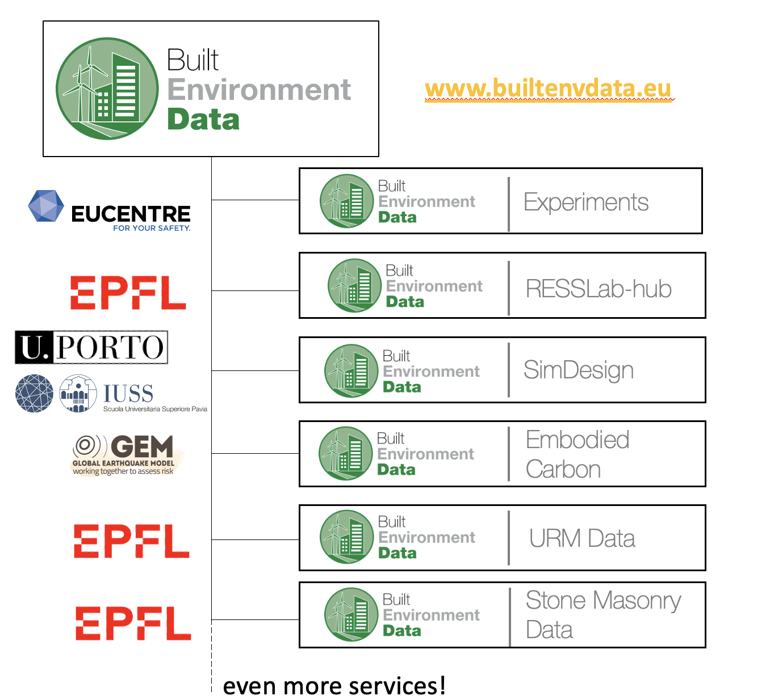
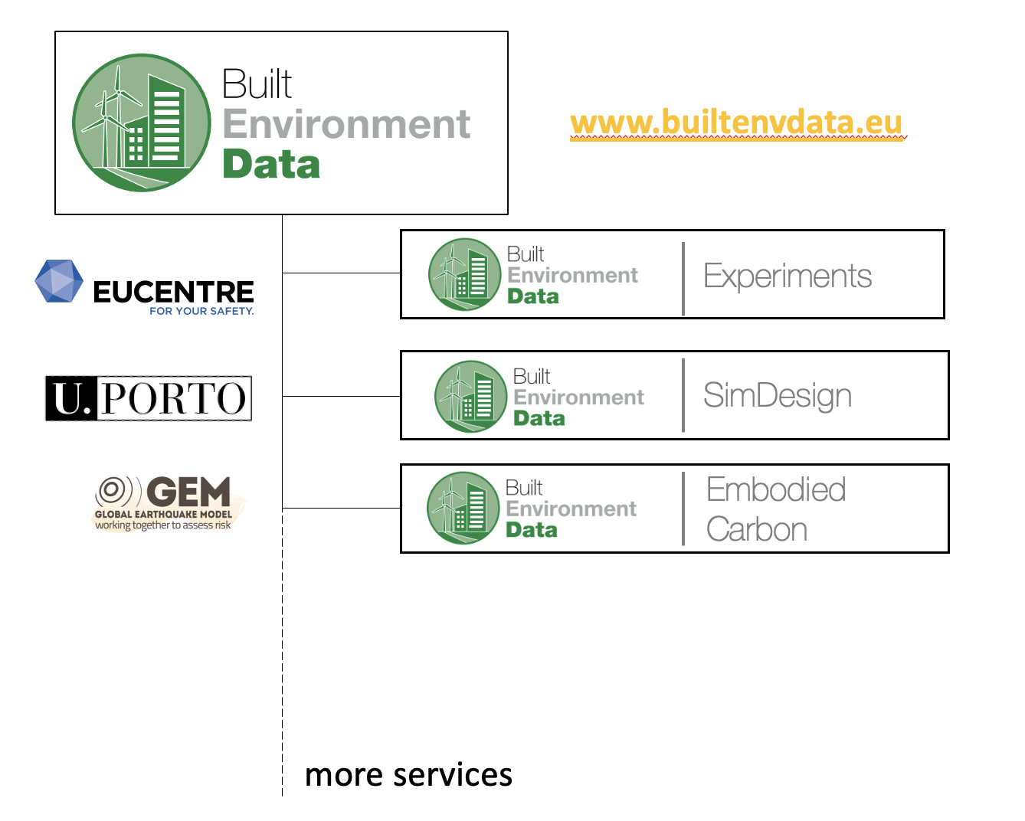
TASK 2.2 – Integration of new communities and
stakeholders to the EPOS RI
New Community: BED
Initially comprised some tentative services led by different institutions
These services are growing alongside the richness of the data/service provided
Several workshops, presentations and publications prepared to disseminate and grow the BED community
Synergistic collaborations with Tsunami TCS
Additional services to be added in 2025, alongside increased FAIRness

Slide 7
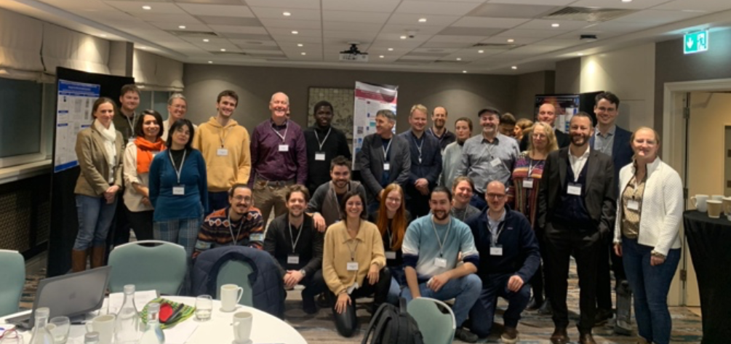
TASK 2.2 – Integration of new communities and
stakeholders to the EPOS RI
Private Sector: KMT
First workshop: Dublin, November 21, 2024
Jointly organized by
33 participants, including experts from industry, academia, and IMPROVE Early Career Researchers, to discuss challenges and innovations in the emerging field of geothermal energy
The workshop focused on addressing the needs of the geothermal energy industry working with high-temperature and superhot geothermal systems, fostering collaboration and knowledge exchange between science and industry.
The success of the workshop prompted the organisers to consider convening a second event, that will be organised in the framework of the EPOS-KMT collaboration within EPOS-ON
(date-venue to be defined).

Slide 8
Private Sector – KMT
2.2b: Roadmap for integration of KMT data in VOLC TCS
Initial steps towards a roadmap for inclusion of KMT data and outputs
scientists from IMO and GEORG met to explore possibilities regarding data from the Krafla volcano
Different types of geophysical, geological and geochemical data might be possible for open access, but there might be issues with data from production wells. This will be explored further together with Landsvirkjun Power in coming months.
An additional possibility could be definition of EPOS supported TNA, providing access to Krafla facilities to carry out field surveys.
Can include access to available geophysical and geochemical instruments required to carry out such surveys. The equipment could come from Icelandic instrument pools, such as Loki seismic instrument bank (incl. BB sensors, SmartSolo Nodes and a portable DAS).

Slide 9
Task 2.3 – Computational Earth Science and Tools
Objectives:
Development of prototypes of selected use cases of the Integrated Core Services – Distributed (ICS-D) in EPOS
Use of the existing architecture developed in EPOS
ICS-D can be of various types
Require definition of technical, legal, and financial aspects under which the ICS-D prototypes and external infrastructures will operate
Status:
Use cases defined and described
Some tools/codes already present, but need to be adjusted and integrated
Some use cases in line with the current Jupyter Notebooks prototypes, some would require more conceptual work on the architecture

Slide 10
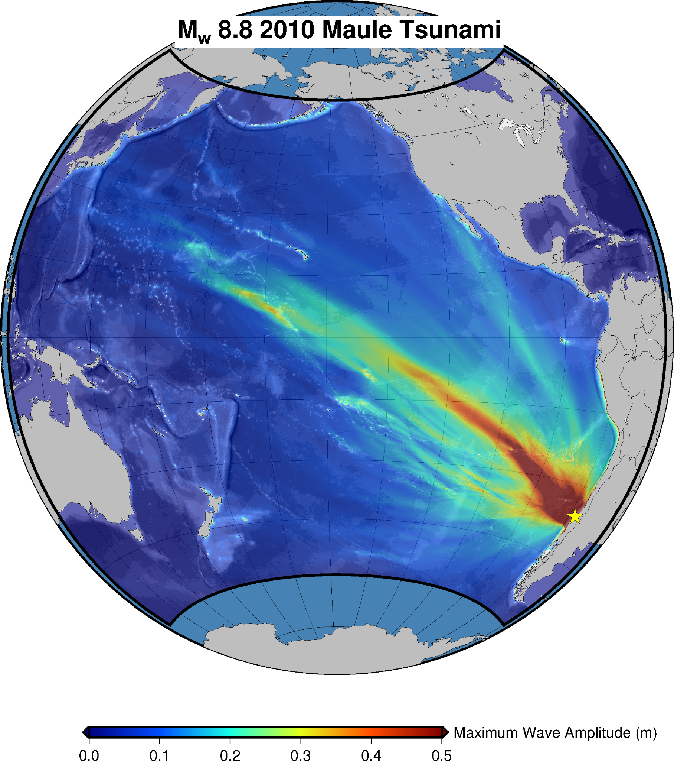
WP3 Objectives
WP3 aims to contribute to tackling societal challenges to make a step forward in defining concrete actions in which EPOS may provide added value for society.
Task 3.3
Enhancement + Interoperability
of services for several natural hazards
Task 3.1
Definition of ethical guidelines
Task 3.4
Interaction w/ operational stakeholders
Environmental impacts of the EPOS RI
Task 3.2
Notes:
Content slide

Slide 11
WP3 Objectives
WP3 aims to contribute to tackling societal challenges to make a step forward in defining concrete actions in which EPOS may provide added value for society.
This objective will be achieved:
Through both the enhancement and the integration of a suite of services existing inside some EPOS Thematic Core Services (TCS) to tackle specific societal challenges related to risk management. We will work towards the interoperability, achieved through the EPOS ICS-C or the new ICS-D, of: Earthquake, Tsunami, and Volcano Monitoring and Alerting; Operational Earthquake Forecasting; Rapid Multi-Hazard Post-Event Assessment. [Task 3.1]
By fostering innovation, learning opportunities, and dialogue between EPOS and the EU Union Civil Protection Knowledge Network (UCPKN) and other operational stakeholders in civil protection and disaster risk management. [Task 3.2]
Through the definition of ethical guidelines to direct EPOS actions towards society and through the development of a codified form aimed at describing the characteristics of products/services, their scientific/technological value for the benefit of society, their opportunities/risks when used by users. [Task 3.3]
By identifying how the environmental impacts of the EPOS RI over its technological life cycle can be reduced and how the data made available by the thematic communities can contribute to the monitoring of climate. [Task 3.4]
Notes:
Content slide

Slide 12
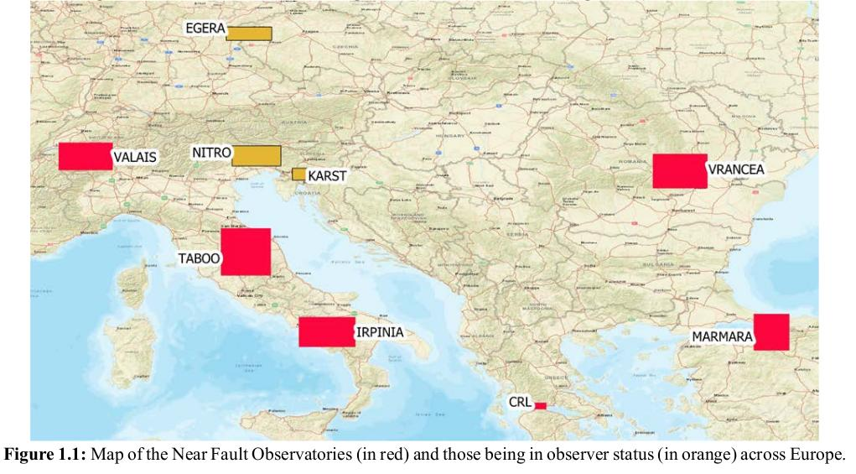
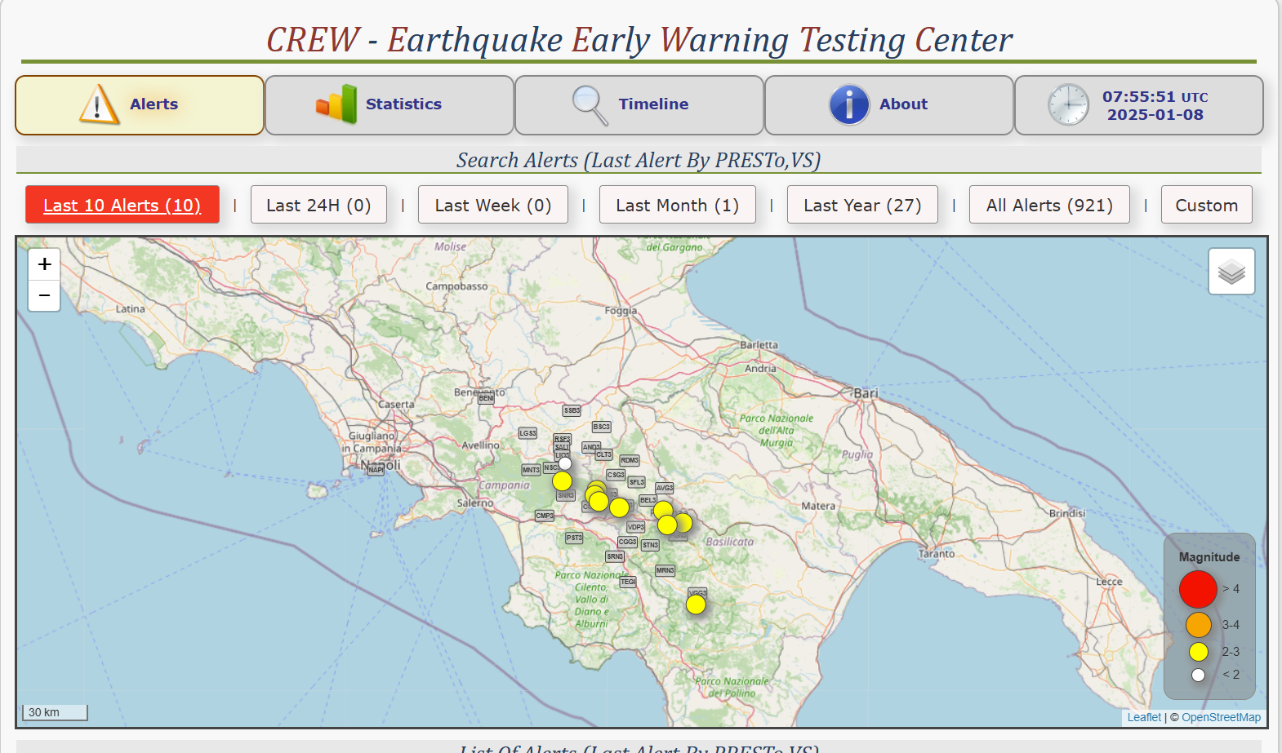
Subtask 3.1.1
Subtask 3.1.1 Earthquake Early Warning Support (EEWS) services (UNINA, INCDFP-RA, NOA, ETH Zürich) - The activity is grounded on the existing Early Warning Testing Center (CREW) and Near-Fault Observatories (NFO) infrastructures. We want to enhance the service by: including the capacity of manage data from different NFOs and extending the testing center to other NFO; including and testing different EEWS algorithms (e.g., Finder, QuakeUp); developing a Decision Module to compare outputs and select the optimal EW message.
Data and alerts from different NFOs integrated within the testing centers (CREW, others)
The NFOs are long term RIs that strive to provide multidisciplinary and high resolution near fault data.
Testing new advanced EEW methodologies
(Impact-based, physics-based, RT extended source)
CREW is the testing center for EEW techniques managed by TCS-NFO within EPOS
Develop a decision module for optimal EEW issued alerts
(link to the stakeholders)

Slide 13
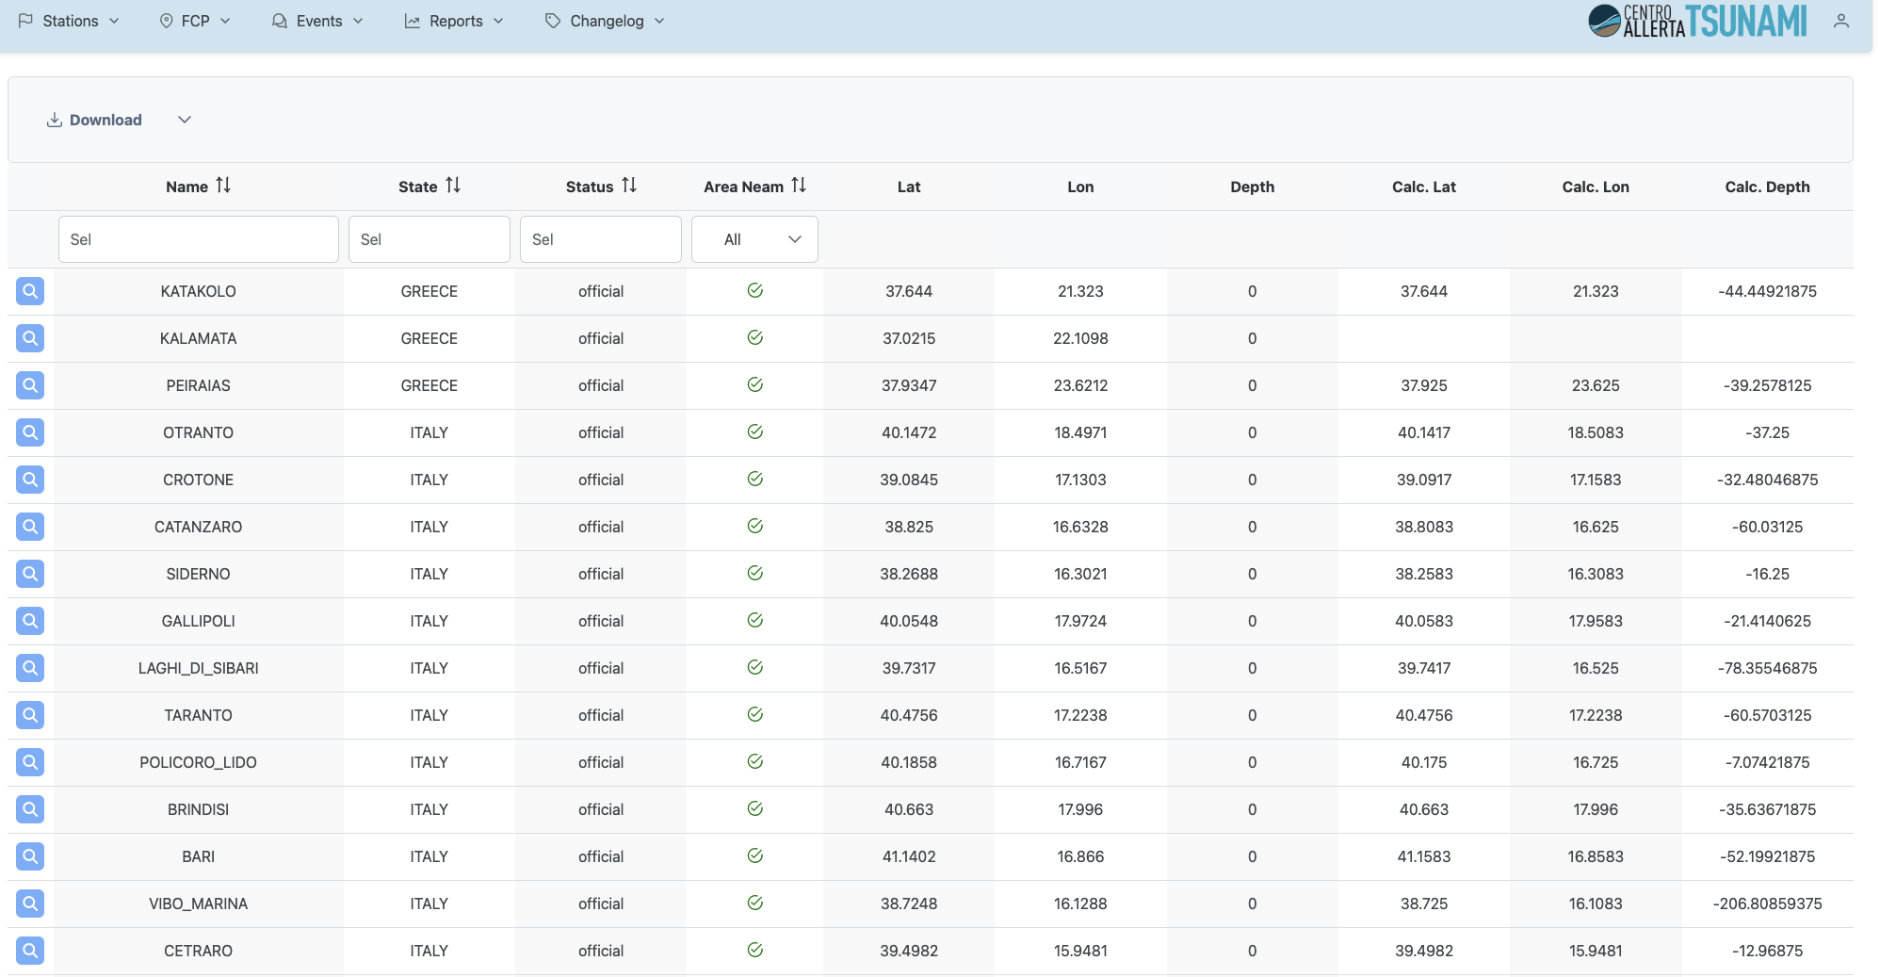
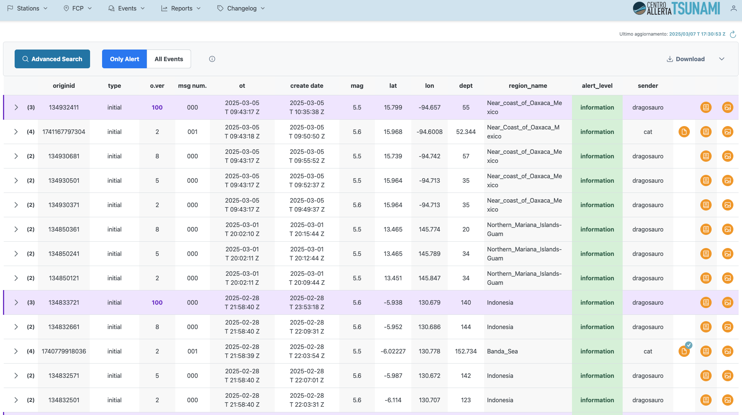
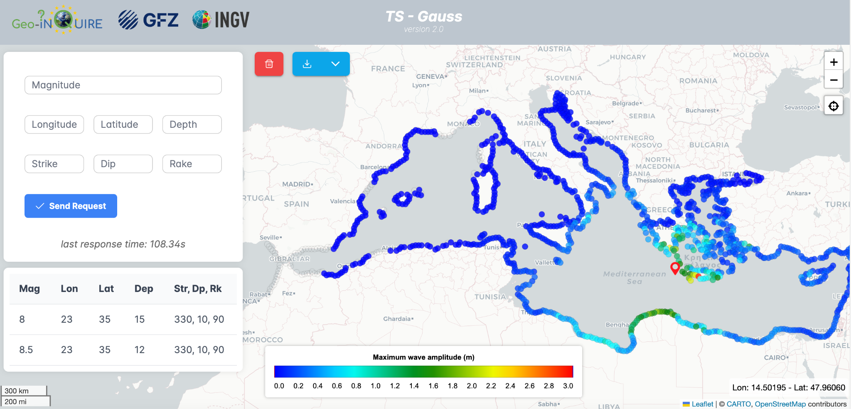
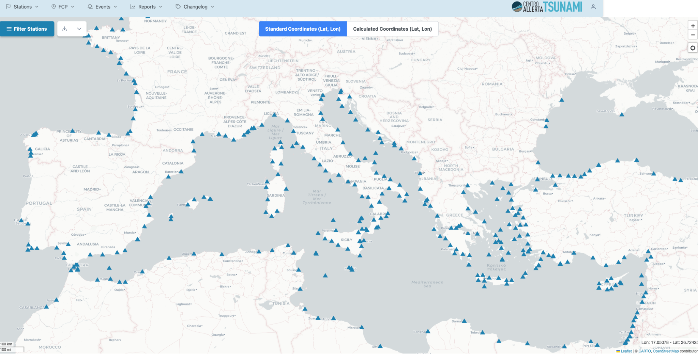
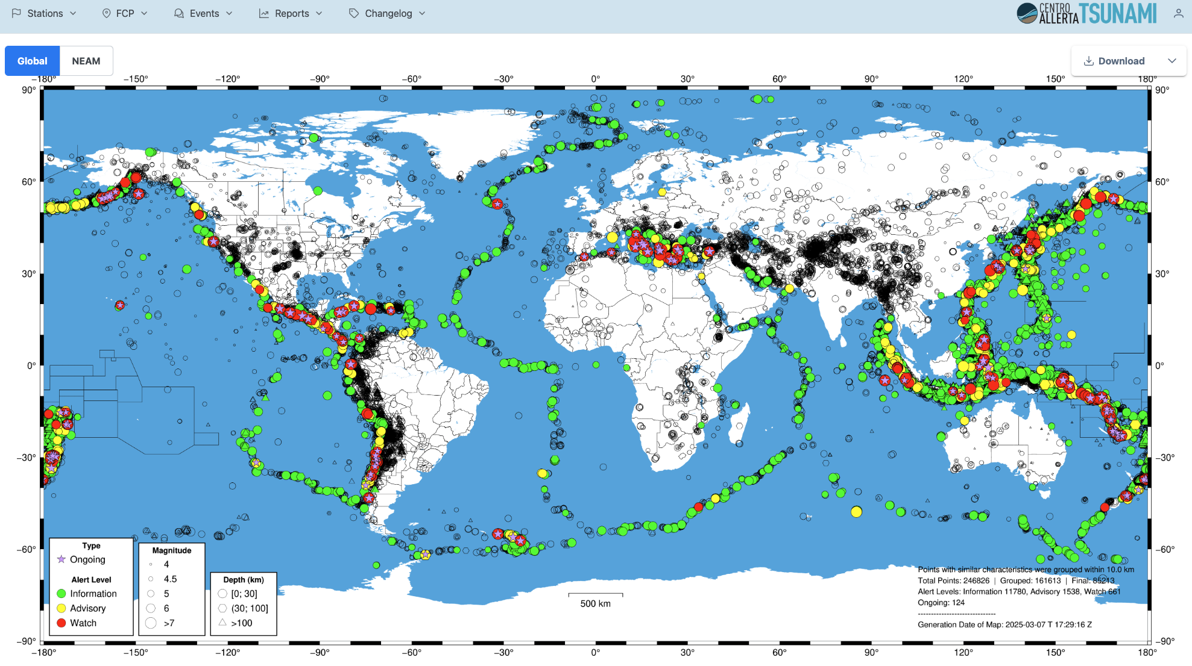
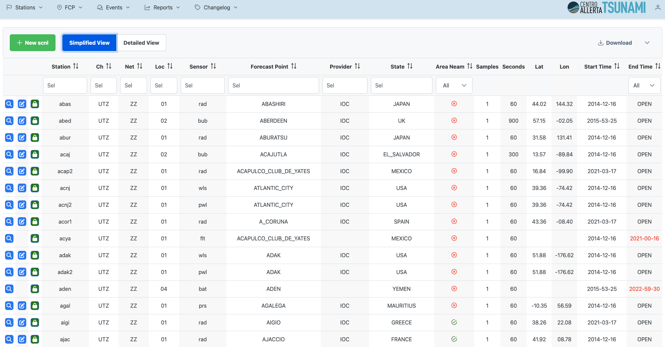
Subtask 3.1.2
Subtask 3.1.2 Tsunami Early Warning Support services (INGV , NOA, GFZ, KOERI, VLIZ) - The activity will regard the enhancement of the TSP-IOT (Tsunami Service Provider InterOperability Tool) running prototype for Tsunami Early Warning support services virtual access (VA).
Simulations
Forecast points and sensors
Earthquake parameters and alert messages
helps Tsunami Service Providers to be more
increases
TSP-IOT
Redundancy
Fallback solutions
Interoperable
Consistent

Slide 14
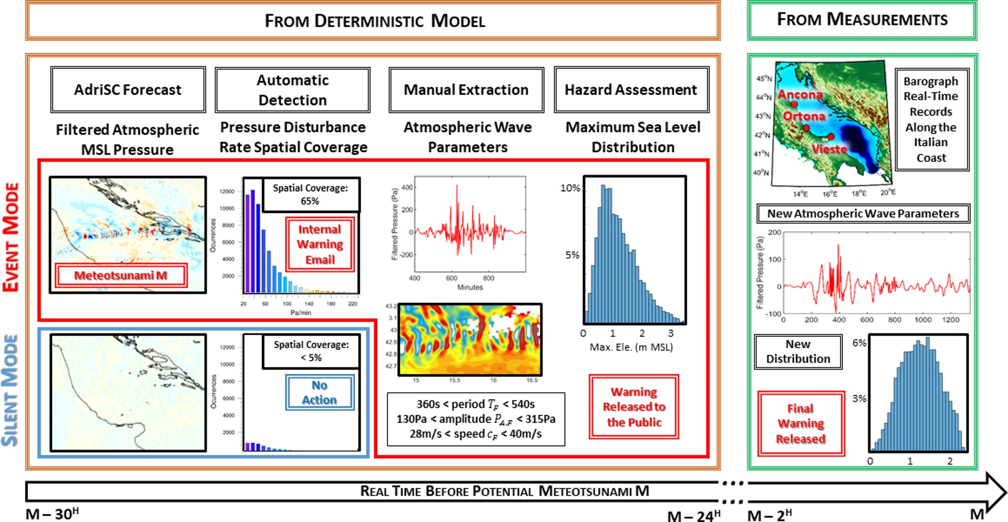
Subtask 3.1.3
Prototype services for improved meteotsunami early warnings to be implemented and tested on specific areas along the Croatian coastline.
This include methods and workflows for daily deterministic forecasts with the possibility of delivering warnings 24 hours in advance; stochastic hazard assessments; observational database.
Notes:
Content slide

Slide 15
Subtask 3.1.4
Improvement of the GEM OQ impact tool for rapid post-event impact assessment of earthquakes and associated secondary hazards
Improvement of GEM exposure models by incorporating the temporal component (e.g. the time of the day and season variations)
Development of a European database of damage-dependent fragility and vulnerability models
PAGER Yellow alert
PAGER Red alert
PAGER Red alert
Event occurs
Information release
(no redistribution)
Information update
GEM triggers
event-response protocol
1-7 days
Notes:
Content slide

Slide 16
Subtask 3.1.5
Quantification of the environmental impact of earthquakes in Europe based on state-of-art exposure, vulnerability and hazard models
Make additional data publicly available for Europe on the GEM GitHub repositories: https://github.com/gem/global_embodied_carbon_model, https://github.com/gem/global_exposure_model (at administrative level 1)
Improve interactive web services accessible via the EPOS Built Environmental Data (BED) service: https://builtenvdata.eu
Production
Construction
Use and Maintenance
End of Life
Beyond Life
A1-A2
A3
A4-A5
B1-B2
B3-B5
C1
C2-C4
D
Raw material supply and transport
Manufacture products
Transport to site and installation
Use and maintenance
Repair and refurbishment
Deconstruction and demolition
Waste transport, processing and disposal
Recovery,
reuse, recycling potential
Source: RMI
B6-B7
Operational energy and water
Embodied
Operational
Whole Life Cycle
Notes:
Content slide

Slide 17
Subtask 3.1.6
Subtask 3.1.6 Support services and data products for rapid earthquake infographic (ETH Zürich) - Development of a rapid infographic for media in the context of a destructive earthquake occurrence; that tool will be useful tool for conveying information to the public in an easily digestible and visually compelling format.
Review best practices for rapid earthquake information displays with a focus on
Operational earthquake forecasting
Rapid impact assessments
Initial information after an earthquake
Product testing
Based on evaluated research gaps, we will design and test prototypes.
Guidance
We will compile a guide with practical recommendations on how to best present rapid earthquake information to the media and the public.
Notes:
Content slide

Slide 18
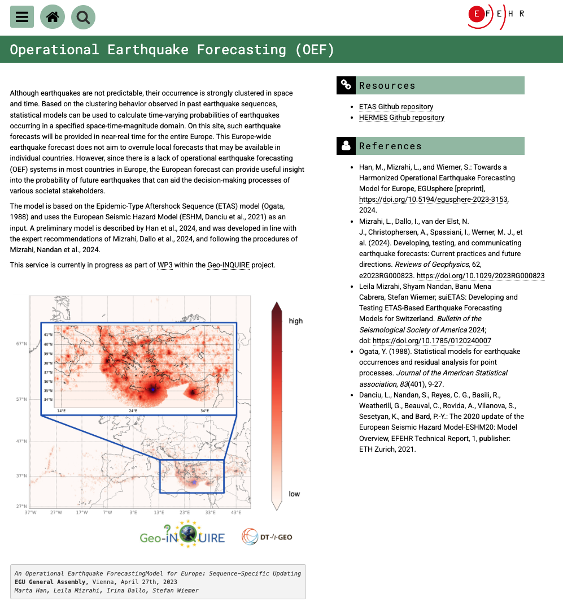
Subtask 3.1.7
Subtask 3.1.7 Support services and data products for earthquake forecasting (ETH Zürich) - Development of an online platform on which standard earthquake forecasting models are made openly available to the earthquake forecasting developers’ community. The platform will contain a suite of models which can serve as a basis for the development of improved models, and they can serve as well as a benchmark to assess the forecasting skill of newly developed alternative models.
Publicly available Operational Earthquake Forecasting (OEF) services (including forecasts, visualizations, and test results) for Europe and Switzerland are being built within DT-GEO and GeoInquire.
Within EPOS-ON, we want to make available not only forecasts and forecast test results, but also the models used to create those forecasts, to enable transparency and reproducibility.
Such sharing of models has been recently been deemed an important next step by worldwide earthquake forecasting experts (Mizrahi et al., 2024)
Milestones
MS23: Web-platform to Access to Earthquake Forecasting Models, documentation and data, alpha version (M18, Demonstrator)
MS24: Service access to Earthquake Forecasting Models and Benchmark against data (M18, Demonstrator)
MS28: Web-platform to Access to Earthquake Forecasting Models, beta version (M24, Demonstrator)
MS35: Web-platform to Access to Earthquake Forecasting Models, final release (M36, Final release)
MS36: Service access to Earthquake Forecasting Models and Benchmark against data (M36, Demonstrator)

Slide 19
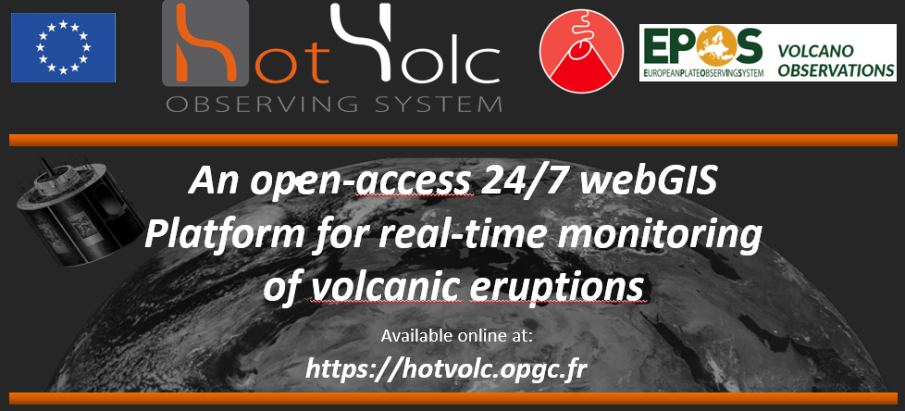
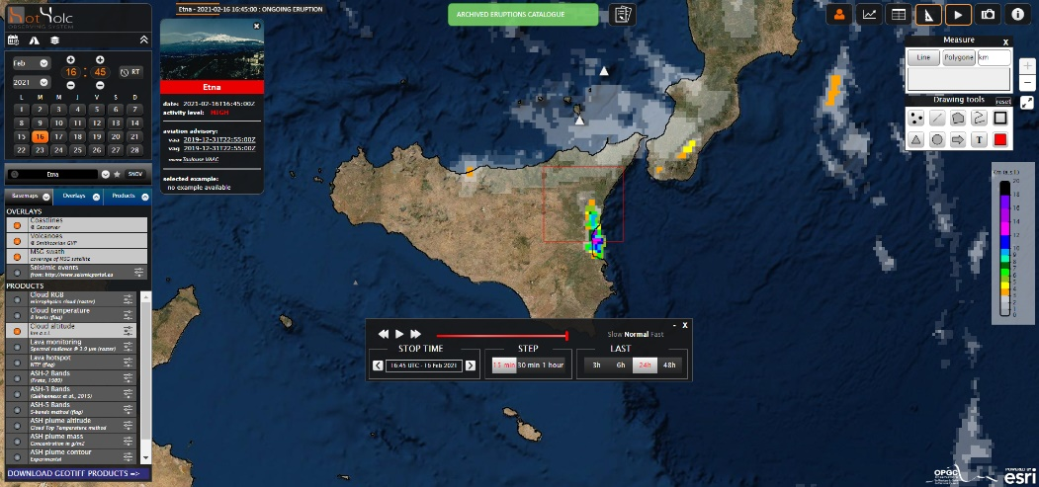
Subtask 3.1.8
Subtask 3.1.8 Prototype service for early ash-/gas-dispersion warning (UCA, IMO, INGV) - The activity will be based on HOTVOLC, a real-time 24/7 WebGIS monitoring system of active volcanoes in real-time
Data and simulations integration from two operational services to provide an integrated service using the
HOTVOLC
webGIS Platform
Virtual Access Interface
Many users’ tool interfaces: GIS edition tool, animation window, snapshots, eruptions reports, seismic events, etc.
i) Tephra and volcanic SO2 dispersion forecasting service for Icelandic volcanoes
Daily simulations (1-72 hours step): evolution of transport and concentration of volcanic products in the atmosphere;
ii) Prediction of tephra and ash deposition for hypothetical eruptions from Etna summit craters
Visualization of the simulations (deposit thicknesses and cumulative surface areas), updated 4 times a day (available on the INGV website)

Slide 20
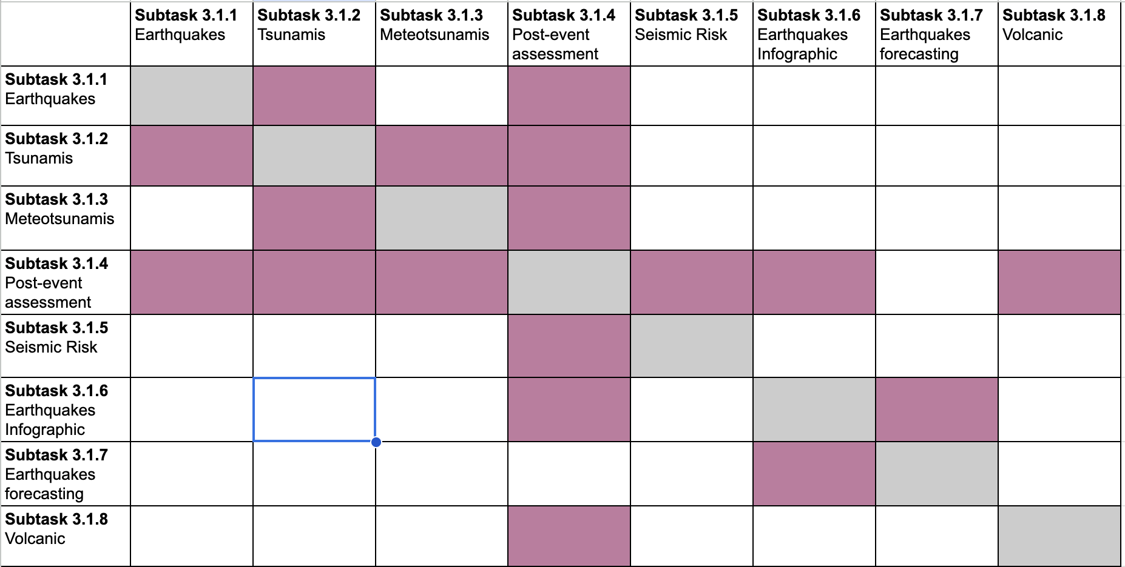
Interoperability’s Matrix
Interoperability between services

Slide 21
Task 3.2 Interaction with operational stakeholders in civil protection and disaster risk management
Task 3.2
Activities:
Internal brainstorming on the how research and users communities and stakeholders (e.g. Civil Protection Agencies) can be involved in the activities of EPOS ON (particularly with the services and products proposed in Task3.1) and what are the ethical references/guidelines for that (through the Task3.3).
Next steps agreed: i) to set a time-space diagramme where to position respectively products VS specific timeframe within the Disaster Risk Reduction and Disaster Risk Reduction framework; ii) to match the demonstrators (T3.1) with the T3.2 activities where both the parties involved (research communities and end-users/stakeholders) may identify gaps and needs and continuous areas for improvement; ii) to link the stakeholders engagement with the EPOS ethical dimension
Exploited the availability of the Union Civil Protection Knowledge Network (UCPKN) to support the planned activities. A meeting between EPOS and UCPKN will be organised soon.
Approached the European Response Coordination Centre (ERCC)
Notes:
Title slide for large pictures, tables, maps, plots…

Slide 22
Tasks 3.1 & 3.2
synergy
Challenges/Opportunities
Task 3.1 offers a great opportunity to enhance interoperable services related to risk management of natural hazards and integrate them in a multi-hazard risk management perspective, which is a great challenge
Stakeholders Engagement
Continuous feedbacks for Mutual Benefit
Endorsement and application from stakeholders
Knowledge network
Knowledge network
Objectives of Task 3.1 fit into Task 3.2 where the Knowledge Network is the formal tool to implement a roadmap
Roadmap for the services implementation
Knowledge Network
Notes:
Empty slide for large pictures, tables, maps, plots…

Slide 23
Task 3.3
Ethical issues related to the EPOS service provision to society
Activities:
Consolidating and improving an ethical framework for the EPOS community
The activity focused on the analysis of all comments and remarks made by members of the EPOS Ethics Working Group on the preliminary version of the document “EPOS Ethics Guidelines - draft version 1.0”.
As per indication of the EPOS ERIC Ethics Board, now this document has been renamed as “EPOS Community Position Paper on Ethics”.
The version 1.0 of this document has been prepared, which takes into account and integrates all the suggestions, modifications and additions reported by the members of the EPOS Ethics Working Group.
References to the responsible use of AI technologies have also been added to the document.
Deliverable D3.3 Recommendations for consolidation of EPOS Ethical Guidelines | M30 | February 2027
Notes:
Title slide for large pictures, tables, maps, plots…

Slide 24
Task 3.4
In parallel and on the basis of the requirements and indicators for monitoring defined by the UNI/PdR 147:2023 practice, an analysis of the ICS services and the technological infrastructure will be carried out in order to monitor digital sustainability as it is and based on the evolution which will require the new proposed thematic services.
The activity will end with the definition of a monitoring plan for the landscape of thematic services (TCS) and integrated services (ICS) both in operation and ex-post and developing an overview of the level of environmental and digital sustainability of the entire EPOS infrastructure.
Notes:
Empty slide for large pictures, tables, maps, plots…

Slide 25
Thank you for your attention!
name.surname@email.something
www.epos-eu.org/on Social media #EPOSon
Notes:
Thank you slide

Slide 26
Notes:
Logo only

