Slide 1
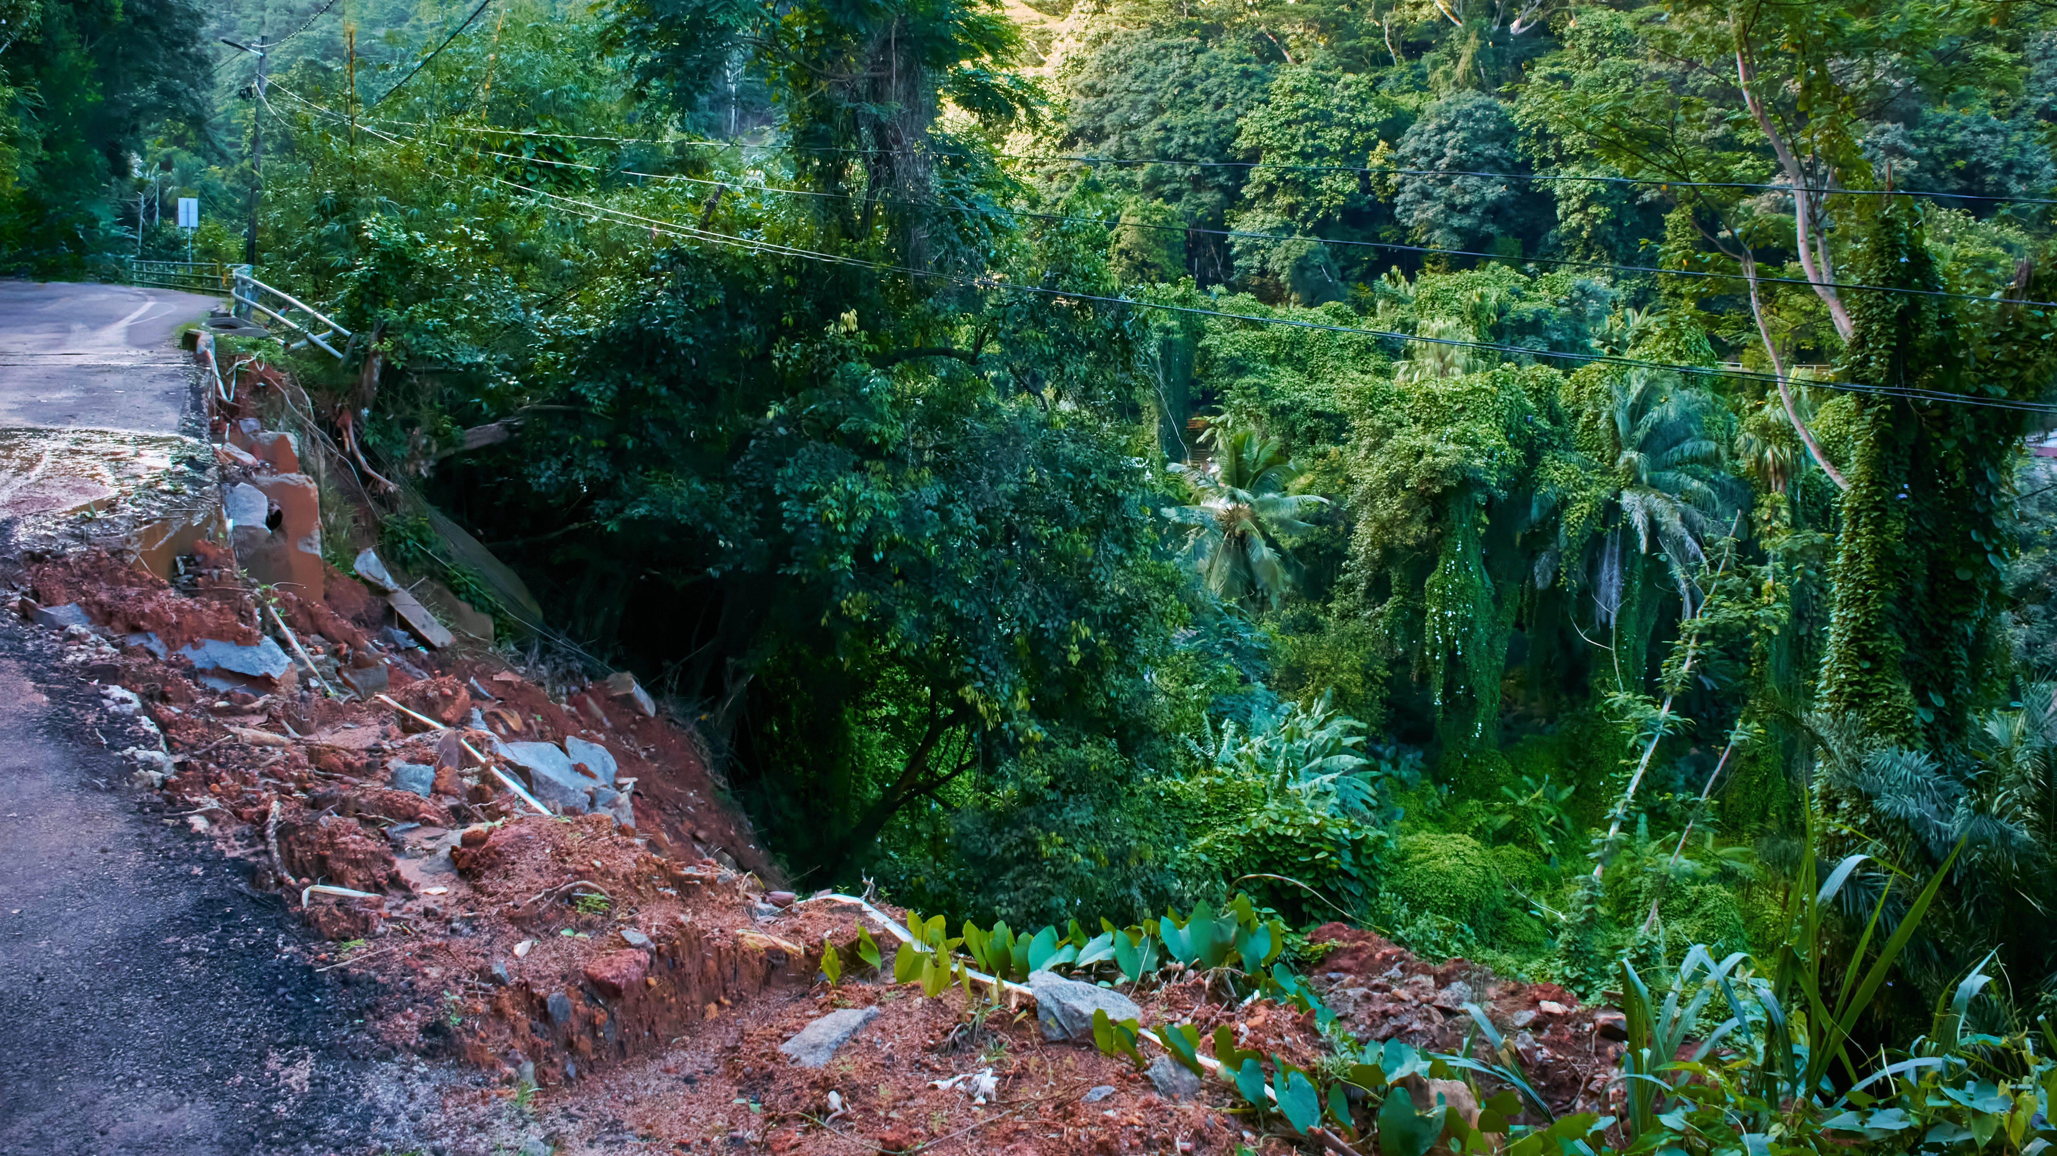
EPOS
Africa Cooperation on
Geo-Hazard Risk Reduction
EPOS Partners Meeting, Italy | March 17-20, 2025
Gatkuoth Kai, PhD
Regional Coordinator for Africa, Disaster Risk Reduction and Recovery for Building Resilience, UNDP, Resilience Hub for Africa

Slide 2
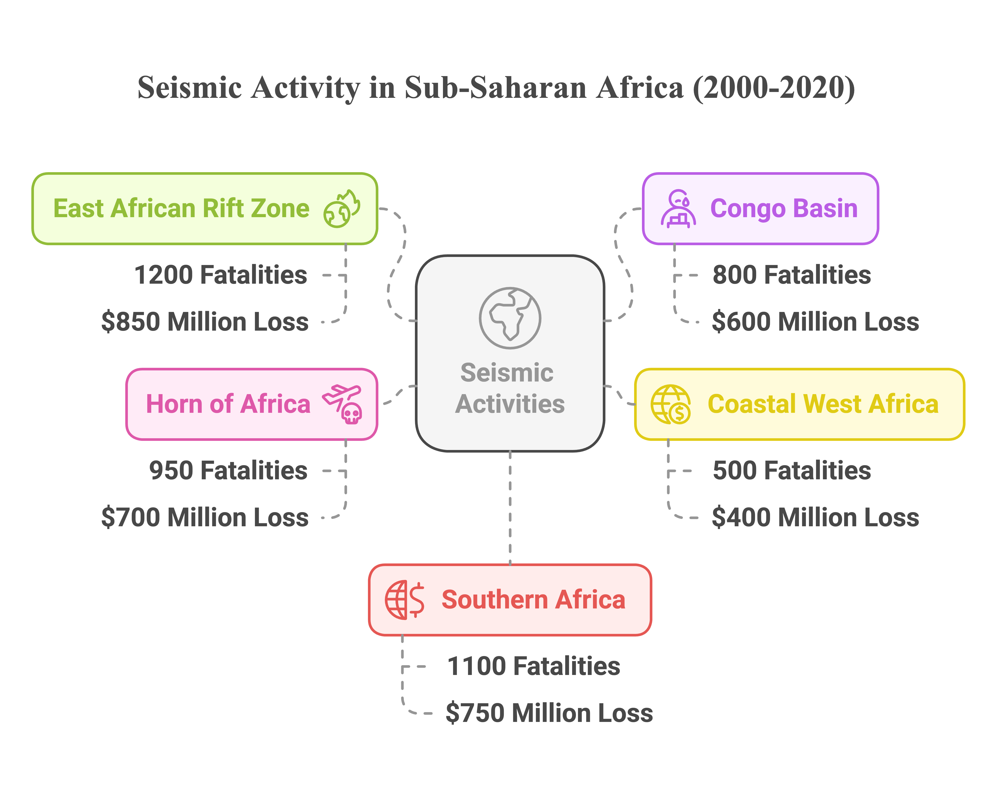
Overview of Africa's Multiple Geo-Hazards
Africa faces multiple geological hazards – notably earthquakes, volcanic eruptions, and landslides – with uneven risk distribution.
(Okwesilia et al.2024)-questjournals.org

Slide 3
Overview of Africa's Multiple Geo-Hazards Con’t
Selected Chronicle of Volcanoes and Landslides
• ⛰️ Landslide (2023) – Oromia, Ethiopia: 229 deaths, Economic loss in millions (homes, farms, infrastructure) (Reliefweb.int 2024)
• ⛰️ Landslide (2019) – Cyclone Idai, Zimbabwe: 340 deaths, $622M in infrastructure loss (worldbank.org,2019)
• ⛰️ Landslide (2019) – Bafoussam, Cameroon: 43 deaths, Loss of homes and farmland (millions USD) (Wantim et al.2023)
• ⛰️ Landslide (2017) – Freetown, Sierra Leone: 1,141 deaths, $80M in rebuilding costs
• 🌋 Volcano (2011) – Nabro, Eritrea: 31 deaths
• ⛰️ Landslide (2010) – Bududa, Uganda: 358 deaths
• 🌋 Volcano (2002) – Nyiragongo, DRC: 147 deaths, Estimated $100–$200M in losses
• 🌋 Volcano (1986) – Lake Nyos, Cameroon: 1,746 deaths, Villages abandoned
• ⛰️ Landslide (1991) – Phalombe, Malawi: 500–1,000 deaths, Economic losses significant but not fully assessed
• 🌋 Volcano (1977) – Nyiragongo, DRC: 600 deaths, 300,000 displaced

Slide 4
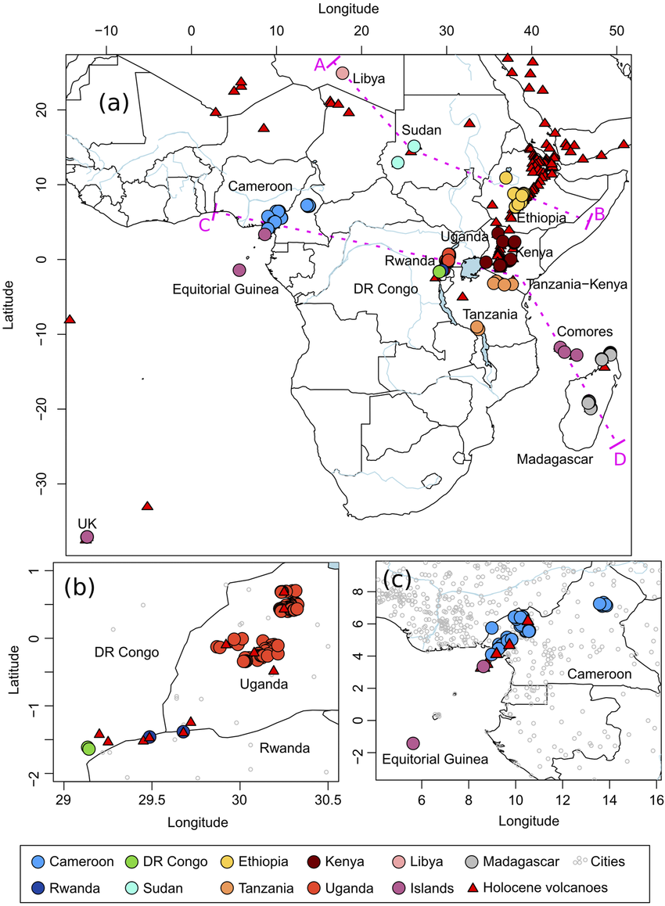
Hotspots of Geo-Hazards in Africa
(A) Location map of the African volcanic lakes, color-coded per country. The zoomed area mainly shows the lakes in Bunyaruguru, Ndali-Kasenda and Fort Portal volcanic fields in Uganda (B), and the Cameroon Volcanic Line (C). Holocene active volcanoes are exported from the Global Volcanism Program-Smithsonian database (https://volcano.si.edu/).
(right) Map showing the location of permanent AfricaArray seismic observatories (white triangles and blue circles) and permanent seismic stations operated by other organizations (red triangles). (left) Map showing the location of project-specifi c seismic networks that have been installed to image lithospheric structure along the southern margin of the Congo Craton (red stars) and mantle structure under the western side of the East African Plateau (white and black circles) (Andrew A. Nyblade et.al 2008)

Slide 5
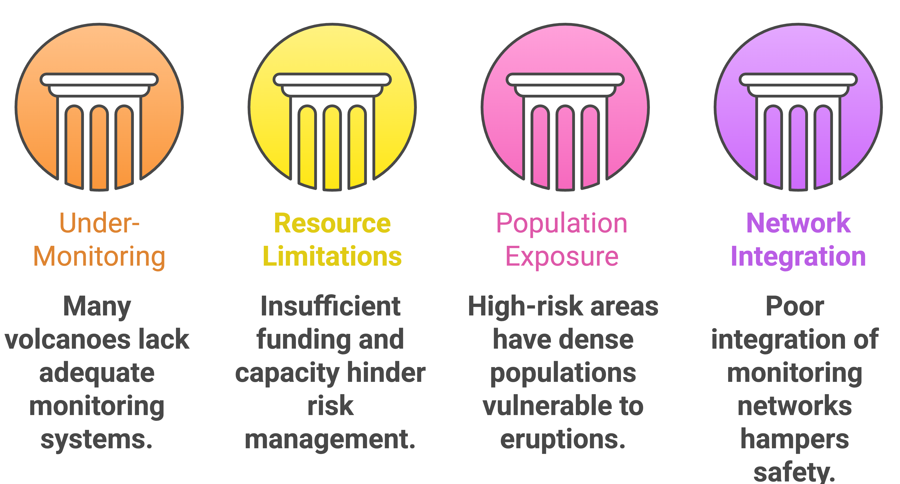
Gaps in Geo-Hazard Risk Reduction in Africa
Many active African volcanoes are under-monitored, including Nyiragongo & Nyamulagira (DR Congo) and Mt. Karthala (Comoros)
Lack of ground-based instruments, real-time data sharing, and early warning systems
High population exposure in hazard-prone areas, e.g., Goma (1M+ people at risk). Rising trends of encroachment to mountains and valleys
Weak integration of geo-hazard EWS to MHEWS and preparedness:
⚠️ Lack of integration of Early Warning Systems (EWS) for multiple hazards increases vulnerability.
Notes:
This slide highlights on the gaps and challenges of Geo-Hazard Risk Reduction in Africa
- On integration of MHEWS: You can reference how the recent heavy rainfall activities have led to land slides in Central and Southern parts of Tanzania. Stress on the lack of integration of the Early Warning Systems for different hazards.

Slide 6
Entry points for Collaborations

Slide 7
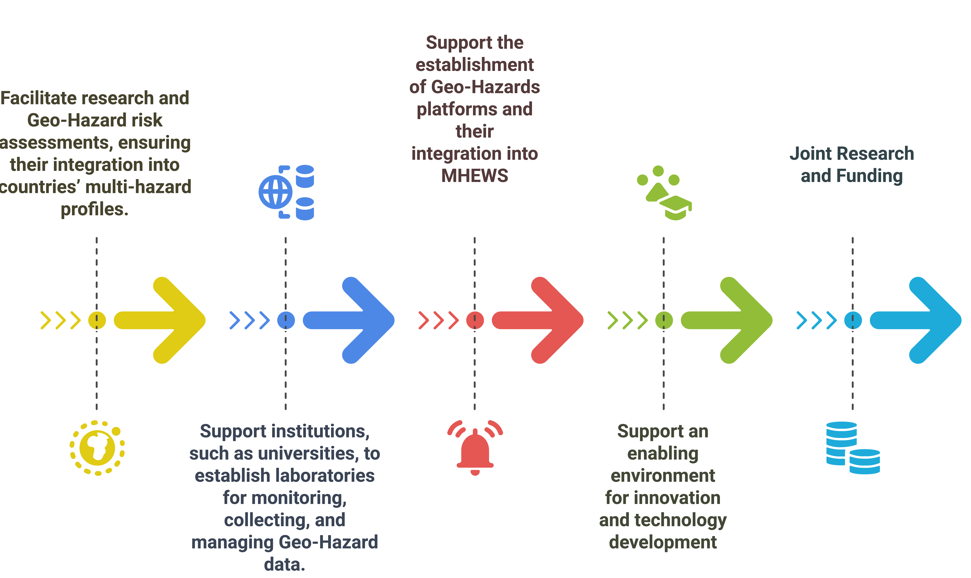
Areas of potential Collaboration: EPOS-UNDP
Strengthened Geo-Hazard Monitoring in Africa
Notes:
- Important to highlight the need for integration and having multi hazard focus and approach

Slide 8
Conclusion
The African continent is one of the tectonic plates where only a few earthquakes have been reported.
Insufficient data has hindered efforts to accurately assess seismic hazards.
Considering the tectonic setting, reviewing the continent’s seismicity is essential for predicting seismic risks
Strengthening Africa–EU cooperation on hazard risk reduction aligns with global goals like the Sendai Framework (2015–2030) and the UN’s 'Early Warnings for All' initiative
Building resilience in Africa not only saves lives and livelihoods locally but also contributes to global stability – a win-win scenario that justifies robust partnerships and knowledge exchange

Slide 9
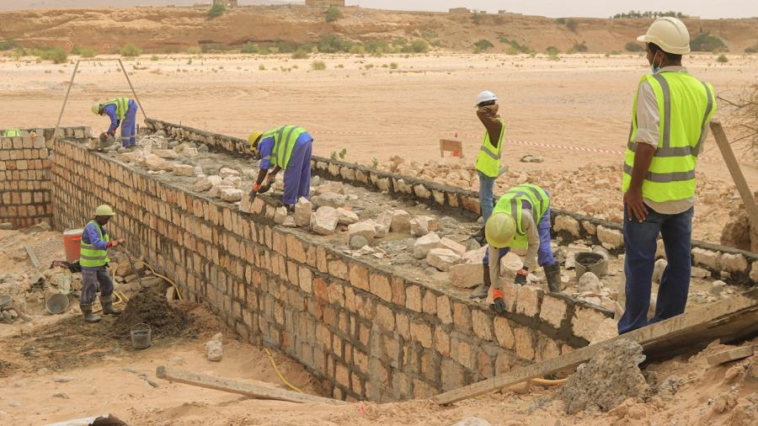
Thank you
Resilience Hub for Africa United Nations Development Programme UNON Complex Gigiri, Block N, Level 2
P.O. Box 30218-00100, Nairobi, Kenya
gatkuoth.kai@undp.org

