Slide 1
EU-LAC RESINFRA PLUS
A sustainable bi-regional collaboration in research infrastructures
EPOS DAYS 2025
Sabina Guaylupo – eu las resinfra plus project manager
FECYT, SPAIN
Perugia, 19 march 2025
This project has received funding from the European Union’s Horizon 2020 research and innovation programme under grant agreement nº 871140. This document reflects only the author’s view and the Commission is not responsible for any use that may be made of the information it contains.
1

Slide 2
EU LAC RESINFRA PLUS
project
The main goal of the EU-LAC ResInfra PLUS project is to lay down a sustainable framework of bi-regional EU and LAC collaboration on Research Infrastructures.
https://resinfra-eulac.eu/

Slide 3
Main Figures
EU LAC RESINFRA PLUS
HE Coordination and Support Action (CSA) – Policy coordination action
Call: INFRA DEV 2023 01-06
24 months duration: From 1/ 01/2024 – until 31/12/2025
Budget: 749.943,98€
Funding: 749.943,98€
19 Partners from LAC and EU + 1 affiliated entity

Slide 4
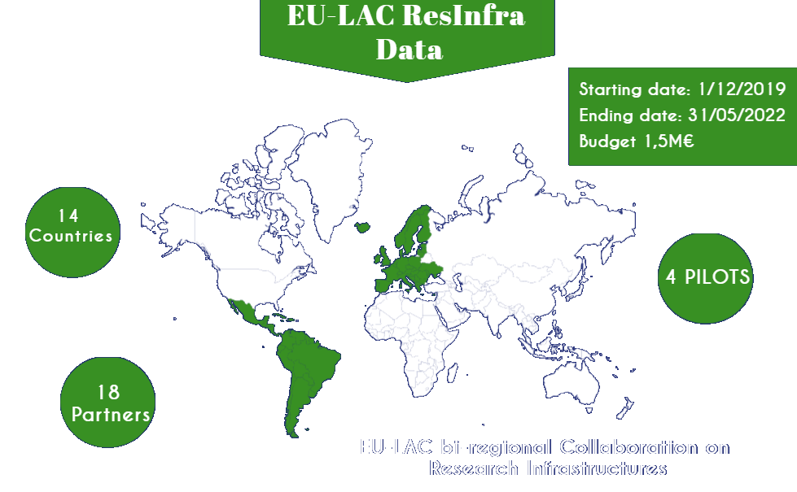
Startind date: 1/1/2024 Ending date: 31/12/2025 Budget: 0,75 M
15
countries
19
partners

Slide 5
EU LAC RESINFRA PLUS
Project Overview
 |  | Consortium composition
1 | MICIU | MINISTERIO DE CIENCIA, INNOVACION Y UNIVERSIDADES | ES
1.1 | FECYT | FUNDACION ESPANOLA PARA LA CIENCIAY LA TECNOLOGIA, F.S.P., FECYT | ES
2 | AUCI | PRESIDENCIA DE LA REPUBLICA | UY
3 | DLR | DEUTSCHES ZENTRUM FUR LUFT - UND RAUMFAHRT EV | DE
4 | FCT | FUNDACAO PARA A CIENCIA E A TECNOLOGIA | PT
5 | CNR | CONSIGLIO NAZIONALE DELLE RICERCHE | IT
6 | VTT | TEKNOLOGIAN TUTKIMUSKESKUS VTT OY | FI
7 | UEFISCDI | UNITATEA EXECUTIVA PENTRU FINANTAREA INVATAMANTULUI SUPERIOR A CERCETARII DEZVOLTARII SI INOVARII | RO
8 | SPI | SOCIEDADE PORTUGUESA DE INOVACAO CONSULTADORIA EMPRESARIAL E FOMENTO DA INOVACAO SA | PT
9 | CNPq | CONSELHO NACIONAL DE DESENVOLVIMENTO CIENTIFICO E TECNOLOGICO | BR
10 | Instruct-ERIC | INSTRUCT-ERIC | UK
11 | LifeWatch-ERIC | E-SCIENCE EUROPEAN INFRASTRUCTURE FOR BIODIVERSITY AND ECOSYSTEM RESEARCH | ES
12 | CIEMAT | CENTRO DE INVESTIGACIONES ENERGETICAS MEDIOAMBIENTALES Y TECNOLOGICAS | ES
13 | MICITT | Ministerio de Ciencia y Tecnologia de Costa Rica | CR
14 | MINCIENCIAS | MINISTERIO DE CIENCIA TECNOLOGIA E INNOVACION MINCIENCIAS | CO
15 | CITMA | MINISTERIO DE CIENCIA TECNOLOGIA Y MEDIO AMBIENTE | CU
16 | ANID | AGENCIA NACIONAL DE INVESTIGACION Y DESARROLLO | CL
17 | UVEG/MIRRI- ERIC | UNIVERSITAT DE VALENCIA | ES
18 | CONCYTEC | CONSEJO NACIONAL DE CIENCIA TECNOLOGIA E INNOVACION TECNOLOGICA | PE
19 | MINCYT | MINISTERIO DE CIENCIA, TECNOLOGIA E INNOVACION | AR
19 Institutions of
15 Countries
(7 EU & 8 LAC)

Slide 6
THE CONTEXT

Slide 7
BI-REGIONAL COOPERATION
The EU-LAC bi-regional cooperation in research and innovation has a long history and it is key in the political agenda of both regions.
CELAC: Community of Latin American and Caribbean States is a regional block of countries that intends to deep a Latin American integration.
May 2010:
Brazil decided to suspend its participation in January 2022.
Feb 2010:
CELAC is
created
6th EU LAC
Summit, Madrid
EU LAC
June 1999: 1st EU LAC
Summit*, Rio
de Janeiro
Knowledge Area
* 2nd meeting was carried out in Madrid in 2002, 3rd in Guadalajara,2004, 4th in Vienna, 2006 and the 5th was held in Lima in mid-May 2008

Slide 8
EU CELAC KNOWLEDGE AREA & JIRI SOM
EU CELAC
Knowledge Area
EU CELAC JIRI SOM
EU CELAC SUMMIT 2010
Priority
Initiative
The instrument
Declaración
Joint Initiative for R&I - JIRI
The VI EU LAC Summit, 2010 Madrid endorsed the development of the EU-LAC
An Action Plan was
launched chapter
The instrument for implementing the JIRI is the SOM: high-level Senior Officials from national bodies of the EU and LAC countries meet regularly in the Senior Official Meeting (SOM) with the objective to implement the EU-CELAC JIRI.
with an specific
devoted to Science, Innovation and technology together with the Joint Initiative for Research and Innovation (JIRI).
Knowledge
Area as a
the two
priority for regions.

Slide 9
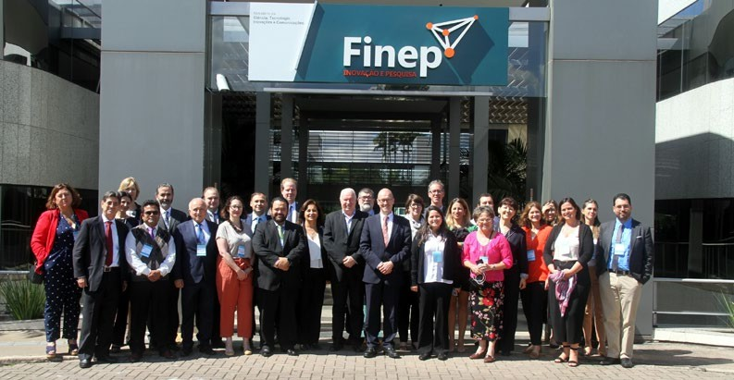
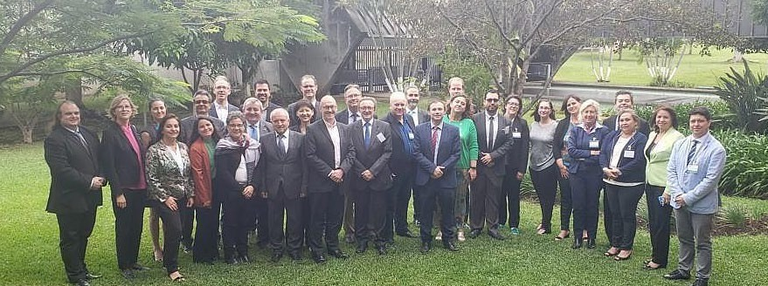
EU CELAC JIRI SOM & EU CELAC CRA
EU CELAC JIRI SOM Meetings
I
Brussels, 28-29 March, 2011
II
Chile, 20-21 March, 2012
III
Brussels , 16-17 April, 2013
IV
Costa Rica, 4-5 April ,2014
V
Brussels, 14 March 2016
RI is identified as a strategic pillar of EU CELAC CRA
VI
Brussels, 14 March, 2017
Establishment of a EU CELAC WG on RI
VII Mexico, 30 October 2020
VIII
Brussels, 28-29 November 2023
Next JIRI SOM – December 2025

Slide 10
EU CELAC JIRI SOM
V JIRI SOM Brussels 2016: "… the Parties acknowledged the political and socio-economic
VI JIRI SOM Brussels 2017: “(…) the
establishment of a aiming
EU CELAC WG on RI
importance to promote access to
Research
to ensure bi-regional policy coordination through sharing of good practices (…)”
Infrastructures of global interest (…)
Information exchange on EU-LAC policies and priorities
Identification of RIs with potential to strengthen bi-regional cooperation
Mobility of researchers
Global challenges
Research Infrastructures

Slide 11
EU CELAC JIRI SOM
EU CELAC JIRI SOM Meetings
VII
San Salvador, October 2017
Mexico, 30 October 2020
EU-LAC ResInfra
was key to support the mandate
VIII
of the EU-CELAC WG on RI.
IX Brussels, 28-29 November2023
X
Spain, December 2025 ?
EU-LAC ResInfra PLUS
will present the results
and recommendations to the JIRI SOM

Slide 12
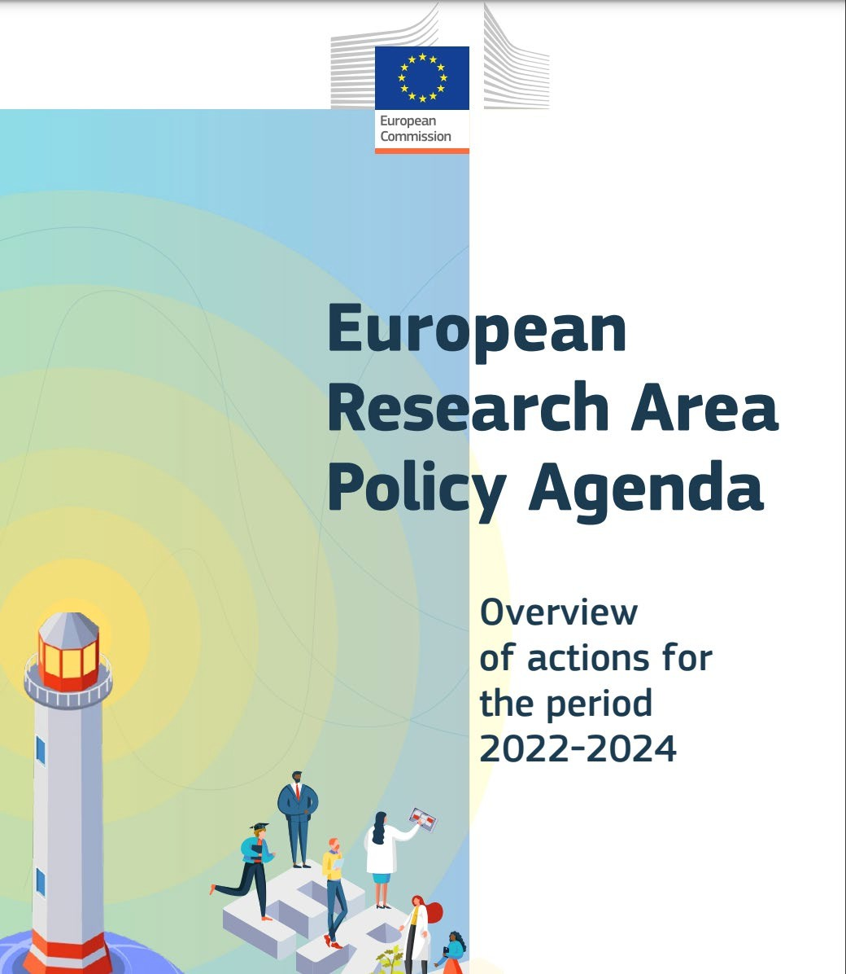
Moderador
2025-03-17 18:15:20
--------------------------------------------
https://ec.europa.eu/info/sites/default/files/research_and_innovation/strategy_on_research_and_innovation/documents/ec_rtd_era-policy-agenda-2021.pdf
“ERA policy Agenda”
https://ec.europa.eu/info/sites/default/files/research_and_inn ovation/strategy_on_research_and_innovation/documents/ec_ rtd_era-policy-agenda-2021.pdf
12

Slide 13
ERA POLICY AGENDA
The Council conclusions “Future governance of the European Research Area”, adopted on 26 November 2021, propose 20 specific ERA actions contained in the ERA policy agenda 2022-2024 which will be implemented on a voluntary basis by the member states, together with the European Commission and in cooperation with countries associated to the ‘Horizon Europe’ programme, with research, academic and business organisations, as well as with other partner countries where applicable.
13

Slide 14
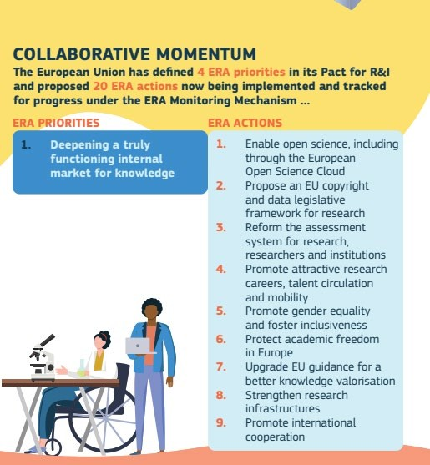
ERA Policy agenda 2022 - 2024
14

Slide 15
THE PROJECT (S)
15

Slide 16
The background: EU LAC RESINFRA project
PLATFORM
Platform with an updated list of LAC RIs elegible for bi-regional
cooperation
PILOTS EXCHANGES
10 staff exchanges, 5 pilots workshops,1st RI HPC administrator academy, Papers/publications, MoU signature
BENCHMARK
LAC Benchmarking report & EU RI relevant show cases report
PARTICIPATION IN EVENTS AND INITIATIVES
Participation in events and initiatives: ICRI2022, JIRI SOM, ESFRI, RedClara, CARLA22, REUNA, INTERCOONECTA, IEEE CLUSTER 2022, EU LAC
Foundation, LAC NCP Network, 4th Joint call EU CELAC Interest Group and other H2020/HE funded projects (RI-VIS, SINCERE,
COOPERATION MODELS
Analysis of the EU-LAC Cooperation models and
practices needs
EU LAC PERMED, MOSBRI, etc)
16

Slide 17
The background: EU LAC RESINFRA project
NETWORK
Network with RI NCPs
LAC countries
WORKSHOPS AND SEMINARST
5 Cooperation workshops and 2 online seminars around the 5 thematic areas prioritized by JIRI SOM: Health, energy, biodiversity & climate change, food security and emerging technologies
COLLABORATION WITH ESFRI RIS:
ERIC FORUM survey on ERICs interested in the LAC collaboration.
ERICS:EuroBioimaging/BB MRI/EATRIS/JIVE/EUIBISB A/EUSOLARIS/ EPOS/EBRAIN
SUSTAINTABILITY PLAN
Sustainability
Plan for the bi-regional collaboration on RIs

Slide 18
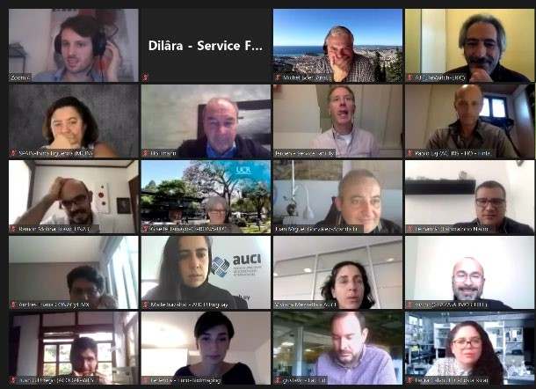
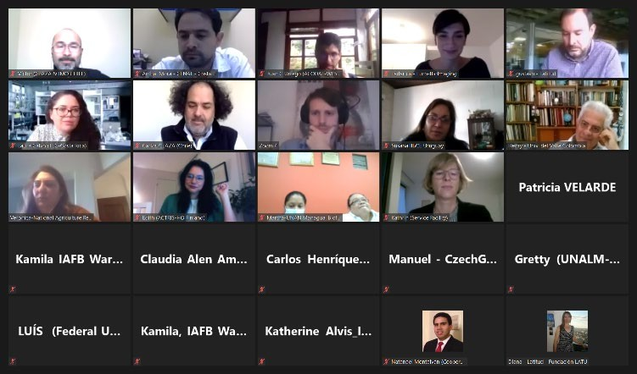
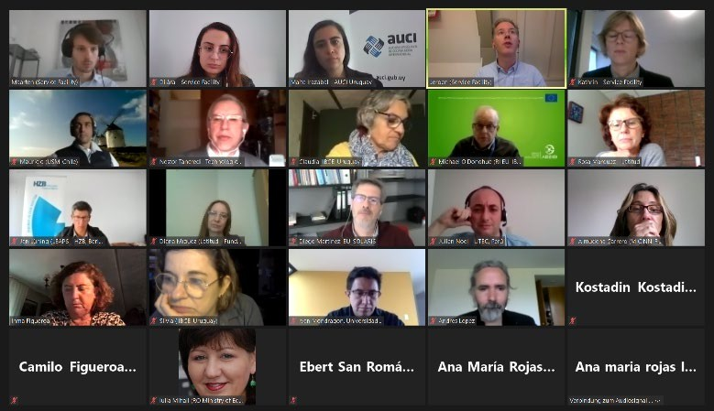
Support to the Working Group
Co-organizate activities of the WG supporting the Service Facility and participate actively in the Tandem Groups Workshops focusing on enhancing the bi-regional collaboration in the Scientific Areas prioritized, supporting communication between RI and WG members.
October & November 2020
5 thematic cooperation workshops:
health
energy
food security
biodiversity and climate change
Emerging technologies
10 Europe countries
11 LAC countries
50 institutions
160 participants

Slide 19
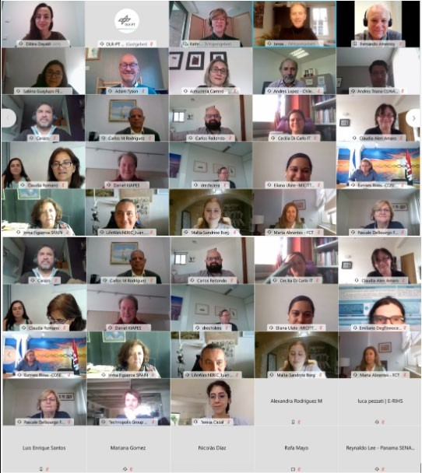
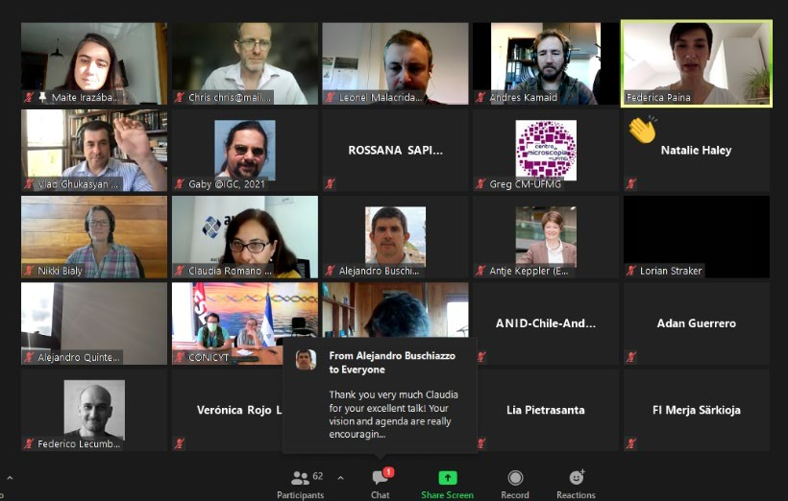
Online seminars
December 2020
Impact and best practices in EU-CELAC cooperation between RI
During the occasion examples of good collaboration practices between Research Infrastructures were given.
February 2021
“EU-CELAC cooperation on RI”
Impact and best practices in EU-CELAC cooperation between RI
“EU-CELAC cooperation on RI”

Slide 20
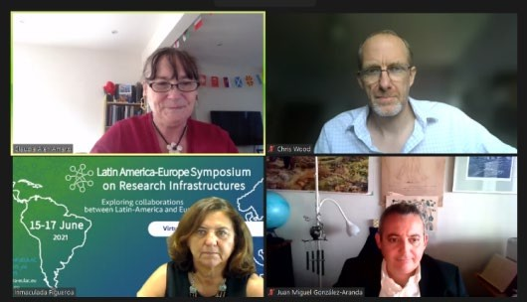
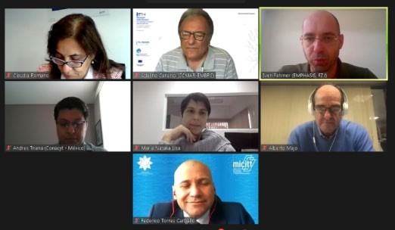
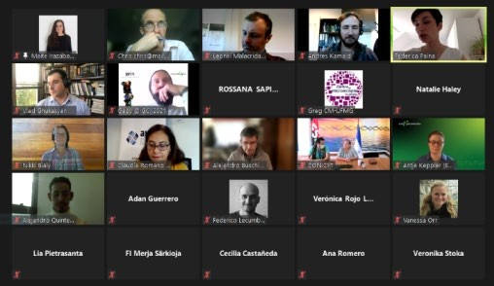
Online seminars
June 15-17th, 2021
“Latin America-Europe Symposium on Research Infrastructures“
RI-VIS & EU LAC RESINFRA projects
Registrations: 700
People who signed up and did attend: 316
June 18th, 2021:
"Latin American Bioimaging Network, facts, experiences, and challenges"·
Registrations: 100
20 countries
40 institutions

Slide 21
EU LAC RESINFRA: IMPACT
EU LAC RESINFRA PLUS
Increased the cooperation among RI fostering internationalisation
(MoUs signed)
Raising awareness of the importance of collaboration
ICRI Conference 2022
RI Conference under Spanish EU Council Presidency 2023
Shared best practices with
other initiatives (eBrain, EPOS ERIC, EU LAC
Interest Group, INTERCOONECTA)
Strengthening the links between RI and reserchers from EU and LAC (staff exchanges, events, workshops)
Proved the feasibility and convenience of birregional
collaboration
(pilots)
New call HE INFRA 2023- 2024 WP
Policy coordination
EU LAC RESINFRA PLUS

Slide 22
PROJECT ACHIEVEMENTS
The main outcome
The Sustainability Plan
The main output will be to draft a proposal for a stable framework of cooperation and a roadmap that will:
promote the internationalization of RIs from both regions,
reinforce EU-LAC cooperation
and perform human capital development and capacity building

Slide 23
EU LAC RESINFRA PLUS
EU LAC RESINFRA PLUS
The main goal of the EU-LAC ResInfra PLUS project is to lay down a regional EU and LAC collaboration on Research Infrastructures.
sustainable framework
of bi-
RIs sustainable framework of biregional cooperation
Keeping support the EU CELAC JIRI SOM & WG
on RIs
Building joint
& complementary RIs development where both regions can benefit
Increasing the visibility of both EU and LAC RIs

Slide 24
EU LAC RESINFRA PLUS ACTIVITIES FORESEEN IN 2024
WP1
WP2
WP3
WP4
WP5
EU- LAC RIs
Collection of good practices and lessons learned
EU-LAC collaboration guidelines.
4 Workshops (policy dialogue) in the field of health, food security, biodiversity & climate change and ICT
Cooperation Report.
Harnessing the potential of RIs to achieve Mission-Oriented Innovation
3 workshops (for managers and researchers)
Staff exchanges
Dissemination and communication activities and DC Plan
Dashboard
▪
New areas of
EU LAC
Collaboration
24

Slide 25
Thank you!
¡Gracias!
25
25

Slide 26
www.resinfra-eulac.eu
info@resinfra.eu
@Resinfra
@ Resinfra
@ Resinfra
@ Resinfra
26

