Slide 1
EPOS Days, Perugia, 17-20 March 2025
GNS Science Te Pū Ao and its GeoNet programme: a multi-peril, multi-domain open data infrastructure
Aotearoa New Zealand
Presenter: Elisabetta D'Anastasio Science Operations Technical Lead
Elizabeth (Libby) Abbott
Jonathan Hanson
Notes:
Top tip: Use an image relevant to your content, and preferably an ‘active’ image – show people / product / service (rather than a landscape) to hero your work and its purpose.

Slide 2
What we will cover
What is GNS Science
What is the GeoNet programme
Similarities and differences to EPOS
How we can collaborate

Slide 3
GNS Science - powering a
cleaner, safer, more prosperous future
for Aotearoa New Zealand.
GNS Science vision
Notes:
You may notice the Click icon to add SmartArt text in this slide – this is part of Powerpoint functionality, it won’t be visible in presentation mode.

Slide 4
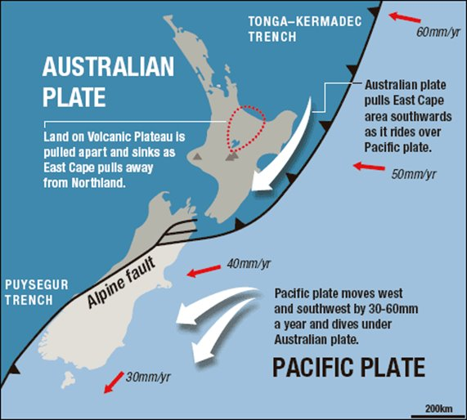
What is GNS Science Te Pū Ao
Crown Research Institute that carry out scientific research for the benefit of New Zealand across 4 main research areas (www.gns.cri.nz)
~500 employees across 6 offices (one in Japan)
Wide range of active international collaborations
Natural hazard laboratory, open data and open science

Slide 5
GNS Science and EPOS TCS potential collaborations areas
GNS interested in accessing Horizon funds (see e.g. https://www.gns.cri.nz/news/new-horizon-europe-project-to-advance-underground-hydrogen-storage/)
reach out if interested in the GNS Science roadmap and research areas "factsheets"

Slide 6
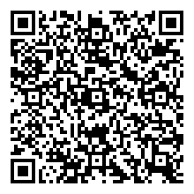
New Zealand Science Section reform
Jan 2025 | NZ government announced Science system reform
March 2025 | Transition Governance Groups formed
October 2025 | New Earth Science PRO is formed
2026 | PRO new legislative framework takes effect
GNS, NIWA (National Institute of Water and Atmosphere) and Metservice are coming together as a new organisation
From Crown Research Institute to Public Research Organisation (PRO)
New organisation will focus on Earth Sciences, climate and hazards resilience
https://www.mbie.govt.nz/science-and-technology/science-and-innovation/agencies-policies-and-budget-initiatives/refocusing-the-science-innovation-and-technology-system

Slide 7
GeoNet – Aotearoa New Zealand’s
national land and geohazards
monitoring system.
GeoNet 10 year Strategy 2024-2034
Notes:
You may notice the Click icon to add SmartArt text in this slide – this is part of Powerpoint functionality, it won’t be visible in presentation mode.

Slide 8
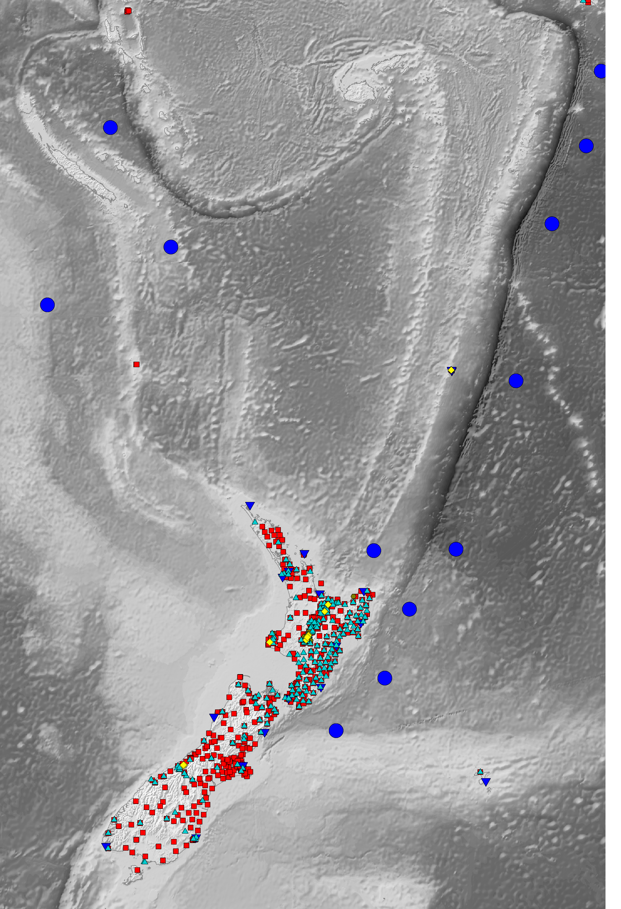
What is GeoNet
New Zealand's national land and geohazards data and monitoring system
Decadal programme run by GNS Science and funded by
NHC (government insurance cover against natural hazards)
LINZ (national mapping agency)
MBIE (ministry of economy, science, business)
NEMA (government agency for emergency management)
providing open data and readily accessible information and tools for geohazard risk management
Multi-hazard focus : earthquake, tsunami, volcano and landslide

Slide 9
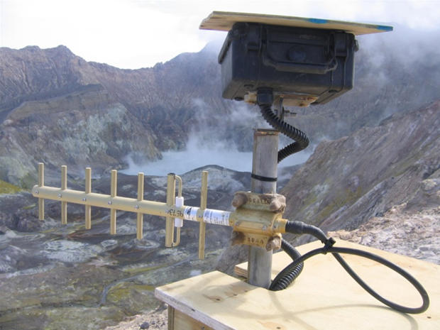
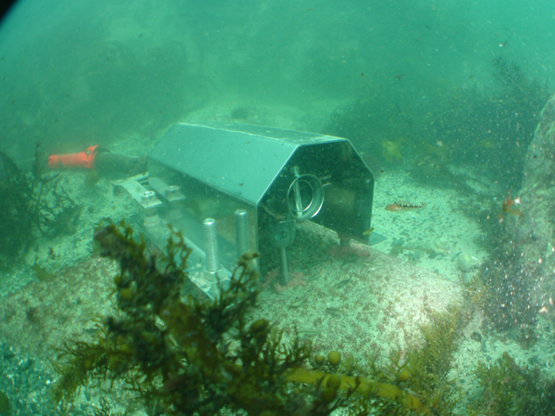
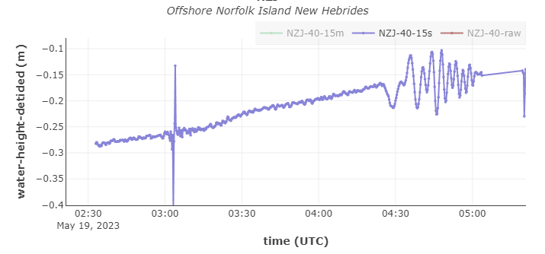
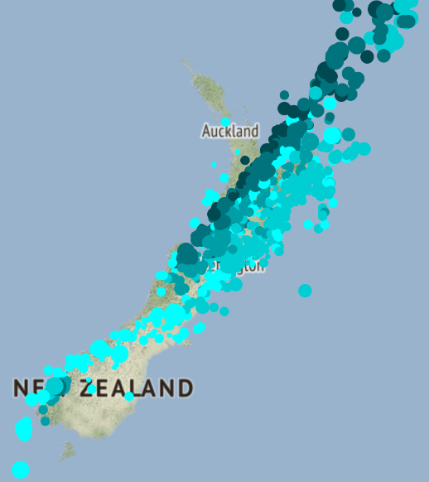
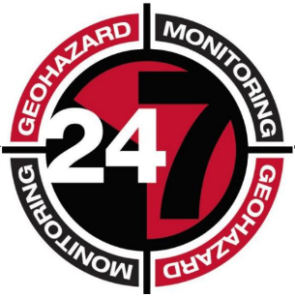
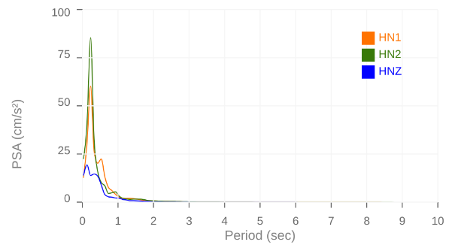
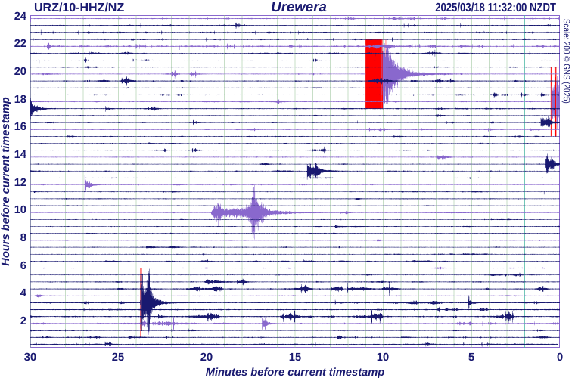
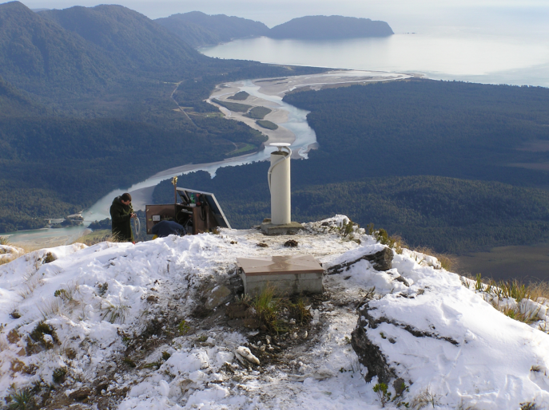
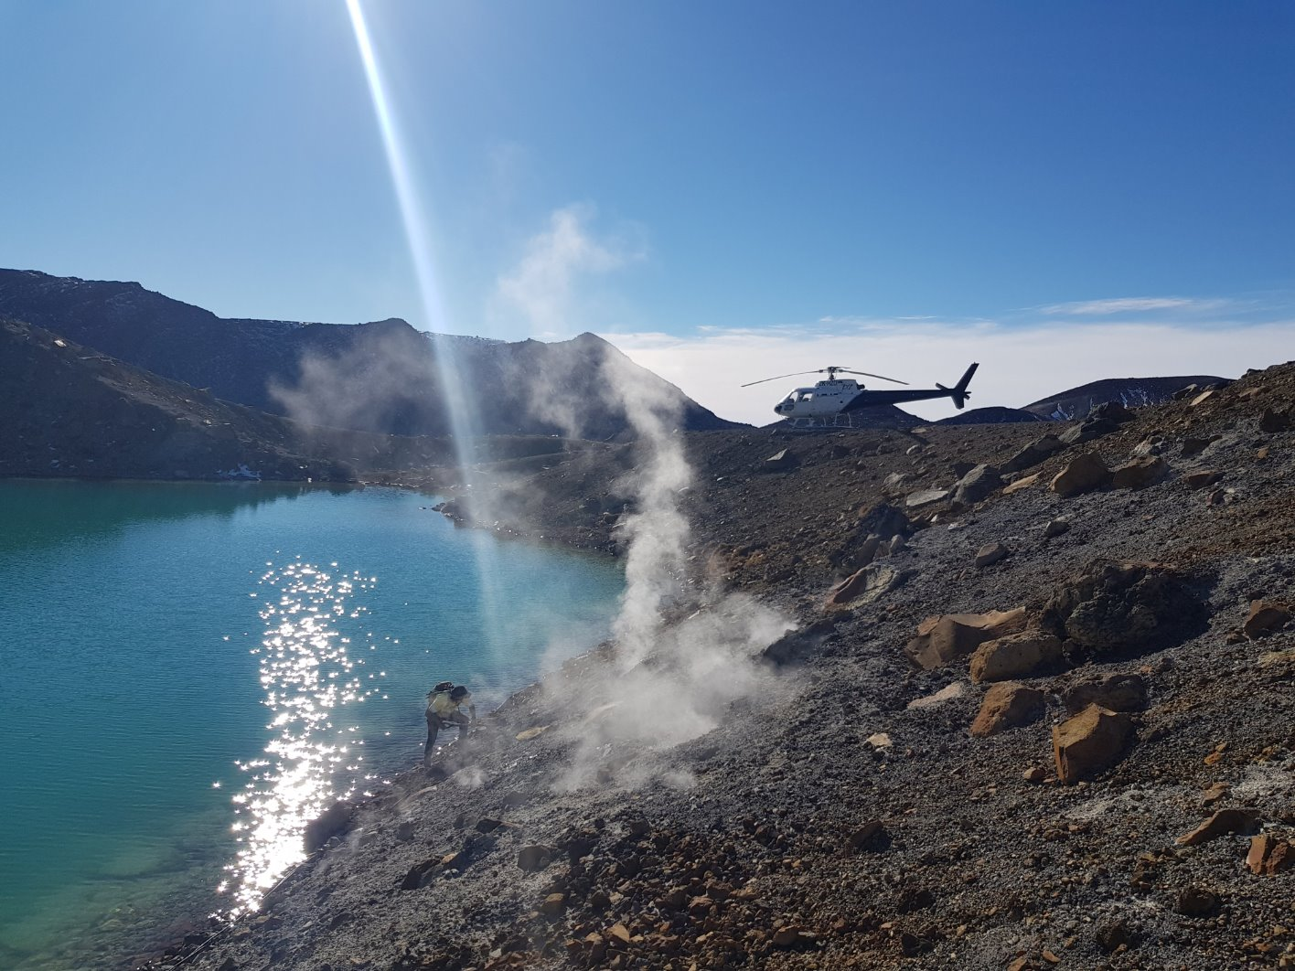
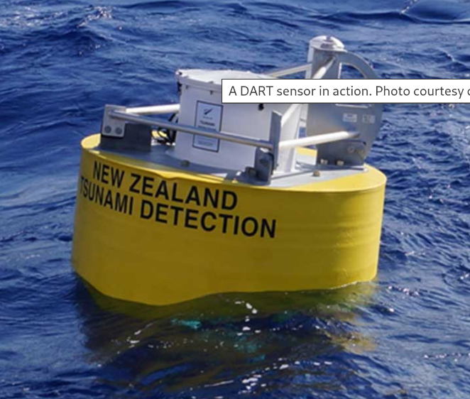
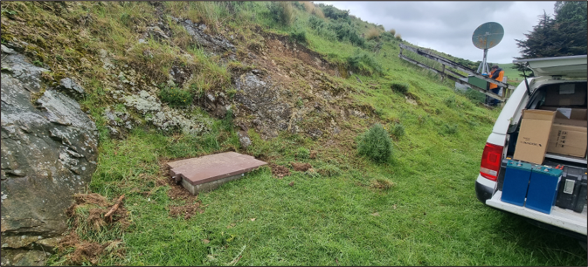
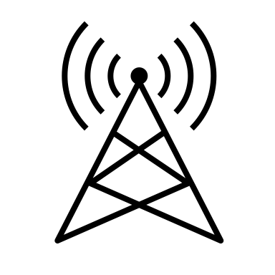
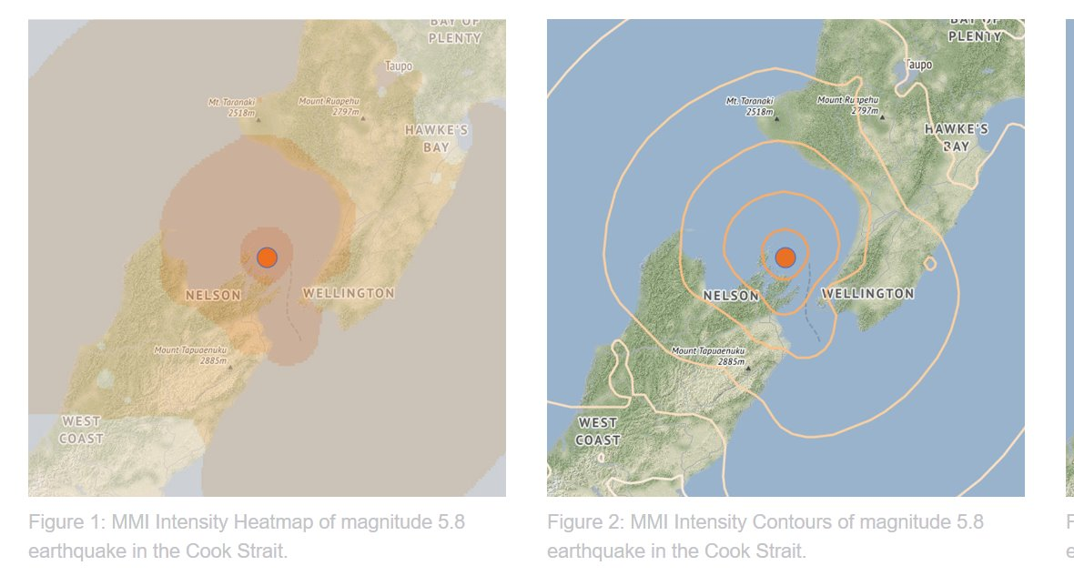
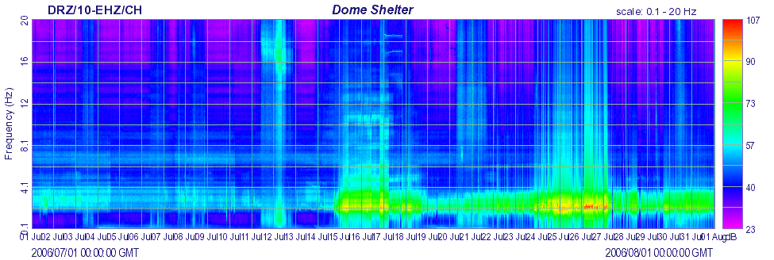
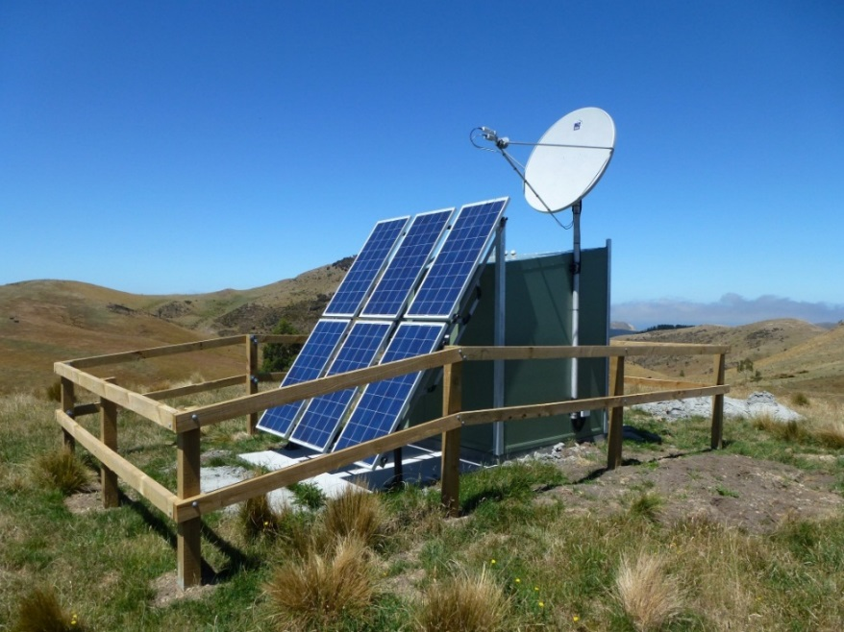
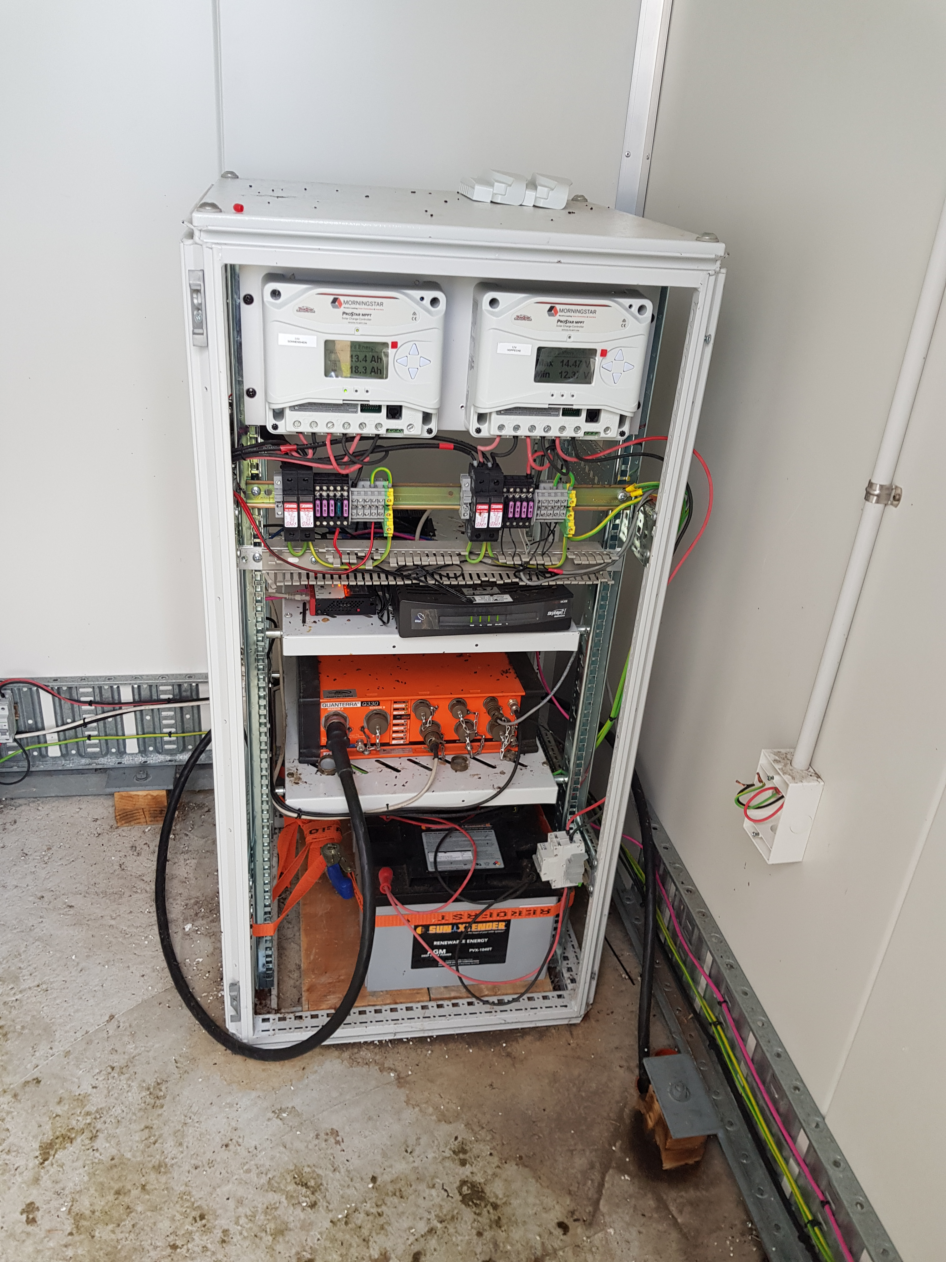
Multi-domain / multi-peril open data infrastructure
multidisciplinary data pipeline: from ground infrastructure to value-added products dissemination and 24/7 geohazards monitoring
Multi sensor network
Over 1000 sensors, from Antarctica to Raoul Island
Seismic
Infrasound
Coastal sea level
DART
GNSS
Cameras
Environmental sensors
Data transport
4 data collection centers
multiple layers of redundancy
fully automated
Data management center
Over 330 TB of data
Raw to derived data processing
Tiered services
Mix of in-house and science software
Fully automated
Data dissemination services
Raw and derived data
Standard and in-house web services
HTTPs
S3 (Open Data)
Datasets catalogue and DOIs
Tutorials
Data blogs
General public communications
Monitoring, response and Science Advice (with wider GNS)

Slide 10
How GeoNet operates
Core teams dedicated to data infrastructure:
~50-60 people across the programme
software developers, Dev/Ops engineers, science operations, data management, field engineers, 24/7 analysts
Research to operations – some successes and some challenges
Science advice and response management
Input from GNS Scientists on the 4 perils (earthquake, volcano, tsunami, landslides)
Service Delivery team
Programme management
Stakeholders engagement
Products and services catalogue
Science Operations and Data
Data custondiaship
User engagement
Data Science Platform
IT infrastructure and solutions
Science Systems Development
Software and IT infrastructure development
24/7 applications support
Science to operations
data center management
Data management
Science advice, on-call teams and expert panels
Scientific input
Duty teams
Peril expertise and science advice to government
Response advisory panels (Tsunami, Earthquakes)
Volcano Monitoring Group
Monitoring and response capability
24/7 monitoring center
Incident management system
Coordination of duty teams

Slide 11
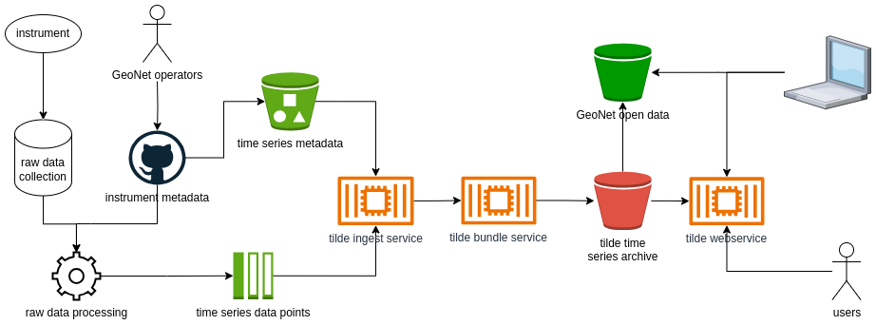
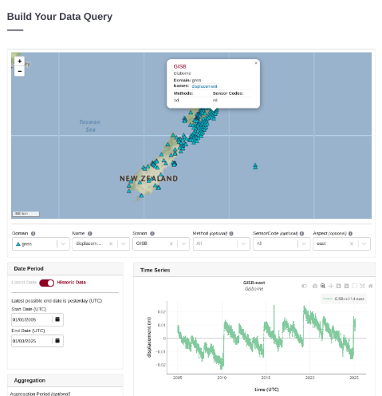
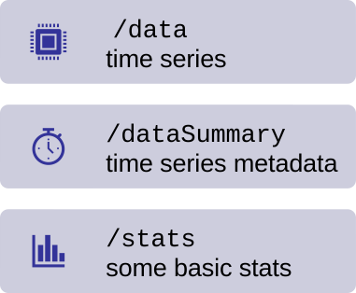
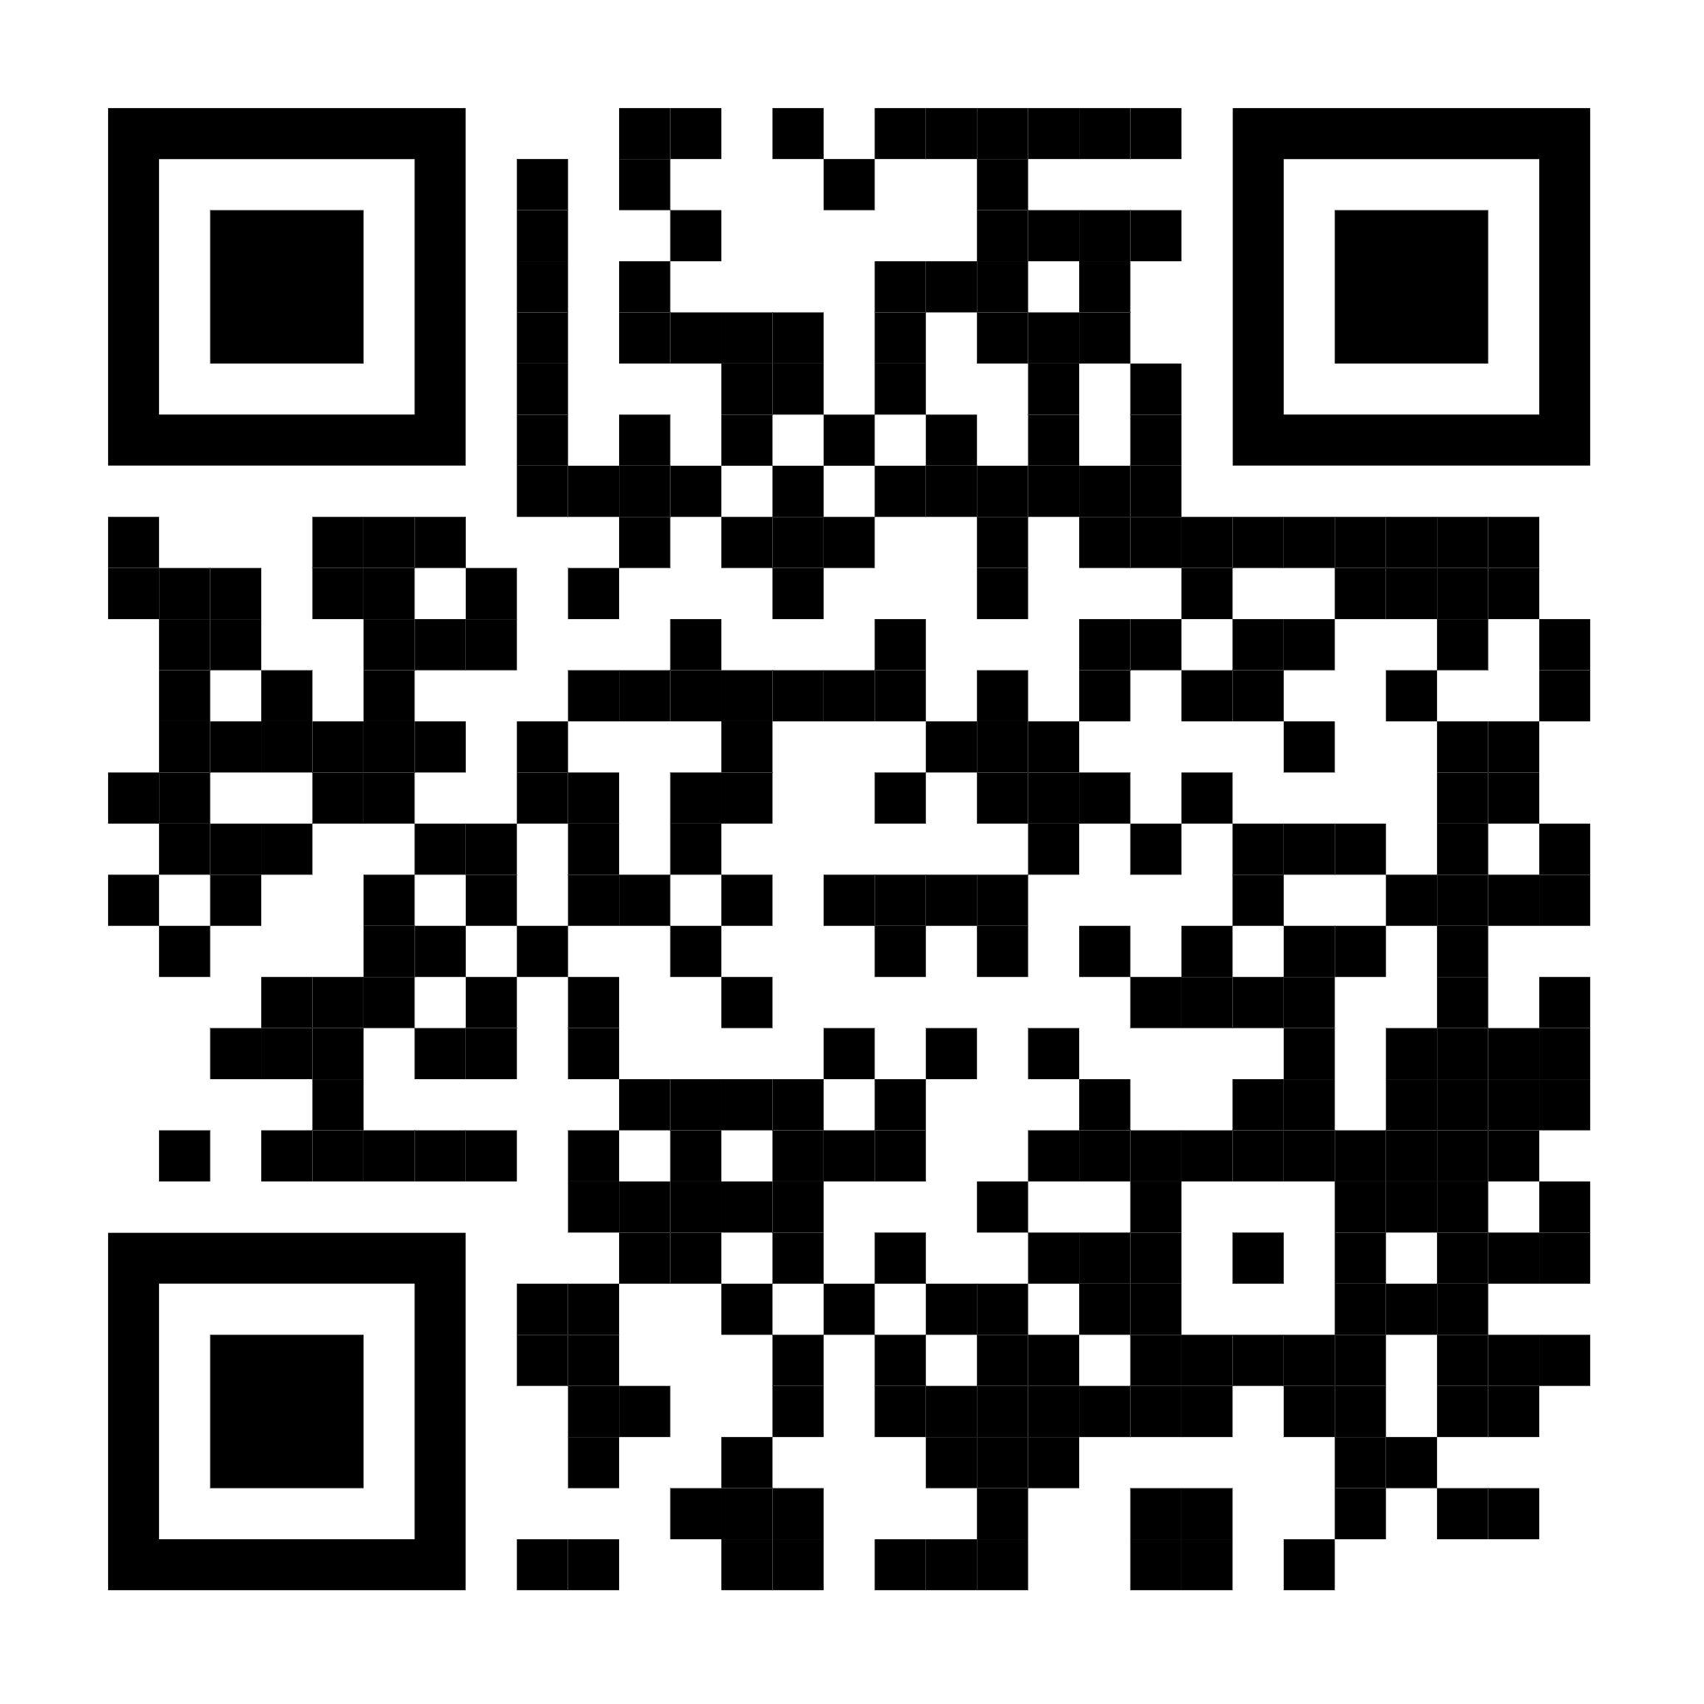
Highlights from some recent projects
Tilde, in-house developed multi-domain data access solution, built in AWS, used for tsunami, volcanology, geomagnetic and geodetic data
Other projects of potential interest
AWS Open Data programme (s3://geonet-open-data)
GeoNet data FAIR assessment and approach for minting DOIs
Low Rate Data Collection platform (used for volcano observations)
Shaking Layers and GNSS data collection and processing in AWS
Geomagnetic observatory data and space weather
https://tilde.geonet.org.nz/
Tilde
D'Anastasio et al.
Bull Volcan 2024

Slide 12
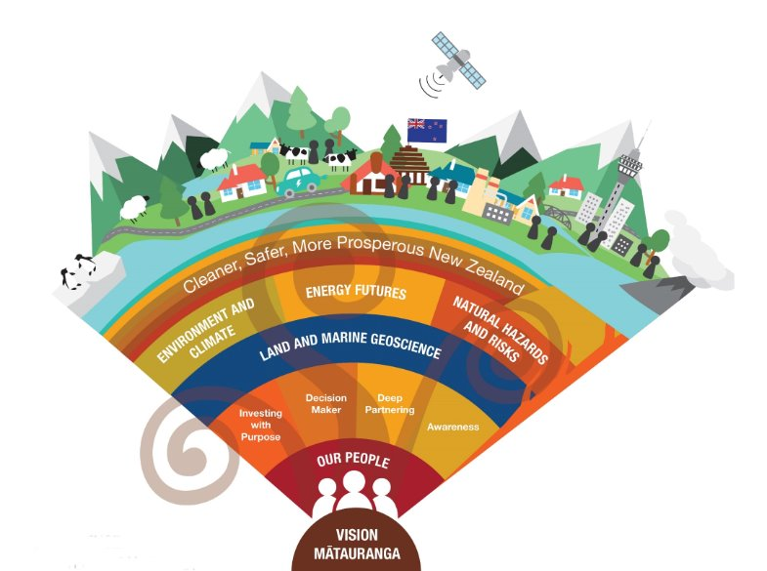
GNS/GeoNet and EPOS TCS, ideas for collaborations
domain specific collaborations:
EPOS-ERIC: multidisciplinary data access mechanisms and web services / APIs
Seismology: earthquake catalogues management, solutions for strong motion data, seismic data quality assessment, ML ready datasets, large data volumes on S3
GNSS Data and Products: modern geodetic data dissemination services
Volcano Observations: volcano monitoring data dissemination and interoperability
Geomagnetic Observations: geomagnetic observatory data dissemination, geomag as a key space weather monitoring dataset, space weather monitoring (nascent)
Tsunami: DART and tsunami monitoring gauge data services, Global Tsunami Models
Near Fault Observatory: knowledge exchange
interdisciplinary topics:
Technical workshops; knowledge and solutions sharing
Facilitate users migration to the cloud
Common geophysics data hub
Multidisciplinary / multi-peril data harmonization (through EPOS-DCAT-API?)

Slide 13
Thank you, kia ora!
GNS Science Te Pū Ao and its GeoNet programme: a multi-peril, multi-domain open data infrastructure
e.danastasio@gns.cri.nz

