Slide 1
AuScope’s DLT and some perspectives from “down under”
Dr Tim Rawling – CEO
  March 2025

Slide 2

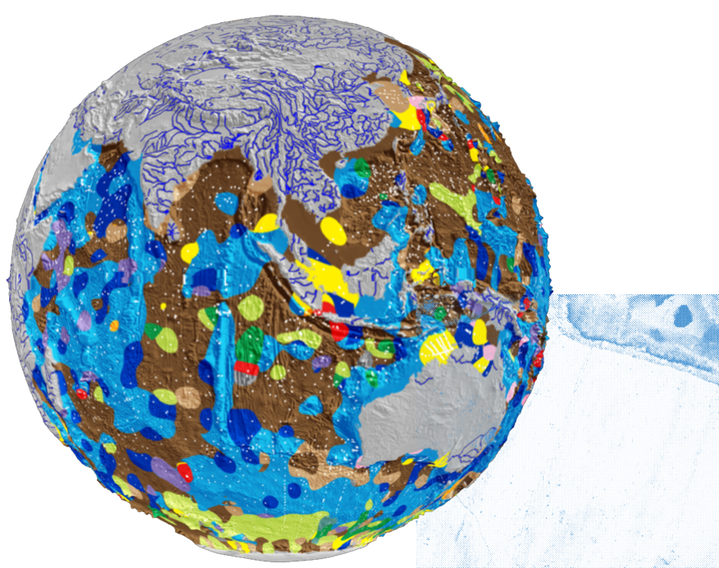
We acknowledge the Traditional Custodians and first Earth scientists
of the lands where our team and facilities are based across Australia.
We pay our deepest respects to their Elders past and present.
We recognise the importance of First Nations participation,
leadership, self-determination, knowledge and approaches
in shaping Australia's sustainable and resilient future.
| 2

Slide 3
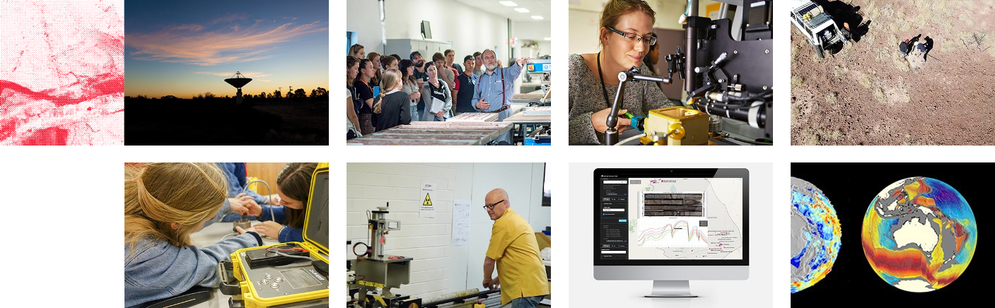
AuScope is Australia’s provider of research laboratories, instruments, data, software and expertise for Earth and geospatial science breakthroughs for Australia.
| 3

Slide 4
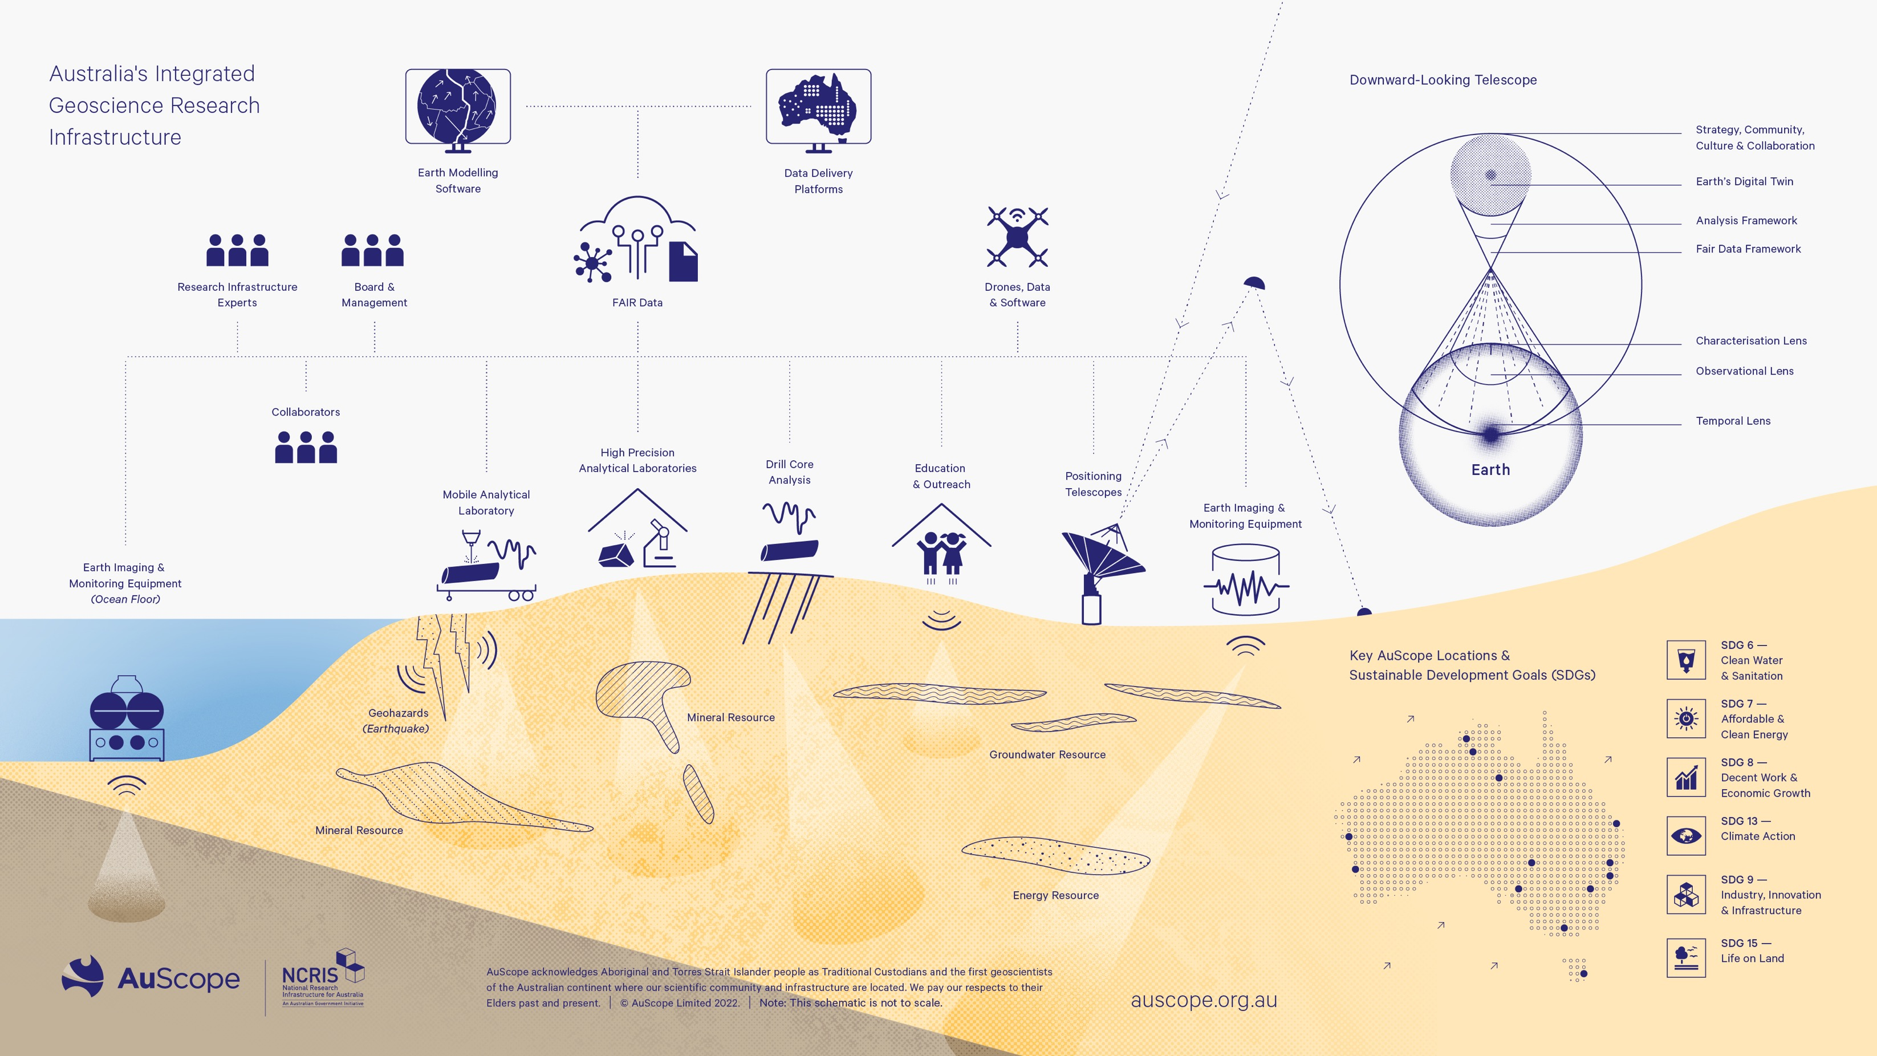
Notes:
AuScope was established in 2008 to develop a national RI capability for the earth and geospatial science communities funded by the National Collaborative Research Infrastructure Strategy (NCRIS)
We are an integrated infrastructure that includes field based observational infrastructure deployments (geophysics and geospatial), analytical laboratories (Geochemistry), characterisation facilities (HyLogger), data repositories, analytics tools and simulation and modelling codes to add value to the data.
We also have permanent, semi-permanent and temporary instrument deployments right across the country, in Antarctica and on the sea-floor
We have a free data model based on economic rivalry principles whereby if you make data free to use, without impacting on the ability of another to use it – empowers people – it empowers researchers - attracts exploration capital to Australia.
We operate as a not-for-profit company limited by guarantee with an independent Board and have received over $130M government funding and nearly $200M of partner co-investment since 2008
We are about to embark on a new phase of capital investment built around the concept of a distributed, integrated downward looking telescope. Like the square kilometer array only much bigger (and cooler)

Slide 5












Notes:
Slide Tip:
We work with scientists and technologists at Geoscience Australia, CSIRO, a number of Australian universities, State and Territory Geological Surveys and other NCRIS capabilities.

Slide 6

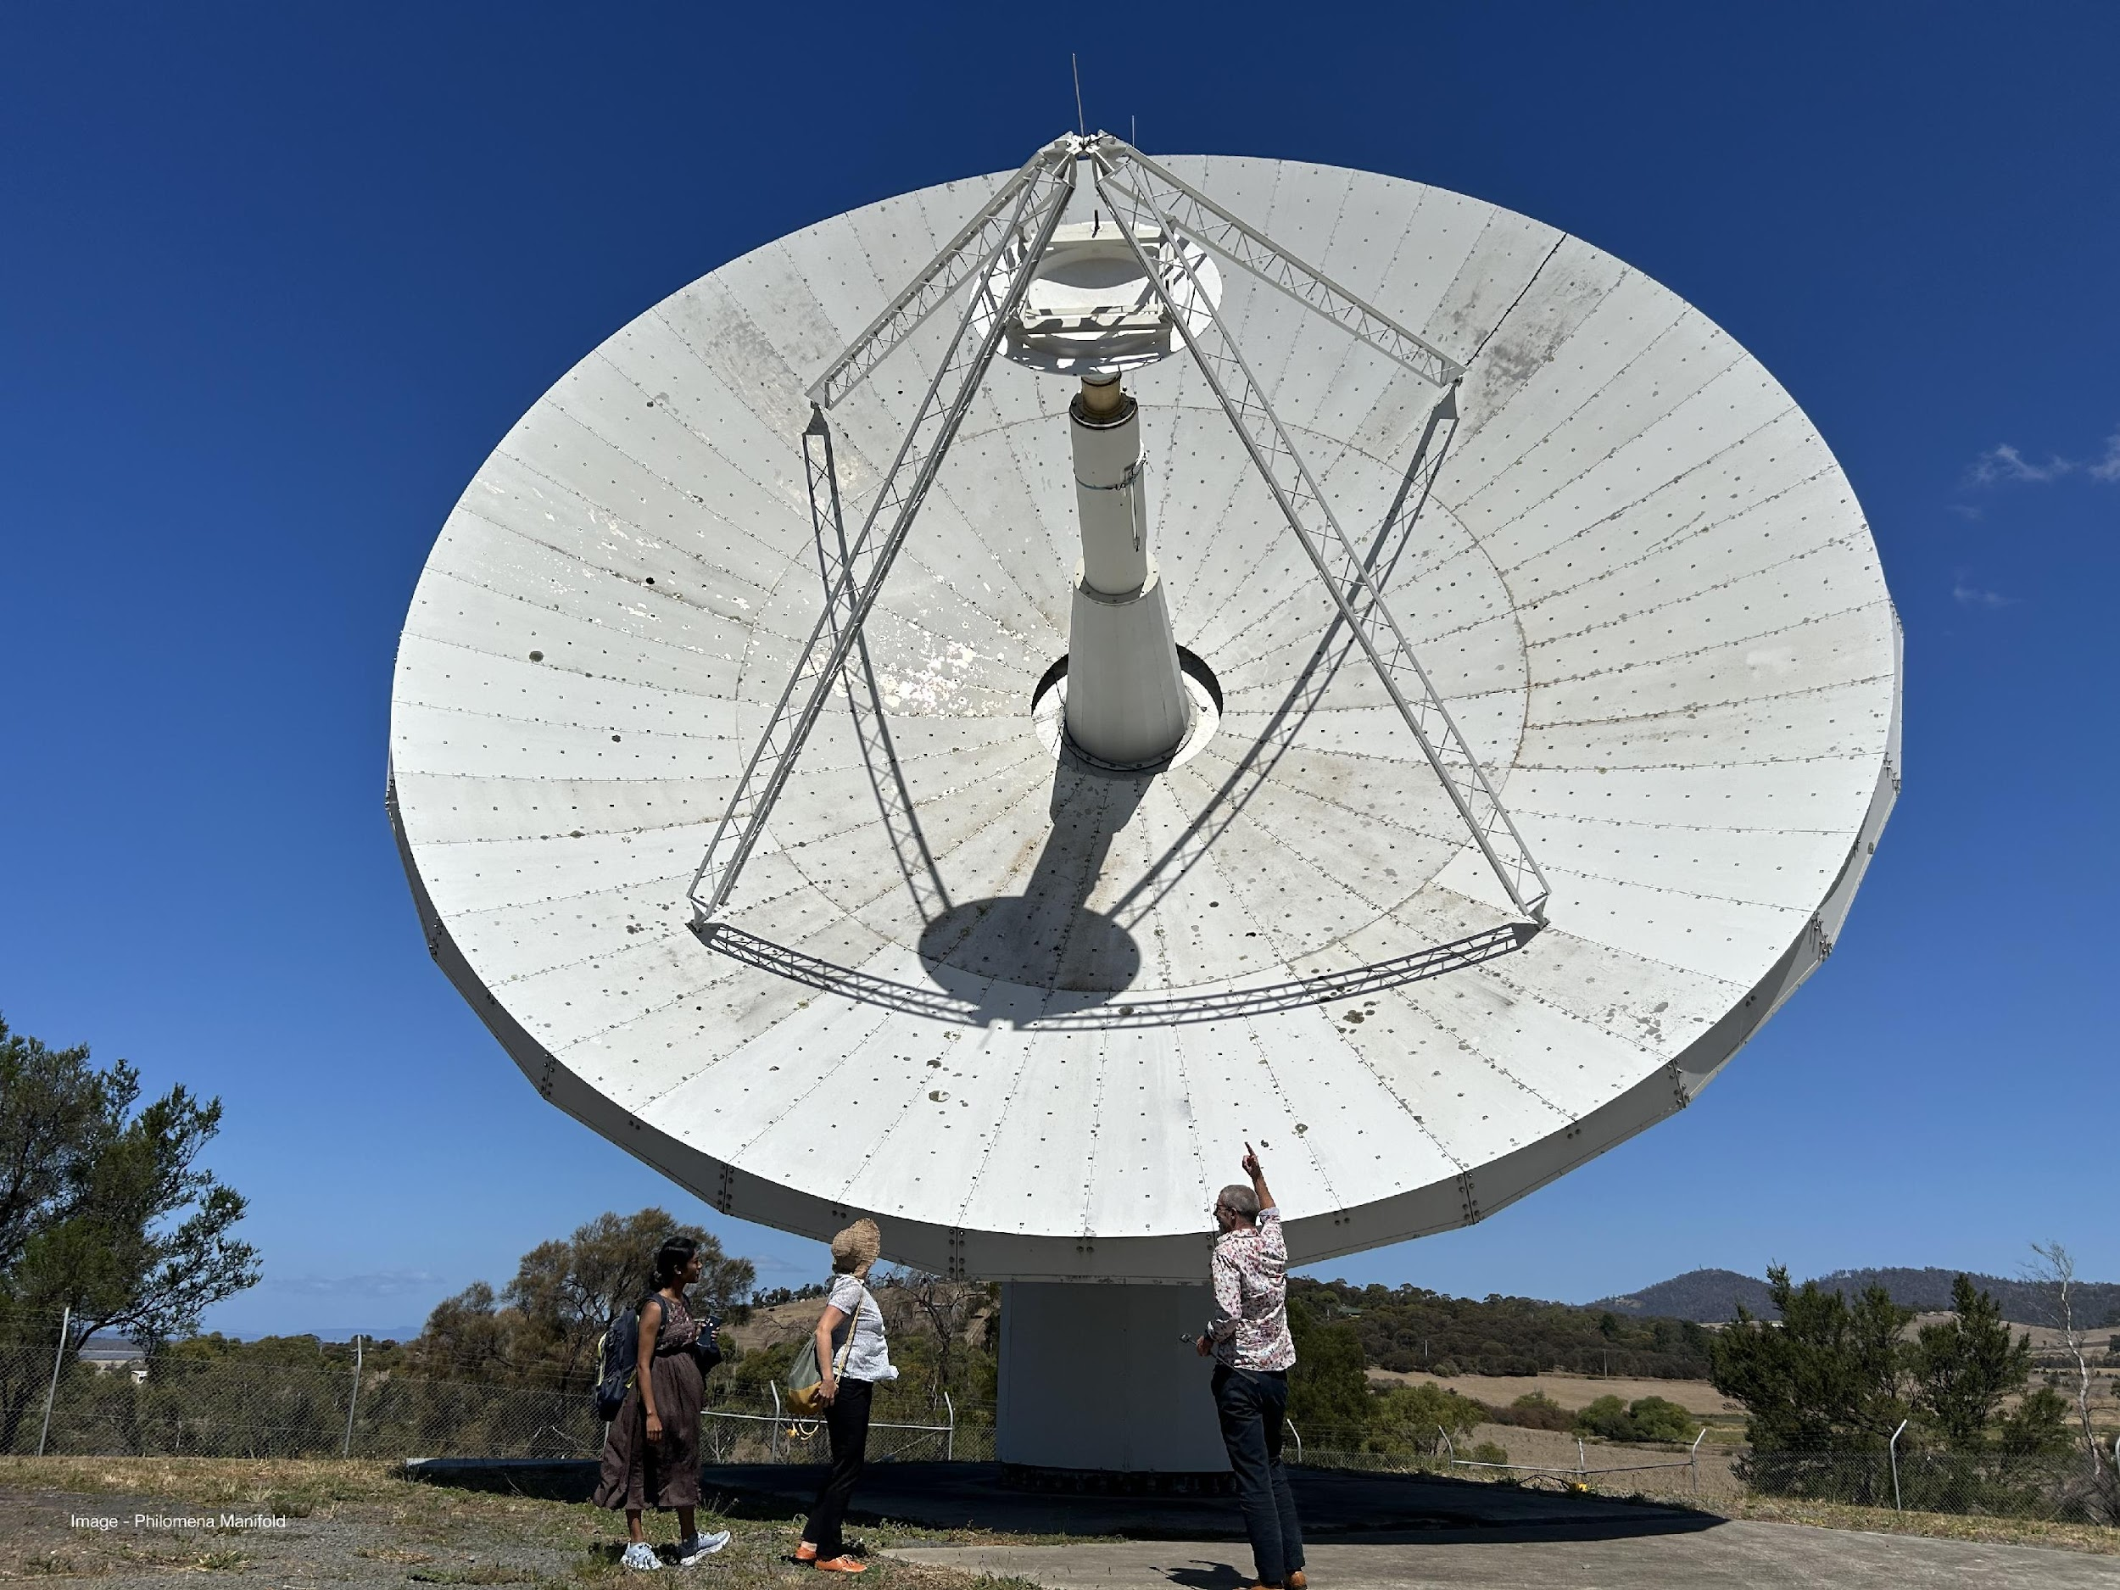
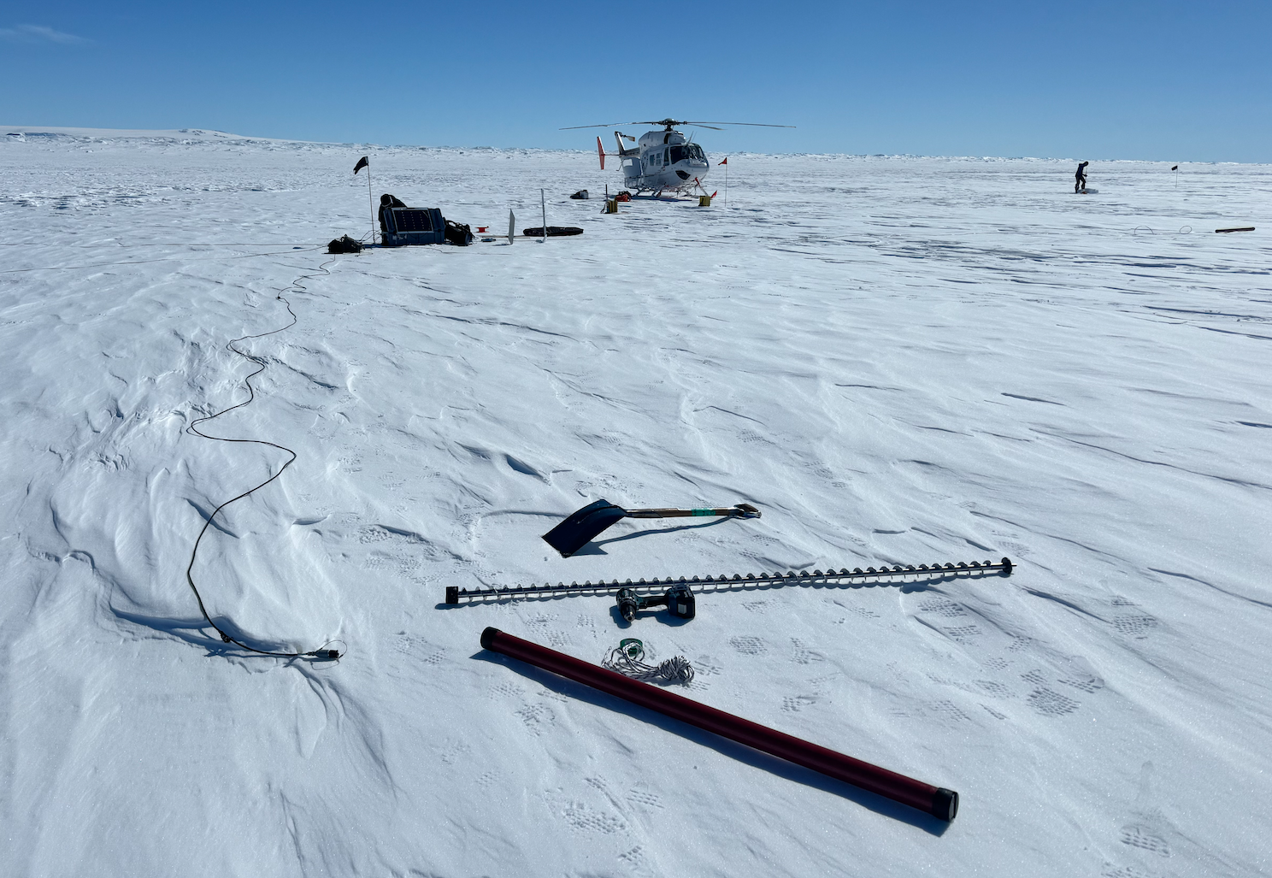
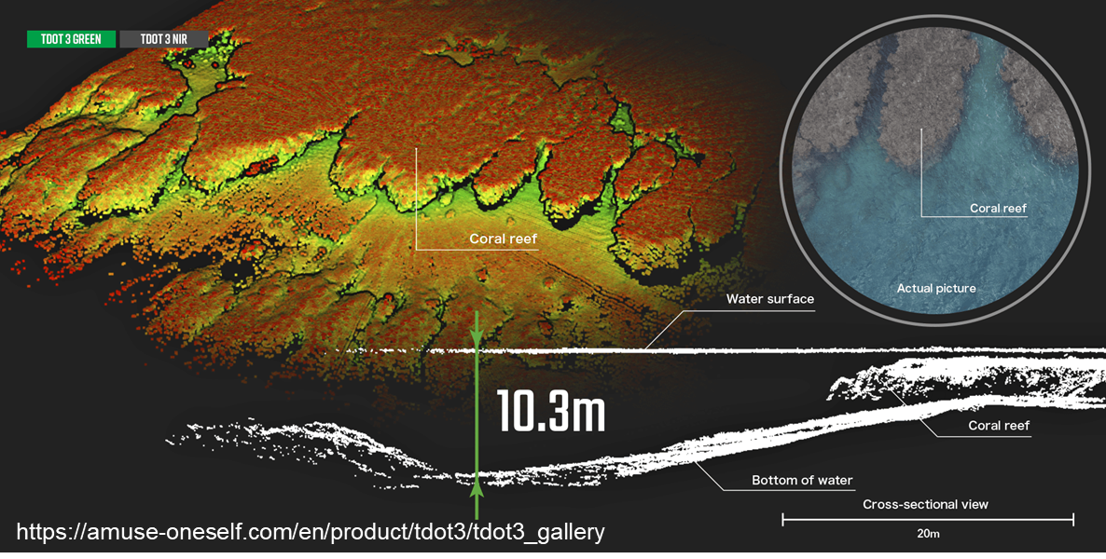
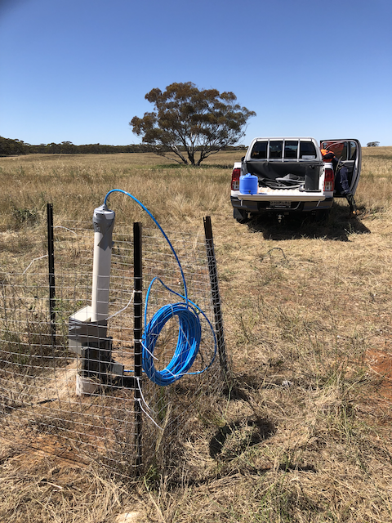

AuScope Programs
- Geospatial
- Earth Imaging and Sounding
- Earth Composition and Evolution
- Characterisation
- Earth Sampling
- Autonomous Sensing (drones)
- Simulation, Analysis and Modelling (SAM)
- AuScope Virtual Research Environment (AVRE)
- Research Data Systems
- Outreach
auscope.org.au
| @auscope

Slide 7
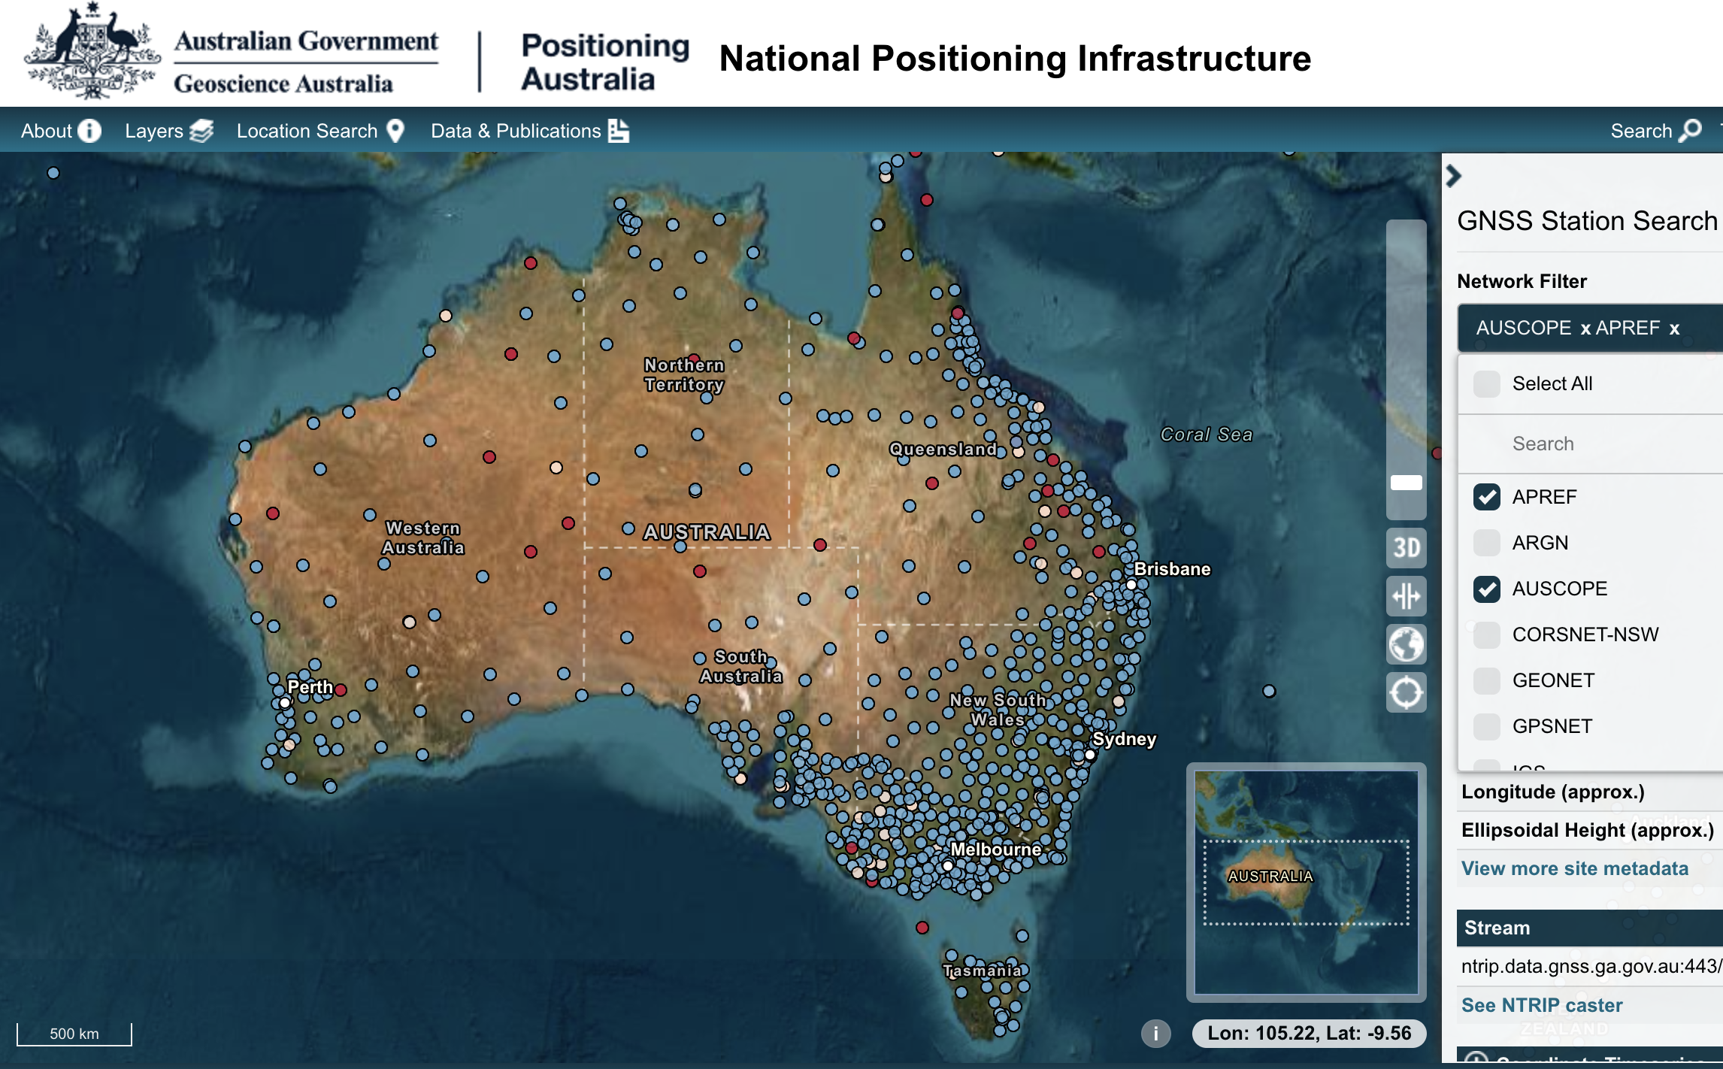
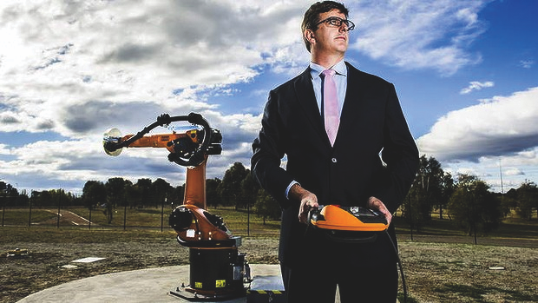
Geospatial
- Geospatial programs managed by GA
- Three VLBI Telescopes
- Optic fibre connections
- AuScope GNSS network
- Absolute gravity and regional gravity
- GNSS receiver calibration facilities
- This community collaborates very well internationally
- We have an interest in learning how to optimise our GNSS data archives (TileDB)
auscope.org.au
| @auscope

Slide 8
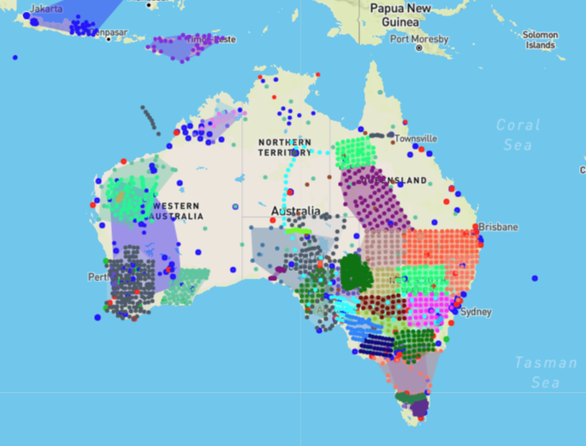
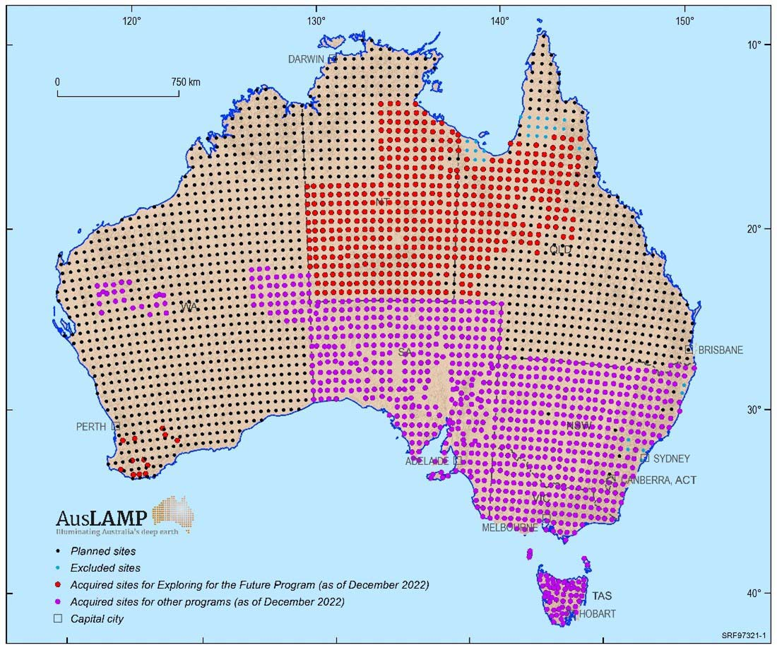
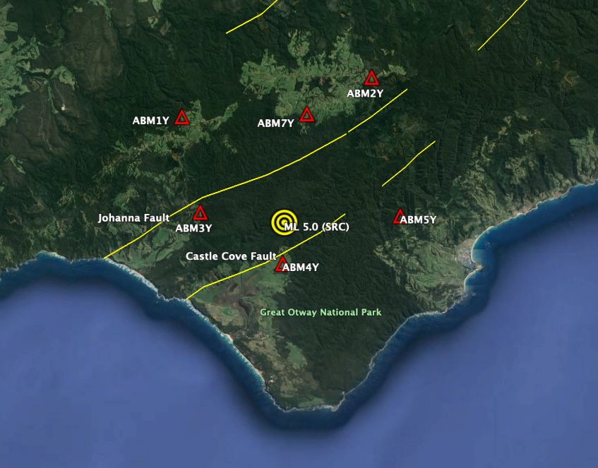
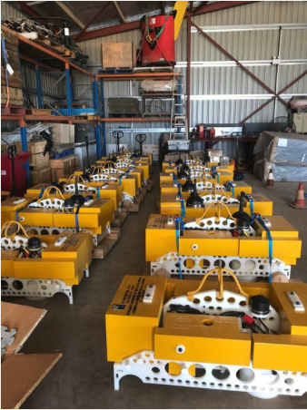
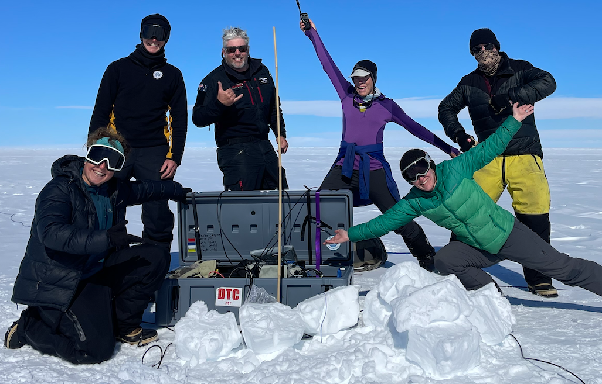
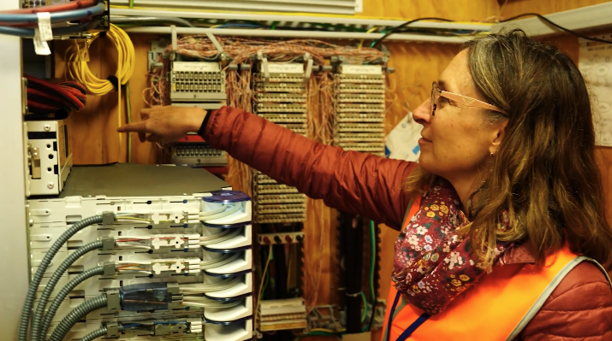
Earth Imaging & Sounding
- Passive seismic instrument array
- AusLAMP MT national coverage
- Subsurface monitoring and aftershock fleet
- Geophysical Research Infrastructure for Antarctica
- Nodal seismometer fleet
- Distributed Acoustic Sensing (DAS) seismology
- Ocean bottom seismometer fleet
- National Geophysics Validation Line
- Critical Zone Observatories
- Data security
- Data standards
- Data readiness for exascale/AI
- Space weather
auscope.org.au
| @auscope

Slide 9
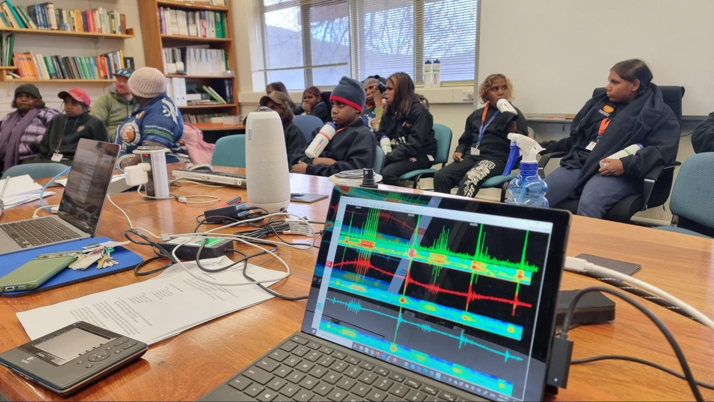

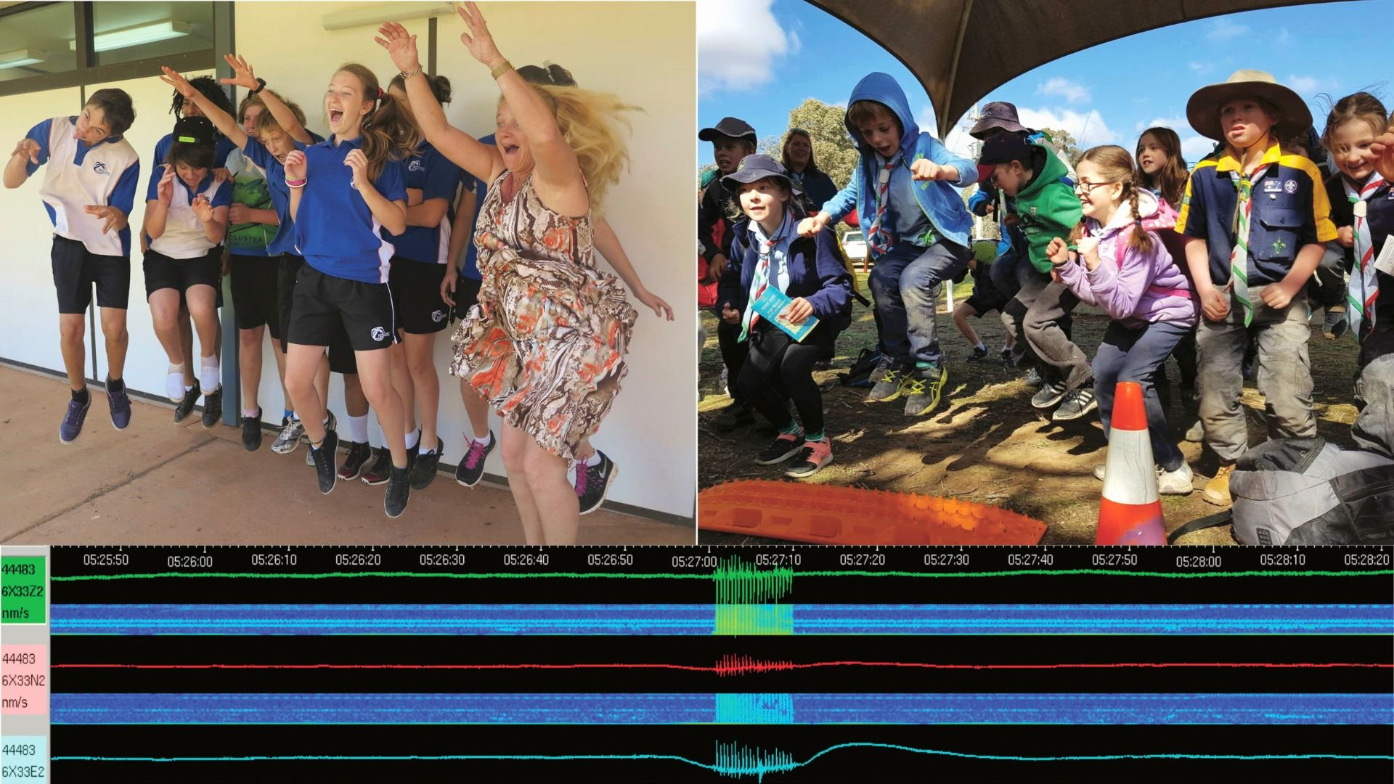
Outreach
- AuSIS (Seismometers in Schools)
- International connections from schools
- Footy-quake World Cup?!
auscope.org.au
| @auscope

Slide 10
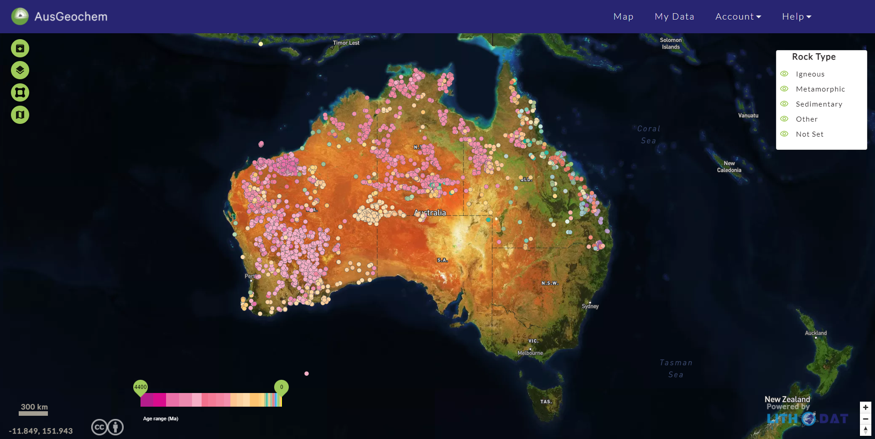
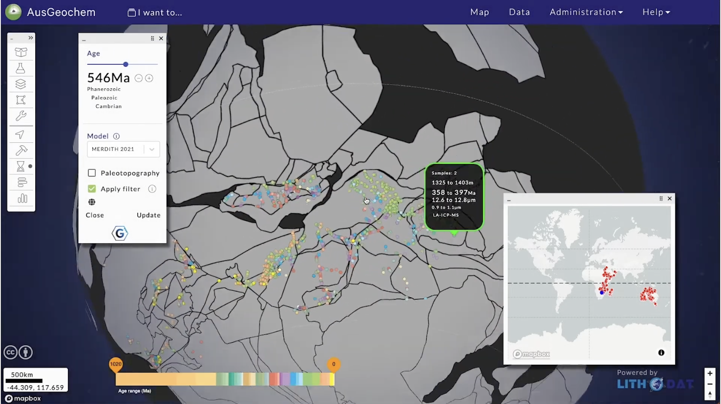
Data Platforms
- Research Data Repositories
- Geophysics 2030 – ready for exascale and AI
- AusGeochem (EarthBank)
- Data assimilation and integration of simulation codes into data platforms
- WordFAIR application across domains (CDIF) - FAIR and CARE – Open Data
- Use-case development and engagement
auscope.org.au
| @auscope

Slide 11
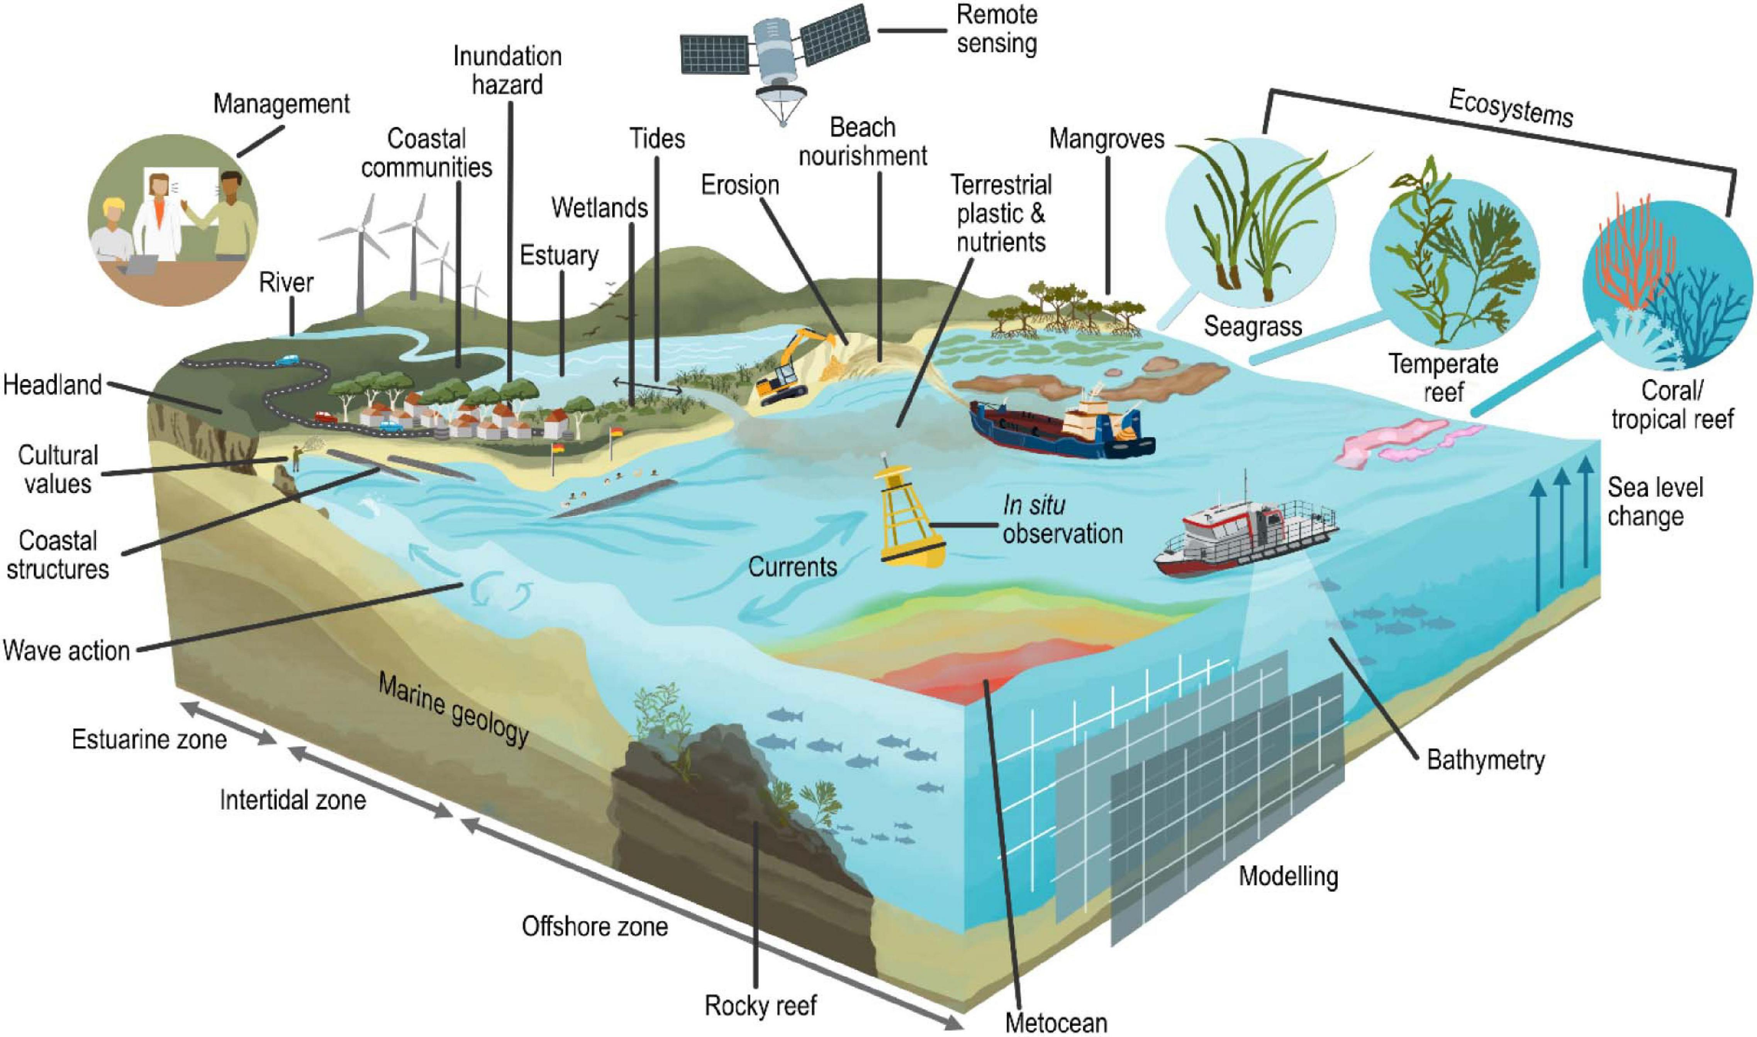
Coastline RI in Australia
DEA
PHRN
ALA
TERN
AURIN
CoastRI
AuScope
IMOS
ARDC
AusSeaBed
ACCESS
NCI
Source: Power et al. (2021)

Slide 12
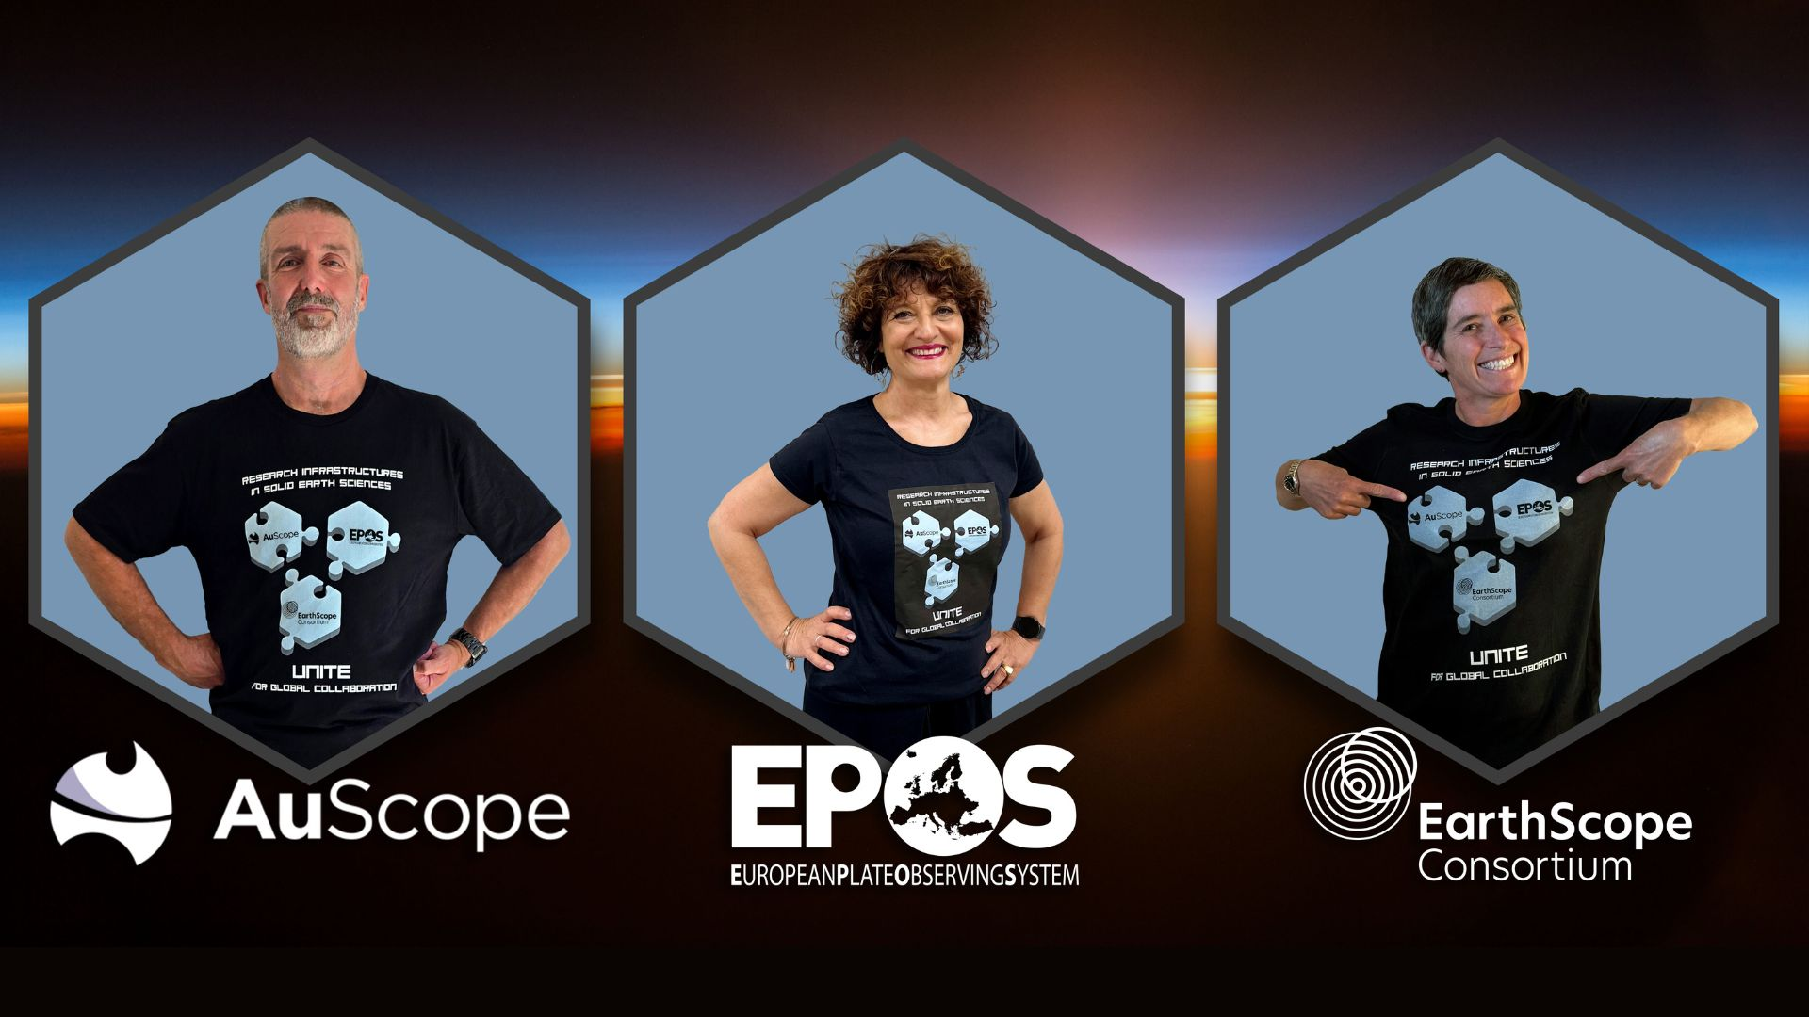
Collaboration
Strategic
- What would a GRI look like?
- Do we need one?
- Data preservation
- Translation
Technical
- Platform and code sharing
- Standards alignment
Community
- Community of practice
- ESIP style clusters
Skills
- Funded exchange fellowships
Instruments
- Calibration – logistics – loans - operation
What we can share
- WorldFAIR experience (geochemistry)
- Application of CDIF to geophysical data
- AusGeochem platform
- Time-series data for exascale compute (AI)
- Outreach / citizen science
What we need
- Geospatial data management
- Vertical motion data / platform (EGMS)
- Better community engagement
- Complex data integration
Opportunities
auscope.org.au
| @auscope

Slide 13

Notes:
Small right image - text

Slide 14
auscope.com.au
Tw @AuScope
Ig @AuScopeToolkit
Li /auscope-limited
Image — Curtin University
Notes:
Thank you for your time today. I hope that this presentation has given you a sense of AuScope programs and activities, our collaborative approach and the well-developed nature of our plans to build a Downward Looking Telescope to support the next generation of Australian geoscience research.

