Slide 1
EarthScope Consortium
EPOS Days
March 19, 2025

Slide 2
About EarthScope

Slide 3
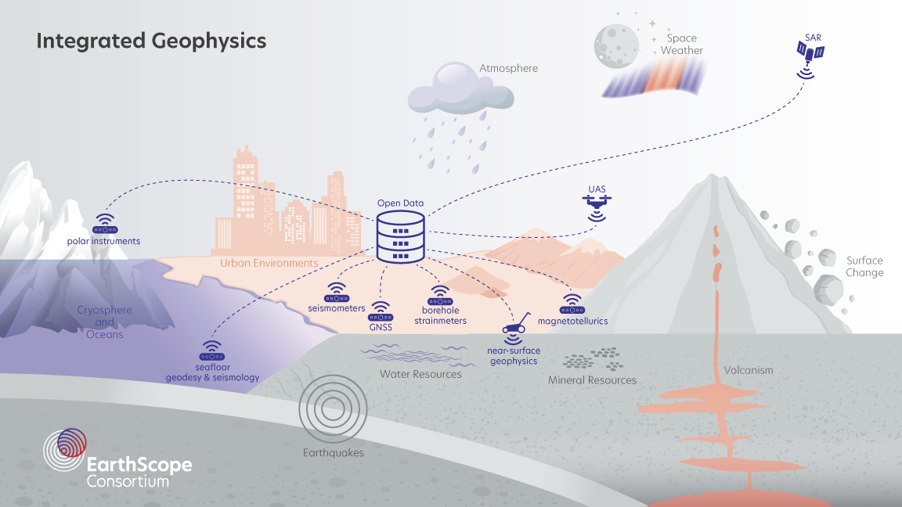
About EarthScope

Slide 4
About EarthScope
Engagement
Data Services
Instrumentation

Slide 5
About EarthScope

Slide 6
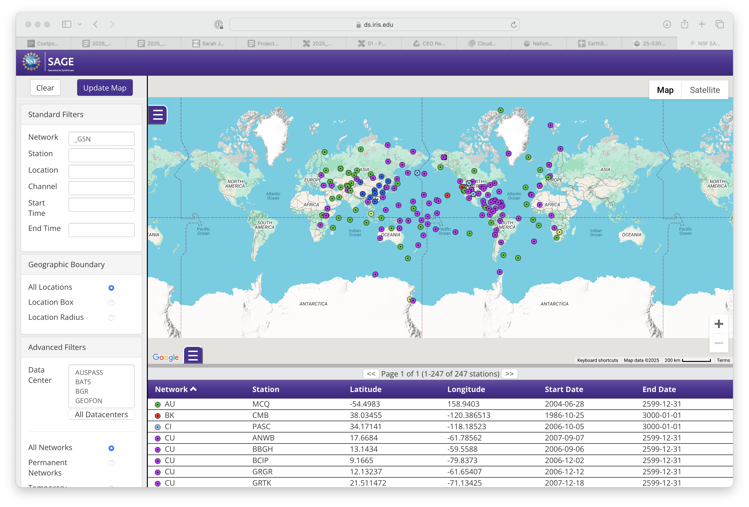
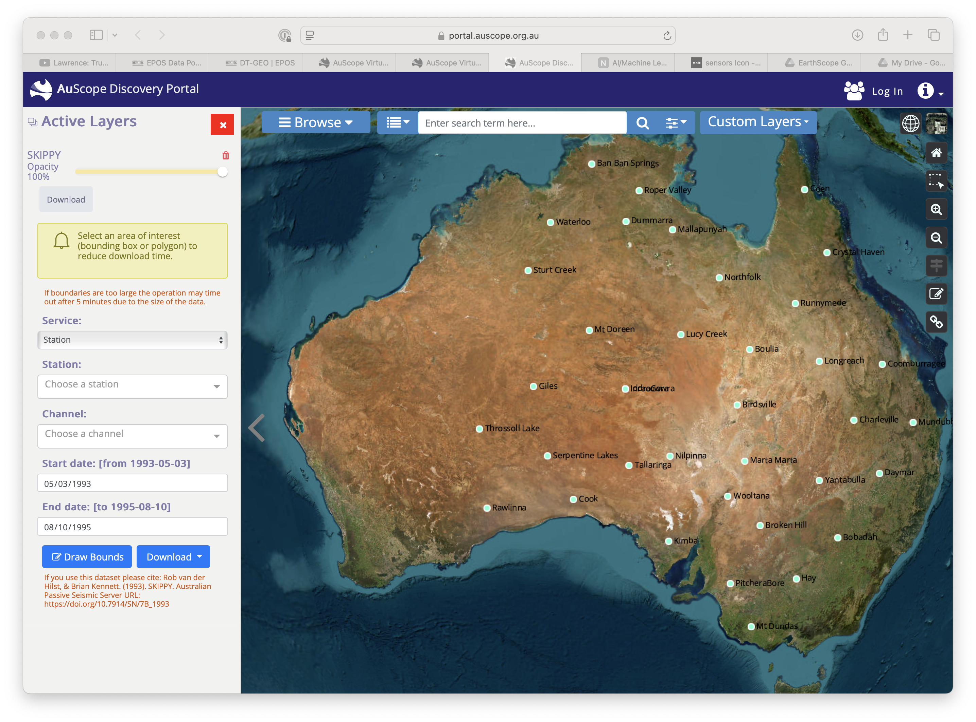
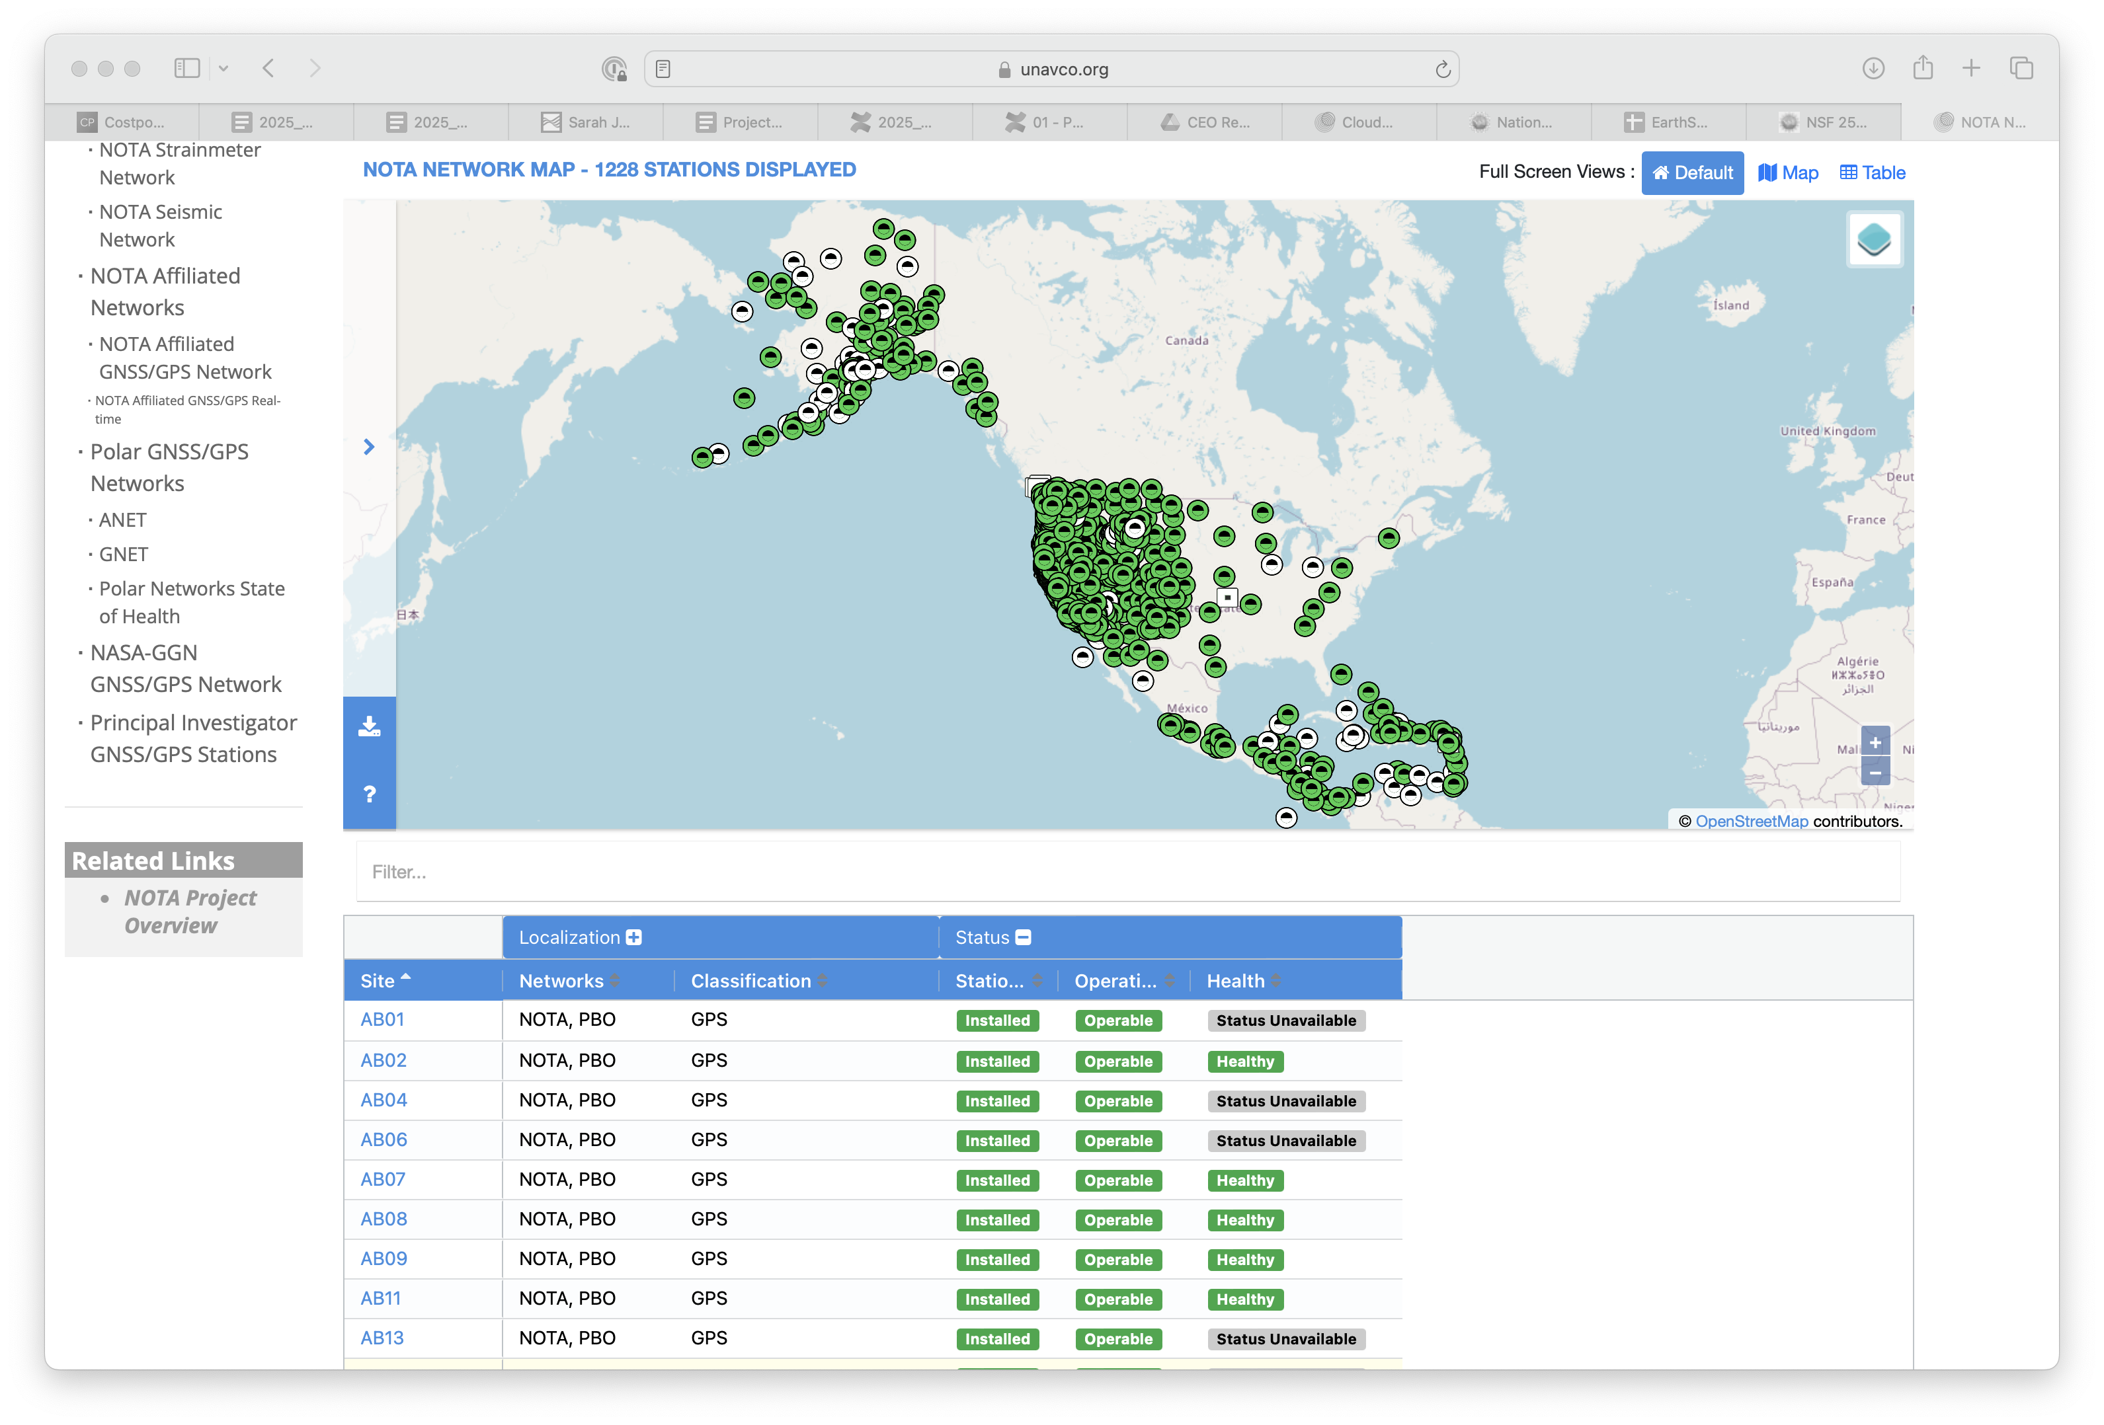
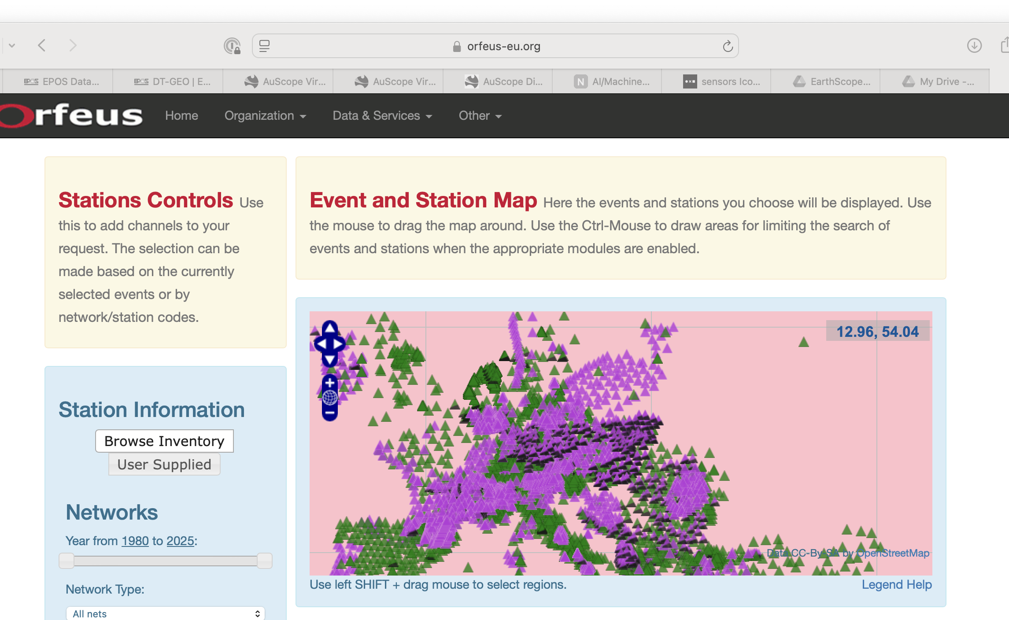
Alignment: sensor infrastructure
Notes:
Sensor deployment and infrastructure

Slide 7
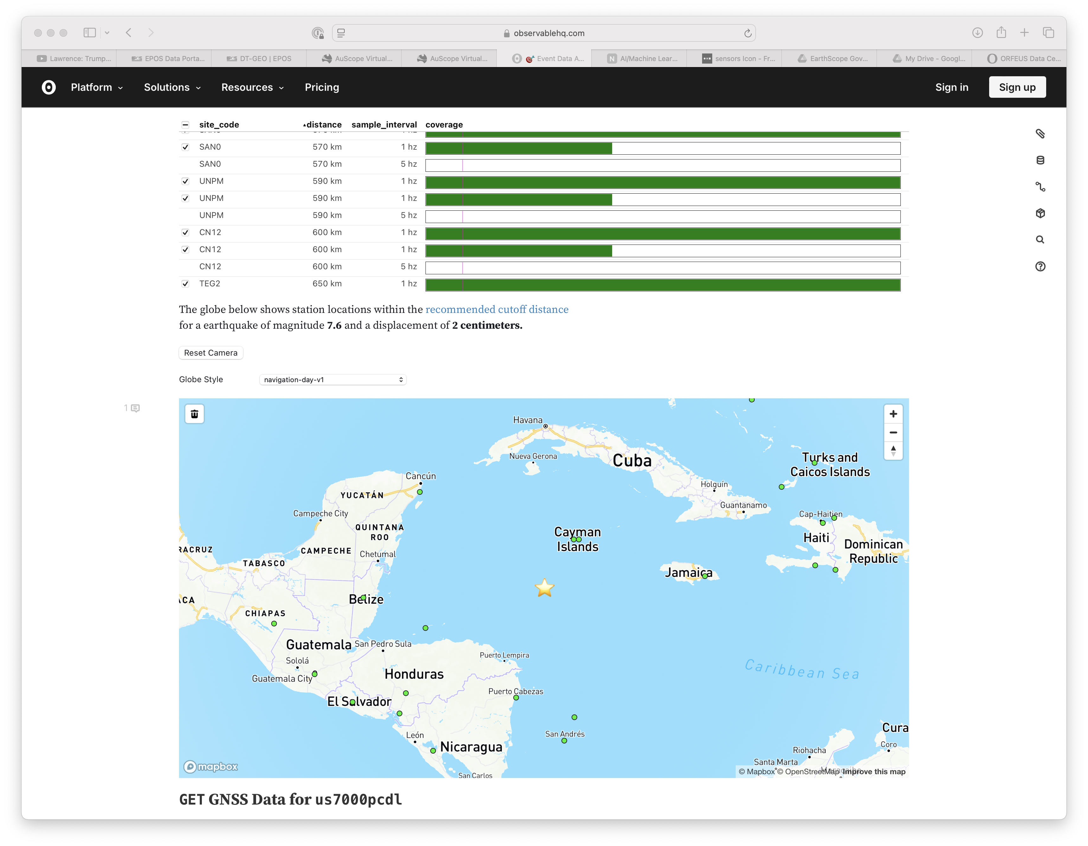
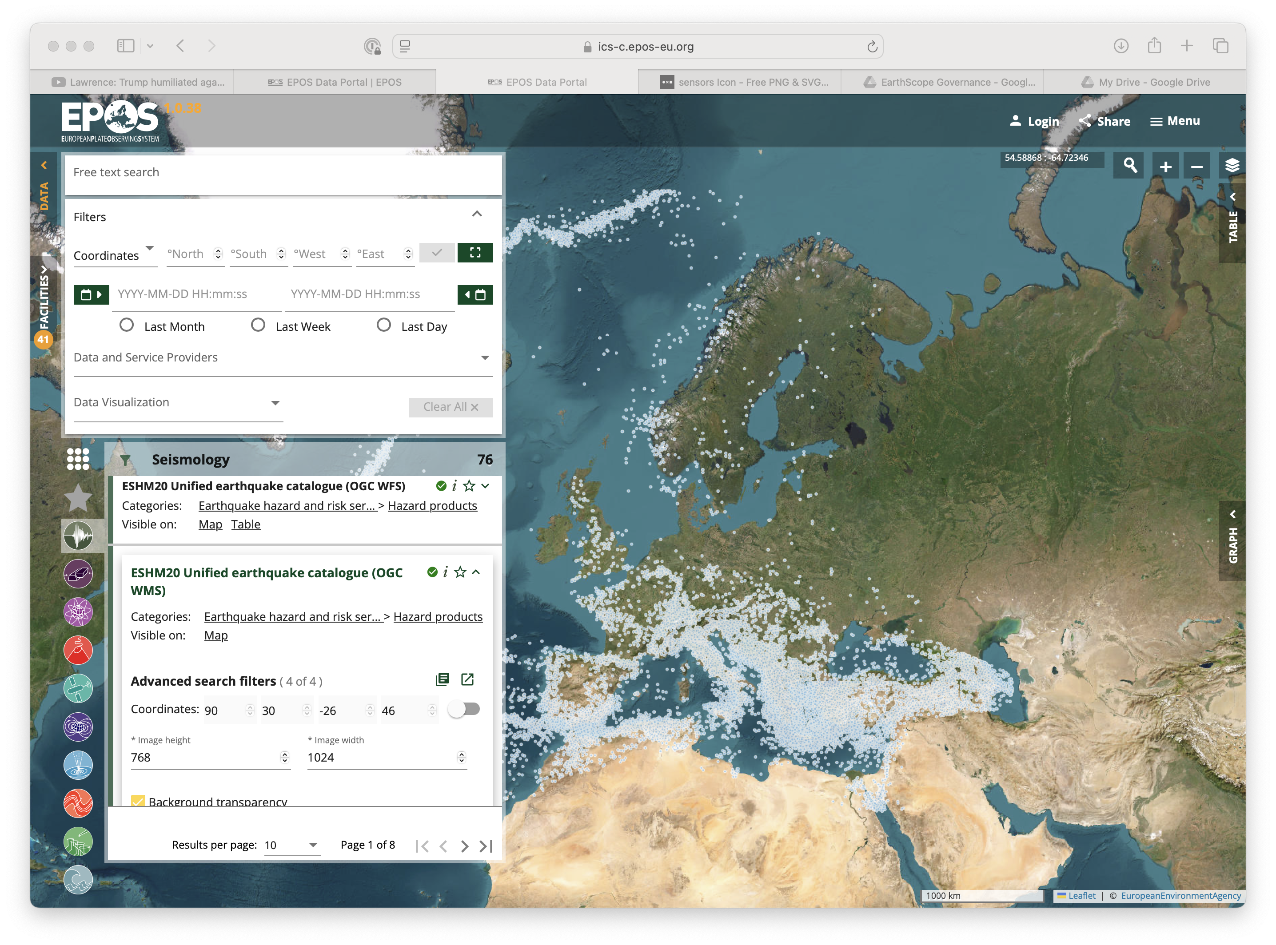
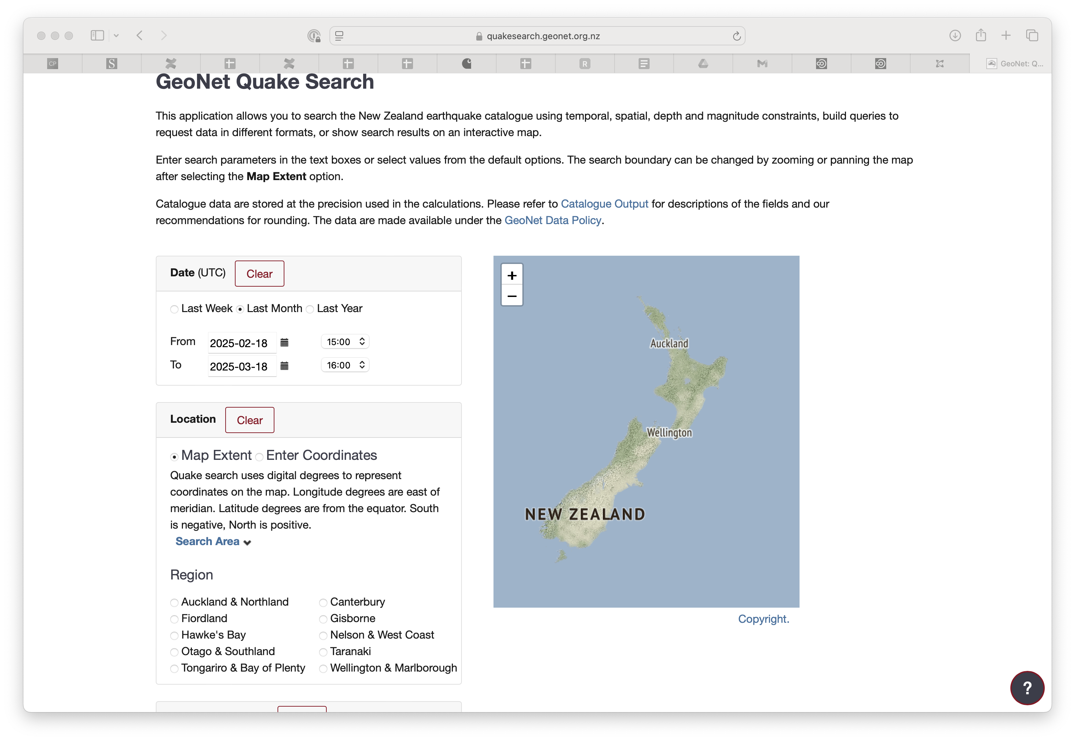
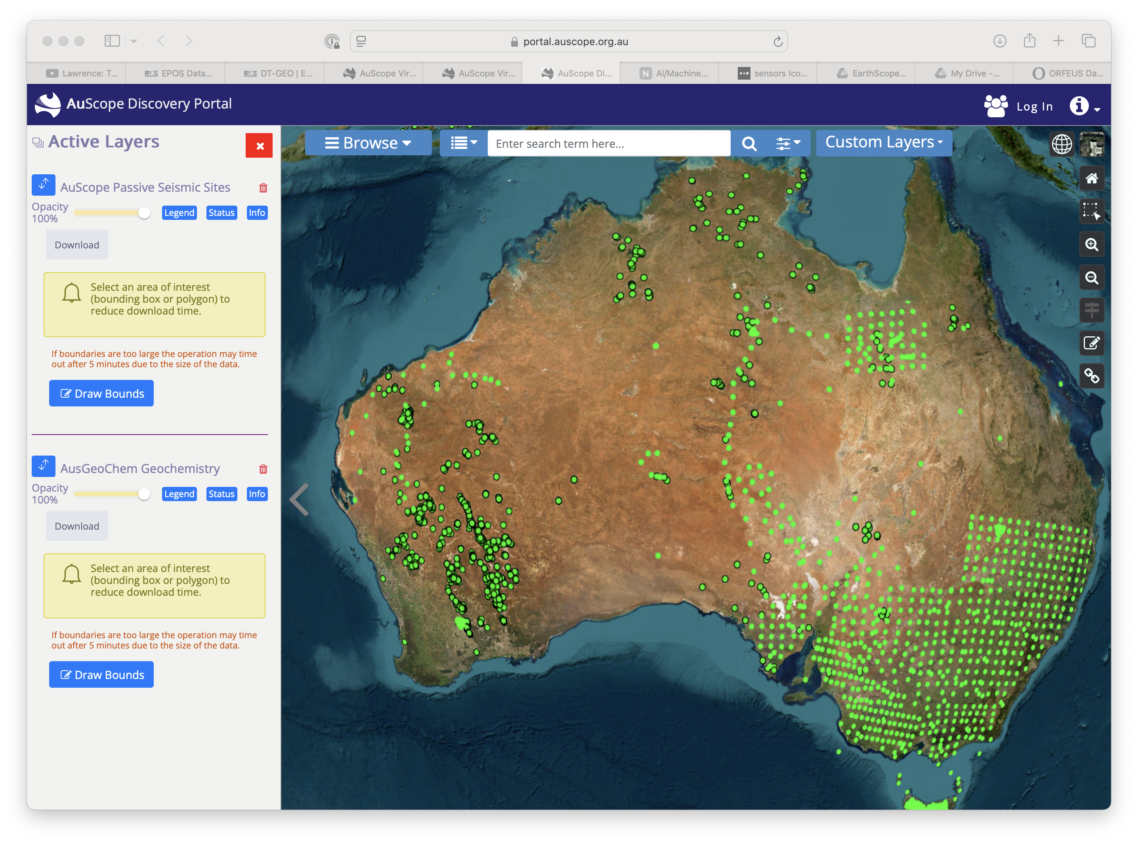
Alignment: data access
Notes:
Data and data products

Slide 8
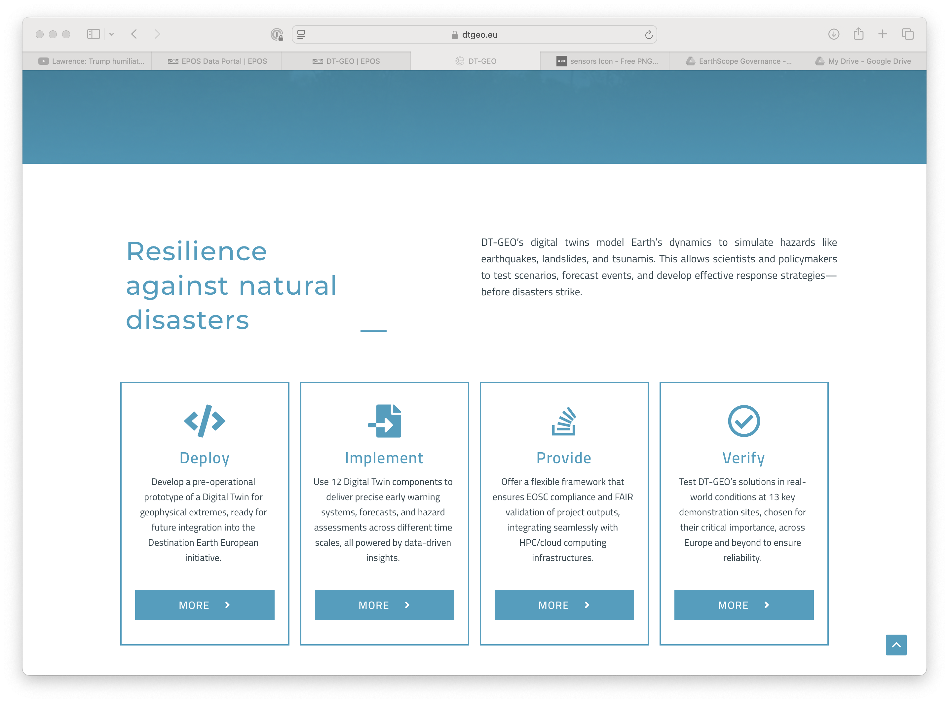
Alignment: use innovation
EPOS: DT-GEO
Notes:
Innovative integration: digital twins and AI/ML

Slide 9
Active collaboration
Introductions
Network Building
Technical Exchange

Slide 10
What next?
Data interdiscoverability
Data attribution challenges
Shared tools for visualization or analysis
Steps toward federation (metadata, formats)
Training/internships/summer schools

Slide 11
What next?
Notes:
We need you!

