Slide 1
International Collaboration
19 March 2025
Perugia

Slide 2
Agenda
09.00-09.05 | Setting the scene | Helen Glaves
09.05-09.20 | EarthScope (USA) | Rebecca Bendick
09.20-09.35 | AuScope (Australia) | Tim Rawling
09.35-09.50 | GNS NZ (New Zealand) | Elisabetta D'Anastasio
09.50-10.05 | EU-CELAC roadmap (Latin America) | Presentation
10:05 – 10:20 | Earth Science EU-Africa cooperation
10.20-10.45 | Discussion and Q&A | Interactive session
Session is linked to the activities of WP3 as part of the EPOS ON project

Slide 3
Setting the Scene……
Helen Glaves

Slide 4
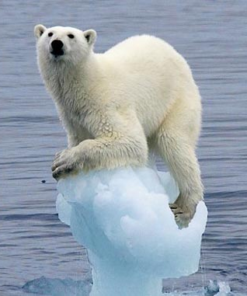
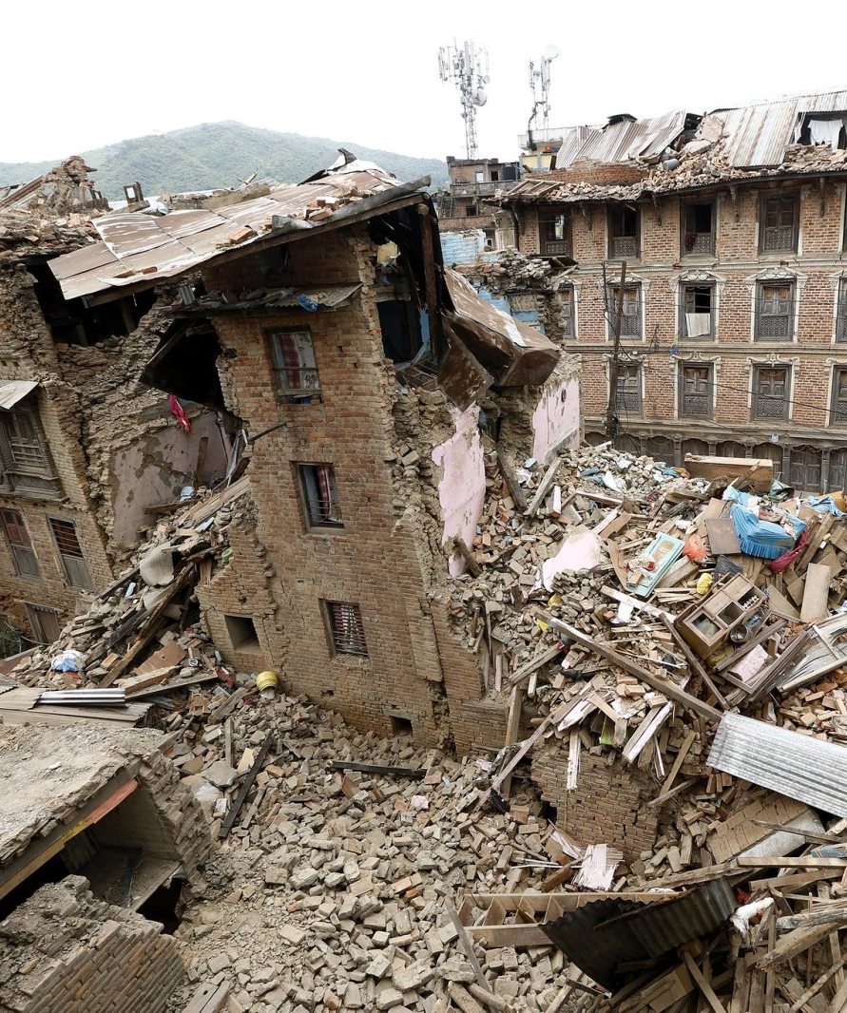
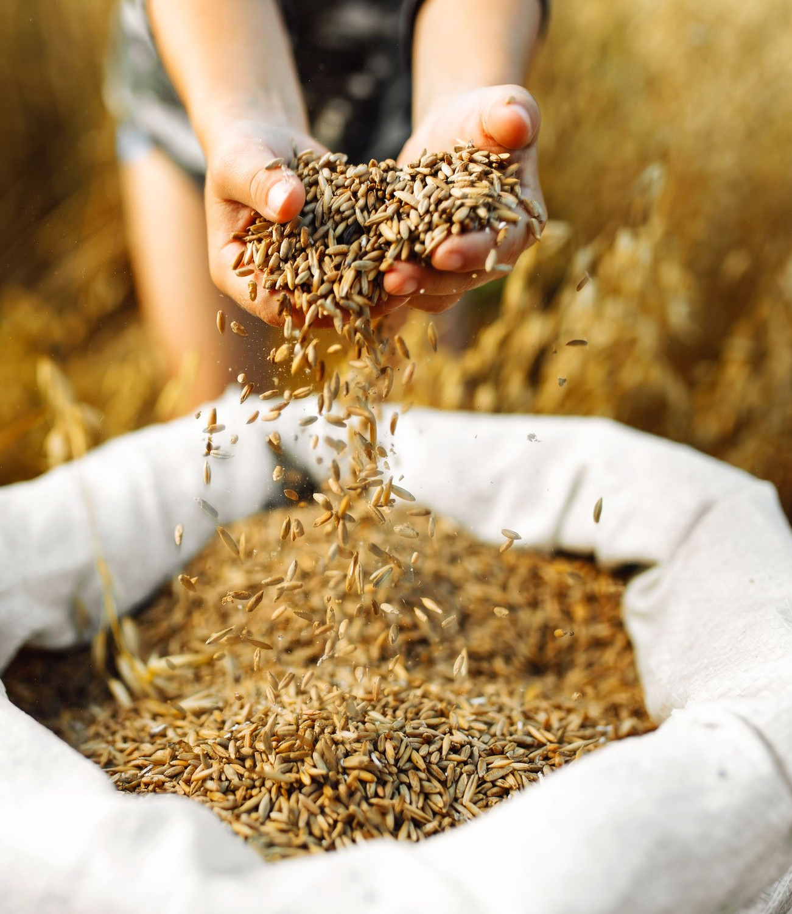
Setting the Scene: why RIs are important?
Crucial in addressing regional and global socio-environmental challenges
Climate change
Photo courtesy of ReSurge International / Flickr Creative Commons
Natural disasters
Food security
Source: the Borgen Project
Source: bbc.com
Source: ESA multimedia gallery
Notes:
Why are RIs important
Through collaboration and integration research infrastructures are a fundamental component of a global network of RIs that are addressing some of the most challenging issues faced by humankind. Providing access to data, services and facilities that are vital for research efforts that seek to address regional and global socio-environmental challenges

Slide 5
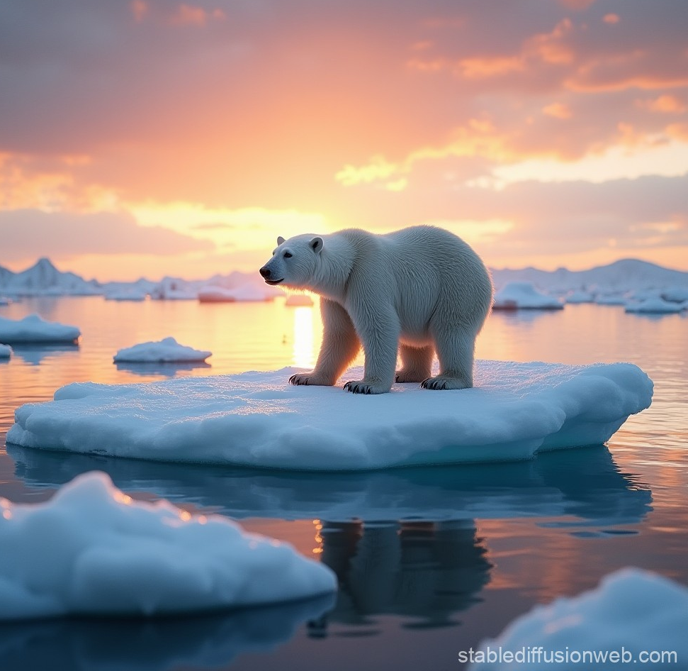
Climate Change - a key challenge
Environmental Research Infrastructures
Fighting Climate Change requires
coordinated interdisciplinary scientific action
integrated information on all aspects of our planet, from environmental to life sciences
joint monitoring of Global Climate Indicators
free and open access to global observation data
Notes:
Data represents the baseline for scientists, as in their hands data becomes information, information becomes knowledge, and knowledge ultimately becomes wisdom that is essential to address key challenges for society of the planet.
For example, fighting climate change requires easy and fast access to open FAIR,trustworthy, high quality, well-documented observations that capture the complexity of the Earth system and the interactions between the atmosphere, the land and the ocean;
The urgency of tackling climate change has highlighted the importance of interdisciplinary scientific collaboration and the need to overcome disciplinary boundaries. There is greater emphasis on interoperability and harmonization of data and services to effectively address present-day environmental challenges.

Slide 6
“We support the development of advanced technologies, research infrastructures and highly-skilled human resource networks that will drive innovation to solve global challenges and enable the next stage of economic growth.”
Source: G7 Hiroshima Leaders’ Communiqué (2023)
Notes:
These socio-environmental imperatives are also recognised as critical drivers for the ongoing development of research infrastructures by the politicians at the highest level.
Statement from Hiroshima G7 summit in 2023 highlighted the importance of cross-border data flows, information, ideas and knowledge generate higher productivity, greater innovation, and improved sustainable development

Slide 7
“Ministers signalled significantly strengthened collaboration on research infrastructures that support cutting-edge science and innovation, benefitting researchers worldwide.”
Notes:
Similarly, the statement from the Italian G7 summit in 2024 highlighted the importance of collaboration to support new and innovative research on a global scale, especially with respect to research infrastructures. The importance of research infrastructures to facilitate collaborative research and the role of RIs for capacity building including for early career researchers was also mentioned in the resulting ministerial declaration. (see QR code)

Slide 8
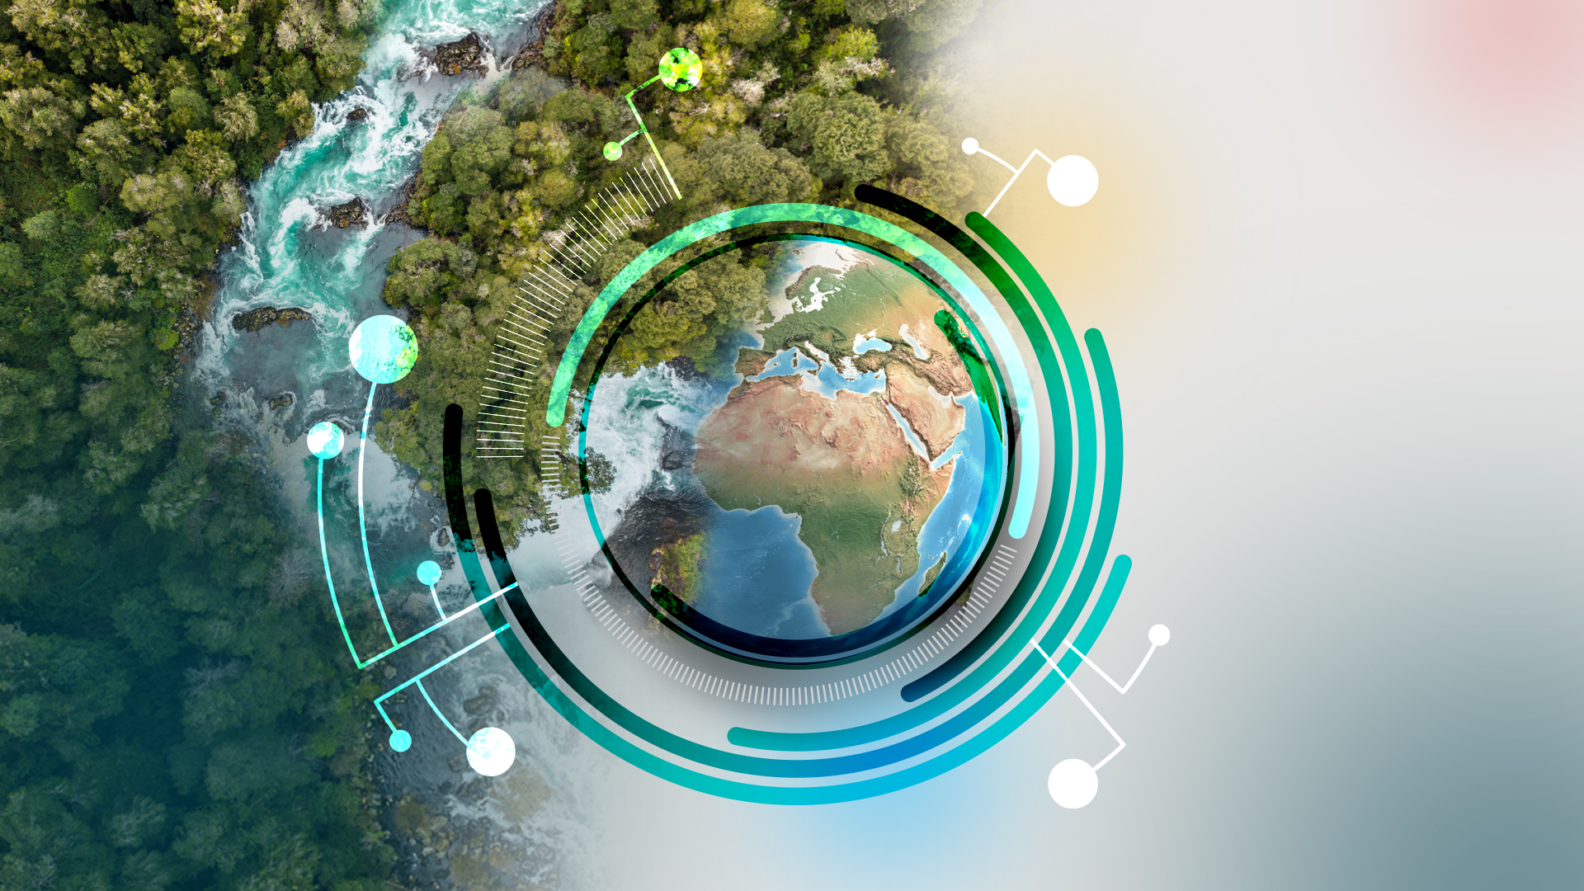
Notes:
On a global scale there are organisations such as the Group on Earth Observation (GEO): aim to provide open access to EO data (satellite and ground-based networks. GEO is made up of members state representatives and has a diversity of stakeholders including 151 Participating Organisations – EPOS of one of these.
Role of GEO
Emphasises the need for international collaboration to foster open access to Earth observation data, products, tools etc. for the benefit of everyone
GEO brings together many regional and national RIs: underpin these high-level objectives

Slide 9
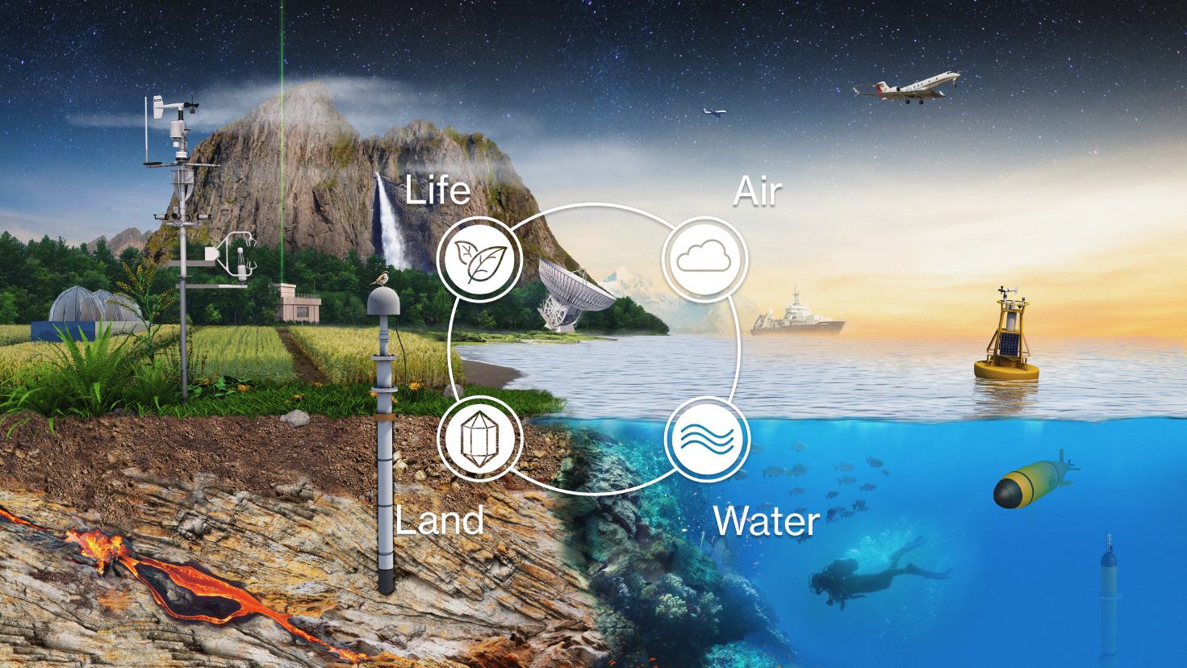
Environmental Research Infrastructures
Specialized observation and analysis platforms
Societal challenges need multidisciplinary methods
Answering societal needs is only possible via collaboration
Observations often unique - huge datasets
High importance to society, economy and resilience
Wide range of disciplines
High level of specialization of individual RIs, depending on their main research fields
Multiple infrastructures for on Earth system segment
Notes:
EPOS along side other European research infrastructures are a vital part of this international landscape being comprised of regional and national initiatives
On the regional scale: EPOS is part of the ENVRI cluster: a community of environmental Research infrastructures working together to observe the Earth as one system. Through collaboration, integrated open and FAIR environmental data, tools, and other services are delivered to support research and innovation goals, including through initiatives such as the ENVRI Hub that aims to deliver seamless access to open data from environmental Research Infrastructures, which facilitates multidisciplinary research across different sectors.

Slide 10
What are the benefits on collaboration?
Addressing common challenges and achieving shared goals
Maximising use of resources and reducing duplication of effort
Sharing of knowledge and expertise, including capacity building
Building an international community and developing partnership networks
Notes:
In this session, we will hear from research infrastructures from other regions that, together with EPOS, are creating a network of RIs for the solid Earth, which will highlight the benefits of collaboration and emphasise the role a cohesive network of RIs plays in addressing those global socio-environmental challenges already mentioned.
(Capacity building: individual researchers and for institutions)

