Slide 1
TCS Tsunami and The Global Tsunami Model (GTM) – outlook for enhanced global collaboration M. Charalampakis (NOA, Greece) & S. Lorito (INGV,Italy) for TCS Tsunami Consortium and the GTM Team

Slide 2
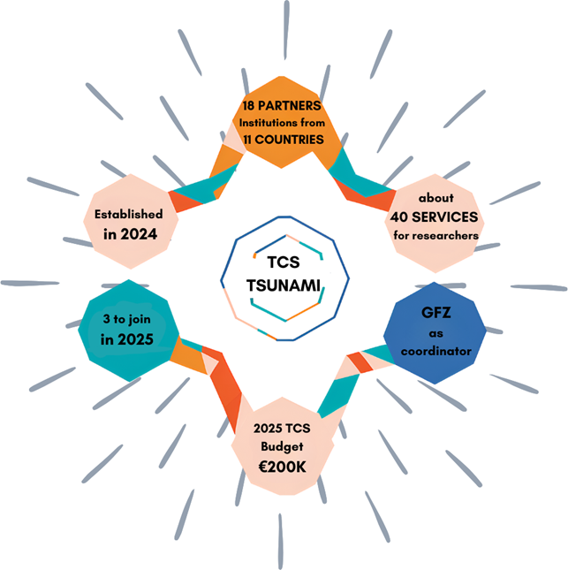
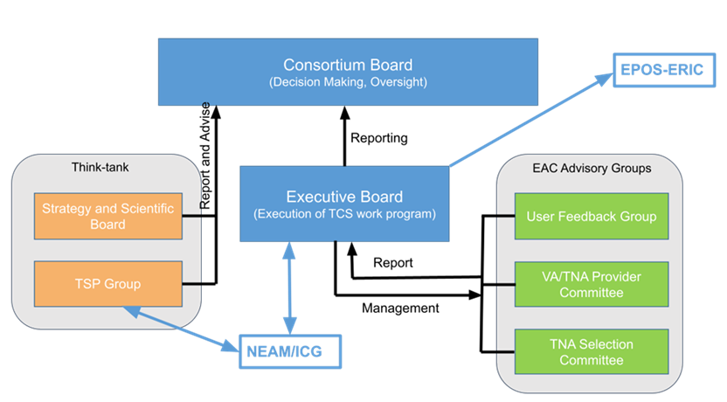
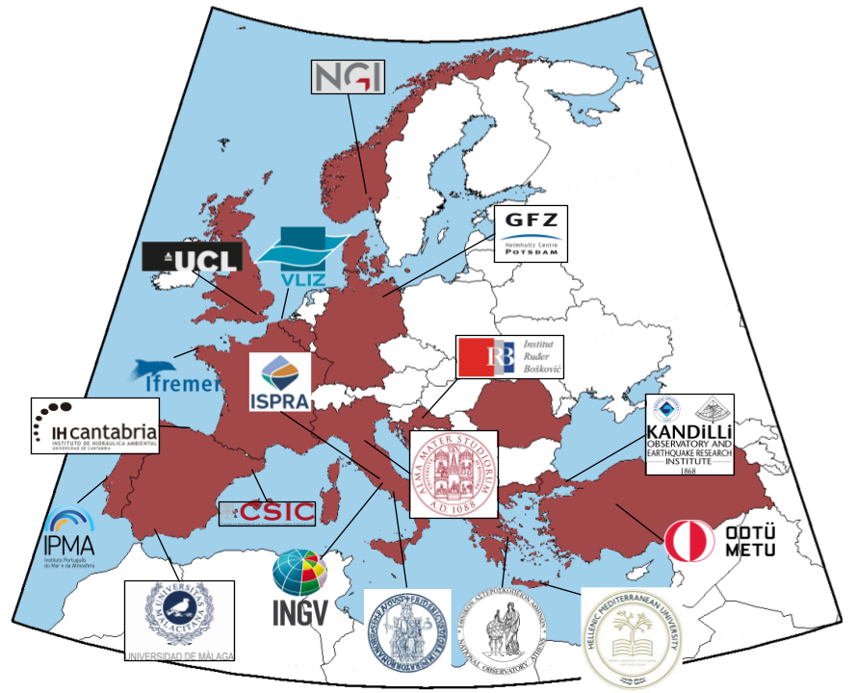
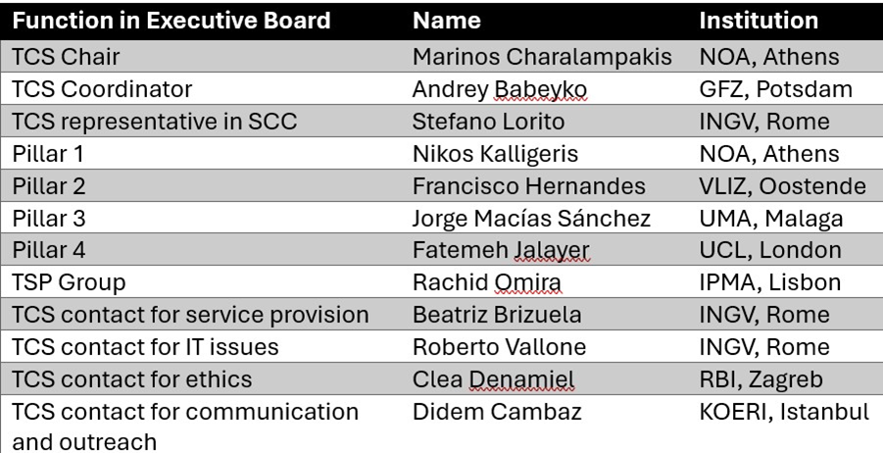
Thematic Core Services TSUNAMI
Governance
Executive Board & functions
https://www.epos-eu.org/tcs/tsunami
https://youtu.be/loFW0vkRwY8?feature=shared
https://tsunamidata.org

Slide 3
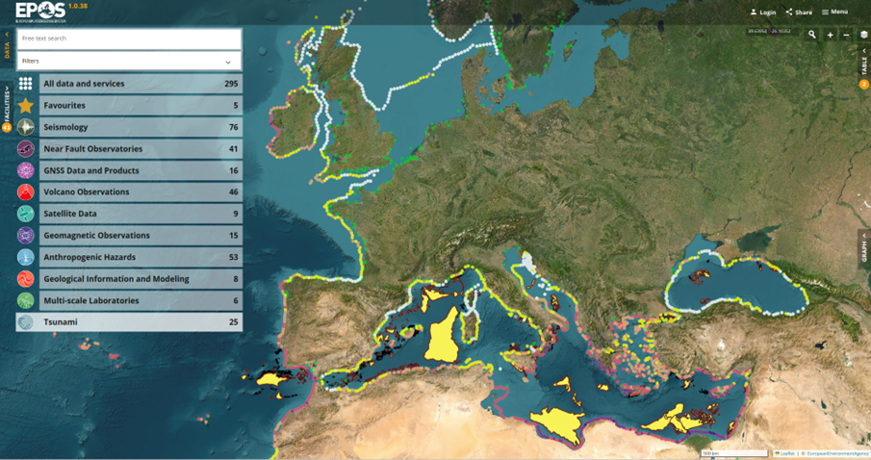
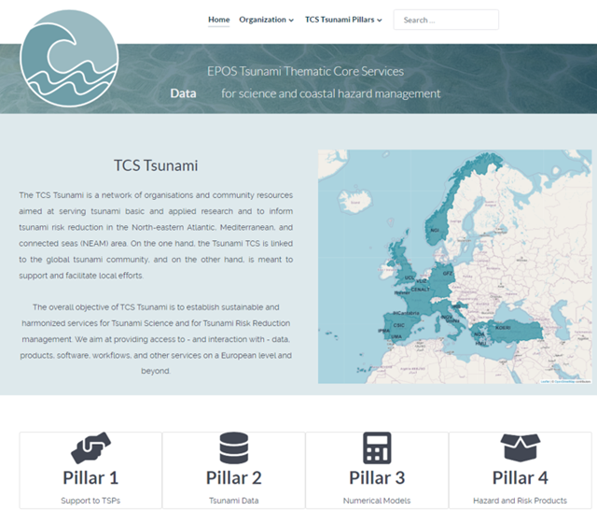
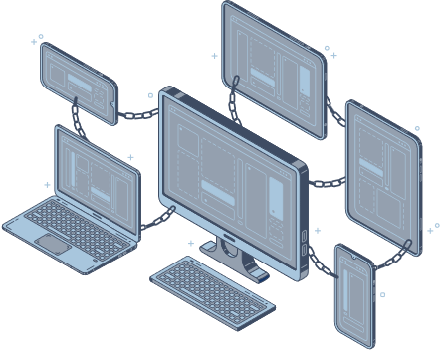
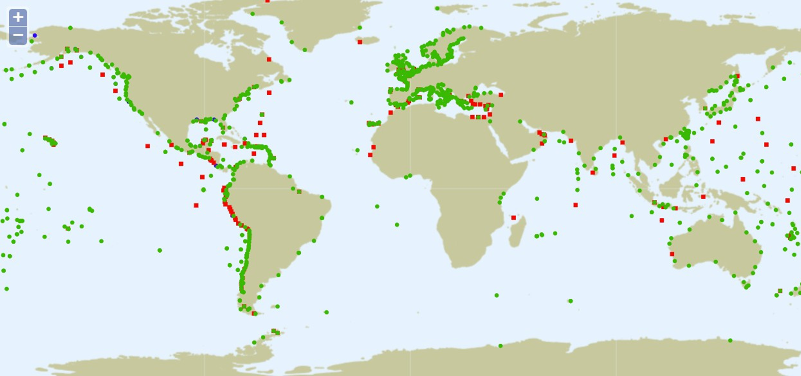
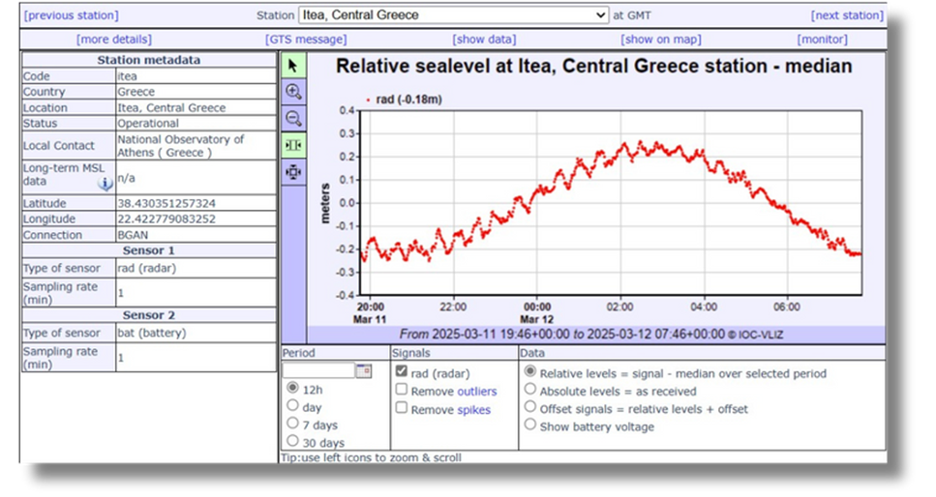
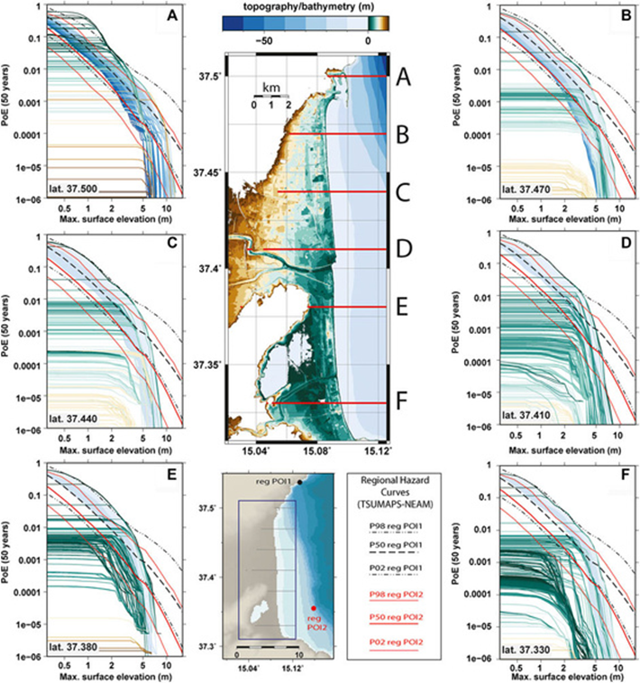
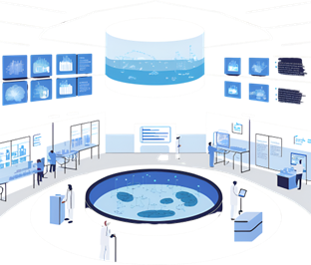
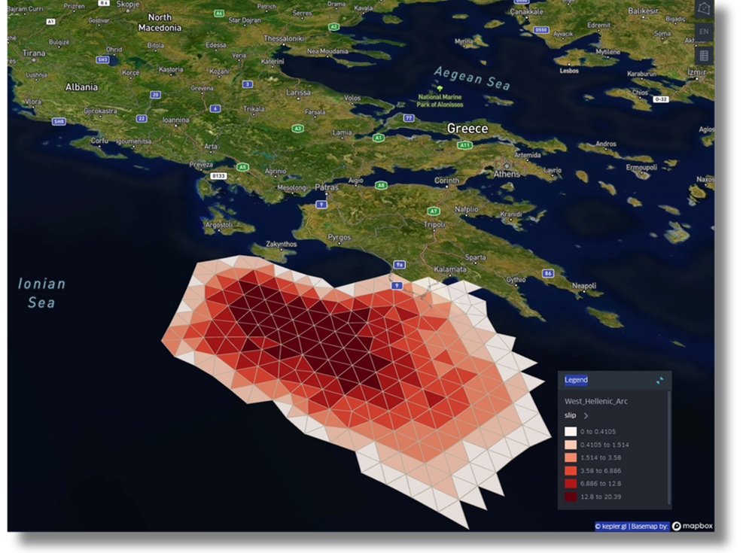
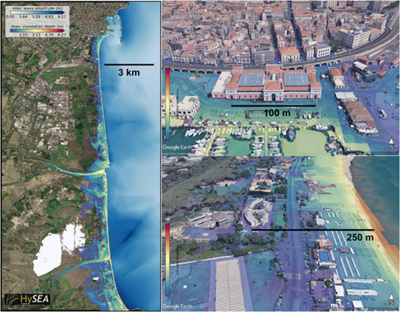
Services to the community
https://tsunamidata.org
ICS-C Data Portal
Community web-portal
Sea Level Station Monitoring Facility
Inundation visualizations
(HySEA)
Interoperable Tsunami Early Warning Tools
Tsunami Models & Benchmarks
Slip distribution (ANTI-FASc)
Probabilistic inundation hazard
Tsunami Data & Experimental Facilities
Tsunami Hazard & Risk Analysis
(Gibbons et al., 2020,
Front. Earth Sci.al.)

Slide 4
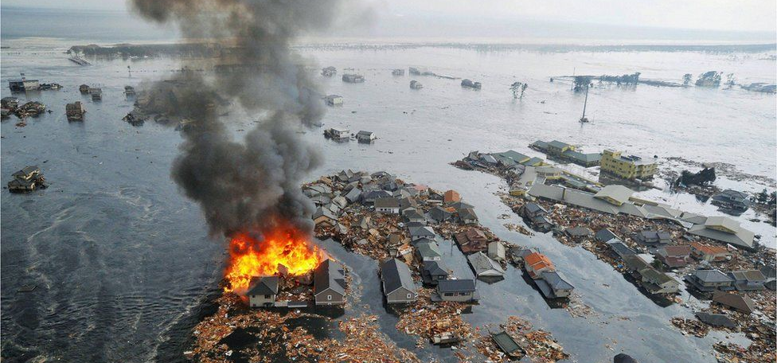
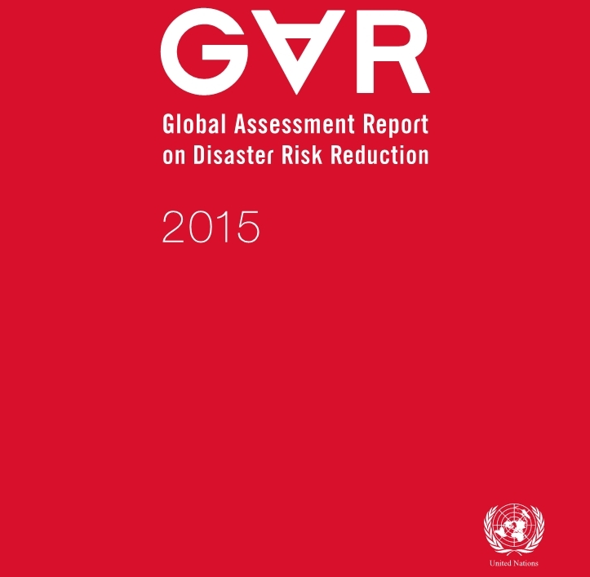
Global tsunami model – a global group of scientists working collectively on tsunami hazard and risk analysis
Saving lives, reducing losses, and enhancing resilience
Advancement of tsunami science, provision of expert information, promoting dialog about tsunami hazard and risk
Background
Vision
Previous Multi-institutional work on hazard and risk for UNISDR/UNDRR
Need for a collective effort for improved understanding of
global tsunami hazard and risk
Need for a competence center for tsunami hazard and risk assessment
Community building
Promoting scientific services, products, and standards
Outreach, collaboration and communication
Training
Overarching Missions Areas
KYODO / REUTERS
KYODO / REUTERS

Slide 5
GTM evolution
First vision statement
PTHA community paper
EPOS TCS initiation
GAP papers on tsunami risk
EPOS TCS
AGITHAR ends →
CIG starts
AGITHAR startup
GTM eV as formal entity
GAR15
Proposition of GTM
LoI
collection
starts
2015
2016
2017
2018
2019
2020
2021
2022
2023
2024
2025
Interdisciplinary EU projects provides advanced hazard and risk products
Many community meetings
(EGU, AGU, WB, UNDRR…)
Tsumaps, GTM Global hazard map

Slide 6
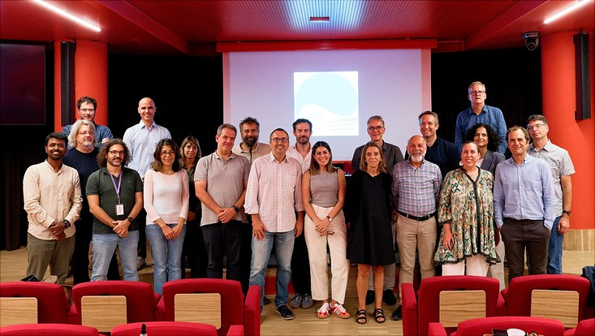
GTM’s new legal entity -
GTM Association
GTM inauguration meeting at INGV in Rome September 2024
Global Tsunami Model Association – first organization formally representing GTM - formally founded 29.9.2024 in Rome
Further rounds of registration before the organization will be effective
GTM will invite institutions and researchers working within tsunami hazard and risk analysis and related fields as members
Our network AGITHAR endorsed by the UN Decade of Ocean Science through UNESCO IOC
GTM will several meetings during EGU General Assembly in Vienna April 2025 30.4.2025
Work meetings (Splinter meeting)
Open Town Hall Meeting 30.4.2025 19.00-20.00

Slide 7
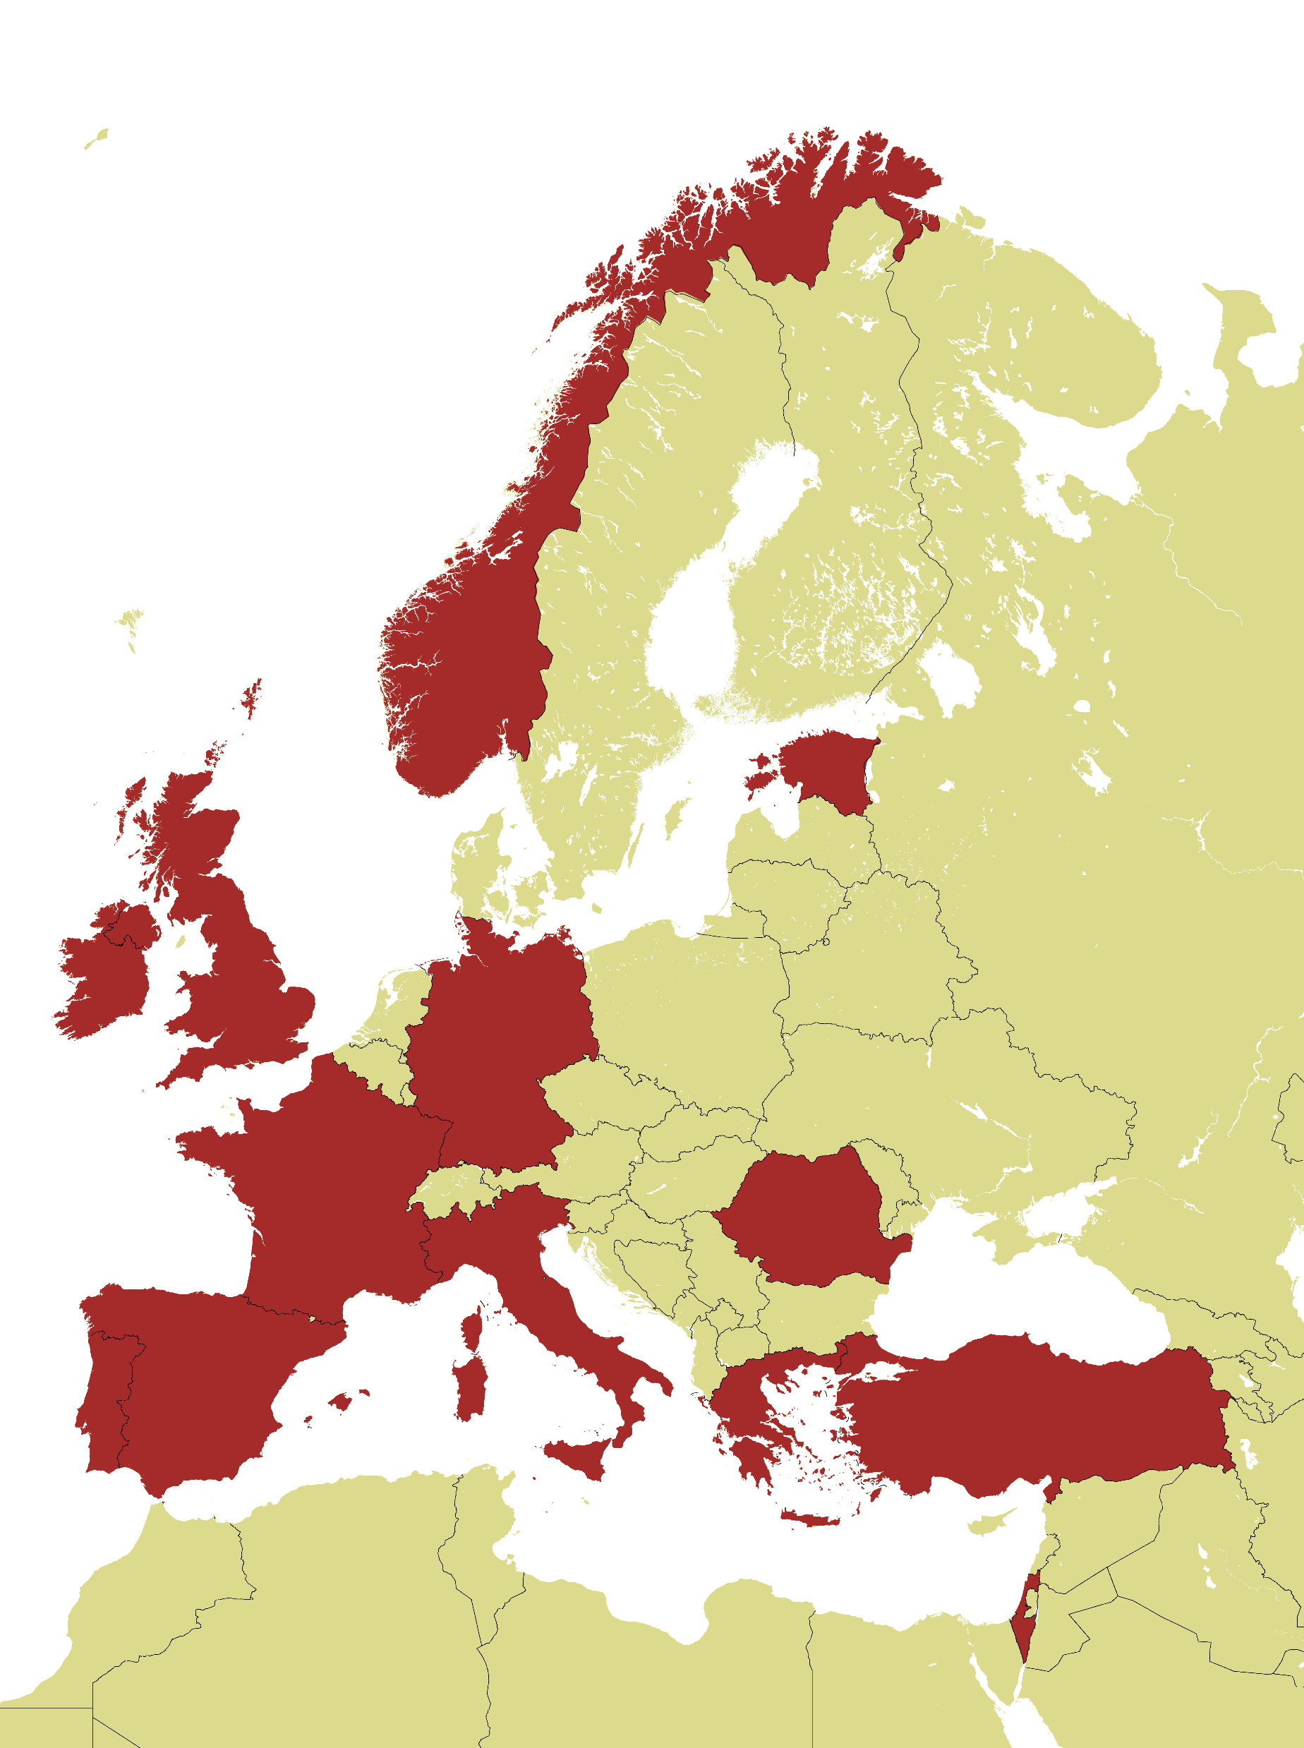
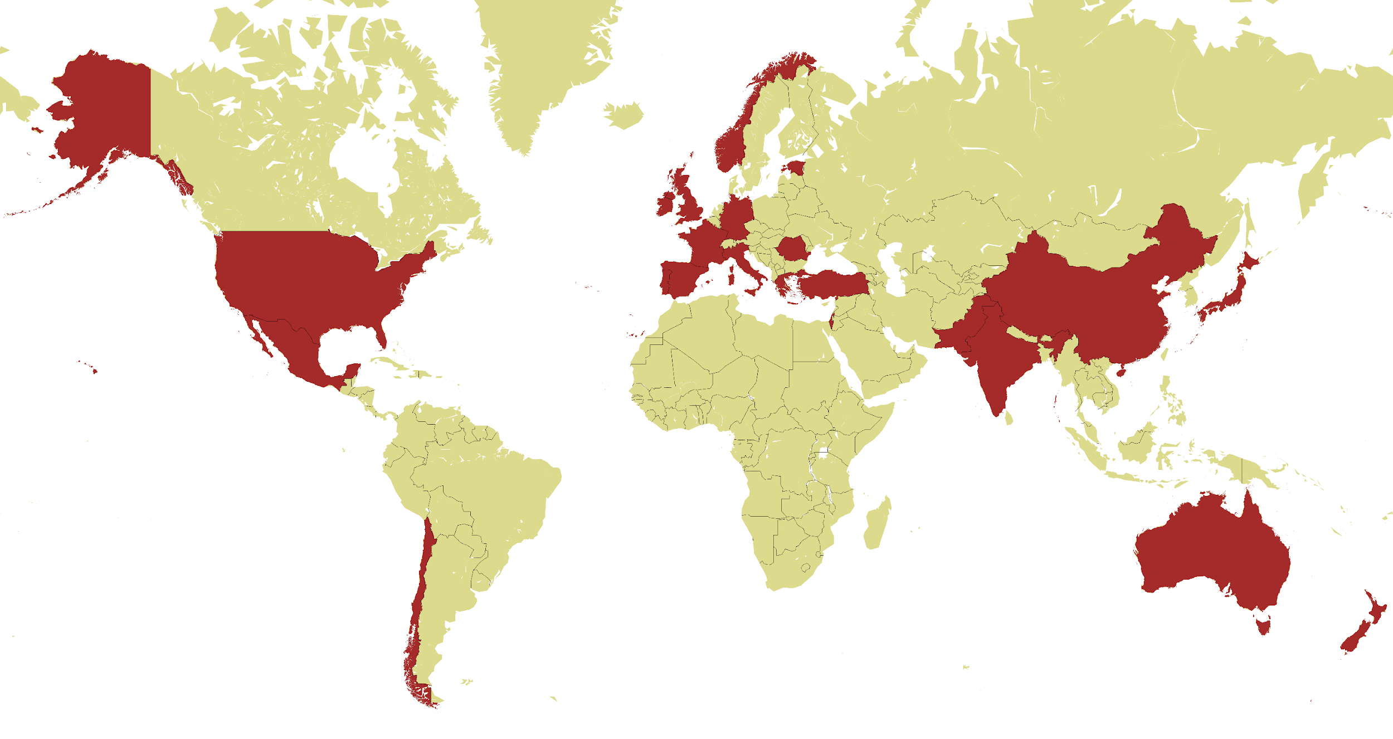
The GTM – a global network
Countries with Letter of Interest subscribers
Notes:
Today, in 2024, the network still consists of a large number of partner institutions worldwide..

Slide 8
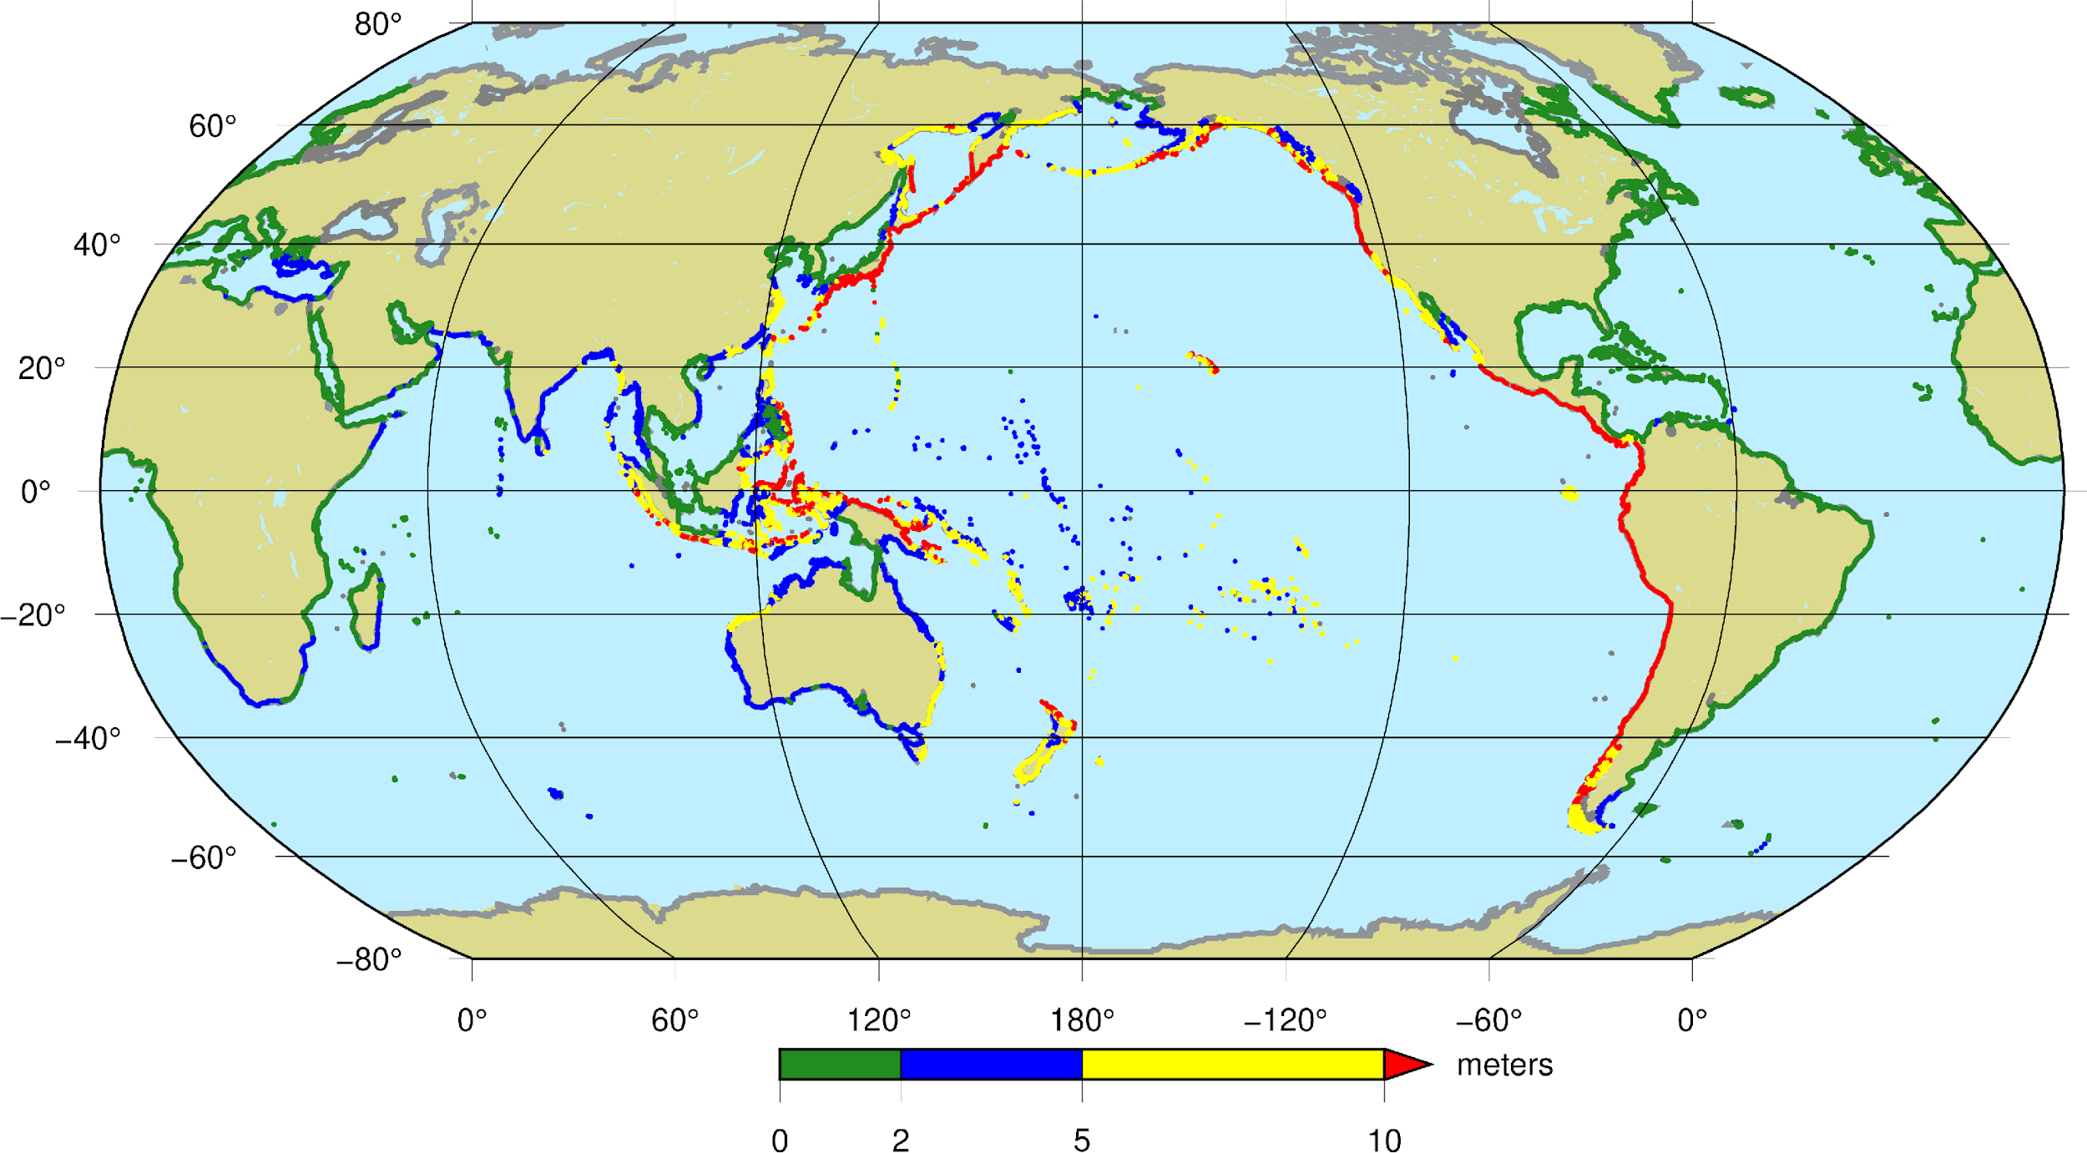
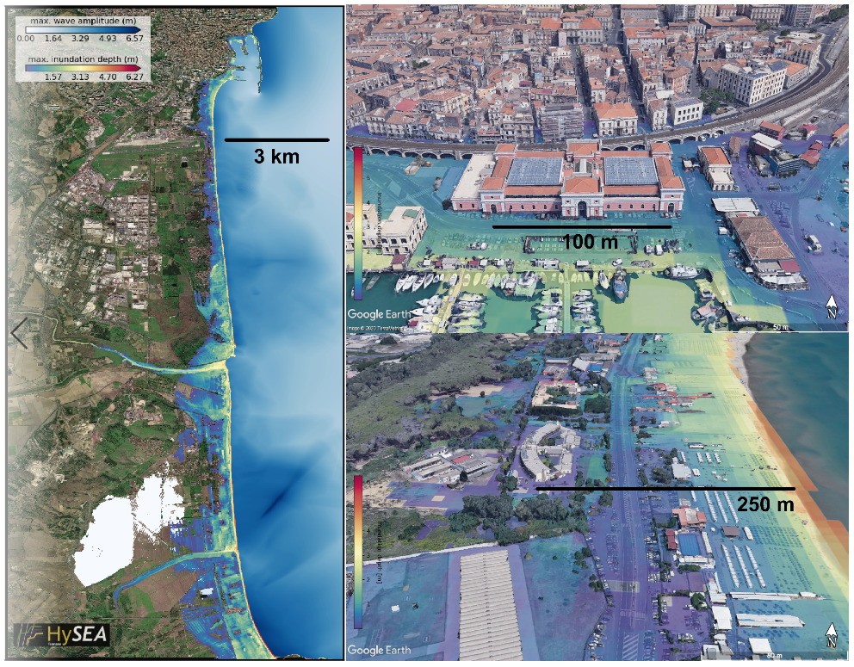
GTM Products
Providing the highest quality and most cost-effective tailored tsunami hazard analyses from global to local scale
Local inundation
map
Global Hazard map
Notes:
First global hazard map 2018, based on the GAR15 report: New aspects concerns uncertainty in the inundation heights. Community effort with improved source characteristics.
We are presently in the process of providing a next generation global map that will be available in the near future, and that will be updatable and usable also as a driver for local hazard and risk studies.
The local hazard map is from Catania

Slide 9
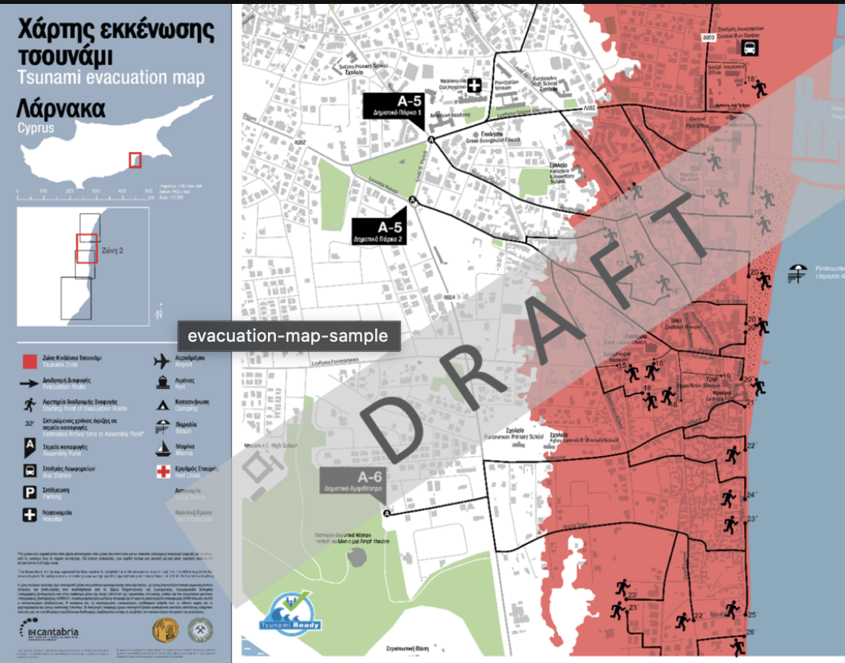
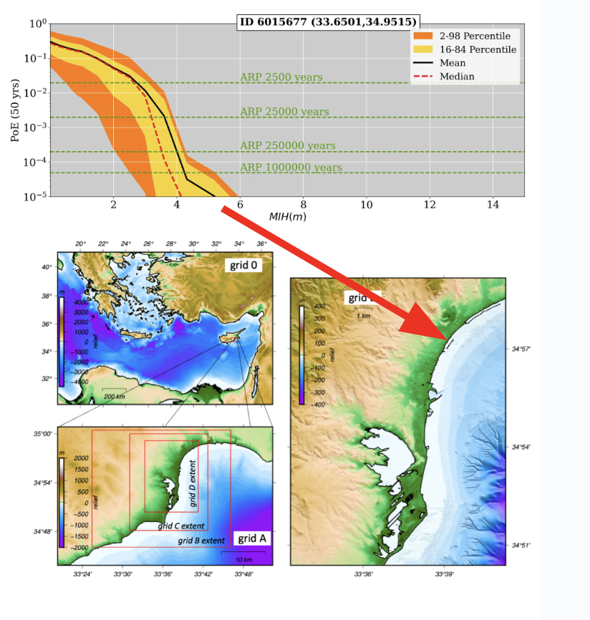
GTM supporting local decision making
Gibbons et al. (2020)
Frontiers earth science
Science informed decision making, planning, and capacity building
Our models are adaptable for local tsunami risk reduction
Notes:
We can take science-based hazard information from regional and global models and provide local hazard information at high resolution. Furthermore, we have expertise to convey this into information useable for end users, such as evacuation maps, integration with vulnerability curves etc.

Slide 10
GTM interface with EPOS and potential benefits
GTM service provision strategy - liaise with EPOS and Tsunami TCS for providing services and DDSS standards for its provision
Tsunami TCS - provision of a series of tsunami services made available publicly
https://tsunamidata.org/
Benefit for EPOS
Possible new users and services from overseas
Numerical model oriented community - can broaden types of services
Several products (e.g. hazard) tailored for end users
Further development of the ‘societal dimension’, i.e., risk products

Slide 11
Thank you for your attention!

