Slide 1
EPOS TCS Seismology at a glance
@ EPOS Days 2025

Slide 2
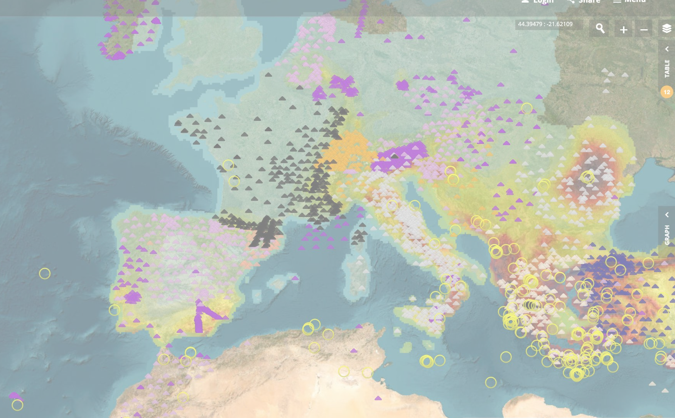
EPOS TCS Seismology facilitates and enhances seismological research through the development and maintenance of infrastructure, data services, data products, and collaborative initiatives.
Observatories & Research Facilities for European Seismology Since 1986 – 60+ Participants
European-Mediterranean Seismological Centre Since 1975 - 70+ Members
European Facilities for Earthquake Hazard and Risk Since 2018 – 40+ Members
From seismic waveform data collection, to earthquake catalogue compilation, to earthquake hazard and risk assessment, and back.

Slide 3
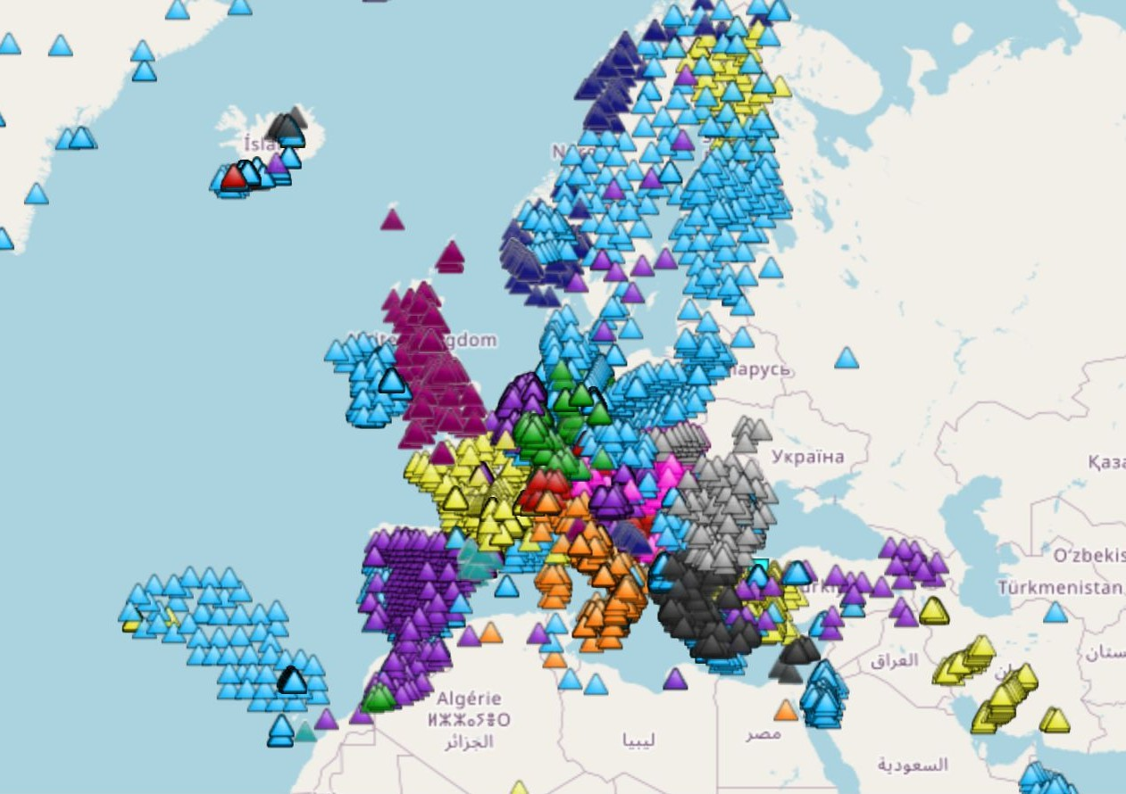
Portfolio of ORFEUS data services/products & activites
European Integrated Data Archive
FDSN & domain-specific web services
31000+ stations
> 73000 unique users/year
(only dataselect & EIDA 2024)
See EPOS Data Portal & https://www.orfeus-eu.org/ https://orfeus.readthedocs.io
European Coordinated “Strong-Motion” Services
European Mobile Instrument Pools
Focus groups on trending topics (DAS, ML, etc.)
Community actions (conferences, workshops, temp. deployments, etc.)
Global collaborations

Slide 4
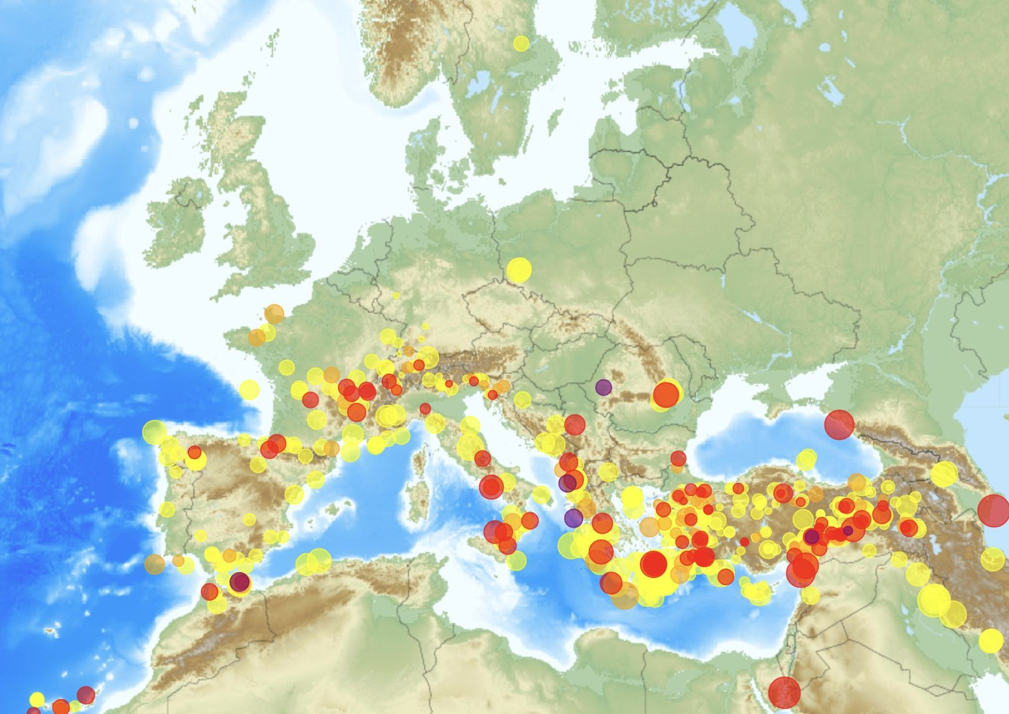
Portfolio of EMSC & AHEAD data services and products
Webservices: 1.5M daily requests
4M unique users in 2024
Public visibility: 9.7M
See EPOS Data Portal & https://emsc-csem.org/ www.seismicportal.eu https://www.emidius.eu/AHEAD/ @LastQuake
Real-time event catalogues
Moment tensors
Felt reports
EventID
Historical event catalogues
Rupture models
Flinn-Engdahl Lookup
Near Real Time notifications (websockets)
Android & iOS app, social media

Slide 5
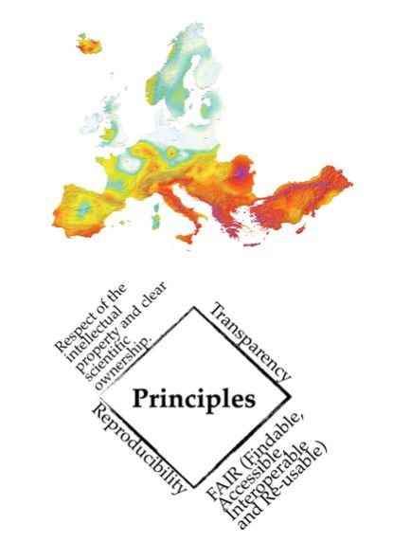
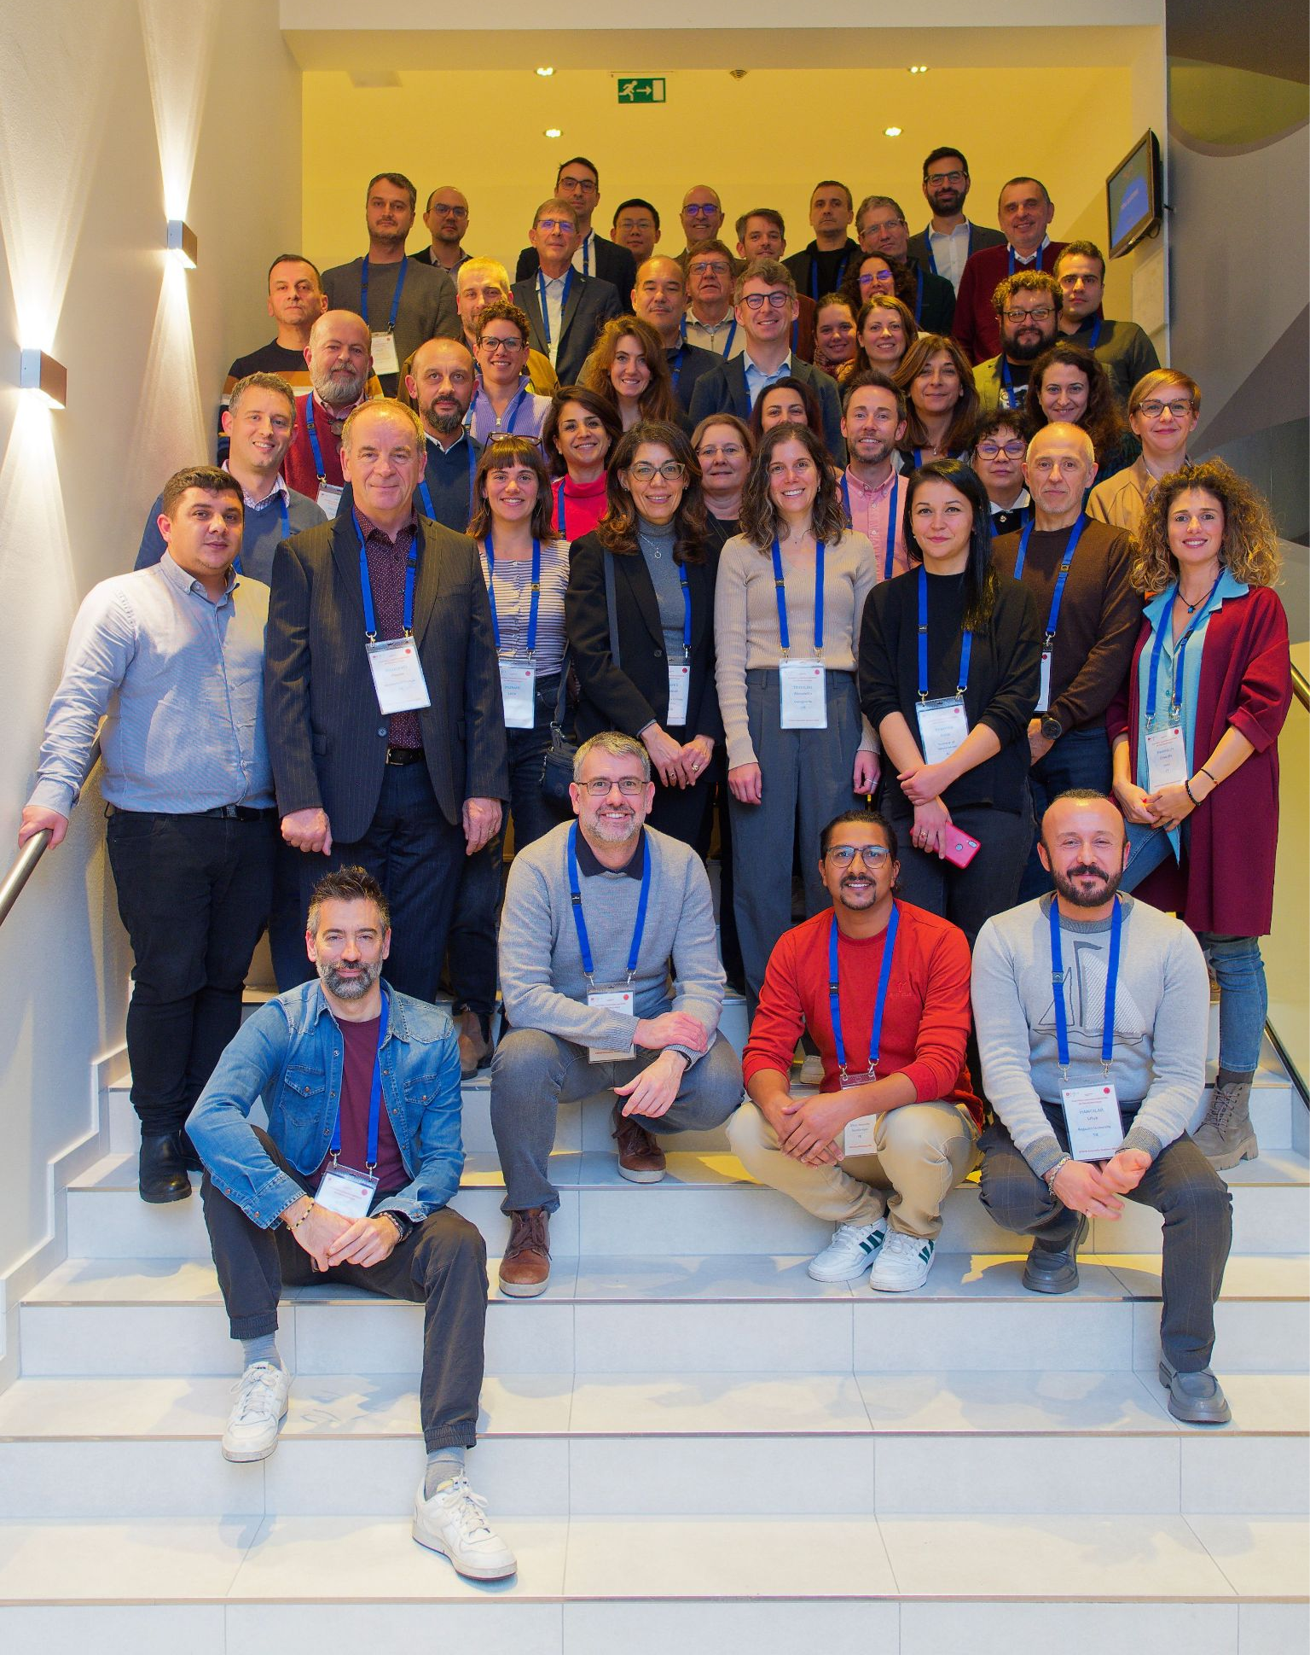
Portfolio of EFEHR data services/products and activities
Seismic Hazard Portal and Data Access
European Seismic Risk Services
Historical Earthquake Catalogue
Instrumental Earthquake Catalogue
European Databases of Seismogenic Faults
Ground Motion Shaking Models
Community engagement:
Fast growing (42 members, 26 countries)
Scientific and networking activities: conference sessions, project workshops, domain workshops
See EPOS Data Portal & http://www.efehr.org

Slide 6
International collaborations
New services
Community actions
Data quality
Massive data access and processing
New DAS metadata and data formats/services
FAIR data assessment
Logging services (KPI measurements)
New and advanced
flatfiles
EU-OEF
EU-CESP testing services
Best practices and community standards (e.g. EarthScope/FDSN/NEIC) on:
Infrasound/OBS/DAS data
AAI
QA
Massive data access and processing, eg. testing data provision via S3 (Object Storage)
FAIRification
Within-TCS & cross-TCS collaborations
Domain conferences and webinars
Grant & mentoring schemes
Editorial initiatives
ShakeMap-EU
ML-ready datasets
ML-driven products
Multi-hazard, multi-risk products
Joint science actions
Towards societal impact – stakeholder engagement
EPOS Seismology &
Geo-INQUIRE
Workshop 2025: 24-27
November, Athens,
Greece.

