Slide 1
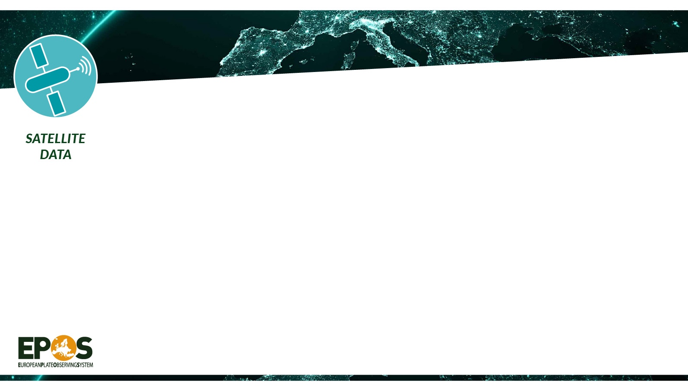
TCS Satellite Data:
Mission and Perspectives
Michele Manunta
CNR-IREA - Italy
(manunta.m@irea.cnr.it)
TCS Satellite Data Director

Slide 2
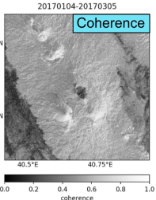
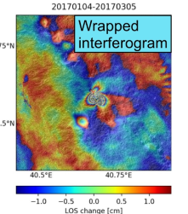
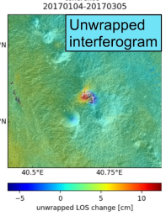
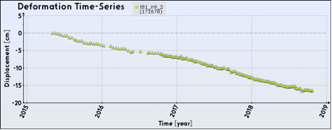
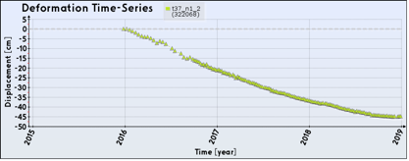
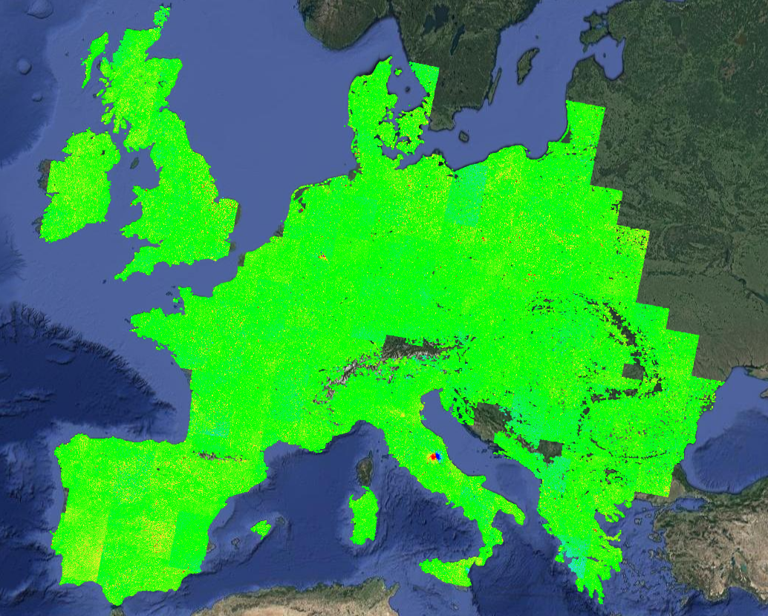

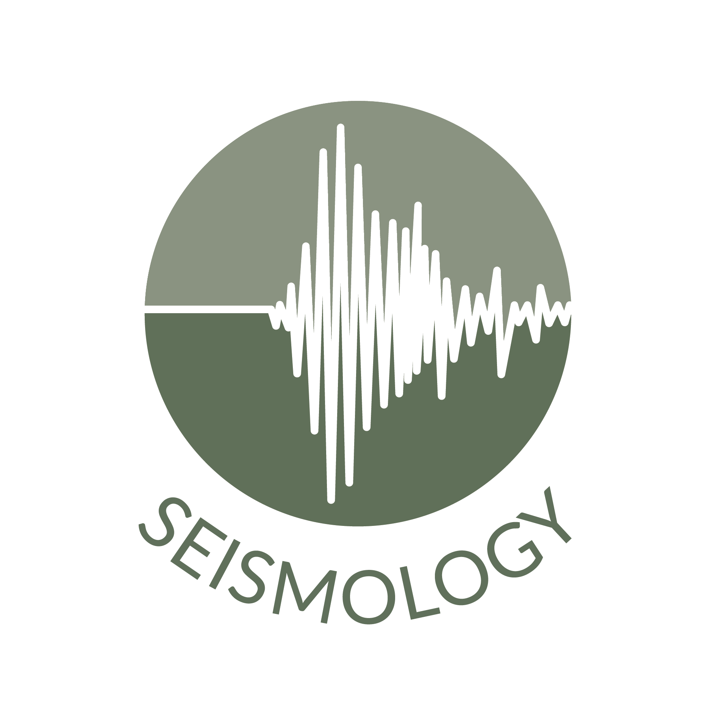


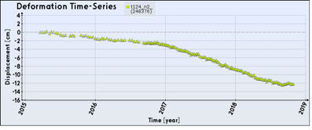
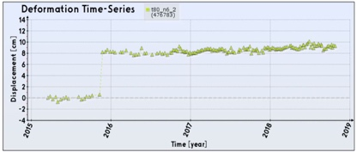



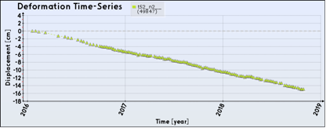
TCS Satellite Data Mission
TCS Satellite Data aims to foster the use and re-use of satellite data and products to establish multidisciplinary research in Earth sciences. TCS SATD widely benefits from the Copernicus Programme to deploy advanced satellite services with a free and open data access policy.
Surface deformation maps and time series
with cm to mm accuracy
to study natural hazards and anthropogenic phenomena
Volcanoes, Earthquakes, Landslides, Man-made activity
>3
Mean deformation velocity [cm/year]
<-3

Slide 3
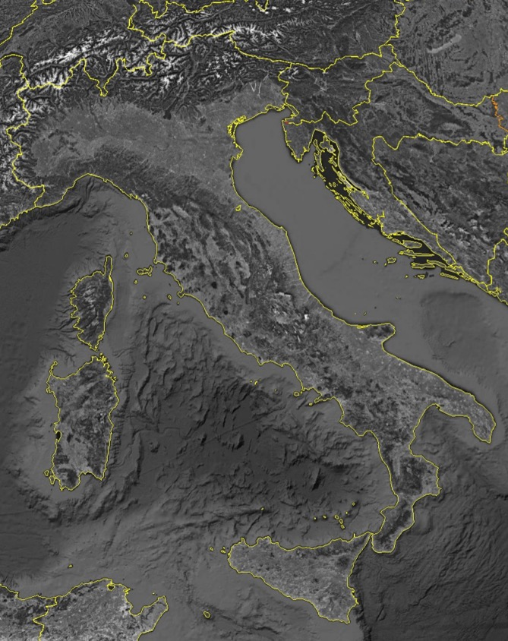
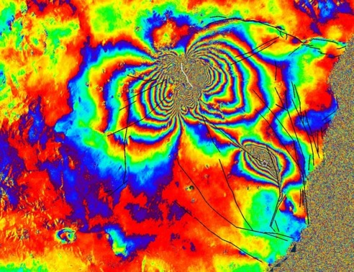
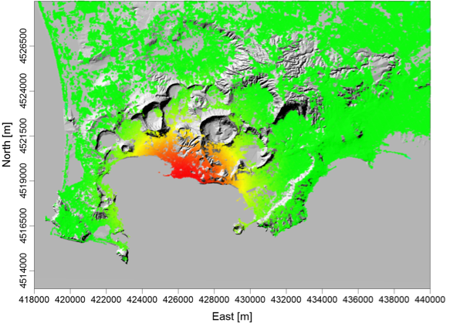
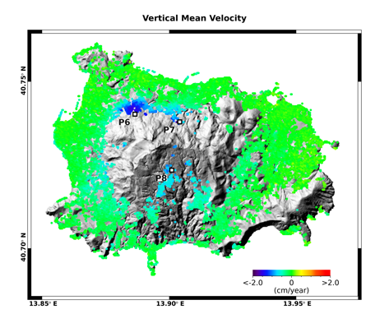
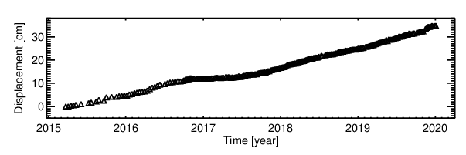
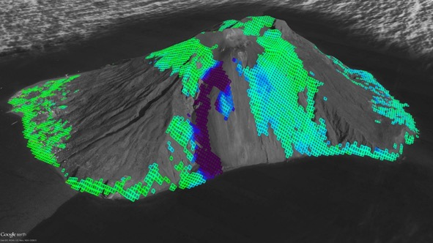

TCS Satellite Data Scientific Context: why satellite in EPOS?
Campi Flegrei
Etna
Ischia
> 6
Down
Up
Down
Up
[cm/year]
Mw 3.9 21.08.2017
Napoli area
< -6
Eolie
Stromboli
Etna
Down
Up
< -5
[cm/year]
> 5

Slide 4

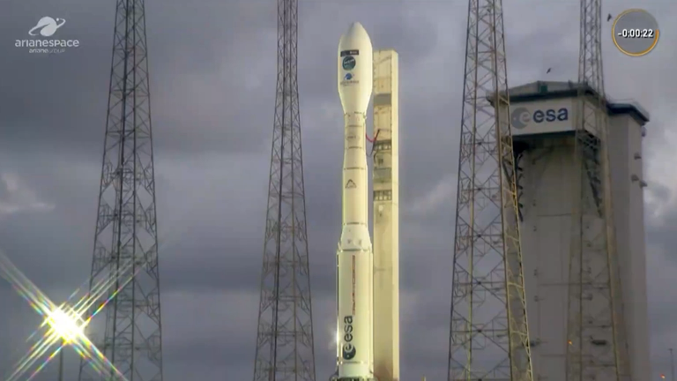

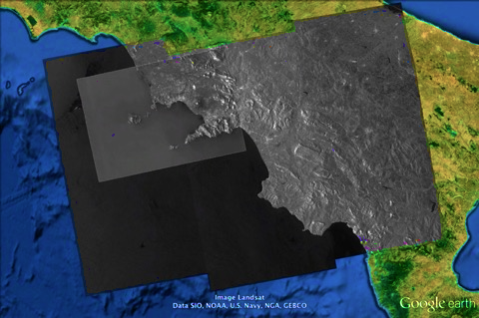
Our Data
Dec 2021
Dec 2024
Sentinel-1A
Sentinel-1B
Sentinel-1C
Sentinel-1A
5TH December 2024
French Guyana
Time
6 days
12 days
Spatial resolution (TOPS): 15 x 4 m
Ground coverage (TOPS): 250km
C-band
2014 - present
Global coverage
Free and open access data policy
CSK-CSG
ERS-ENV
SENTINEL-1

Slide 5
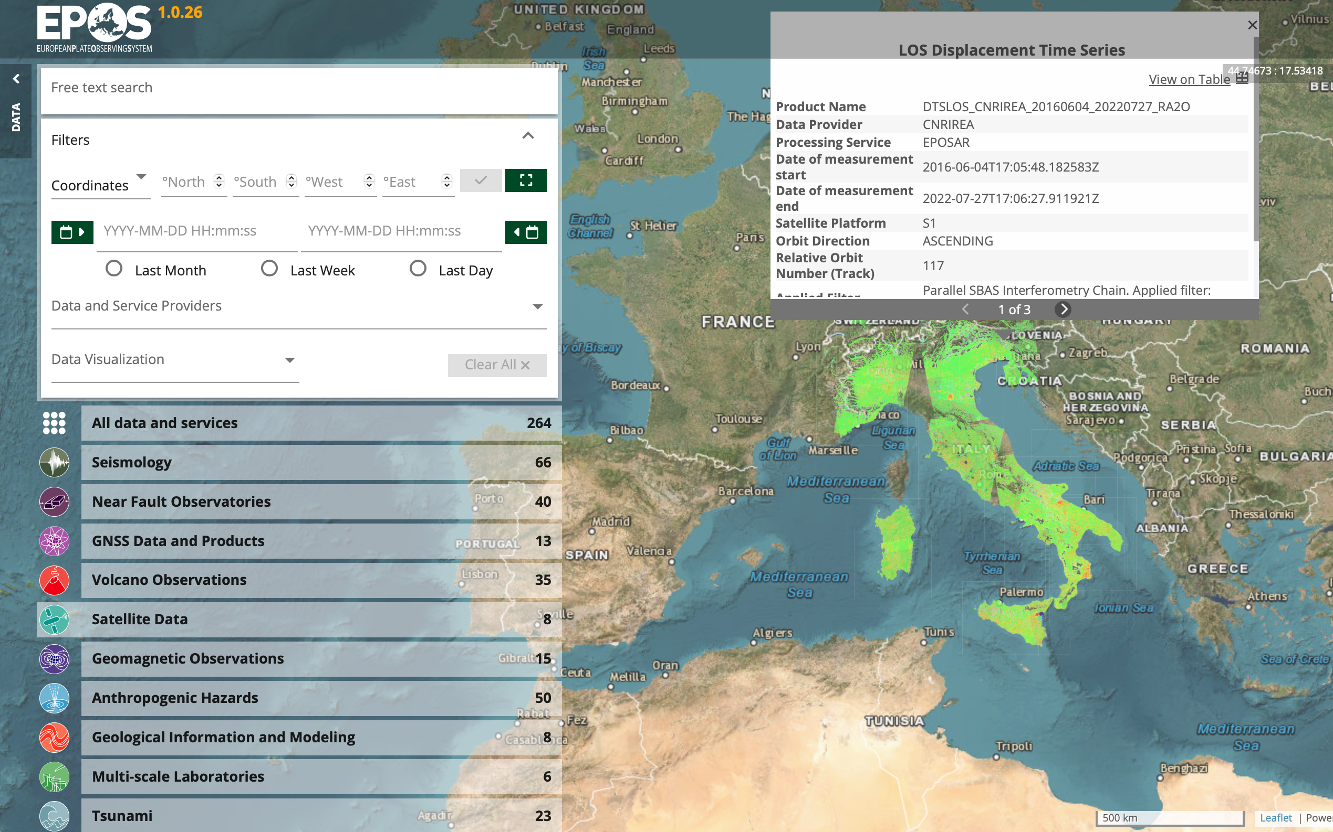
Our Products and Services
TCS SATD distributes services
based on InSAR technology
9 Services
  LOS Displacements Time Series
  Spatial Coherence
  Wrapped Interferograms
  Displacements Maps
  …..
Global Coverage (Sentinel-1 images)
Medium spatial resolution (>30 m)
Centimeter-to-millimeter accuracy
Quasi real-time data availability

Slide 6
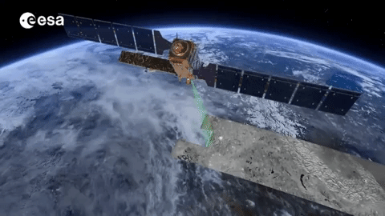
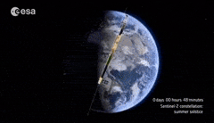
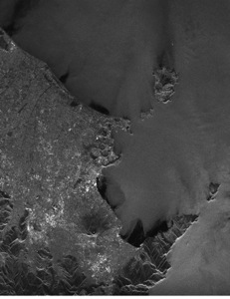
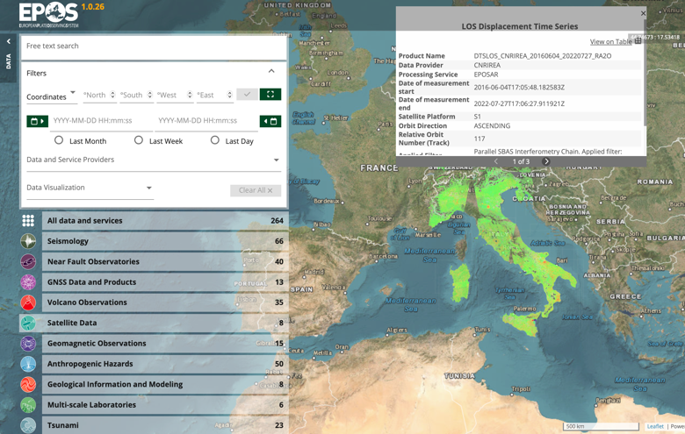

Data Infrastructure
Sentinel-1 revisit time : 6/12 days
TCS Services
EPOS Data Portal
>6
Campi Flegrei
[cm/year]
<-6

Slide 7
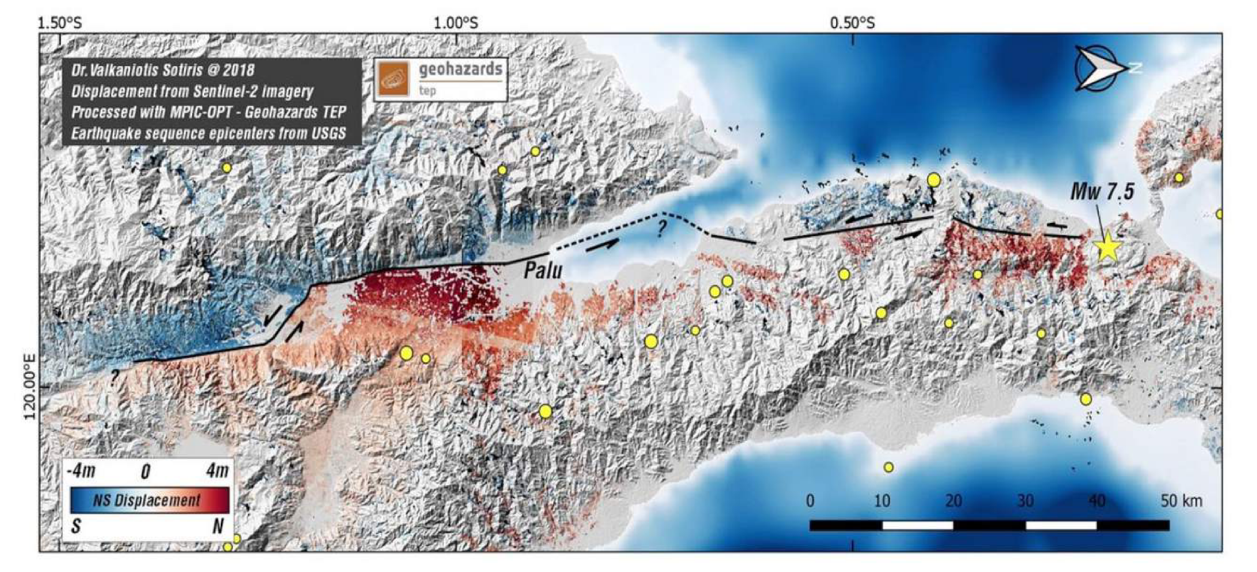
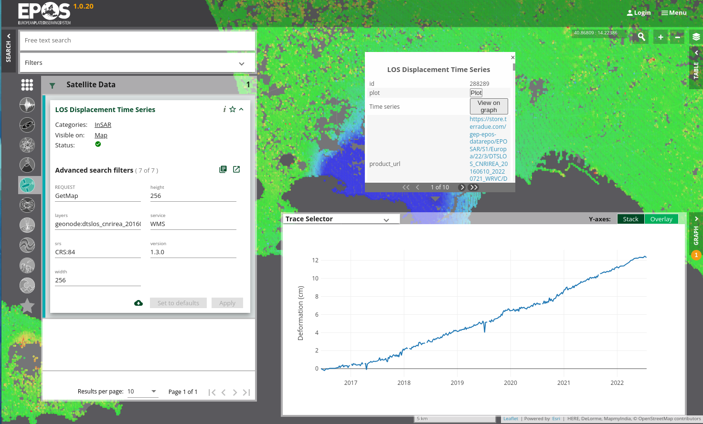
Future Developments
New
TCS Services
User Experience on EPOS Data Portal

Slide 8
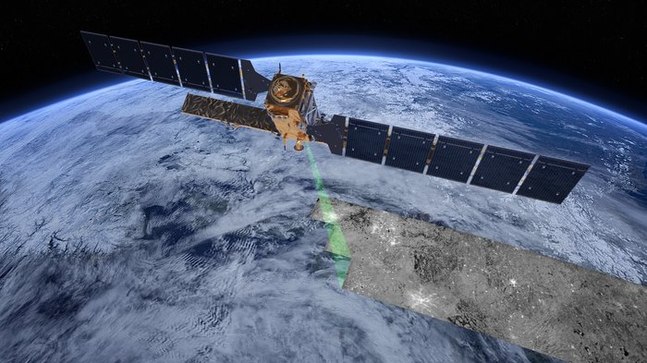
Thank you

