Slide 1
TCS Near Fault Observatories HR Data and HL scientific products for Science
Lauro Chiaraluce (INGV) – Chair of Executive Committee
Gaetano Festa (UNINA) – Chair of Consortium Board
Alexandru Marmureanu (INFP) – Chair of Service Committee
and NFO team

Slide 2
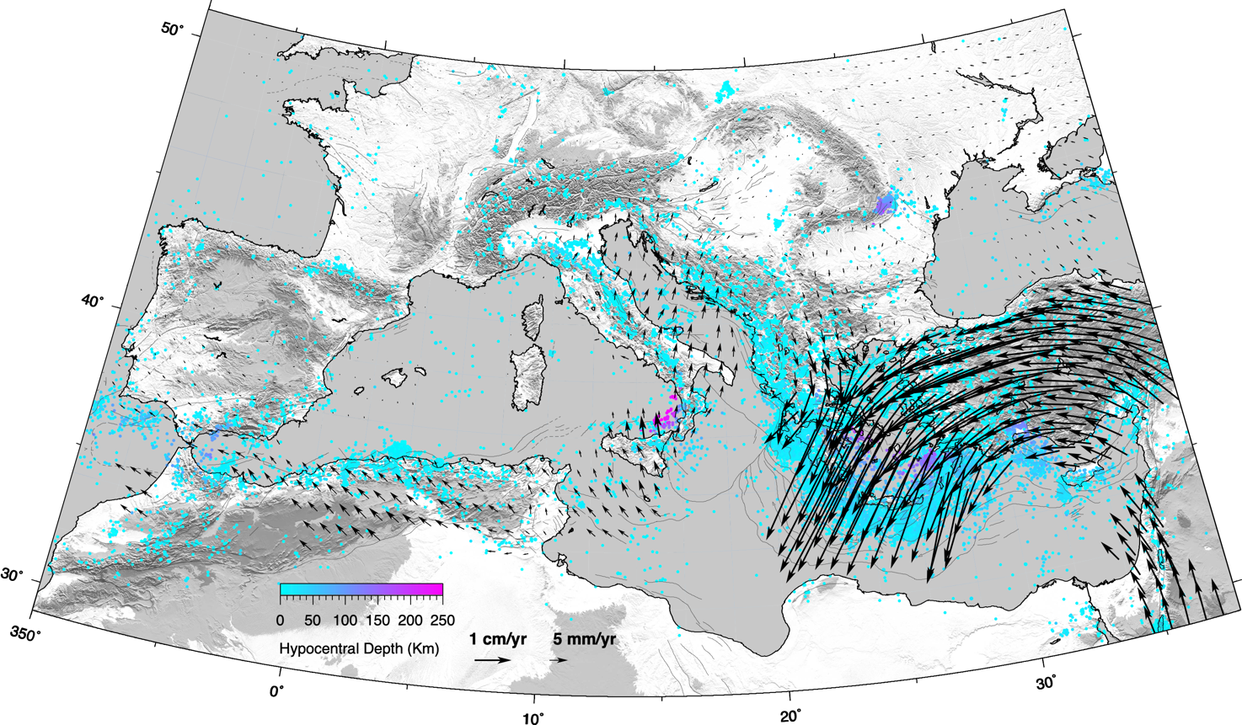
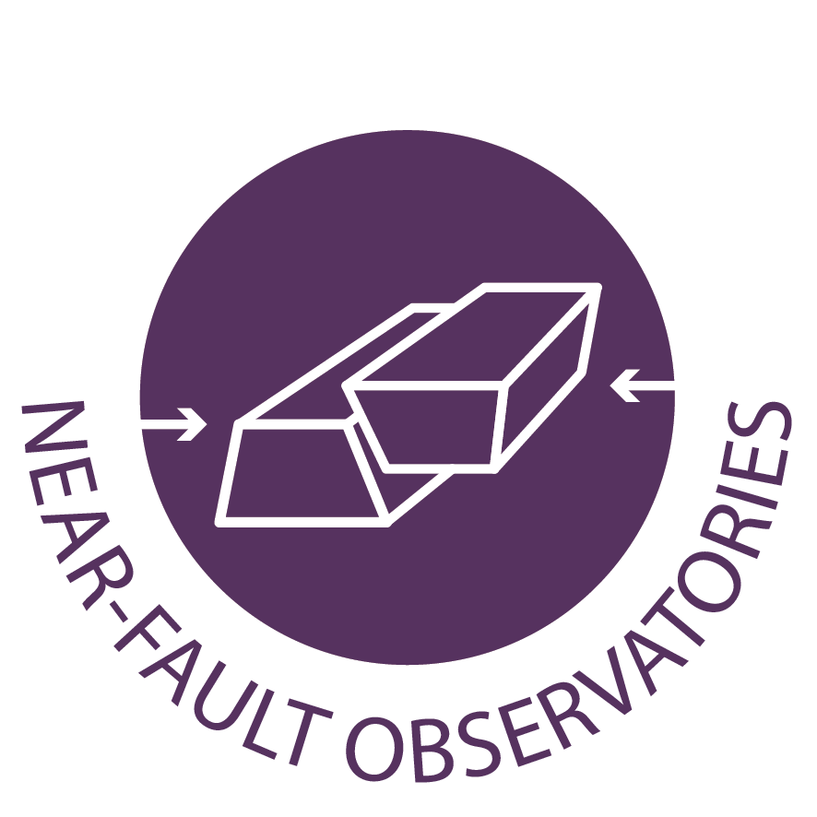
NFOs across EU
8 NFO Members
7 EU countries
12 ORGANIZATIONS
1 New interest
SCIENTIFIC PLAN: a better understanding of the multi-scale physico-chemical processes responsible for earthquakes and the search for mechanisms that can anticipate future large-scale events.
HOW: through the collection of high-quality multidisciplinary observations made near active faults and the generation of high-level scientific products describing phenomena that intersect different research fields.
NITRO
KARST
VALAIS
VRANCEA
TABOO
ALMA
MARMARA
IRPINIA
CORINTH
Connections: Seismology – Geodesy – Satellite Data – Anthropogenic Hazard – Volcanology

Slide 3
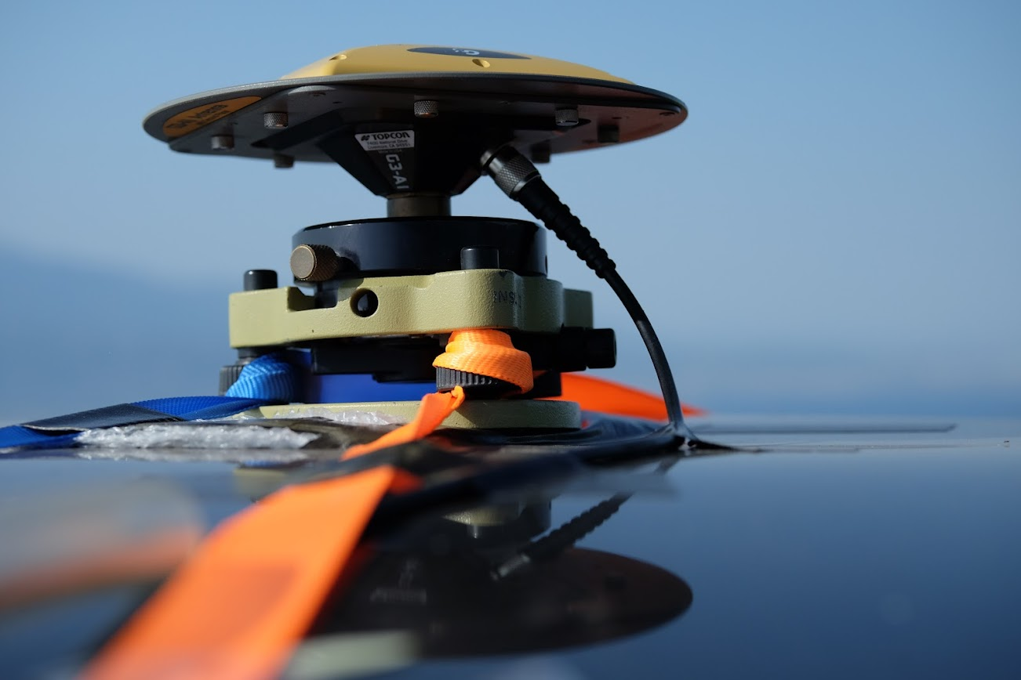
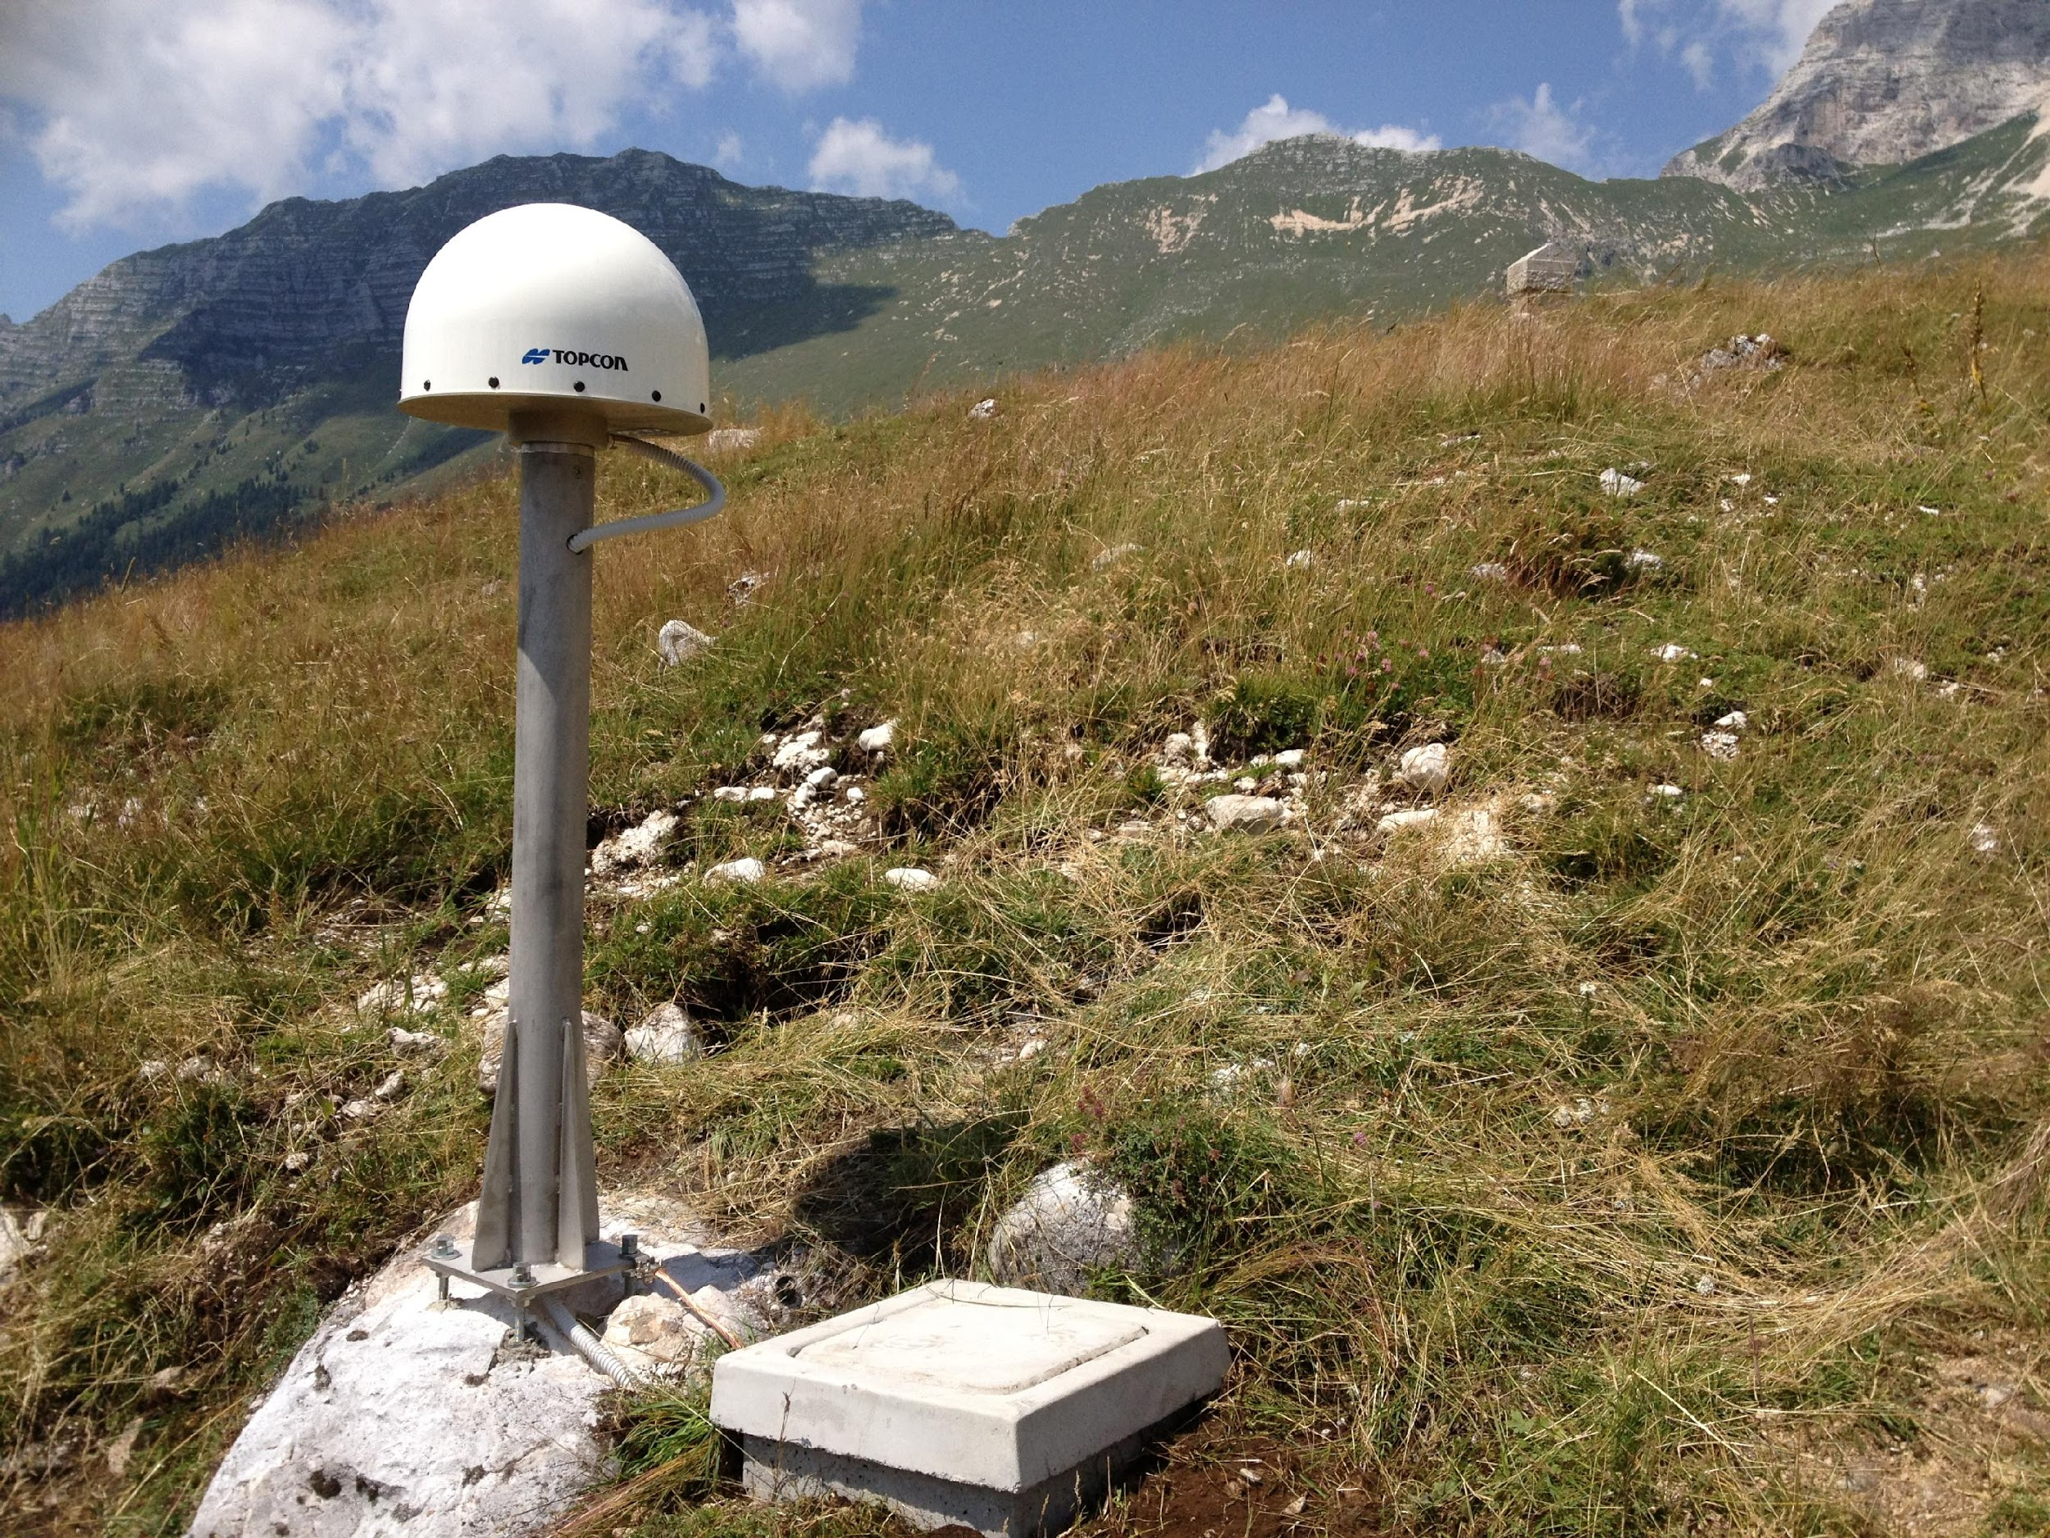
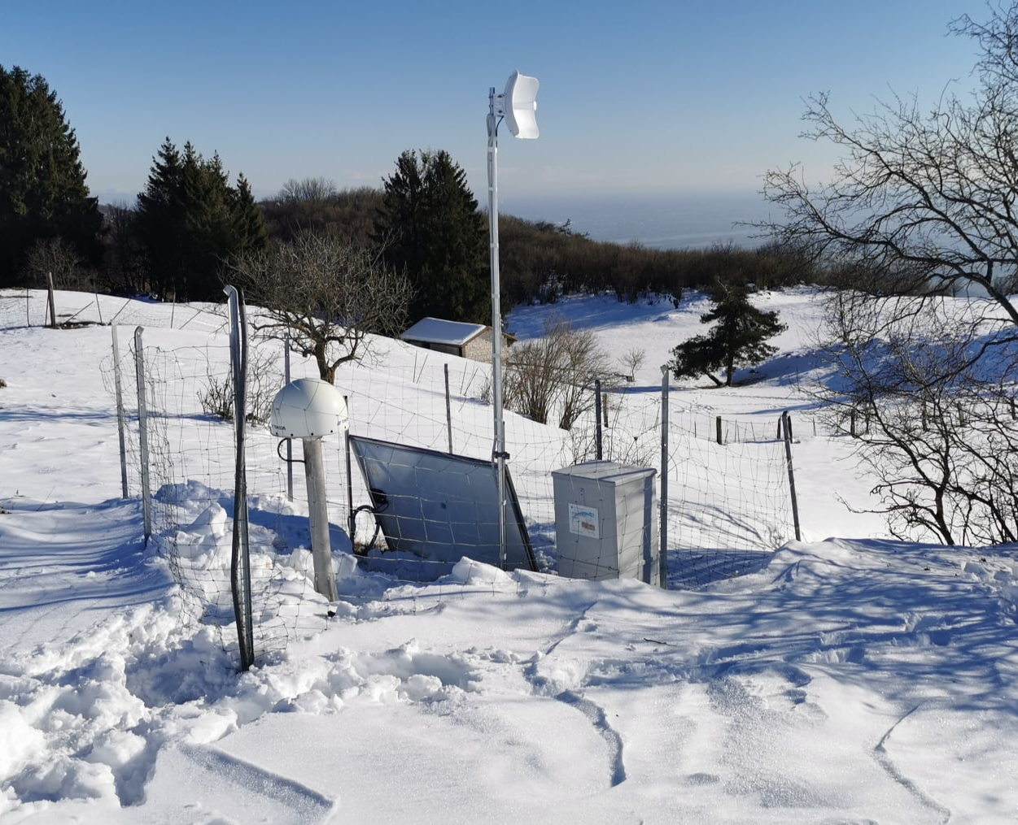
NFOs across EU
To reach the scientific goals we settled modern multidisciplinary infrastructures near active faults embedded in different tectonic contexts.
NFO Portfolio provided by the eight full member European NFOs consists of high-resolution raw data collected at dense networks and innovative scientific products generated through advanced scientific tools for data analysis plus target-oriented monitoring and alert systems and decision modules for risk mitigation actions.

Slide 4
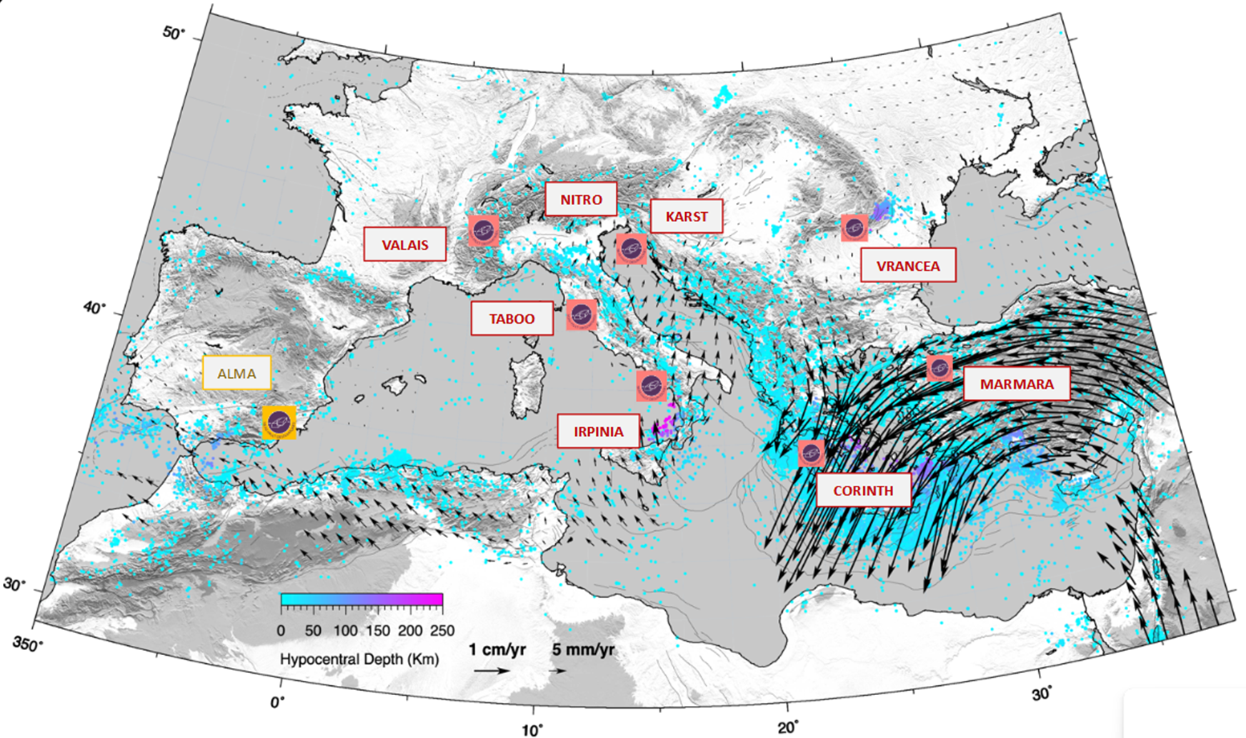
TCS-NFO community organization
Executive Committee
Supervision for implementation of
the Work Programmes
L. Chiaraluce (Chair), E. Sokos, G. Festa
ExCom
NFO Consortium
Consortium Board
G. Festa (Chair), UNINA
INGV (Taboo, IT)
INFP (Vrancea, RO)
CNRS (CRL, GR)
NOA - NKUA - UPAT (CRL, GR)
KOERI (Marmara, TR)
ETHZ (Valais, CH)
ZRC-SAZU (Slo-Karst, SLO)
OGS - UNITS (Nitro, IT)
Novel
UGR (Alma, SP)
Service Committee
technical vision on the services
A. Marmureanu (Chair)
1 IT Person per NFO; core group NIEP, INGV, UNINA
SeC
AdB
Advisory Board
User perspective
on the services
S. Ergintav (Chair) and external people

Slide 5
TCS-NFO Strategic view
(Inter-) National Research Infrastructures
Develop infrastructural implementation and scientific plans for single NFOs Provide relevant Data and products to the scientific community
NFO Consortium
EPOS
Coordinate strategic effort for data and product distribution and new products development Federate services via the common community portal FRIDGE
Allow Data and
products discovery via a common portal, fostering cross-thematic research
Warrant visibility to data and service providers and to the whole scientific community

Slide 6
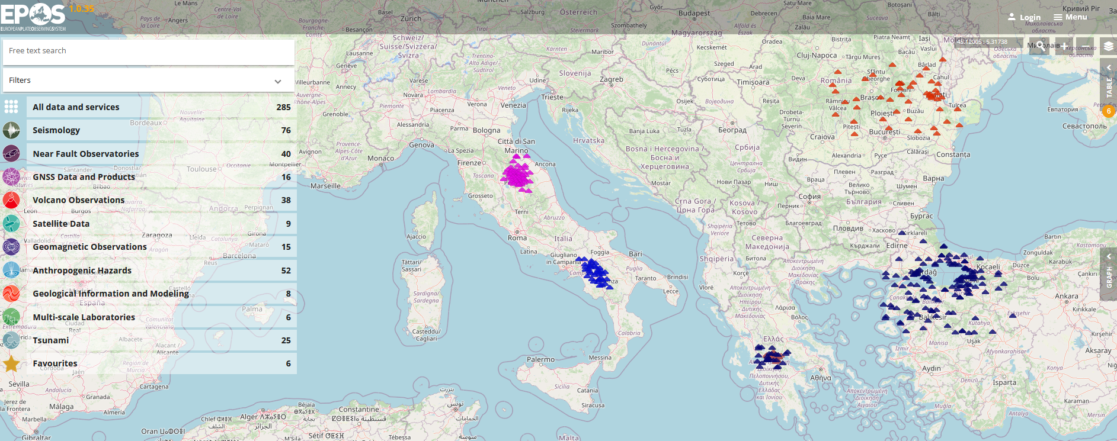
TCS-NFO data and products on EPOS portal
40 DDSS (data and data products) provided by the eight (8) full member European NFOs are available via web services on both the EPOS platform and community getaway, put in place as interoperability layer.
https://www.ics-c.epos-eu.org

Slide 7
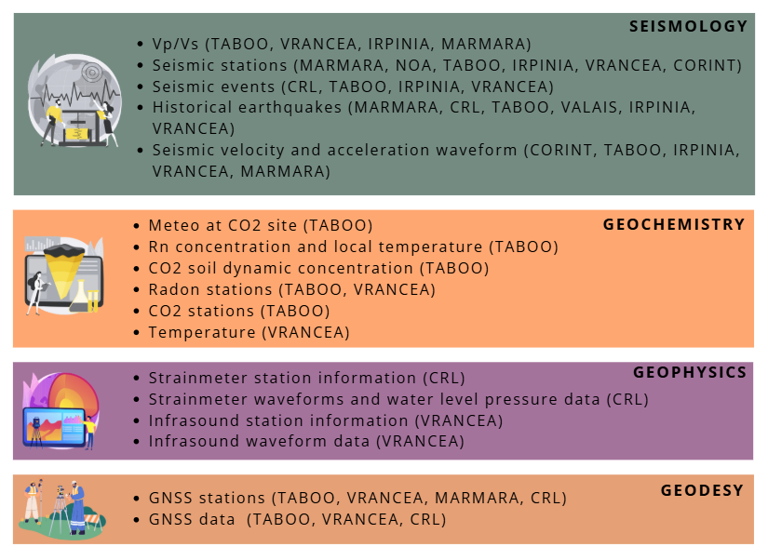
Services in operation on the EPOS Data Portal
2 community portals:
CREW
FRIDGE
The Near-Fault Observatories TCS integrates
seismological, geodetic, geological, geochemical, and
satellite data collected by individual observatories
into a network with common monitoring standards.

Slide 8
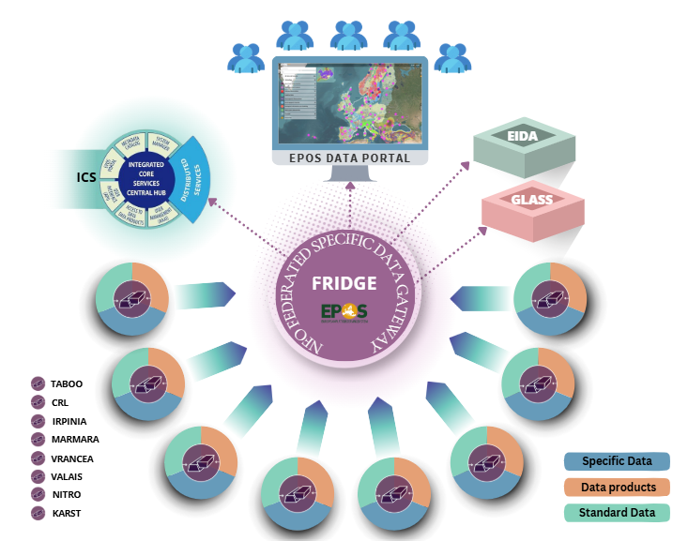
TCS-NFO federated data gateway and interoperability layer - FRIDGE - http://fridge.ingv.it

Slide 9
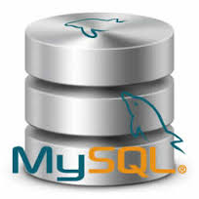
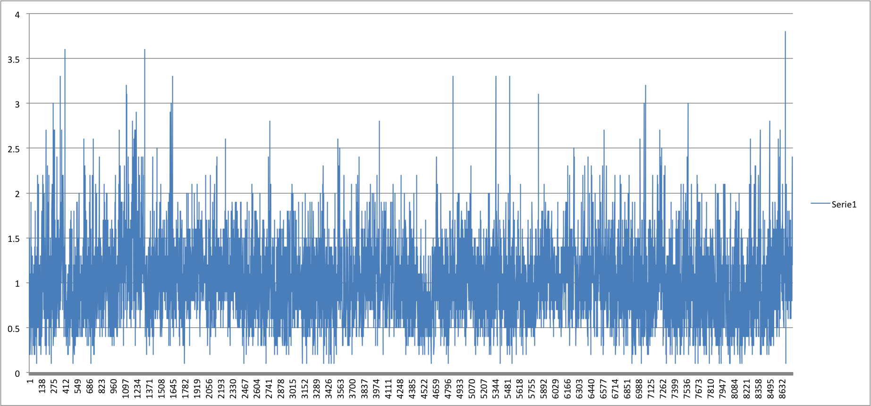
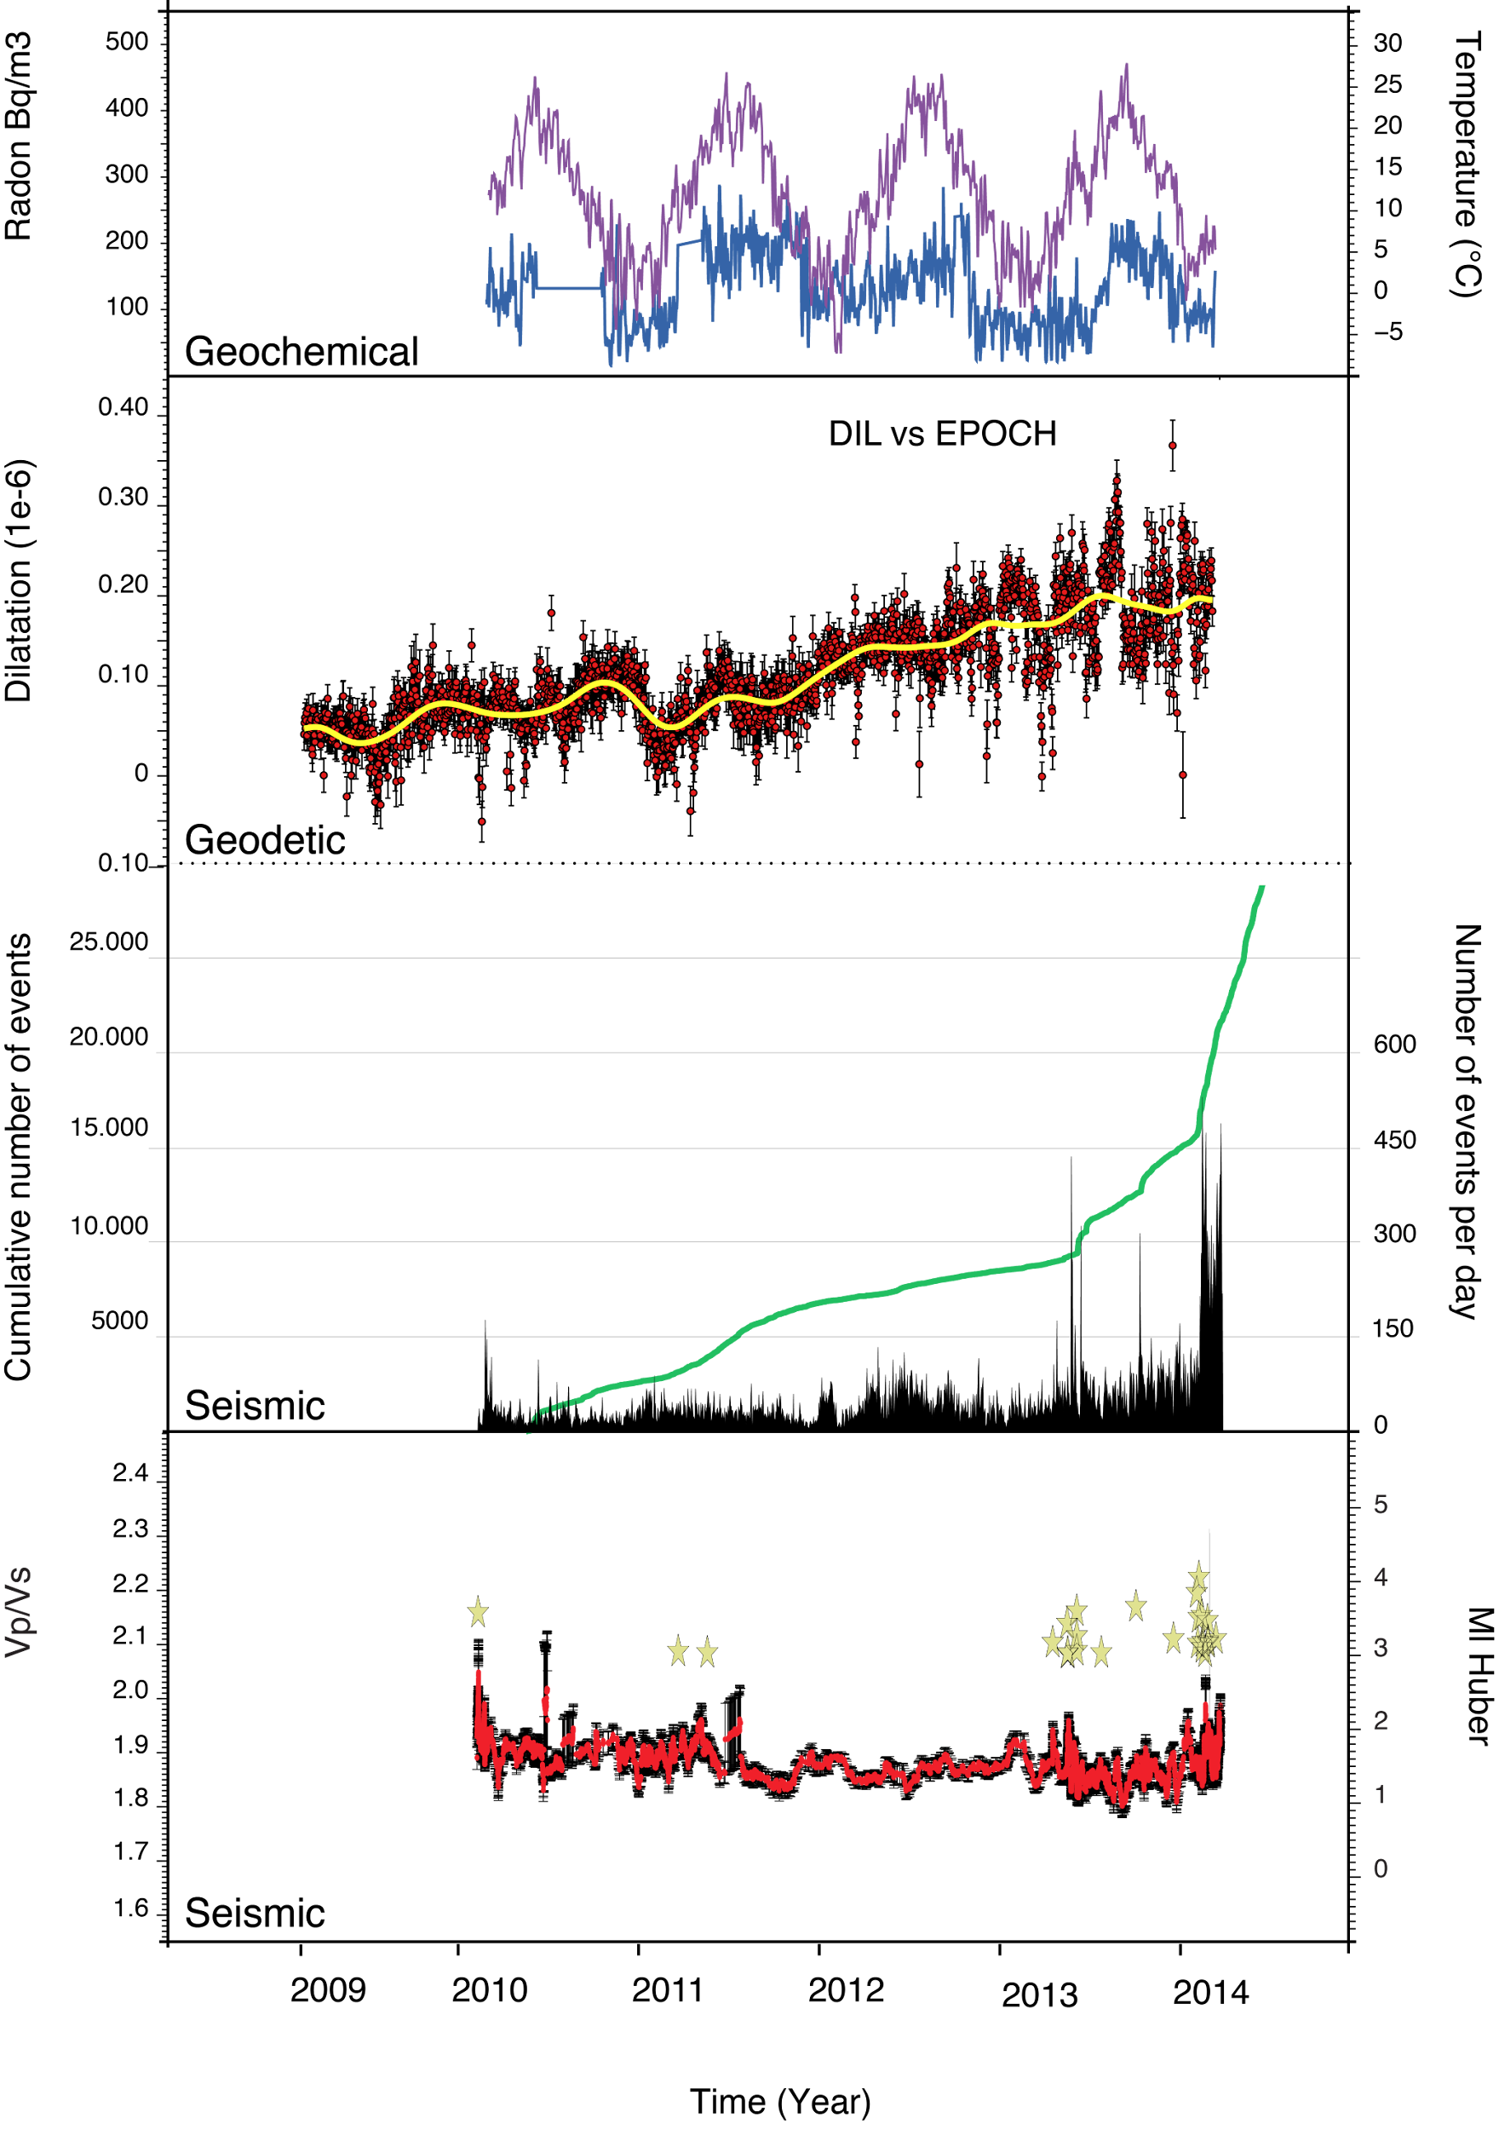
Toward a VIRTUAL LABORATORY for NFOs
M_{W}
Episodes
Handling and visualising together diverse raw data (e.g., Vp/Vs, geochemical and geophysical time series) and
scientific products
(e.g., earthquakes catalogues, thematic maps) to look for novel interconnections
Seismological Data
R_{D}
events
Geochemical Data
T
Geological Data
Torbidites
GPS
Acustic Basement
Active Fault
Cenozoic Carbonates
Triassic Evaporites
Cristalline Basement
Geodetic Data
Number events
Borehole Data
V_{P}/V_{S}

Slide 10
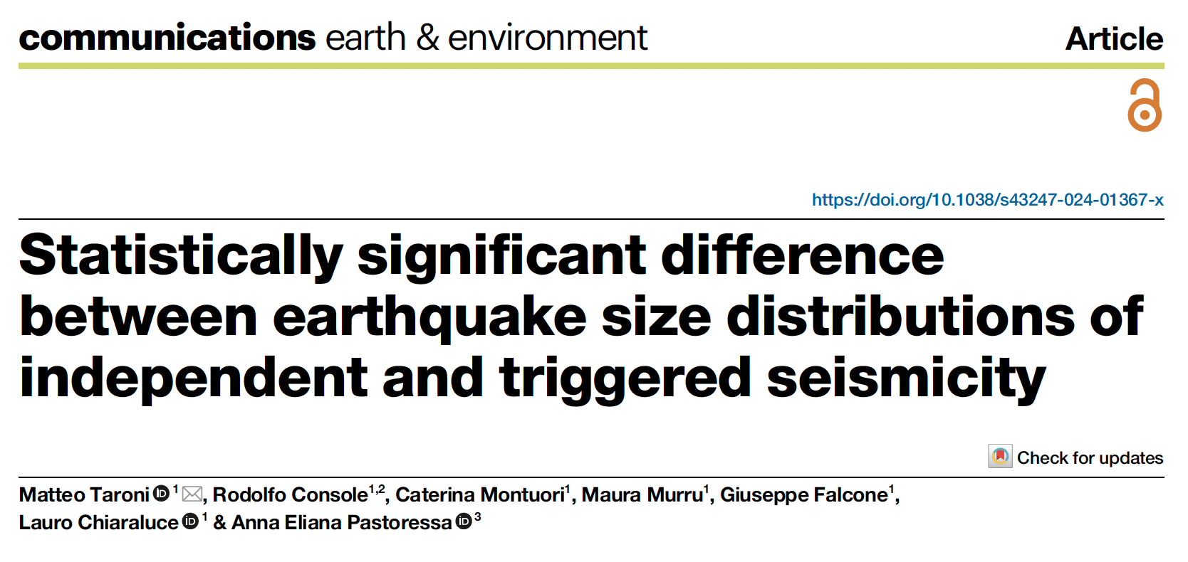
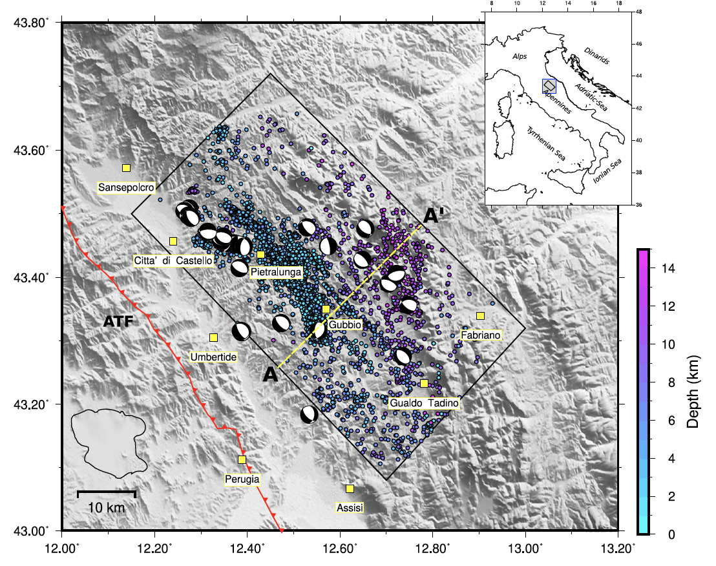
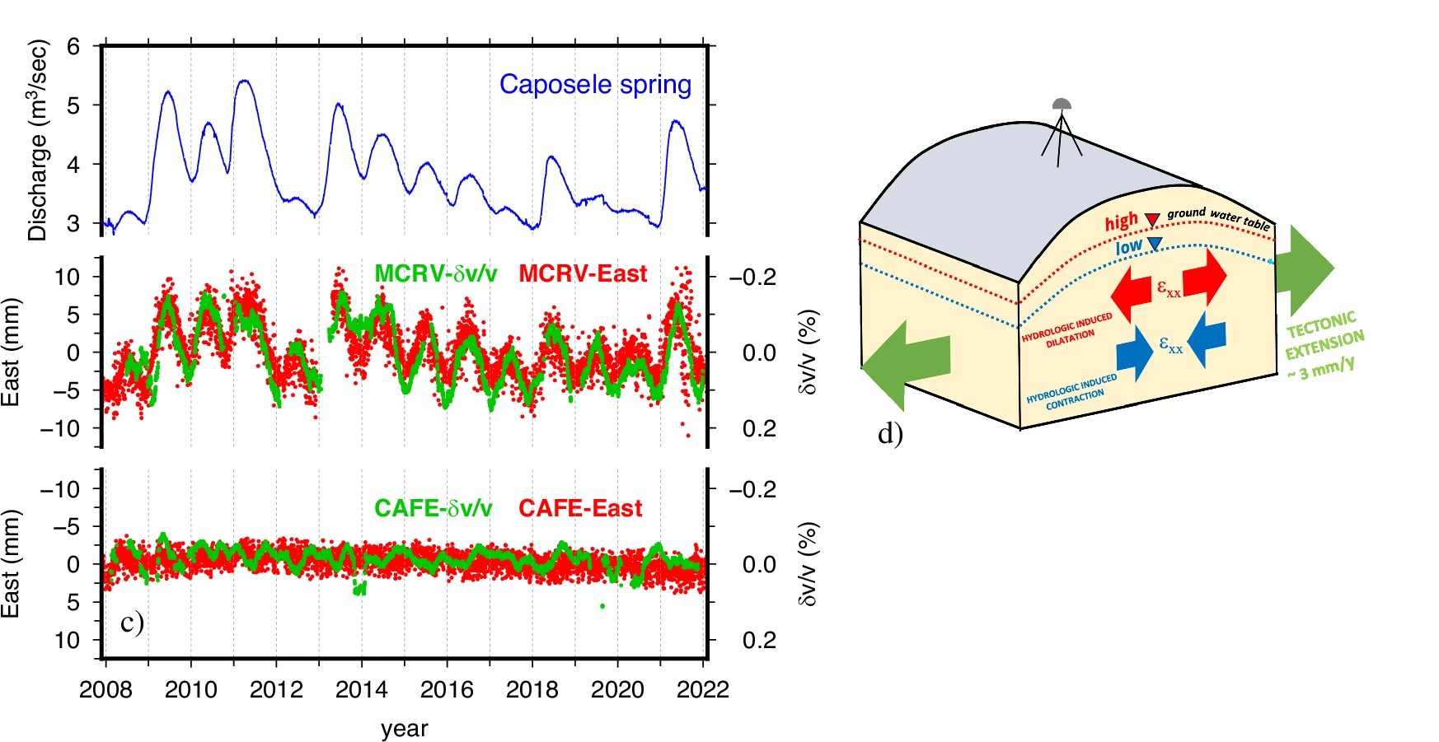
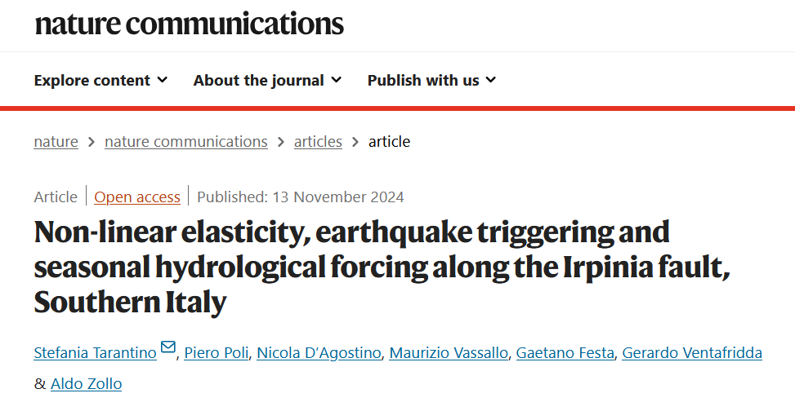
TCS-NFO for Scientific excellence
ERC Scientific projects - Filling the gap between lab experiments and small-large earthquakes.
Papers in high-impact journals - Breakthrough multi-disciplinary research at the boundary between disciplines (solid earth science, atmosphere, statistics, …).
Capabilities to attract fundings beyond EPOS - Advanced instrumentation, tools and data for curiosity- driven fundamental and applied research, impacting on society (early warning and mitigation of risks - Geo-Inquire, TRASFORM2).

Slide 11
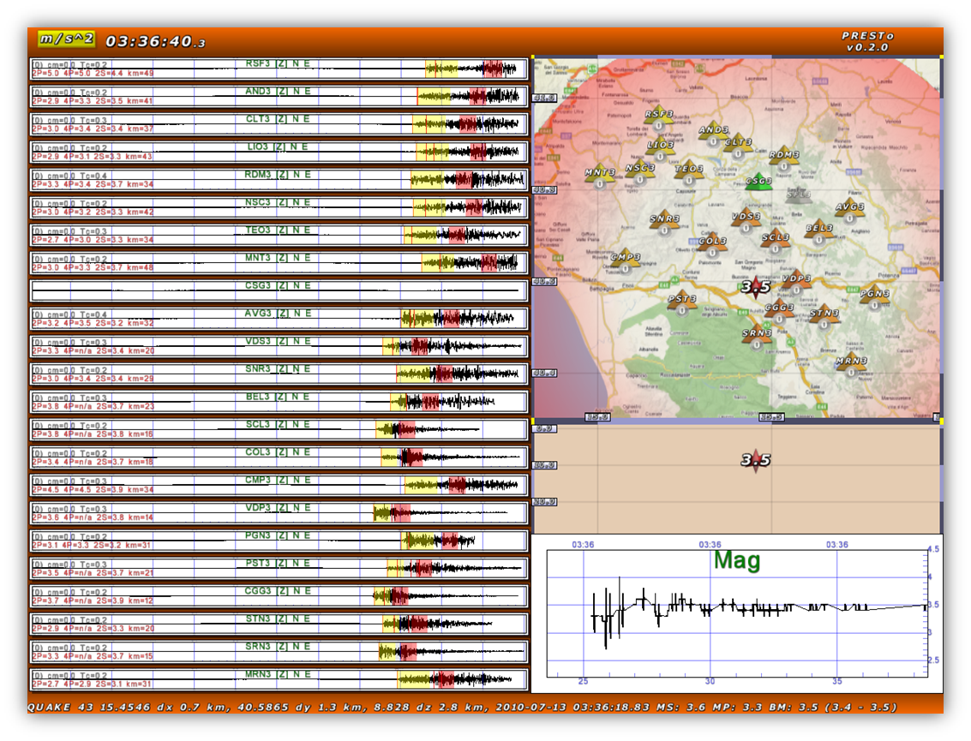
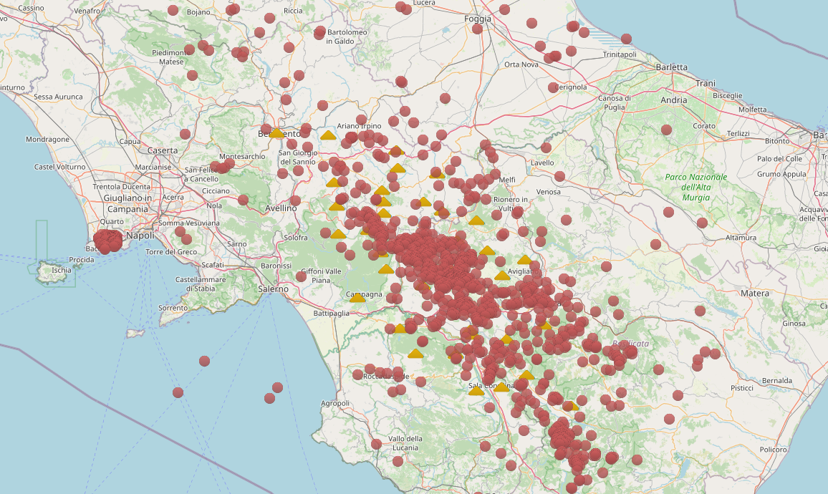
TCS-NFO community monitoring facility – CREW
The Early Warning Testing Centre
WEB BULLETIN & STATS
End-User tailored performance evaluation
(Two) Early Warning systems
SM data from EPOS portal
Expected to be extended to all NFOs with EPOS-ON
Notes:
Our TCS also manages the CREW facility that is the Testing Centre for EEW.
The EEW systems ingest and process strong-motion data of single earthquakes, available on the EPOS portal, generating outputs
that can be compared with authoritative bulletins to evaluate the system performances.
Currently there are two software running on the platform.
The performances are published on a web interface and can be used to combine the outputs of the EWSs to setup end-user tailored modules and support decision makers and other stakeholders.
Within the new EPOS-ON project the facility will be implemented to process (real time) data provided by all the NFOs of the community.

Slide 12
TCS-NFO funding model
funding security 🡪 impact not only on services sustainability but also on community governance and scientific products generation (🡪 NFO portfolio)
Human resources /hardware and software maintenance from National in-kind contribution and soft money (Eu/national projects)
Implementation from competitive projects and ERC
Human resources/ software maintenance from in-kind contribution, national support to EPOS and EPOS-ERIC
Developments from EU projects (e.g., EPOS-ON, Geo-Inquire, Transform2)
Human resources/ software maintenance from EPOS-ERIC
Implementation from EU projects (e.g., EPOS-ON, Transform2)
NFO Infrastructure
NFO DDSS distribution
NFO community
EPOS – ICS
Diverse landscape for different countries (e.g., National consortia not always existing)

Slide 13
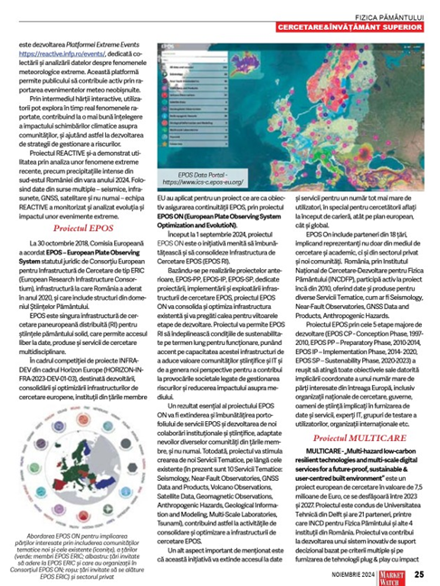
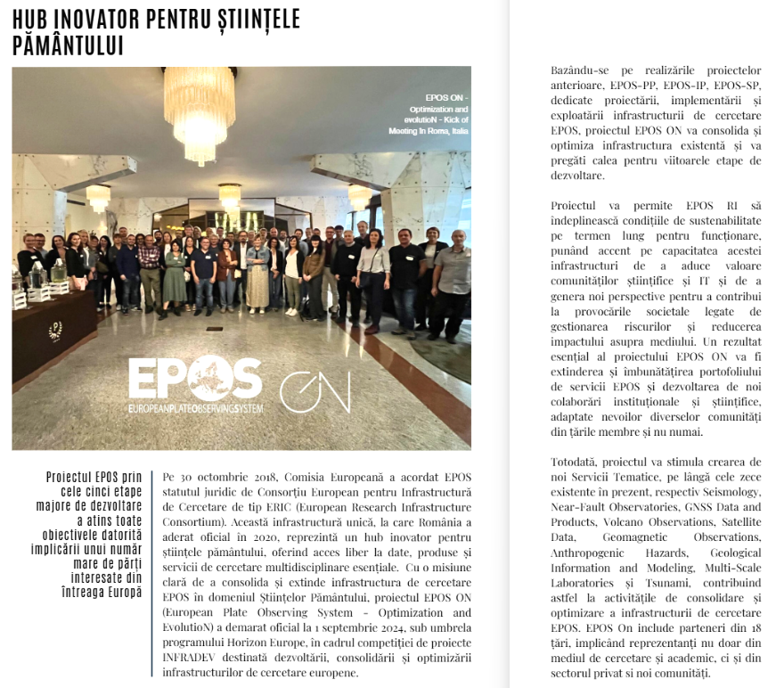
TCS Communication and Dissemination
The dissemination of the EPOS DATA PORTAL and ongoing projects such as EPOS-ON and was the key focus of the NFO’s communication.
A significant campaign was undertaken to highlight the importance of the EPOS-ON project. As part of this initiative, two articles were published: one in Market Watch, a magazine focusing on business, IT&C, case studies, and industry trends; and the other in INHOUSE, the official publication of the Ministry of Research, Innovation, and Digitalization, distributed across Romanian ministries and affiliated entities.

Slide 14
TCS-NFO next challenges
New services implementation to enlarge NFO DDSS portfolio (1D-2D-3D VELOCITY MODELS – STRAIN MAPS – HIGH RESOLUTION EQKS CATALOGUES – GEOLOGICAL INFO FROM SEISMIC PROFILES)
EU fundamental research funding model sometimes lacking in building collaborative efforts
Community enlargement NEW NFOs and …OFO (e.g., BEDRETTO LAB.)
Future of NFO community linked to Success of EPOS Initiative also regarding the connection with private companies

