Slide 1
Multi-Scale Laboratories
Ronald Pijnenburg, Audrey Ougier-Simonin (Chairs MSL)
Coordinated at Utrecht University, the Netherlands

Slide 2
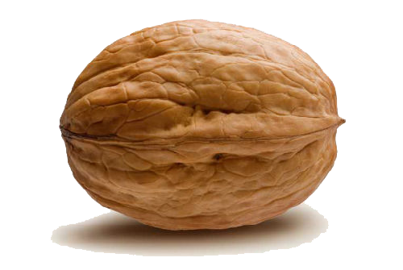
MSL in a nutshell
>100 labs, studying the properties and processes
controlling rock system behaviour, from nm to km scale

Slide 3
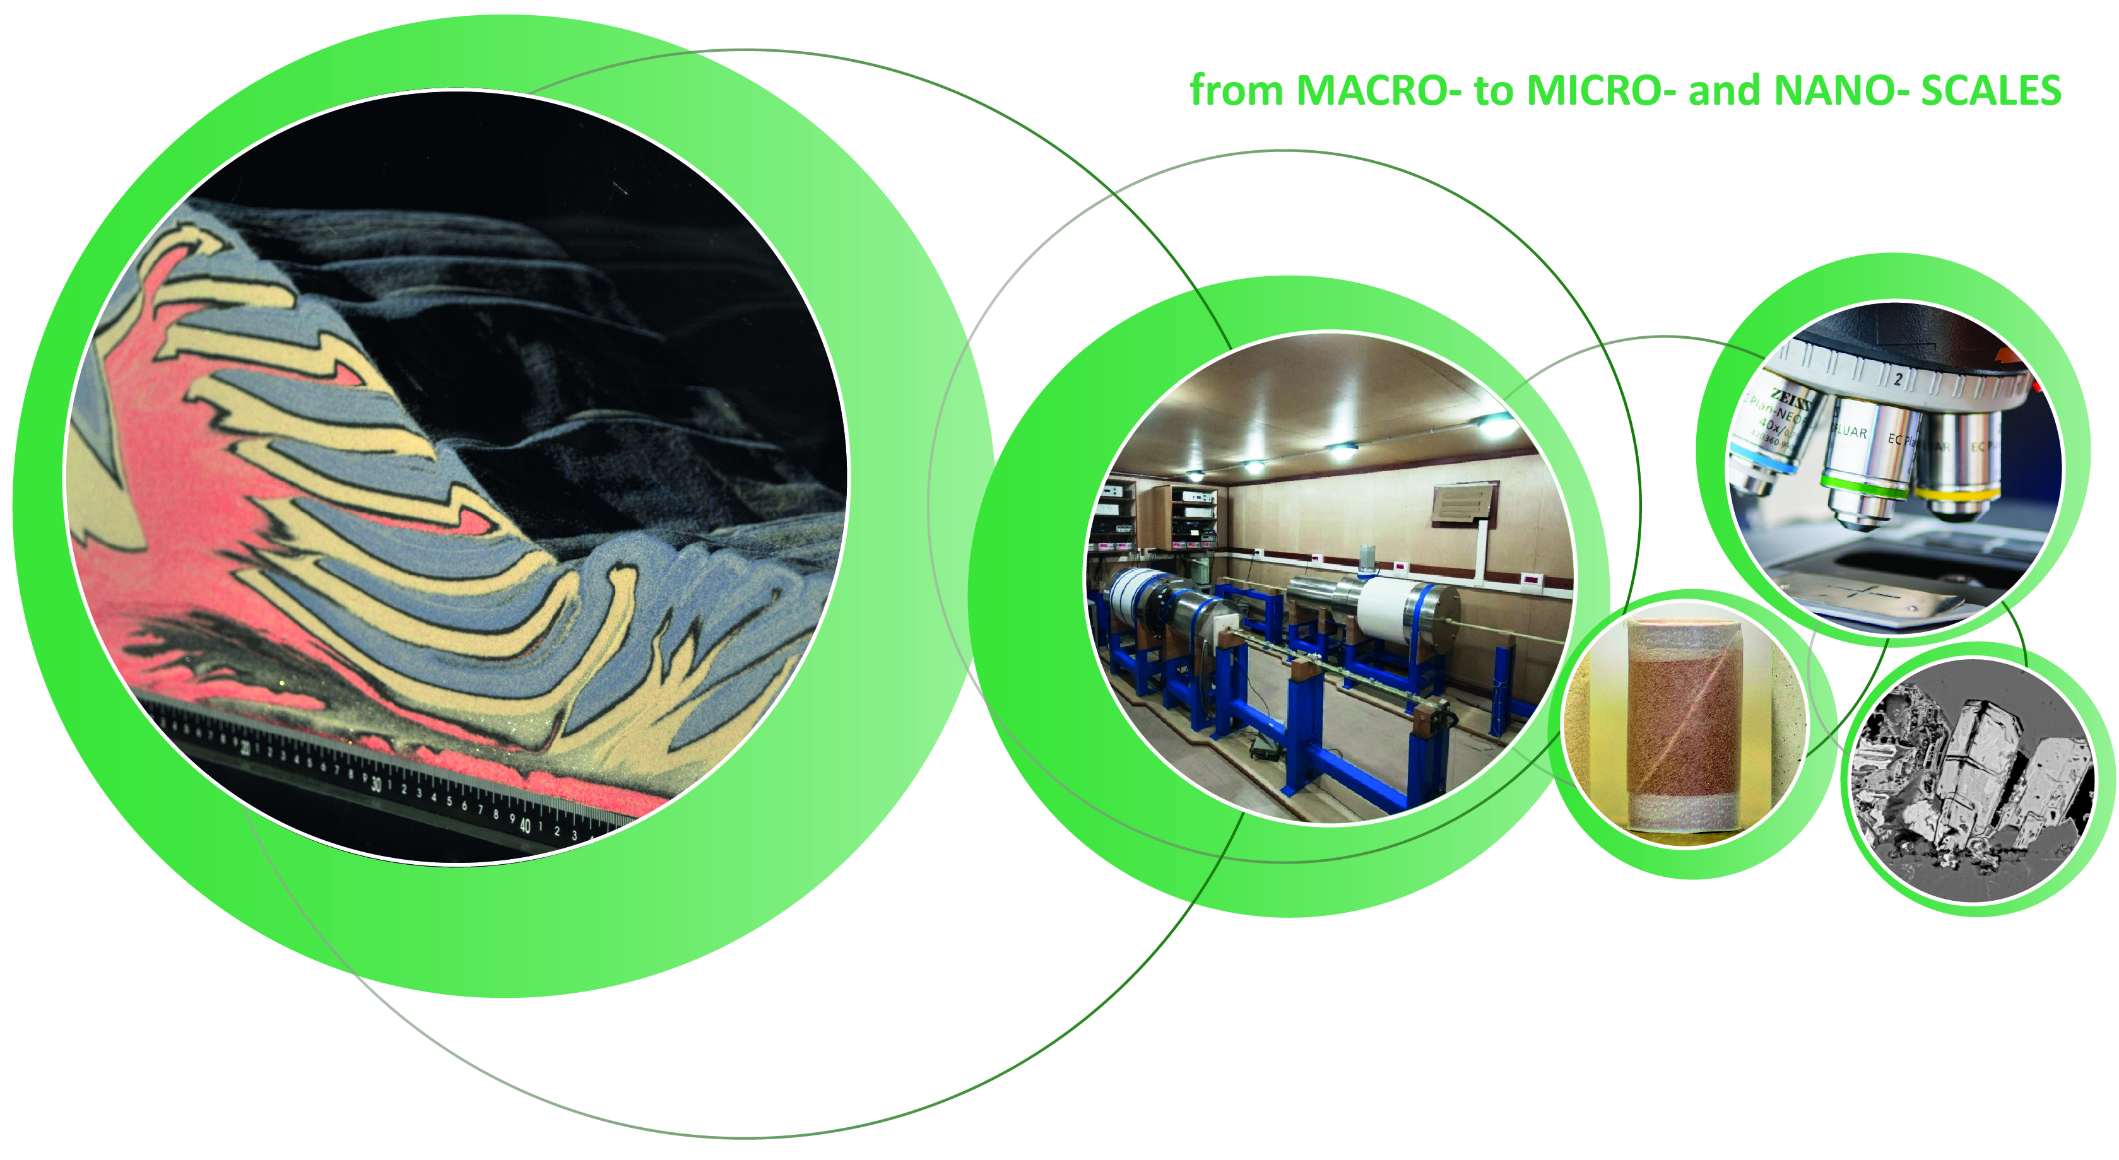
controlled at small scale
Large-scale behavior…
Subsurface response during energy production?
Porosity?
Reservoir heterogeneity?
Subsurface storage?
Deformation behavior?
Earthquakes?
Governing processes?
Efficiency?
Assessment of subsurface behavior requires Multi-Scale understanding

Slide 4
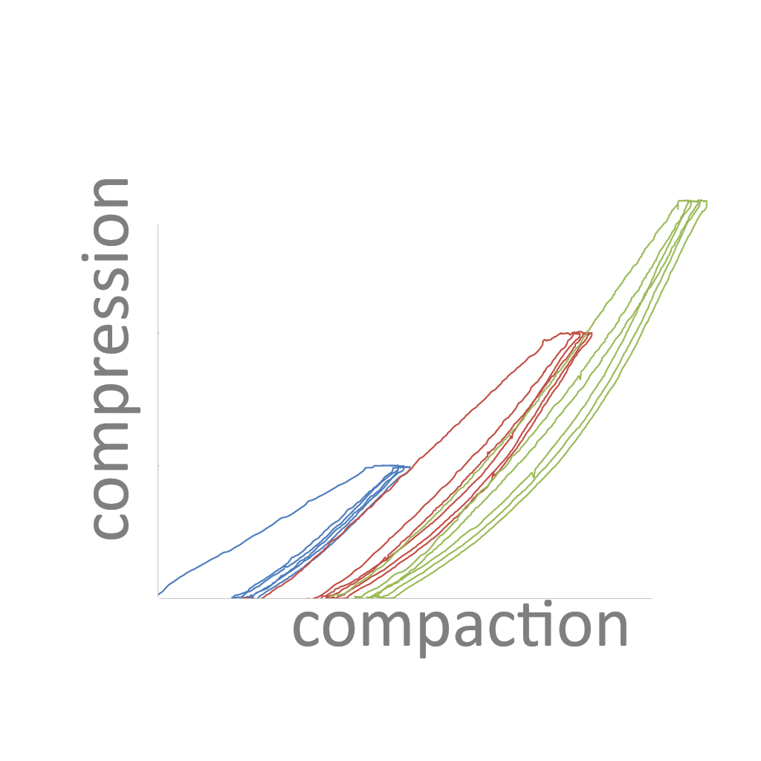
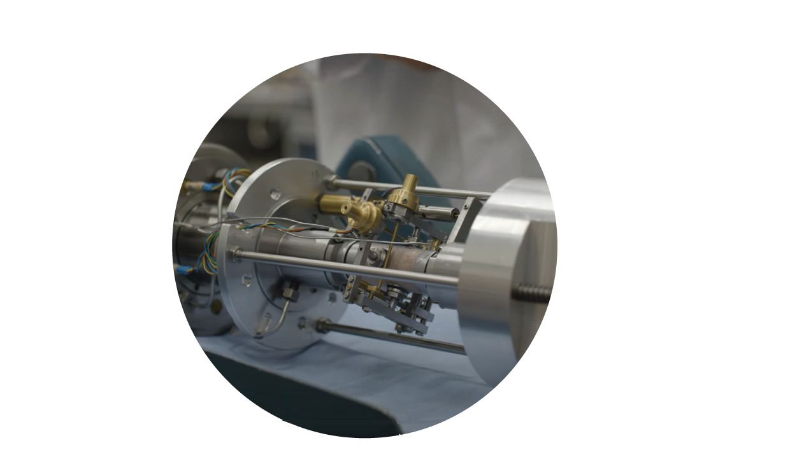
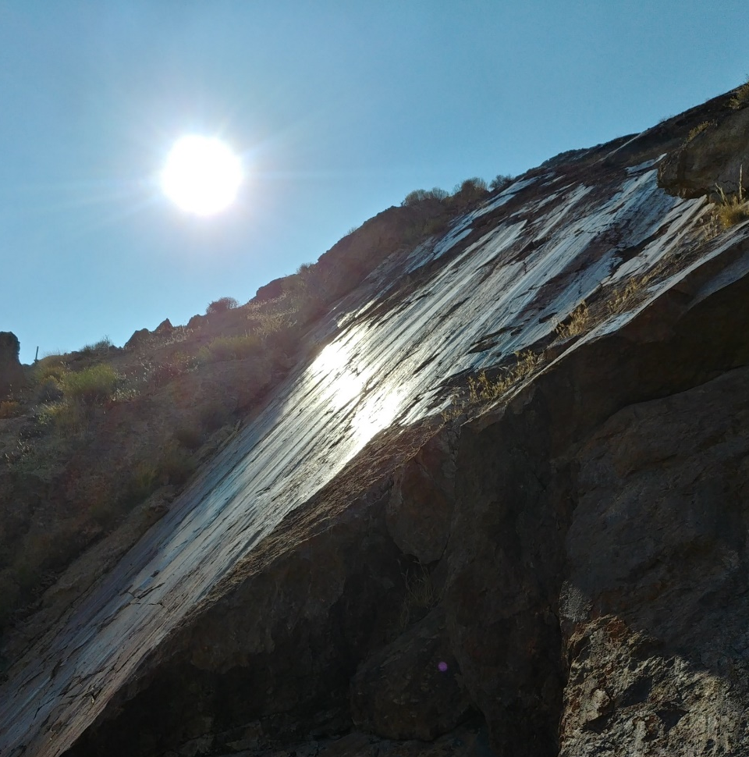
Multi-Scale understanding:
Rock physics
Lab experiments at crustal P/T conditions
Quantify rock/fault strength
Fluid flow properties

Slide 5
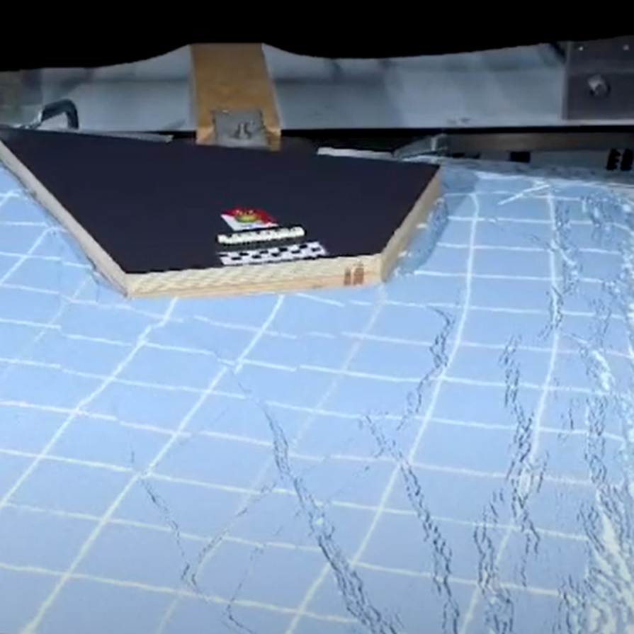
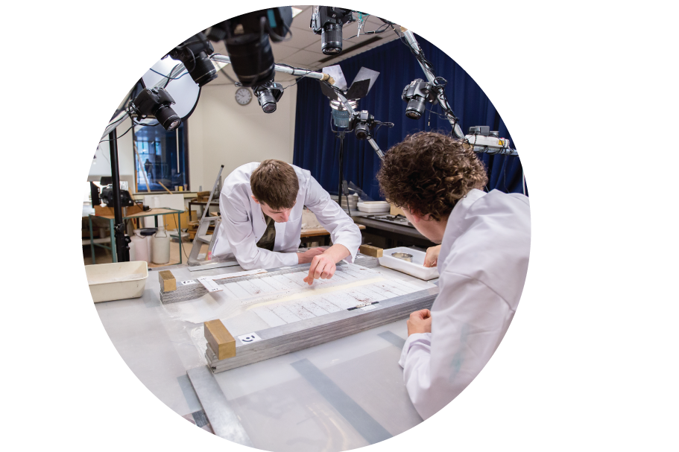
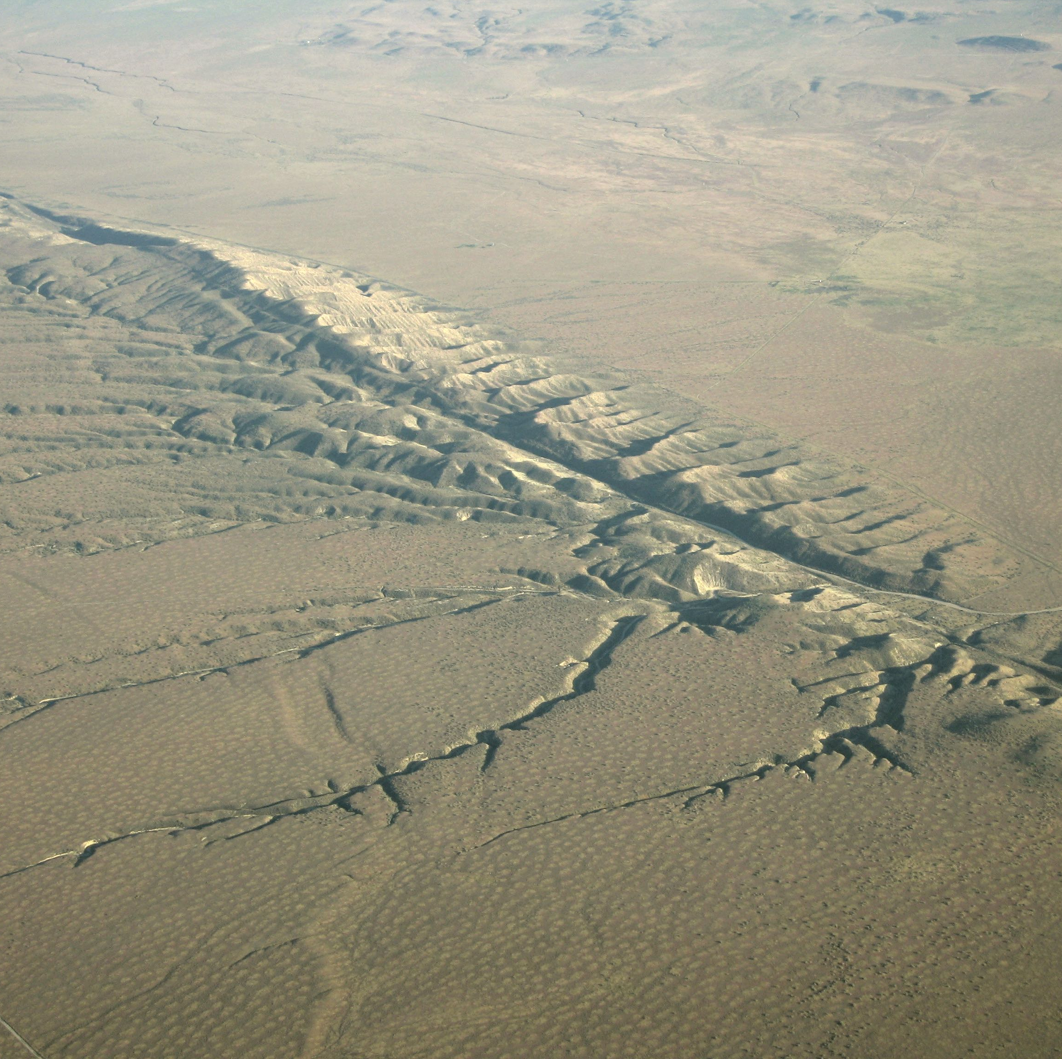
Multi-Scale understanding:
Analogue modelling
Scaled-down models of deforming crust or lithosphere
Explore processes underlying large deformation
e.g. why and where do faults form?

Slide 6
Multi-Scale understanding:
Microscopy and X-ray tomography
Identify micro/nano-processes governing lab or field behavior
Mapping of elements/minerals/isotopes
Down scale

Slide 7
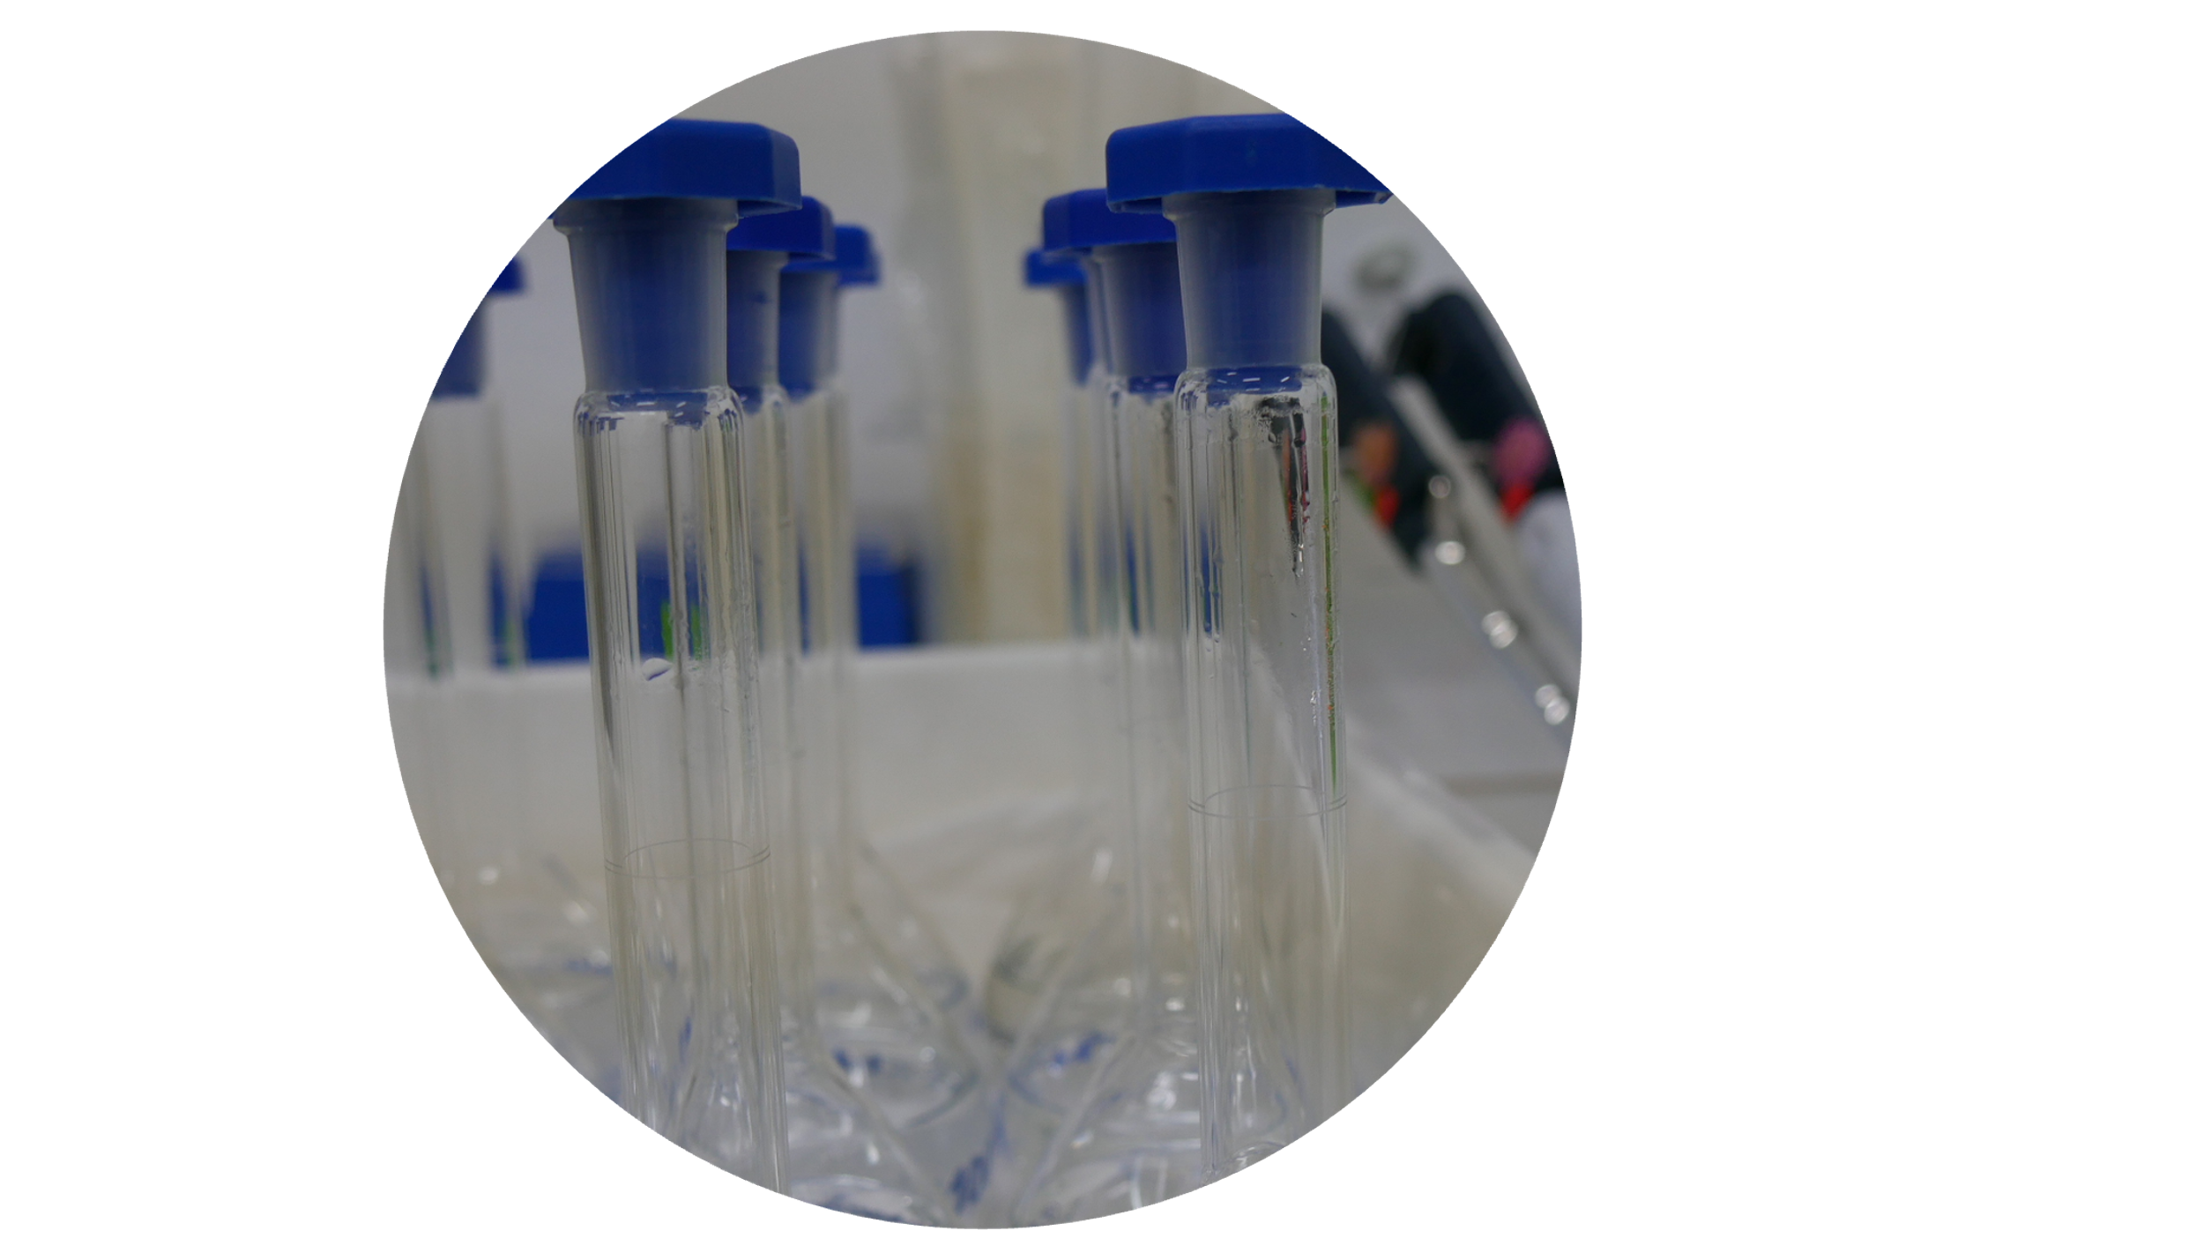
Multi-Scale Laboratories:
Rock physics
Analogue modelling
Microscopy and X-ray tomography
Geochemistry

Slide 8
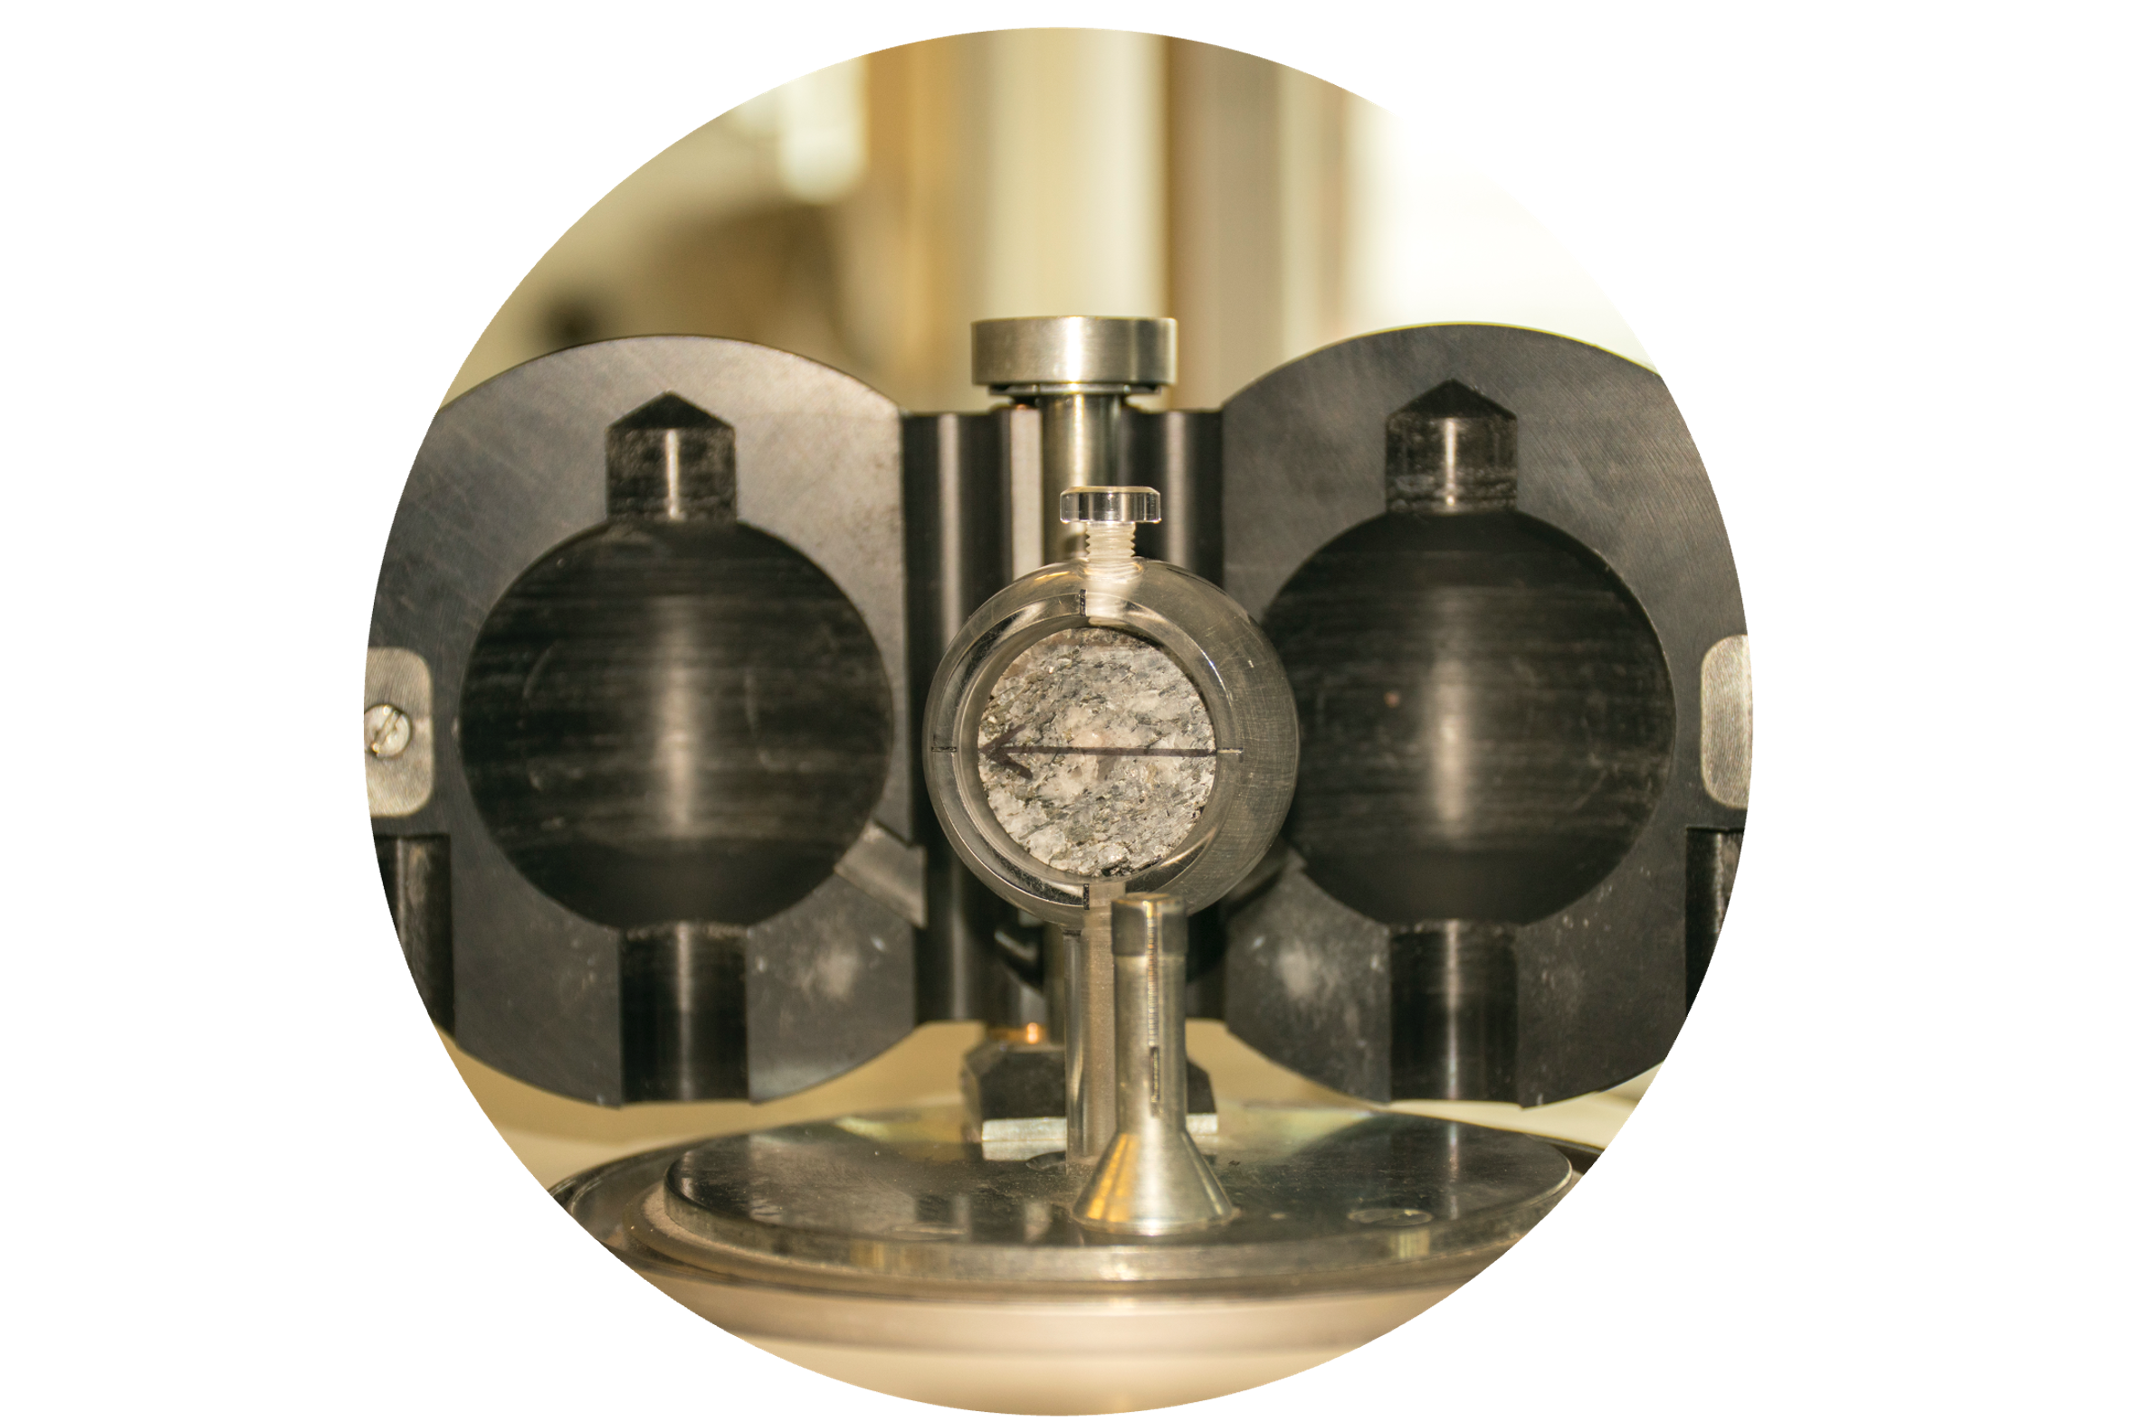
Multi-Scale Laboratories:
Rock physics
Analogue modelling
Microscopy and X-ray tomography
Geochemistry
Paleomagnetism

Slide 9
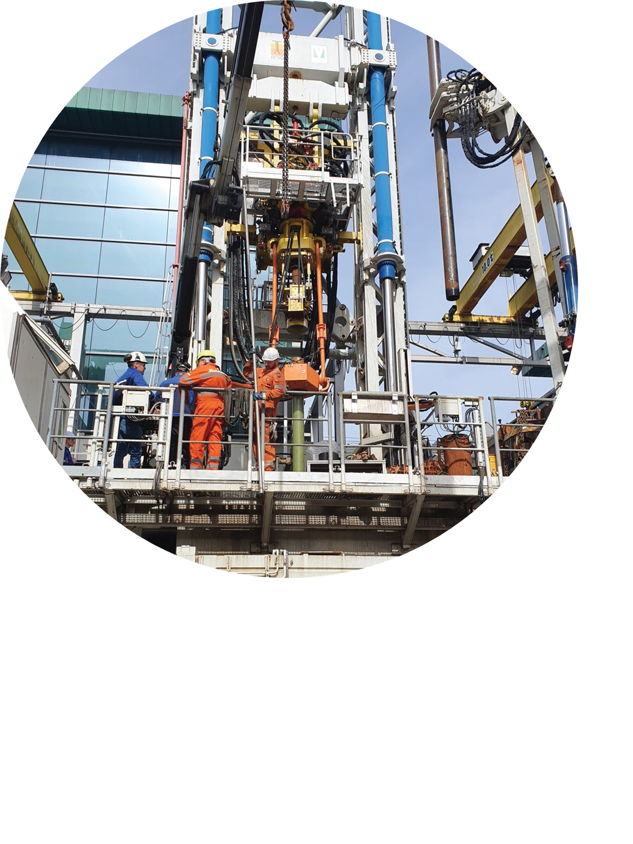
Multi-Scale Laboratories:
Rock physics
Analogue modelling
Microscopy and X-ray tomography
Geochemistry
Paleomagnetism
Geo-energy test beds
New domain! Presented tomorrow by Susanne Laumann

Slide 10
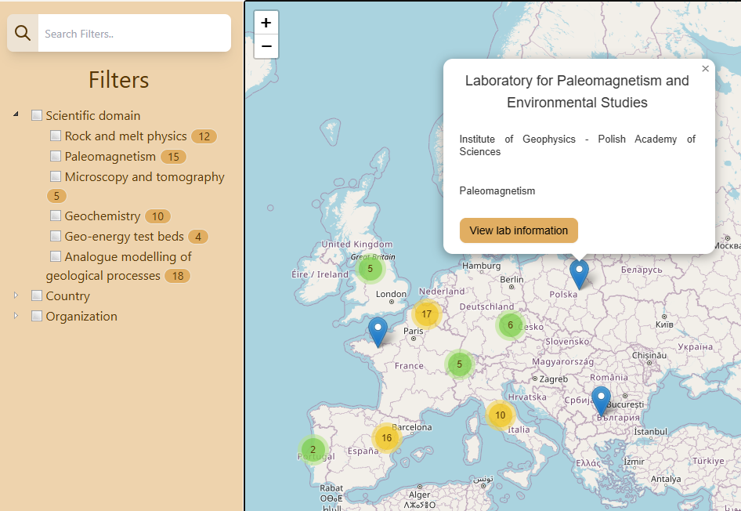
115 MSL Laboratories in Europe
epos-msl.uu.nl/labs/map
This map is a new service. Not all MSL labs displayed yet

Slide 11
EPOS MSL data catalogue
EPOS-MSL.uu.nl

Slide 12
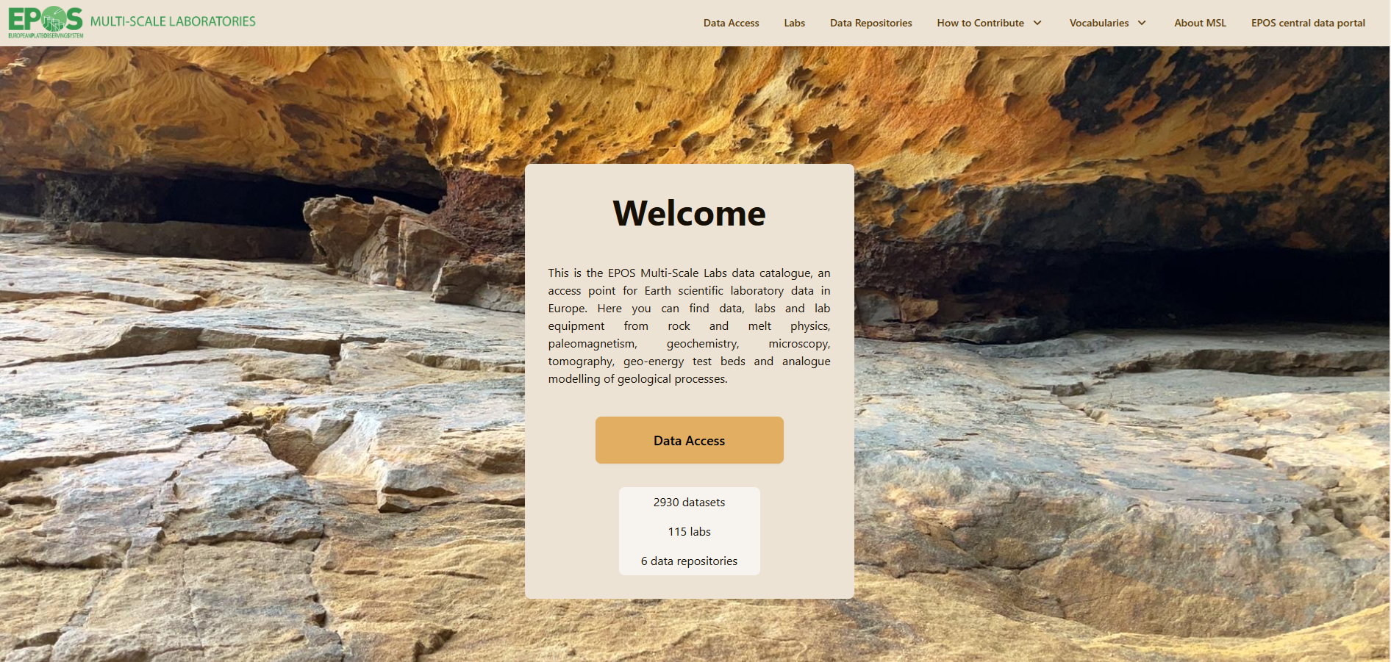
EPOS-MSL.uu.nl
EPOS MSL data catalogue

Slide 13
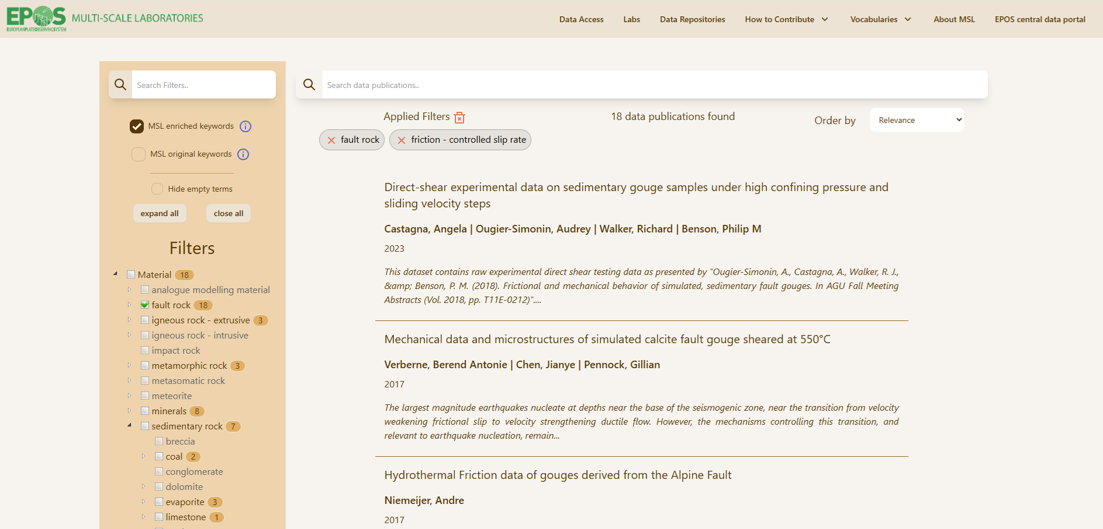
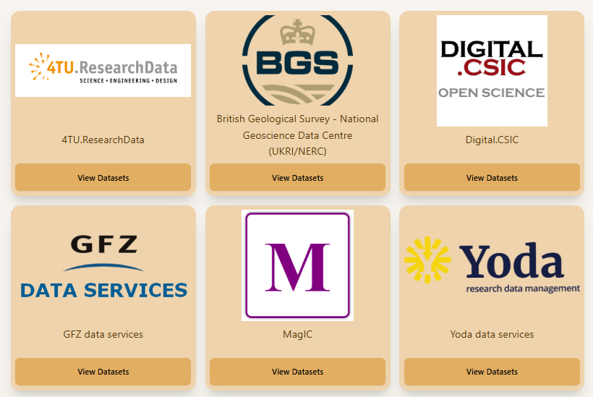
EPOS-MSL.uu.nl
EPOS MSL data catalogue
We can add your repository too!

Slide 14
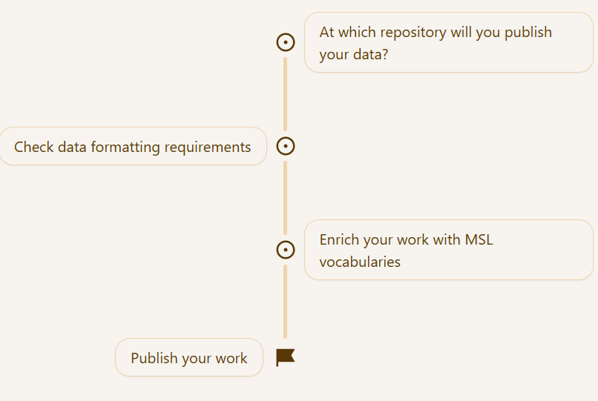
How to contribute your data?

Slide 15
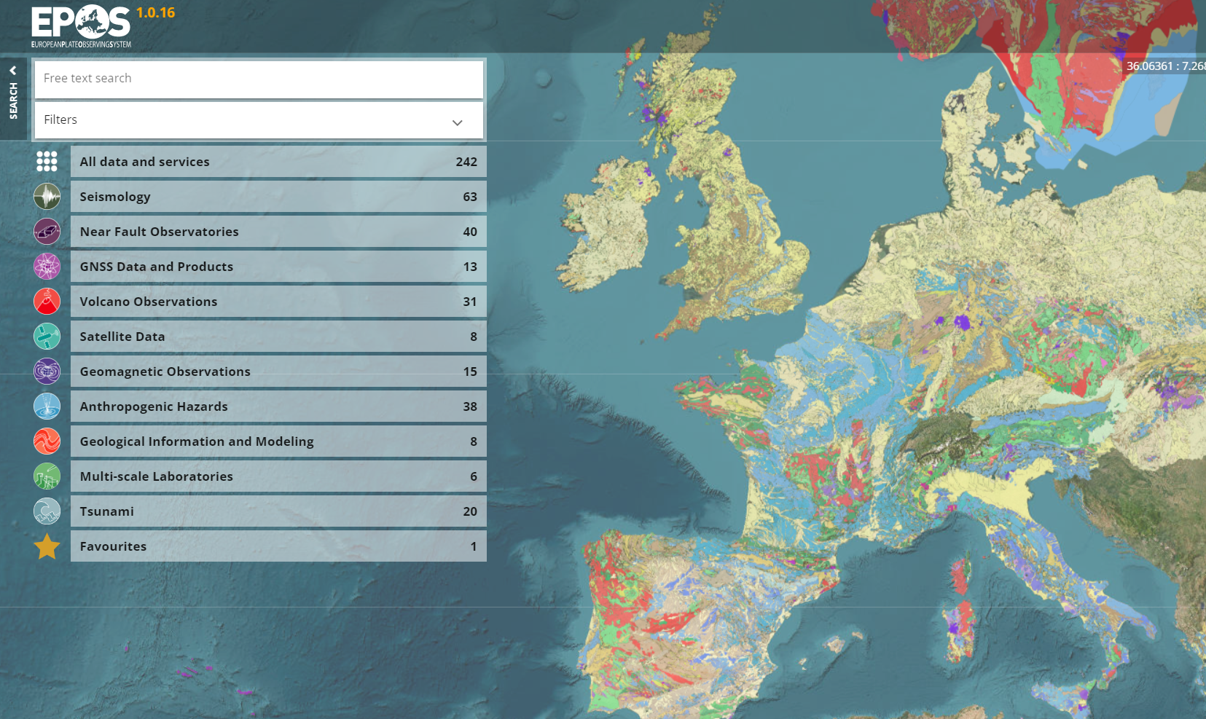
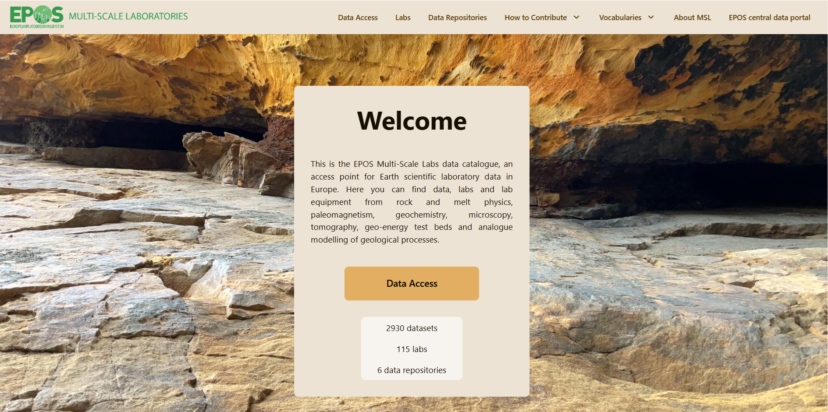
Why have a separate data catalogue for MSL?
Same MSL data
Multi-disciplinary portal
Developed for full EPOS community
End product for MSL services
Portal specific for lab community
Under direct MSL control
Acts for sharing info and developing/testing new services

Slide 16
Upcoming developments

Slide 17
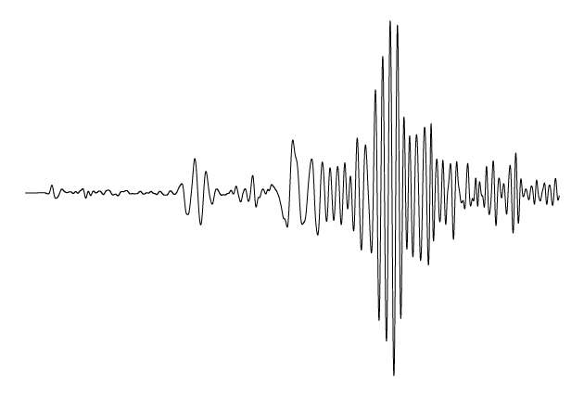
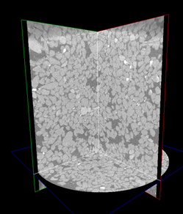
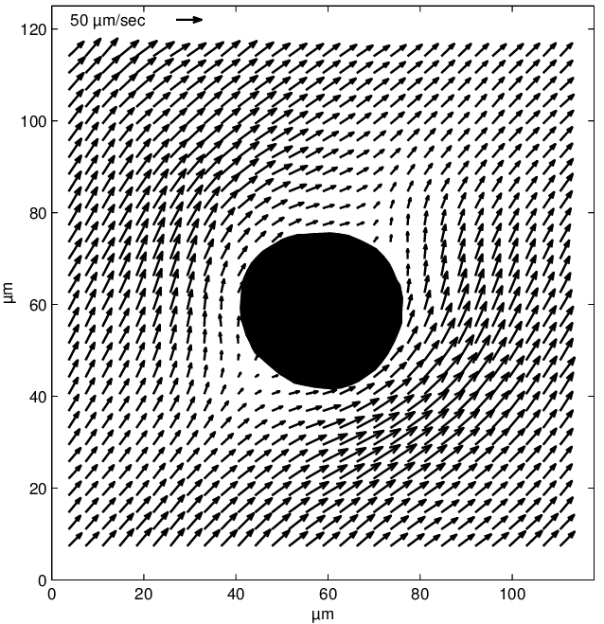
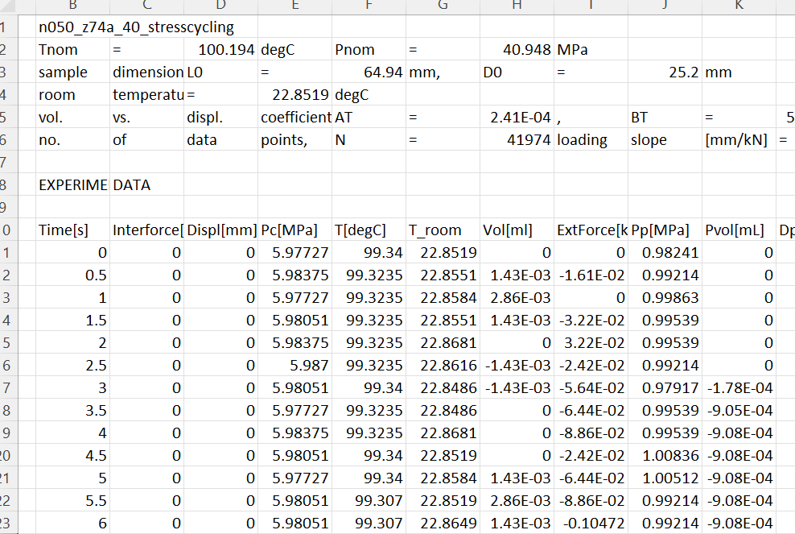
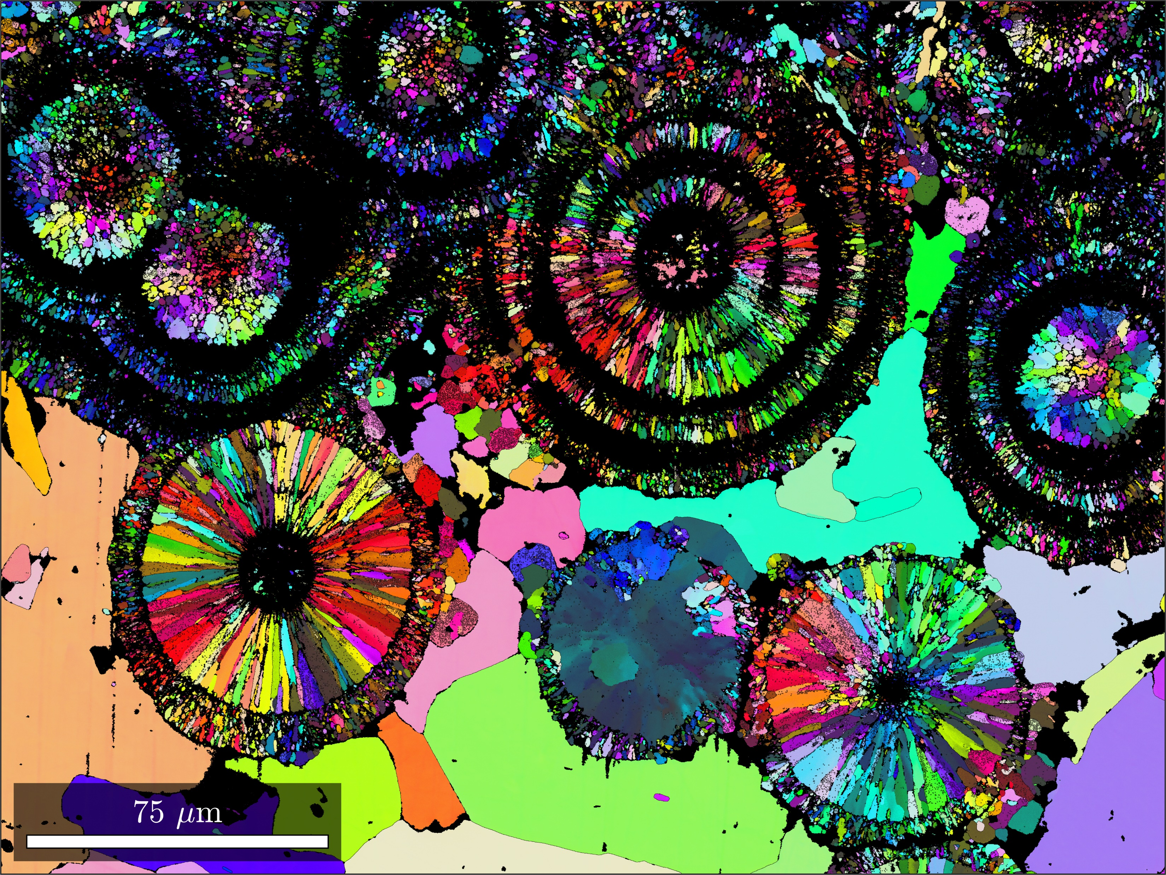
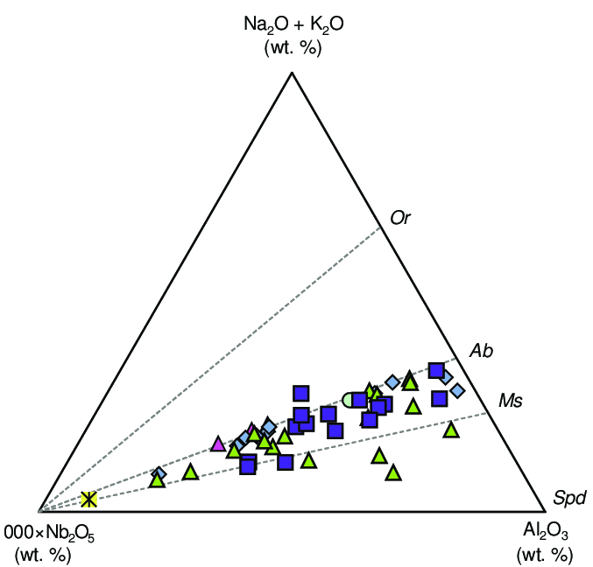
From Findable data towards easy-to-Reuse data
MSL subdomains:
Geochemistry
Geo energy test-beds
Paleomagnetism
Analogue modelling
Rock physics
Microscopy and X-ray Tomography
Towards data standards and best practices!

Slide 18
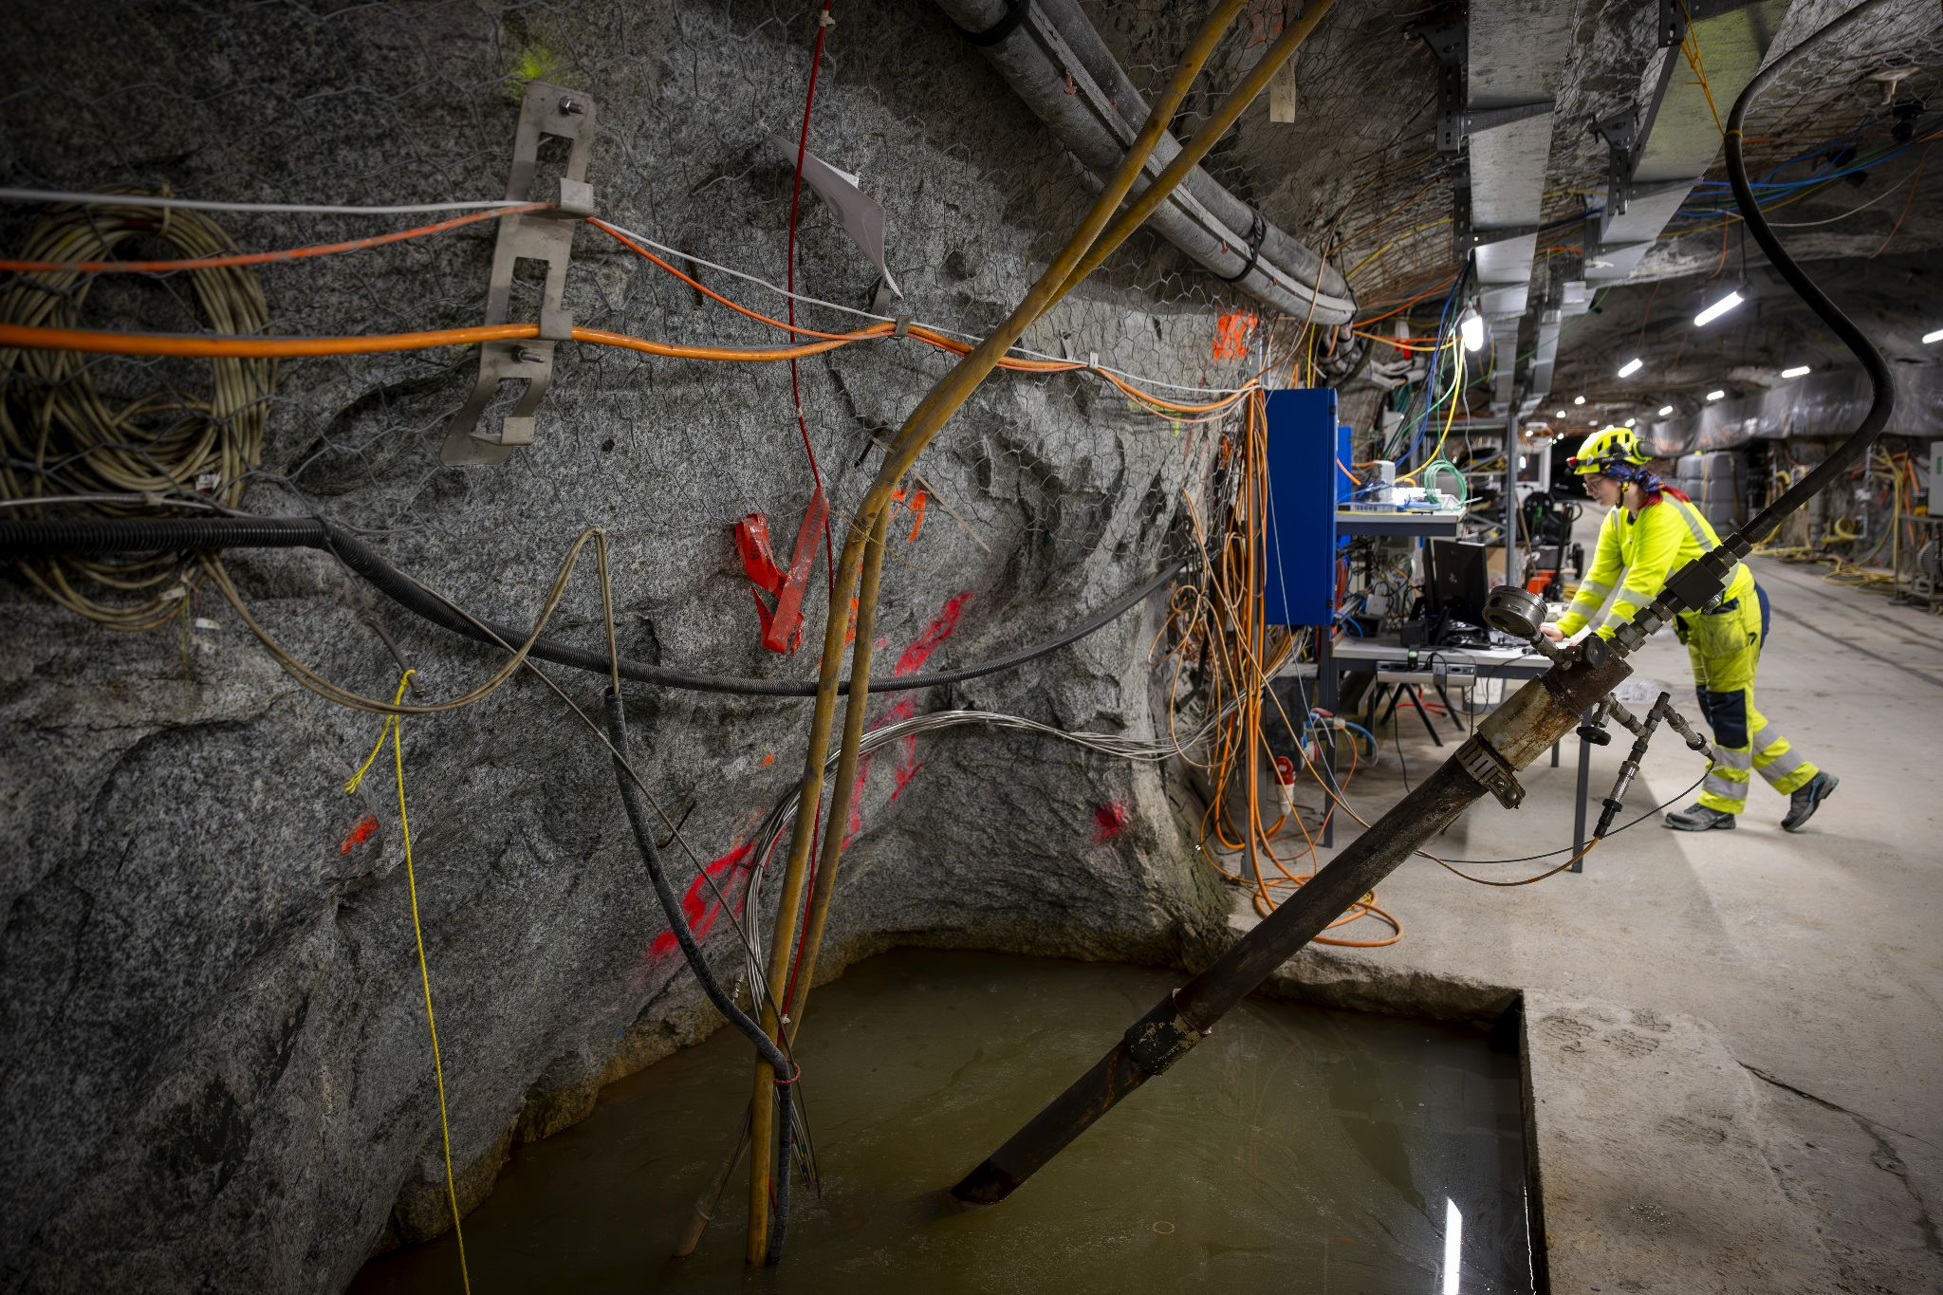
Geo-energy test bed data on EPOS platform
More about this tomorrow!

Slide 19
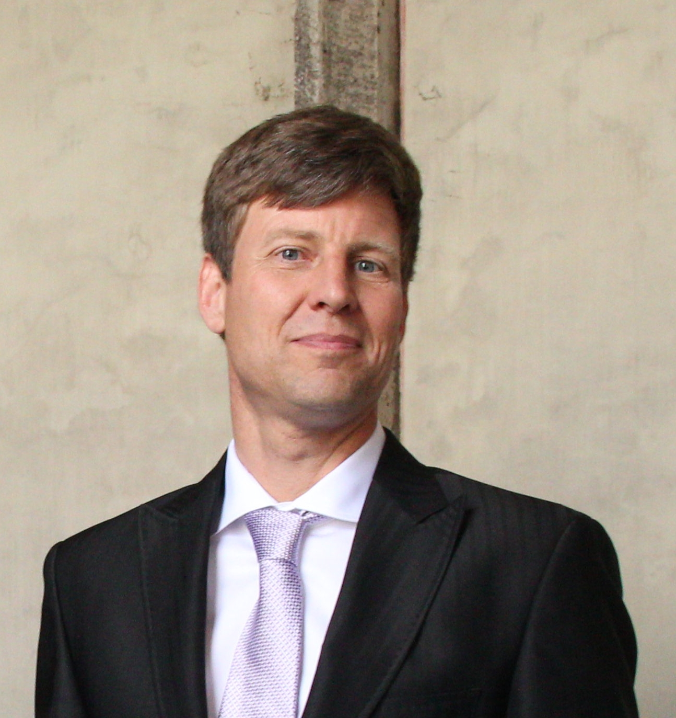
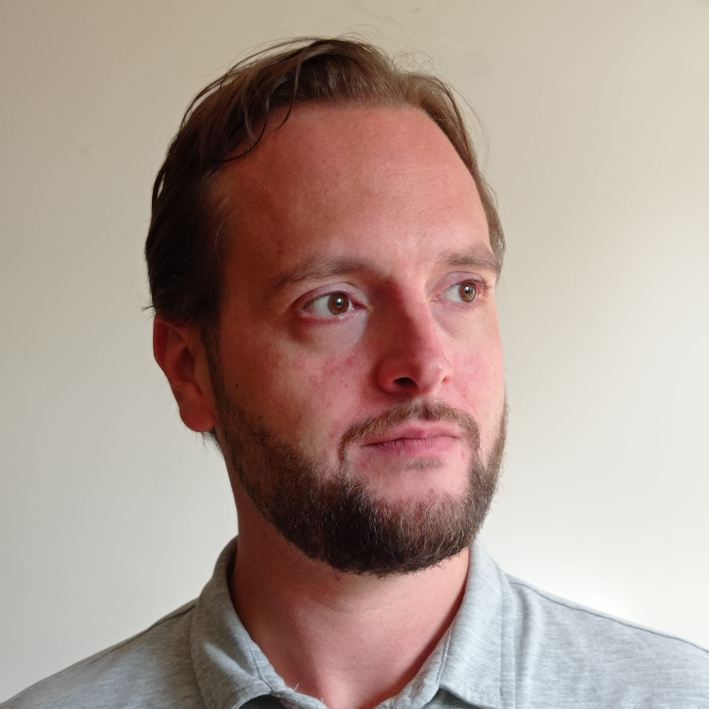
Looking forward to meeting you!

