Slide 1
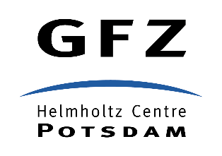
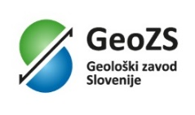
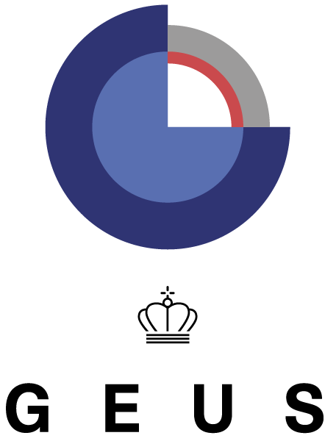
TCS Geological Information and Modeling Marc URVOIS, BRGM – French Geological Survey TCS GIM Coordinator

Slide 2
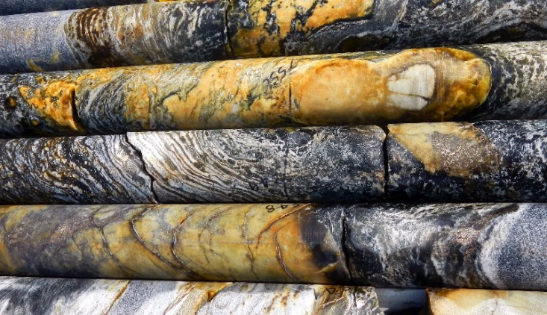
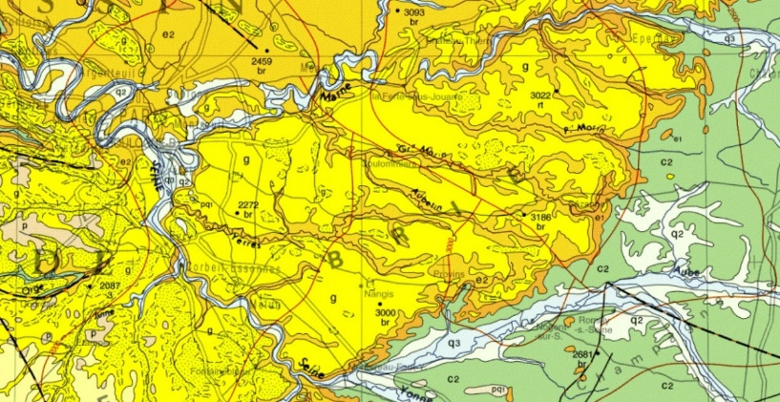
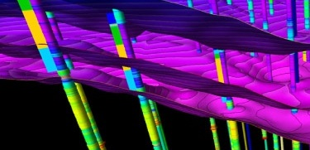
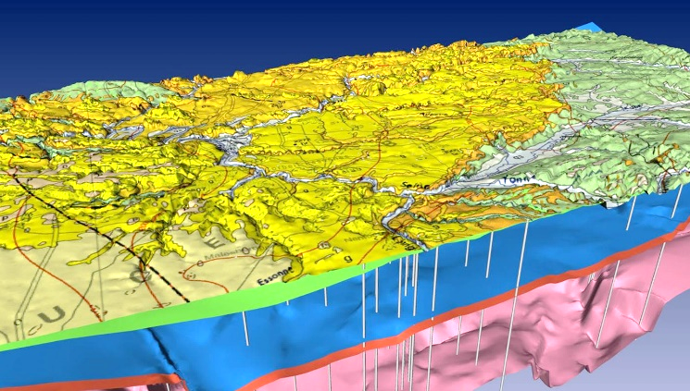
Scientific areas of TCS GIM
Overall objective: design and implement efficient and sustainable access to geological multi-scale data assets: observations, measurements, maps, models…
Describe and understand the geological characteristics of soil and subsoil
Essential base information in solid Earth sciences is geology or a property that depends on geology or an interpretation of such properties
Geological map: interpretation from field and remote sensing observations with the most recent knowledge. Revisable document with new observations and updated geological concepts
In addition to geological outcrops, boreholes are the only subsurface features observable in-situ: (1) sample material (drill cores) supplemented by a geological description, image documentation and geophysical downhole logs; (2) time series data from downhole sensors (e.g., seismometers, piezometers…)
Public Service mission of Geological Surveys: provide data and knowledge to support researchers

Slide 3
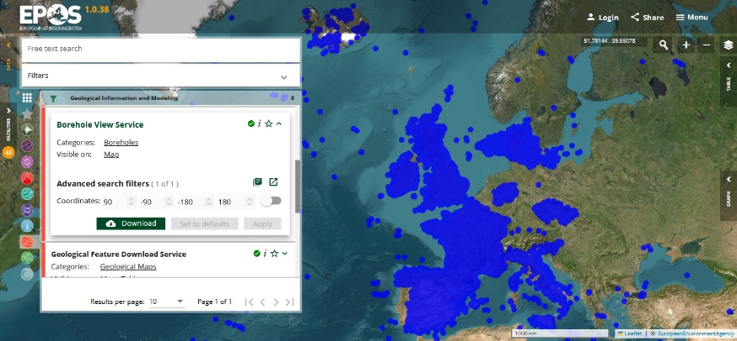
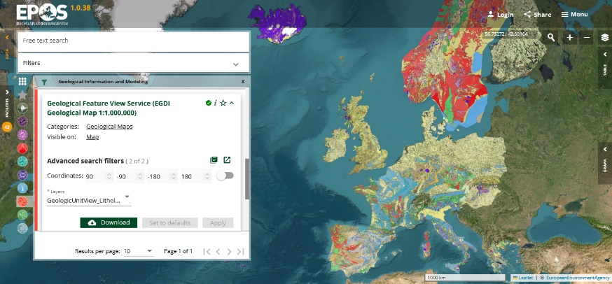
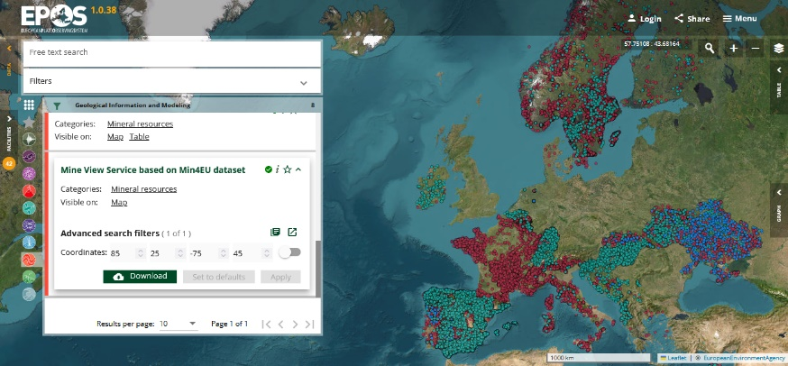
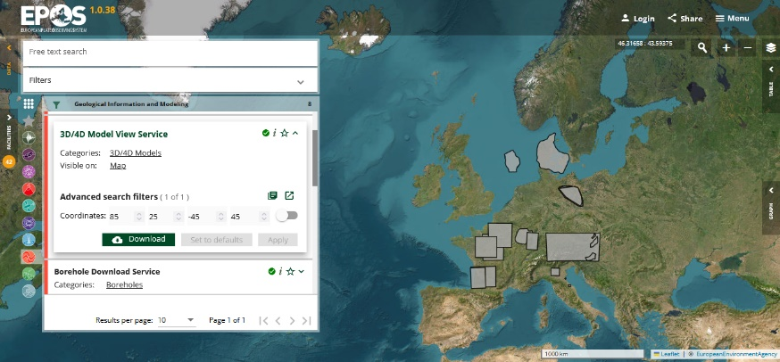
Key activities of TCS GIM (2024)
Extend the geographical coverage with new data assets and upgrade current TCS services
Boreholes from new providers (Czech Republic and Spain)
New boreholes from current providers (Italy re. shallow drillings for geothermal exploration – France, United Kingdom, Denmark re. daily updates)
3D models: new geological models in France and Italy
Improve the service provision after the Data Portal stress tests, e.g. manage the workload
Improve the borehole harvester (differential harvesting - impact at central service and data provider levels)
Prepare the connection of borehole and geological map data to the Anthopogenic Hazards Episodes
Extend the positive test of Borehole Persistent Identifier to all TCS GIM data providers (IGSN- International Generic Sample Number)
Monitor the data service usage (boreholes and geological map): number of users and requests, volume of responses

Slide 4
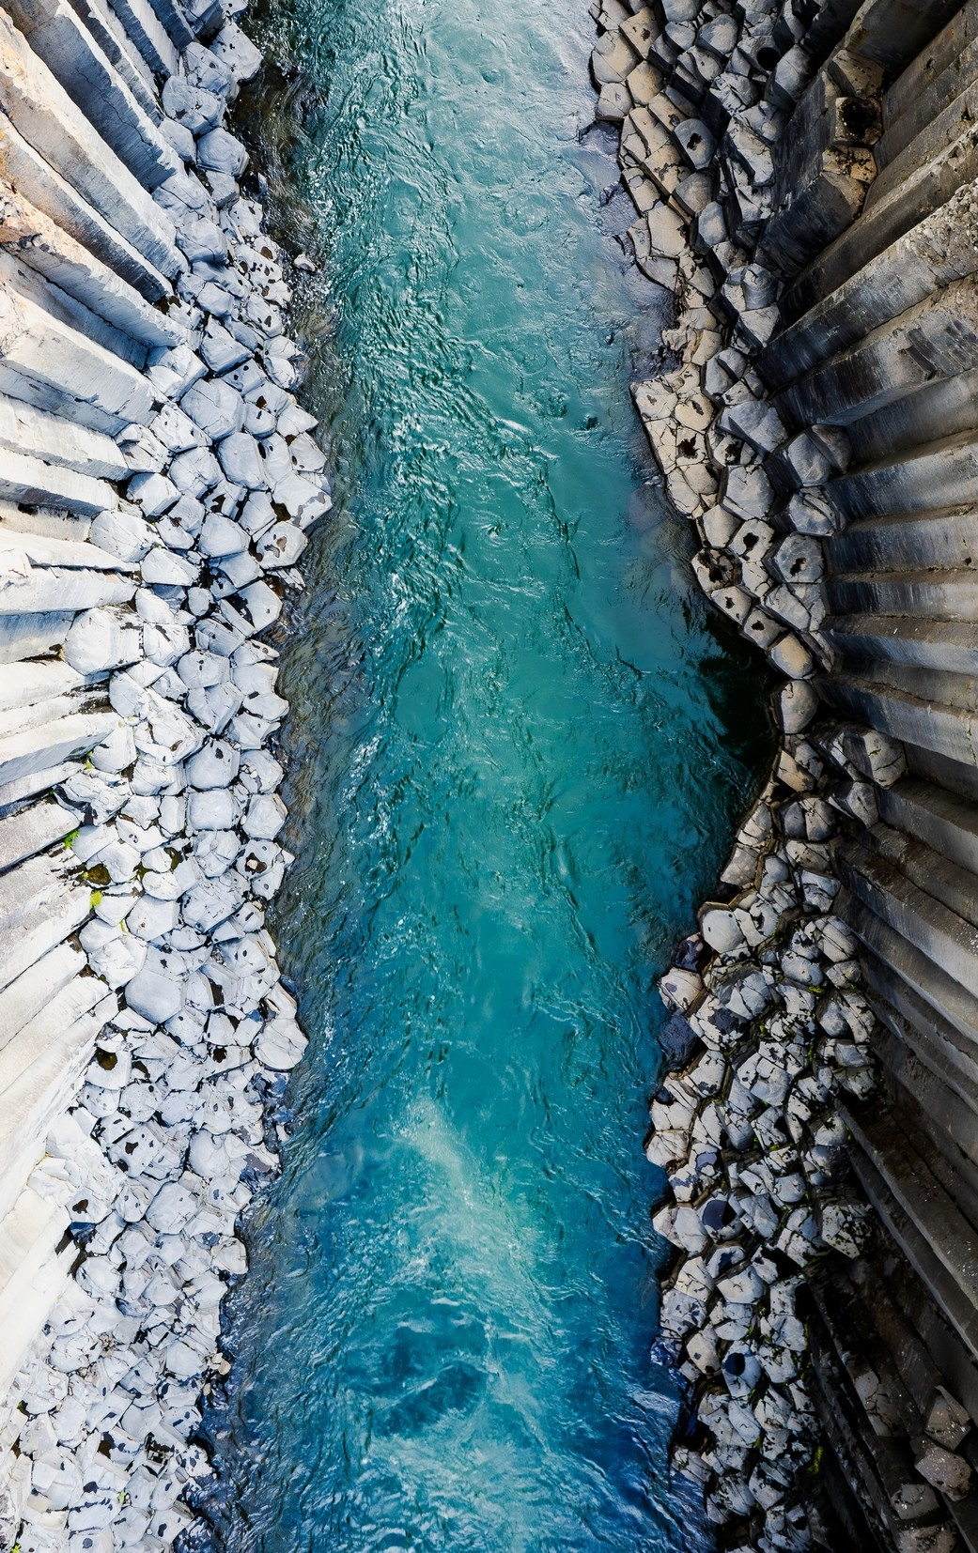
Future plans of TCS GIM
Extend the geographical coverage with new data assets and upgrade current TCS services
Boreholes from current providers and new ones (e.g., TNO-Geological Survey of the Netherlands with EPOS eNLarge)
Boreholes from synergy through EGDI-European Geological Data Infrastructure with GSEU-Geological Service for Europe/EUGM-European Groundwater Monitoring Database
Finalise the dynamic legend for the geological map
Extend the list of data services exposed by EGDI on EPOS Platform
Increase the granularity of the data: implement the access to borehole detailed information (geological and geophysical log, water level…) [Complex Feature]
Improve the Borehole data quality (European geoscience codelists and registers for better filtering in EPOS user interface)
FAIR compliance and FAIRness assessment of Borehole data service

Slide 5
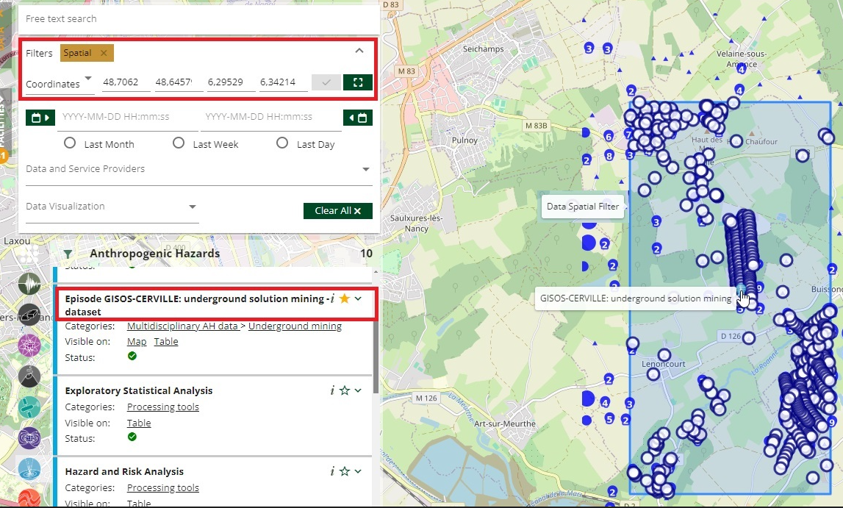
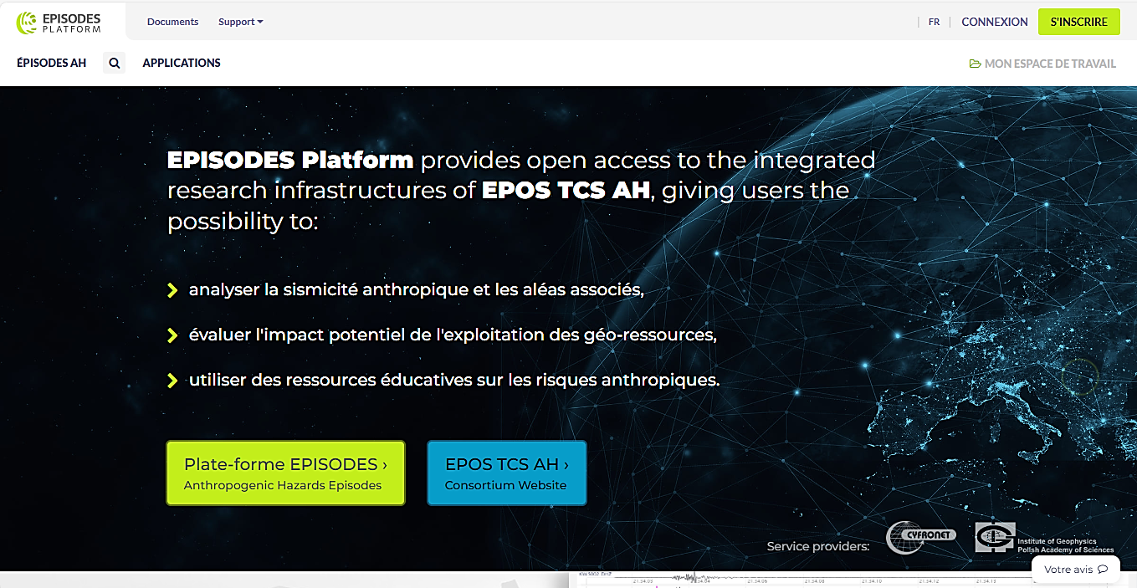
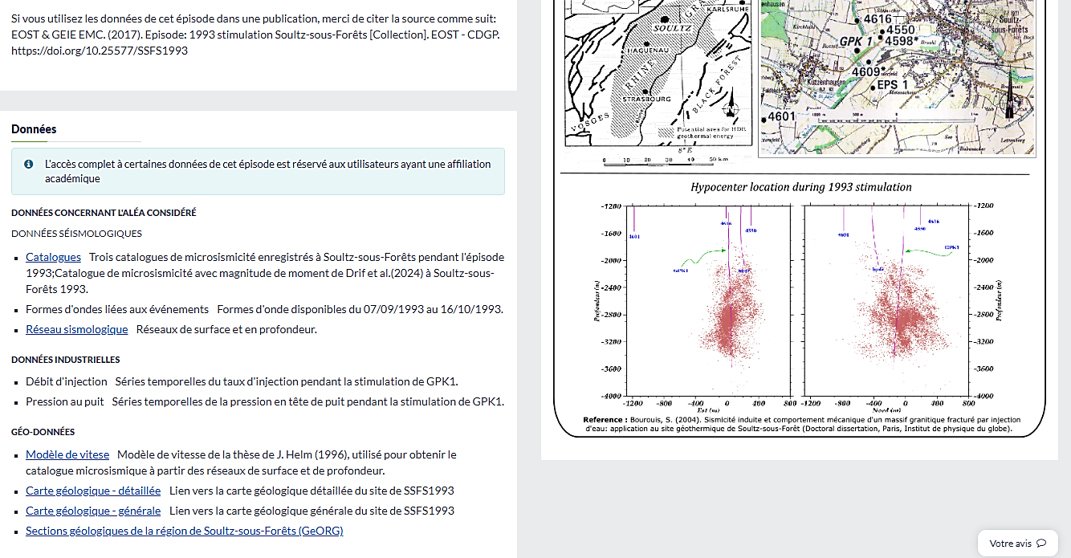
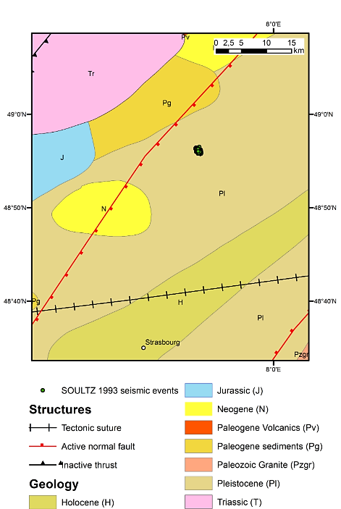
Multidisciplinarity: TCS GIM & induced seismicity
Collaboration TCS GIM with TCS AH in Geo-INQUIRE HE Project, WP4 “Access to products enabling curiosity-driven science for georesources exploration and exploitation”
Objective: Link boreholes and geological models to Episodes in the EPISODES Platform
Preparatory work in 2024: requirements, bounding box of episodes, filtering descriptors and parameters, specifications of the necessary improvements of European borehole data service
Implementing this interactive link has an impact “upstream” on the data contents exposed by the TCS GIM data providers and the European borehole database
Planned to be operational in 2025

Slide 6
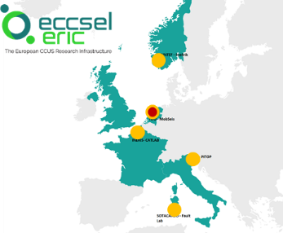
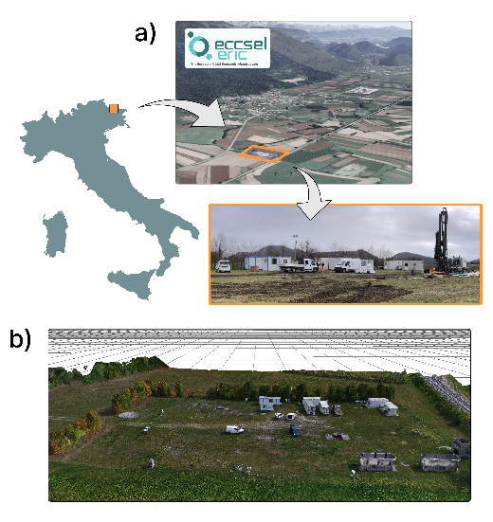
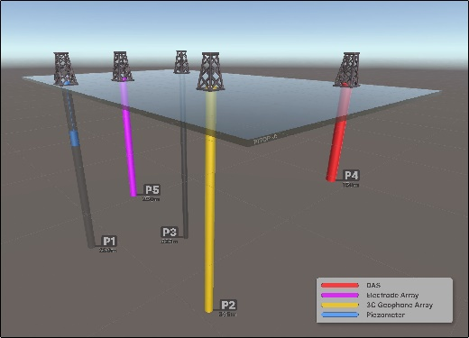
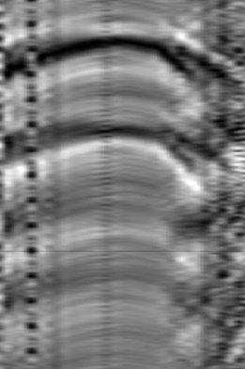
Multidisciplinarity: TCS GIM & CO₂ storage
Collaboration EPOS RI with ECCSEL RI in Geo-INQUIRE HE Project, WP4 “Access to products enabling curiosity-driven science for georesources exploration and exploitation”
ECCSEL RI: World’s largest RI on Carbon Capture, Utilisation and Storage (CCUS) and Carbon Dioxide Removal (CDR) value chain
Objective: Provide access to ECCSEL borehole experimental data on EPOS Platform
First implementation at “PITOP” platform (operated by OGS, Italy): geophysical test site with cutting-edge equipment for borehole and surface experiments, with possible applications in the fields of CCUS and geoenergy. PITOP includes 5 wells used for multidisciplinary tests and research projects
First stages (2024): borehole data collection -> local capitalisation -> compliance to interoperable data model (TCS GIM BoreholeView)
Upcoming stages (2025): Upload and curation at national level (Italian borehole database) -> harvesting through TCS GIM and access through EPOS Platform

