Slide 1
Making geoelectromagnetic data accessible through the EPOS portal in 2024/2025 Maxim Yu. Smirnov*, Juliane Hübert*, Aude Chambodut, Oli Chambers*, Juan Jose Curto, Roman Leonhardt, Vincent Lesur, Jürgen Matzka,
Anne Neska, Oliver Ritter, Ari Viljanen, Petya Trifonova*
* attending EPOS Days 2025

Slide 2
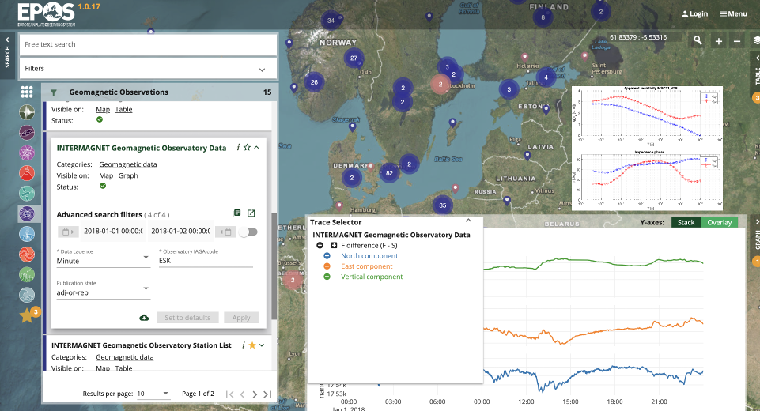
Current data products
WP13-DDSS-001 | Geomag. observatory data (WDC & INTERMAGNET) | BGS
WP13-DDSS-002 | Variometer data IMAGE + Baltic extensions | FMI
WP13-DDSS-003 | Magnetic survey data (e.g. WDC) | BGS
WP13-DDSS-004 | Magnetotelluric time-series (TS) | LTU
WP13-DDSS-006 | Geomagnetic indices (ISGI) | CNRS, GFZ
WP13-DDSS-007 | Geomagnetic events (OE, ISGI) | CNRS, EBRO
WP13-DDSS-008 | IMAGE electrojet indices (IE/IL/IU) | FMI
WP13-DDSS-009 | IMAGE Substorm events | FMI
WP13-DDSS-010 | Magnetotelluric transfer functions (TF) | LTU
WP13-DDSS-012 | IGRF and WMM (global magnetic models) | BGS
WP13-DDSS-013 | Lithospheric conductivity models | LTU

Slide 3
Developments and Highlights
Visualisation of time series and transfer functions
New API for geomagnetic data
New portal and API for MT data
Development of training material for Geomag data products on EPOS website
Improve services by including jupyter notebooks for data analysis

Slide 4
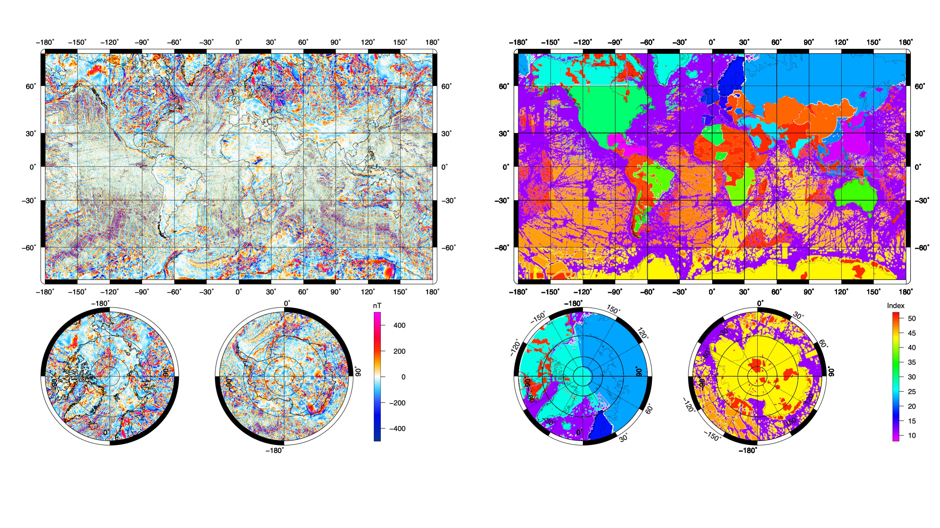
New developments and data services: World Magnetic Anomaly map

Slide 5
Space Weather impacts on grounded infrastructure (see also Mirjam’s poster) using geomagnetic data and magnetotelluric data for GIC modelling
Mineral exploration (airborne magnetic data, Magnetotelluric data, control source EM)
Case studies and addressing societal challenges

Slide 6
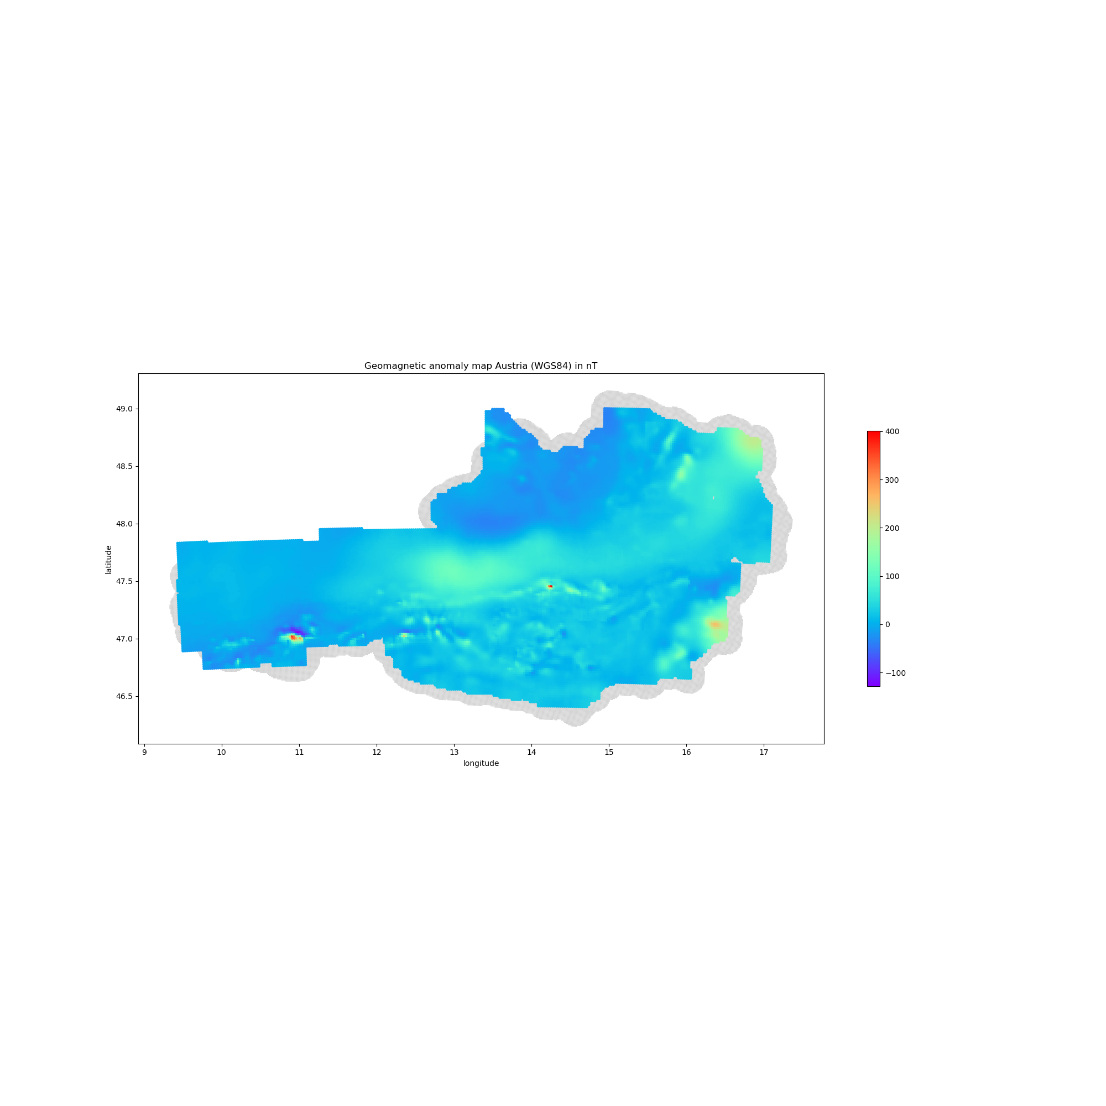
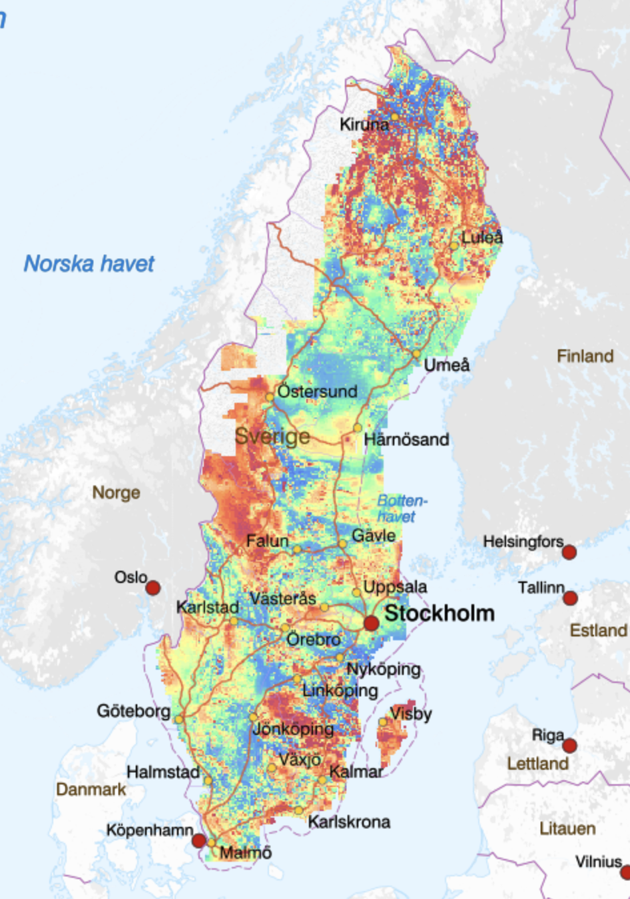
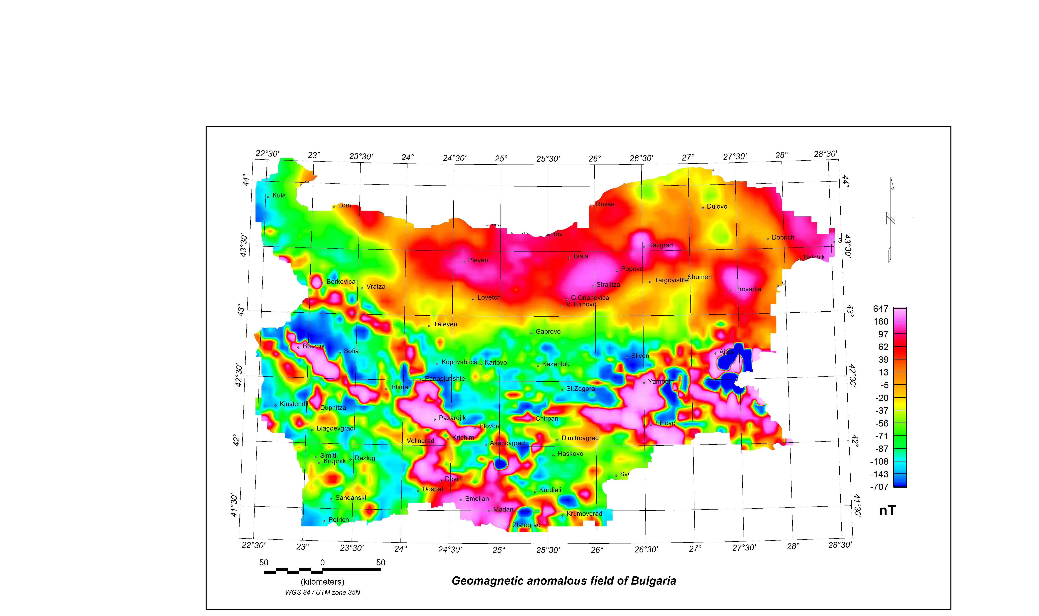
New data services
Building new service to provide high-resolution country-wide aeromagnetic surveys

