Slide 1
EPOS Thematic Core Service Anthropogenic Hazards
the path to scientific excellence in AH research
Ania Leśnodorska, Agnieszka Mtupa-Ndiaye, Joanna Kocot
EPOS DAYS 2025, PERUGIA

Slide 2
TCS AH CONSORTIUM
TCS AH Consortium:
16 Institutions, from 8 European and 1 non-European country
13 research institutions
1 industrial partner
1 private company
1 associate partner (non-EU)
2019 - 2028
Hosting Institution: Institute of Geophysics PAS

Slide 3
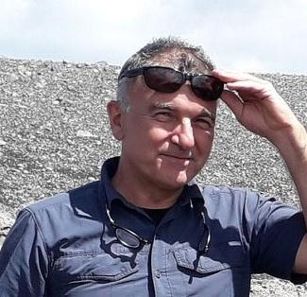
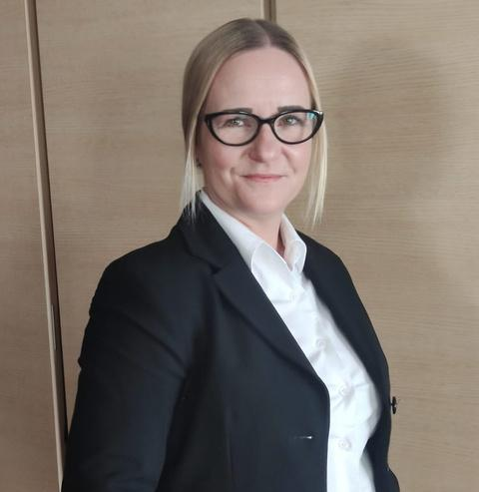
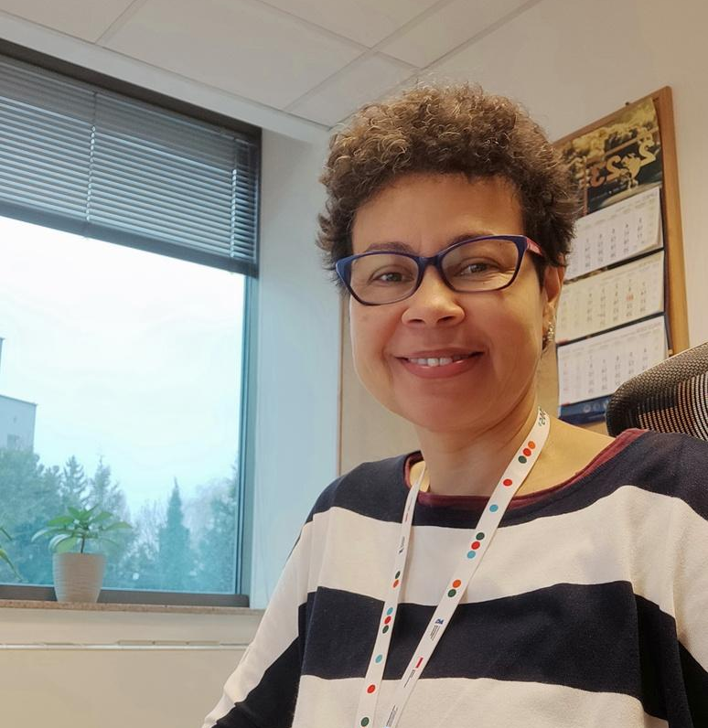
MEET OUR EXECUTIVE TEAM
Gilberto Saccorotti
Chair of the
TCS AH Consortium Board
Anna Leśnodorska
TCS AH Director
Agnieszka Mtupa-Ndiaye
TCS AH RI Manager
Savka Dineva
Section For
Projects and
Partnership
Glenda Jones
Section For
Promotion and Dissemination
Joanna Kocot
Section For
Implementation
of TCS AH services
Izabela
Dobrzycka
TCS AH Office
Notes:
Przerobić stronę na TEAM TCS AH
ECO:
TCS AH Director AL
TCS AH RI Manager AMN
SECTIONS:
For Project and Partnership: SD
For Promotion and Dissemination: GJ
For the implementation of TCS AH Services: JK
For episode integration and application implementation: vacancy

Slide 4
TCS AH INTEGRATED INFRASTRUCTURE
- New episodes - New applications
new TCS AH data node at GFZ (CIBIS software)
3 new multi-scale episodes:
AE LAB-EXPERIMENT: Fluid injection into fault - monitoring
acoustic emissions during laboratory rock experiment (Germany),
ASPO: Hydraulic stimulation experiment (Sweden),
JAGUARS: deep mining induced seismicity, physics of earthquakes experiment in the Mponeng gold mine (South Africa)
New data types defined and new visualizations:
Cartesian Station, Interval Pressure, Mechanical Data, Stress Data.
4 new applications
Maximum Magnitude Deterministic/Probabilistic Models
Phase Association with PyOcto
Spectral Parameters
MIDSTREAM („Modeling fluid induced Seismicity Rates using a covariate Model”)
integration of digital twins and workflows into the EPISODES Platform (in progress)

Slide 5
TCS AH AI
EPOS AI platform
Developed within EPOS-PL+ project
EPOS AI Workbench
Script and tools repository
Integrated with EPISODES Platform
Integrated with PLGrid computation resources
Automated AI-based phase detection
Integrated as application within EPISODES Platform
Based on SeisBench, using PhaseNet and GPD models
Adjusted to anthropogenic seismicity cases

Slide 6
TCS AH INTEGRATED INFRASTRUCTURE - statistics
with affiliations from 487 institutions
72 different countries
1981
users from
154 new users registered in 2024
45 worldwide episodes
Language:
English
Polish
French
Italian
79 services
New!!!
Spanish soon available
Map of new registrations on the EPISODES Platform in 2024

Slide 7
WEBINARS
Francesco Grigoli
Ian Stimpson, Glenda Jones
Ade Nascimento
Offshore microseismic monitoring (with application to the Castor case, Spain)
Integration of reflection seismics and earthquake monitoring in a salt solution mining seismicity case in Brazil
EPISODES Platform use cases for teaching and outreach
March
2024
April
2024
June
2024
September
2024
October
2024
December
2024
Grzegorz Kwiatek
Francesca De Santis, Julie Maury
Adam Lurka
How to find a group of clusters of induced seismicity in space and time? - Hierarchical cluster analysis example
Tracking deviation from stable seismic energy release during hydraulic stimulations using physics-informed features
Good practices guide for managing seismicity induced by deep geothermal operations

Slide 8
WORKSHOPS
Workshop on EPISODES Platform: EPOS Workshop. Side event at the Polish Open Science Conference 2024.
Two days 11 and 12.04.2024.
Funded and organised within
Geo-INQUIRE H2020 project
EPOS TCS-AH Workshop Bologna (Italy),
21-22 November 2024 INGV & Università di Bologna ,
Dipartimento di Fisica e Astronomia.
Viale Carlo Berti Pichat, 6/2 - Bologna (Italy)

Slide 9
OBJECTIVES & COLLABORATION WITH OTHER TCSs
Collaboration with other TCSs to enhance the interdisciplinary approach:
On-going collaboration with TCS GIM on the integration of borehole information to the existing episodes (in the framework of Geo-INQUIRE project)
Contribution from the new TCS AH member - Institute of Geological Science PAS
TCS AH member - UPWr discussion with TCS GNSS on potential integration of GNSS products and services of UPWr to the TCS GNSS
Objectives for 2025:
Extend the multidisciplinary aspect of the TCS AH episodes by complementing them with additional data eg. geological data (borehole information)
Integrate new datasets on the EPISODES Platform: Castanhao (Brasilian reservoir impoundment episode), Garpenberg (Swedish mine episode)
Acquire new data providers.
Engage and attract new partners. Meetings with two institutions (Universidad Complutense de Madrid, Spain, and CODELCO-Teniente, Chile), candidates interested in joining TCS AH have already taken place. Admission procedure in progress.

