Slide 1
Integrating high-resolution, small scale imagery into EPOS Examples of drone- and ground-based measurements David E. Jessop & colleagues from the SNOV/Epos-France/VOLC-TCS

Slide 2
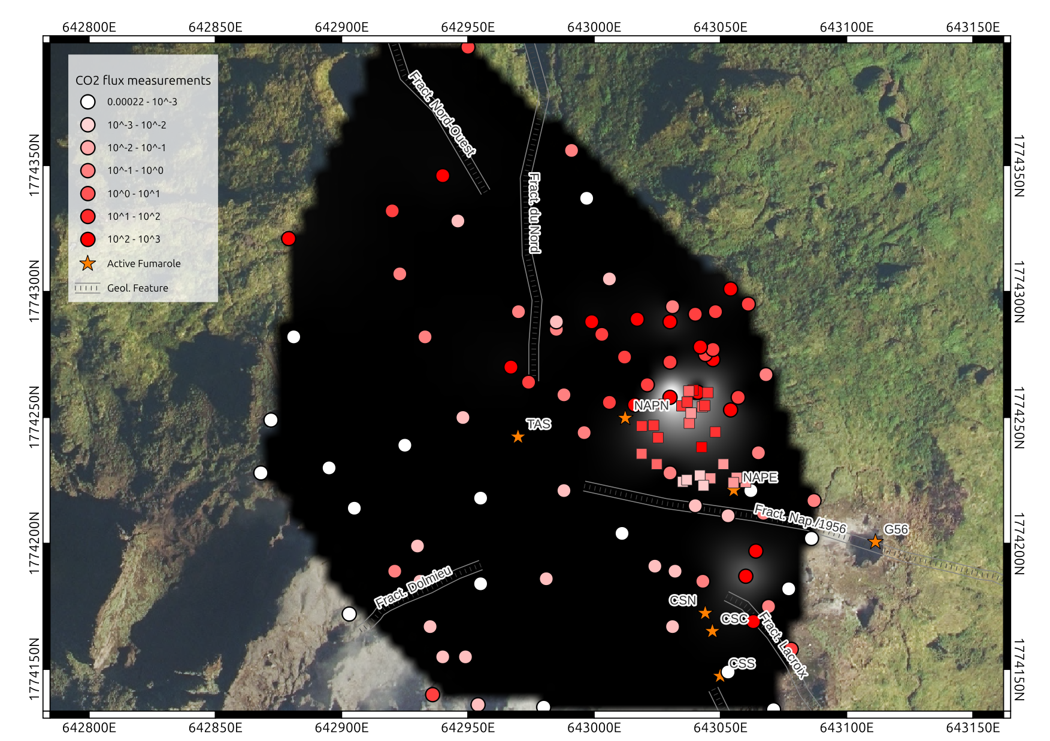
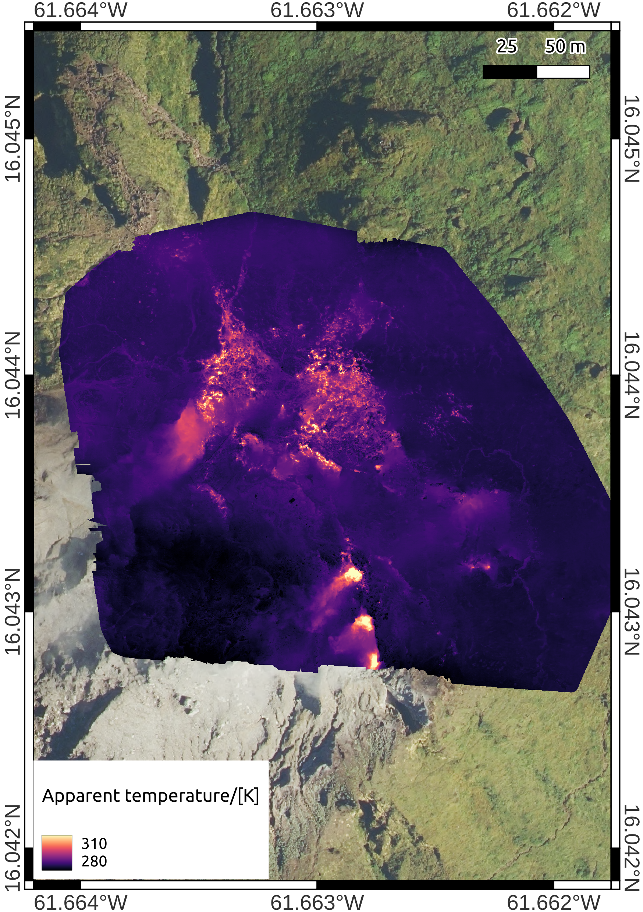
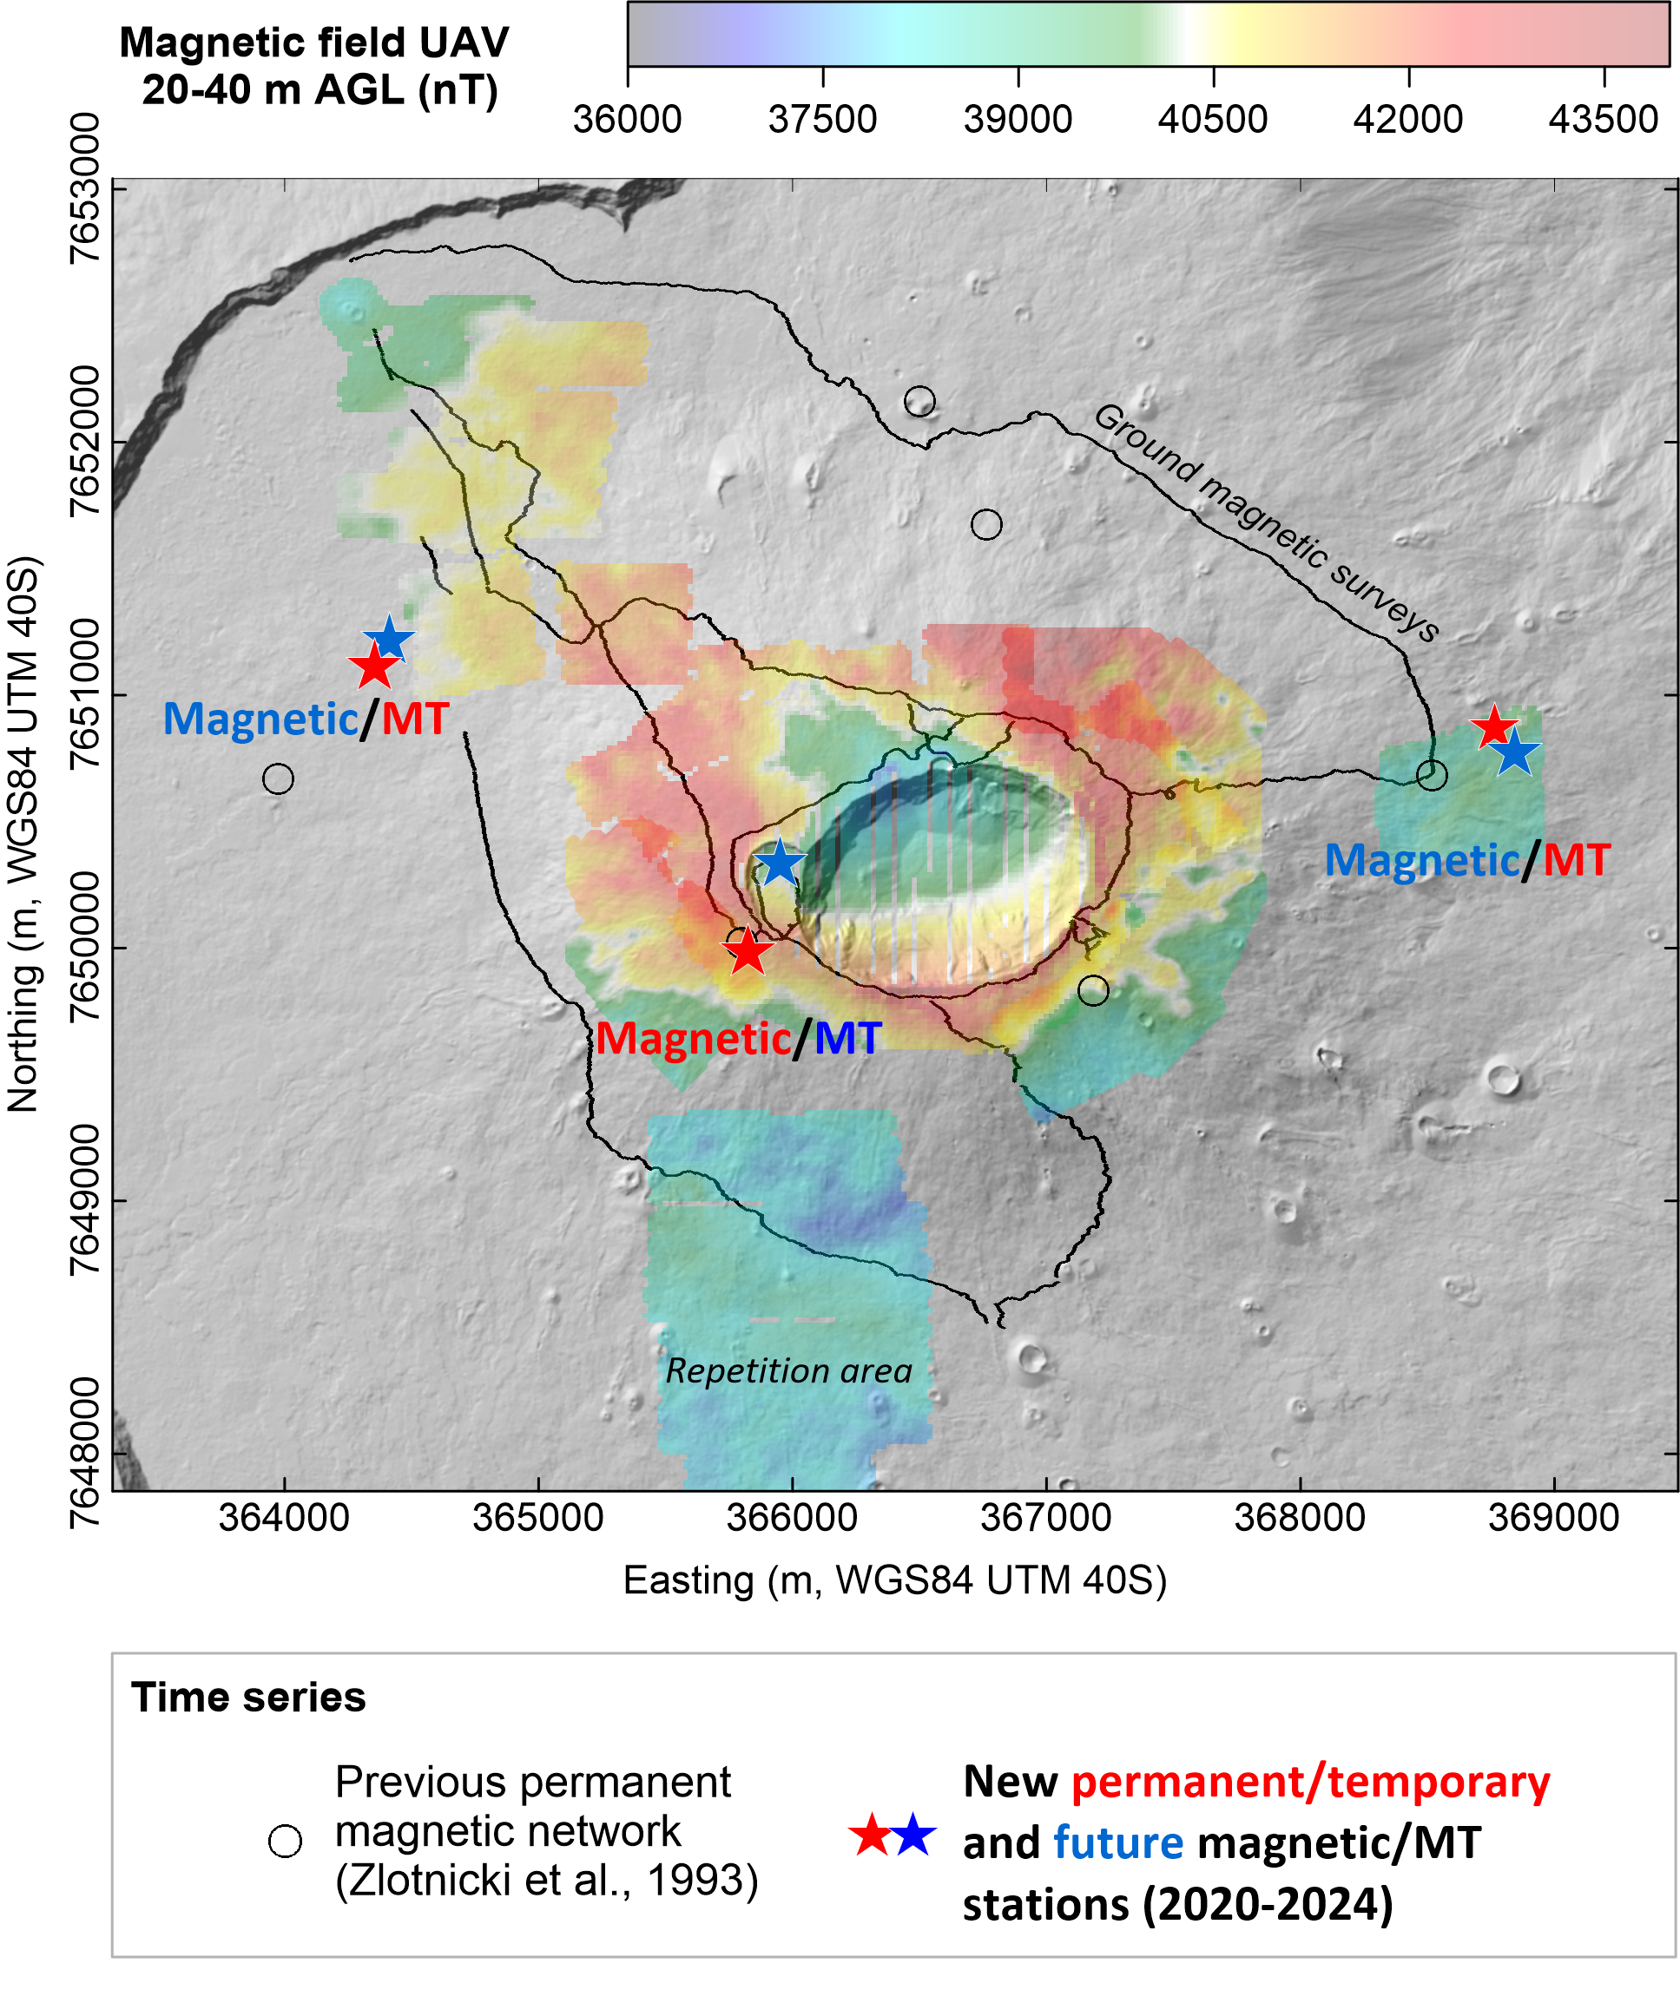
Challenges
CO2 soil flux measurements, la Soufrière de Guadeloupe
Thermal orthophoto, la Soufrière de Guadeloupe
Magnetisation, Piton de la Fournaise (la Réunion)
Collections of point measurements → geospatial “interpolation” / SfM → “image”
High resolution (cm to m), low spatial extent
How to integrate these into EPOS?

Slide 3
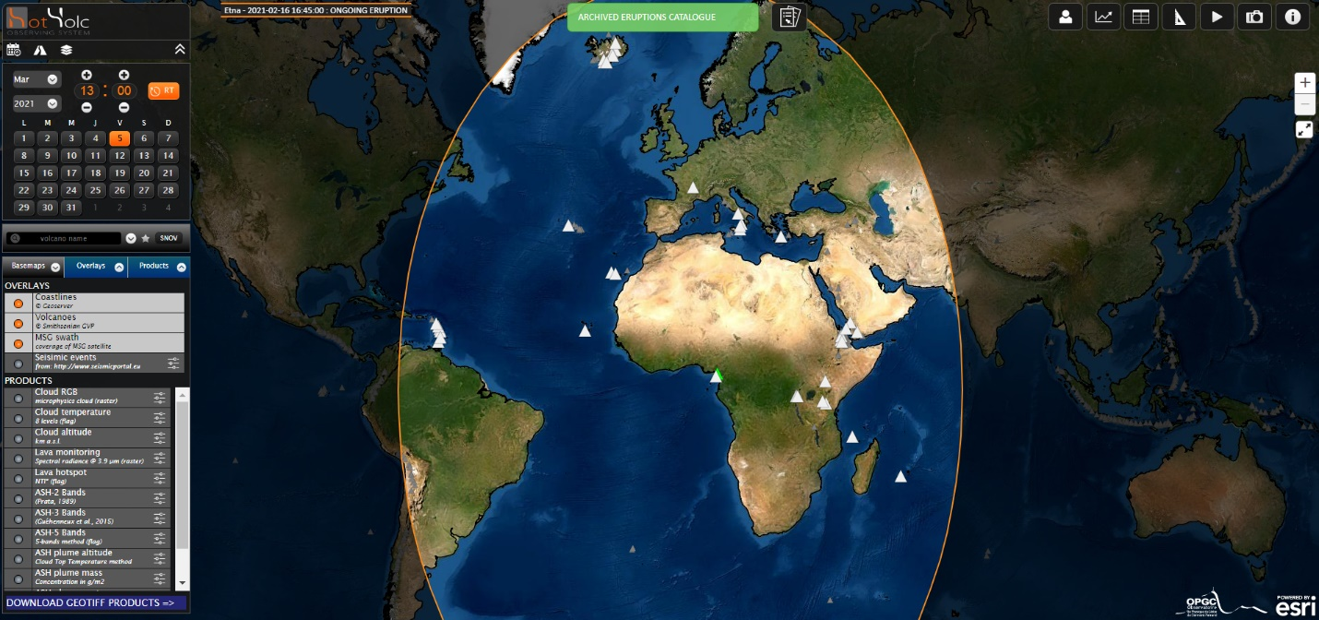
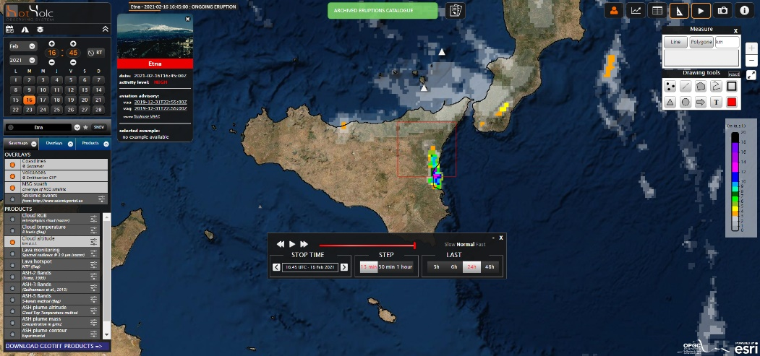
Solution?
Images in GeoTIFF format → already in use in satellite imagery, e.g. Epos-FR HOTVOLC service (thermal images from geostationary satellites).
Unified platform for image type data (imagery, geodesic modelling, geospatially-interpolated information, …)

