Slide 1
Making Icelandic GNSS Data EPOS-Compliant: Challenges and Solutions Hildur María Friðriksdóttir Icelandic Meteorological Office hildur@vedur.is

Slide 2
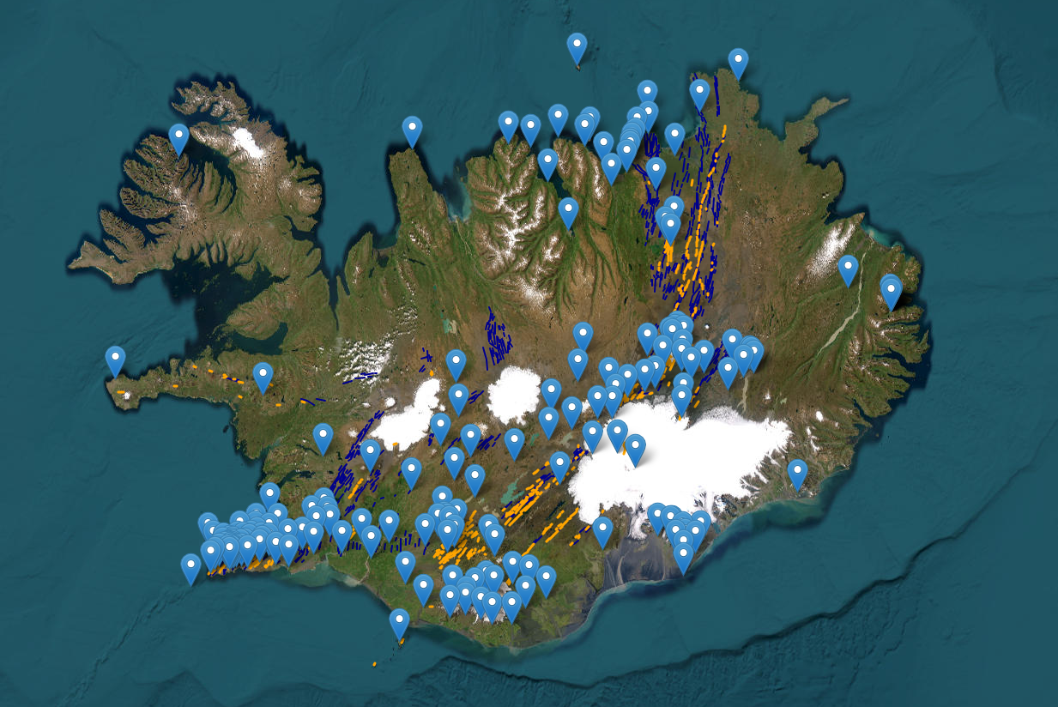
Iceland has over 150 continuous GNSS stations. 35 of those have been added to the EPOS Data Portal.
Hildur María Friðriksdóttir - Icelandic Meteorological Office - hildur@vedur.is

Slide 3
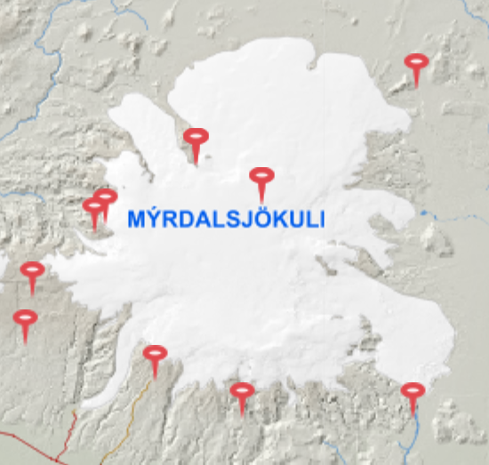
Case example: AUST cGNSS station
Hildur María Friðriksdóttir - Icelandic Meteorological Office - hildur@vedur.is

Slide 4
The road ahead
Hildur María Friðriksdóttir - Icelandic Meteorological Office - hildur@vedur.is

Slide 5
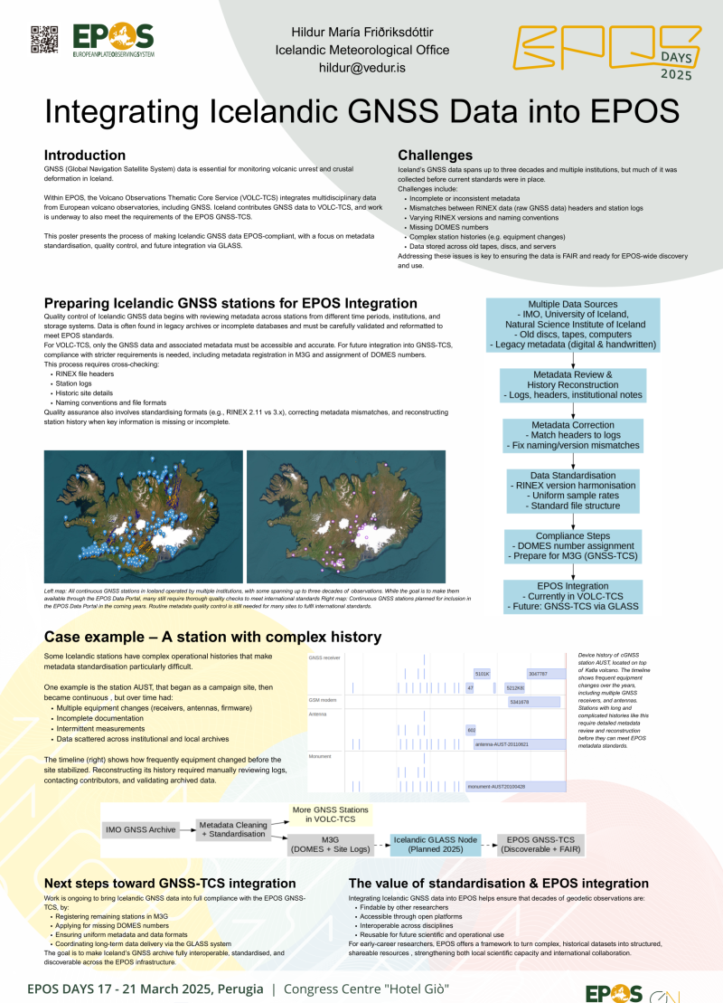
Want to know more?
Have questions?
Interested in data? GNSS? Icelandic volcanoes?
Then I hope to see you at my poster!
Hildur María Friðriksdóttir - Icelandic Meteorological Office - hildur@vedur.is

