Slide 1
Agent-based Probabilistic Tsunami Evacuation Modeling and the potential future EPOS integration Saeed Soltani ¹*, Fatemeh Jalayer ², Manuela Volpe ³, Stefano Lorito ³, Saman Ghaffarian ², Hossein Ebrahimian ¹, Julie Dugdale ⁴
¹ University of Naples Federico II, Naples, Italy
² University College London, London, United Kingdom
³ National Institute of Geophysics and Volcanology, Roma, Italy
⁴ University Grenoble Alps, Grenoble, France
*Manager of European Tsunami Risk service (ETRiS) Postdoc researcher at University Naples Federico II Responsile of User Feedback Group of TCS Tsunami

Slide 2
Agent based modeling
Geo
science
Computer
science
Agent-Based Modeling (ABM) is a simulation approach where autonomous agents interact within an environment, following defined rules, to model complex system behaviors.
Social
science
GIS
Why ABM in Tsunami science?
ABM is essential for tsunami evacuation as it provides a tool to simulate human responses to tsunami inundation, assessing safe evacuation probabilities through a simulation-based workflow that incorporates detailed simulated tsunami scenarios, baseline conditions, and human behavior.
Can recieve information from its environment
Has a set of charchtristics (attributes)
Age
Speed
Has a set of action (behaviours
/methods)
Can decide what to do
Run
Can communiate with other agents
Can be reactive or proactive
with different level of inteligence

Slide 3
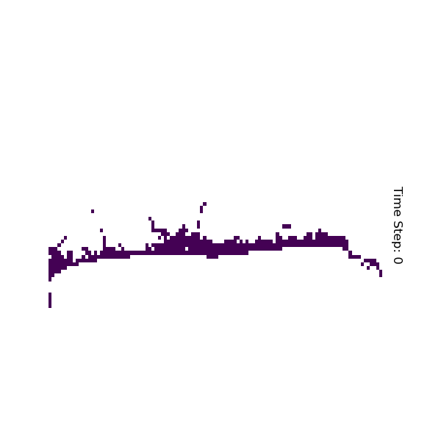
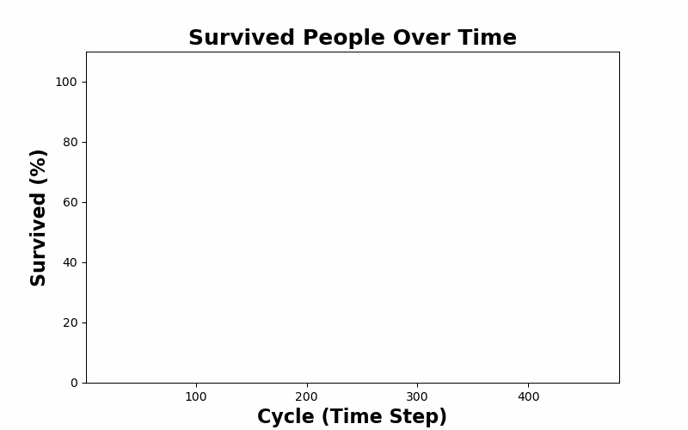
ABM in Catania (Eastern Sicily)
ABM in Catania is relying on different DDSS from TCS Tsunami. It develops a high-resolution digital model of the evacuation environment, using geospatial, demographic, and social data. It integrates detailed tsunami simulation scenarios as a product of site-specific PTHA results (Relevant TCS Tsunami software and workflows: TS Gauss, ANTI:FASc, HySEA Platform, and ChEESE PTHA workflows, …).
Our ABM model incorporates and propagates uncertainty analysis of all input parameters ranging from tsunami source characteristics (e.g., magnitude and slip) to various human response factors influenced by different behavioral patterns and choices.
Name | family_members | Age | Sex | Is_head_household | Is_it-Evacuate | Disability | Velocity(m/s) | Delay time (min) | building_id
person0 | person(0) | 35 | Male | TRUE | TRUE | FALSE | 0.852 | 16.178128 | 65
person1 | person(2) | 17 | Female | FALSE | TRUE | FALSE | 1.656 | 2.5279726 | 73
person2 | person(2) | 43 | Male | TRUE | TRUE | FALSE | 1.144 | 4.3145443 | 73
person3 | person(2) | 41 | Female | FALSE | TRUE | FALSE | 1.135 | 8.0923847 | 73
person4 | person(2) | 31 | Female | FALSE | TRUE | FALSE | 1.165 | 10.49451 | 73
person5 | person(6) | 8 | Male | FALSE | TRUE | FALSE | 1.522 | 7.8099076 | 22
person6 | person(6) | 58 | Male | TRUE | TRUE | TRUE | 1.398 | 3.876623 | 22

Slide 4
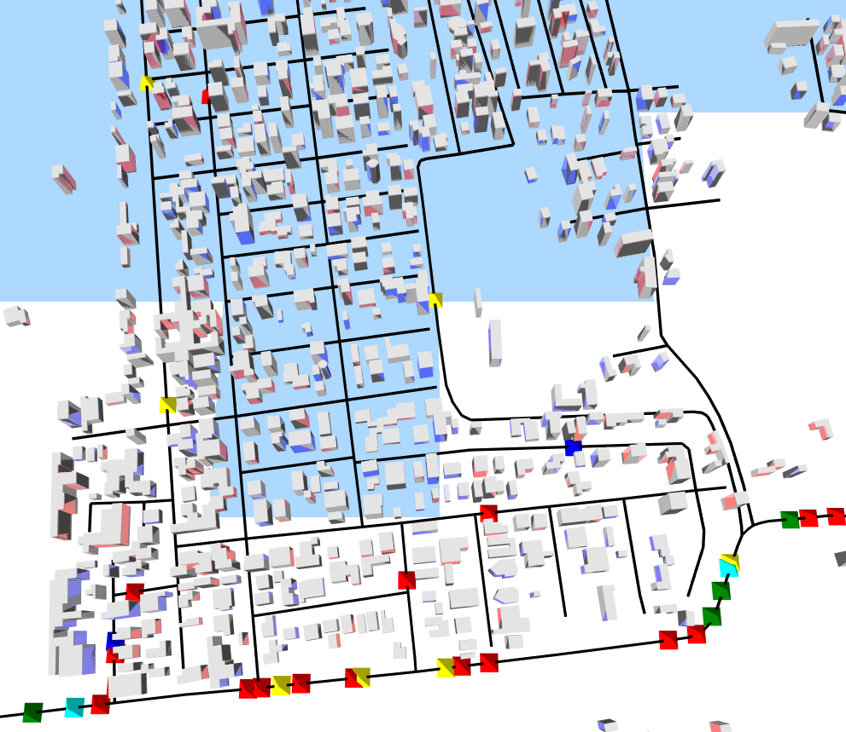
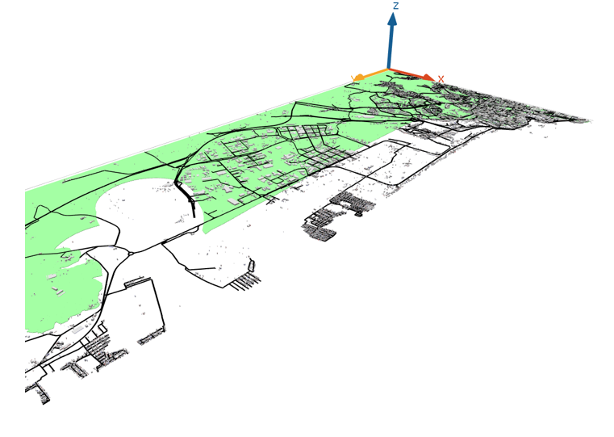
Simulation execution example
Each color represents different age group of evacuues

Slide 5
EPOS Integration and Conclusion
Enhancing Cross-TCS Collaboration: Integrating multi-hazard impacts such as earthquake-damaged buildings, debris-blocked roads, and bridges with impaired viability due to the damage by tsunami triggering events (e.g., earthquakes leading to tsunamis) within the ABM framework.
Potential ICS-D Use Case: Establishing a tsunami evacuation modelling platform.
Vision for the Future: Pioneering the development of a Digital Twin for Tsunami Evacuation, enabling real-time multi-channel data fusion, adaptive updating of the evacuation environment, predictive analytics, scenario planning, and dynamic decision-making to protect communities against tsunami threats.

Slide 6
Thank you

