Slide 1
Global Tsunami Model (GTM) Probabilistic Tsunami Hazard Assessment (PTHA) Hafize Başak Bayraktar and GTM PTHA Working Group

Slide 2
Probabilistic Tsunami Hazard Analysis (PTHA) Workflow
STEP-1
Probabilistic earthquake model

Slide 3
Probabilistic Tsunami Hazard Analysis (PTHA) Workflow
STEP-1
Probabilistic earthquake model
STEP-2
Tsunami generation and propagation
List of events

Slide 4
Probabilistic Tsunami Hazard Analysis (PTHA) Workflow
STEP-1
Probabilistic earthquake model
STEP-2
Tsunami generation and propagation
List of events
STEP-3
Hazard aggregation and uncertainty quantification
Mean annual rates and related epistemic uncertainty

Slide 5
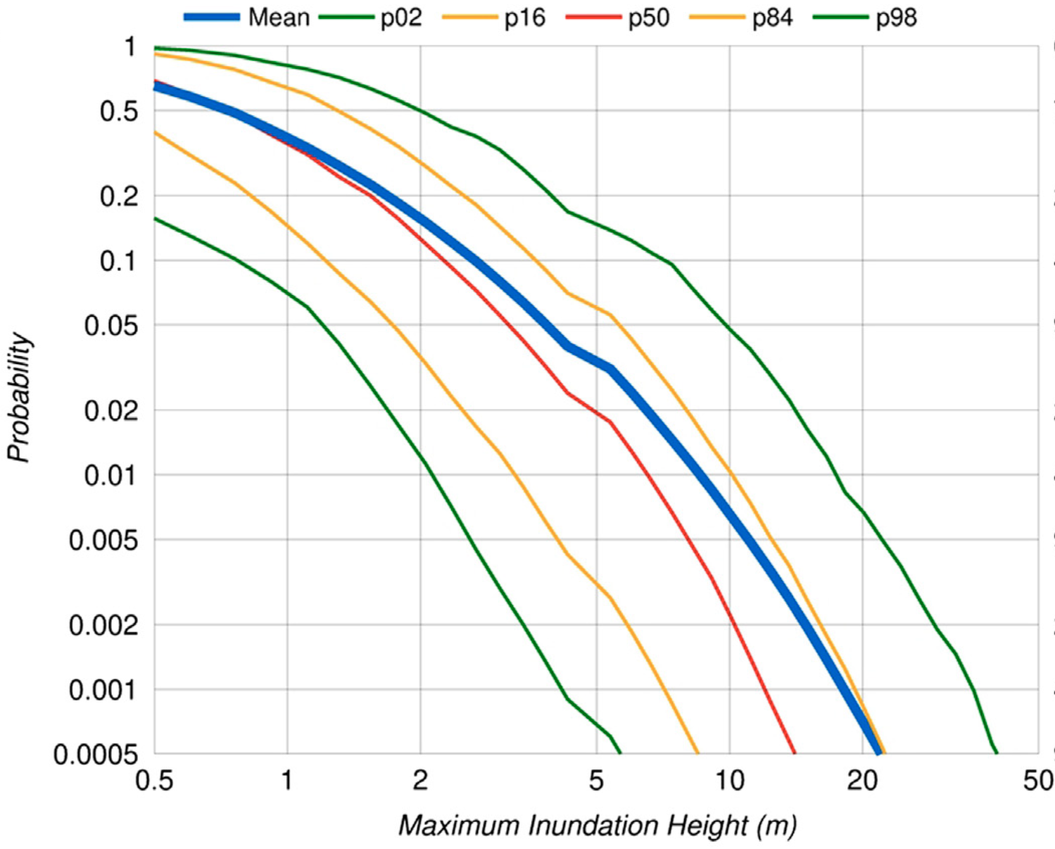
Probabilistic Hazard Model
Hazard Curve
P( > MIH_{th} , 50 yr)_{POI}

Slide 6
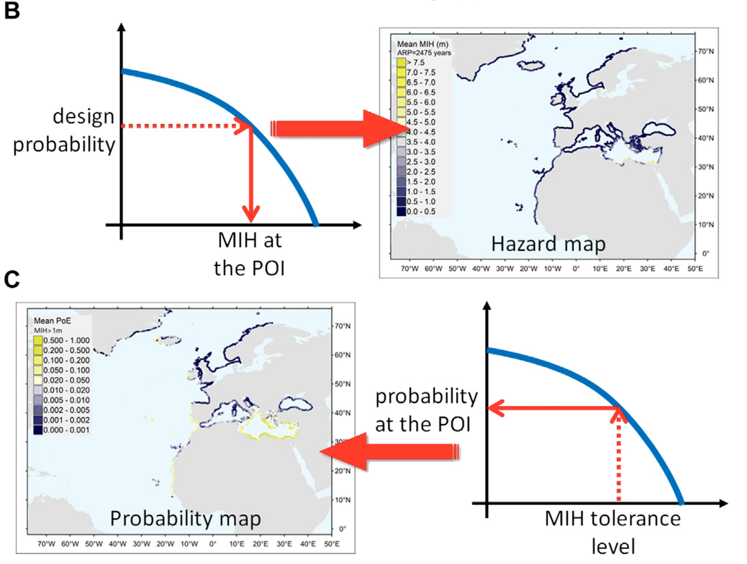
Probabilistic Hazard Model
Hazard or Probability Map

Slide 7
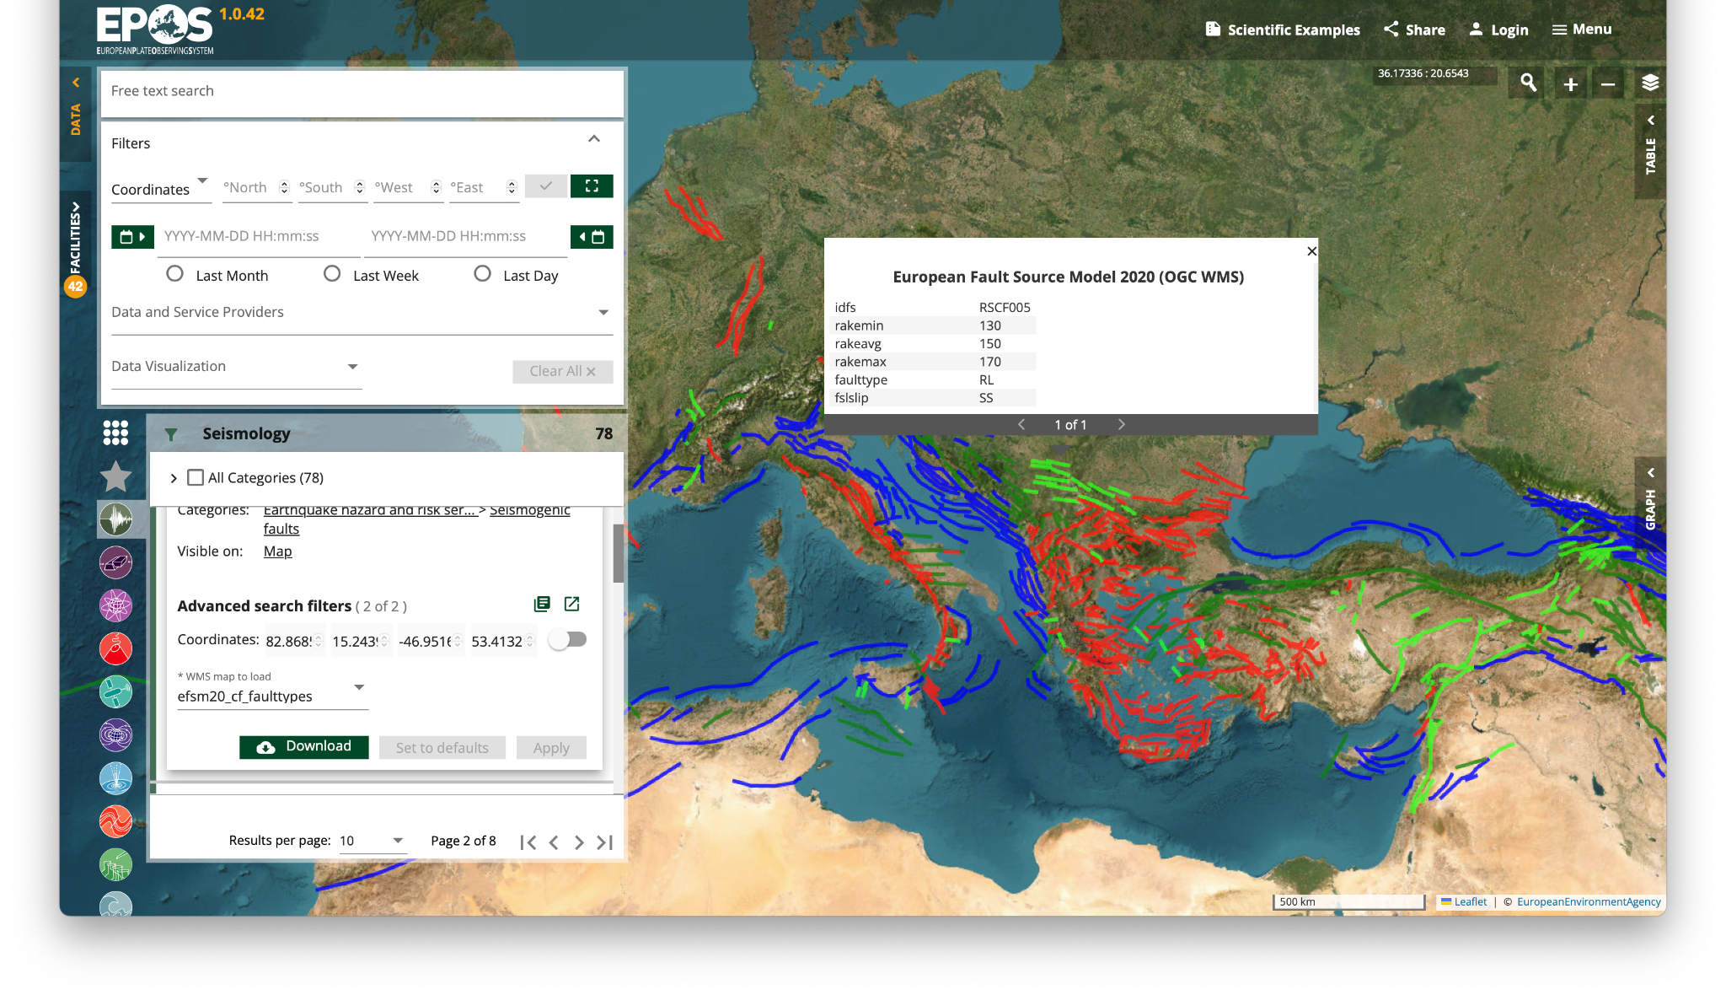
EPOS Services
European Fault Source Model

Slide 8
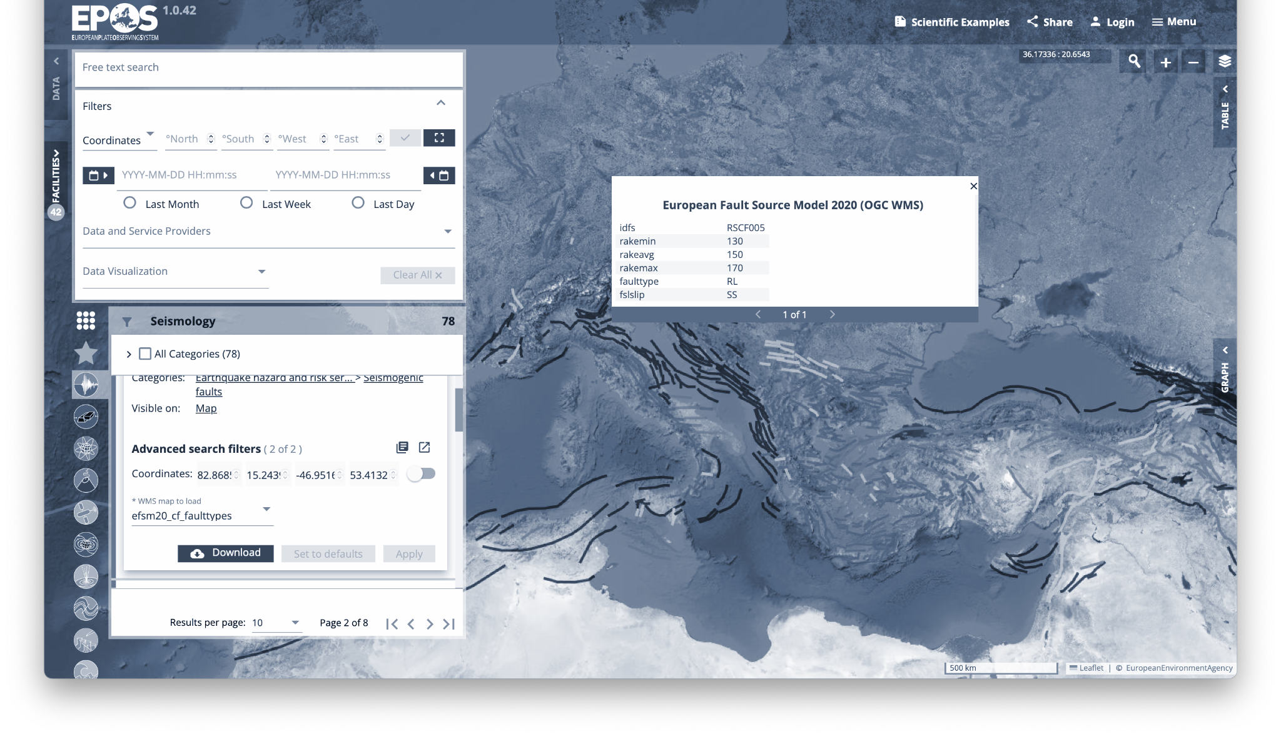
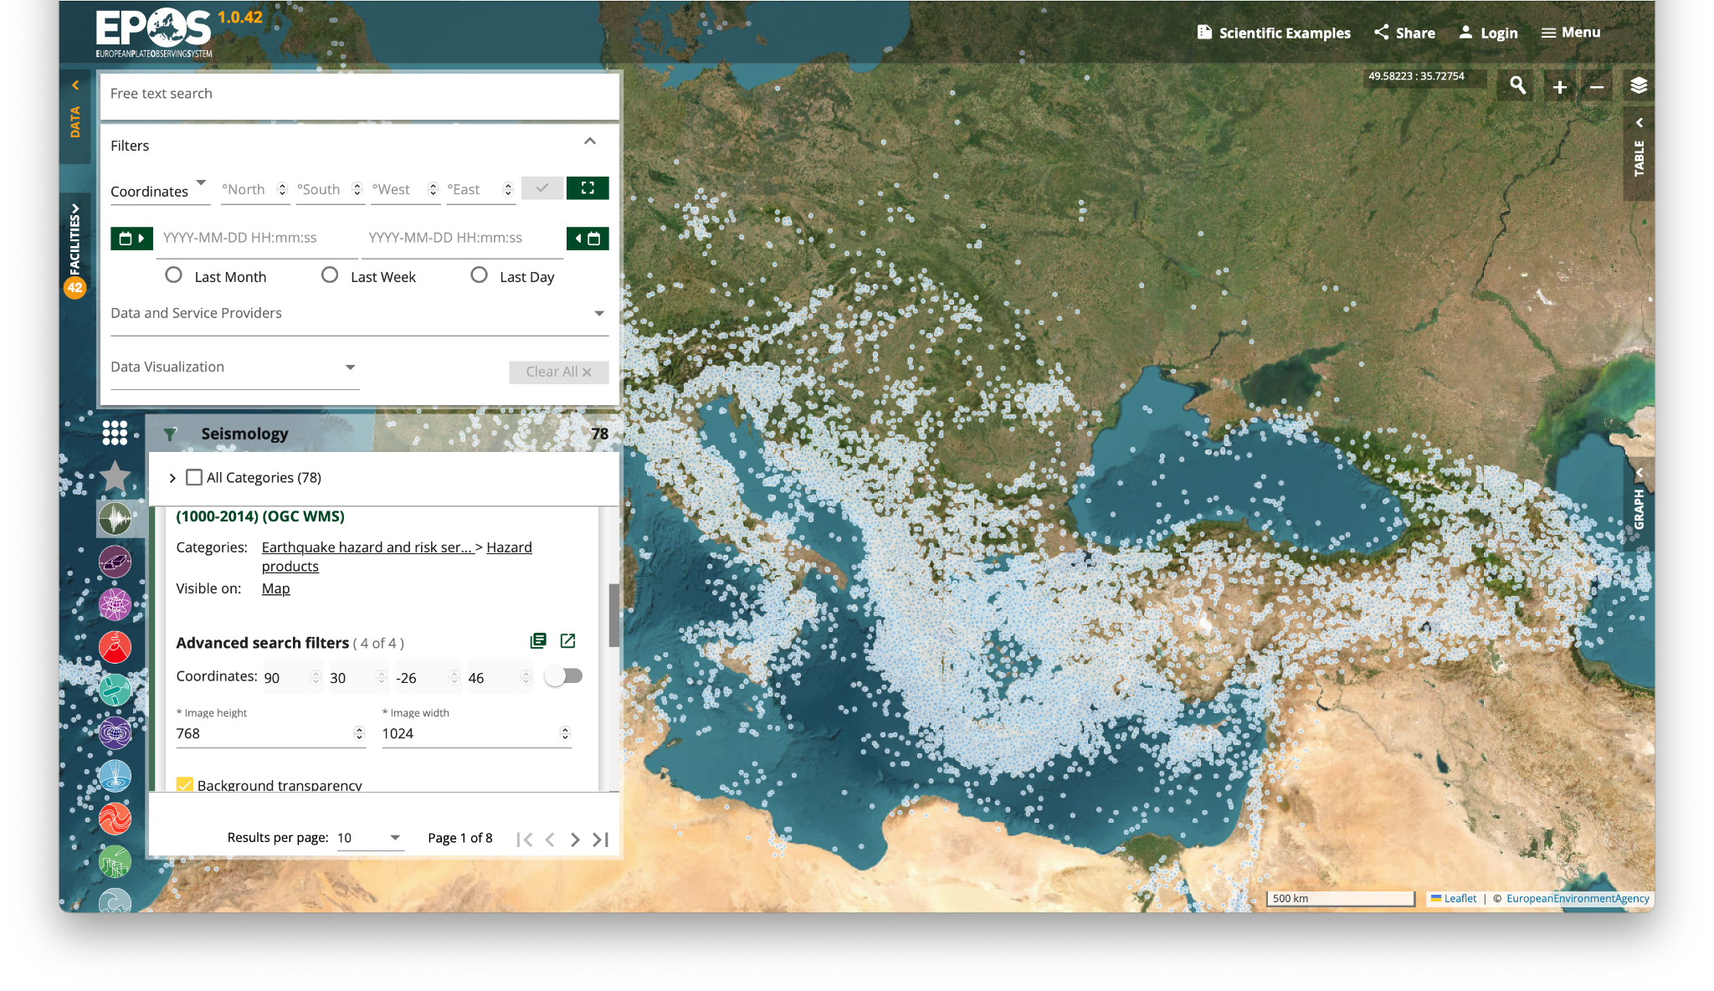
EPOS Services
Unified Earthquake Catalogue

Slide 9
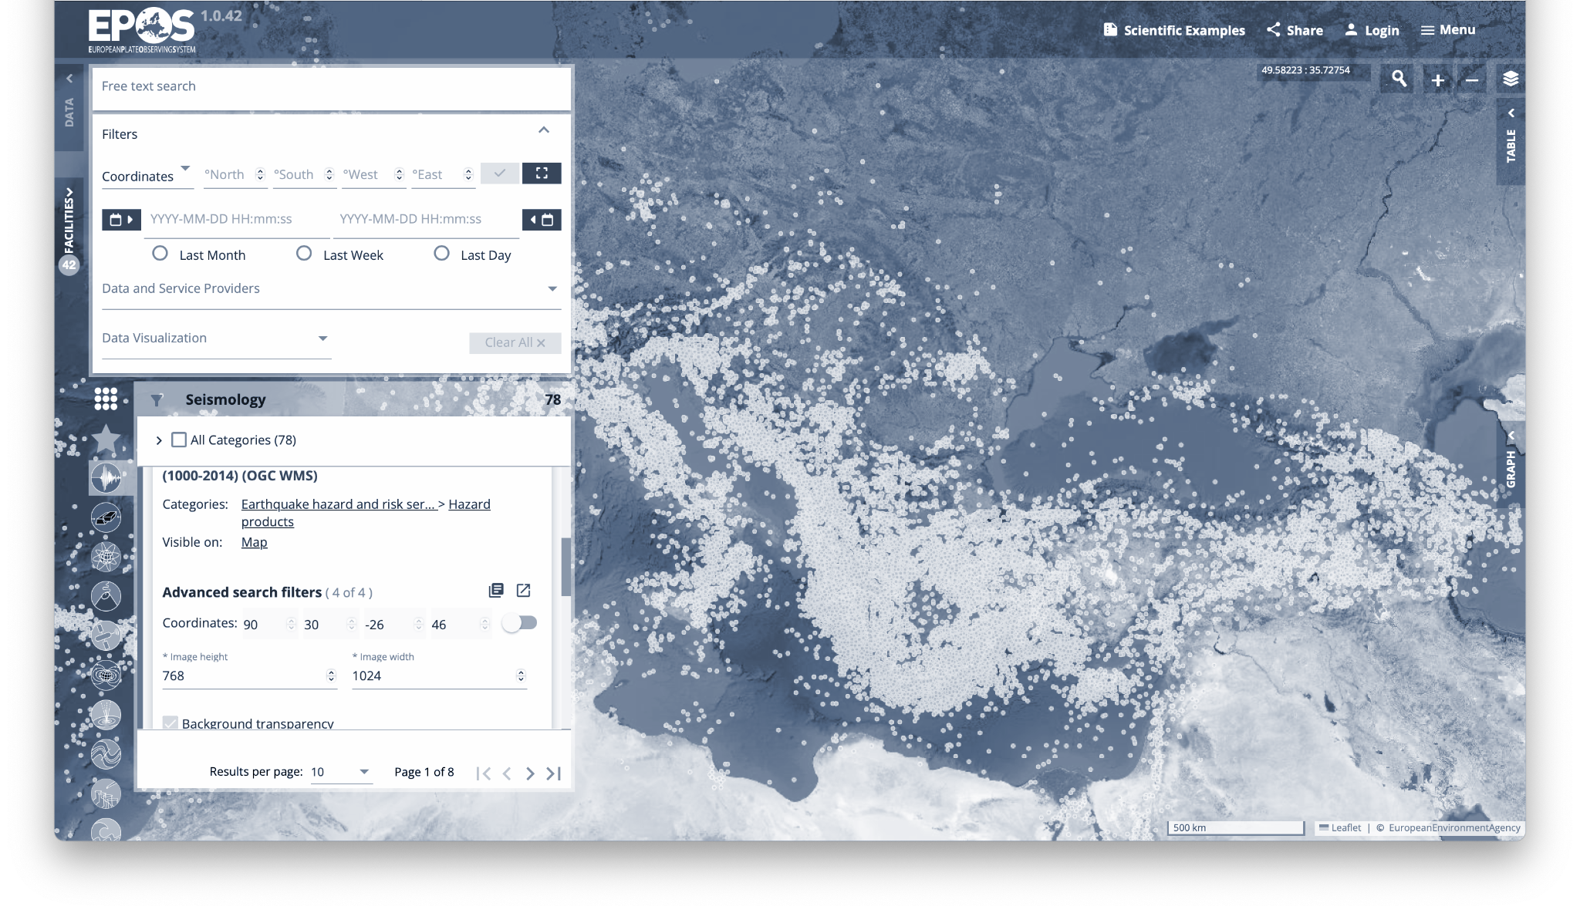
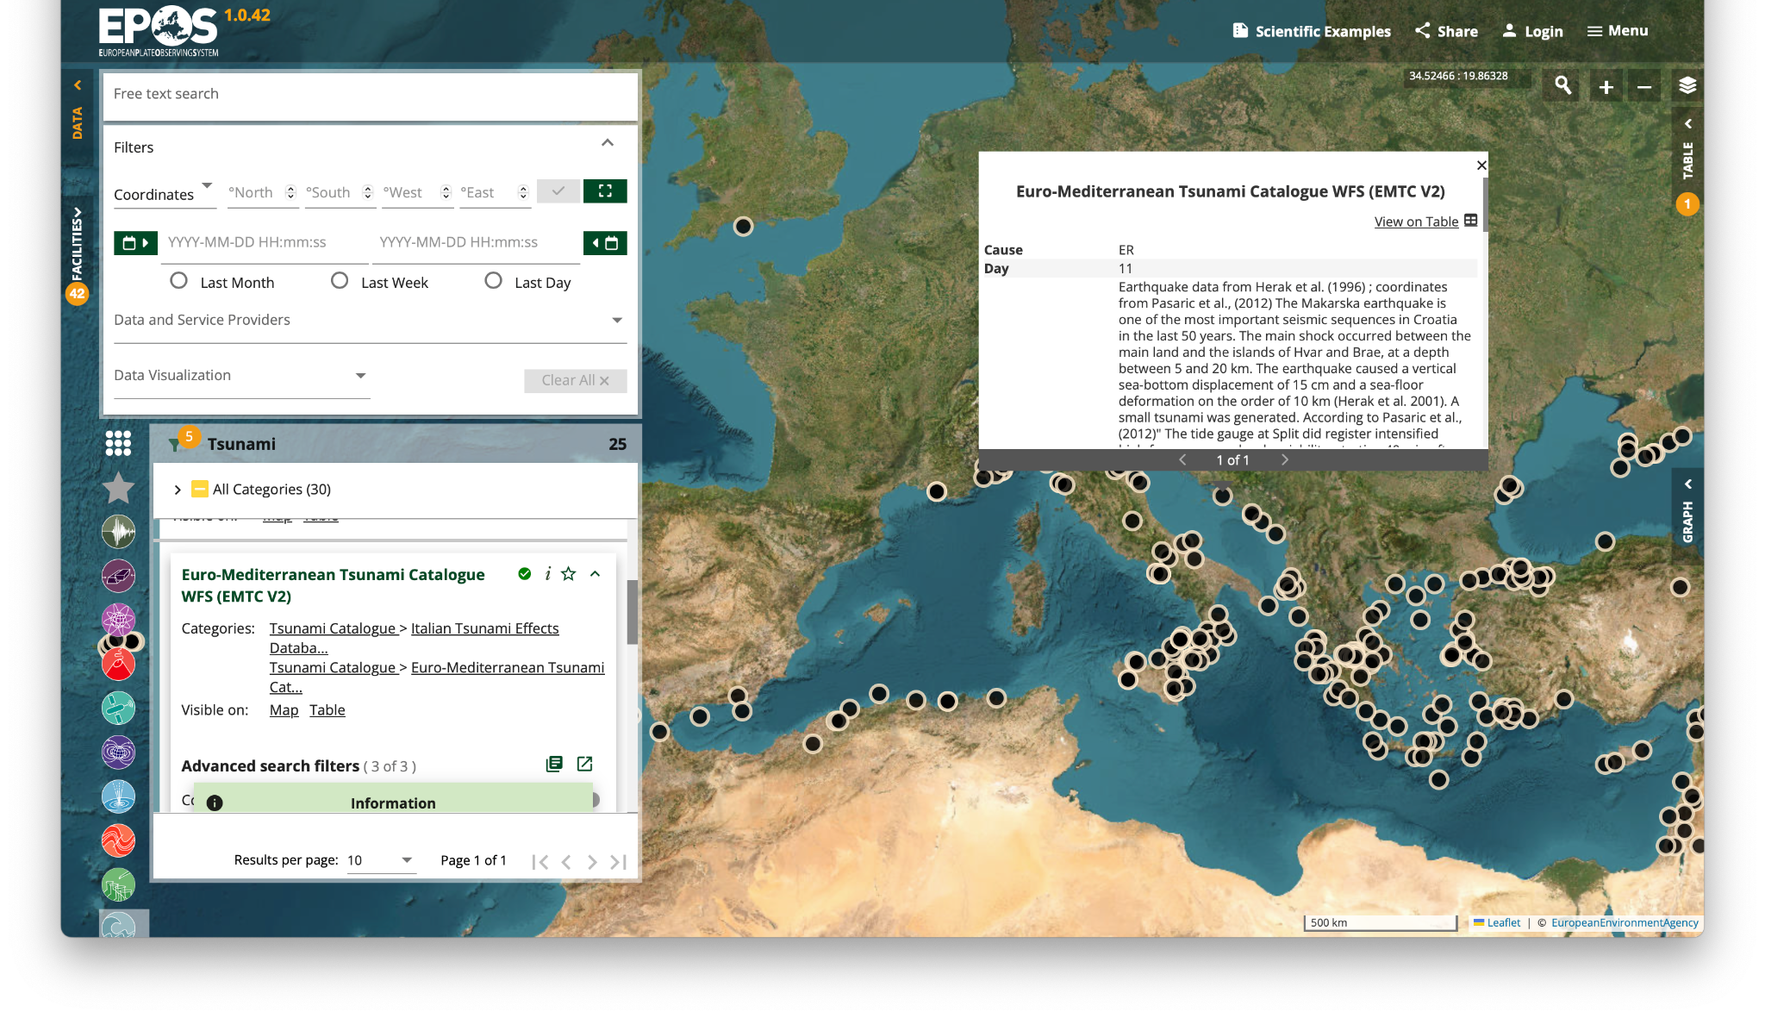
EPOS Services
Euro-Mediterranean Tsunami Catalogue

Slide 10
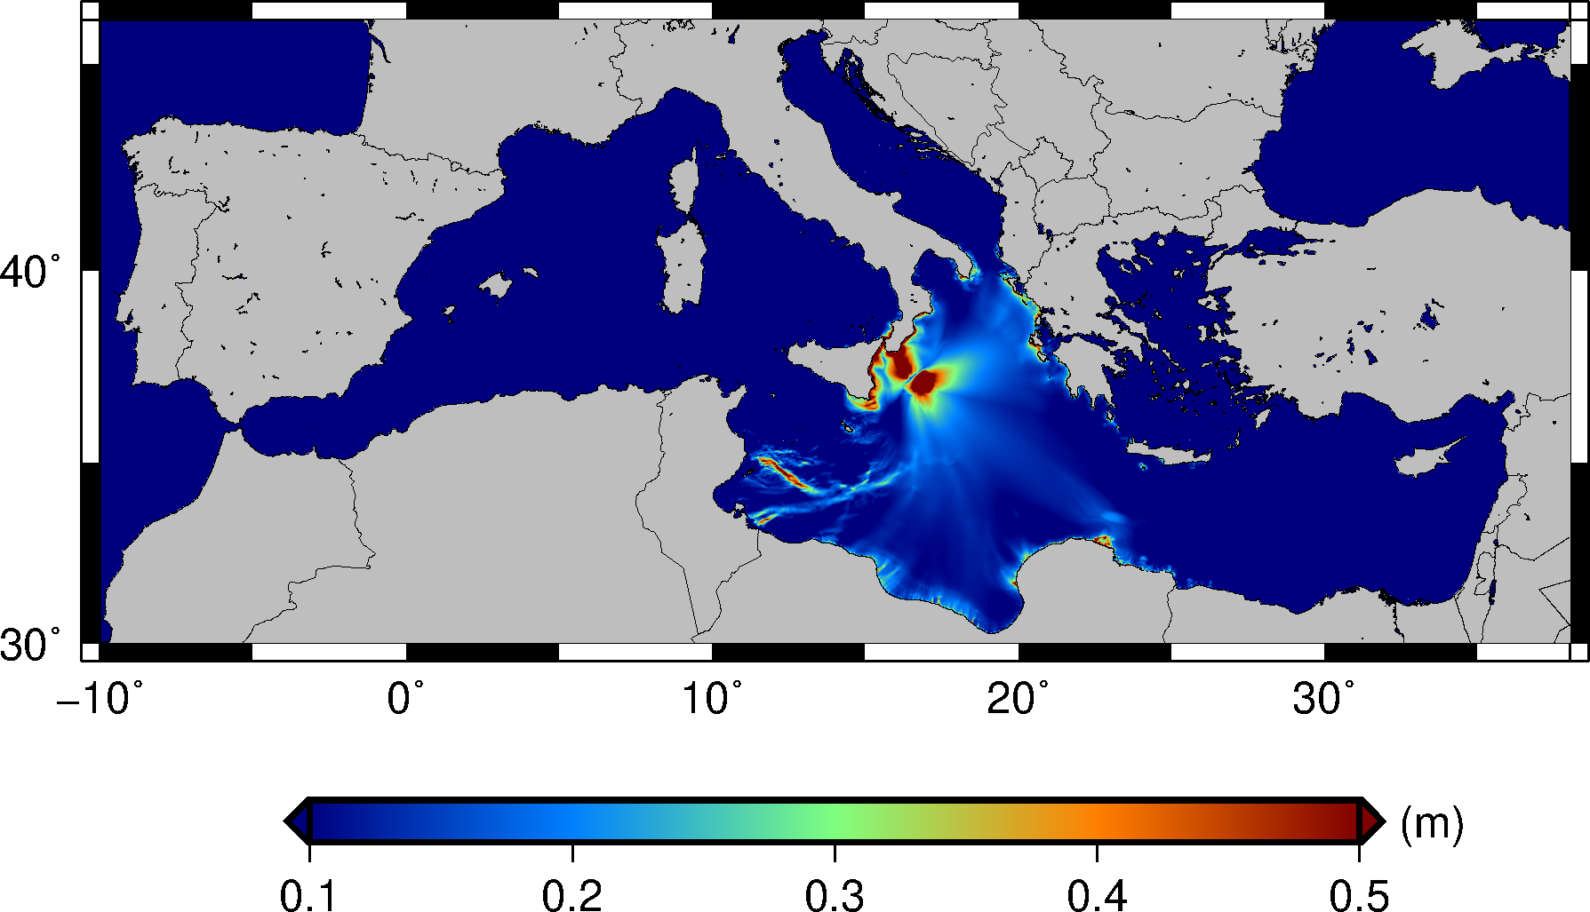
EPOS Services
Tsunami-HySEA
Numerical tsunami simulations
Depth-dependent
Depth-independent

Slide 11
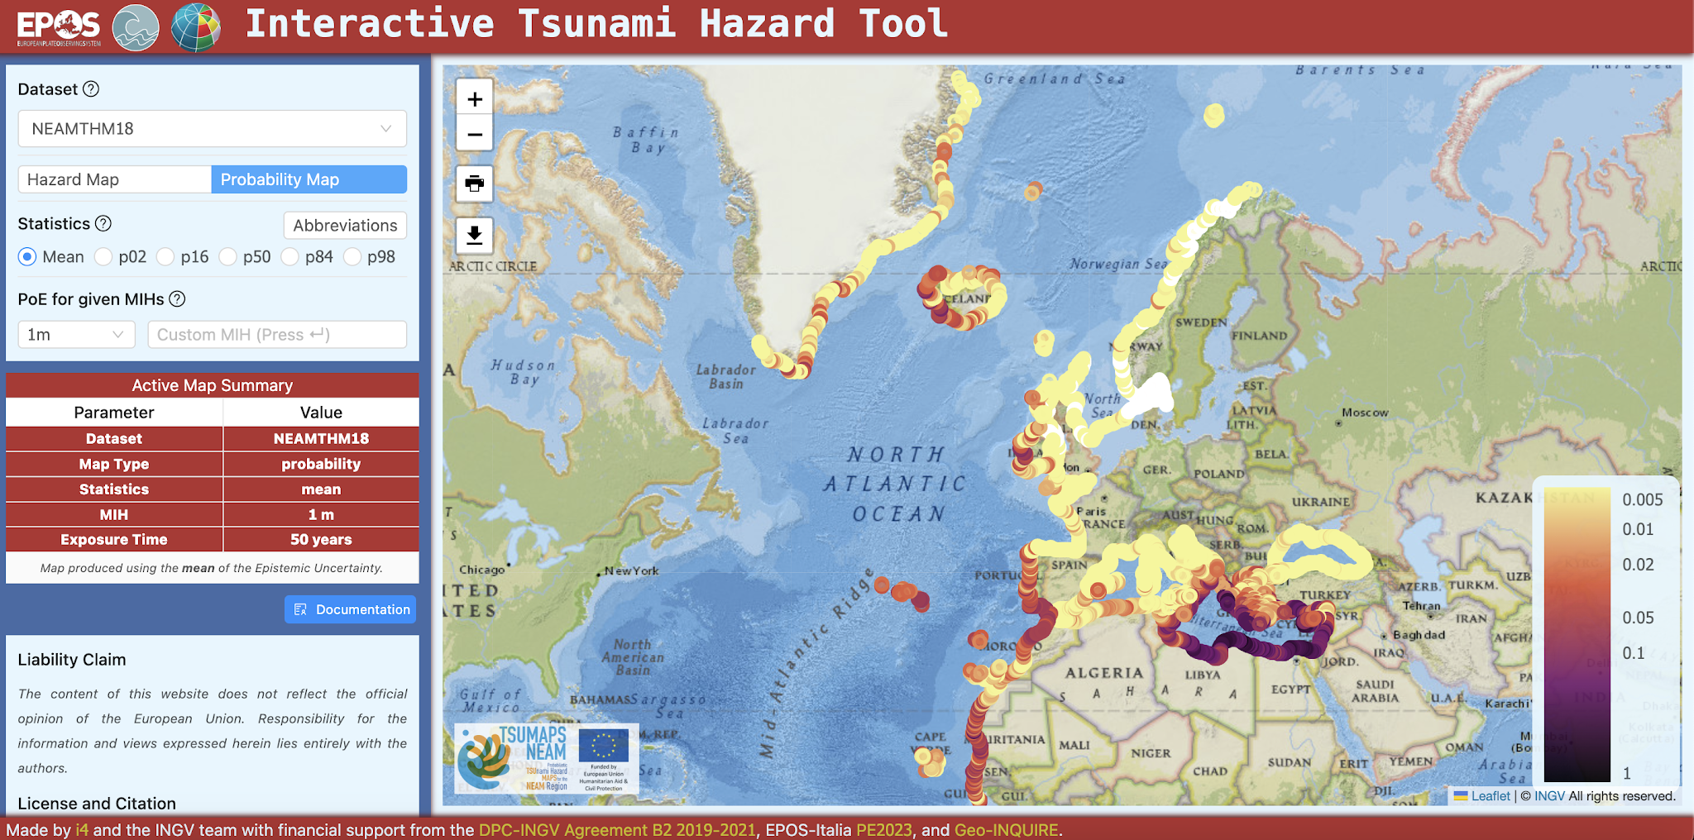
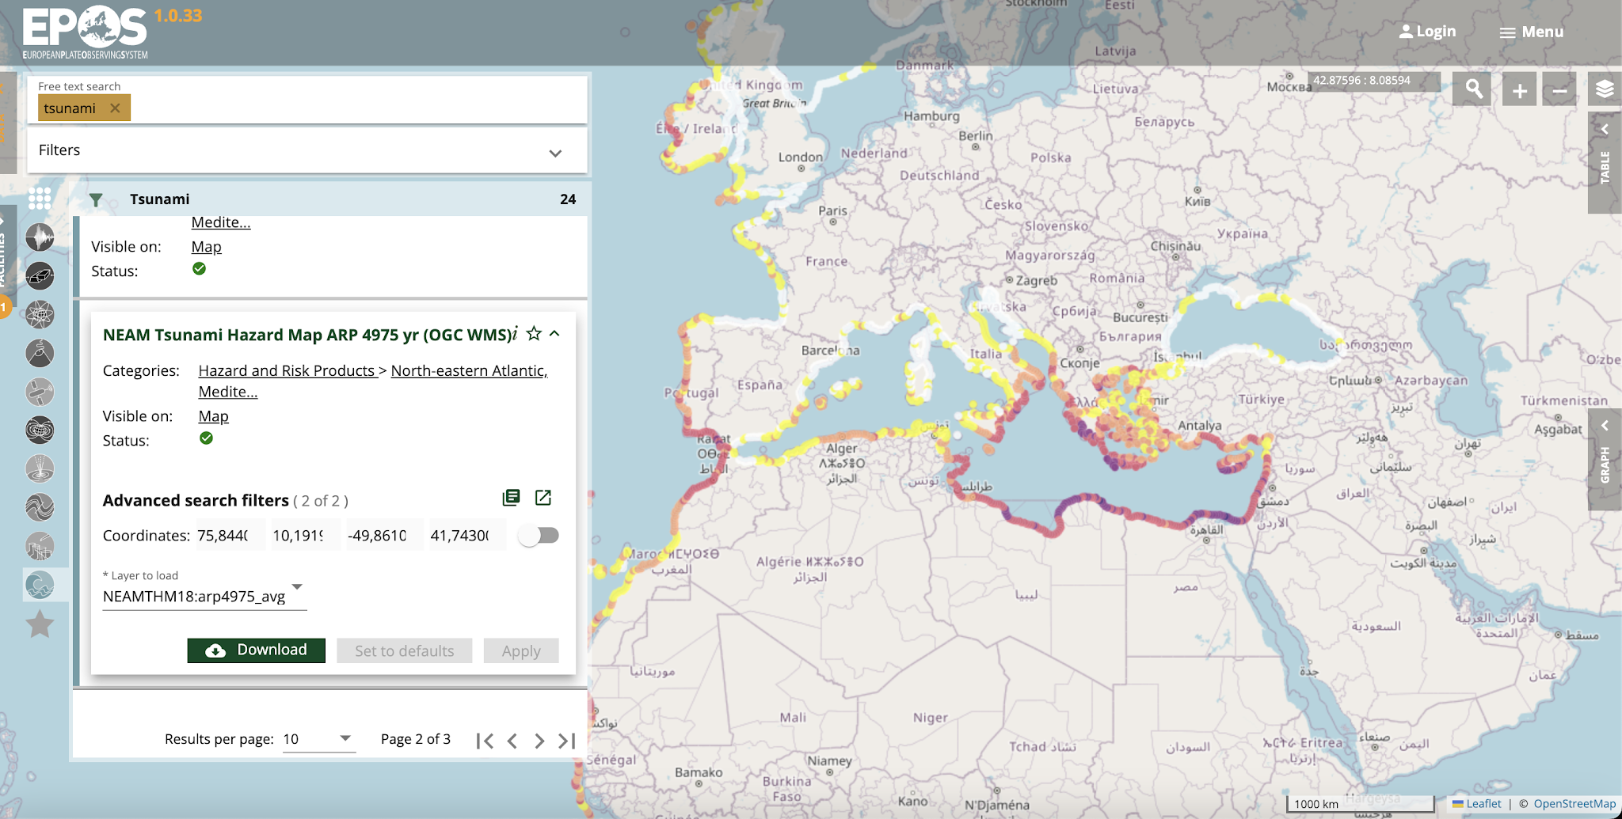
EPOS Services
Distribution from the Thematic Core Service Tsunami in EPOS
https://hazard.tsunamidata.org/
https://www.ics-c.epos-eu.org/

Slide 12
Thank you
hafizebasak.bayraktar@ingv.it

