Slide 1
Multiscale, Multihazard assessment from field-based and remote sensing data PhD Pietro Marincioni UNICAM

Slide 2
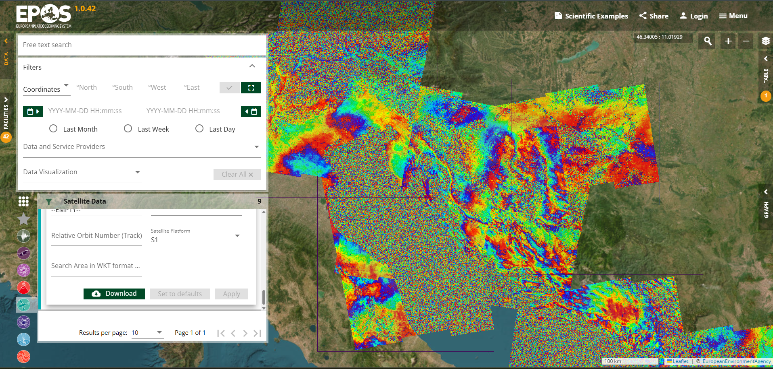
Multi-hazard study and evaluation, focusing on the relationship between earthquakes and secondary effects at different scales.
Aim of the study
Object of the study
- Normal Fault System - Central Italy - Transcurrent Fault System - EAFZ
Data collection
Preliminary Data for Multi-hazard Research
Using satellite data, drones, and remote sensors and implementing them in hazard mapping.
https://www.ics-c.epos-eu.

Slide 3
Why EPOS?
PROS
CONS
SUGGESTIONS
Valuable database for different data;
Valuable datasets from different research centers;
New in the spotlight, meaning the great possibility for innovation and completion;
EPOS platform is user-friendly.
Implementation of datasets and databases.

Slide 4
THANK YOU FOR THE ATTENTION

Slide 5
REFERENCES:
- Civico R., Pucci S., Villani F., Pizzimenti L., De Martini P. M., Nappi R. & the Open EMERGEO Working Group (2018) Surface ruptures following the 30 October 2016 Mw 6.5 Norcia earthquake, central Italy, Journal of Maps, 14:2, 151-160, DOI: 10.1080/17445647.2018.1441756
- Gasparini P., and A. Garcia-Aristizabal (2014). Seismic Risk Assessment, Cascading Effects. In: Beer M., Patelli E., Kougioumtzoglou I., Au I. (Ed.) Encyclopedia of Earthquake Engineering, SpringerReference, p 1-20. Springer-Verlag Berlin Heidelberg. ISBN: 978-3-642-36197-5. doi: 10.1007/978-3-642-36197-5_260-1.
- Gironelli, V., Volatili, T., Luzi, L., Brunelli, G., Zambrano, M., & Tondi, E. (2023). Ground motion simulations of historical earthquakes: the case study of the Fabriano (1741, Mw= 6.1) and Camerino (1799, Mw= 6.1) earthquakes in central Italy. Bulletin of Earthquake Engineering, 21(13), 5809-5830.
- Gómez Zapata, J. C., Pittore, M., Brinckmann, N., Lizarazo-Marriaga, J., Medina, S., Tarque, N., & Cotton, F. (2022). Scenario-based multi-risk assessment from existing single-hazard vulnerability models. An application to consecutive earthquakes and tsunamis in Lima, Peru. Natural Hazards and Earth System Sciences Discussions, 2022, 1-35.
- Merz, B., Kuhlicke, C., Kunz, M., Pittore, M., Babeyko, A., Bresch, D. N., et al. (2020). Impact forecasting to support emergency management of natural hazards. Reviews of Geophysics, 58, e2020RG000704. https://doi.org/10.1029/2020RG000704
- Petersen, G. M., P. Büyükakpinar, F. O. Vera Sanhueza, M. Metz, S. Cesca, K. Akbayram, J. Saul, and T. Dahm (2023). The 2023 Southeast Türkiye Seismic Sequence: Rupture of a Complex Fault Network, The Seismic Record. 3(2), 134–143, doi: 10.1785/0320230008.
- Tocchi, G., Ottonelli, D., Rebora, N., & Polese, M. (2023). Multi-Risk Assessment in the Veneto Region: An Approach to Rank Seismic and Flood Risk. Sustainability, 15(16), 12458.
- Zuccaro, G., De Gregorio, D., & Leone, M. F. (2018). Theoretical model for cascading effects analyses. International journal of disaster risk reduction, 30, 199-215.
- https://www.ics-c.epos-eu.
- http://zonesismiche.mi.ingv.it/
- http://www.pcn.minambiente.it/viewer/
- https://diss.ingv.it/mapper/

