Slide 1
A workflow to analytically investigate seismogenic sources of historical earthquakes: new insights from Central Italy pre-instrumental seismicity V. Gironelli, L. Luzi, T. Volatili, E. Tondi
Contacts: 📩 Email: veronica.gironelli@ingv.it 🔗 LinkedIn: linkedin.com/in/veronica-gironelli-329b96210
Notes:
Introduce yourself with your name, affiliation and TCS only

Slide 2
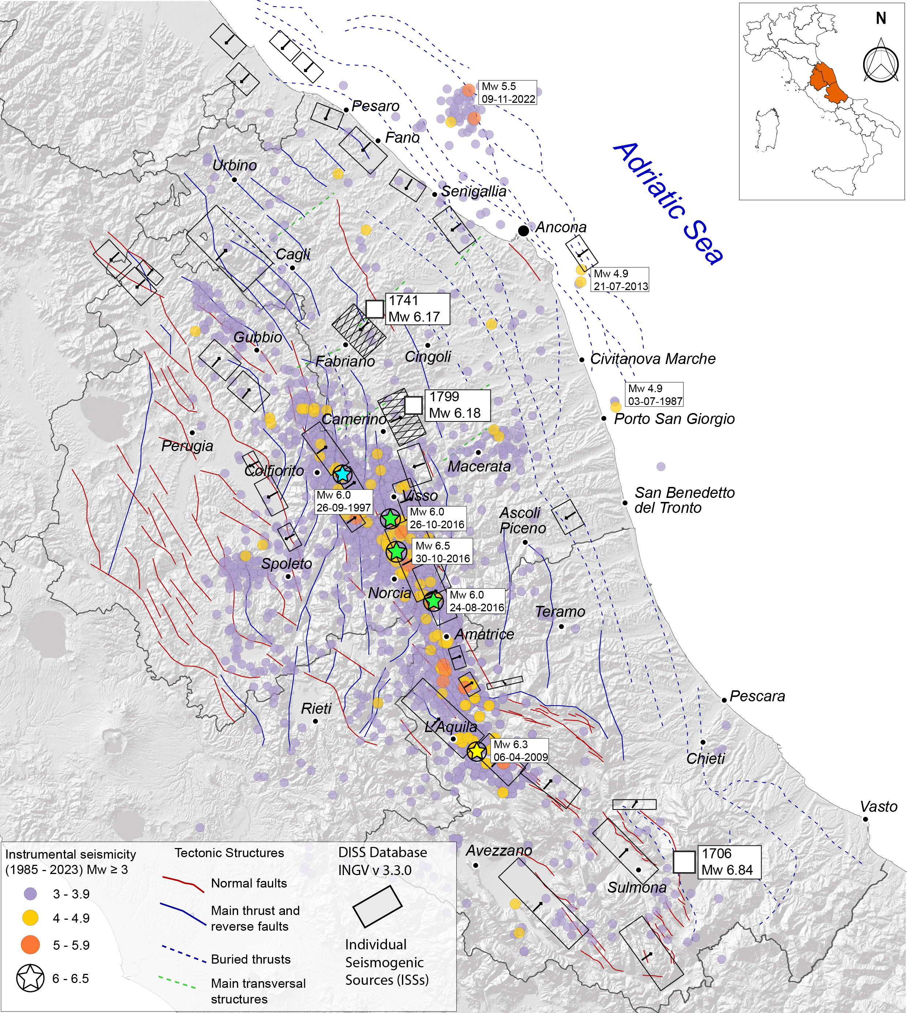
Uncertain Historical Seismogenic sources in Central Italy
STUDY AREA
Marche region
SH depends on expected ground motion;
April 24, 1741:
"Fabriano earthquake"
(Imax 9 MCS; Mw 6.17)
Ground motion depends on the source;
July 28, 1799:
"Camerino earthquake"
(Imax 9-10 MCS; Mw 6.18)
Most historical earthquake source are uncertain.
Abruzzi region
How to determine the 3D historical earthquake sources?
November 3, 1706:
"Maiella earthquake"
(Imax 10-11 MCS; Mw 6.84)
Notes:
SH → depends on ground motion;
Ground motion → controlled by the source;
Historical EQ source → often uncertain ?

Slide 3
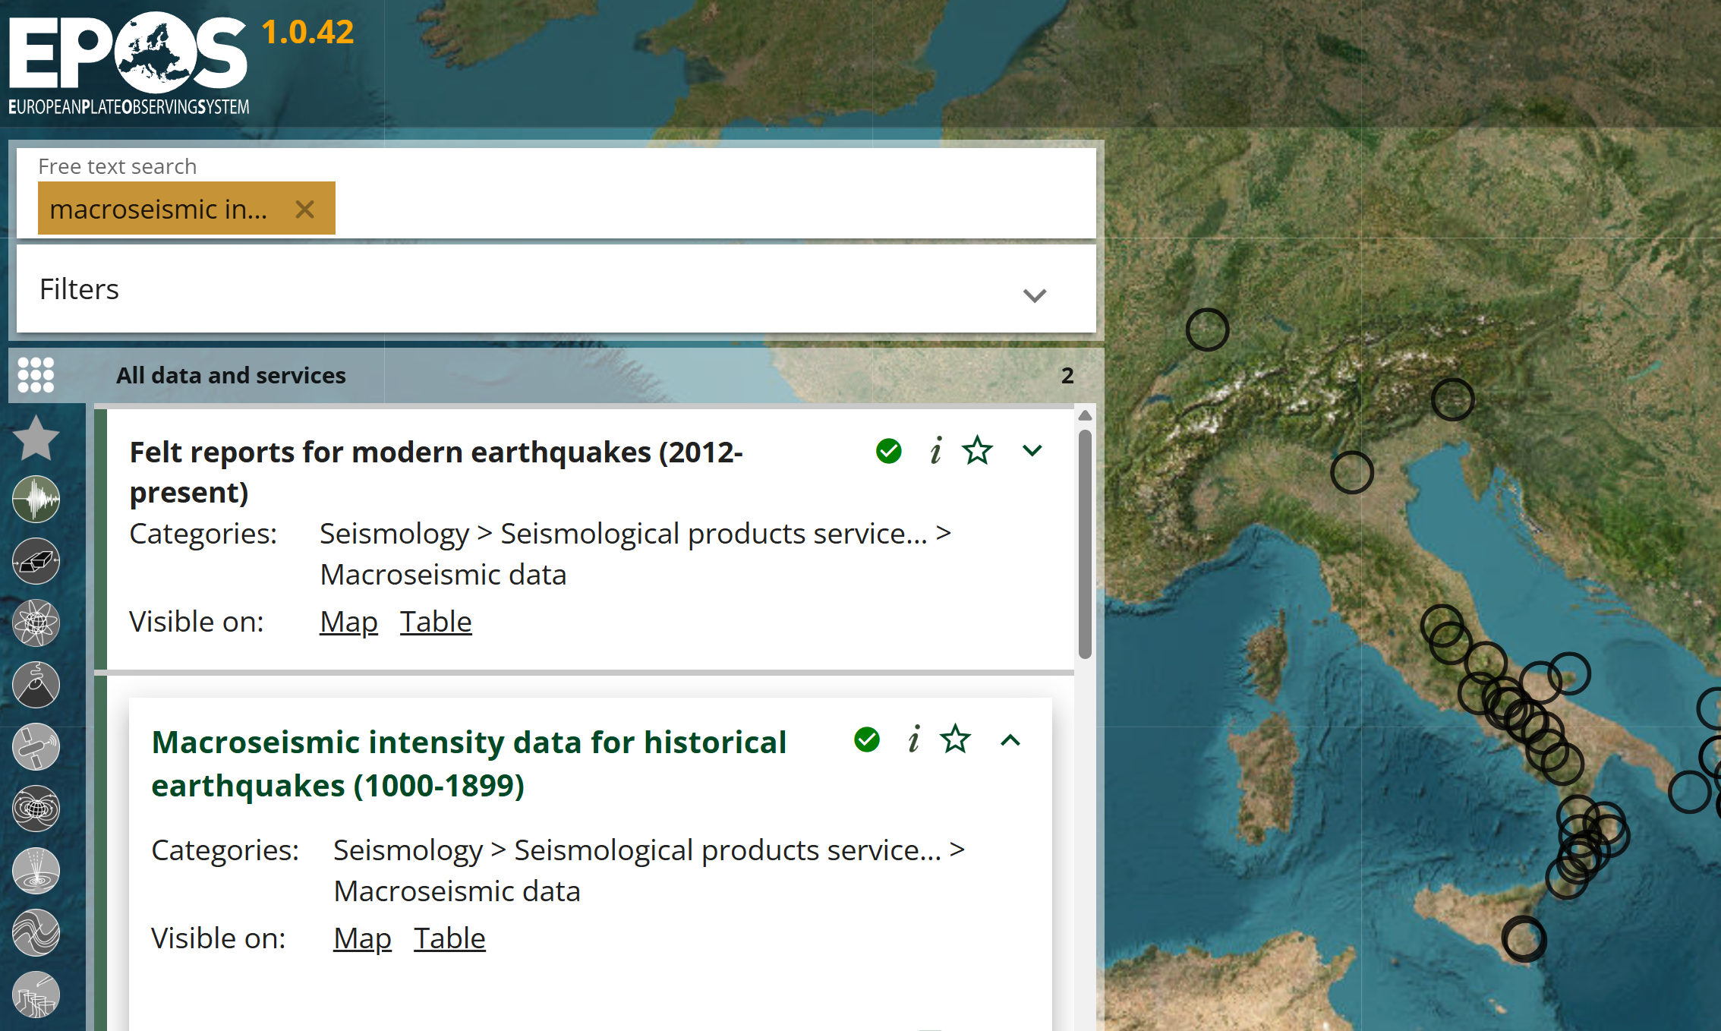
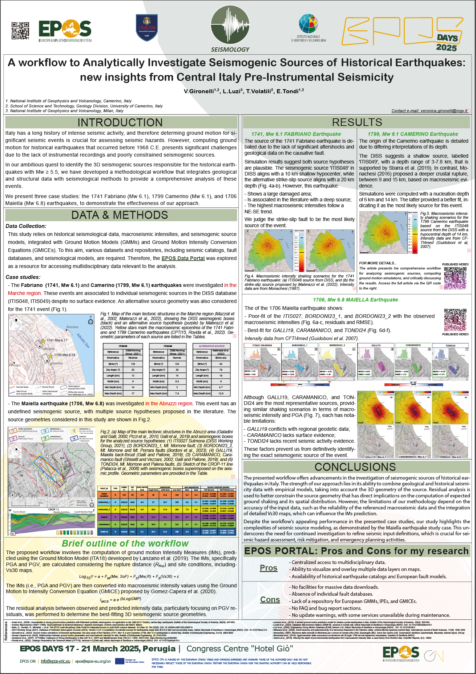
MATLAB-based WORKFLOW
INPUTS
PROCESSING
OUTPUTS
Earthquake data (magnitude, location, depth);
Source parameters (L, W, strike, dip, rake);
Macroseismic intensity data.
1
2
GMM + Vs30 map → GMPs prediction (PGA, PGV)
GMICE → Conversion of GMPs to intensity
Residual analysis → Best source evaluation by comparing obs vs. pred intensity
3
POSTER SESSION!
SHAKING SCENARIOS in PGA – PGV - INTENSITY

